Slide 1
Simple is Better: Training an End-to-end Contract Bridge Bidding Agent without Human Knowledge
Qucheng Gong, Tina Jiang, Yuandong Tian
ICLR 2020 Conference Blind Submission, September 26, 2020,
Addis Ababa, Ethiopia
Presenter: Yun-An Chen
Date: Oct. 18, 2023

Slide 2
Abstract(1/2)
Contract bridge is a multi-player imperfect-information game where one partnership collaborate with each other to compete against the other partnership. The game consists of two phases: bidding and playing. While playing is relatively easy for modern software, bidding is challenging and requires agents to learn a communication protocol to reach the optimal contract jointly, with their own private information. The agents need to exchange information to their partners, and interfere opponents, through a sequence of actions.

Slide 3
Abstract(2/2)
In this work, we train a strong agent to bid competitive bridge purely through self-play, outperforming WBridge5, a championship-winning software. Furthermore, we show that explicitly modeling belief is not necessary in boosting the performance. To our knowledge, this is the first competitive bridge agent that is trained with no domain knowledge. It outperforms previous state-of-the-art that use human replays with fewer number of parameters.

Slide 4
Baseline 16
36-dimension bidding history
Hand of player1
Hand of player2
Bid1
DNN layer 1
Output layer
Bid2
52-dimension raw data
Output layer
DNN layer 2
Continue until PASS occurs
DNN layer 3
Reference: Chih-Kuan Yeh and Hsuan-Tien Lin. Automatic bridge bidding using deep reinforcement learning. CoRR, abs/1607.03290, 2016.

Slide 5
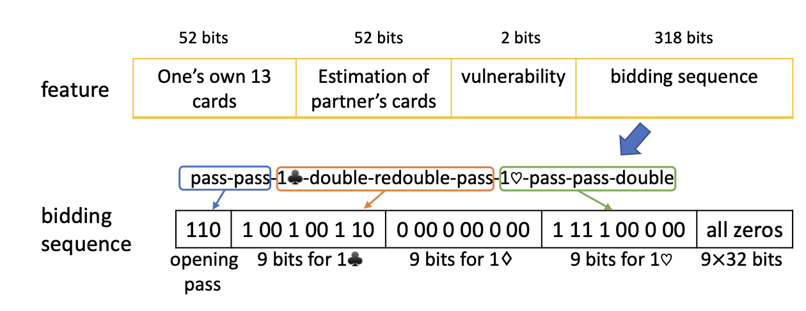
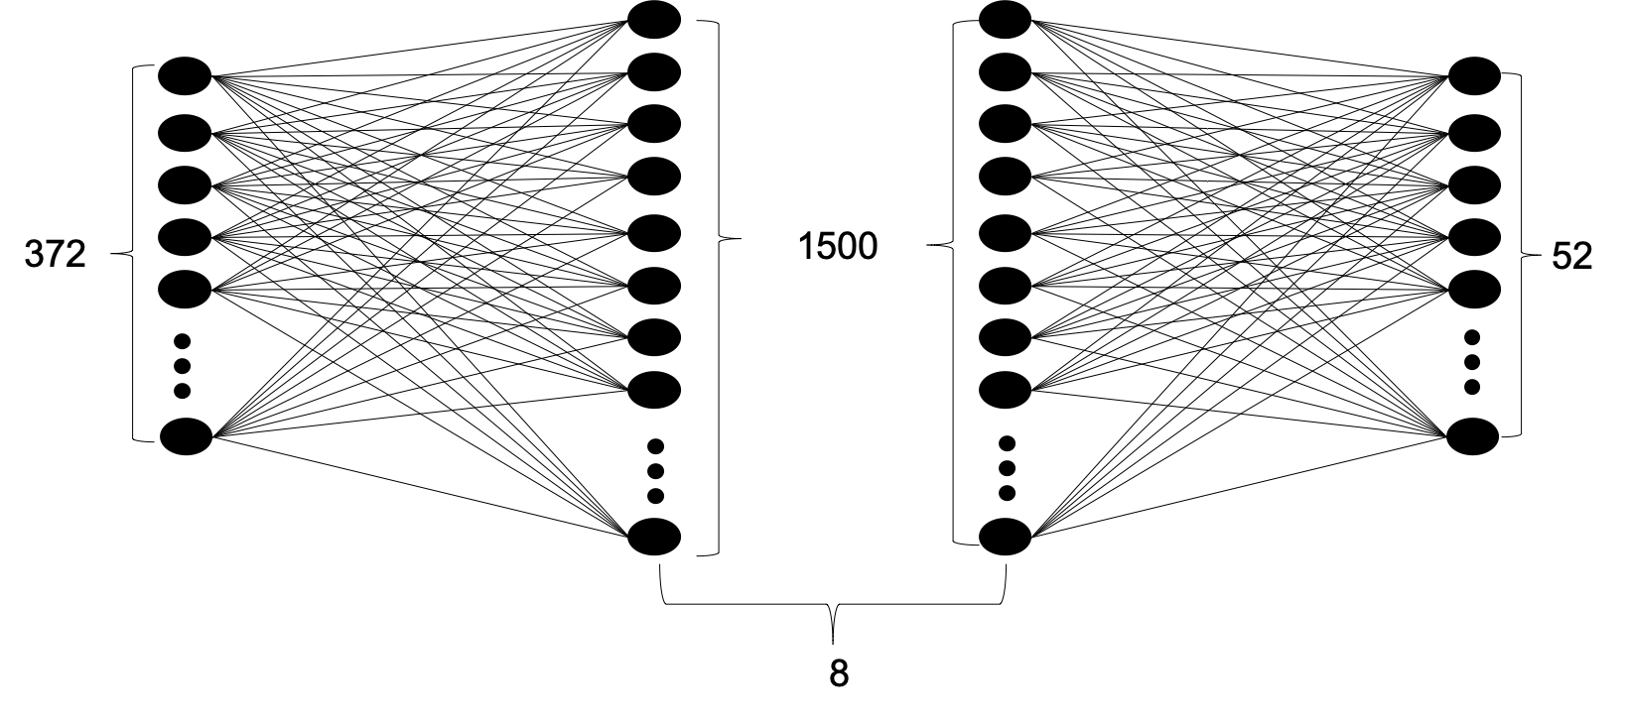
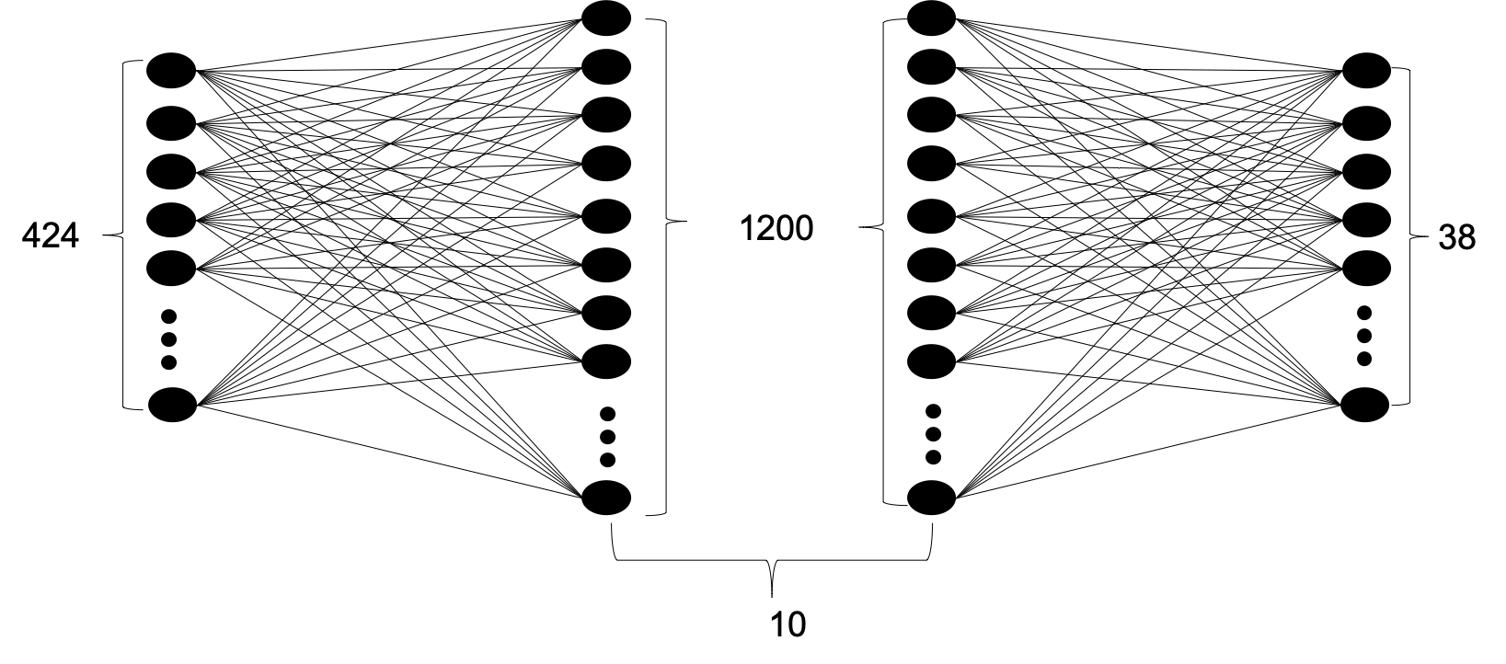
Baseline 19
Estimation Neural Network (ENN)
Policy Neural Network (PNN)
Reference: Jiang Rong, Tao Qin and Bo An, “Competitive Bridge Bidding with Deep Neural Networks,“18th International Conference on Autonomous Agents and Multiagent Systems, AAMAS '19, Montreal, QC, Canada, May 13-17, 2019

Slide 6
Problem Setup
Training dataset: randomly generated 2,500,000 hands.
Evaluation dataset: 100,000 hands.
The final reward is the difference in the results of the two tables. The difference in scores is then converted to IMPs scale, and then normalized to [-1, 1].

Slide 7
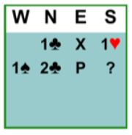
Input Representation
267-bit vector
Own cards | Bid history, multi-hot of contract bids |  |  |  |  | Vulnerability | Available Action
 | Own | Partner | Left Opp. | Right Opp. | Double Indicator
52 | 35 | 35 | 35 | 35 | 35 | 2 | 38
 | 1C | 1D | 1H | 1S | 1N | 2C | 2D | 2H | 2S | 2N | 3C | 3D | 3H | 3S | 3N |  | 7N
Own | 0 | 0 | 1 | 0 | 0 | 0 | 0 | 0 | 0 | 0 | 0 | 0 | 0 | 0 | 0 | … | 0
Partner | 1 | 0 | 0 | 0 | 0 | 1 | 0 | 0 | 0 | 0 | 0 | 0 | 0 | 0 | 0 | … | 0
Left Opp. | 0 | 0 | 0 | 1 | 0 | 0 | 0 | 0 | 0 | 0 | 0 | 0 | 0 | 0 | 0 | … | 0
Right Opp. | 0 | 0 | 0 | 0 | 0 | 0 | 0 | 0 | 0 | 0 | 0 | 0 | 0 | 0 | 0 | … | 0
Double Indicator | 1 | 0 | 0 | 0 | 0 | 0 | 0 | 0 | 0 | 0 | 0 | 0 | 0 | 0 | 0 | … | 0

Slide 8
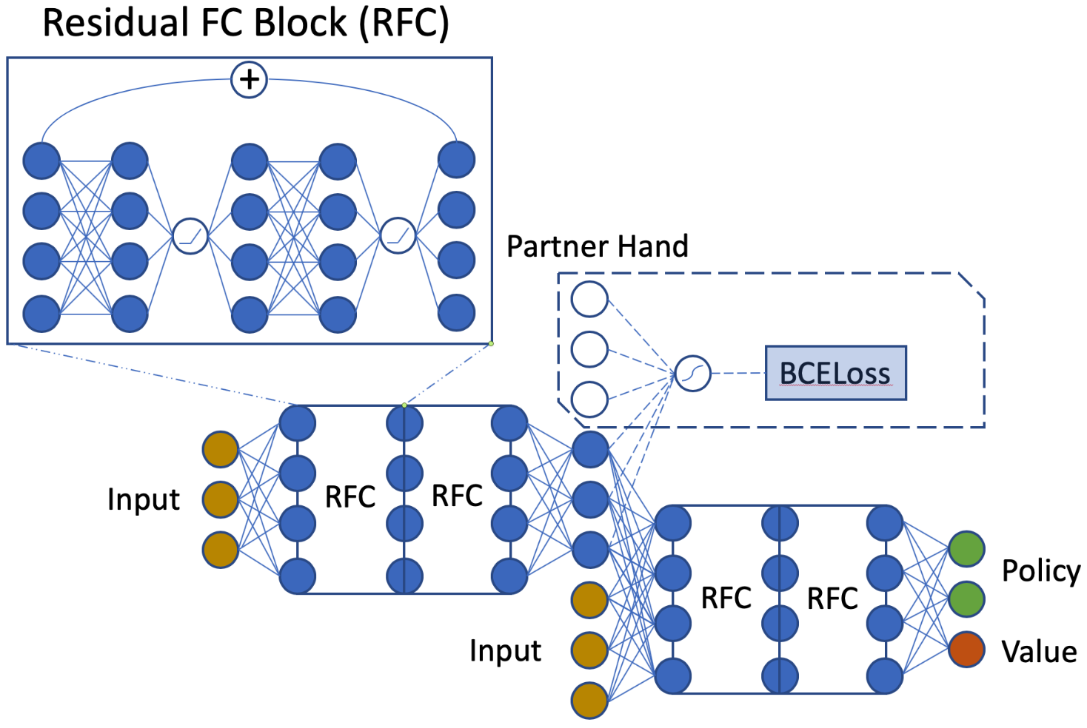
Network
An initial fully connected layer and 4 fully connected layer with skip connections added every 2 layers.
Policy head:
38 output neurons
Masking out illegal actions
Value head:
1 neuron
estimating partner’s hand

Slide 9
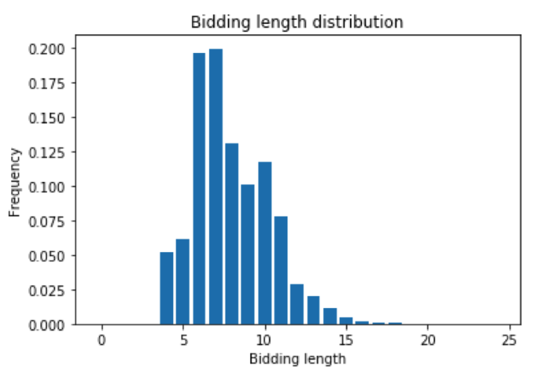
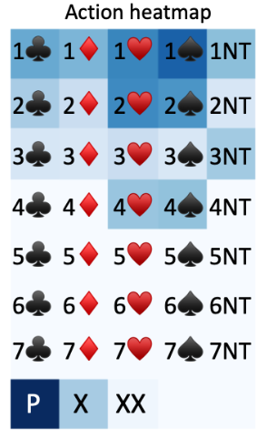
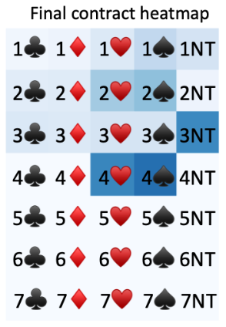
Visualization

Slide 10
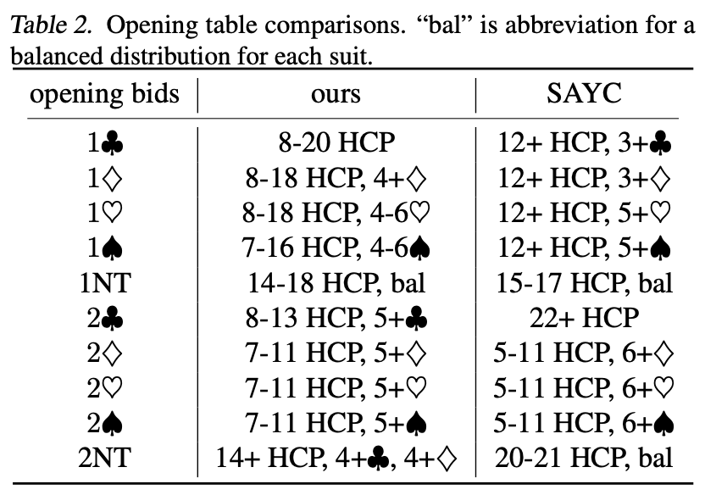
Opening table

Slide 11
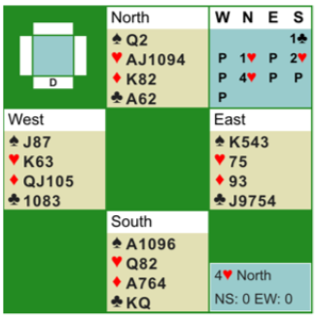
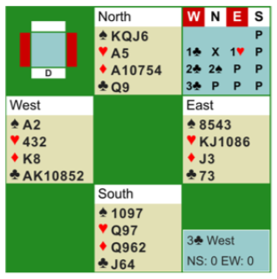
Bidding examples

Slide 12
Experiments
We beat baseline16 2.31 IMPs per board in 64 board tournament.
We beat Wbridge5 0.41 IMPs per board in 64 board tournament.
Baseline19 outperforms Wbridge5 by 0.25 IMPs per board.

Slide 13
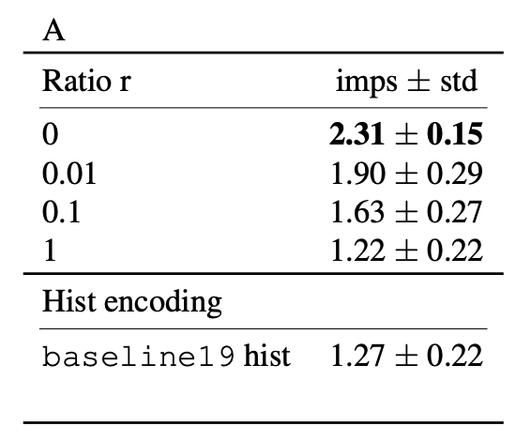
Experiments
Final loss: L = r ．L_{belief}+ L_{A3C}

