Slide 1
A Fast Algorithm for Computing Longest Common Subsequences
James W. Hunt, Thomas G. Szymanski
Communications of the ACM. vol. 20. pp.350–353 (1977)
Presenter: Yen-Yu Chen
Date: Oct.18, 2023

Slide 2
Abstract
Previously published algorithms for finding the longest common subsequence of two sequences of length n have had a best-case running time of O(n²). An algorithm for this problem is presented which has a running time of O((r + n) log n), where r is the total number of ordered pairs of positions at which the two sequences match. Thus in the worst case the algorithm has a running time of O(n² log n). However, for those applications where most positions of one sequence match relatively few positions in the other sequence, a running time of O(n log n) can be expected.

Slide 3
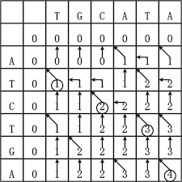
DP
Notes:
LCS使用DP
因為每個格子都要算，所以時間複雜度是O(n)

Slide 4
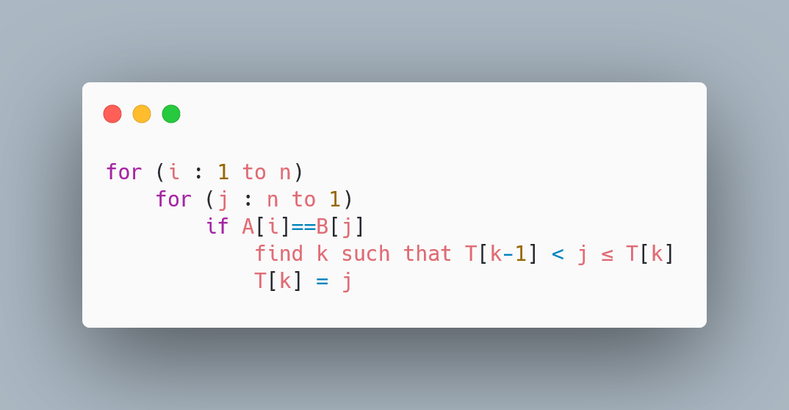
Algorithm 1
B
 | B | A | D | B | A | B | D
A
B
C
B
D
D
A
A
Notes:
畫線順序

Slide 5
Algorithm 1
B
 | B | A | D | B | A | B | D
A |  | 2 |  |  | 1
B | 5 |  |  | 4 |  | 3
C
B | 8 |  |  | 7 |  | 6
D |  |  | 10 |  |  |  | 9
D |  |  | 12 |  |  |  | 11
A |  | 14 |  |  | 13
A
Notes:
需要處理的格子的順序
數字是處理的順序

Slide 6
Update T
0 | 1 | 2 | 3 | 4 | 5 | 6 | 7
B
T
0 | 8 | 8 | 8 | 8 | 8 | 8 | 8
 | B | A | D | B | A | B | D
A
B
C
B
D
D
A
i=1, j=5
T[k-1]<5≤T[k]
k=1
A
T[1-1]<5≤T[1]
0<5≤8
0 | 1 | 2 | 3 | 4 | 5 | 6 | 7
T
0 | 5 | 8 | 8 | 8 | 8 | 8 | 8
Notes:
陣列T
初始長度是8，帶表還沒有解，因為字串長度是7
T[1]=5代表 B的前5個字LCS長度1(index)

Slide 7
Update T
0 | 1 | 2 | 3 | 4 | 5 | 6 | 7
B
T
0 | 5 | 8 | 8 | 8 | 8 | 8 | 8
 | B | A | D | B | A | B | D
A
B
C
B
D
D
A
i=1, j=2
T[k-1]<2≤T[k]
k=1
A
T[1-1]<2≤T[1]
0<2≤8
0 | 1 | 2 | 3 | 4 | 5 | 6 | 7
T
0 | 2 | 8 | 8 | 8 | 8 | 8 | 8
Notes:
這就是為什麼要從後面開始找，因為找到後會無條件取代，而小的本來就比較好，所以小的數字會無條件取代大的

Slide 8
Update T
0 | 1 | 2 | 3 | 4 | 5 | 6 | 7
B
T
0 | 2 | 8 | 8 | 8 | 8 | 8 | 8
 | B | A | D | B | A | B | D
A
B
C
B
D
D
A
i=2, j=6
T[k-1]<6≤T[k]
k=2
A
T[2-1]<6≤T[2]
2<6≤8
0 | 1 | 2 | 3 | 4 | 5 | 6 | 7
T
0 | 2 | 6 | 8 | 8 | 8 | 8 | 8
Notes:
T[2]=6代表 B的前6個字LCS長度2(index)

Slide 9
Update T
0 | 1 | 2 | 3 | 4 | 5 | 6 | 7
B
T
0 | 2 | 6 | 8 | 8 | 8 | 8 | 8
 | B | A | D | B | A | B | D
A
B
C
B
D
D
A
i=2, j=4
T[k-1]<4≤T[k]
k=2
A
T[2-1]<4≤T[2]
2<4≤8
0 | 1 | 2 | 3 | 4 | 5 | 6 | 7
T
0 | 2 | 4 | 8 | 8 | 8 | 8 | 8
Notes:
跳

Slide 10
Update T
0 | 1 | 2 | 3 | 4 | 5 | 6 | 7
B
T
0 | 2 | 4 | 8 | 8 | 8 | 8 | 8
 | B | A | D | B | A | B | D
A |  | 1
B | 1 |  |  | 2
C
B |  |  |  |  |  | 3
D |  |  |  |  |  |  | 4
D
A
i=2, j=1
T[k-1]<1≤T[k]
k=1
A
T[1-1]<1≤T[1]
0<1≤2
0 | 1 | 2 | 3 | 4 | 5 | 6 | 7
T
0 | 1 | 4 | 8 | 8 | 8 | 8 | 8
Notes:
從A[:1]B[:2] 變成A[:2]B[:1]
LCS是上面的4個
會不會因為選擇了紅色的格子讓他找不到最佳解?答案是不會，因為綠色的點已經被記錄到T[2]裡面了，所以第3點可以接在他後面成為T[3]

Slide 11
The meaning of update T[k]
Notes:
直觀的解釋 為何要更新
找完第5行
原本長度為3的時候(紫色)可以在紫色區域找到3以後的
更新之後(紅色)可以在紅色區域找到3以後的
明顯紅色比較好

Slide 12
The meaning of T
 | 2
1 |  | 3
Notes:
直觀的解釋 T
找完第5行 123點是目前記錄在T裡面的
可以在綠色區域找到1以後的
可以在紫色區域找到2以後的
可以在紅色區域找到3以後的

Slide 13

Algorithm 1
B
 | B | A | D | B | A | B | D
A
B
C
B
D
D
A
j=1
0 | 1 | 2 | 3 | 4 | 5 | 6 | 7
T
0 | 2 | 4 | 8 | 8 | 8 | 8 | 8
A
$$O(n^{2}\log{n})$$
Notes:
遍歷每一點要n²
更新T如果用binary search要log n
總共是 O(n² log n)

Slide 14
Algorithm 2
B
 | B | A | D | B | A | B | D
A
B
C
B
D
D
A
MATCHLIST[1] = (5, 2)
MATCHLIST[2] = (6, 4, 1)
MATCHLIST[3] = ( )
MATCHLIST[4] = MATCHLIST[2]
MATCHLIST[5] = (7, 3)
MATCHLIST[6] = MATCHLIST[5]
MATCHLIST[7] = MATCHLIST[1]
A

Slide 15
Preprocess
 | 1 | 2 | 3 | 4 | 5 | 6 | 7
B | B | A | D | B | A | B | D
 | 7 | 3 | 6 | 4 | 1 | 5 | 2
B | D | D | B | B | B | A | A
sort
 | 1 | 2 | 3 | 4 | 5 | 6 | 7
A | A | B | C | B | D | D | A
 | 6 | 5 | 3 | 4 | 2 | 7 | 1
A | D | D | C | B | B | A | A

Slide 16
Preprocess
MATCHLIST[1] = ()
MATCHLIST[2] = ()
MATCHLIST[3] = ( )
MATCHLIST[4] = MATCHLIST[2]
MATCHLIST[5] = ()
MATCHLIST[6] = MATCHLIST[5]
MATCHLIST[7] = MATCHLIST[1]
 | 7 | 3 | 6 | 4 | 1 | 5 | 2
B | D | D | B | B | B | A | A
 | 6 | 5 | 3 | 4 | 2 | 7 | 1
A | D | D | C | B | B | A | A
 | 5 | 6 | 3 | 2 | 4 | 1 | 7
A | D | D | C | B | B | A | A
sort
Notes:
Sort O(n log n)

Slide 17
Preprocess
MATCHLIST[1] = ()
MATCHLIST[2] = ()
MATCHLIST[3] = ( )
MATCHLIST[4] = MATCHLIST[2]
MATCHLIST[5] = (7)
MATCHLIST[6] = MATCHLIST[5]
MATCHLIST[7] = MATCHLIST[1]
 | 7 | 3 | 6 | 4 | 1 | 5 | 2
B | D | D | B | B | B | A | A
 | 5 | 6 | 3 | 2 | 4 | 1 | 7
A | D | D | C | B | B | A | A
Notes:
紀錄7
一樣時動B

Slide 18
Preprocess
MATCHLIST[1] = ()
MATCHLIST[2] = ()
MATCHLIST[3] = ( )
MATCHLIST[4] = MATCHLIST[2]
MATCHLIST[5] = (7,3)
MATCHLIST[6] = MATCHLIST[5]
MATCHLIST[7] = MATCHLIST[1]
 | 7 | 3 | 6 | 4 | 1 | 5 | 2
B | D | D | B | B | B | A | A
 | 5 | 6 | 3 | 2 | 4 | 1 | 7
A | D | D | C | B | B | A | A
Notes:
一樣時動B

Slide 19
Preprocess
MATCHLIST[1] = ()
MATCHLIST[2] = ()
MATCHLIST[3] = ( )
MATCHLIST[4] = MATCHLIST[2]
MATCHLIST[5] = (7,3)
MATCHLIST[6] = MATCHLIST[5]
MATCHLIST[7] = MATCHLIST[1]
 | 7 | 3 | 6 | 4 | 1 | 5 | 2
B | D | D | B | B | B | A | A
 | 5 | 6 | 3 | 2 | 4 | 1 | 7
A | D | D | C | B | B | A | A
Notes:
不一樣時動value大的，D>B動A

Slide 20
Preprocess
MATCHLIST[1] = ()
MATCHLIST[2] = ()
MATCHLIST[3] = ( )
MATCHLIST[4] = MATCHLIST[2]
MATCHLIST[5] = (7,3)
MATCHLIST[6] = MATCHLIST[5]
MATCHLIST[7] = MATCHLIST[1]
 | 7 | 3 | 6 | 4 | 1 | 5 | 2
B | D | D | B | B | B | A | A
 | 5 | 6 | 3 | 2 | 4 | 1 | 7
A | D | D | C | B | B | A | A
Notes:
不一樣時動value大的，C>B動A

Slide 21
Preprocess
MATCHLIST[1] = ()
MATCHLIST[2] = (6)
MATCHLIST[3] = ( )
MATCHLIST[4] = MATCHLIST[2]
MATCHLIST[5] = (7,3)
MATCHLIST[6] = MATCHLIST[5]
MATCHLIST[7] = MATCHLIST[1]
 | 7 | 3 | 6 | 4 | 1 | 5 | 2
B | D | D | B | B | B | A | A
 | 5 | 6 | 3 | 2 | 4 | 1 | 7
A | D | D | C | B | B | A | A
Notes:
紀錄6
會發現這個過程中紅藍指標不會倒退，所以只會執行2n次，時間複雜度是O(n)

Slide 22
Preprocess
MATCHLIST[1] = (5,2)
MATCHLIST[2] = (6,4,1)
MATCHLIST[3] = ( )
MATCHLIST[4] = MATCHLIST[2]
MATCHLIST[5] = (7,3)
MATCHLIST[6] = MATCHLIST[5]
MATCHLIST[7] = MATCHLIST[1]
Notes:
最後長這樣

Slide 23
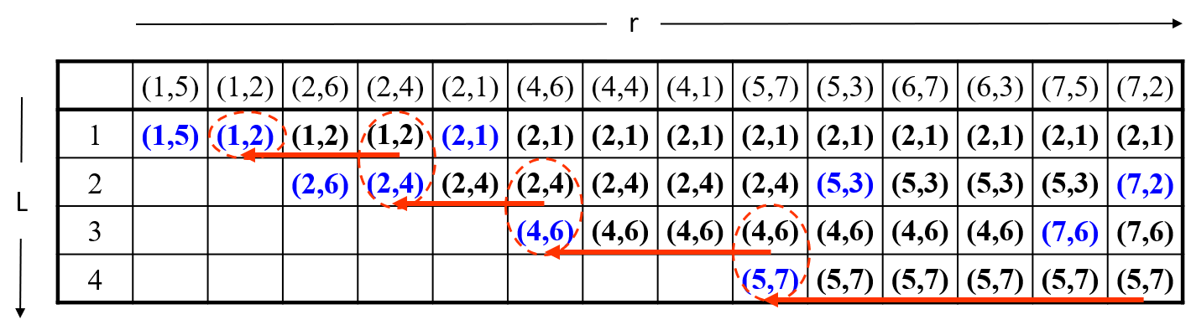
Record last posision
Notes:
T從一開始更新到最後
更新的時候會知道前一個是誰，用linked list的方式接到前一個

Slide 24
Algorithm 2
Preprocess : O(n log n)+O(n)
Update T : O(r log n)
Total : O((r+n)log n)
Worst : O(n² log n)
Normal : O(n log n)
Notes:
正常情況下r=n O(n log n)

