Slide 1
Efficient Computation of Longest Common Subsequences with Multiple Substring Inclusive Constraints
XiaoDong Wang, Lei Wang, and Daxin Zhu
Journal of Computational Biology, Volume 26, Number 9, 2019, pp. 938-947
Presenter: Wen-Wen Liao
Date: Oct. 18, 2023
Notes:
特拉維夫市以色列

Slide 2
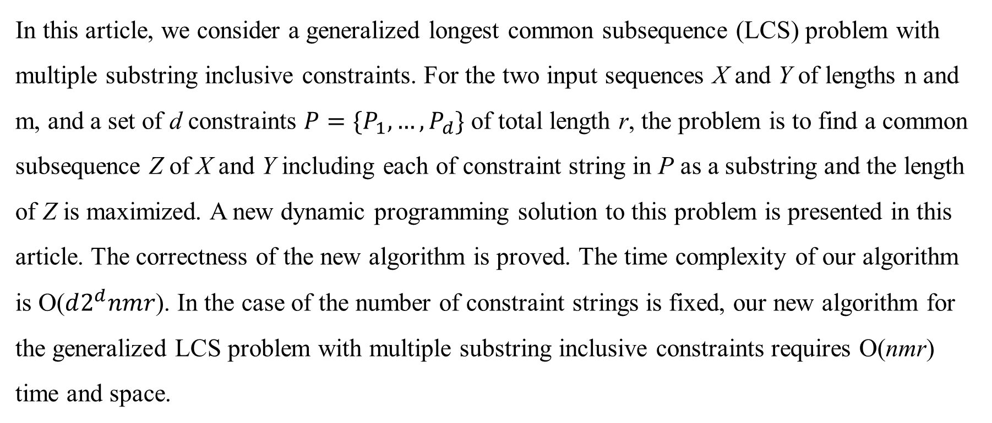
Abstract
In this article, we consider a generalized longest common subsequence (LCS) problem with multiple substring inclusive constraints. For the two input sequences X and Y of lengths n and m, and a set of d constraints $P=\{P_{1}, …,P_{d}\}$ of total length r, the problem is to find a common subsequence Z of X and Y including each of constraint string in P as a substring and the length of Z is maximized. A new dynamic programming solution to this problem is presented in this article. The correctness of the new algorithm is proved. The time complexity of our algorithm is O($d2^{d}nmr$). In the case of the number of constraint strings is fixed, our new algorithm for the generalized LCS problem with multiple substring inclusive constraints requires O(nmr) time and space.

Slide 3
M-STR-IC-LCS
X = aabbbba
Y = aababa
Constraint set P = {aab‚ aba‚ ba}
M-STR-IC-LCS(X, Y, P) = aaba
d = 3
r = 8

Slide 4
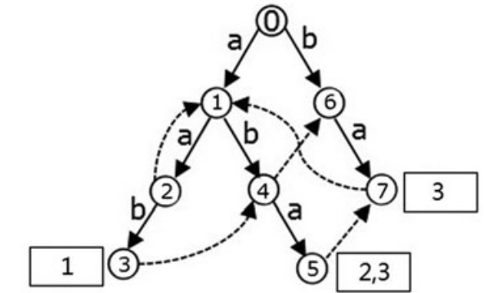
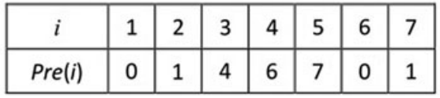
Keyword trees
P = {aab‚ aba‚ ba}
Goto (solid edges)
Output
Failure (dashed edges)

Slide 5
Failure list
node(5) = {7→1→0}
node(6) = {0}

Slide 6
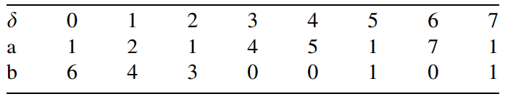
Aho–Corasick-Next Function

Slide 7

State (𝛼, 𝛽)
$\overline{a}=a⊕c$
$\overline{α}=δ$($α, β$); $\overline{s_{β}}$= $s_{β}Uo_{\overline{α}};$ $\overline{β}$ = g($\overline{s_{β}}$)
($α, β$) => ($δ(α, c$), $γ(α, β, c$))
r2^{d} states
$α=4, S_{β}=\left\{0\right\}, β=0$
$\overline{α}=5, \overline{s_{β}}=\left\{2, 3\right\}, \overline{β}=2^{2−1}+2^{3−1}=6$

Slide 8
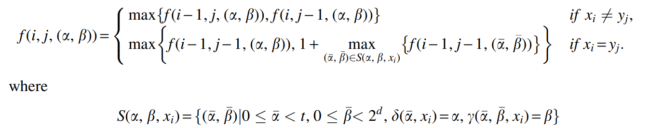

f (i‚ j‚ (𝛼, 𝛽))
$\max_{0 ≤ i < t}{\{f(n, m, (i, { 2}^{d−1}))\}}$

Slide 9
Dynamic programming algorithm
X = aabbbba
Y = aababa
P = {aab‚ aba‚ ba}
Ans = a
𝛽
 | 0 | 1 | 2 | 3 | 4 | 5 | 6 | 7
0 | 0 | 0 | 0 | 0 | 0 | 0 | 0 | 0
1 | 1 | 0 | 0 | 0 | 0 | 0 | 0 | 0
2 | 0 | 0 | 0 | 0 | 0 | 0 | 0 | 0
3 | 0 | 0 | 0 | 0 | 0 | 0 | 0 | 0
4 | 0 | 0 | 0 | 0 | 0 | 0 | 0 | 0
5 | 0 | 0 | 0 | 0 | 0 | 0 | 0 | 0
6 | 0 | 0 | 0 | 0 | 0 | 0 | 0 | 0
7 | 0 | 0 | 0 | 0 | 0 | 0 | 0 | 0
𝛼
i = 1, j = 1

Slide 10
Dynamic programming algorithm
X = aabbbba
Y = aababa
P = {aab‚ aba‚ ba}
Ans = aa
𝛽
 | 0 | 1 | 2 | 3 | 4 | 5 | 6 | 7
0 | 0 | 0 | 0 | 0 | 0 | 0 | 0 | 0
1 | 1 | 0 | 0 | 0 | 0 | 0 | 0 | 0
2 | 2 | 0 | 0 | 0 | 0 | 0 | 0 | 0
3 | 0 | 0 | 0 | 0 | 0 | 0 | 0 | 0
4 | 0 | 0 | 0 | 0 | 0 | 0 | 0 | 0
5 | 0 | 0 | 0 | 0 | 0 | 0 | 0 | 0
6 | 0 | 0 | 0 | 0 | 0 | 0 | 0 | 0
7 | 0 | 0 | 0 | 0 | 0 | 0 | 0 | 0
𝛼
i = 2, j = 2

Slide 11
Dynamic programming algorithm
X = aabbbba
Y = aababa
P = {aab‚ aba‚ ba}
Ans = aab
𝛽
 | 0 | 1 | 2 | 3 | 4 | 5 | 6 | 7
0 | 0 | 0 | 0 | 0 | 0 | 0 | 0 | 0
1 | 1 | 0 | 0 | 0 | 0 | 0 | 0 | 0
2 | 2 | 0 | 0 | 0 | 0 | 0 | 0 | 0
3 | 0 | 3 | 0 | 0 | 0 | 0 | 0 | 0
4 | 0 | 0 | 0 | 0 | 0 | 0 | 0 | 0
5 | 0 | 0 | 0 | 0 | 0 | 0 | 0 | 0
6 | 0 | 0 | 0 | 0 | 0 | 0 | 0 | 0
7 | 0 | 0 | 0 | 0 | 0 | 0 | 0 | 0
𝛼
i = 3, j = 3

Slide 12
Dynamic programming algorithm
X = aabbbba
Y = aababa
P = {aab‚ aba‚ ba}
Ans = aab
𝛽
 | 0 | 1 | 2 | 3 | 4 | 5 | 6 | 7
0 | 0 | 0 | 0 | 0 | 0 | 0 | 0 | 0
1 | 1 | 0 | 0 | 0 | 0 | 0 | 0 | 0
2 | 2 | 0 | 0 | 0 | 0 | 0 | 0 | 0
3 | 0 | 3 | 0 | 0 | 0 | 0 | 0 | 0
4 | 0 | 0 | 0 | 0 | 0 | 0 | 0 | 0
5 | 0 | 0 | 0 | 0 | 0 | 0 | 0 | 0
6 | 0 | 0 | 0 | 0 | 0 | 0 | 0 | 0
7 | 0 | 0 | 0 | 0 | 0 | 0 | 0 | 0
𝛼
i = 4, j = 4

Slide 13
Dynamic programming algorithm
X = aabbbba
Y = aababa
P = {aab‚ aba‚ ba}
Ans = aab
𝛽
 | 0 | 1 | 2 | 3 | 4 | 5 | 6 | 7
0 | 0 | 0 | 0 | 0 | 0 | 0 | 0 | 0
1 | 1 | 0 | 0 | 0 | 0 | 0 | 0 | 0
2 | 2 | 0 | 0 | 0 | 0 | 0 | 0 | 0
3 | 0 | 3 | 0 | 0 | 0 | 0 | 0 | 0
4 | 0 | 0 | 0 | 0 | 0 | 0 | 0 | 0
5 | 0 | 0 | 0 | 0 | 0 | 0 | 0 | 0
6 | 0 | 0 | 0 | 0 | 0 | 0 | 0 | 0
7 | 0 | 0 | 0 | 0 | 0 | 0 | 0 | 0
𝛼
i = 3, j = 4

Slide 14
Dynamic programming algorithm
X = aabbbba
Y = aababa
P = {aab‚ aba‚ ba}
Ans = aab
𝛽
 | 0 | 1 | 2 | 3 | 4 | 5 | 6 | 7
0 | 0 | 0 | 0 | 0 | 0 | 0 | 0 | 0
1 | 1 | 0 | 0 | 0 | 0 | 0 | 0 | 0
2 | 2 | 0 | 0 | 0 | 0 | 0 | 0 | 0
3 | 0 | 3 | 0 | 0 | 0 | 0 | 0 | 0
4 | 0 | 0 | 0 | 0 | 0 | 0 | 0 | 0
5 | 0 | 0 | 0 | 0 | 0 | 0 | 0 | 0
6 | 0 | 0 | 0 | 0 | 0 | 0 | 0 | 0
7 | 0 | 0 | 0 | 0 | 0 | 0 | 0 | 0
𝛼
i = 4, j = 3

Slide 15
Dynamic programming algorithm
X = aabbbba
Y = aababa
P = {aab‚ aba‚ ba}
Ans = aab
𝛽
 | 0 | 1 | 2 | 3 | 4 | 5 | 6 | 7
0 | 0 | 0 | 0 | 0 | 0 | 0 | 0 | 0
1 | 1 | 0 | 0 | 0 | 0 | 0 | 0 | 0
2 | 2 | 0 | 0 | 0 | 0 | 0 | 0 | 0
3 | 0 | 3 | 0 | 0 | 0 | 0 | 0 | 0
4 | 0 | 0 | 0 | 0 | 0 | 0 | 0 | 0
5 | 0 | 0 | 0 | 0 | 0 | 0 | 0 | 0
6 | 0 | 0 | 0 | 0 | 0 | 0 | 0 | 0
7 | 0 | 0 | 0 | 0 | 0 | 0 | 0 | 0
𝛼
i = 4, j = 4

Slide 16
Dynamic programming algorithm
X = aabbbba
Y = aababa
P = {aab‚ aba‚ ba}
Ans = aab
𝛽
 | 0 | 1 | 2 | 3 | 4 | 5 | 6 | 7
0 | 0 | 0 | 0 | 0 | 0 | 0 | 0 | 0
1 | 1 | 0 | 0 | 0 | 0 | 0 | 0 | 0
2 | 2 | 0 | 0 | 0 | 0 | 0 | 0 | 0
3 | 0 | 3 | 0 | 0 | 0 | 0 | 0 | 0
4 | 3 | 0 | 0 | 0 | 0 | 0 | 0 | 0
5 | 0 | 0 | 0 | 0 | 0 | 0 | 0 | 0
6 | 0 | 0 | 0 | 0 | 0 | 0 | 0 | 0
7 | 0 | 0 | 0 | 0 | 0 | 0 | 0 | 0
𝛼
i = 5, j = 5

Slide 17
Dynamic programming algorithm
X = aabbbba
Y = aababa
P = {aab‚ aba‚ ba}
Ans = aab
𝛽
 | 0 | 1 | 2 | 3 | 4 | 5 | 6 | 7
0 | 0 | 0 | 0 | 0 | 0 | 0 | 0 | 0
1 | 1 | 0 | 0 | 0 | 0 | 0 | 0 | 0
2 | 2 | 0 | 0 | 0 | 0 | 0 | 0 | 0
3 | 0 | 3 | 0 | 0 | 0 | 0 | 0 | 0
4 | 3 | 0 | 0 | 0 | 0 | 0 | 0 | 0
5 | 0 | 0 | 0 | 0 | 0 | 0 | 0 | 0
6 | 0 | 0 | 0 | 0 | 0 | 0 | 0 | 0
7 | 0 | 0 | 0 | 0 | 0 | 0 | 0 | 0
𝛼
i = 6, j = 6

Slide 18
Dynamic programming algorithm
X = aabbbba
Y = aababa
P = {aab‚ aba‚ ba}
Ans = aab
𝛽
 | 0 | 1 | 2 | 3 | 4 | 5 | 6 | 7
0 | 0 | 0 | 0 | 0 | 0 | 0 | 0 | 0
1 | 1 | 0 | 0 | 0 | 0 | 0 | 0 | 0
2 | 2 | 0 | 0 | 0 | 0 | 0 | 0 | 0
3 | 0 | 3 | 0 | 0 | 0 | 0 | 0 | 0
4 | 3 | 0 | 0 | 0 | 0 | 0 | 0 | 0
5 | 0 | 0 | 0 | 0 | 0 | 0 | 0 | 0
6 | 0 | 0 | 0 | 0 | 0 | 0 | 0 | 0
7 | 0 | 0 | 0 | 0 | 0 | 0 | 0 | 0
𝛼
i = 5, j = 6

Slide 19
Dynamic programming algorithm
X = aabbbba
Y = aababa
P = {aab‚ aba‚ ba}
Ans = aab
𝛽
 | 0 | 1 | 2 | 3 | 4 | 5 | 6 | 7
0 | 0 | 0 | 0 | 0 | 0 | 0 | 0 | 0
1 | 1 | 0 | 0 | 0 | 0 | 0 | 0 | 0
2 | 2 | 0 | 0 | 0 | 0 | 0 | 0 | 0
3 | 0 | 3 | 0 | 0 | 0 | 0 | 0 | 0
4 | 3 | 0 | 0 | 0 | 0 | 0 | 0 | 0
5 | 0 | 0 | 0 | 0 | 0 | 0 | 0 | 0
6 | 0 | 0 | 0 | 0 | 0 | 0 | 0 | 0
7 | 0 | 0 | 0 | 0 | 0 | 0 | 0 | 0
𝛼
i = 6, j = 5

Slide 20
Dynamic programming algorithm
X = aabbbba
Y = aababa
P = {aab‚ aba‚ ba}
Ans = aab
𝛽
 | 0 | 1 | 2 | 3 | 4 | 5 | 6 | 7
0 | 0 | 0 | 0 | 0 | 0 | 0 | 0 | 0
1 | 1 | 0 | 0 | 0 | 0 | 0 | 0 | 0
2 | 2 | 0 | 0 | 0 | 0 | 0 | 0 | 0
3 | 0 | 3 | 0 | 0 | 0 | 0 | 0 | 0
4 | 3 | 0 | 0 | 0 | 0 | 0 | 0 | 0
5 | 0 | 0 | 0 | 0 | 0 | 0 | 0 | 0
6 | 0 | 0 | 0 | 0 | 0 | 0 | 0 | 0
7 | 0 | 0 | 0 | 0 | 0 | 0 | 0 | 0
𝛼
i = 6, j = 6

Slide 21
Dynamic programming algorithm
X = aabbbba
Y = aababa
P = {aab‚ aba‚ ba}
Ans = aaba
𝛽
 | 0 | 1 | 2 | 3 | 4 | 5 | 6 | 7
0 | 0 | 0 | 0 | 0 | 0 | 0 | 0 | 0
1 | 1 | 0 | 0 | 0 | 0 | 0 | 0 | 0
2 | 2 | 0 | 0 | 0 | 0 | 0 | 0 | 0
3 | 0 | 3 | 0 | 0 | 0 | 0 | 0 | 0
4 | 3 | 0 | 0 | 0 | 0 | 0 | 0 | 0
5 | 0 | 0 | 0 | 0 | 0 | 0 | 0 | 4
6 | 0 | 0 | 0 | 0 | 0 | 0 | 0 | 0
7 | 0 | 0 | 0 | 0 | 0 | 0 | 0 | 0
𝛼
i = 7, j = 6

Slide 22

Time complexity
O($d2^{d}nmr$)
If d is fixed => O(nmr)

