Slide 1
A Novel Spatio–Temporal Deep Learning Vehicle Turns Detection Scheme Using GPS-Only Data
Mussadiq Abdul Rahim; Sultan Daud Khan; Salabat Khan; Muhammad Rashid; Rafi Ullah; Hanan Tariq. IEEE Access 11 (2023): 8727-8733.
Presenter: Yu-Chen Lin
Date: Oct. 24, 2023

Slide 2
Abstract
Whether the computer is driving your car or you are, advanced driver assistance systems (ADAS) come into play on all levels, from weather monitoring to safety. These modern-day ADASs use various assisting tools for drivers to keep the journey safe; these sophisticated tools provide early signals of numerous events, such as road conditions, emerging traffic scenarios, and weather warnings. Many urban applications, such as car-sharing and logistics, rely on accurate and up-to-date road map data. Map generation methods use a variety of data sources, including but not limited to global positioning systems (GPS). In this research we propose a GPS-only data trajectory analysis and a novel scheme to convert GPS trajectory data to image-based data to train a custom Convolutional Neural Network (CNN) model. The empirical results with an extensive 5-fold cross-validation show that the proposed scheme identifies turn and not turn with more than 94% recall. It outperforms the existing turn detection schemes on two major frontiers, the required data and the accuracy achieved in detecting different driving behaviors.

Slide 3
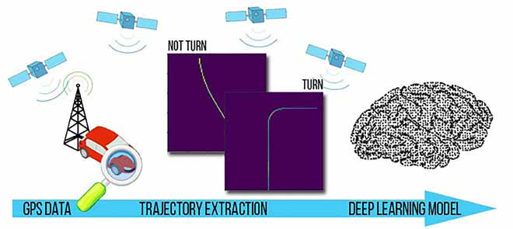
Deep Learning Method

Slide 4
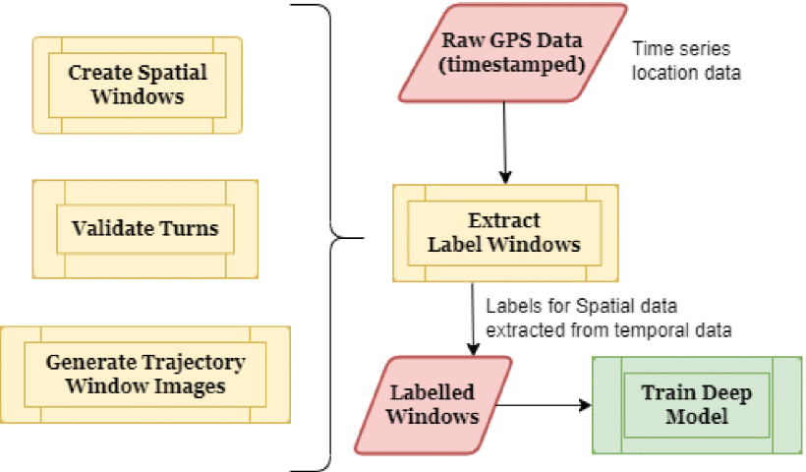

Slide 5
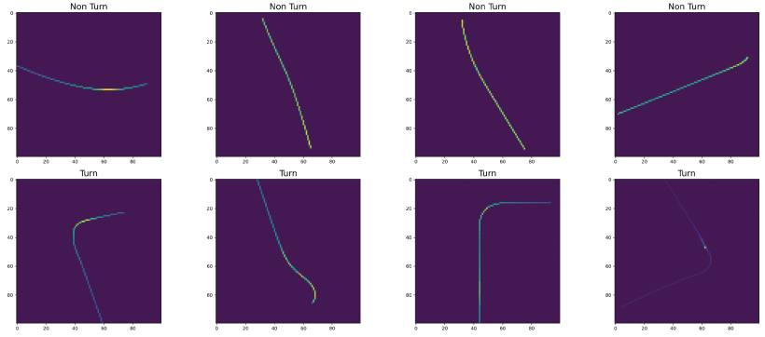
Spatio–Temporal Vehicle Turn Detection

Slide 6
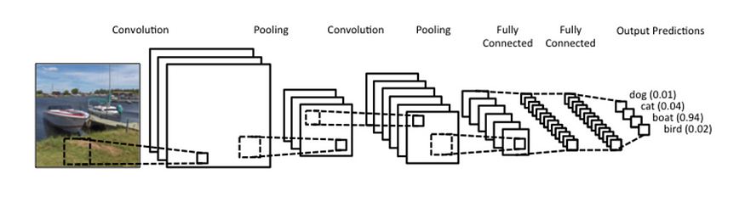
Convolutional Neural Network

Slide 7
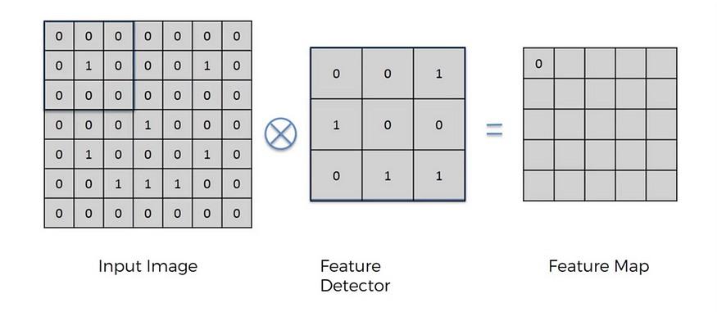

Slide 8
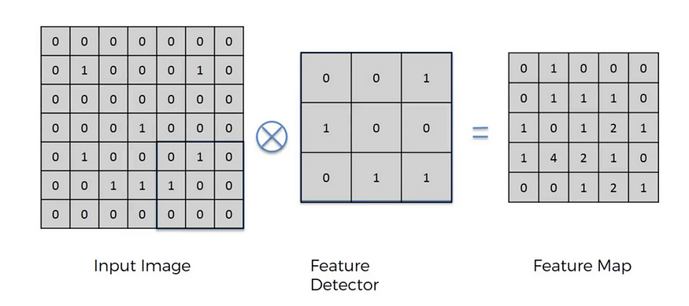

Slide 9
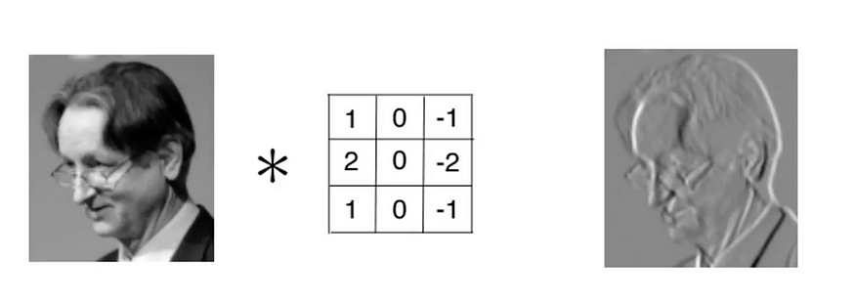

Slide 10
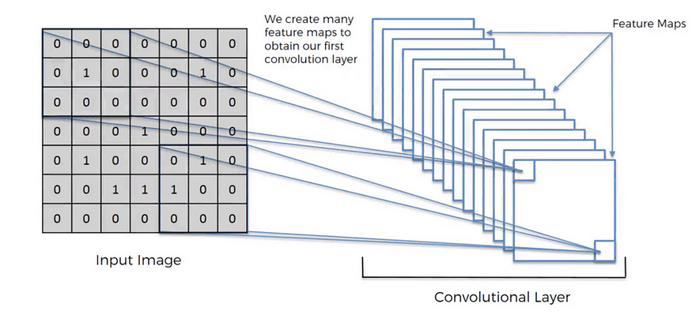

Slide 11
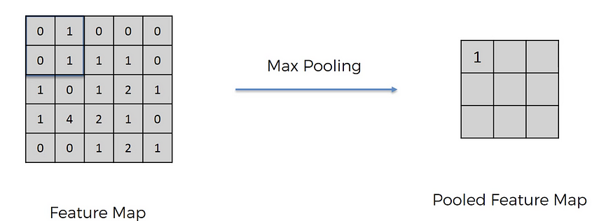

Slide 12
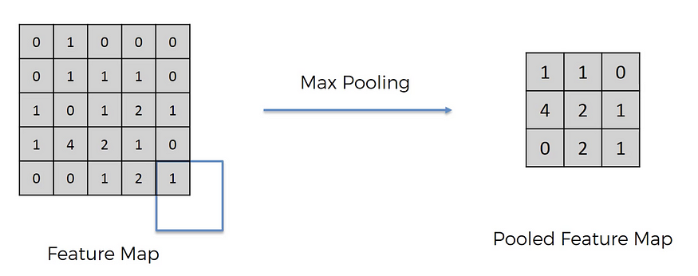

Slide 13
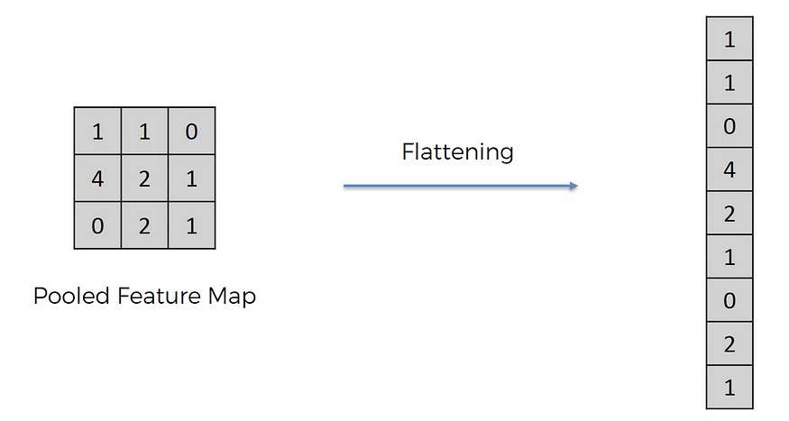

Slide 14
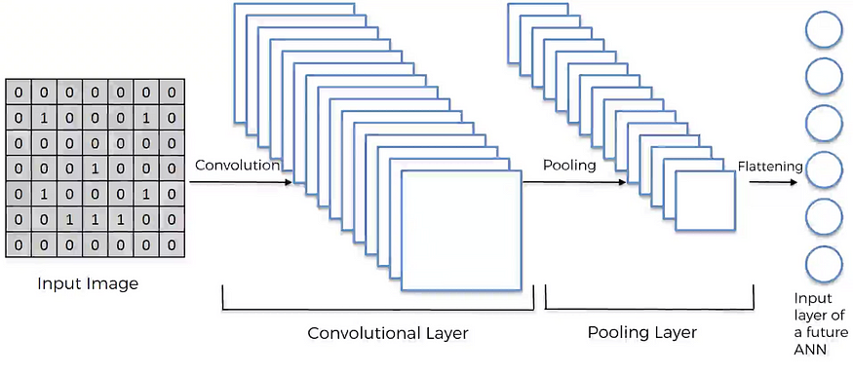

Slide 15
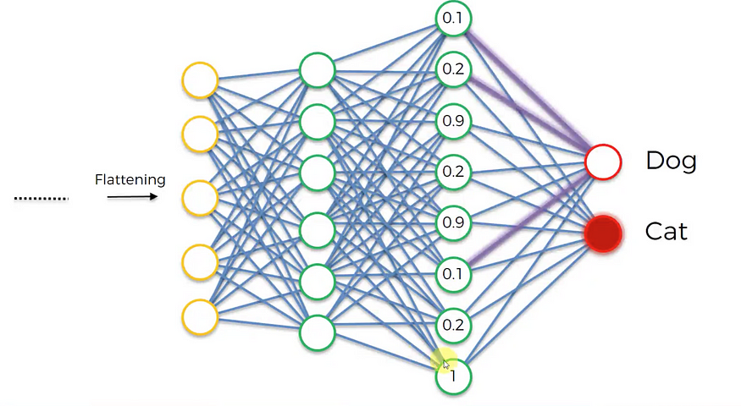

Slide 16
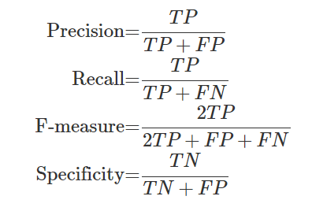
Model Performance

Slide 17
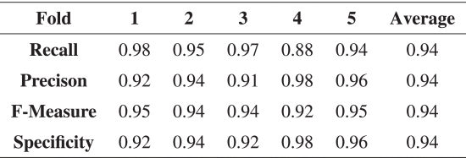
Experiment

Slide 18
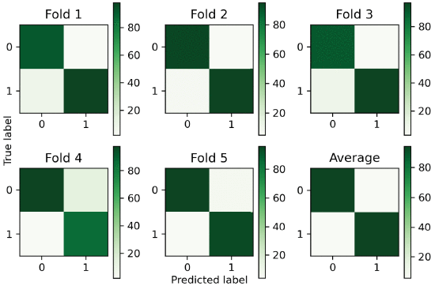

Slide 19
Conclusion
This research work proposes a deep learning-based turn detection model for GPS-only data.
It propose spatial window-based algorithms to transform GPS-only data into image data for use in the deep learning process.

