Slide 1
A fast and simple algorithm for computing the longest common subsequence of run-length-encoded strings
Hsing-Yen Ann, Chang-Biau Yang, Chiou-Ting Tseng, Chiou-Yi Information Processing Letters 108 (2008) 360–364
Presenter: Shih-Hong Li
Date: Oct. 24, 2023

Slide 2
Abstract
Let X and Y be two strings of lengths n and m, respectively, and k and l, respectively, be the numbers of runs in their corresponding run-length encoded forms. We propose a simple algorithm for computing the longest common subsequence of two given strings X and Y in O(kl + min{p₁, p₂}) time, where p₁ and p₂ denote the numbers of elements in the bottom and right boundaries of the matched blocks, respectively. It improves the previously known time bound O(min{nl,km}) and outperforms the time bounds O(kl log kl) or O((k + l + q)log(k + l + q)) for some cases, where q denotes the number of matched blocks.

Slide 3
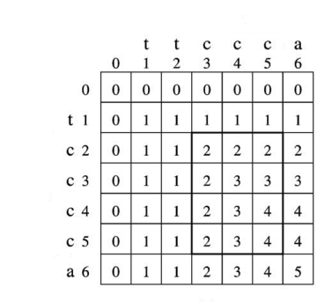
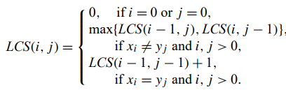
Longest common subsequence(LCS)
X=ttccca
Y=tcccca
LCS=tccca
Time complecity:O(mn)
Notes:
當(u,v)有edge相連時代表 len(u) + 2 = len(v)

Slide 4

Run-length-encoded(RLE)
X=x₁x₂…x_{n}
Y=y₁y₂…y_{m}
n=|X| , m=|Y|
RLE String of X=RX₁RX₂…RX_{k} ,where all symblos RX_{i} are the same,
and the symbols in RX_{i} and RX_{i+1}, 1$≤$i $≤$k-1, are different

Slide 5
The block & data structure
If RX_{i} = RY_{j} ,then the block is called dark block ,otherwise it’s called a light block
M[i,j] : the value of LCS(RX_{1..i}, RY_{1..j})
W[i,j,r] : holds the value of the rth element on the bottom wall of block (i, j)

Slide 6
Forced path
Traverse the dark block by strickly diagonal moves
Traverse the light block by strictly horizontal (or vertical, respectively) moves

Slide 7
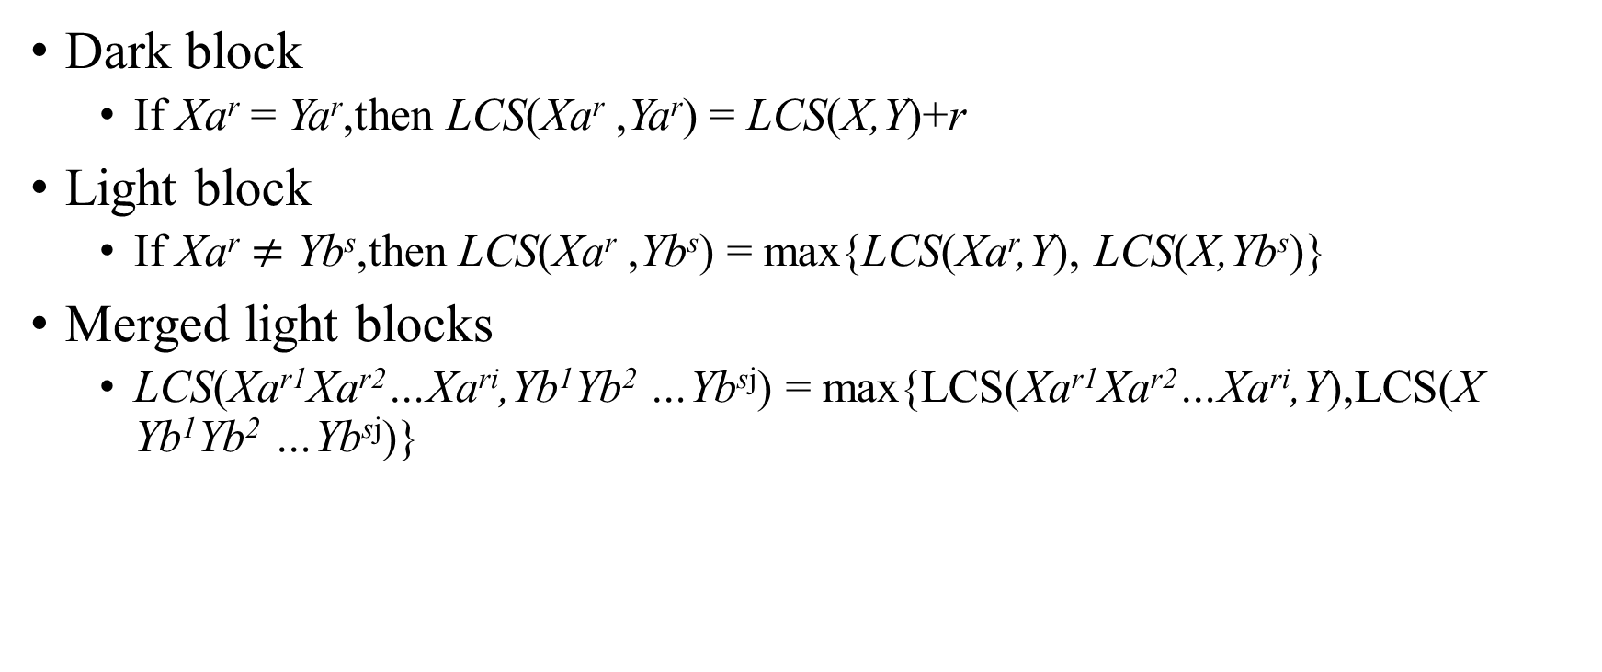
Properties of the LCS problem on RLE strings
Dark block
If Xa^{r} = Ya^{r},then LCS(Xa^{r} ,Ya^{r}) = LCS(X,Y)+r
Light block
If Xa^{r} $≠$ Yb^{s},then LCS(Xa^{r} ,Yb^{s}) = max{LCS(Xa^{r},Y), LCS(X,Yb^{s})}
Merged light blocks
LCS(Xa^{r1}Xa^{r2}…Xa^{ri},Yb¹Yb² …Yb^{sj}) = max{LCS(Xa^{r1}Xa^{r2}…Xa^{ri},Y),LCS(X Yb¹Yb² …Yb^{sj})}

Slide 8
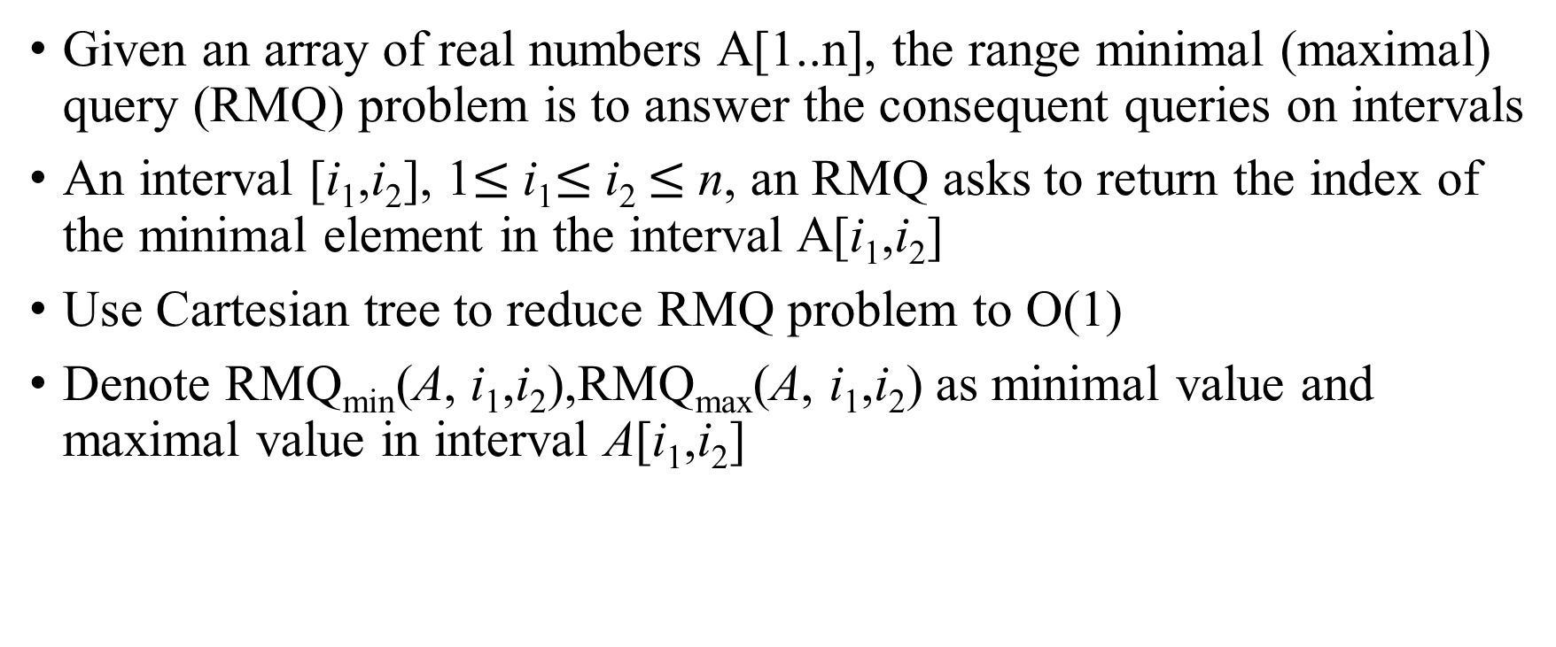
The Range Minimal Query (RMQ) problem
Given an array of real numbers A[1..n], the range minimal (maximal) query (RMQ) problem is to answer the consequent queries on intervals
An interval [i₁,i₂], 1$≤$i₁$≤$i₂ $≤$n, an RMQ asks to return the index of the minimal element in the interval A[i₁,i₂]
Use Cartesian tree to reduce RMQ problem to O(1)
Denote RMQ_{min}(A, i₁,i₂),RMQ_{max}(A, i₁,i₂) as minimal value and maximal value in interval A[i₁,i₂]

Slide 9
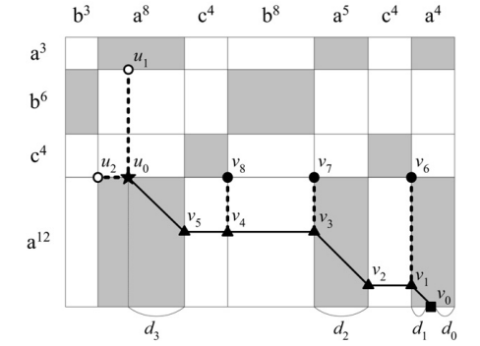
The basic idea(1/2)
X=a³b⁶c⁴a¹²,Y=b³a⁸c⁴b⁸a⁵c⁴a⁴
Calculate W[4,7,2]:
v₀(dark block) = v₁ + d₁
v₁(light block) = max{v₂, v₆}
By expanding the values of the remaining elements on the forced path between u₀ and v₀ we get v₂ = v₃ + d₂，v₃ = max{v₄, v₇}，v₄ = max{v₅, v₈}，v₅ = u₀ + d₃
Then we get v₀ = max{v₆ + d₁ , v₇ + (d₁ + d₂), v₈ + (d₁ + d₂), u₀ + (d₁ + d₂ + d₃)}
W[4,7,2]

Slide 10
The basic idea(2/2)
v₀ = max{v₆ + d₁ , v₇ + (d₁ + d₂), v₈ + (d₁ + d₂), u₀ + (d₁ + d₂ + d₃)}
{v_{6,} v_{7,} v₈} are right corner of the block
u₀ is located at either the bottom wall of a light block or the lower right corner of a dark block
Case 1: u₀=max{u₁, u₂}， u₁ is bottom wall
of the dark block
The element need to be calculated in original
dp lattice include the lower right corners of all blocks and the bottom blocks and bottom walls of the dark blocks

Slide 11
Algorithm(1/4)
LCS(X,Y)
preprocessing
σ_{i} :RX_{i}
P[i]:the index of the former run of RX_{i} which contains the same symbol σ_{i}
C[j,r]:the number of ocurences of σ_{i} in suffix Y σ_{(j,r)..m}
L_{i}[j]:the values of the lower right corners of the blocks in row (i − 1) plus the number of occurrences of σ_{i} between the corners to the right end of Y, L_{i}[j]=M[i-1,j]+C_{i}[j,m_{j}]
H_{i}[j,r]: points out the head of the forced path corresponding to (i, j,r)

Slide 12
Algorithm(2/4)
LCS(X,Y)
If block at light block :M[i,j] = max{M[i-1,j], M[i,j-1]}
If block at dark block : ComputeWall(i,j)
M[i,j] = W[i,j,m_{j}]

Slide 13
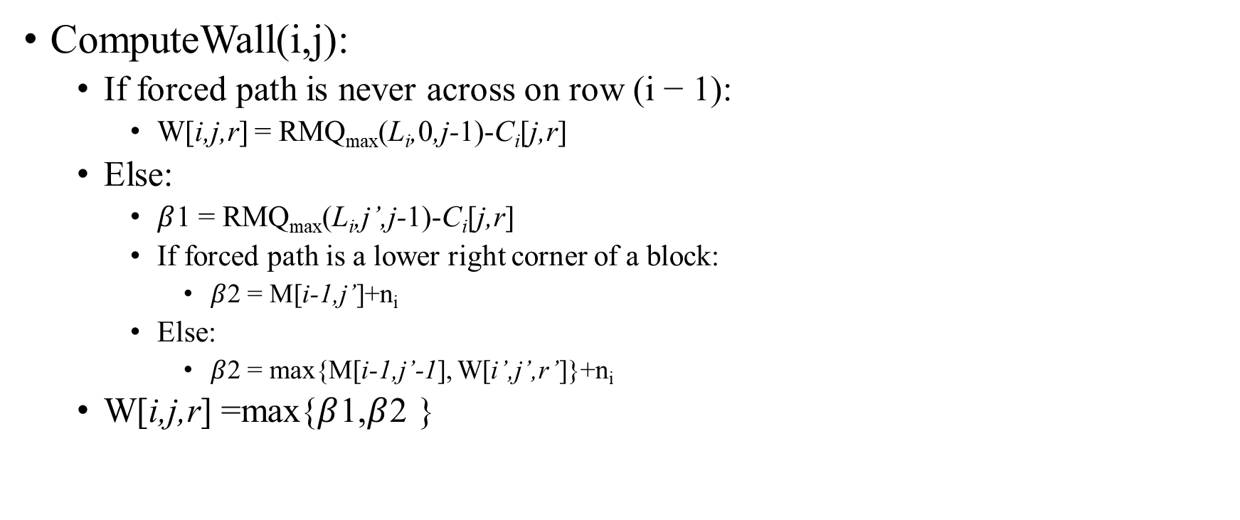
Algorithm(3/4)
ComputeWall(i,j):
If forced path is never across on row (i − 1):
W[i,j,r] = RMQ_{max}(L_{i},0,j-1)-C_{i}[j,r]
Else:
$β$1 = RMQ_{max}(L_{i},j’,j-1)-C_{i}[j,r]
If forced path is a lower right corner of a block:
$β$2 = M[i-1,j’]+n_{i}
Else:
$β$2 = max{M[i-1,j’-1], W[i’,j’,r’]}+n_{i}
W[i,j,r] =max{$β$1,$β$2 }
Notes:
如果強制路徑從未橫跨到第 i - 1 列，我們會忽略強制路徑的起始元素，因為它的值等於 M[i - 1, 0]，即 0，而 W[i, j, r] 的值可以透過考慮值 {Li[0], Li[1],..., Li[j - 1]} 的最大值來確定，每個值代表對應的共同子序列的長度。請注意，在找到最大值後，應該減去 Y 的範圍 [α(j, r), m] 內 σi 的出現次數。另一方面，如果起始元素 (i - 1, j, r) 存在，則其值也必須考慮在內。如果起始元素位於一個區塊的右下角，則其值已經計算並存儲在 M 中。否則，根據推論 1，可以通過找到兩個值 M[i - 1, j - 1] 和 W[i, j, r] 的最大值來確定這個值。臨時變數 β1 和 β2 用於分別存儲這兩種共同子序列的最佳長度，我們可以在其中找到以 (i, j, r) 結束的最長公共子序列的長度。

Slide 14
Algorithm(4/4)
Time complexity:
LCS(X,Y)
Preprocessing:O(min(P1,P2))
P1 :the numbers of elements on the bottom and P2 right boundaries of the dark blocks
If block at light block :O(1)
If block at dark block : ComputeWall(i,j)(O(1))
Time complexity : O(kl+min(P1,P2))

Slide 15

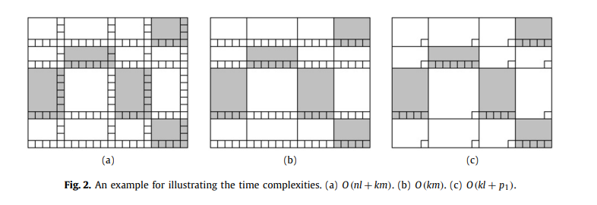
Compare to other algorithm

Slide 16
Longest common subsequence with run-length-encoded(a)
 |  | t | t | c | c | c | a
 | 0 | 0 | 0 | 0 | 0 | 0 | 0
t | 0 | 1 | 1 | 1 | 1 | 1 | 1
c | 0 |  | 1 |  |  | 2 | 2
c | 0 |  | 1 |  |  | 3 | 3
c | 0 |  | 1 |  |  | 4 | 4
c | 0 | 1 | 1 | 2 | 3 | 4 | 4
a | 0 | 1 | 1 | 2 | 3 | 4 | 5
X=ttccca(t²c³a¹)
Y=tcccca(t¹c⁴a¹)
LCS=tccca
Time complecity:
O(nl+mk)

Slide 17
Longest common subsequence with run-length-encoded(c)
X=ttccca(t²c³a¹)
Y=tcccca(t¹c⁴a¹)
LCS=tccca
Time complecity:
O(kl+min(X,Y))
 |  | t | t | c | c | c | a
 | 0 | 0 | 0 | 0 | 0 | 0 | 0
t | 0 | 1 | 1 |  |  | 1 | 1
c | 0
c | 0
c | 0
c | 0 |  | 1 | 2 | 3 | 4 | 4
a | 0 |  | 1 |  |  | 4 | 5

Slide 18
Thanks

