Slide 1
BridgeHand2Vec Bridge Hand Representation
Sztyber-Betley, A., Kołodziej, F., Betley, J., & Duszak, P.
arXiv:2310.06624, 2023.
Presenter: Yun-An Chen
Date: Nov. 7, 2023

Slide 2
Abstract(1/2)
Contract bridge is a game characterized by incomplete information, posing an exciting challenge for artificial intelligence methods. This paper proposes the BridgeHand2Vec approach, which leverages a neural network to embed a bridge player’s hand (consisting of 13 cards) into a vector space. The resulting representation reflects the strength of the hand in the game and enables interpretable distances to be determined between different hands. This representation is derived by training a neural network to estimate the number of tricks that a pair of players can take.

Slide 3
Abstract(2/2)
In the remainder of this paper, we analyze the properties of the resulting vector space and provide examples of its application in reinforcement learning, and opening bid classification. Although this was not our main goal, the neural network used for the vectorization achieves SOTA results on the DDBP2 problem (estimating the number of tricks for two given hands).

Slide 4
Neural network training for DDBP
BridgeHand2Vec: vector-based representation of a bridge hand.
400,000 hands were generated for training.
The training data were generated using Bridge Calculator.
For each NS hand, 10 EW hands were generated, and the results obtained from the DDS were averaged.

Slide 5
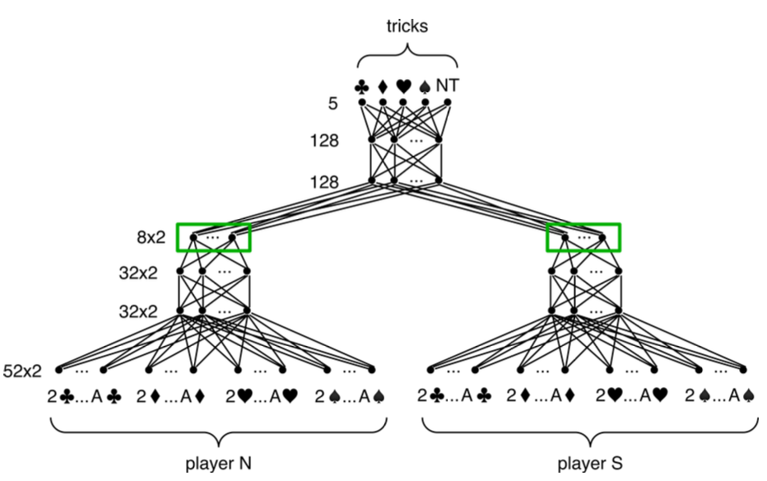
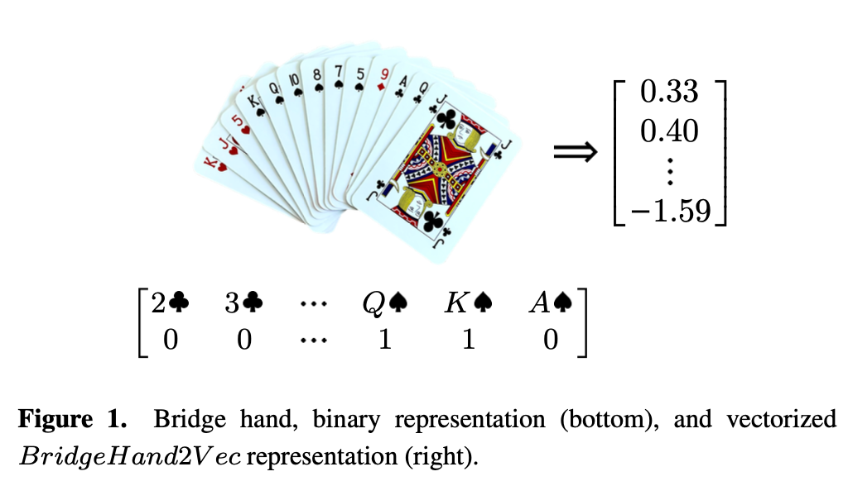
Network structure
BridgeHand2Vec embedding: a vector with 8 elements representing the hand.

Slide 6
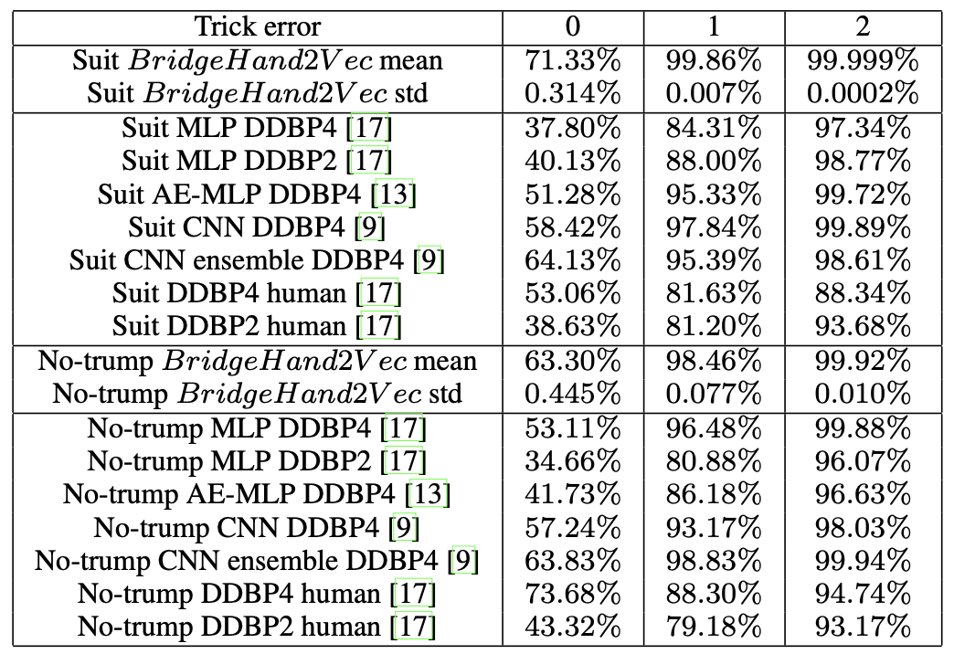
Experiment: trick error

Slide 7
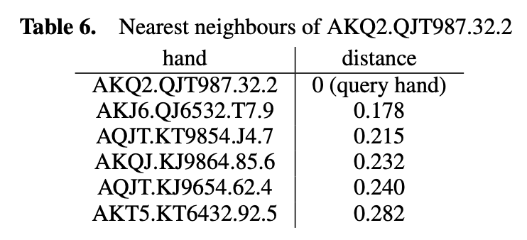
BridgeHand2Vec properties
By searching for hands with vector representation closest to the zero vector, we obtain the following: A72.K432.JT9.Q96, QT6.A432.Q95.Q94, QT6.Q95.K432.A32, A62.K432.Q86.Q96.

Slide 8
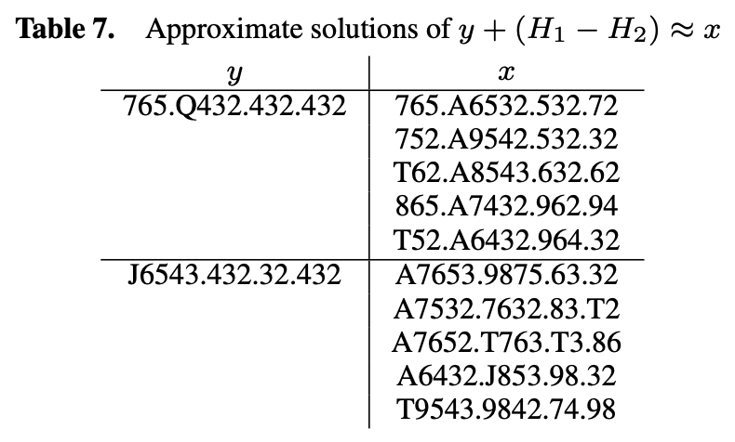
BridgeHand2Vec properties
The property of word embeddings: woman + (king − man) = queen
H1 = A82.A7643.Q62.Q5 H2 = A82.Q764.Q62.Q53

Slide 9
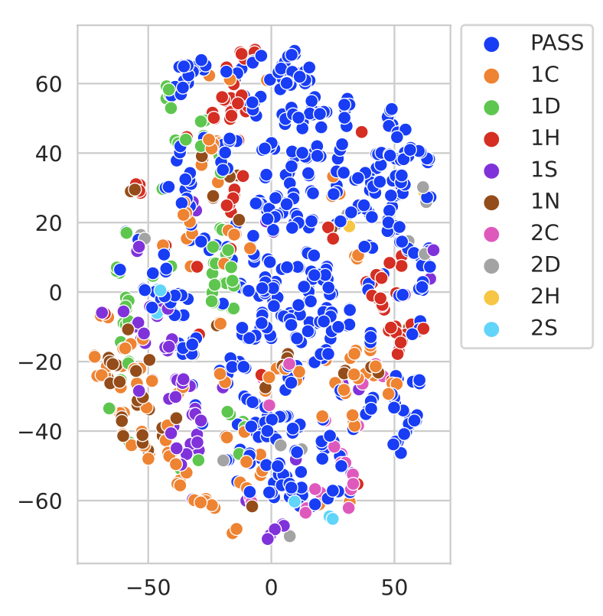
Experiment: opening bid classification
7 skilled bridge players determined the best opening bid for 1213 hands.
System: Polish club
BridgeHand2Vec dimensions are related to features used in human bidding systems:
Strong openings (1C and 1NT) are close
Weak openings (2S) are close to PASS

Slide 10
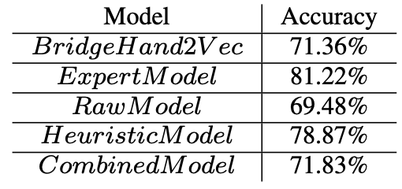
Experiment: opening bid classifiers
BridgeHand2Vec KNN classifier
Four models which did not use vectorization for comparison
Expert Model: Polish Club bidding system.
Raw Model: only information about the player’s cards.
Heuristic Model: HCP, distribution of all suits, typical information.
Combined Model(Raw + Heuristic)

Slide 11
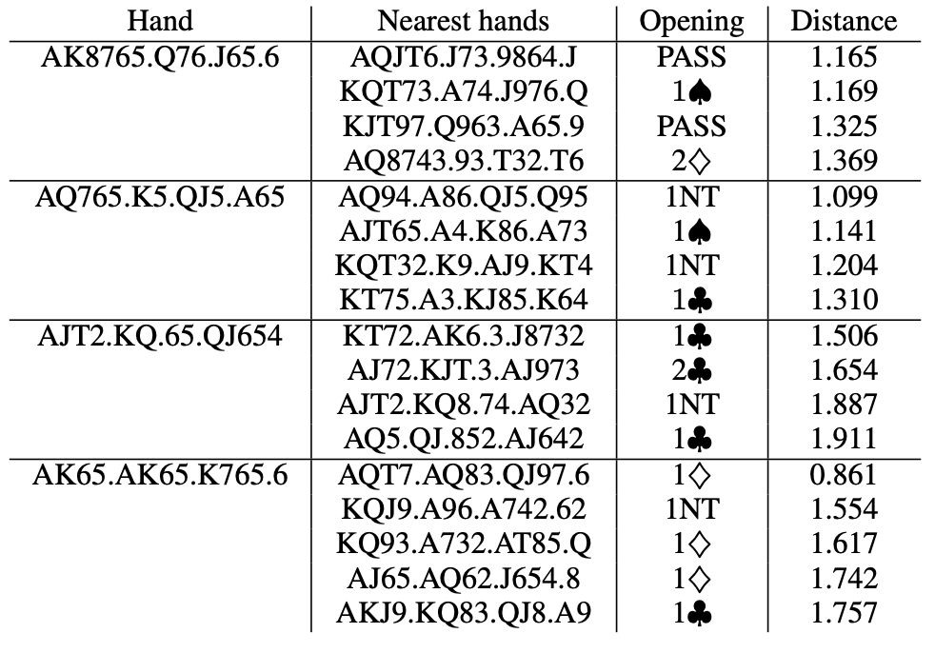
Experiment: controversial hands
1S / 2D
1H / 1N
1C / 2C
1C / 1D

Slide 12
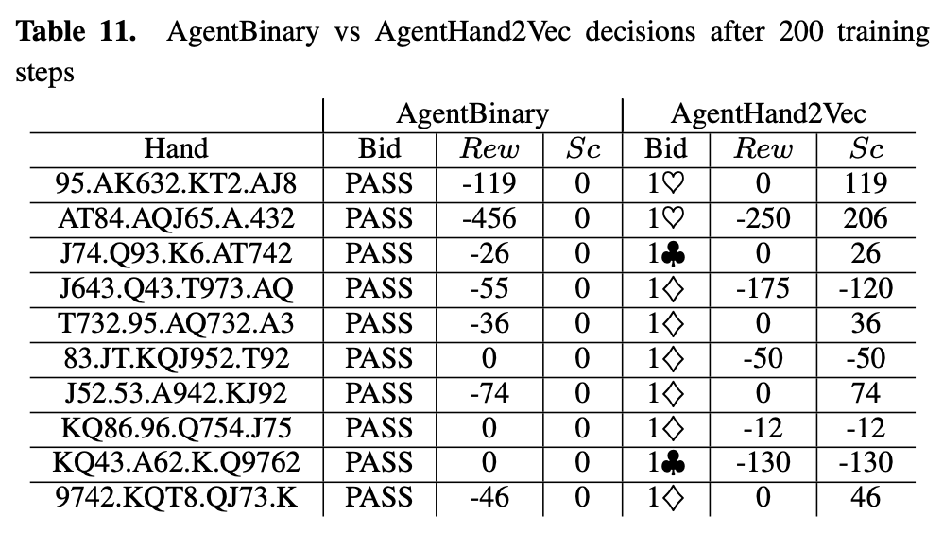
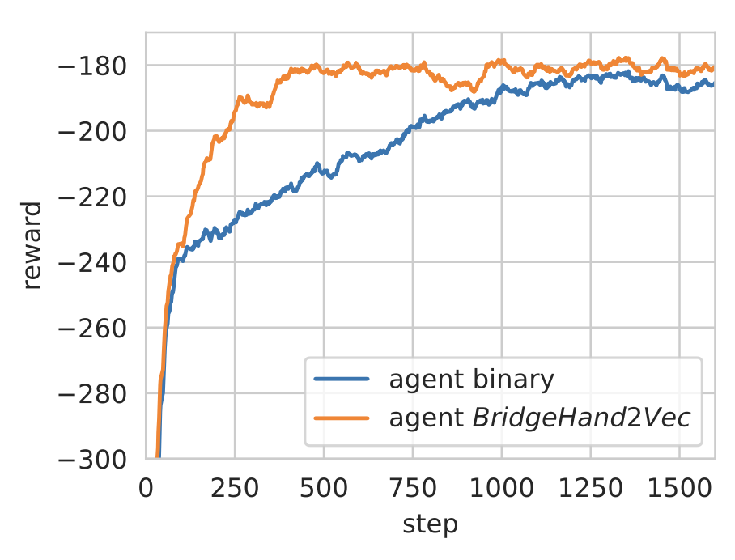
Experiment: RL learning for opening bid
Sc: EW hands are dealt 10 times. Calculate the best possible bridge score for NS for the guessed contract.

