Slide 1
GREEDY FUNCTION APPROXIMATION: A GRADIENT BOOSTING MACHINE
Jerome H. Friedman
The Annals of Statistics 2001, Vol. 29, No. 5, 1189–1232
Presenter : Jing-Xiang.Yang
Date : Nov. 7, 2023

Slide 2
ABSTRACT(1/2)
Function estimation approximation is viewed from the perspective of numerical optimization in function space, rather than parameter space. A connection is made between stagewise additive expansions and steepest descent minimization. A general gradient descent “boosting” paradigm is developed for additive expansions based on any fitting criterion. Specific algorithms are presented for least-squares, least absolute deviation, and Huber-M loss functions for regression, and multiclass logistic likelihood for classification.

Slide 3
ABSTRACT(2/2)
Special enhancements are derived for the particular case where the individual additive components are regression trees, and tools for interpreting such “TreeBoost” models are presented. Gradient boosting of regression trees produces competitive, highly robust, interpretable procedures for both regression and classification, especially appropriate for mining less than clean data. Connections between this approach and the boosting methods of Freund and Shapire and Friedman, Hastie and Tibshirani are discussed

Slide 4
Ensemble Learning
Build a strong model from the number of weak model
(三個臭皮匠勝過一個諸葛亮)

Slide 5
Boosting
A kind of a method in Ensemble Learning
Training weak classifier sequentially
Each model reduces the error of the previous one

Slide 6
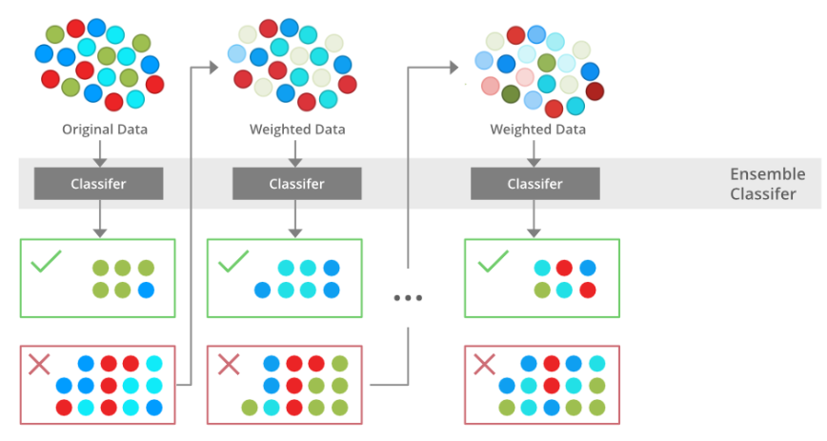
參考網址

Slide 7
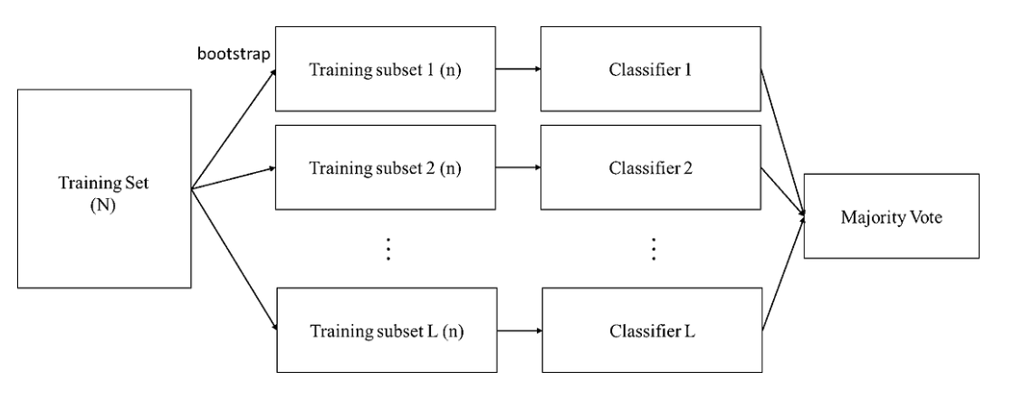
Bagging
參考網址

Slide 8
Gradient Boosting
Like Gradient Descent
Train newly weak classifier based on the negative gradient of the current model
Combine with different Loss Function, it can handle different problem

Slide 9
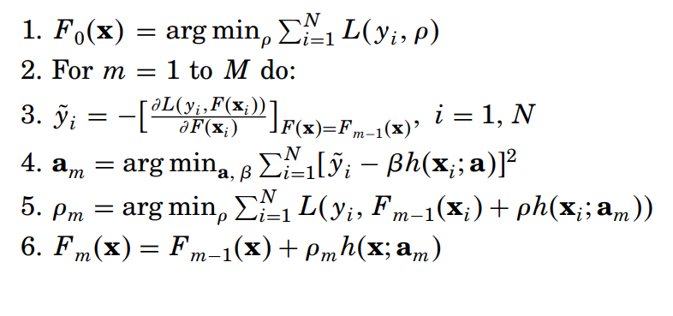
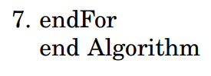
Gradient Boosting
資料個數
利用負梯度來訓練新的小model
求Learning Rate

Slide 10

Gradient Boost Decision Tree(GBDT)
Use Decision Tree as weak classifier
Least-squares regression
Loss function :

Slide 11
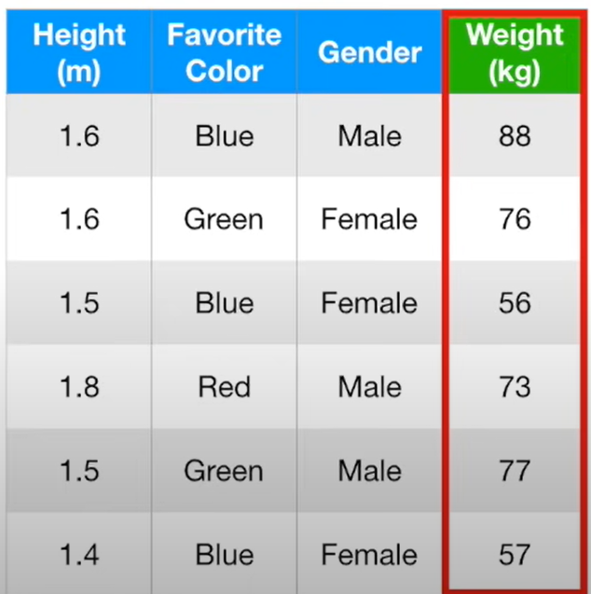

Slide 12
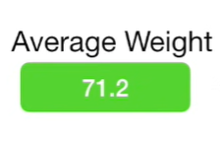
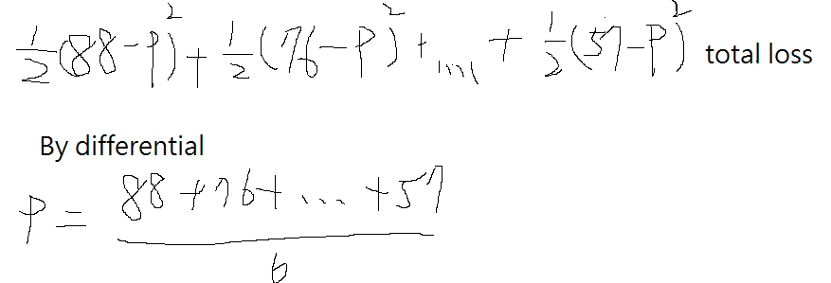
Find the first model
Calculate the average weight as first model predict value

Slide 13



Residual

Slide 14
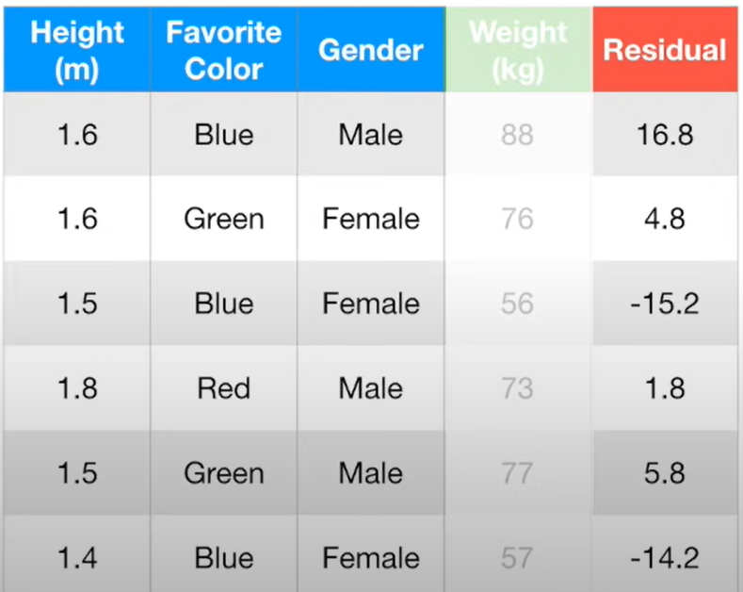
88 – 71.2
76 – 71.2

Slide 15
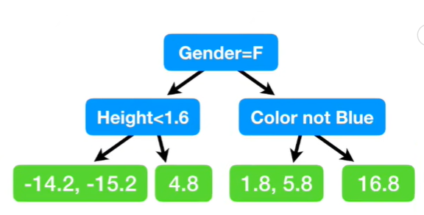
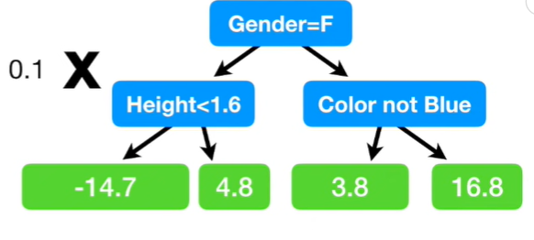

Next step : Build another tree based on residual from the first tree

Slide 16
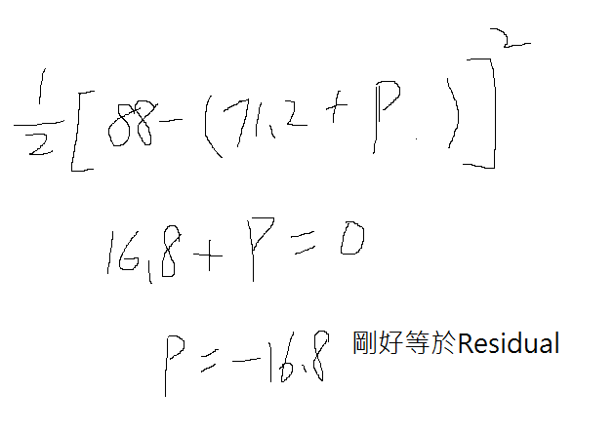

Slide 17
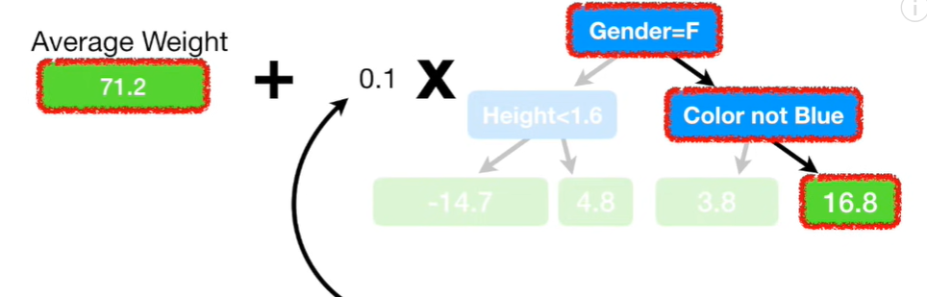
Learning rate

Slide 18
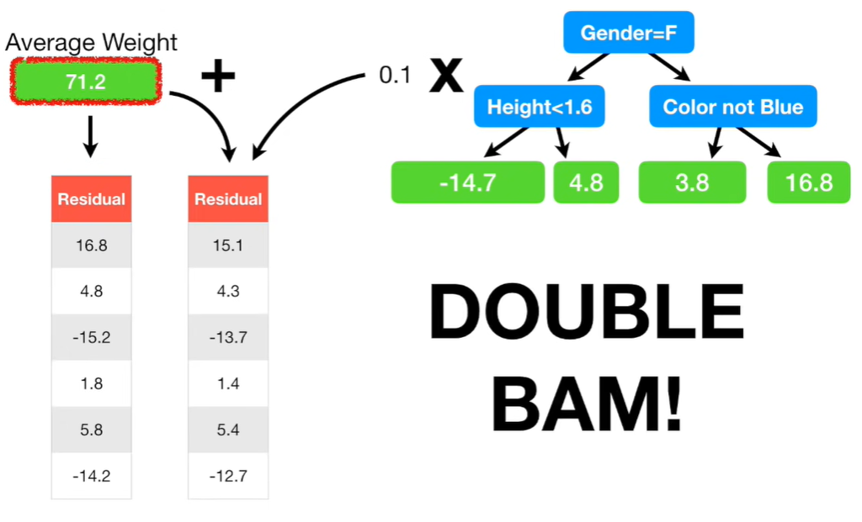

Slide 19
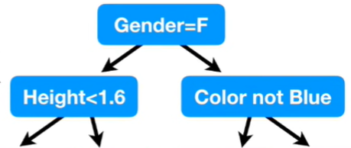
-12.7, -13.7
4.3
1.4, 5.4
15.1

Slide 20
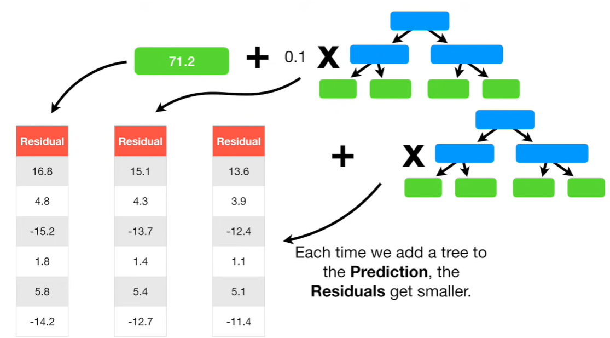

Slide 21
GBDT Application
XGBoost(2016), CatBoost(2018), LightGBM(2017)
These algorithms are frequent champions in Kaggle competitions.

Slide 22
Reference
https://www.youtube.com/watch?v=2xudPOBz-vs

Slide 23
Thanks

