Slide 1
Search Economics: A Solution Space and Computing Resource Aware Search Method
Chun-Wei Tsai
2015 IEEE International Conference on Systems, Man, and Cybernetics
Presenter: Chih-Hsuan Chien
Date: May. 25, 2022

Slide 2
Abstract
Although most metaheuristic algorithms claimed that they have a chance to find the optimal solution if given sufficient computation time. In fact, a metaheuristic algorithm may search the same region or particular solutions for a long time when the search process is approaching the convergence state. The question that arises now is, how to invest the limited computing resource to search for the “solutions on the right region” instead of wasting time to search for the irrelevant solutions. This paper introduces a new metaheuristic algorithm, called search economics (SE), for solving optimization problems. The basic idea of the SE is to depict the solution space based on the solutions that have been checked by the search algorithm and use the information of solution space to search for the solution on the convergence process. Based on these concepts, the investment of a search process will be more meaningful and thus not easy to fall into local optimum at the early iterations. The experimental results show that the proposed algorithm can provide a result that is significantly better than those provided by state-of-the-art metaheuristic algorithms in terms of the quality.

Slide 3
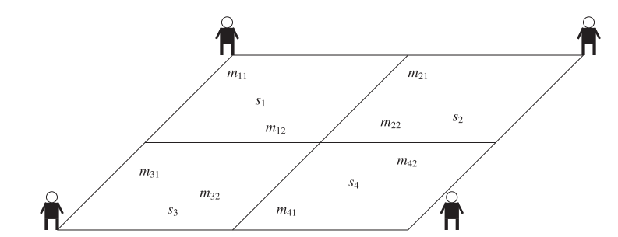
Concept
Notes:
將解空間分成好幾個區域，看哪個區域比較值得被搜尋就去搜尋他

Slide 4
Algorithm
Resource Arrangement
Vision Search
Marketing Research

Slide 5
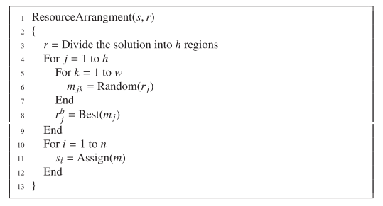

Resource arrangement
h regions
w possible goods
n searchers
Notes:
初始化

Slide 6
Vision search
Transit(crossover,mutation)
Evaluate
Determine

Slide 7

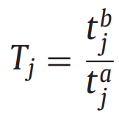
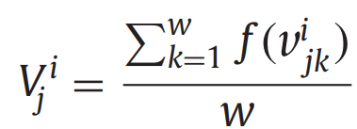
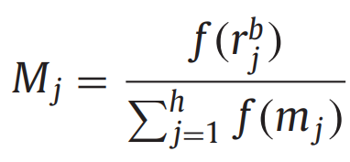


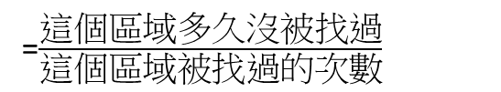
Evaluate
=$\frac{這個區域多久沒被找過}{這個區域被找過的次數}$
$$=\frac{這個區域的fitness和}{這個區域解的數量}$$
= $\frac{這個區域最好的fitness}{所有區域最好的fitness和}$

Slide 8
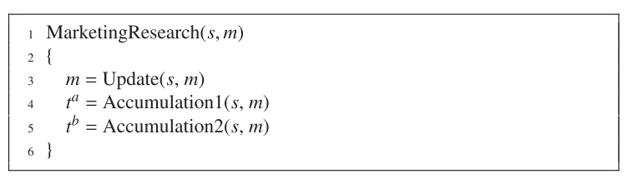
Marketing Research
Update information

Slide 9
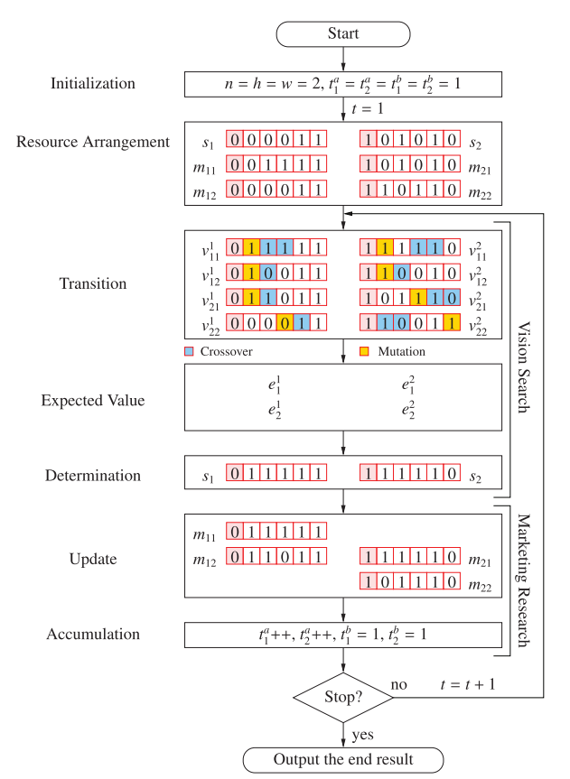

Slide 10
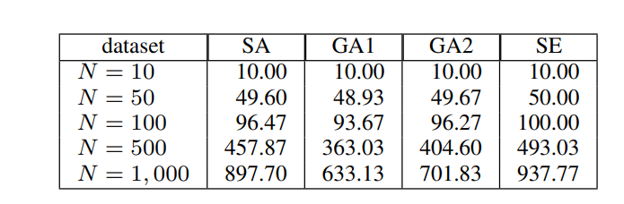
Experiment
Ex:01011

