Slide 1
Task scheduling for heterogeneous computing systems
Shaikhah AlEbrahim , Imtiaz Ahmad
The Journal of Supercomputing
Date: May. 26, 2022
Presenter: Jue-Jun Wu

Slide 2
Abstract
Efficient scheduling of tasks in heterogeneous computing systems is of primary importance for high-performance execution of programs. The programs are to be considered as multiple sequences of tasks that are presented as directed acyclic graphs (DAG). Each task has its own execution timeline that incorporates into multiple processors. Moreover, each edge on the graph represents constraints between the sequenced tasks. In this paper, we propose a new list–scheduling algorithm that schedules the tasks represented in the DAG to the processor that best minimizes the total execution time by taking into consideration the restriction of crossover between processors. This objective will be achieved in two major phases: (a) computing priorities of each task that will be executed, and (b) selecting the processor that will handle each task. The first phase, priorities computation, focuses on finding the best execution sequence that minimizes the makespan of the overall execution. In list-scheduling algorithm, the quality of the solution is very sensitive to the priority assigned to the tasks.

Slide 3
Therefore, in this paper, we include an enhanced calculation of weight that is used in the ranking equation for determining the priority of tasks. The second phase, processor selection, primarily focuses on allocating a processor that is a best fit for each task to be executed. In this paper, we enhance the processor selection by introducing a randomized decision mechanism based on a threshold which decides whether the task be assigned to the processor with the lowest execution time or to the processor that produces the lowest finish time. This mechanism considers a balanced combination of the local and global optimal results to explore the search space efficiently to optimize the overall makespan. The proposed algorithm is evaluated on different randomly generated DAGs, and results are compared with the well-known existing approaches to show the effectiveness of the proposed algorithm in reducing the makespan of execution. The experiment’s results show improvement in the makespan that reaches up to 6–7%.

Slide 4
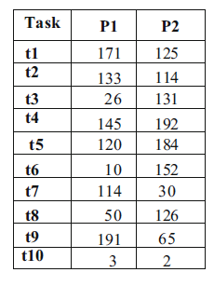
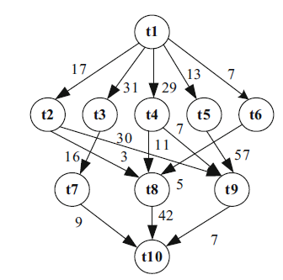

Slide 5
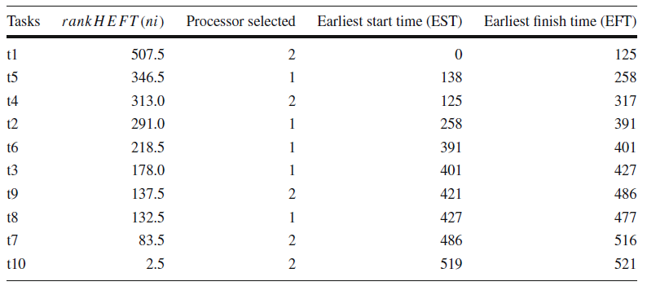

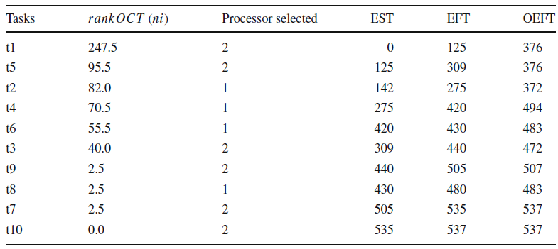


Slide 6



Slide 7



Slide 8
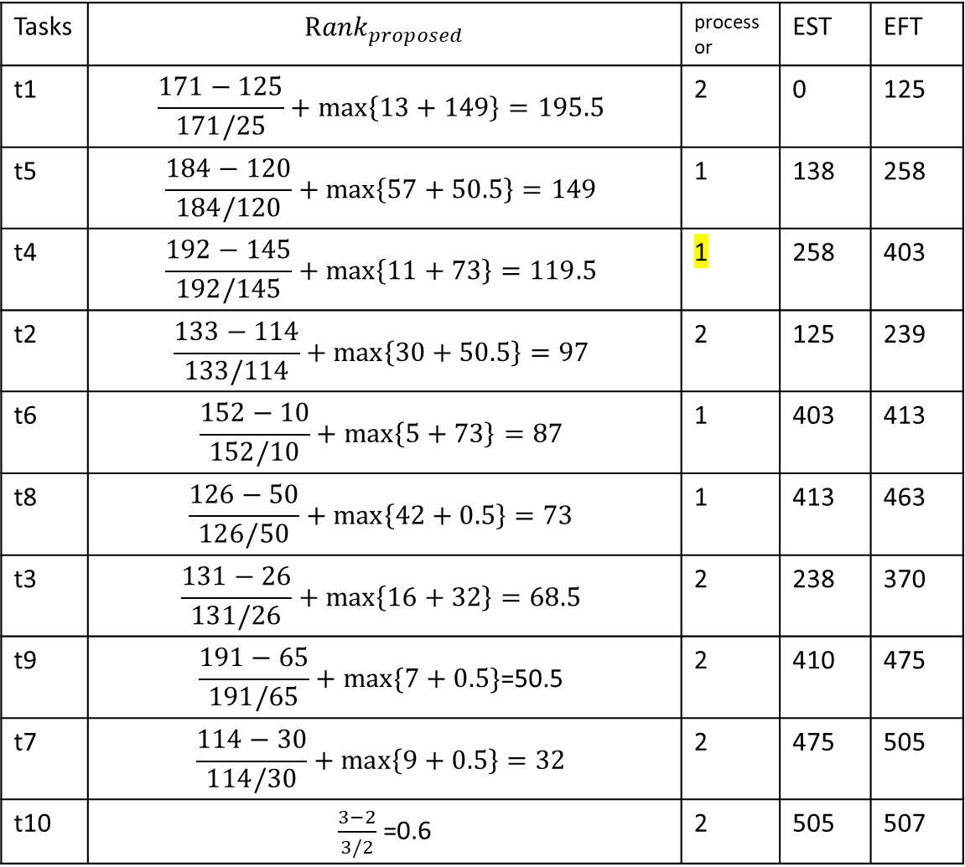
Tasks | $${Rank}_{proposed}$$ | processor | EST | EFT
t1 | $$\frac{171−125}{171/25}+\max\left\{13+149\right\}=195.5$$ | 2 | 0 | 125
t5 | $$\frac{184−120}{184/120}+\max\left\{57+50.5\right\}=149$$ | 1 | 138 | 258
t4 | $$\frac{192−145}{192/145}+\max\left\{11+73\right\}=119.5$$ | 1 | 258 | 403
t2 | $$\frac{133−114}{133/114}+\max\left\{30+50.5\right\}=97$$ | 2 | 125 | 239
t6 | $$\frac{152−10}{152/10}+\max\left\{5+73\right\}=87$$ | 1 | 403 | 413
t8 | $$\frac{126−50}{126/50}+\max\left\{42+0.5\right\}=73$$ | 1 | 413 | 463
t3 | $$\frac{131−26}{131/26}+\max\left\{16+32\right\}=68.5$$ | 2 | 238 | 370
t9 | $$\frac{191−65}{191/65}+max⁡\{7+0.5\}\text{=50.5}$$ | 2 | 410 | 475
t7 | $$\frac{114−30}{114/30}+\max\left\{9+0.5\right\}=32$$ | 2 | 475 | 505
t10 | $\frac{3−2}{3/2}$ =0.6 | 2 | 505 | 507

Slide 9
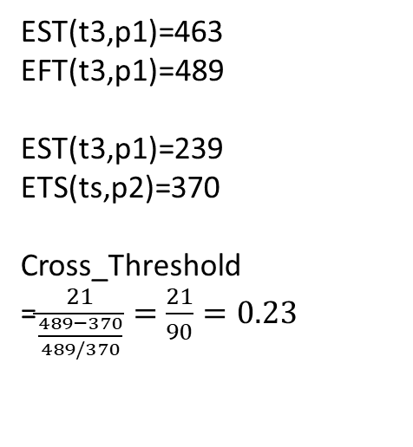
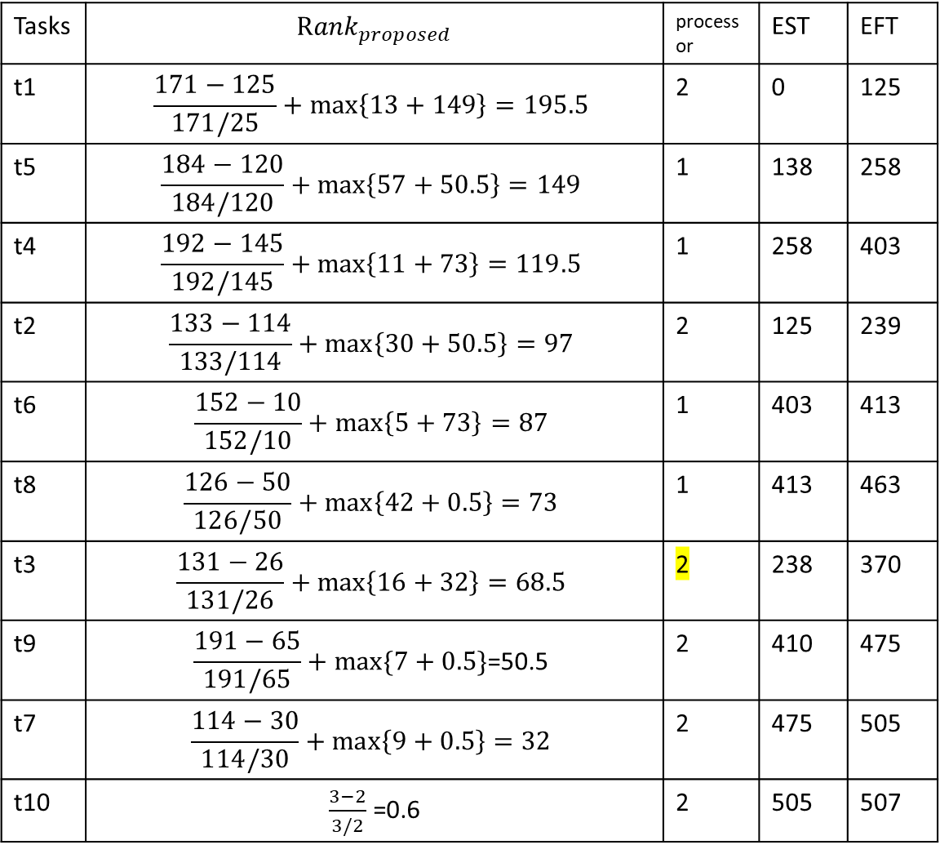
Tasks | $${Rank}_{proposed}$$ | processor | EST | EFT
t1 | $$\frac{171−125}{171/25}+\max\left\{13+149\right\}=195.5$$ | 2 | 0 | 125
t5 | $$\frac{184−120}{184/120}+\max\left\{57+50.5\right\}=149$$ | 1 | 138 | 258
t4 | $$\frac{192−145}{192/145}+\max\left\{11+73\right\}=119.5$$ | 1 | 258 | 403
t2 | $$\frac{133−114}{133/114}+\max\left\{30+50.5\right\}=97$$ | 2 | 125 | 239
t6 | $$\frac{152−10}{152/10}+\max\left\{5+73\right\}=87$$ | 1 | 403 | 413
t8 | $$\frac{126−50}{126/50}+\max\left\{42+0.5\right\}=73$$ | 1 | 413 | 463
t3 | $$\frac{131−26}{131/26}+\max\left\{16+32\right\}=68.5$$ | 2 | 238 | 370
t9 | $$\frac{191−65}{191/65}+max⁡\{7+0.5\}\text{=50.5}$$ | 2 | 410 | 475
t7 | $$\frac{114−30}{114/30}+\max\left\{9+0.5\right\}=32$$ | 2 | 475 | 505
t10 | $\frac{3−2}{3/2}$ =0.6 | 2 | 505 | 507
EST(t3,p1)=463
EFT(t3,p1)=489
EST(t3,p1)=239
ETS(ts,p2)=370
Cross_Threshold
=$\frac{21}{\frac{489−370}{489/370}}=\frac{21}{90}=0.23$

Slide 10
Experimental
Number of tasks (n) = {10, 50, 100, 200, 500}
Graph shape (FAT) = {0.1, 0.5, 1, 5, 10}
Computation to Communication Ratio (CCR) = {0.1, 5, 10}
Density = {0.5}
Jump = {5}

Slide 11
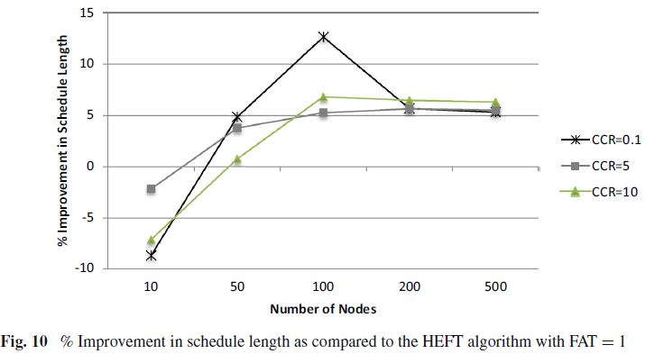
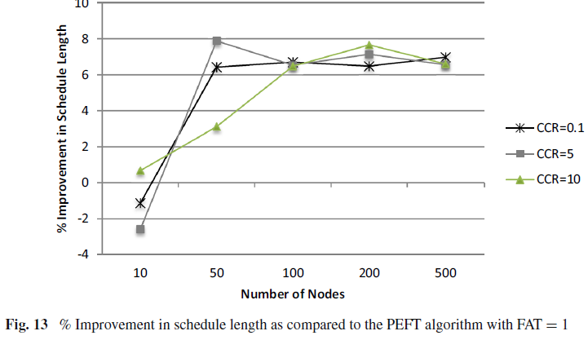
Results

Slide 12
