Slide 1
Longest common substrings with k mismatches
Tomas Flouri, Emanuele Giaquinta, Kassian Kobert,
Esko Ukkonen
Information Processing Letters 115 (2015) 643–647
Presenter: Cheng-Han Ho
Date: June 28, 2022

Slide 2
Abstract
The longest common substring with k-mismatches problem is to ﬁnd, given two strings S₁ and S₂, a longest substring A₁ of S₁ and A₂ of S₂ such that the Hamming distance between A₁ and A₂ is ≤ k. We introduce a practical O(nm) time and O(1) space solution for this problem, where n and m are the lengths of S₁ and S₂, respectively. This algorithm can also be used to compute the matching statistics with k-mismatches of S₁ and S₂ in O(nm) time and O(m) space. Moreover, we also present a theoretical solution for the k = 1 case which runs in O(n logm) time, assuming m ≤ n, and uses O(m) space, improving over the existing O(nm) time and O(m) space bound of Babenko and Starikovskaya.

Slide 3
Longest common substring with k mismatches
A = bacdacba
B = adcadba
k = 2
bac acda dacba
adc adca cadba
ans = 5

Slide 4
A = bacdacba
B = adcadba
k = 2
(i+p, j+p) | init | (2, 1) | (3, 2) | (4, 3) | (5, 4) | (6, 5) | (7, 6) | (8, 7)
Start | 0 | 0 | 0 | 0 | 0 | 2 | 2 | 2
p | 0 | 1 | 2 | 3 | 4 | 5 | 6 | 7
Queue | empty | empty | 1 | 1 → 2 | 1 → 2 | 2 | 2 | 2
Length | 0 | 1 | 2 | 3 | 4 | 3 | 4 | 5

Slide 5
A = bacdacba
B = adcadba
k = 2
Ans:
bacdacba
adcadba
(i+p, j+p) | init | (2, 1) | (3, 2) | (4, 3) | (5, 4) | (6, 5) | (7, 6) | (8, 7)
Start | 0 | 0 | 0 | 0 | 0 | 2 | 2 | 2
p | 0 | 1 | 2 | 3 | 4 | 5 | 6 | 7
Queue | empty | empty | 1 | 1 → 2 | 1 → 2 | 2 | 2 | 2
Length | 0 | 1 | 2 | 3 | 4 | 3 | 4 | 5

Slide 6
A = bacdacba
B = adcadba
k = 2
Ans:
bacdacba
adcadba
(i+p, j+p) | init | (2, 1) | (3, 2) | (4, 3) | (5, 4) | (6, 5) | (7, 6) | (8, 7)
Start | 0 | 0 | 0 | 0 | 0 | 2 | 2 | 2
p | 0 | 1 | 2 | 3 | 4 | 5 | 6 | 7
Queue | empty | empty | 1 | 1 → 2 | 1 → 2 | 2 | 2 | 2
Length | 0 | 1 | 2 | 3 | 4 | 3 | 4 | 5

Slide 7
A = bacdacba
B = adcadba
k = 2
Ans:
bacdacba
adcadba
(i+p, j+p) | init | (2, 1) | (3, 2) | (4, 3) | (5, 4) | (6, 5) | (7, 6) | (8, 7)
Start | 0 | 0 | 0 | 0 | 0 | 2 | 2 | 2
p | 0 | 1 | 2 | 3 | 4 | 5 | 6 | 7
Queue | empty | empty | 1 | 1 → 2 | 1 → 2 | 2 | 2 | 2
Length | 0 | 1 | 2 | 3 | 4 | 3 | 4 | 5

Slide 8
A = bacdacba
B = adcadba
k = 2
Ans:
bacdacba
adcadba
(i+p, j+p) | init | (2, 1) | (3, 2) | (4, 3) | (5, 4) | (6, 5) | (7, 6) | (8, 7)
Start | 0 | 0 | 0 | 0 | 0 | 2 | 2 | 2
p | 0 | 1 | 2 | 3 | 4 | 5 | 6 | 7
Queue | empty | empty | 1 | 1 → 2 | 1 → 2 | 2 | 2 | 2
Length | 0 | 1 | 2 | 3 | 4 | 3 | 4 | 5

Slide 9
A = bacdacba
B = adcadba
k = 2
Ans:
bacdacba
adcadba
(i+p, j+p) | init | (2, 1) | (3, 2) | (4, 3) | (5, 4) | (6, 5) | (7, 6) | (8, 7)
Start | 0 | 0 | 0 | 0 | 0 | 2 | 2 | 2
p | 0 | 1 | 2 | 3 | 4 | 5 | 6 | 7
Queue | empty | empty | 1 | 1 → 2 | 1 → 2 | 2 | 2 | 2
Length | 0 | 1 | 2 | 3 | 4 | 3 | 4 | 5

Slide 10
A = bacdacba
B = adcadba
k = 2
Ans:
bacdacba
adcadba
(i+p, j+p) | init | (2, 1) | (3, 2) | (4, 3) | (5, 4) | (6, 5) | (7, 6) | (8, 7)
Start | 0 | 0 | 0 | 0 | 0 | 2 | 2 | 2
p | 0 | 1 | 2 | 3 | 4 | 5 | 6 | 7
Queue | empty | empty | 1 | 1 → 2 | 1 → 2 | 2 | 2 | 2
Length | 0 | 1 | 2 | 3 | 4 | 3 | 4 | 5

Slide 11
A = bacdacba
B = adcadba
k = 2
Ans:
bacdacba
adcadba
(i+p, j+p) | init | (2, 1) | (3, 2) | (4, 3) | (5, 4) | (6, 5) | (7, 6) | (8, 7)
Start | 0 | 0 | 0 | 0 | 0 | 2 | 2 | 2
p | 0 | 1 | 2 | 3 | 4 | 5 | 6 | 7
Queue | empty | empty | 1 | 1 → 2 | 1 → 2 | 2 | 2 | 2
Length | 0 | 1 | 2 | 3 | 4 | 3 | 4 | 5

Slide 12
Time complexity
k mismatch: O(mn)
A = a₁ a₂ … a_{m}
B = b₁ b₂ … b_{n}
A = a₁ a₂ … a_{m}
B = b₁ b₂ … b_{n}

Slide 13
Longest common substring with 1 mismatch
A = gcctaxx
B = xgcata
k = 1
gccta
gcata
ans = 5
reduce to longest k-repeats problem

Slide 14
The longest k-repeats problem
S = gcctaxxxgcata
k = 1
find: u ∗^{k} v
gccta
gcata
ans = 5

Slide 15
1 mismatch 1 repeats
A = gcctaxx
B = xgcata
k = 1
gccta
gcata
ans = 5
S = gcctaxxxgcata
k = 1
find: u ∗^{k} v
gccta
gcata
ans = 5

Slide 16
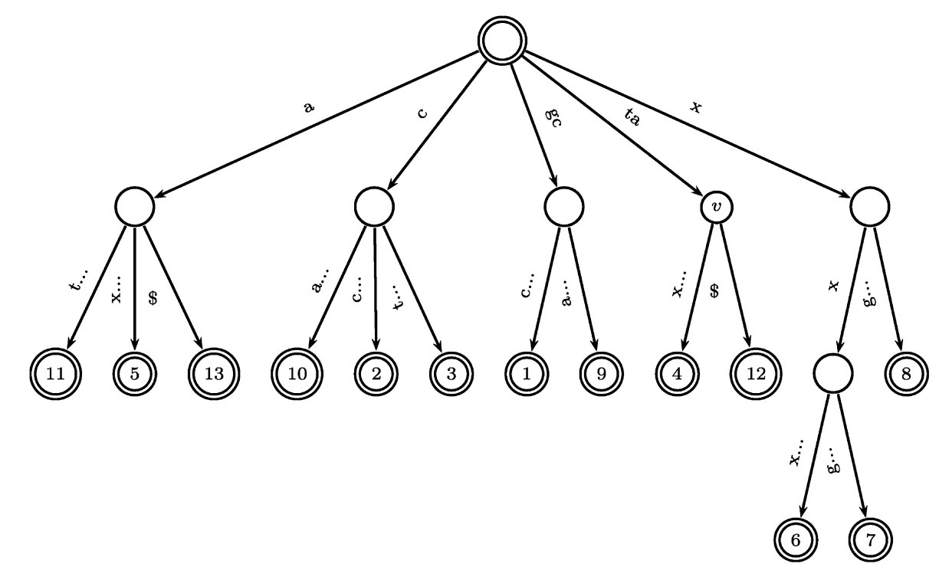
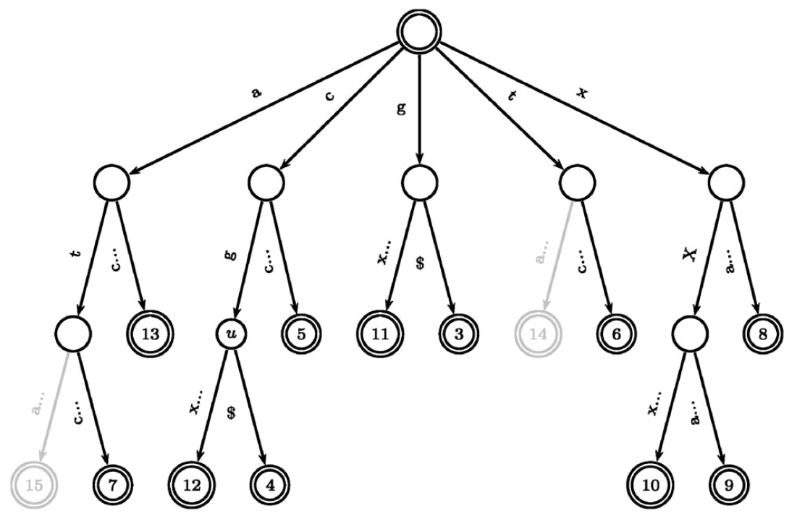
Suffix tree
S = gcctaxxxgcata reverse of S = atacgxxxatccg

Slide 17
S = gcctaxxxgcata reverse of S = atacgxxxatccg
|S| = 13
k = 1
find: u ∗¹ v
v = ta
第4個位置往前跳過 k 個: 4 – (k+1) = 2
反向: |S| – 2 + 1 = 12
u = gc

Slide 18
S = gcctaxxxgcata reverse of S = atacgxxxatccg
u ∗¹ v
v: ta
u: gc
ans = gc*ta

Slide 19
Time complexity
k-repeats: O(n log n)
reduce by S’ = S₁$₁S₂$₂
1 mismatch: O((n + m) log(n + m))

