Slide 1
Interval Matrices with Monge Property
Martin Černý
Applications of Mathematics, 2020
Vol. 65, No. 5, pp. 619-643
Presenter: Tsung-Lin Lu
Date: June 28, 2022

Slide 2
Abstract
We generalize Monge property of real matrices for interval matrices. We define two classes of interval matrices with Monge property - in a strong and in a weak sense. We study fundamental properties of both classes. We show several different characterizations of the strong Monge property. For weak Monge property we give a polynomial characterization and several sufficient and necessary conditions. For both classes we study closure properties. We further propose a generalization of an algorithm by Deineko & Filonenko which for a given matrix returns row and column permutations such that the permuted matrix is Monge if the permutations exist.

Slide 3
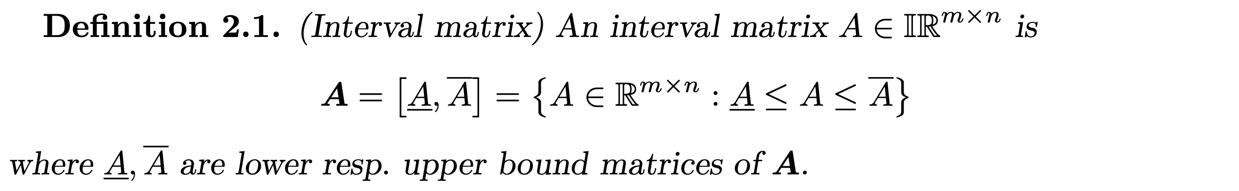
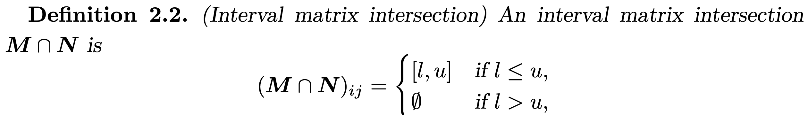
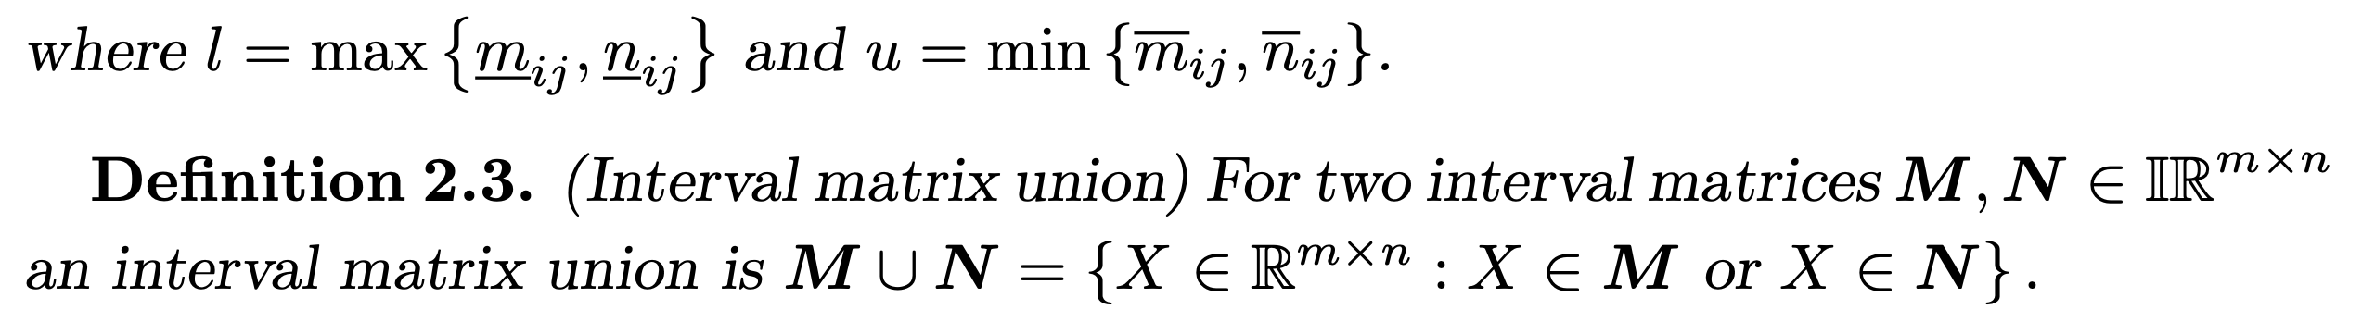
Interval analysis (1/3)
[0, 5] | 5
[0,8] | 0
Interval matrix

Slide 4
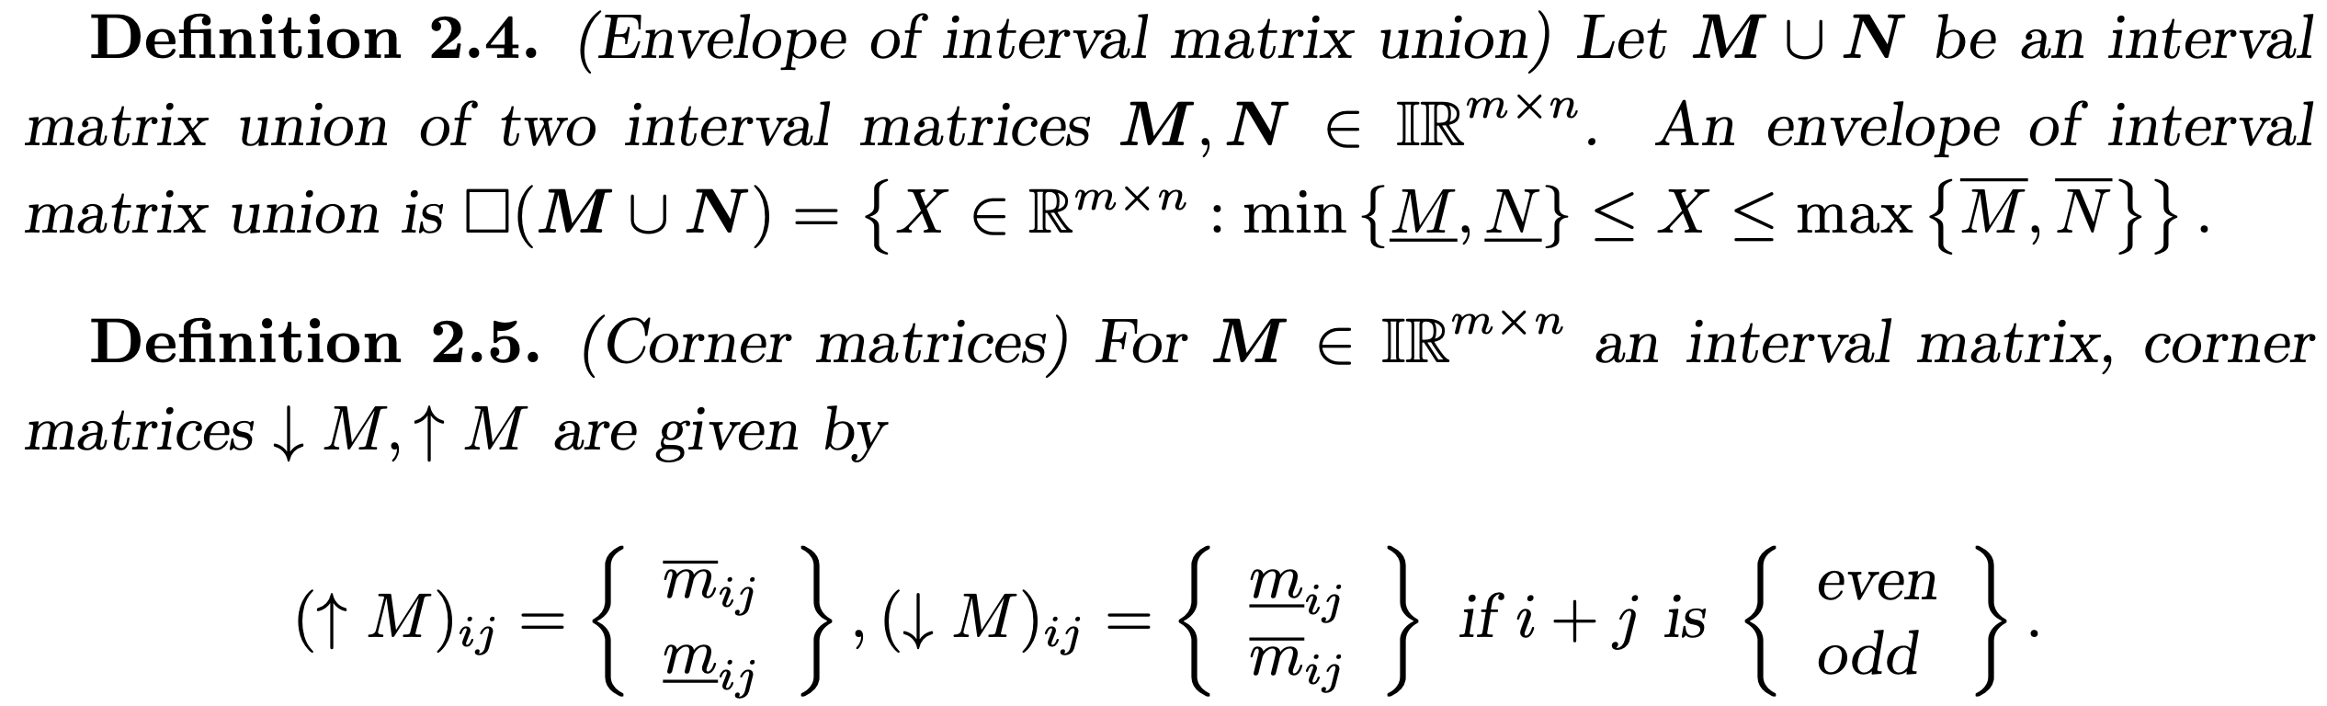
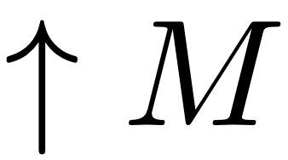
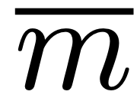

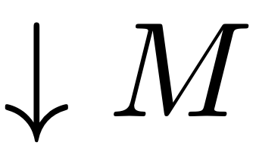
Interval analysis (2/3)
e | o | e | o
o | e | o | e
e | o | e | o
o | e | o | e
[0, 5] | 5
[0,8] | 0
5 | 5
0 | 0
0 | 5
8 | 0

Slide 5
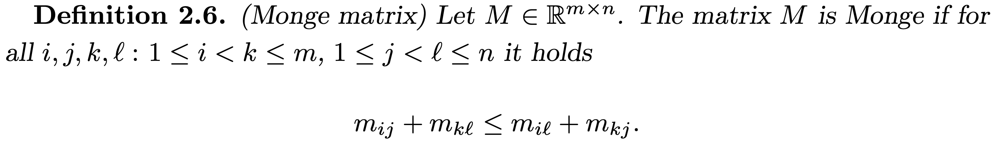
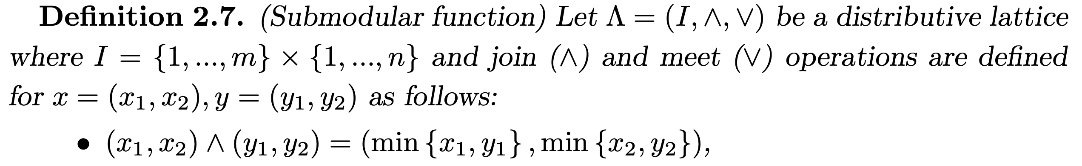
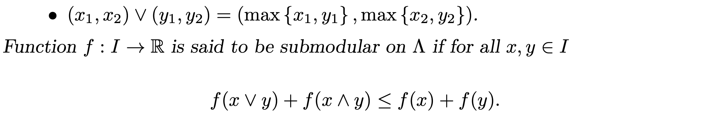
Interval analysis (3/3)
對角和≤反對角和
join(∧) : min
meet(∨) : max
對角和 ≤ 反對角和

Slide 6
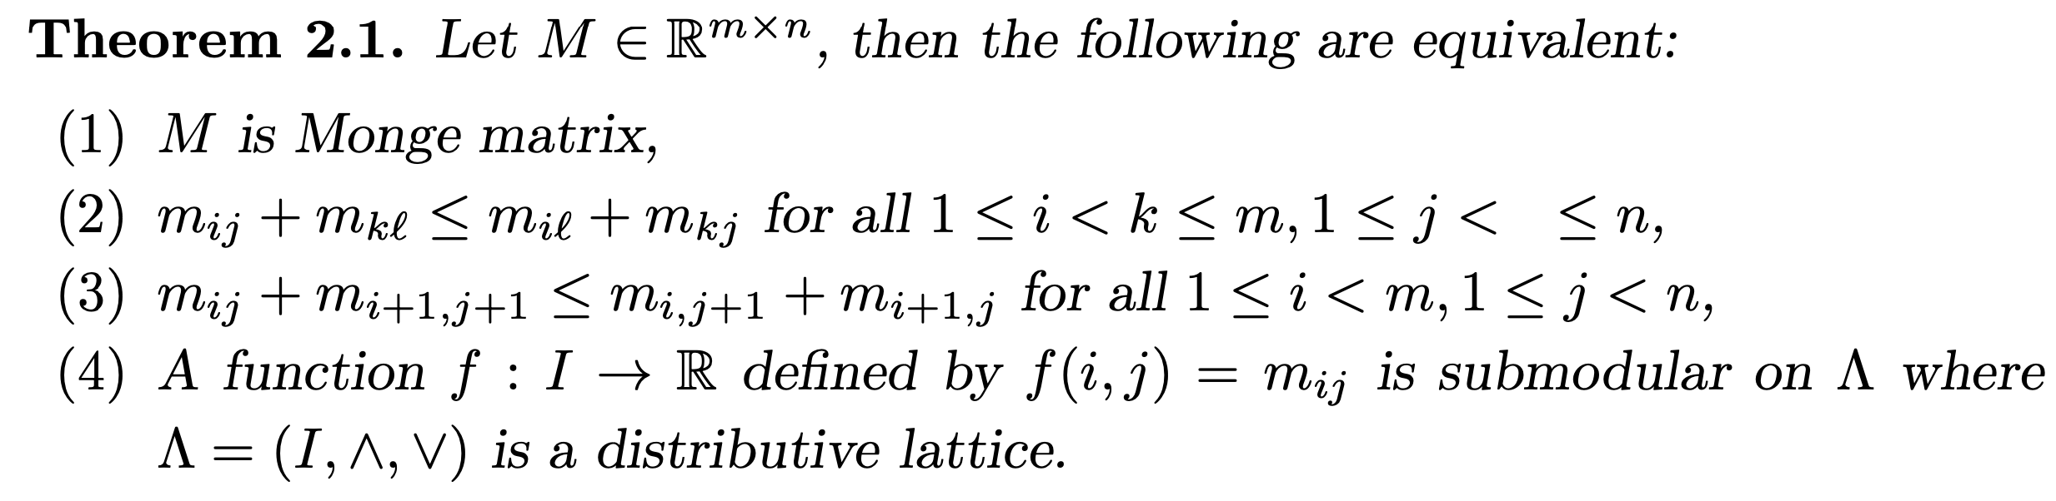
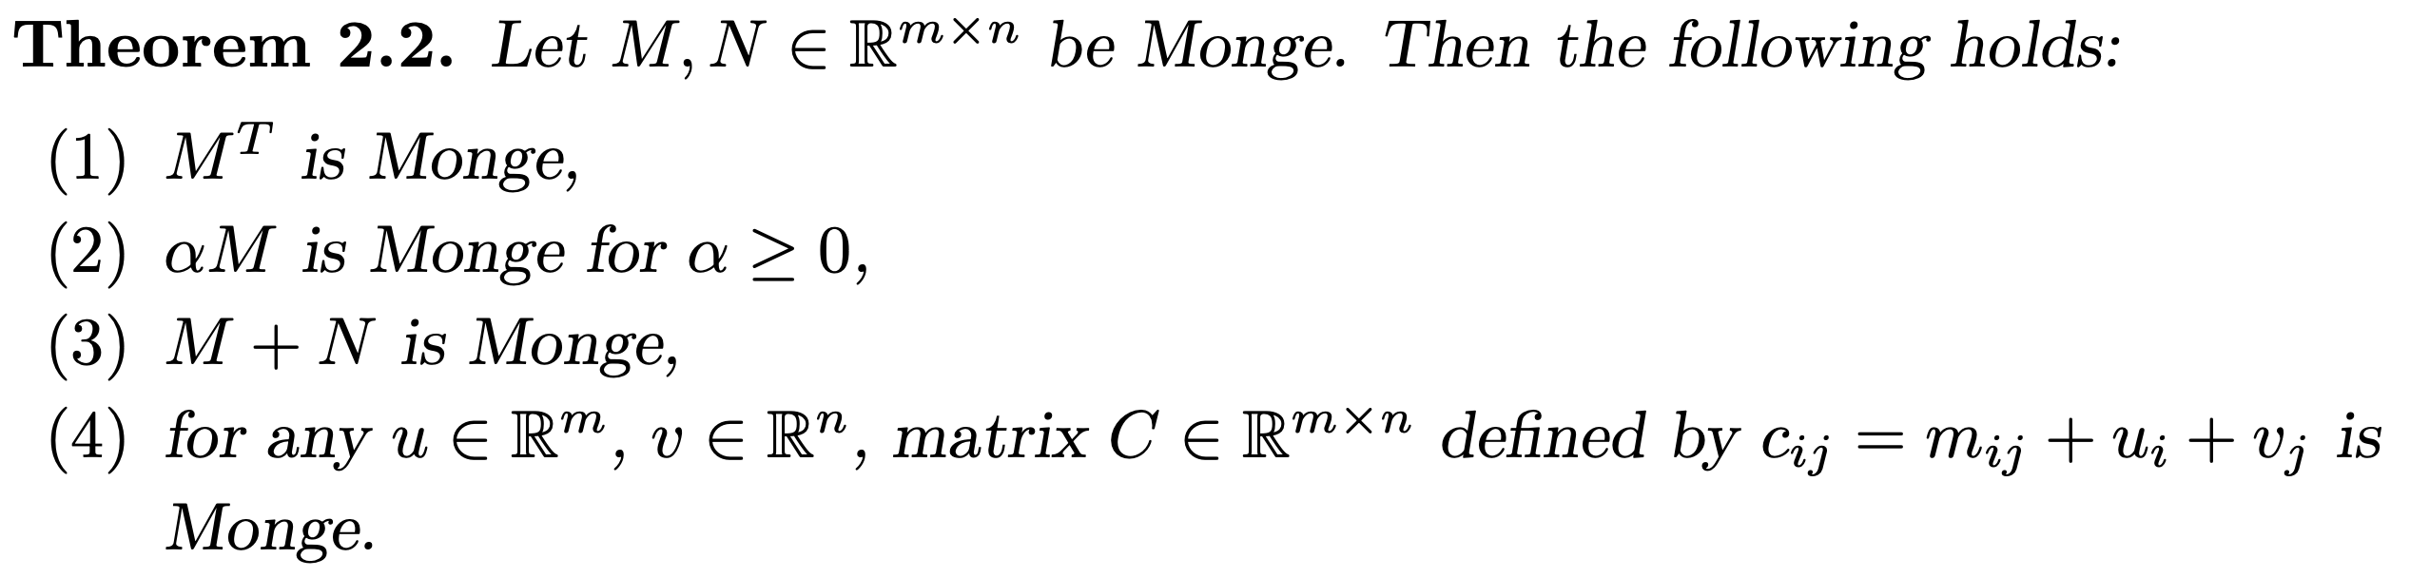
Real Matrices with Monge Property (1/2)
Monge : 全部都是等價
s
轉置
倍數
相加
分解

Slide 7
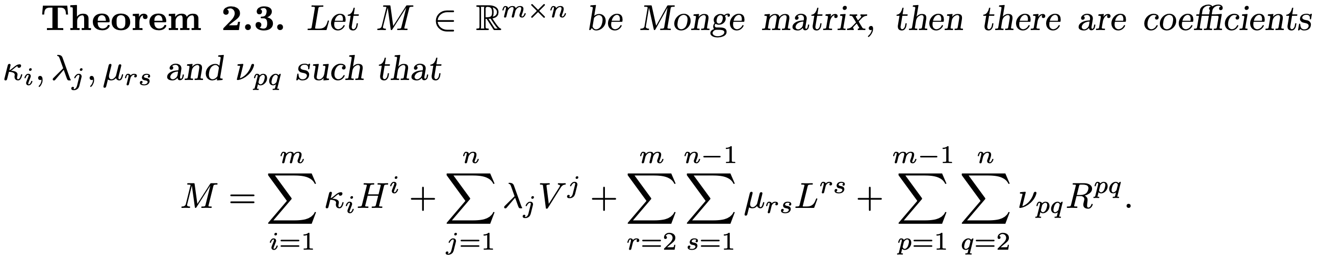
Real Matrices with Monge Property (2/2)
列
行
左下
右上
Example1 : Monge matrix
[0, 5] | 5
[0,8] | 0
0 | 1
1 | 0
1 | 0
1 | 0
0 | 1
0 | 0
= [0, 3] *
+ [0, 5] *
+ 5 *
Example2 : not Monge matrix
1 | 5
6 | 0

Slide 8
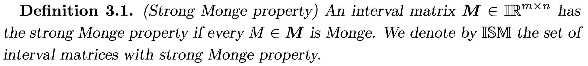
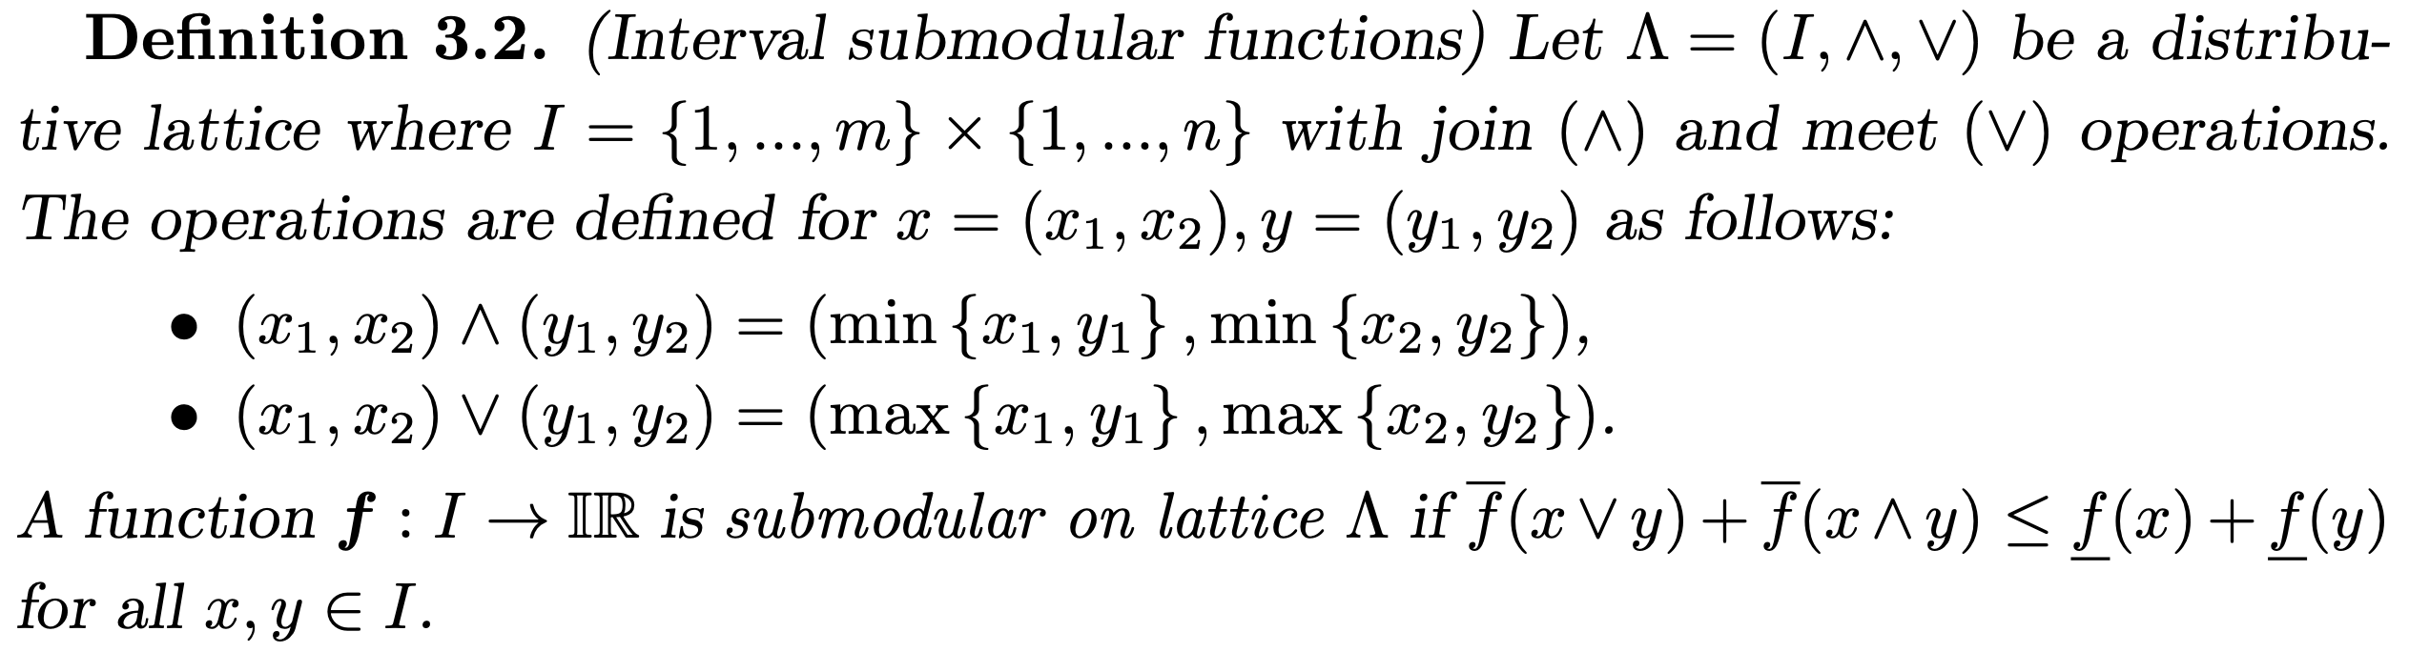
𝕀𝕊𝕄 (1/2)
[0, 5] | 5
[0,8] | 0
𝕀𝕊𝕄 : 所有矩陣都是Monge
join(∧) : min
meet(∨) : max
對角和 ≤ 反對角和

Slide 9
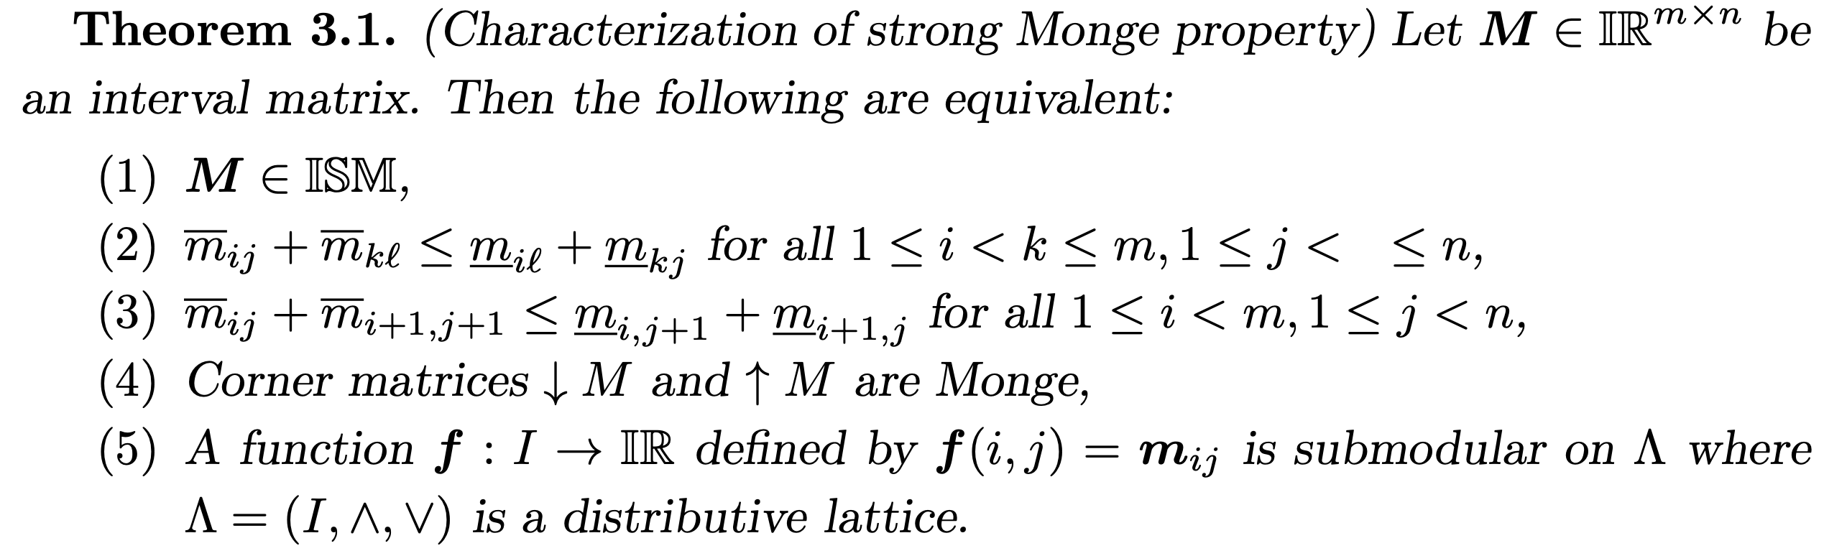
𝕀𝕊𝕄 (2/2)
 | j | l
i | [a1, a2] | [b1, b2]
k | [c1, c2] | [d1, d2]

Slide 10
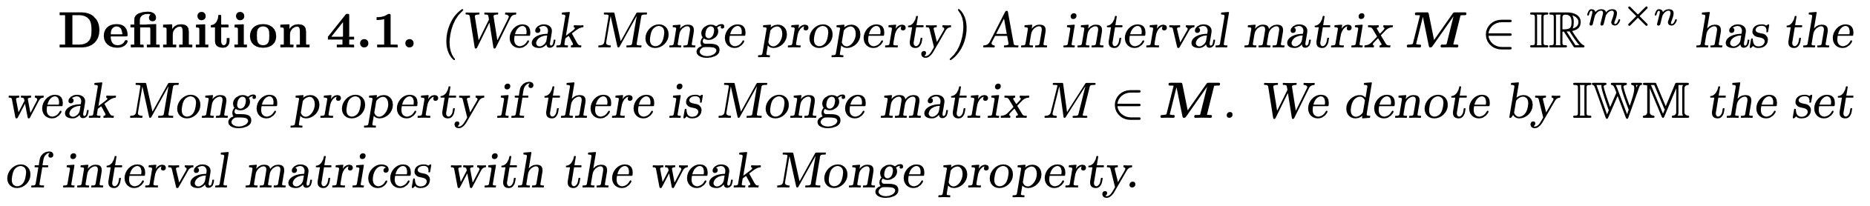
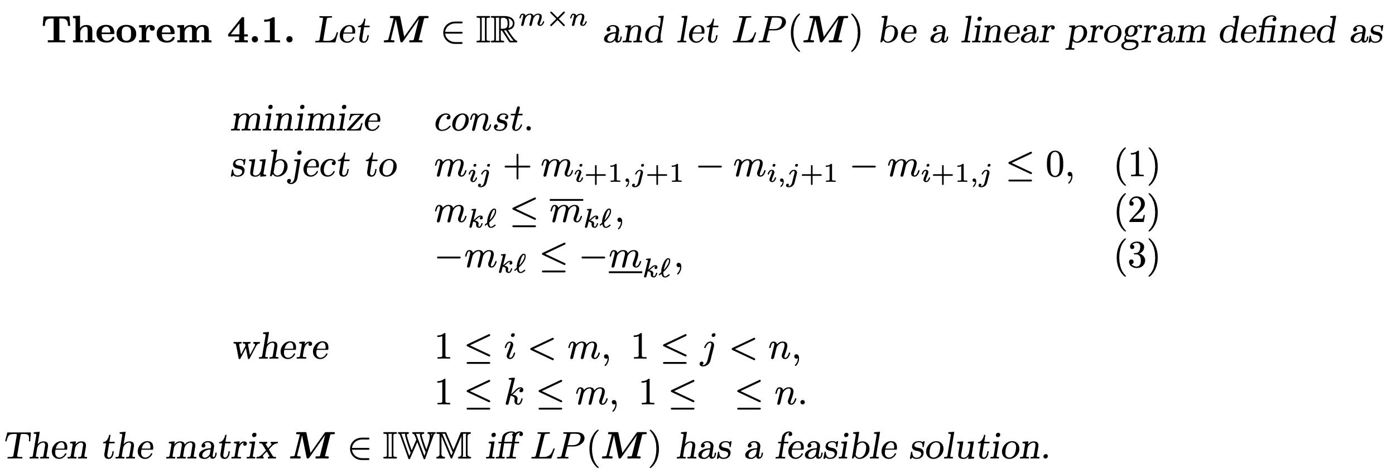
𝕀𝕎𝕄 (1/5)
𝕀𝕎𝕄 : 部分矩陣是Monge
Monge
不超過上界
不超過下界

Slide 11
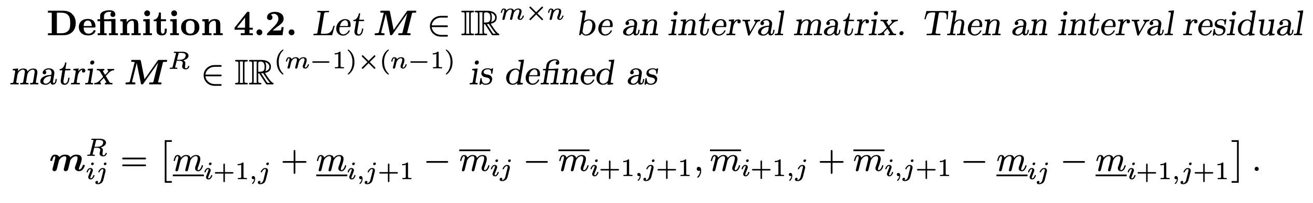
𝕀𝕎𝕄 Necessary conditions (2/5)
殘差
殘差皆不為負數
Example :
M | 1 | 2 | 3 | 4
1 | [3, 1000] | [10, 120] | [17, 20] | [0, 24]
2 | [2, 20] | [7, 9] | [0, 12] | [17, 85]
3 | [2, 5] | [0, 6] | [10, 14] | [14, 100]
4 | [0, 1] | [3, 6] | [5, 21] | [7, 1000]
M^{R} | 1 | 2 | 3
1 | [-997, 130] | [-108, 19] | [-105, 2]
2 | [-17, 12] | [-23, 1] | [-85, 85]
3 | [-11, 2] | [-14, 15] | [-995, 104]

Slide 12
𝕀𝕎𝕄 Necessary conditions (3/5)
和上界相等值的數列至少為max(row, col)
Example :
[3, 1000] | [10, 120] | [17, 20] | [0, 24]
[2, 20] | [7, 9] | [0, 12] | [17, 85]
[2, 5] | [0, 6] | [10, 14] | [14, 100]
[0, 1] | [3, 6] | [5, 21] | [7, 1000]
3 | 10 | 17 | 24
2 | 7 | 12 | 17
2 | 6 | 10 | 14
1 | 3 | 5 | 7

Slide 13
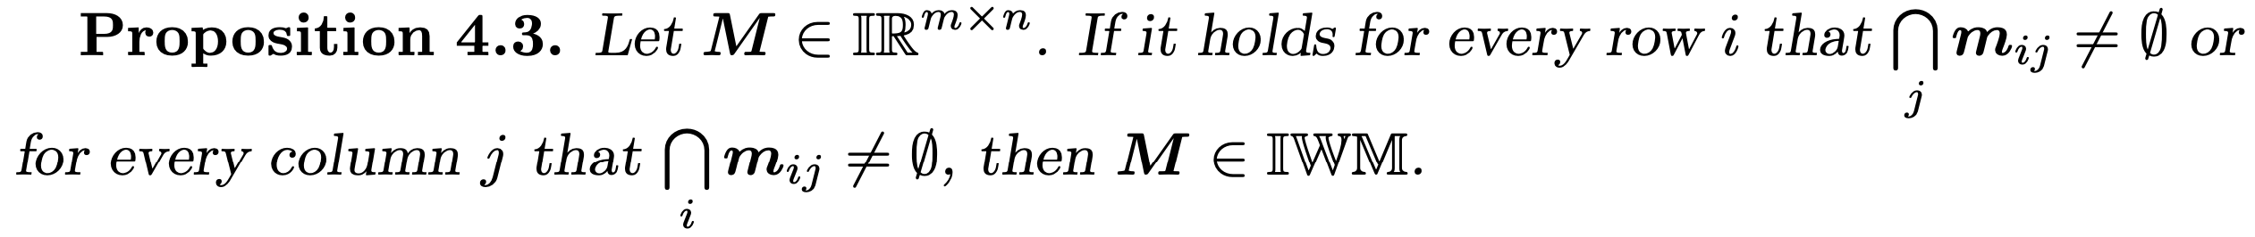
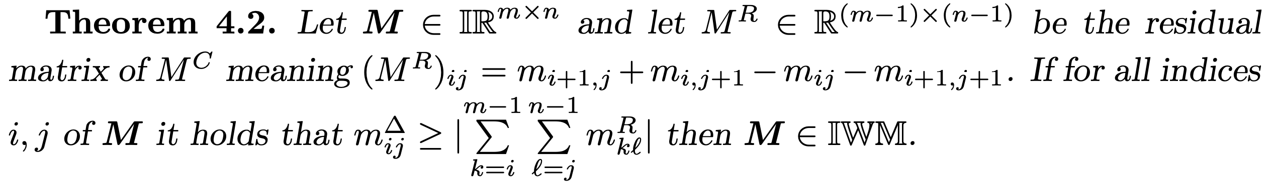
𝕀𝕎𝕄 Sufficient conditions (4/5)
每行或每列交集不為空集合
每個元素半徑 ≥ |中心|
每個元素半徑 ≥ |左上角殘差和|
M | 1 | 2 | 3 | 4
1 | [3, 1000] | [10, 120] | [17, 20] | [0, 24]
2 | [2, 20] | [7, 9] | [0, 12] | [17, 85]
3 | [2, 5] | [0, 6] | [10, 14] | [14, 100]
4 | [0, 1] | [3, 6] | [5, 21] | [7, 1000]
(半徑, 中心)
 | 1 | 2 | 3 | 4
1 | (498.5, 501.5) | (55, 65) | (1.5, 8.5) | (12, 12)
2 | (9, 11) | (1, 8) | (6, 6) | (34, 51)
3 | (1.5, 3.5) | (3, 3) | (2, 12) | (43, 57)
4 | (0.5, 0.5) | (1.5, 4.5) | (8, 13) | (496.5, 503.5)
每列交集
[17, 20]
[17, 9]
[14, 5]
[7,1]

Slide 14
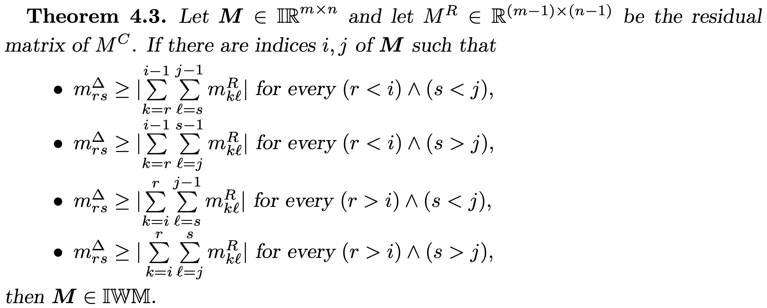
𝕀𝕎𝕄 Sufficient conditions (5/5)

Slide 15
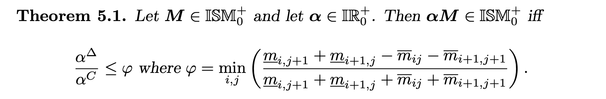
Closure Properties
正實數
正實數區間
𝛼區間除了要正實數外，半徑/中心比和殘差比有關
轉置

Slide 16
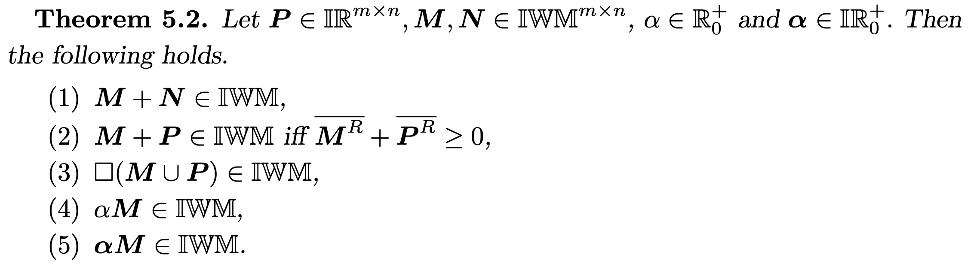
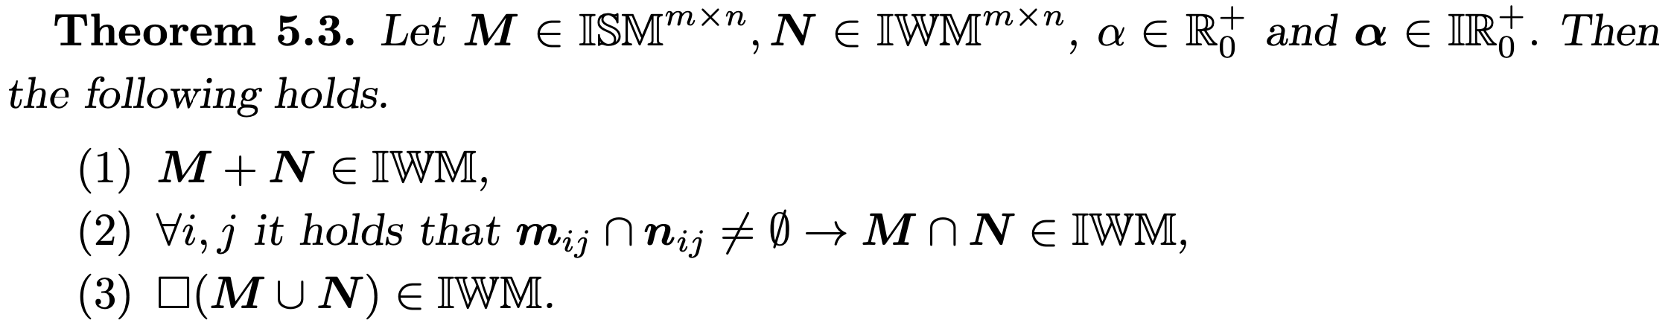
Closure Properties
區間矩陣
𝕀𝕎𝕄
正實數
正實數區間
𝕀𝕊𝕄
𝕀𝕎𝕄
正實數
正實數區間

Slide 17
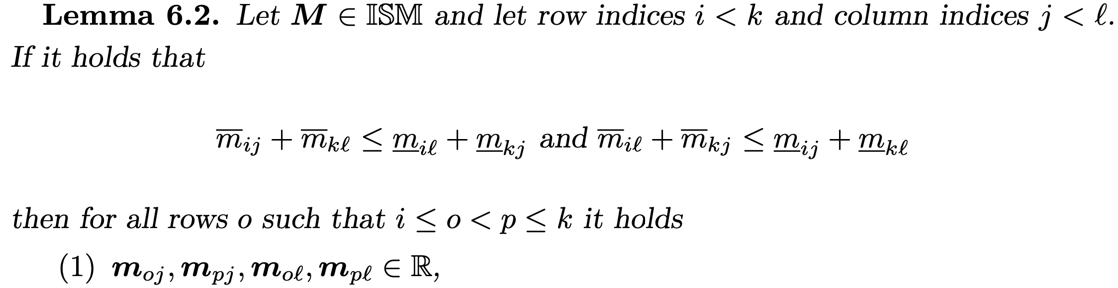
Algorithm
𝕀𝕊𝕄 is closed under an operation of flipping the matrix upside down and left to right.
 | j | l
i | (i, j) | (i, l)
k | (k, j) | (k, l)
 | l | j
i | (i, l) | (i, j)
k | (k, l) | (k, j)
If the order of columns is ambiguous, the order of columns and rows does not really matter because all four interval entries are actually real values.

Slide 18
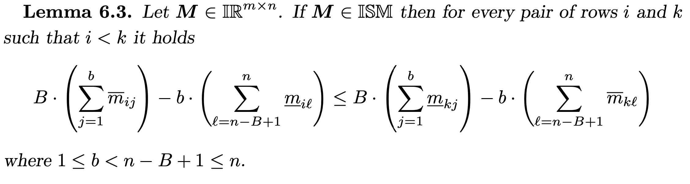
Algorithm
①第i列前b行上界和
②第i列後B行下界和
③第k列前b行下界和
④第k列後B行上界和
①
②
Example : 𝕀𝕊𝕄
i
[a1, a2] | .... | .... | .... | .... | .... | [b1, b2]
.... |  |  |  |  |  | ....
.... |  |  |  |  |  | ....
[c1, c2] | .... | .... | .... | .... | .... | [d1, d2]
[0, 5] | [5, 5]
[0,8] | [0, 0]
令b=1, B=1
1*5-1*5 ≤ 1*0-1*0
k
③
④

Slide 19
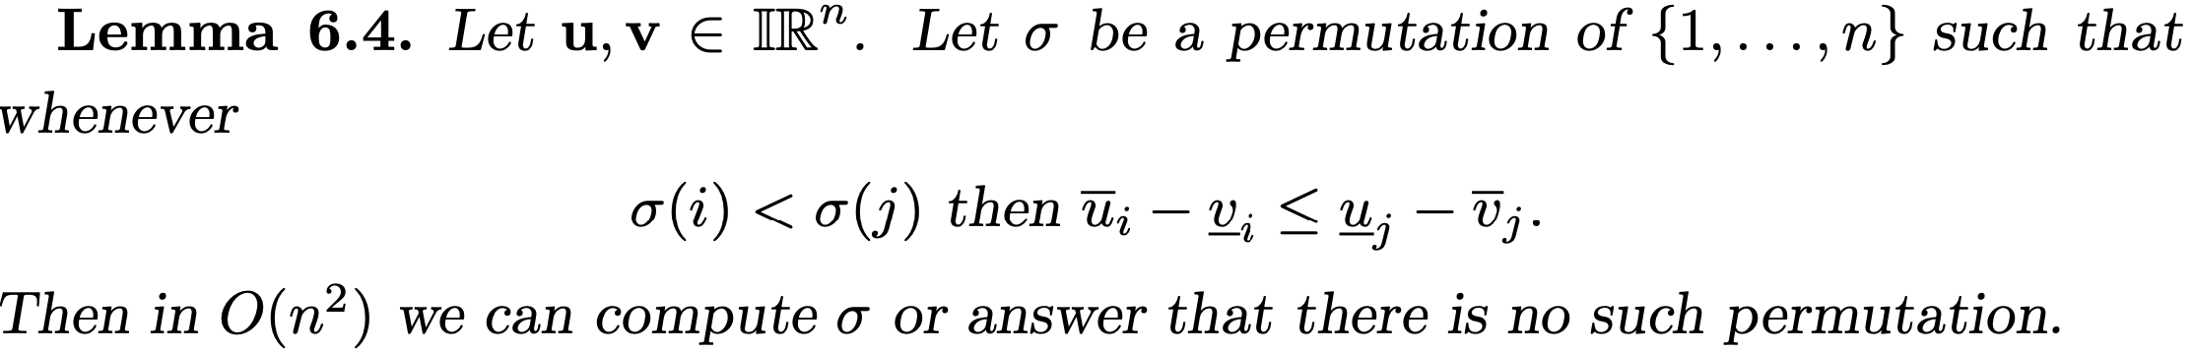
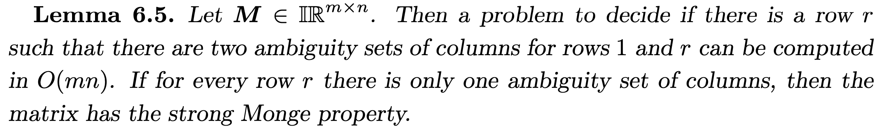
Algorithm
第i的直徑 ≤ 第j的負直徑

Slide 20
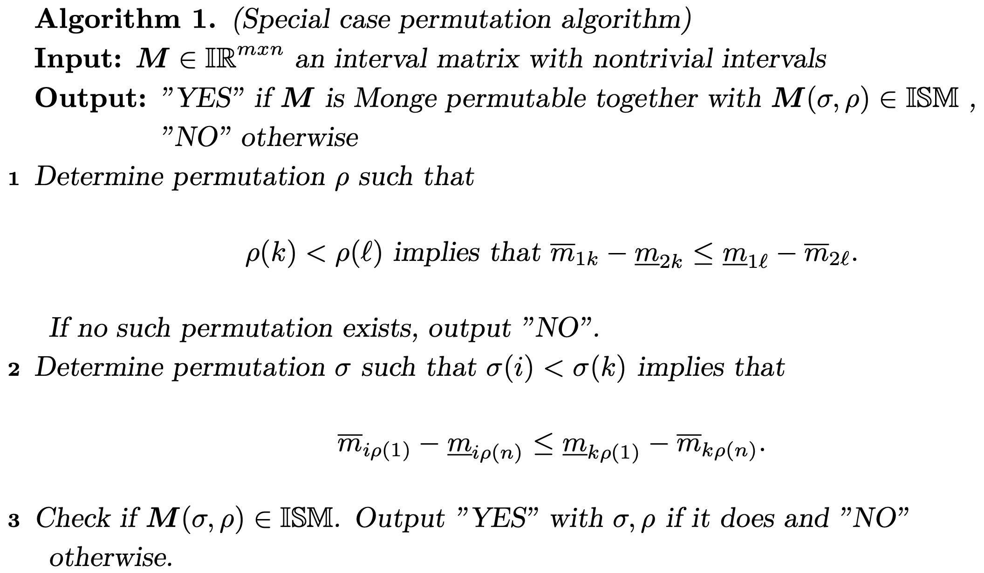
區間矩陣所有元素半徑>0
1. 利用第1和n列，找𝛒排列（行）
2. 利用𝛒₁和𝛒n找𝛅排列（列）
3. 如果有找𝛒和𝛅排列，則M(𝛅,𝛒) ∈ 𝕀𝕊𝕄

Slide 21
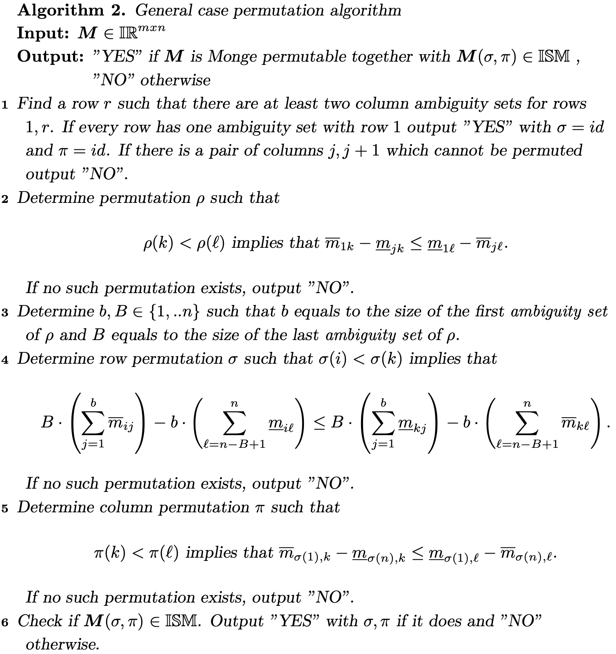
1. 先找到第1和r列至少有兩個行模糊組和
2. 利用第1和j列，找𝛒排列
3. 設定b和B值

Slide 22
4. 利用b和B找𝛅排列（列）
5. 利用𝛅₁和𝛅_{n}找𝛑排列（行）
6. 如果找到𝛅和𝛑，則M(𝛅, 𝛑) ∈ 𝕀𝕊𝕄

Slide 23
Thank you for listening

Slide 24
Abstract
s

