Slide 1
A Pretreatment Workflow Scheduling Approach for Big Data Applications in Multicloud Environments
Bing Lin, Wenzhong Guo, Naixue Xiong
IEEE Transactions on Network and Service Management, vol. 13, no. 3, pp. 581- 594, Sept. 2016
Presenter: Chih-Hsuan Chien​
Date: July 5, 2022

Slide 2
Abstract (1/2)
The rapid development of the latest distributed computing paradigm, i.e., cloud computing, generates a highly fragmented cloud market composed of numerous cloud providers and offers tremendous parallel computing ability to handle big data problems. One of the biggest challenges in multiclouds is efficient workflow scheduling. Although the workflow scheduling problem has been studied extensively, there are still very few primal works tailored for multicloud environments. Moreover, the existing research works either fail to satisfy the quality of service (QoS) requirements, or do not consider some fundamental features of cloud computing such as heterogeneity and elasticity of computing resources.

Slide 3
Abstract (2/2)
In this paper, a scheduling algorithm, which is called multiclouds partial critical paths with pretreatment (MCPCPP), for big data workflows in multiclouds is presented. This algorithm incorporates the concept of partial critical paths, and aims to minimize the execution cost of workflow while satisfying the defined deadline constraint. Our approach takes into consideration the essential characteristics of multiclouds such as the charge per time interval, various instance types from different cloud providers, as well as homogeneous intrabandwidth vs. heterogeneous interbandwidth. Various types of workflows are used for evaluation purpose and our experimental results show that the MCPCPP is promising.

Slide 4
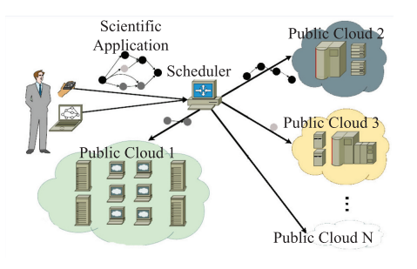
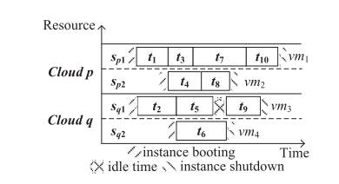
Problem

Slide 5
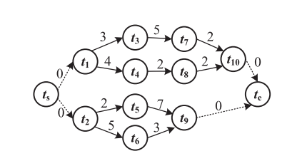
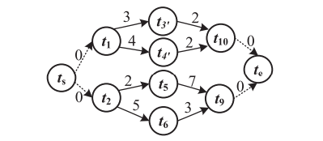
Preprocess
Notes:
outdegree=1 Indegree=1 , merge
Goal:reducing the runtime of our proposed strategy, we merge the two tasks with a common ‘directed cut-edges’ into a single task based on the workflow structure. It has significant improvement on the performance of our scheduling result.
意義?同一個partial critical path

Slide 6
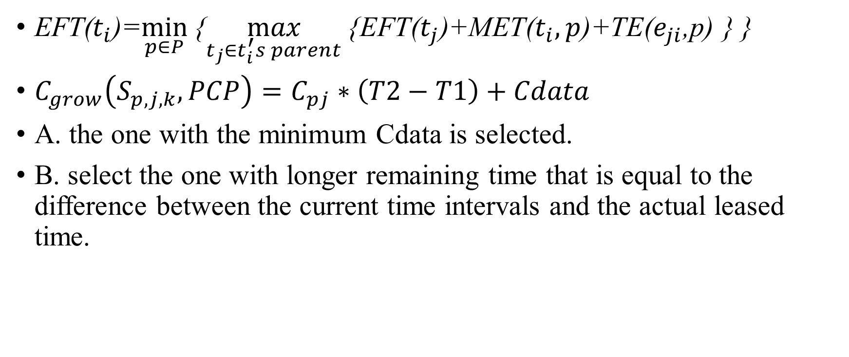
EFT($t_{i}$)=$\min_{p∈P}${$\max_{t_{j}∈t_{i}^{′}s parent}${EFT($t_{j}$)+MET($t_{i},p$)+TE($e_{ji}$,p) } }
$C_{grow}\left(S_{p,j,k},PCP\right)=C_{pj}∗\left(T2−T1\right)+Cdata$
A. the one with the minimum Cdata is selected.
B. select the one with longer remaining time that is equal to the difference between the current time intervals and the actual leased time.

Slide 7
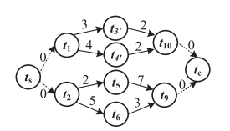
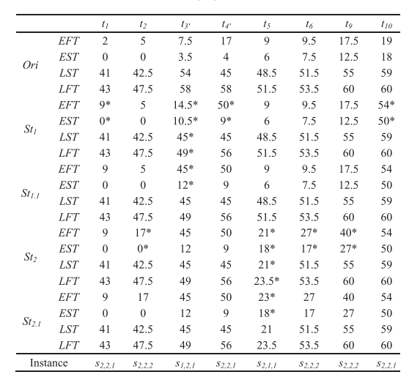
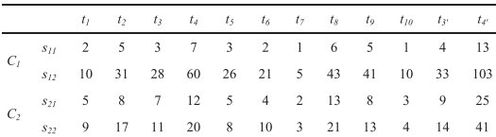



Slide 8
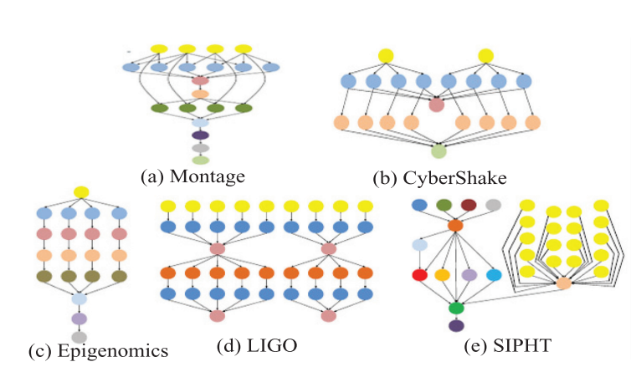

Slide 9
