Slide 1
Building a Computer Mahjong Player Based on Monte Carlo Simulation and Opponent Models
Naoki Mizukami and Yoshimasa Tsuruoka
2015 IEEE Conference on Computational Intelligence and Games (CIG)
Presenter: Ying-Yu Lin
Date: July 5, 2022

Slide 2
Abstract
Predicting opponents’ moves and hidden states is important in imperfect information games. This paper describes a method for building a Mahjong program that models opponent players and performs Monte Carlo simulation with the models. We decompose an opponent’s play into three elements, namely, waiting, winning tiles, and winning scores, and train prediction models for those elements using game records of expert human players. Opponents’ moves in the Monte Carlo simulations are determined based on the probability distributions of the opponent models. We have evaluated the playing strength of the resulting program on a popular online Mahjong site “Tenhou”. The program has achieved a rating of 1718, which is significantly higher than that of the average human player.

Slide 3
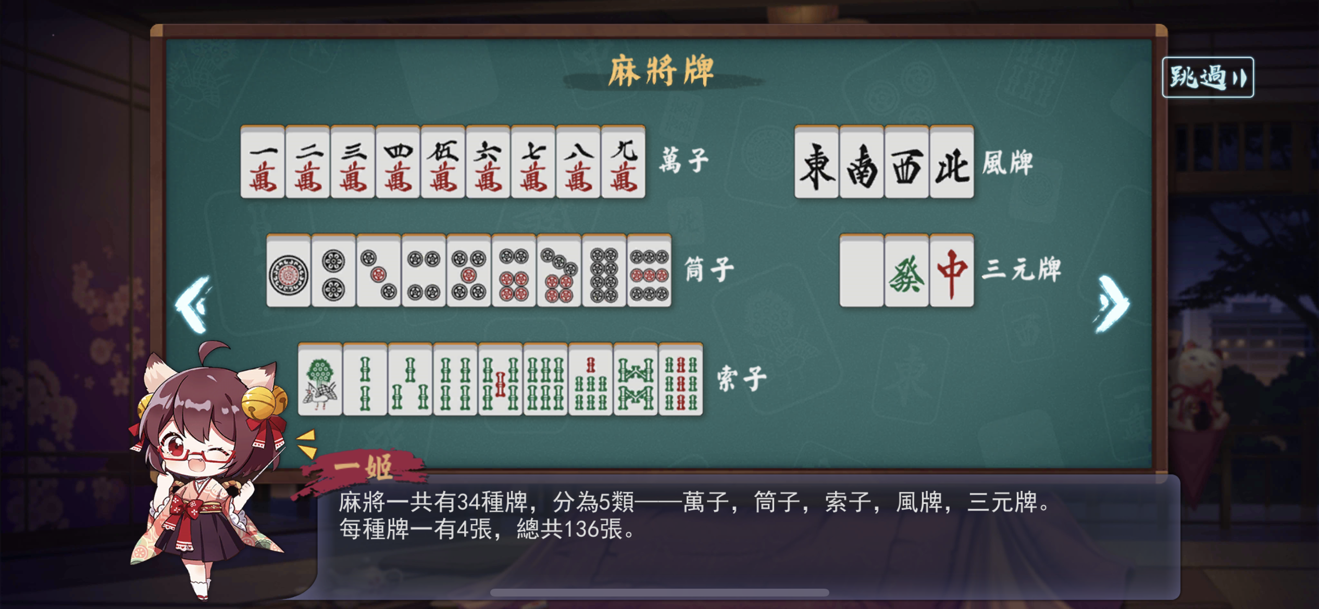
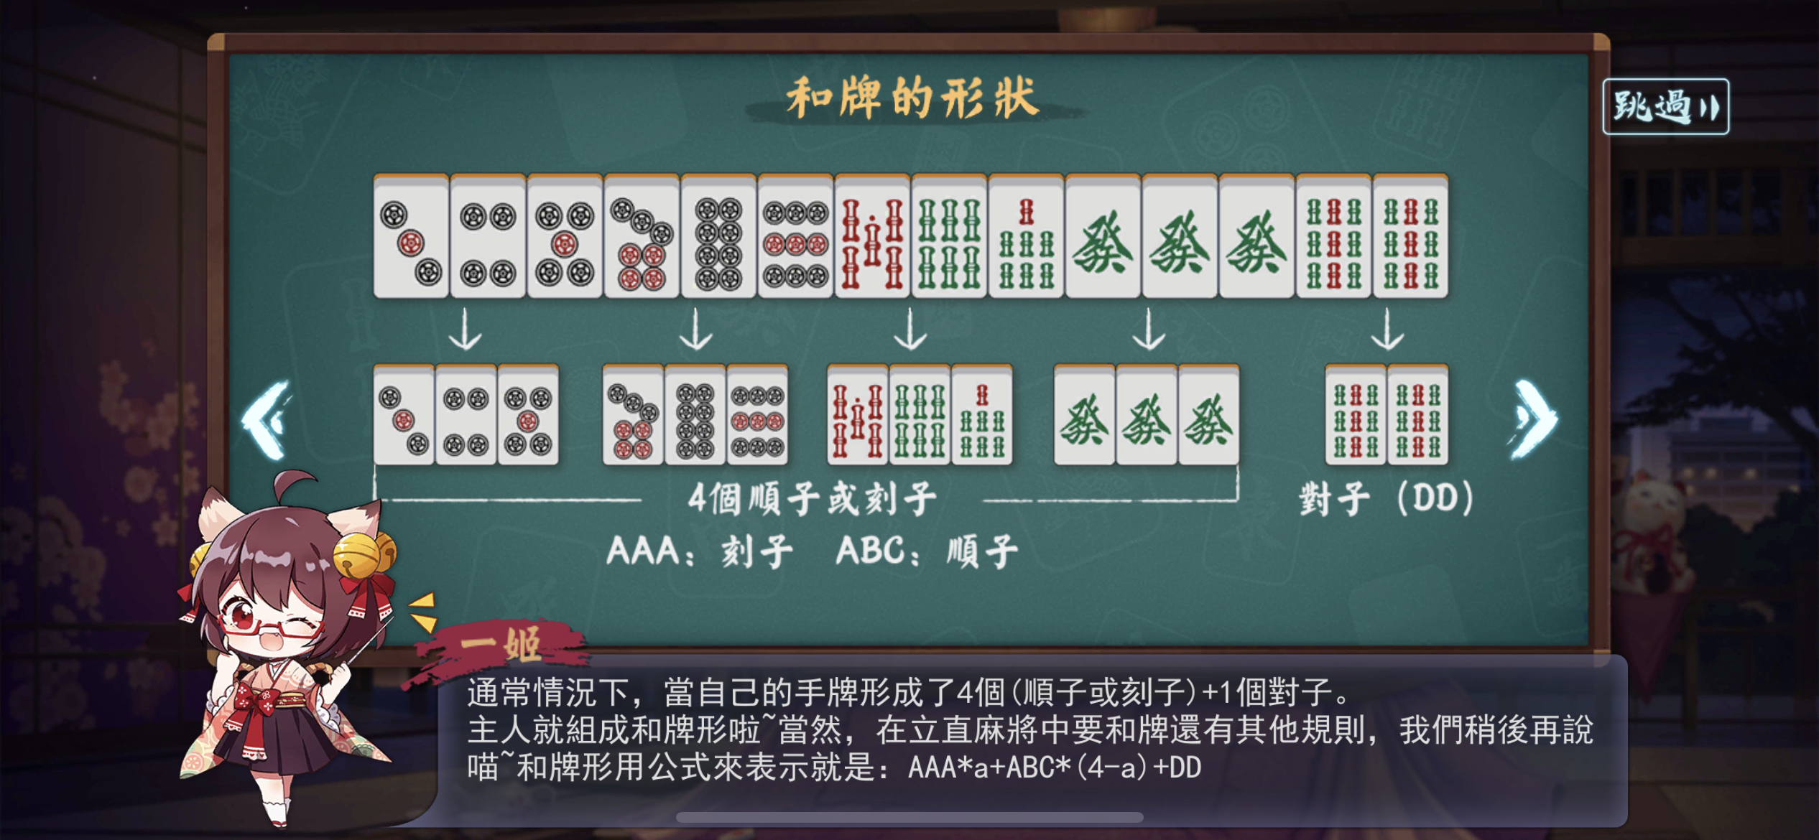
Mahjong

Slide 4
Mahjong
Waiting : A player is waiting if his hand needs only one tile to become complete.
Riichi : A player can declare riichi when he is waiting with no melds made by stealing.
Folding : A player folds if he gives up to win and only tries to avoid discarding a winning tile for other players.

Slide 5
One-player Mahjong moves
The goal of the player in a one-player Mahjong game is to complete his hand.
One-player Mahjong moves is not a good strategy because you never make a meld by stealing.
main idea is to achieve a good balance between quick completion of a hand and minimizing the expected loss from discarding a winning tile for other players.

Slide 6
Three prediction models
Prediction of waiting
Prediction of winning tiles
Prediction of scores

Slide 7
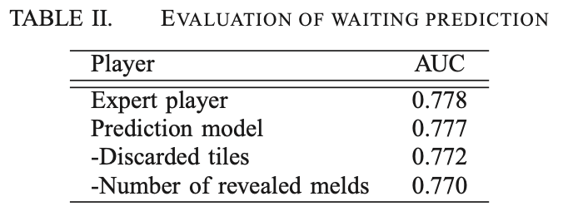
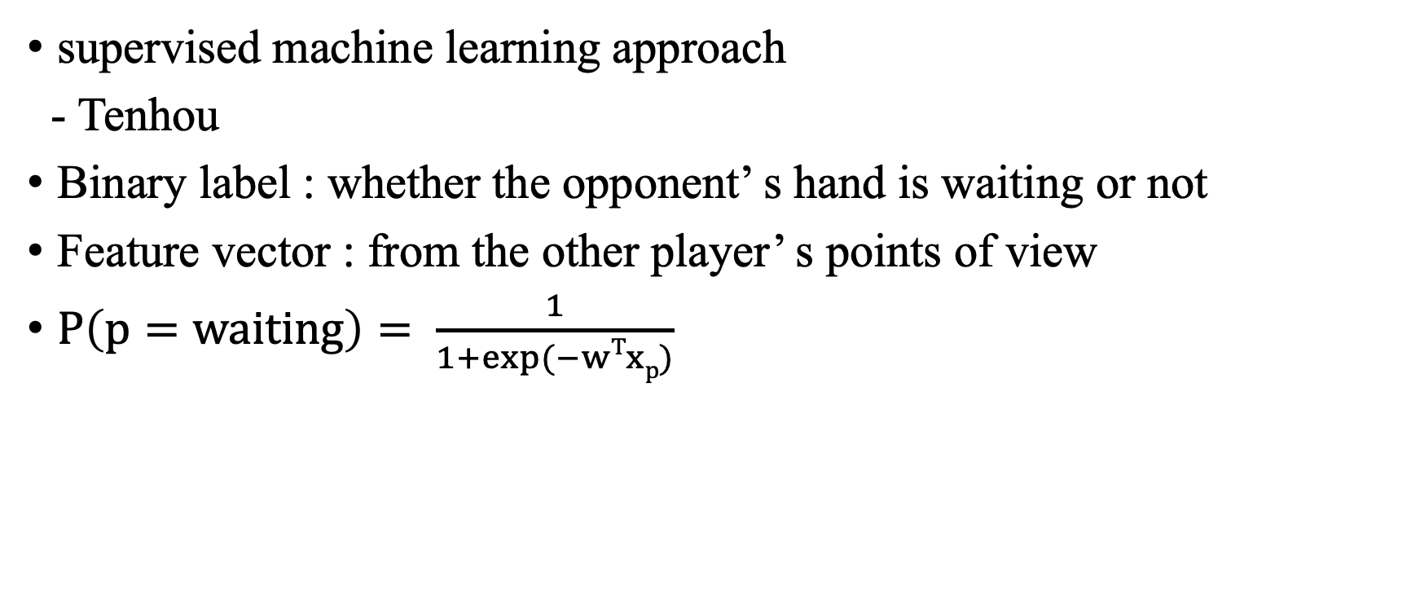
Prediction of waiting
supervised machine learning approach
- Tenhou
Binary label : whether the opponent’ s hand is waiting or not
Feature vector : from the other player’ s points of view
$P\left(p=waiting\right)= \frac{1}{1+exp⁡(−wTxp)}$

Slide 8
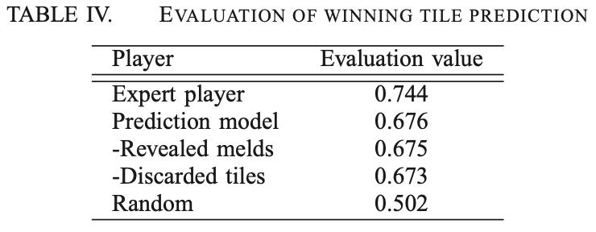
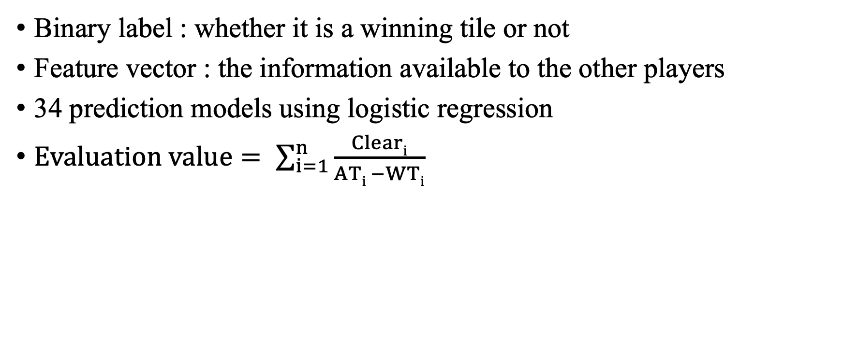
Prediction of winning tiles
Binary label : whether it is a winning tile or not
Feature vector : the information available to the other players
34 prediction models using logistic regression
$Evaluation value= \sum_{i=1}^{n}{\frac{Cleari}{ATi −WTi}}$

Slide 9
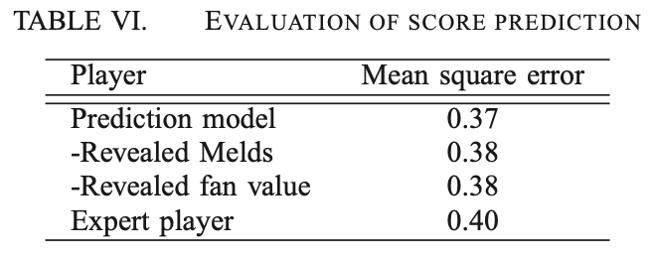
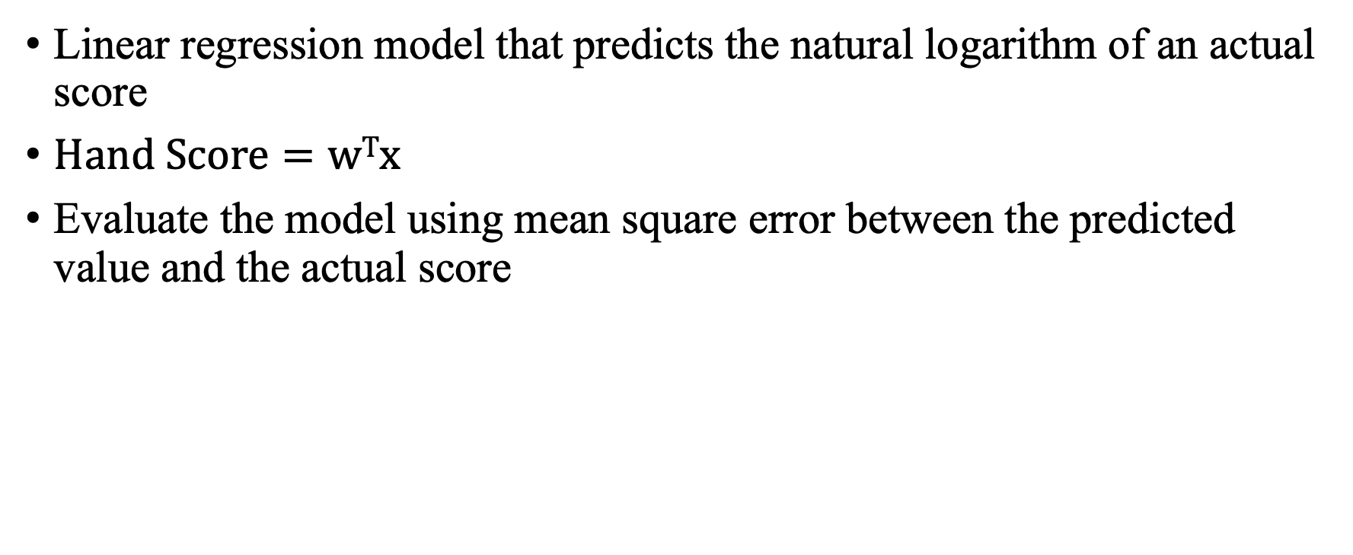
Prediction of scores
Linear regression model that predicts the natural logarithm of an actual score
$Hand Score=wTx$
Evaluate the model using mean square error between the predicted value and the actual score

Slide 10

Monte Carlo moves
$LP \left(p,Tile\right)=P\left(p=waiting\right)∗P\left(Tile=winning\right)$
$EL\left(p,Tile\right)=LP\left(p,Tile\right)∗HS(p,Tile)$
$Score\left(Tile\right)=Sim\left(Tile\right)∗Π\left(1−LP\left(p,Tile\right)\right)−ΣEL(p,Tile)$

Slide 11
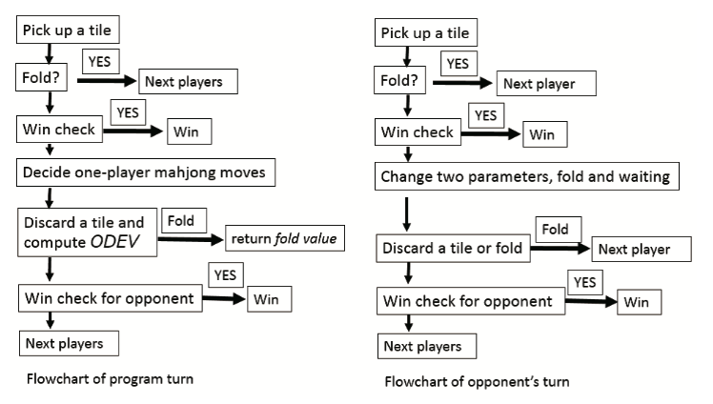
Flowchart of each player

Slide 12
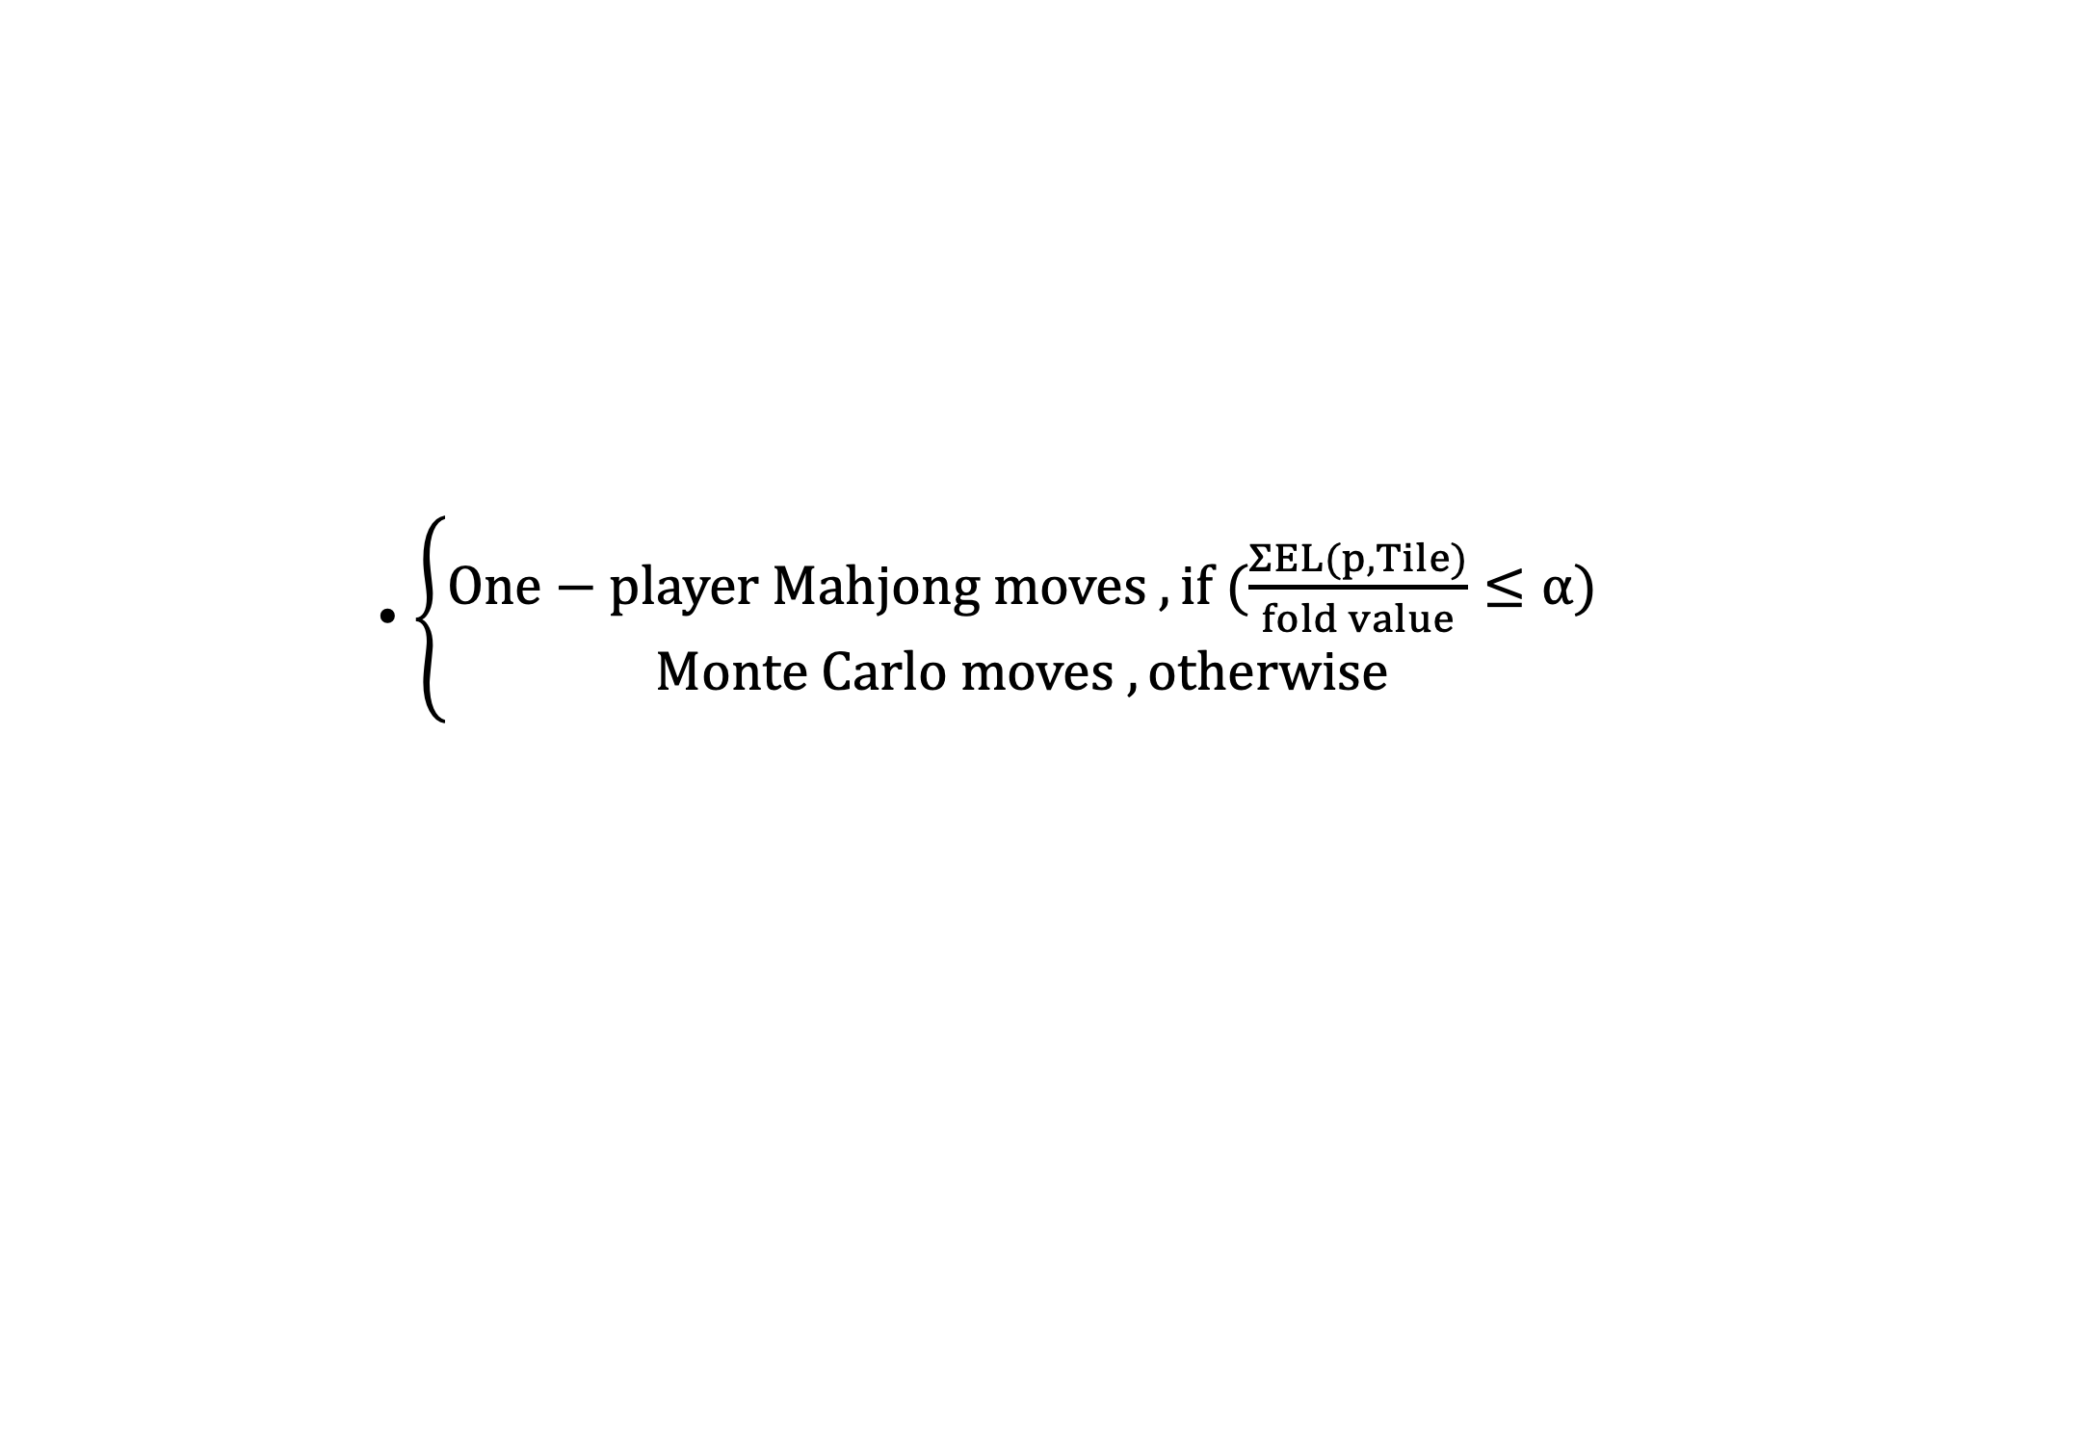
Switching from one-player Mahjong moves to Monte Carlo moves
$\left\{\begin{aligned}One−player Mahjong moves , if (\frac{ΣEL(p,Tile)}{fold value}≤α) \\ Monte Carlo moves , otherwise\end{aligned}\right.$

Slide 13
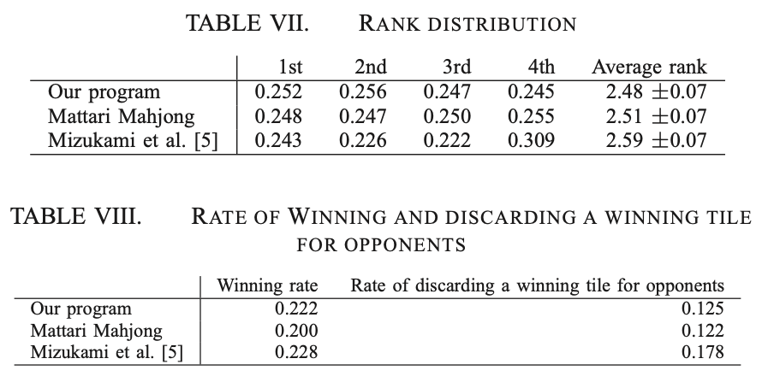
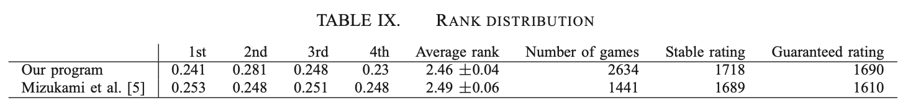
Experiment

