Slide 1
Minimum Height and Sequence Constrained Longest Increasing Subsequence
C.T. Tseng, C.B. Yang, H.Y. Ann,
Journal of Internet Technology, Vol. 10, 2009, pp.173 ~ 178
Presenter: Guan-Ting Chen
Date: July 20, 2022

Slide 2
Abstract
Given a string S = a₁a₂a₃...a_{n}, the longest increasing subsequence (LIS) problem is to find a subsequence of S such that the subsequence is increasing and its length is maximum. In this paper, we propose and solve two variants of the LIS problem. The first one is the minimum height LIS where the height means the difference between the largest and smallest elements. We propose an algorithm with O(n log n) time and O(n) space for solving it. The second one is the sequence constrained LIS (SCLIS) that given a string S and a constraint C, we are to find the LIS of S containing C as its subsequence. We propose an algorithm with O(n log(n+|C|)) time for solving it. And then we solve the SCLIS with preprocessing. We propose a preprocessing algorithm with O(n²loglogn) time on S so that with a given sequence of positions, we can answer the SCLIS query in O(|C|+|OUTPUT |) time where the constraint is the subsequence on the given positions of S.

Slide 3
Longest Increasing Subsequence
S = 4683571
LIS
468
…

Slide 4
Minimum Height LIS
S = 4683571
Minimum Height LIS
468
457
467
357

Slide 5
Representative Increasing Subsequence
S = 4683571
Length
1
{4, 6, 8, 3, 5, 7, 1}
2
{46, 48, 45, 47, 68, 67, 35, 37}
3
{468, 467, 457, 357}
RIS
157

Slide 6
RIS
S = 4683571
 | Length
 | 1 | 2 | 3
4 | 4
6 | 4 | 6
8 | 4 | 6 | 8
3 | 3 | 6 | 8
5 | 3 | 5 | 8
7 | 3 | 5 | 7
1 | 1 | 5 | 7

Slide 7
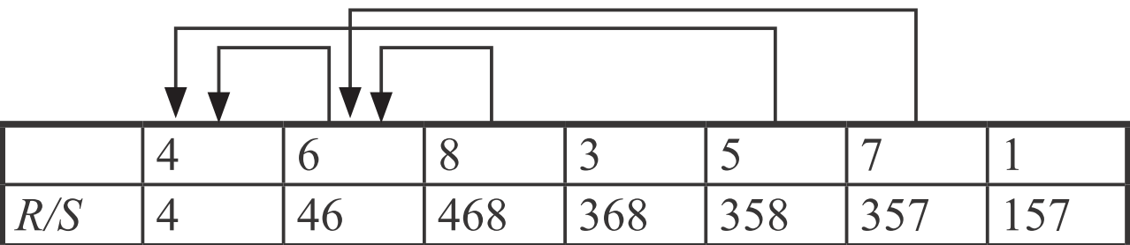
MHLIS
Height = 2
Height = 1
Height = 1

Slide 8
Time Complexity
O(n log n)
Deciding the length of LIS
O(log n)
Finding predecessor
O(log n)
Inserting
O(log n)
Tracing
O(n)

Slide 9
Sequence Constrained LIS
S = 1529367
C = 59
LIS
12367
SCLIS
159

Slide 10
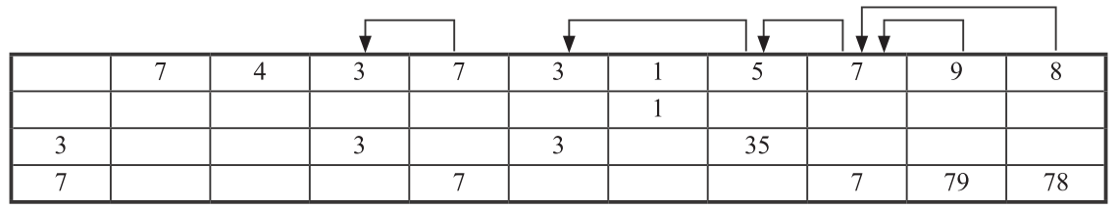
SCLIS
Time Complexity: O(n log(n + |C|))

Slide 11
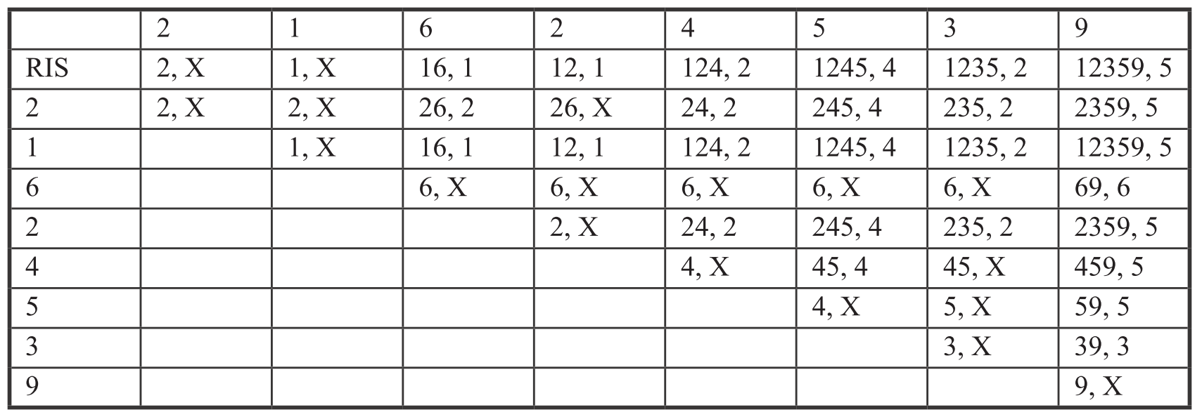
The Constrained RIS Table
Time Complexity: O(n² log log n)

