Slide 1
Bridge Bidding with Imperfect Information
Lori L. DeLooze and James Downey
IEEE Symposium on Computational Intelligence and Games, 2007.
p. 368-373. IEEE.
Presenter: Yun-An Chen
Date: Aug. 9, 2022

Slide 2
Abstract
Multiplayer games with imperfect information, such as Bridge, are especially challenging for game theory researchers. Although several algorithmic techniques have been successfully applied to the card play phase of the game, bidding requires a much different approach. We have shown that a special form of a neural network, called a self-organizing map (SOM), can be used to effectively bid no trump hands. The characteristic boundary that forms between resulting neighboring nodes in a SOM is an ideal mechanism for modeling the imprecise and ambiguous nature of the game.

Slide 3

Bridge bidding
Four common acts: asserting, denying, asking and answering questions, interrupting.
Layout of bidder’s hand: distribution of cards in each suit, quality of the cards(HCP).
Information to the bidder: his hand, current bidding history.
Opening hand for no trump(NT): 15-17HCP, balance hand.

Slide 4
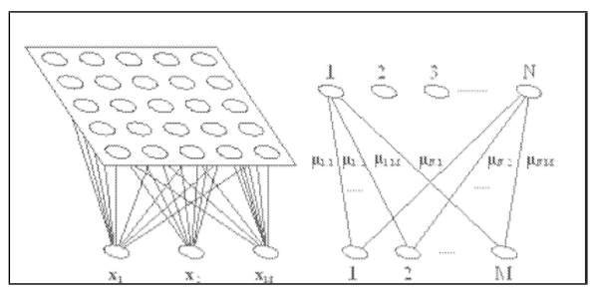
SELF-ORGANIZING MAPS
Initialize each node's weights.
Choose a vector at random from the set of training data.
Examine every node and determine the Best Matching Unit (BMU).
Calculate the radius of the neighborhood of the BMU.
Adjust the weights of each neighboring node to make them more like the input vector.
Repeat step 2 for N iterations.
Input vector (5values): the number of cards in each suit, the total number of high card points.

Slide 5
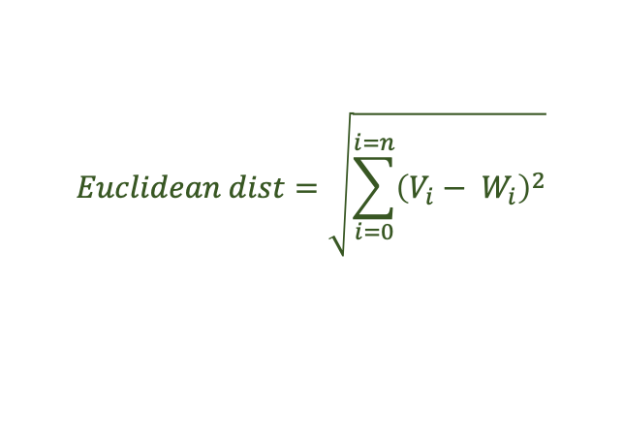
SELF-ORGANIZING MAPS
Initialize each node's weights.
Choose a vector at random from the set of training data.
Examine every node and determine the Best Matching Unit (BMU).
Calculate the radius of the neighborhood of the BMU.
Adjust the weights of each neighboring node to make them more like the input vector.
Repeat step 2 for N iterations.
$$Euclidean dist=\sqrt{\sum_{i=0}^{i=n}{{\left(V_{i}− W_{i}\right)}^{2}}}$$

Slide 6
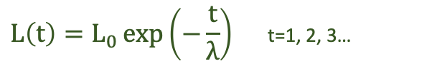

SELF-ORGANIZING MAPS
Initialize each node's weights.
Choose a vector at random from the set of training data.
Examine every node and determine the Best Matching Unit (BMU).
Calculate the radius of the neighborhood of the BMU.
Adjust the weights of each neighboring node to make them more like the input vector.
Repeat step 2 for N iterations.
$σ\left(t\right)=σ_{0}\exp\left(−\frac{t}{λ}\right)$ t=1, 2, 3…
$$W\left(t+1\right)=W\left(t\right)+L(t)(V\left(t\right)−W\left(t\right))$$
$$L\left(t\right)=L_{0}\exp\left(−\frac{t}{λ}\right) \text{t}\text{=1, 2, 3…}$$

Slide 7
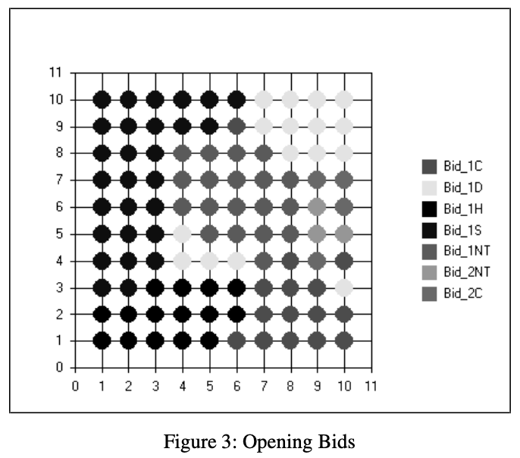
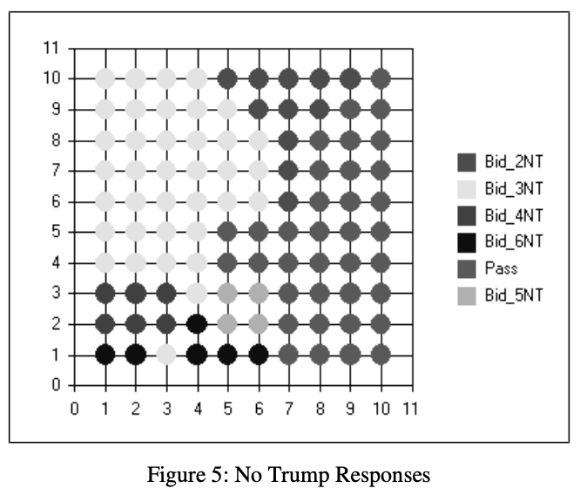
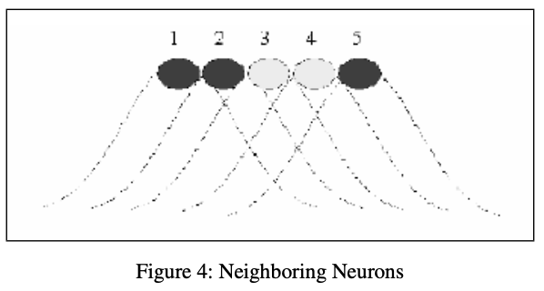
SELF-ORGANIZING MAPS
6 SOMs: opening bids, no trump responses, primary responses, overcalls, re-bids by responders, re-bids by opener.
fuzzy boundary

Slide 8
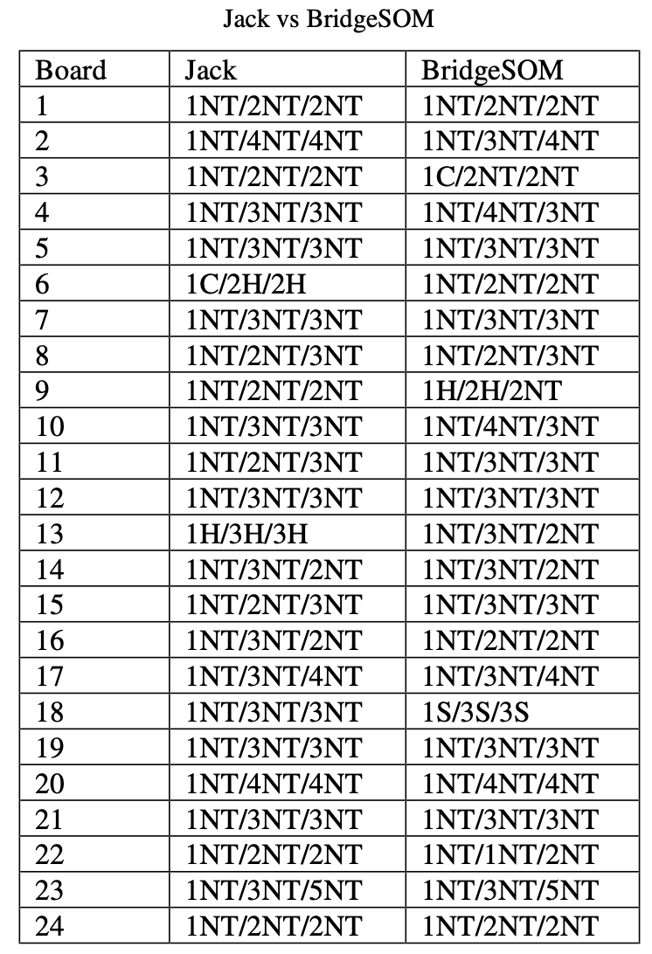
No trump results
Two table tournament between Jack and BridgeSOM.
The same set of 24 boards.
The same dealer each hand and no vulnerability designated.

