Slide 1
Heads-up limit hold’em poker is solved
Michael Bowling, Neil Burch, Michael Johanson, Oskari Tammelin
Science Volume 347, Issue 6218, 9 Jan. 2015, pp. 145-149
Presenter: Ying-Yu Lin
Date: Aug.9, 2022

Slide 2
Abstract
Poker is a family of games that exhibit imperfect information, where players do not have full knowledge of past events. Whereas many perfect-information games have been solved (e.g., Connect Four and checkers), no nontrivial imperfect-information game played competitively by humans has previously been solved. Here, we announce that heads-up limit Texas hold’em is now essentially weakly solved. Furthermore, this computation formally proves the common wisdom that the dealer in the game holds a substantial advantage. This result was enabled by a new algorithm, CFR+, which is capable of solving extensive-form games orders of magnitude larger than previously possible.

Slide 3
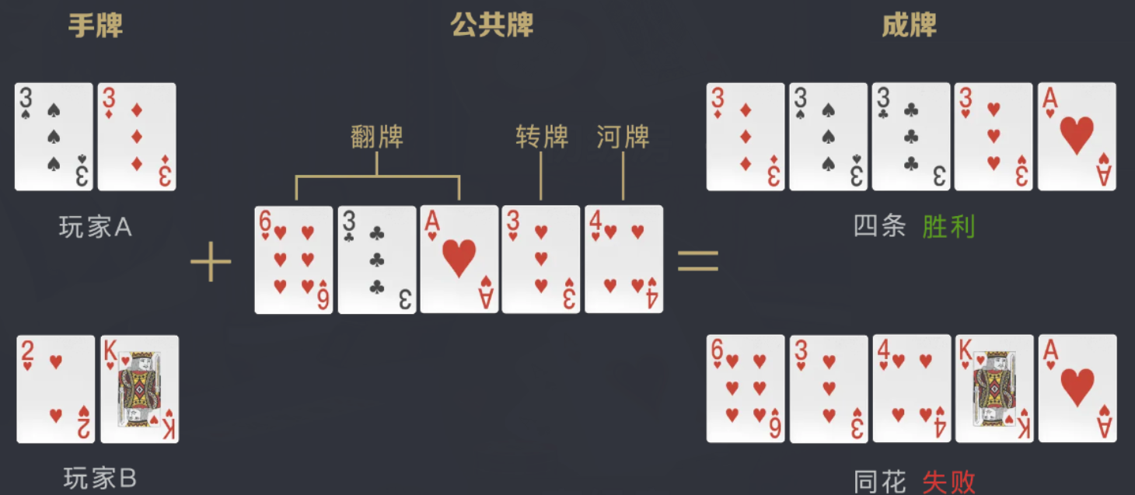
Heads up Limit Texas Hold’em(HULHE)
Fold
Call
Raise

Slide 4

Heads up Limit Texas Hold’em(HULHE)

Slide 5
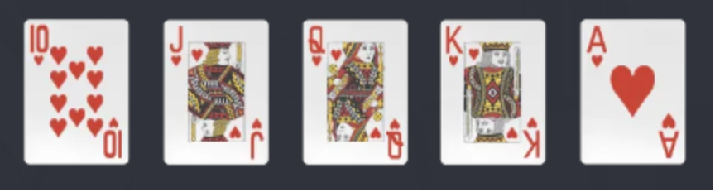
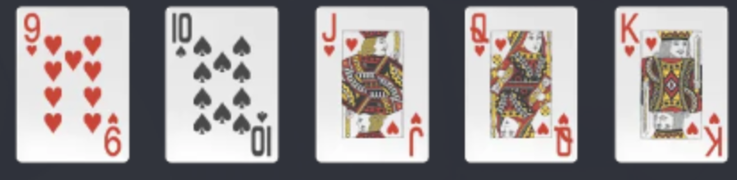
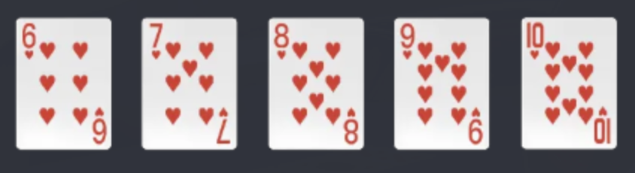
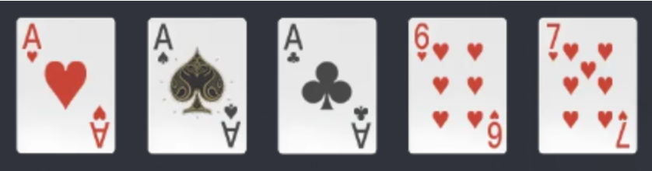
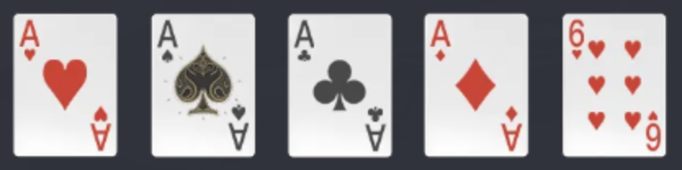
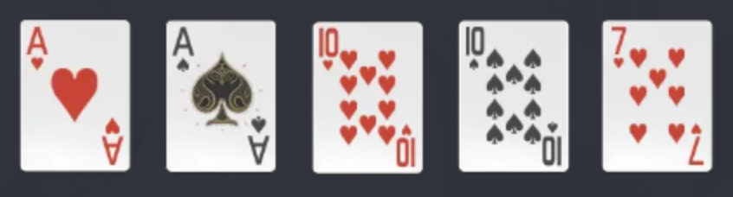
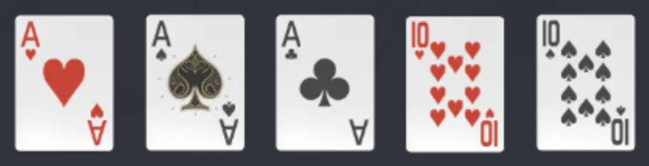
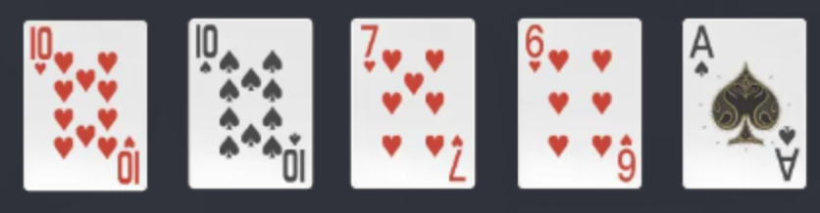
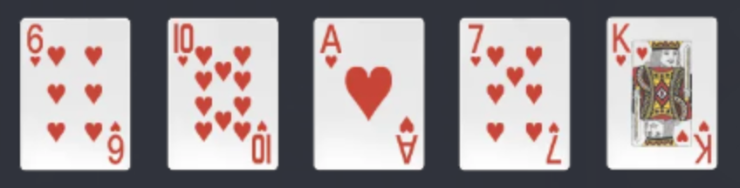
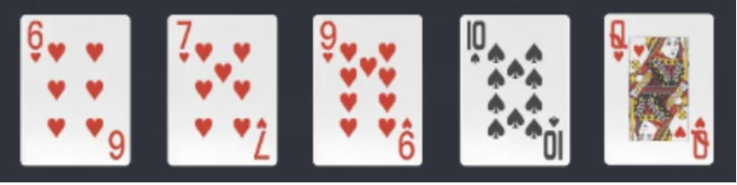
Heads up Limit Texas Hold’em(HULHE)
1.皇家同花順 同一花色中 最大的順子 | 6.順子 花色不同的順子
2.同花順 同一花色的順子 | 7.三條 三張數值相同的牌 加上兩張單張
3.四條 有四張相同數值的牌 | 8.兩對 兩對加一張單張
4.葫蘆 三張相同數值的牌 加上一對 | 9.對子 一對加三張單張
5.同花 五張牌花色相同 | 10.散牌 五張單牌

Slide 6
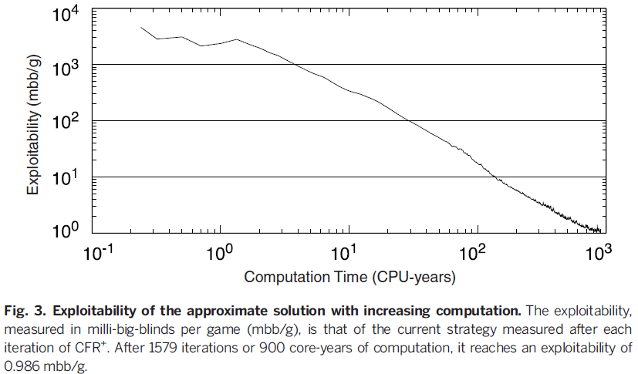

CFR+ solve the HULHE
Essentially solved: If a lifetime of play is unable to statistically differentiate it from being solved at 95% confidence.
mbb/g: milli-big blinds per game
Exploitability must below 1mbb/g $\frac{1.64×5}{\sqrt{200×12×365×70}}≈1.05$ mbb/g

Slide 7
Introduction- Nash equilibrium
利潤 (億元) |  | Ｂ航空公司
 |  | 保持 原價 | 降價
Ａ航空 公司 | 保持 原價 | 10,6 | 8,7
 | 降價 | 14,4 | 16,2

Slide 8
Introduction- Nash equilibrium
利潤 (億元) |  | Ｂ航空公司
 |  | 保持 原價 | 降價
Ａ航空 公司 | 保持 原價 | 10,6 | 8,7
 | 降價 | 14,4 | 16,2
14>10
16>8

Slide 9
Introduction- Nash equilibrium
利潤 (億元) |  | Ｂ航空公司
 |  | 保持 原價 | 降價
Ａ航空 公司 | 保持 原價 | 10,6 | 8,7
 | 降價 | 14,4 | 16,2

Slide 10
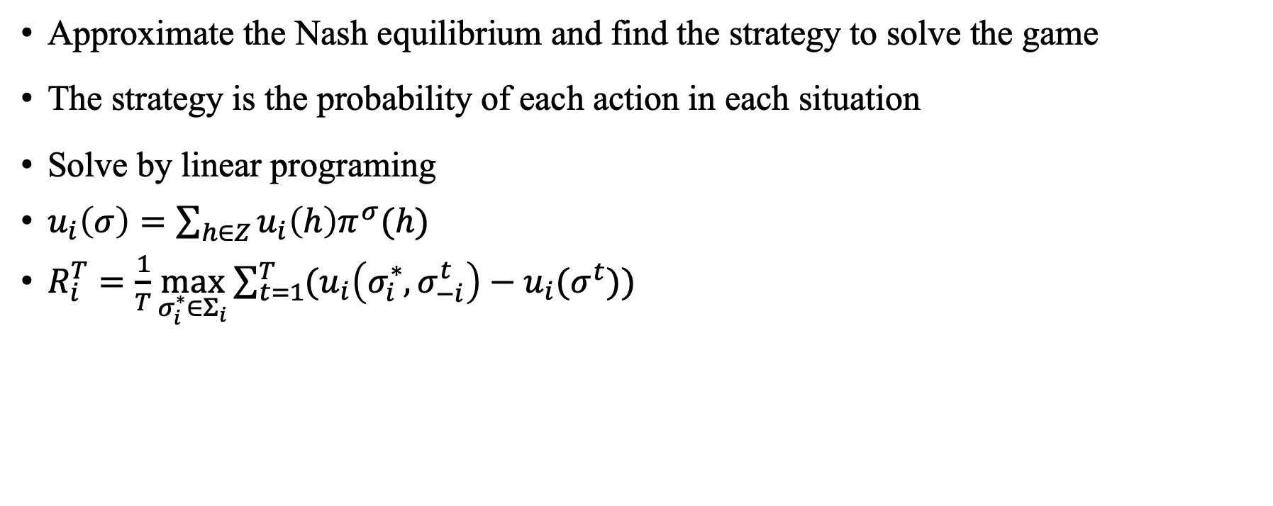
Regret minimization
Approximate the Nash equilibrium and find the strategy to solve the game
The strategy is the probability of each action in each situation
Solve by linear programing
$u_{i}\left(σ\right)=\sum_{h∈Z}{u_{i}\left(h\right)π^{σ}(h)}$
$R_{i}^{T}=\frac{1}{T}\max_{σ_{i}^{∗}∈Σ_{i}}{\sum_{t=1}^{T}{(u_{i}\left(σ_{i}^{∗}, σ_{−i}^{t}\right)−u_{i}(σ^{t}))}}$

Slide 11
Regret minimization
Kuhn poker
With three cards: J, Q, K
Each player antes 1
One betting round
One-bet maximum
12 information sets

Slide 12
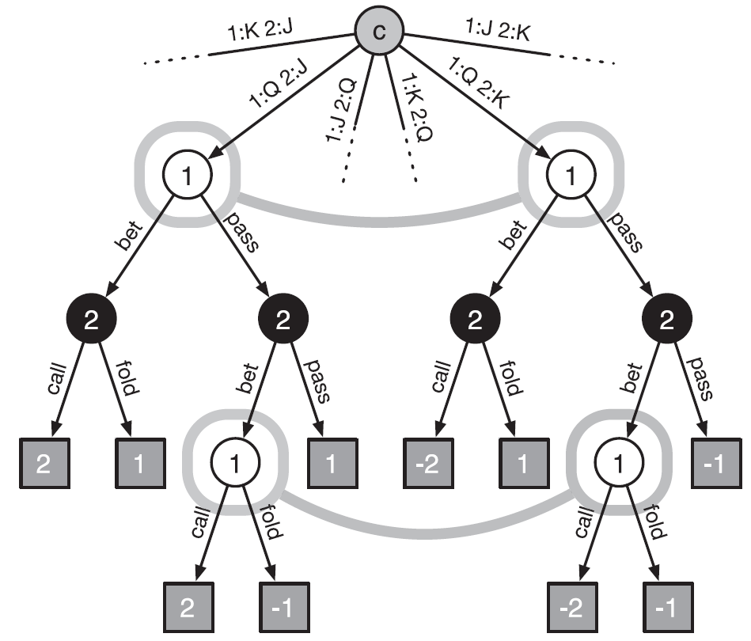
Regret minimization

Slide 13
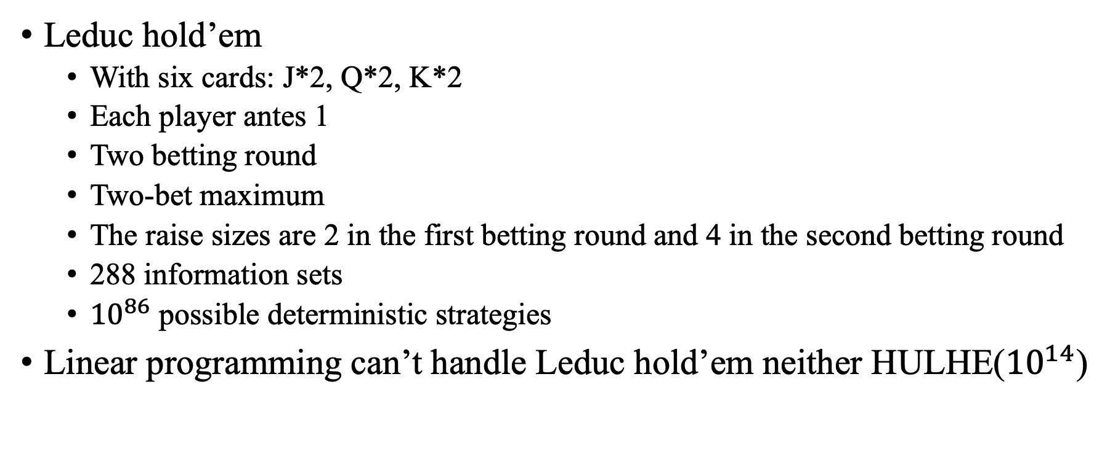
Regret minimization
Leduc hold’em
With six cards: J*2, Q*2, K*2
Each player antes 1
Two betting round
Two-bet maximum
The raise sizes are 2 in the first betting round and 4 in the second betting round
288 information sets
${10}^{86}$ possible deterministic strategies
Linear programming can’t handle Leduc hold’em neither HULHE(${10}^{14}$)

Slide 14
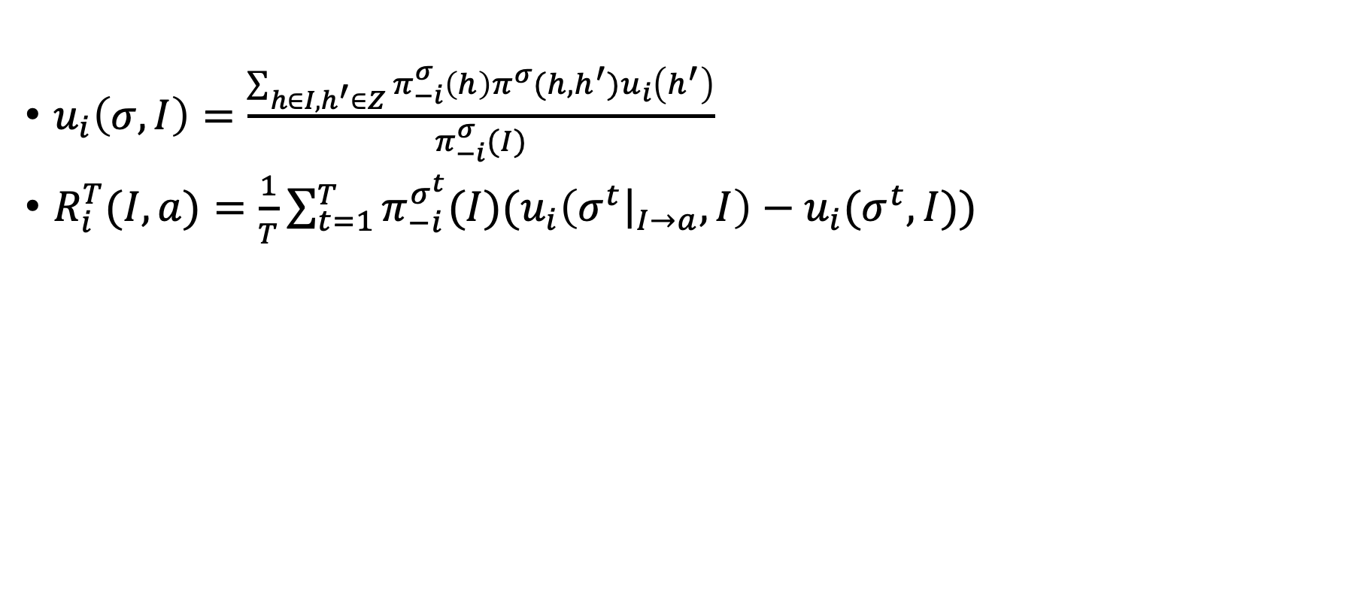
Counterfactual regret minimization(CFR)
$u_{i}\left(σ,I\right)=\frac{\sum_{h∈I,h^{′}∈Z}{{π_{−i}^{σ}\left(h\right)π^{σ}(h,h^{′})u}_{i}\left(h^{′}\right)}}{π_{−i}^{σ}(I)}$
$R_{i}^{T}(I,a)=\frac{1}{T}{\sum_{t=1}^{T}{π_{−i}^{σ^{t}}(I)(u_{i}\left(σ^{t}{\left.​\right|}_{I→a},I\right)−u_{i}(σ^{t},I))}}$

Slide 15
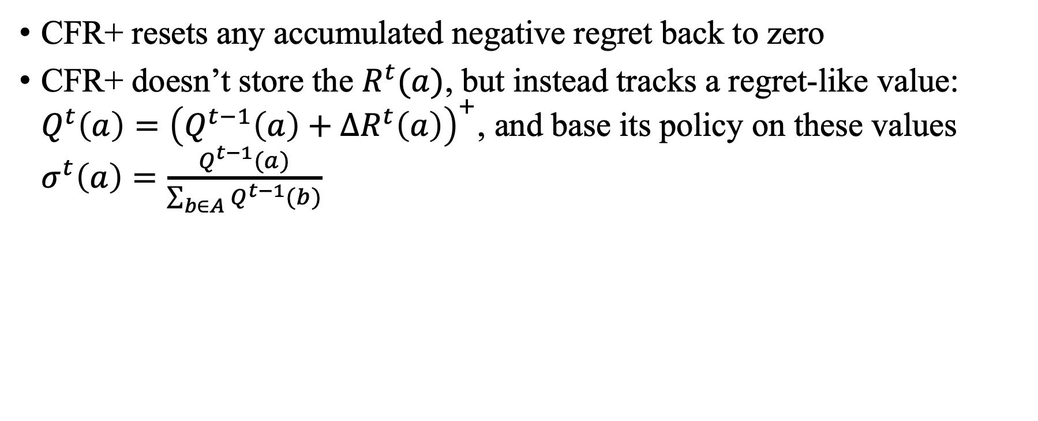
CFR+
CFR+ resets any accumulated negative regret back to zero
CFR+ doesn’t store the $R^{t}(a)$, but instead tracks a regret-like value: $Q^{t}\left(a\right)={\left(Q^{t−1}\left(a\right)+ΔR^{t}\left(a\right)\right)}^{+}$, and base its policy on these values $σ^{t}\left(a\right)=\frac{Q^{t−1}(a)}{\sum_{b∈A}{Q^{t−1}(b)}}$

Slide 16
CFR+ solve the HULHE
Need 262TB (unlikely to fit in RAM)
Storing value as fixed-point numbers instead of floating-point numbers
Need 4800 CPUs running for 68days.

