Slide 1
The Graph Neural Network Model
Franco Scarselli, Marco Gori, Ah Chung Tsoi, Markus Hagenbuchner, and
Gabriele Monfardini
IEEE Transactions on Neural Networks ( Volume: 20, Issue: 1, January 2009)
Presenter: Yen-Yu Chen
Date: Jan.15, 2024

Slide 2
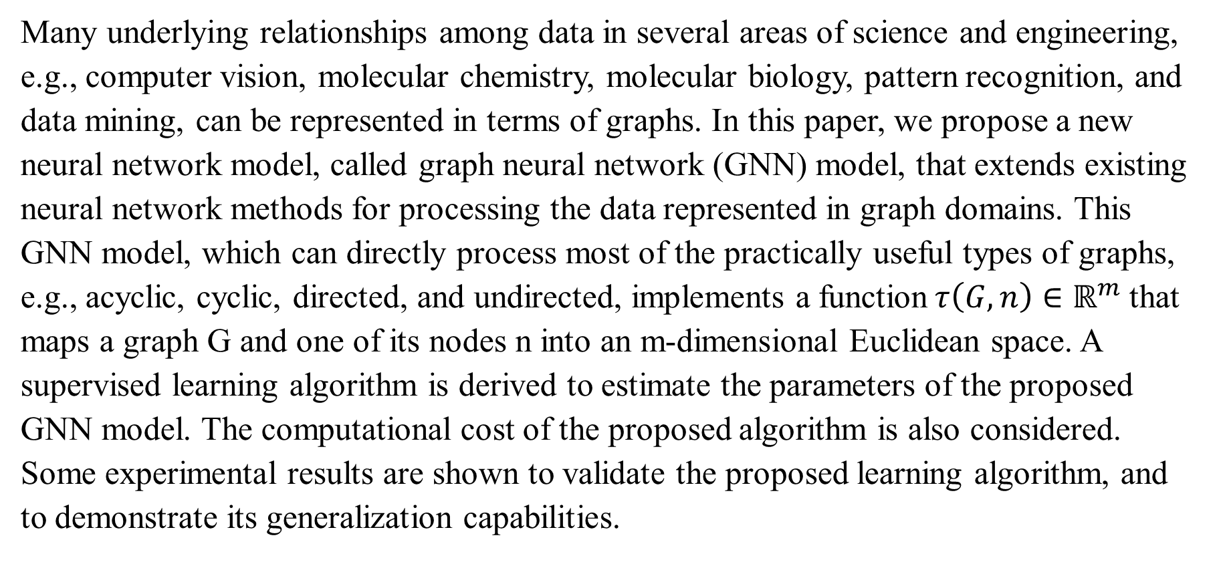
Abstract
Many underlying relationships among data in several areas of science and engineering, e.g., computer vision, molecular chemistry, molecular biology, pattern recognition, and data mining, can be represented in terms of graphs. In this paper, we propose a new neural network model, called graph neural network (GNN) model, that extends existing neural network methods for processing the data represented in graph domains. This GNN model, which can directly process most of the practically useful types of graphs, e.g., acyclic, cyclic, directed, and undirected, implements a function$τ\left(G,n\right)∈ℝ^{m}$that maps a graph G and one of its nodes n into an m-dimensional Euclidean space. A supervised learning algorithm is derived to estimate the parameters of the proposed GNN model. The computational cost of the proposed algorithm is also considered. Some experimental results are shown to validate the proposed learning algorithm, and to demonstrate its generalization capabilities.

Slide 3
A Gentle Introduction to Graph Neural Networks
Benjamin Sanchez-Lengeling
Emily Reif
Adam Pearce
Alexander B. Wiltschko

Slide 4
What is Graph
A graph represents the relations (edges) between a collection of entities (nodes).

Slide 5
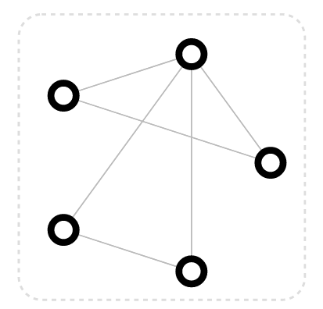
Vertex Attributes
Node identity
Number of neighbors

Slide 6
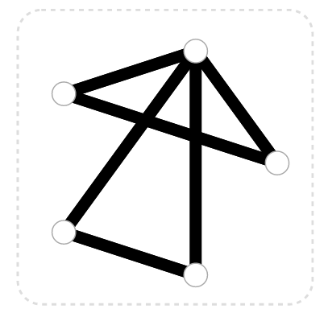
Edge Attributes and Directions
Edge identity
Edge weight

Slide 7
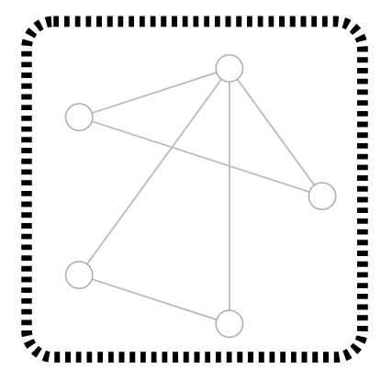
Global Attributes
Number of identity
Longest path

Slide 8
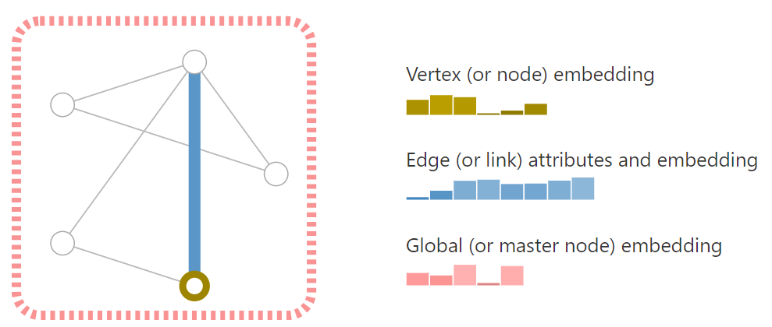
Store Information

Slide 9
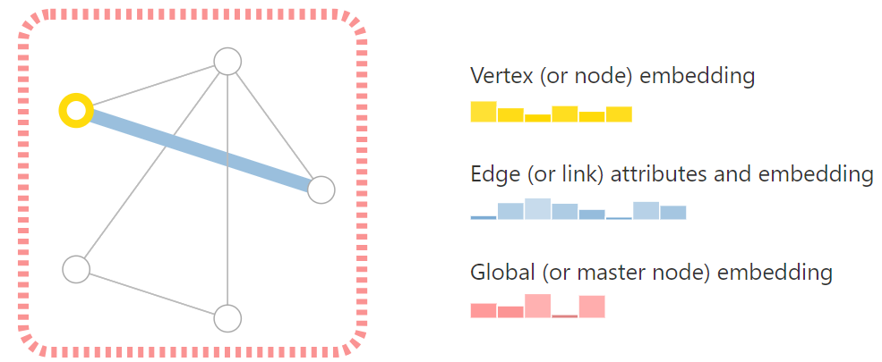
Store Information

Slide 10
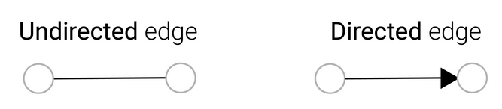
Store Information

Slide 11
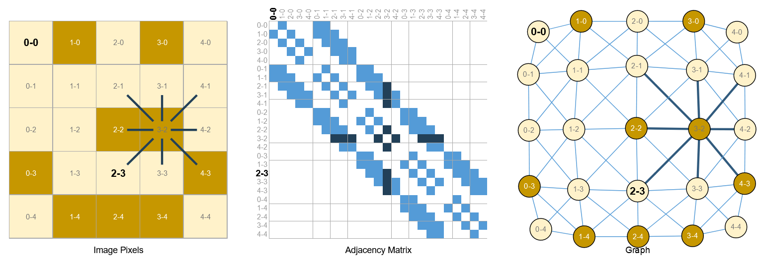
Images as Graphs

Slide 12
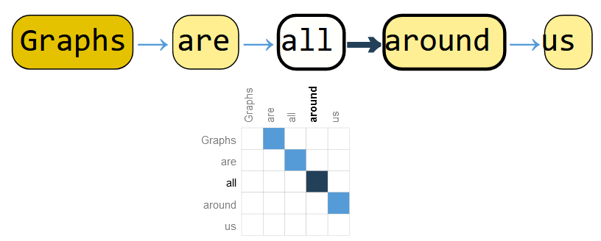
Text as Graphs

Slide 13
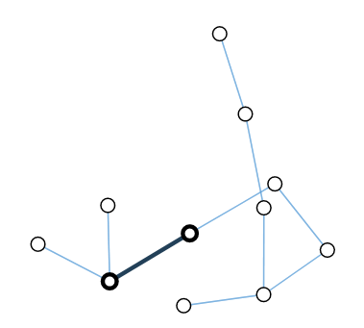
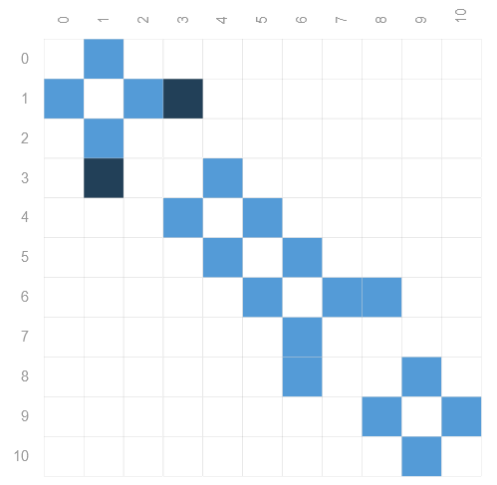
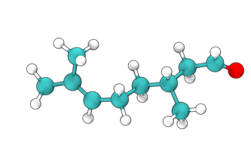
Molecules as Graphs

Slide 14
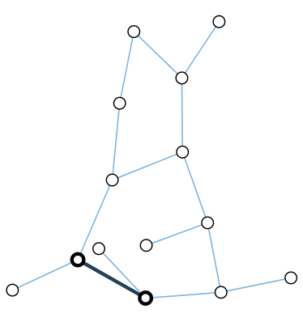
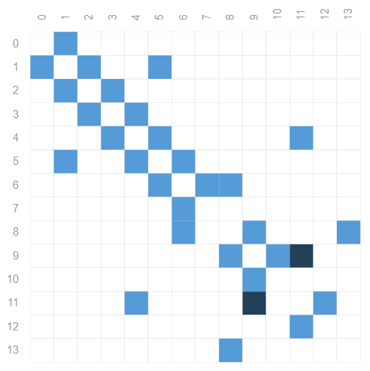
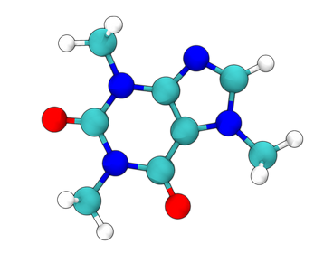
Molecules as Graphs

Slide 15
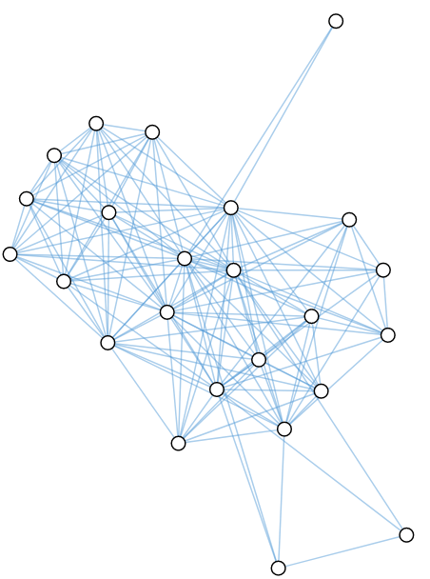
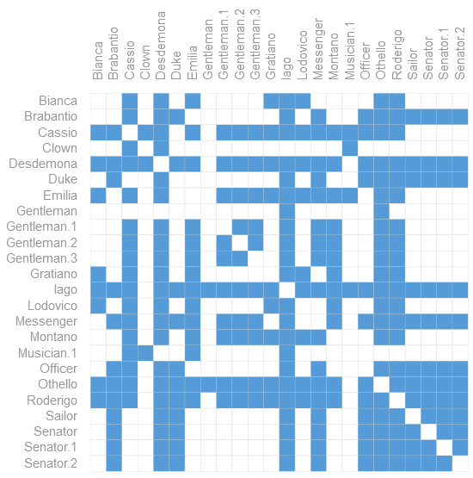
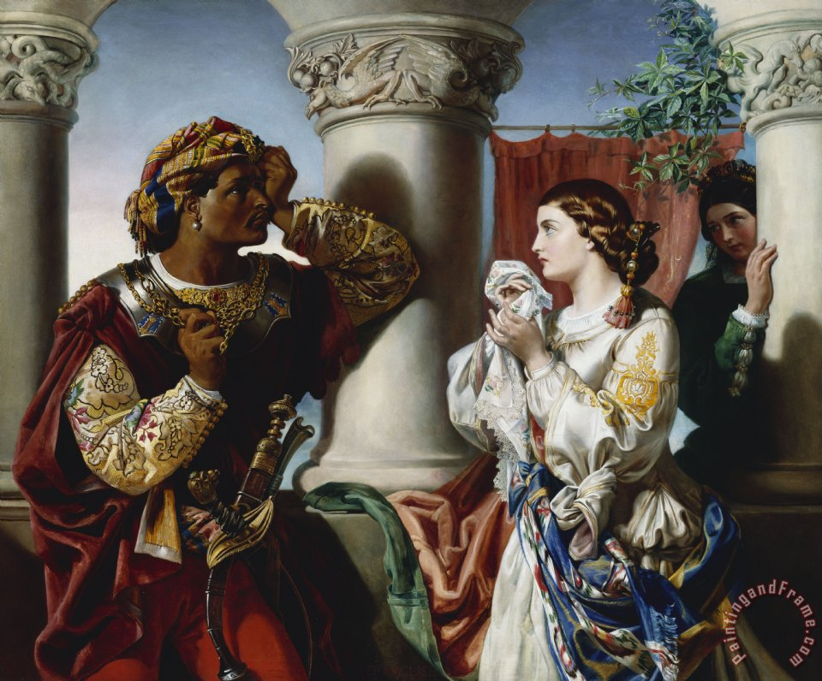
Social Networks as Graphs

Slide 16
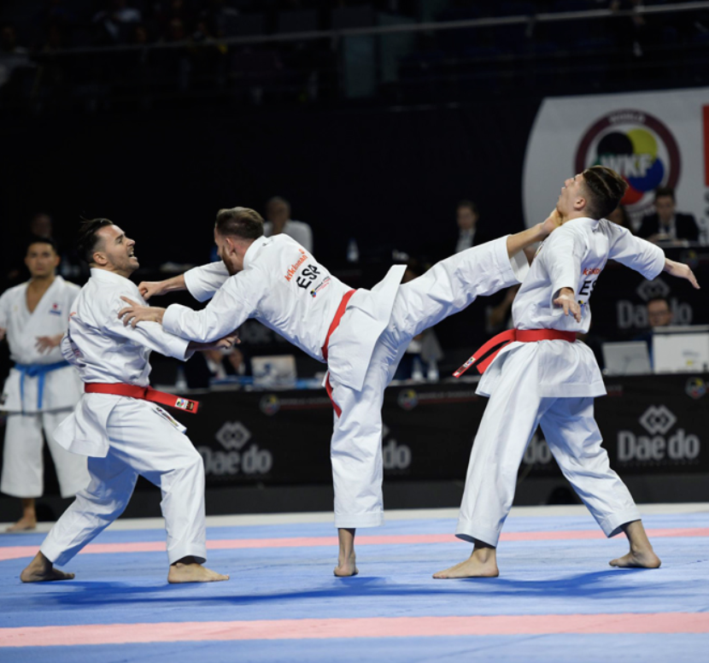
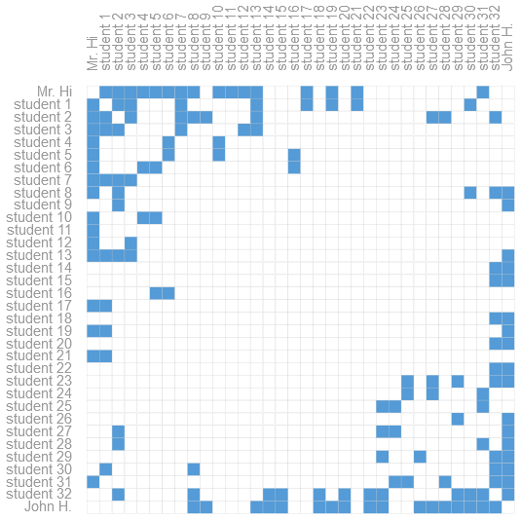
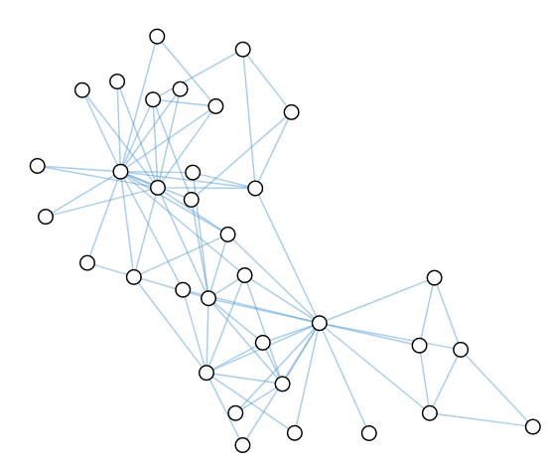
Social Networks as Graphs
Notes:
Node跆拳道學生
Edge對戰紀錄

Slide 17
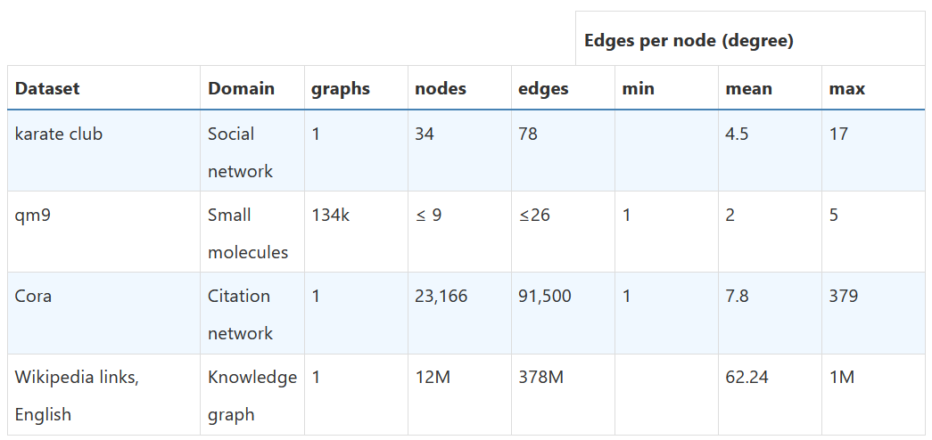
Notes:
Cora 引用圖types of problems

Slide 18
Types of Problems

Slide 19
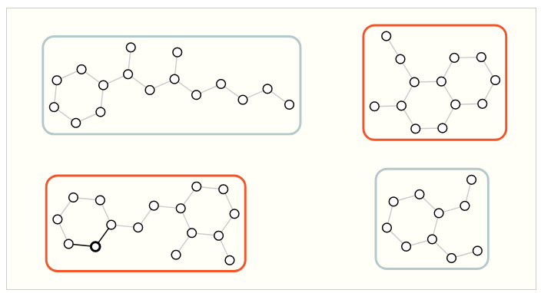
Graph-level Task

Slide 20
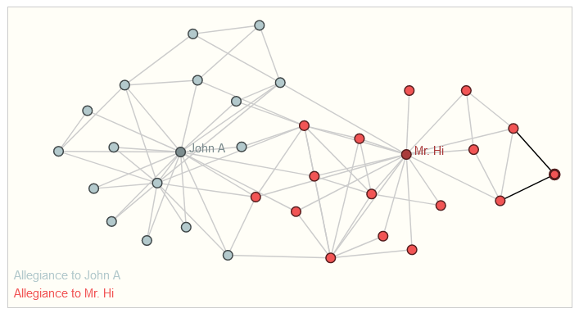
Node-level Task
Notes:
跆拳道分兩個老師

Slide 21
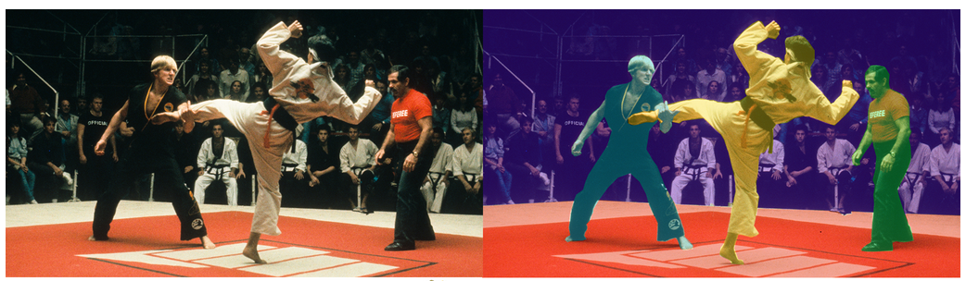
Edge-level Task
Notes:
人物的關係

Slide 22
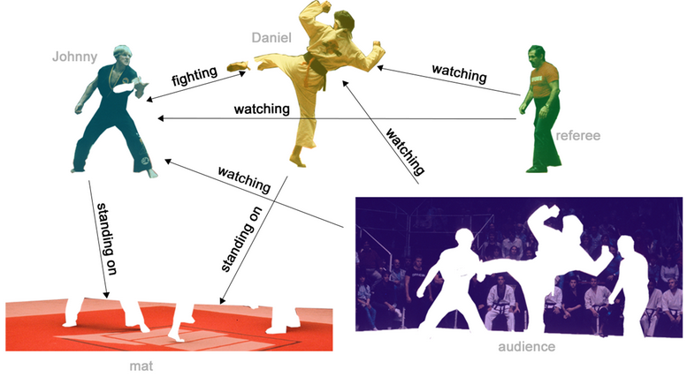
Edge-level Task
Notes:
人物的關係

Slide 23
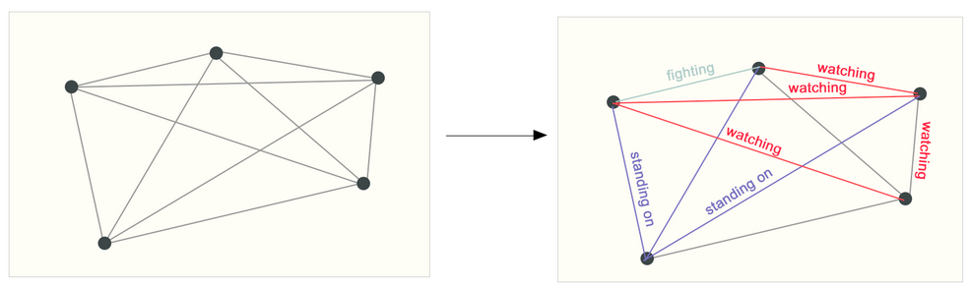
Edge-level Task
Notes:
人物的關係

Slide 24
The Challenges of Using Graphs in Machine Learning

Slide 25
Type of Infromation
Nodes
Edges
Global-content
Connectivity
Adjacency matrix
Notes:
前三個很容易，因為可以用vector表示，而NN對vector是友好的
連接性可以使用鄰接矩陣

Slide 26
Challenges of Adjacency Matrix 1
Large and sparse adjacency matrices, which are space-inefficient.
Notes:
大而稀疏

Slide 27
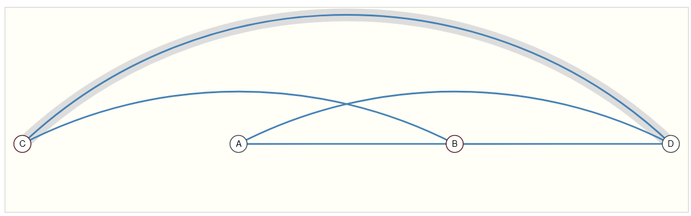
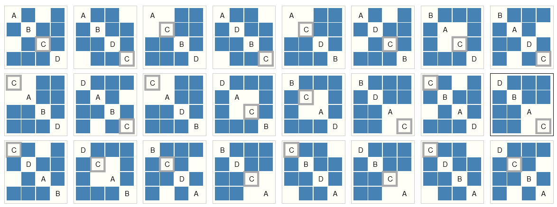
Challenges of Adjacency Matrix 2
Notes:
多個鄰接矩陣都表示相同的圖，應該要在NN有相同的結果

Slide 28
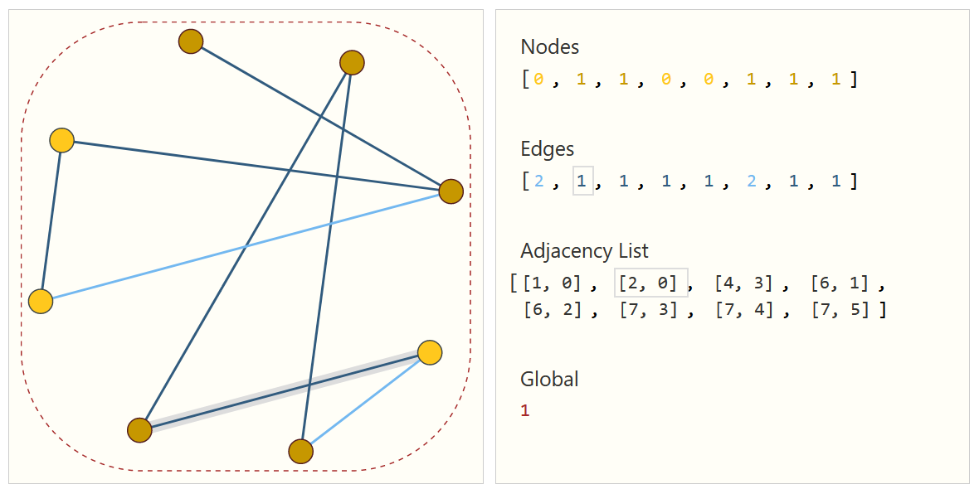
Adjacency List
Notes:
第一條edge對應到Adjacency List的第一項，代表此邊的兩頂點
只儲存實際存在的邊

Slide 29
Graph Neural Networks
A GNN is an optimizable transformation on all attributes of the graph (nodes, edges, global-context) that preserves graph symmetries (permutation invariances).
Notes:
可以對圖上的信息進行轉換，並且轉換後這些信息會變有用

Slide 30
Graph Neural Networks
Framework: message passing neural network
Architecture: graph-in, graph-out
Progressively transform these embeddings, without changing the connectivity of the input graph
Notes:
人物的關係

Slide 31
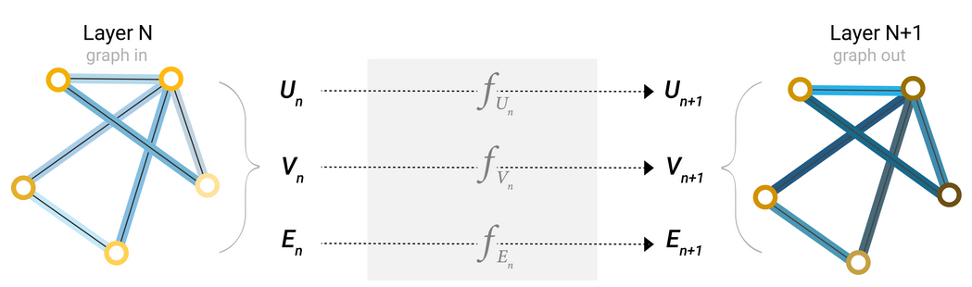
GNN Layer
Notes:
頂點、邊、全局 的vector都有一個MLP(多層感知機)，這三個MLP組成GNN的一個layer，不管圖有多大一層就是只有三個MLP
屬性變換，連接性不改變
MLP對象量獨自作轉換，所以對排序後的結果會一樣

Slide 32
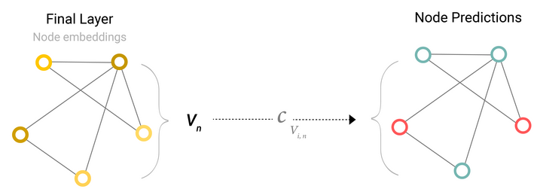

GNN Prediction
Notes:
多層轉換後，用最後一層的資訊當作全連接層的輸出，用來分類(Classification)
跆拳道學生，分類老師問題
適用於所有問題，Node Edge Graph

Slide 33
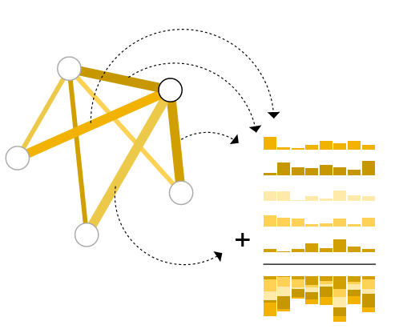
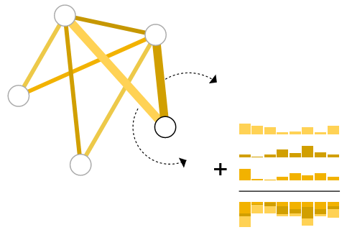
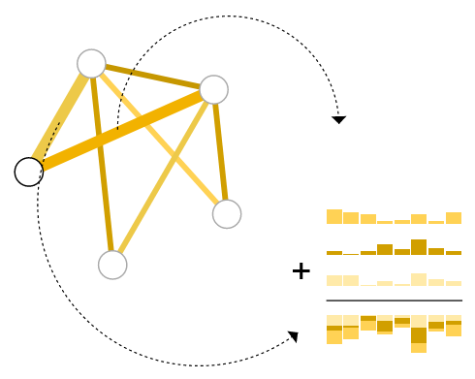
Pooling
Notes:
原本並沒有哪個屬性的特徵，但是目標問題必須要對他作預測
Ex:缺少node的屬性，用鄰邊

Slide 34
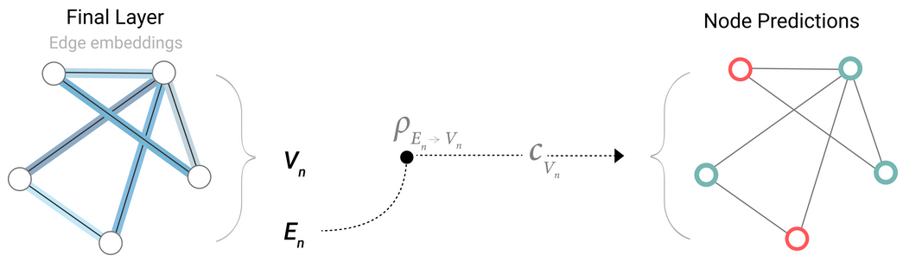
Pooling to Node

Slide 35
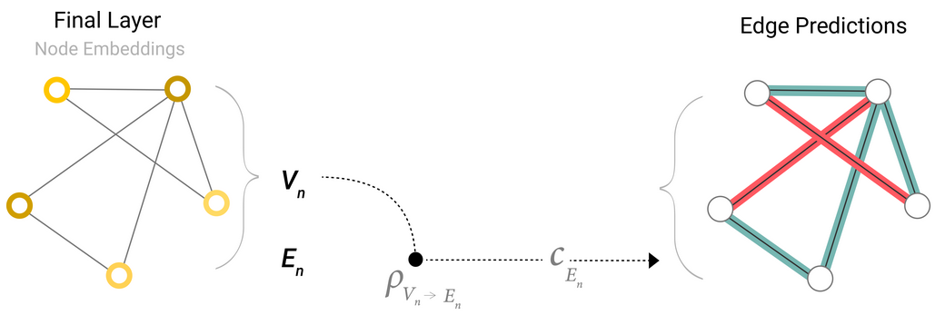
Pooling to Edge

Slide 36
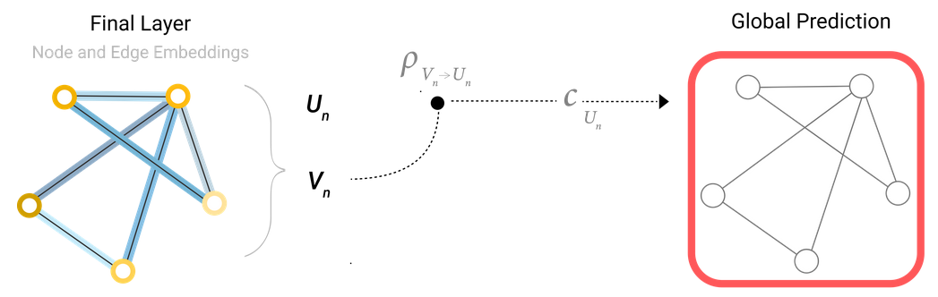
Pooling to Global

Slide 37
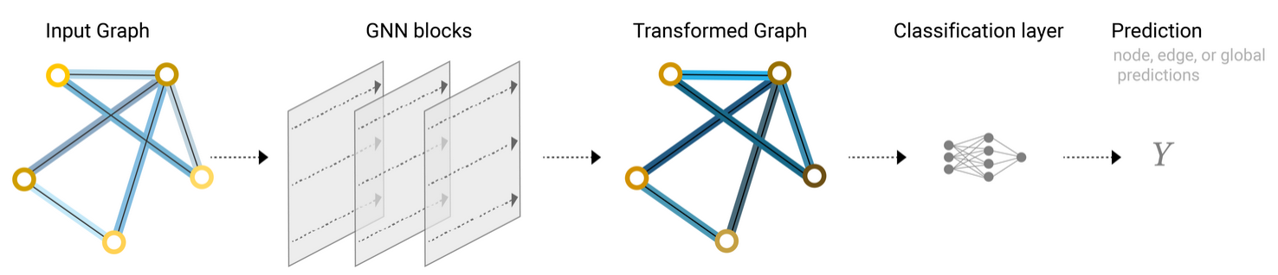
The Simplest GNN Model
Notes:
經過多層，屬性已經發生轉換

Slide 38
Simplest Model Problem
Not using the connectivity of the graph at all inside the GNN layer. Each node is processed independently
Notes:
Layer並沒有考慮到連接性

Slide 39
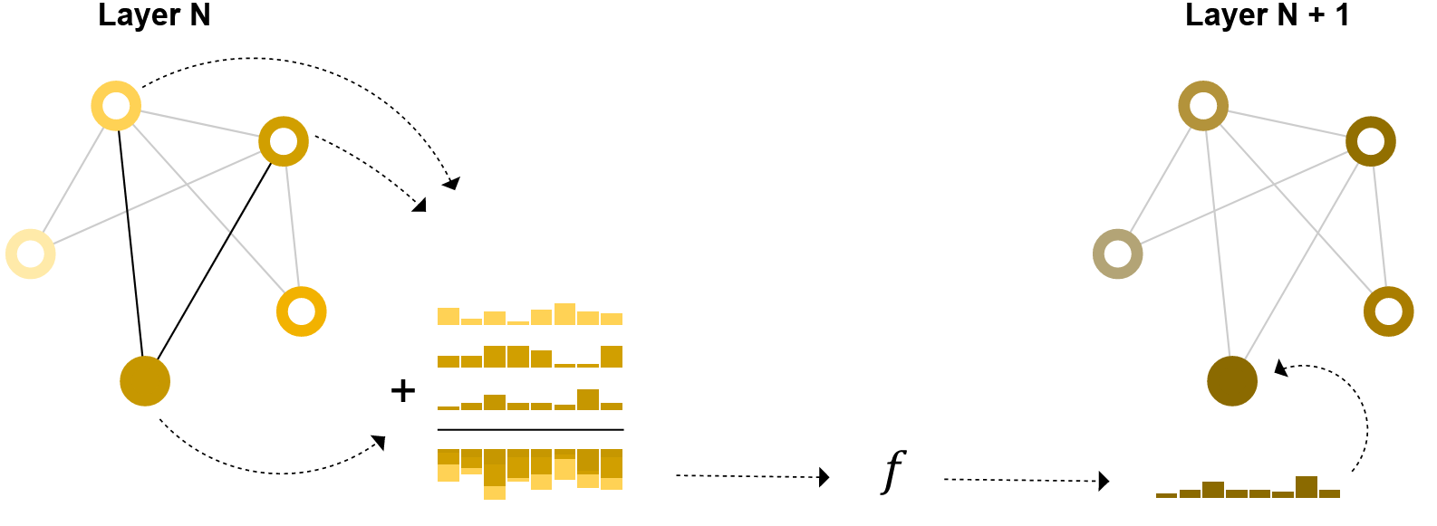
Passing Messages
Notes:
類似CNN 的convolution

Slide 40
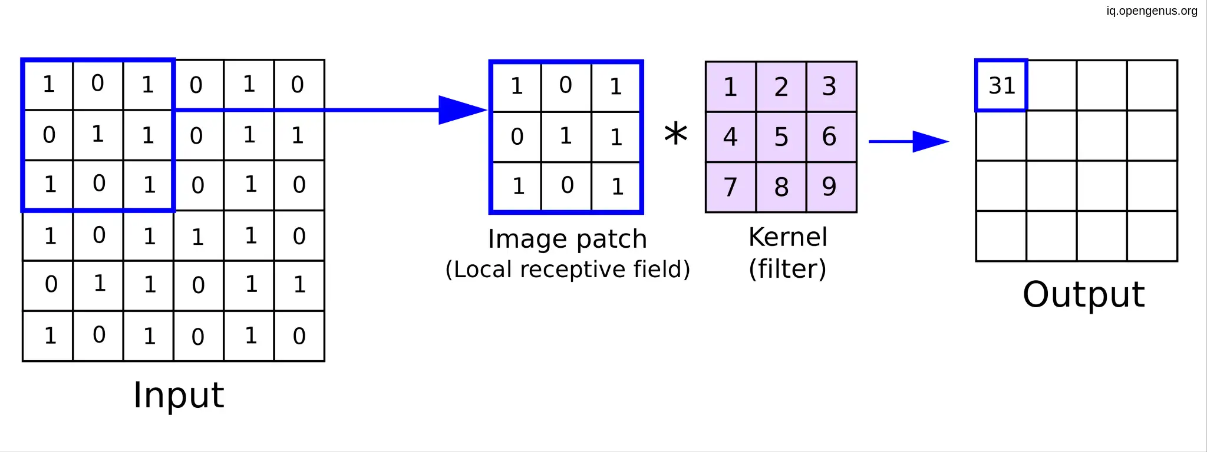
Convolution of CNN

Slide 41
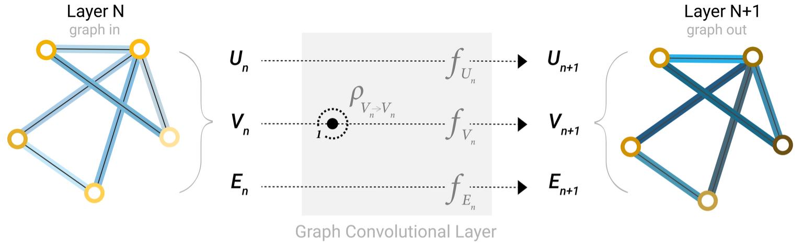
Simple Message Passing Model
Notes:
從鄰居node pooling到自己

Slide 42
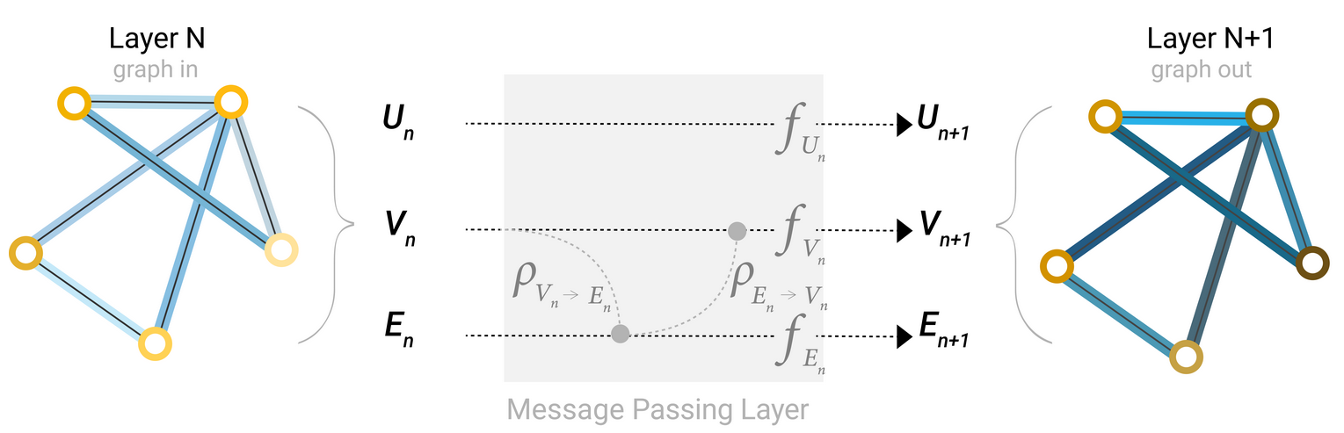
Learning Edge Representations
Notes:
就算我們使用convolution layer讓node的資訊可以passing到node，
如果我要對node作分類，從頭到尾都只用node的feature作轉換，
Ex:跆拳道(身高，體重)，但是其實Edge(對戰紀錄)對這個問題也是有用的資訊

Slide 43
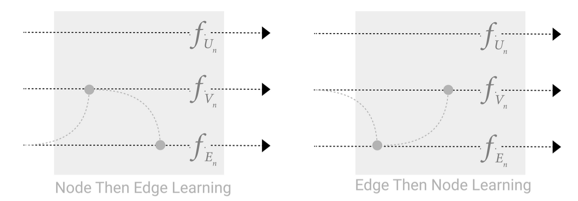
Pooling Order
Notes:
不知道哪一個先比較好

Slide 44
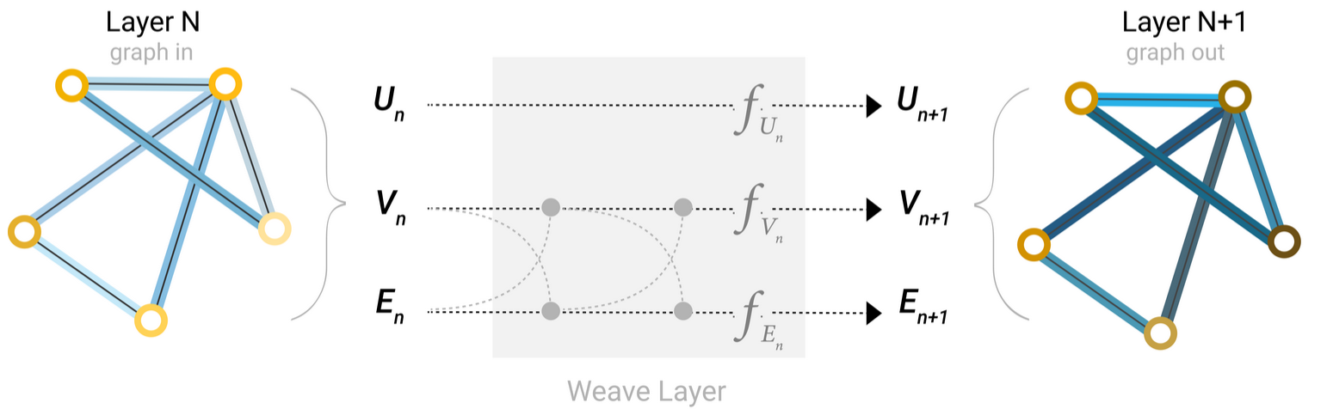
Weave Layer

Slide 45
Adding Global Representations
Large and sparse Graph
Master node or context vector
Abstract
Notes:
大而稀疏，message passing太慢

Slide 46
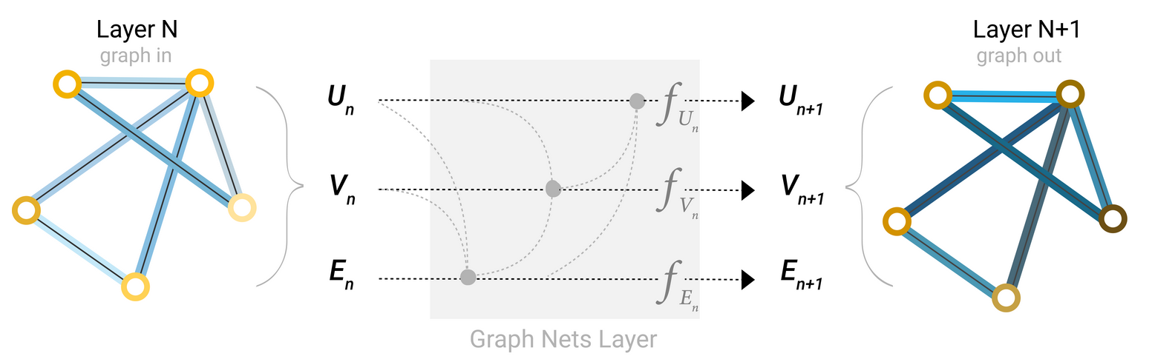
Graph Nets Layer

Slide 47
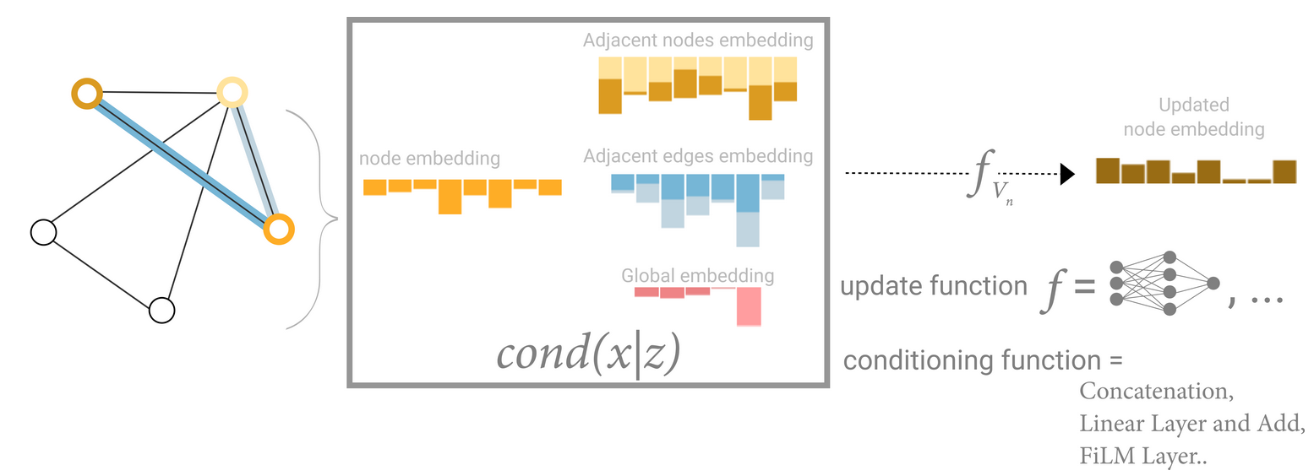
Message Passing Model

Slide 48
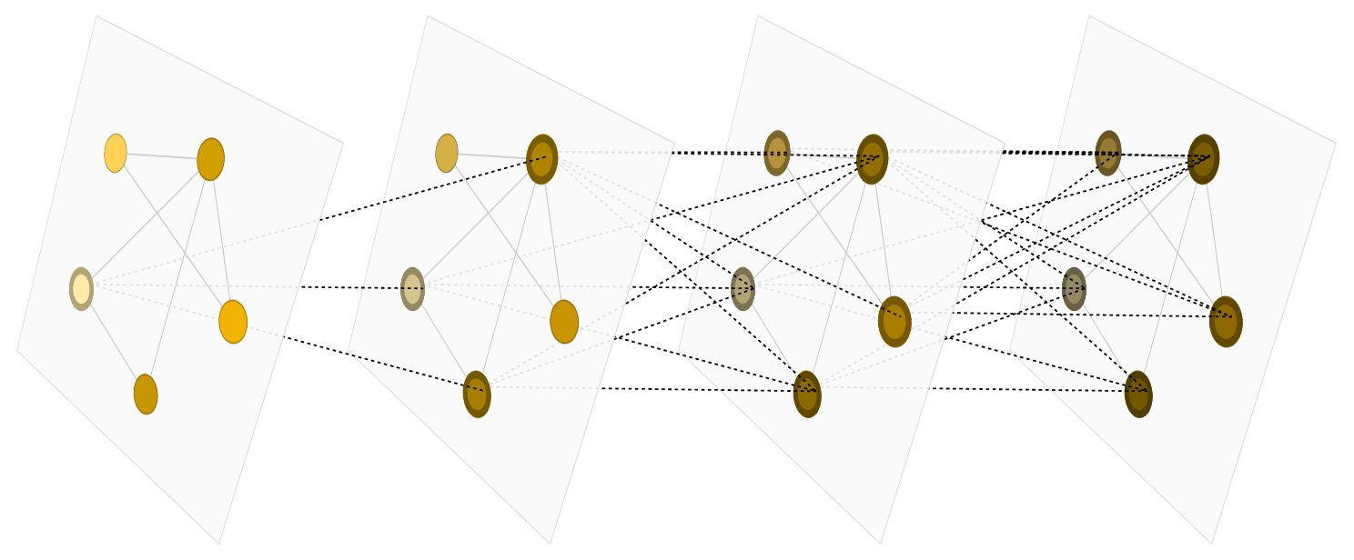
Message Passing Model

Slide 49

Feature for Node n
$ne\left[n\right]$
$co\left[n\right]$
$l_{n}$
$l_{\left(n_{1},n_{2}\right)}$
$l$

Slide 50


Learning Set
Notes:
Supervise learning
有p個圖，第i個圖有qi個node
ti,j則是此點的目標

Slide 51


Set of A Pair

Slide 52
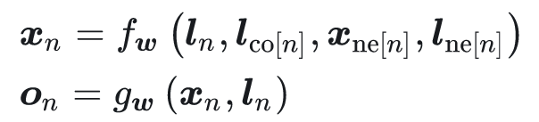
Local Transition Function
Notes:
F是Local transition function

Slide 53


Slide 54

Global Transition Function
Notes:
F是Global transition function

Slide 55

Contraction Mapping

Slide 56

Banach Fixed-point Theorem
Notes:
映射的不動點的存在性和唯一性

Slide 57

Fixed-point Iteration
Notes:
F 是 壓縮映射

Slide 58

The Learning Algorithm

Slide 59


Proof
Differentiable
Back propagation

Slide 60

Initial State

Slide 61

Next State

Slide 62

Process

Slide 63

Experimental Result

