Slide 1
Quick greedy computation for minimum common string partition
Isaac Goldstein, Moshe Lewenstein
Theoretical Computer Science 542 (2014) 98–107
Speaker: Zhi-Cheng Shen
Date: 2024/01/15
Notes:
以色列 拉馬干 巴伊蘭大學

Slide 2
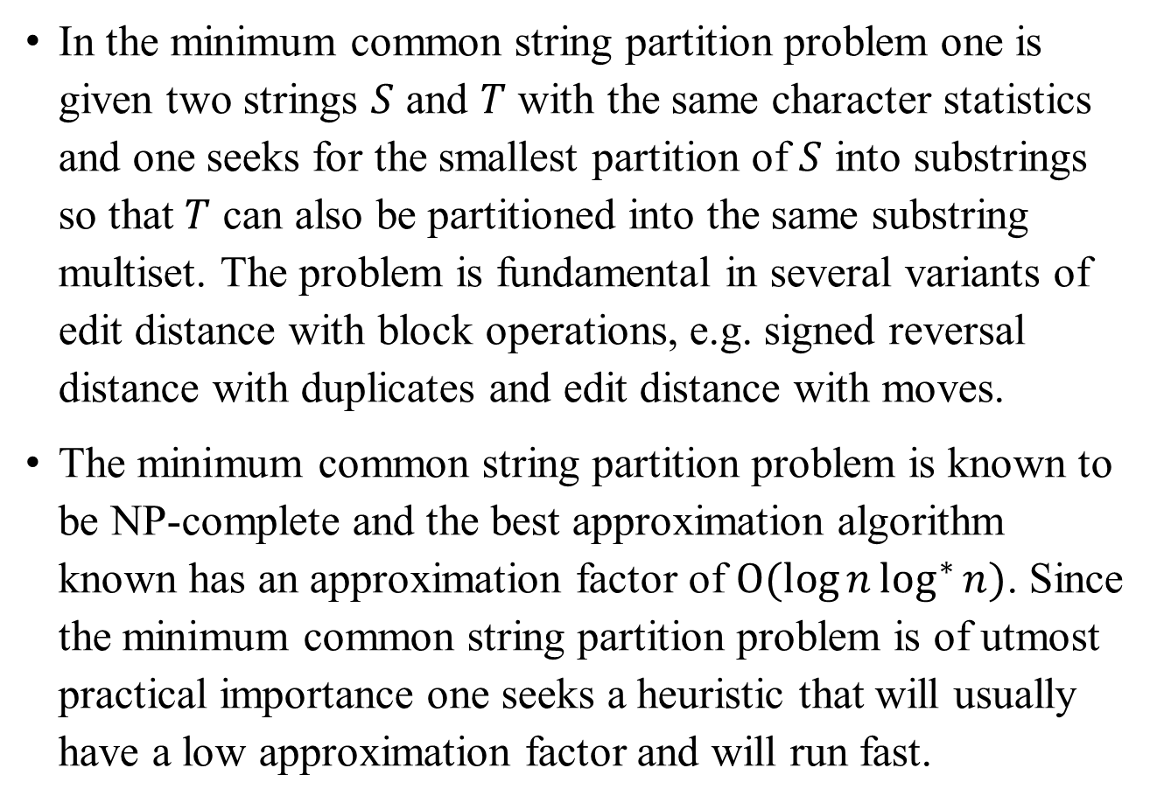
Abstract (1/2)
In the minimum common string partition problem one is given two strings $S$ and $T$ with the same character statistics and one seeks for the smallest partition of $S$ into substrings so that $T$ can also be partitioned into the same substring multiset. The problem is fundamental in several variants of edit distance with block operations, e.g. signed reversal distance with duplicates and edit distance with moves.
The minimum common string partition problem is known to be NP-complete and the best approximation algorithm known has an approximation factor of $O(\log{n}\log^{∗}{n})$. Since the minimum common string partition problem is of utmost practical importance one seeks a heuristic that will usually have a low approximation factor and will run fast.

Slide 3
Abstract (2/2)
A simple greedy algorithm is known, which iteratively choose non-overlapping longest common substrings of the input strings. This algorithm has been well-studied from an approximation point of view and it has been shown to have a bad worst case approximation factor. However, all the bad approximation factors presented so far stem from complicated recursive construction. In practice the greedy algorithm seems to have small approximation factors. However, the best current implementation of greedy runs in quadratic time.
We propose a novel method to implement greedy in linear time.

Slide 4




MCSP problem
The minimum common string partition problem
Input: Two equi-statistic strings S and T
Output: A common string partition B1, ..., Bl ( l minimized )
$$S=a b a a b c a$$
$$T=a a b c a a b$$
$$S=a b a a b c a$$
$$T=a a b c a a b$$

Slide 5







Properties of equi-statistic strings
1. equi-statistic: 兩字串的字元組成相同，順序不同
2. equi-statistic的兩字串，必存在一組common string partition，即每個block為一個字母，共n個(假設字串長度為n)block
3. 兩字串若存在一個common string partition，必為equi-statistic
i.e. 2,3等價
4. equi-statistic的兩字串，可能有不只一組common string partition
$$S=a b a a b c a$$
$$S=a b c d e$$
$$T=a a b c a a b$$
$$T=e d c b a$$
$${CSP}_{1}:aabca, ab$$
$$CSP=a, b, c, d, e$$
$${CSP}_{2}:aab, ca, ab$$

Slide 6










The GREEDY algorithm
while (還有 unmarked letters){
find $LCS$(longest common substring) with all unmarked letters
mark all letters in $LCS$
}
$$S=a b a a b c a$$
$$S=a b a a b c a$$
$$a b$$
$$T=a a b c a a b$$
$$T=a a b c a a b$$
$$a b$$
$$LCS=a a b c a$$
$LCS=a b$
minimum common
string partition(MCSP)
$$= a a b c a\left(B_{1}\right), a b\left(B_{2}\right)$$

Slide 7


















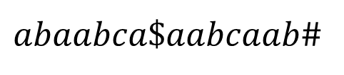































Suffix tree of S$T#
$$S=a b a a b c a$$
$$T=a a b c a a b$$
$$round 1$$
$abaabca\$aabcaab$#
$$\$a…\#$$
$$c$$
$$8$$
$$\#$$
$$a$$
$$b$$
$$16$$
$$a$$
$$\$a…\#$$
$$a$$
$$a…\#$$
$$c$$
$$\#$$
$$b$$
$$2$$
$1$5
$$7$$
$$\#$$
$$c$$
$$a$$
$$\$a…\#$$
$$ab\#$$
$$b$$
$$a..\#$$
$$14$$
$$6$$
$$12$$
$$1$$
$$c$$
$$\#$$
$$\$a…\#$$
$$ab\#$$
$$a$$
$1$3
$$5$$
$$11$$
$$\$a…\#$$
$$ab\#$$
$$a$$
suffix of T
suffix of S
$$4$$
$$10$$
$$\$a…\#$$
$$ab\#$$
$$CurrentLCS=aabca$$
$$3$$
$$9$$

Slide 8
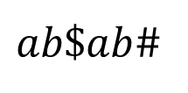





Suffix tree of S$T#
$$S=a b$$
$$T=a b$$
$$round 2$$
$ab\$ab$#
$$…$$
minimum common
string partition(MCSP)
$$= a a b c a\left(B_{1}\right), a b\left(B_{2}\right)$$

Slide 9
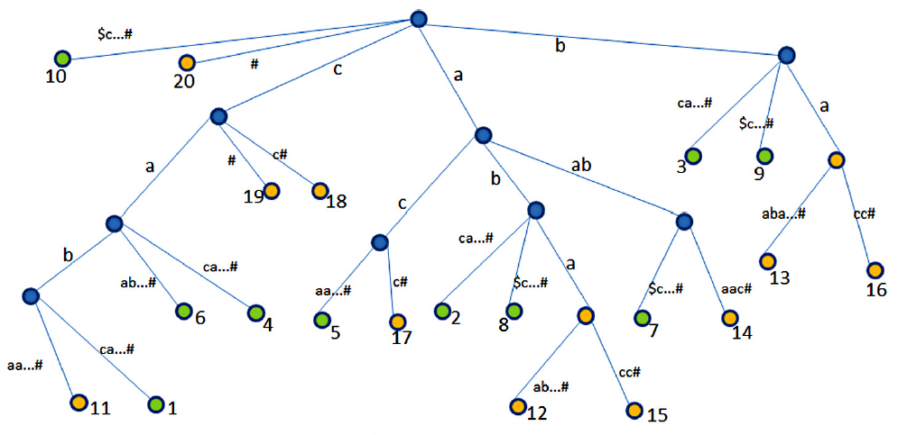



Suffix tree of S$T#
$$S=c a b c a c a a b$$
$$T=c a b a a b a c c$$
$$cabcacaab\text{\$}cabaabacc\#$$

Slide 10
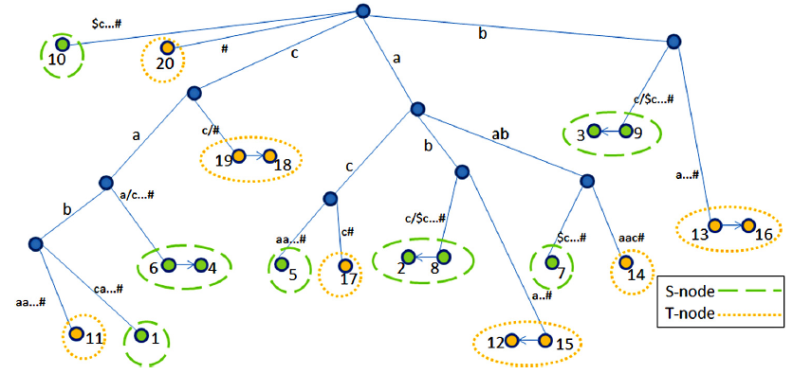
Suffix Skeleton Tree
essential node
S-node
T-node

Slide 11
Suffix Skeleton Tree

Slide 12
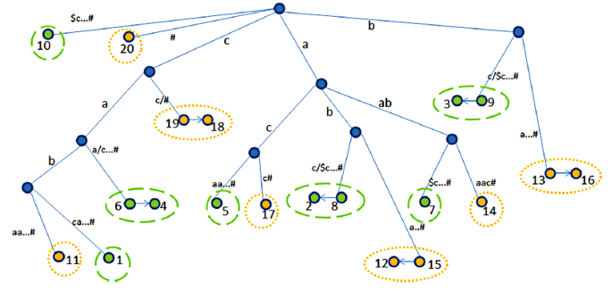












LPB Array
$$S=c a b c a c a a b$$
$$T=c a b a a b a c c$$
The Longest Prefix Bucket Array
$$E_{1}$$
$$E_{2}$$
$$E_{5}$$
$$E_{3}$$
$$E_{4}$$
1 | 2 | 3 | 4 | 5 | 6 | 7 | 8 | 9
string depth
$$E_{1}$$
$$E_{2}$$
$$E_{4}$$
Maximal Pointer
preprocess
$$E_{3}$$
$$E_{5}$$

Slide 13
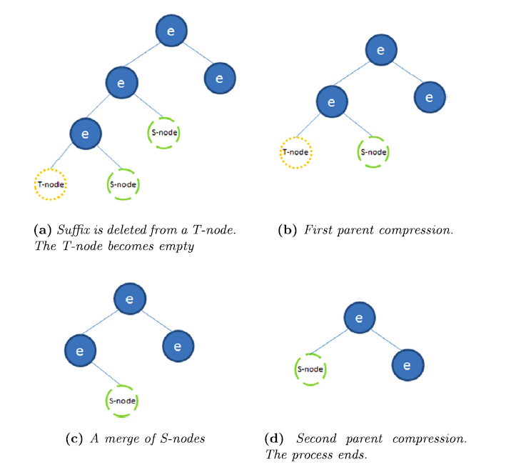

Update Suffix Skeleton Tree

Slide 14







First Round(Before)
$$S=c a b c a c a a b$$
$$T=c a b a a b a c c$$
The Longest Prefix Bucket Array
$$E_{1}$$
$$E_{3}$$
$$E_{4}$$
$$E_{2}$$
$$E_{5}$$
1 | 2 | 3 | 4 | 5 | 6 | 7 | 8 | 9
$$E_{1}$$
$$E_{2}$$
$$E_{4}$$
Maximal Pointer
$$E_{3}$$
$$E_{5}$$

Slide 15
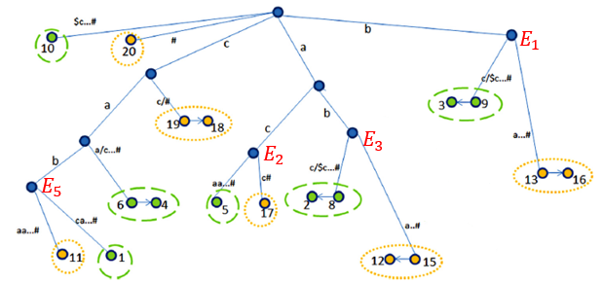



First Round(After)
$$S=c a b c a c a a b$$
$$T=c a b a a b a c c$$
The Longest Prefix Bucket Array
1 | 2 | 3 | 4 | 5 | 6 | 7 | 8 | 9
$$E_{1}$$
$$E_{2}$$
$$E_{4}$$
Maximal Pointer
$$E_{3}$$
$$E_{5}$$
partition: $aab$

Slide 16


Second Round(Before)
$$S=c a b c a c$$
$$T=c a b a c c$$
The Longest Prefix Bucket Array
1 | 2 | 3 | 4 | 5 | 6 | 7 | 8 | 9
$$E_{1}$$
$$E_{2}$$
Maximal Pointer
$$E_{3}$$
$$E_{5}$$
partition: $aab$

Slide 17
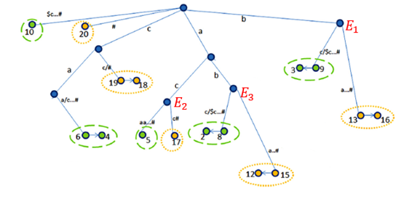





Second Round(After)
$$S=c a b c a c$$
$$T=c a b a c c$$
The Longest Prefix Bucket Array
$$E_{6}$$
1 | 2 | 3 | 4 | 5 | 6 | 7 | 8 | 9
$$E_{1}$$
$$E_{2}$$
Maximal Pointer
$$E_{6}$$
$$E_{3}$$
$$E_{5}$$
partition: $aab, cab$

Slide 18




Third Round(Before)
$$S=c a c$$
$$T=a c c$$
The Longest Prefix Bucket Array
$$E_{6}$$
1 | 2 | 3 | 4 | 5 | 6 | 7 | 8 | 9
$$E_{6}$$
$$E_{2}$$
Maximal Pointer
partition: $aab, cab$

Slide 19
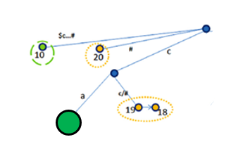




Third Round(After)
$$S=c a c$$
$$T=a c c$$
The Longest Prefix Bucket Array
$$E_{6}$$
1 | 2 | 3 | 4 | 5 | 6 | 7 | 8 | 9
$$E_{6}$$
$$E_{2}$$
Maximal Pointer
partition: $aab, cab, ac$

Slide 20



Forth Round
$$S=c$$
$$T=c$$
The Longest Prefix Bucket Array
$$E_{6}$$
1 | 2 | 3 | 4 | 5 | 6 | 7 | 8 | 9
$$E_{6}$$
Maximal Pointer
partition: $aab, cab, ac, c$

Slide 22
Time Complexity
Build suffix tree: O(n)
Deletion: O(n)
Total complexity: O(n)
At first glance, it seems as if this process can be quite expensive, but we should observe that each parent compression involves a node deletion. Therefore, as a consequence of the fact that there are no more than O(n) nodes in our suffix skeleton tree and we do not add more than O(n) nodes during the shortening process in all rounds together, we deduce that the cost of all the deletions during the whole algorithm is no more than O(n).

