Slide 1
A New Algorithmic Approach to Finding Minimum Spanning Tree
Afsana Khan, Afrida Anzum Aesha, Juthi Sarker
2018 4th International Conference on Electrical Engineering and Information & Communication Technology (iCEEiCT), Dhaka, Bangladesh, 13-15 Sept. 2018
Presenter: Hsin-Chang Yu
Date: Jan. 15, 2024

Slide 2
Abstract
Spanning tree of a graph is formed when each and every vertex of a graph are connected having no cycles in them and therefore minimum spanning tree as its name refers, is the tree with the smallest possible length among all spanning trees. Calculating minimum spanning tree of a graph has always been a common problem throughout ages. A number of efficient algorithms has been already developed for this problem.

Slide 3
Abstract
In this paper a different approach has been proposed where we profusely used sets and disjoint sets union data structure for reducing the number of edges under consideration while determining minimum spanning tree of a graph.

Slide 4
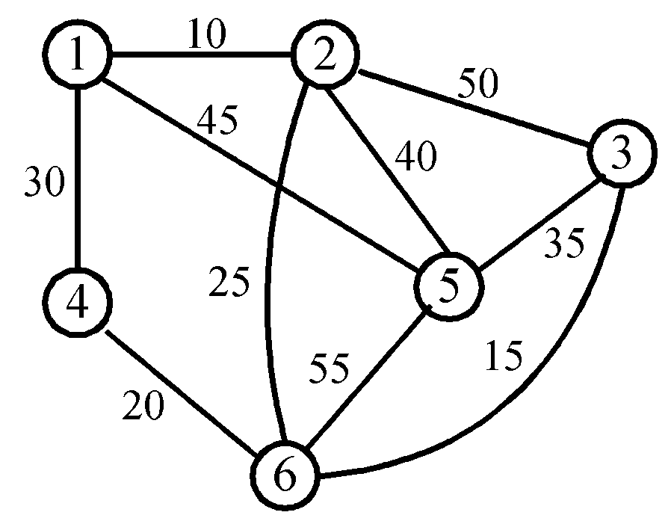
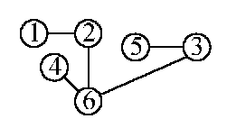
Minimum Spanning Tree (MST)

Slide 5
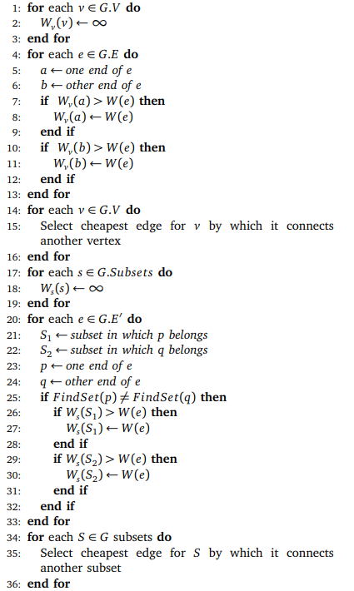
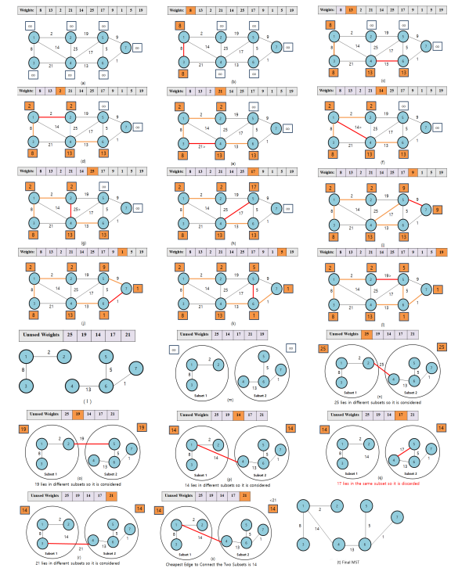

Slide 6
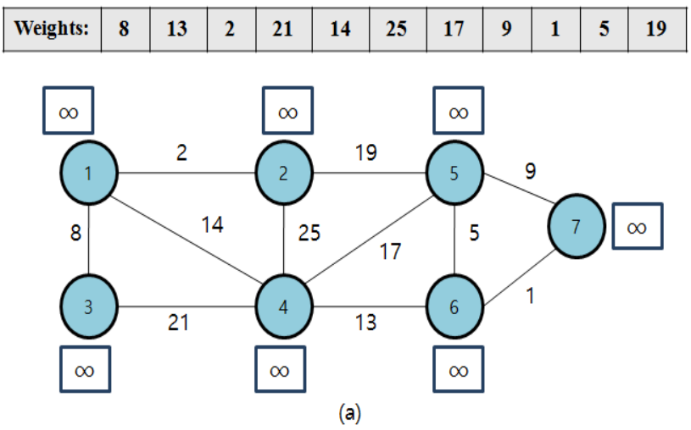
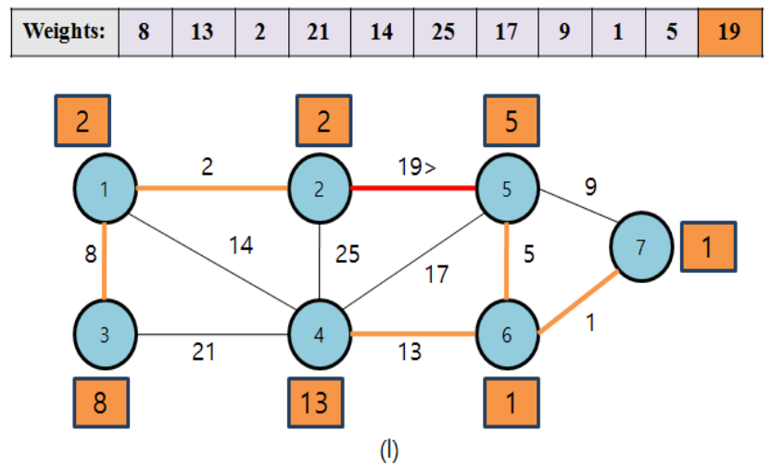
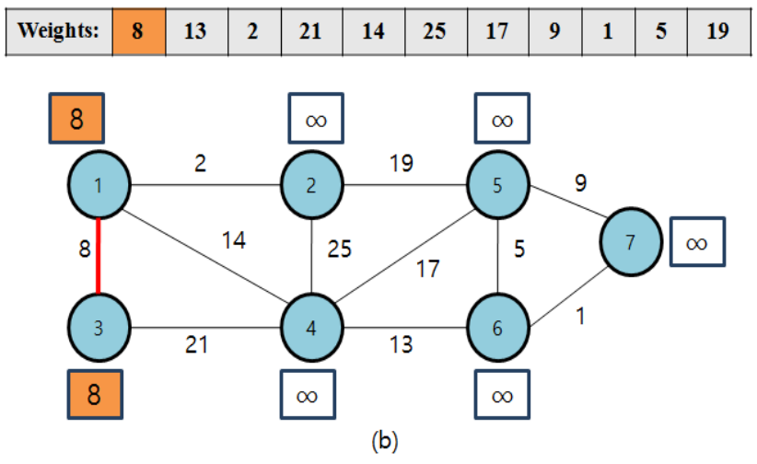
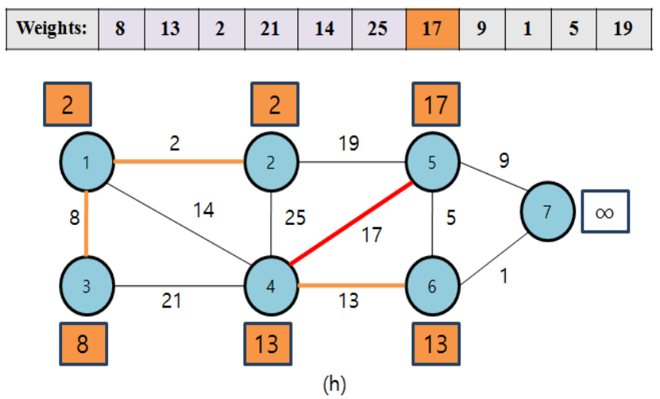
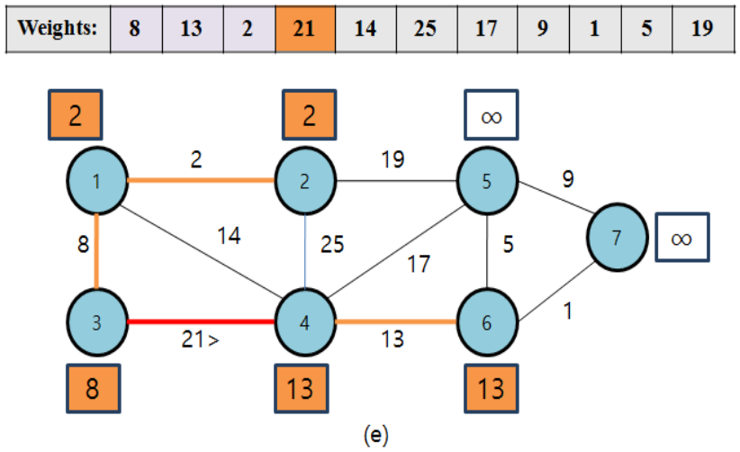
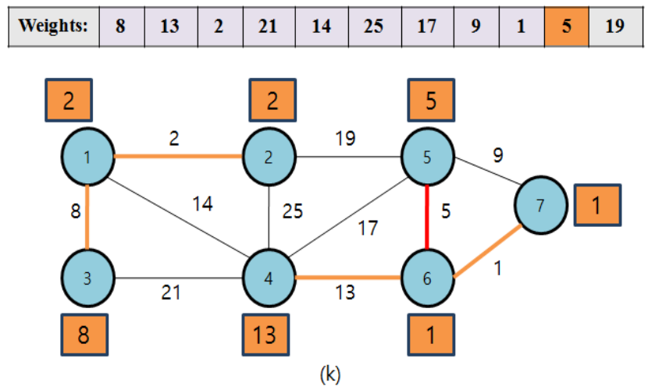
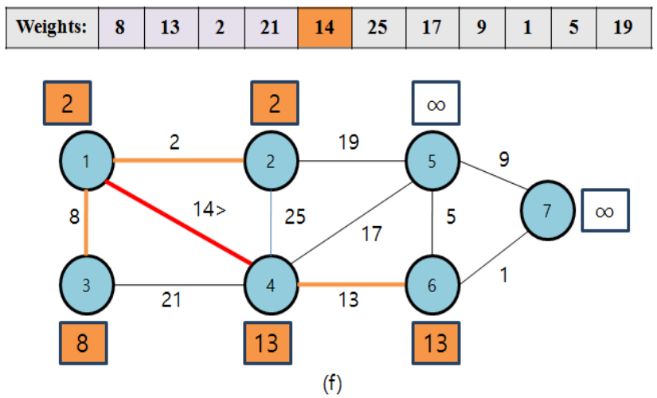
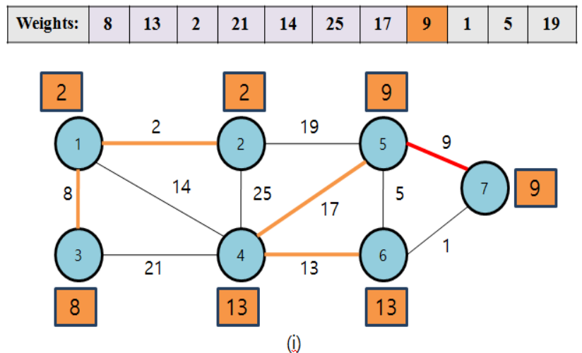
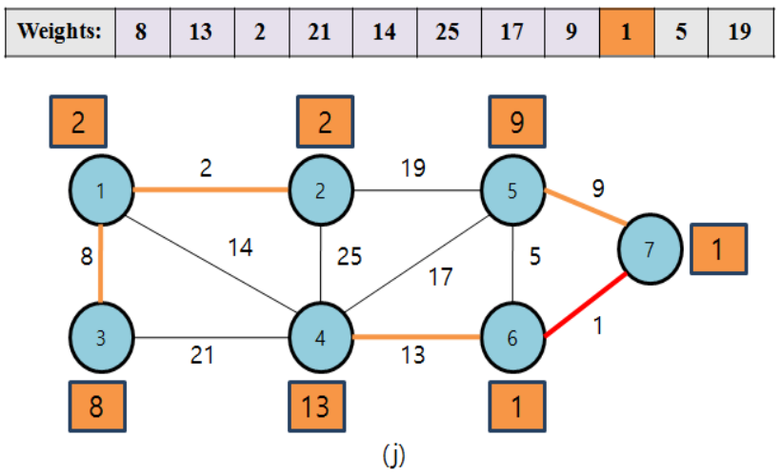
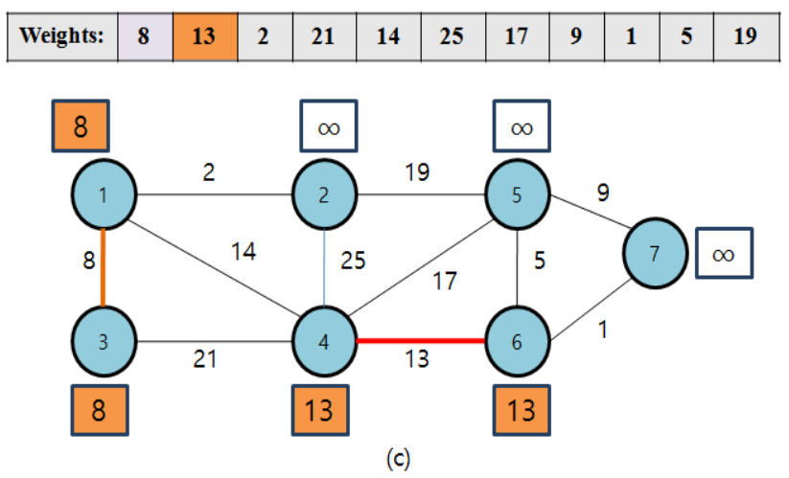
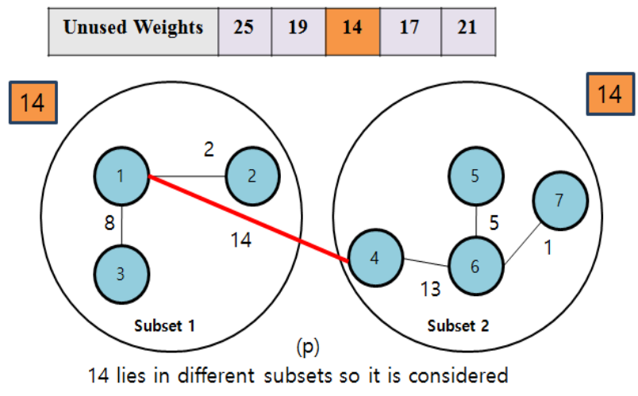
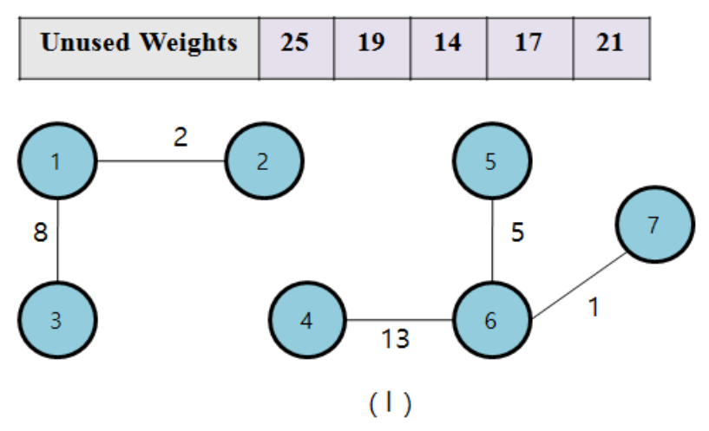
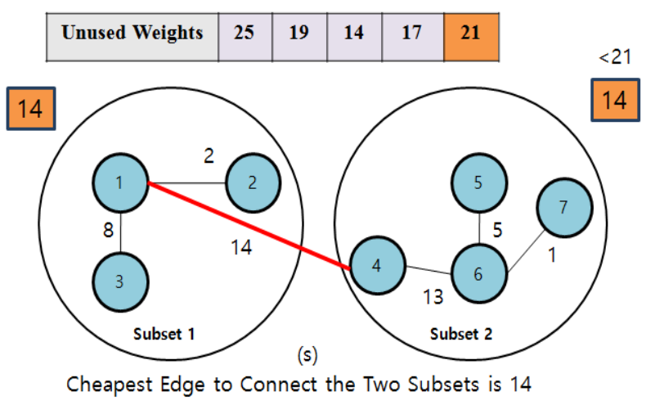
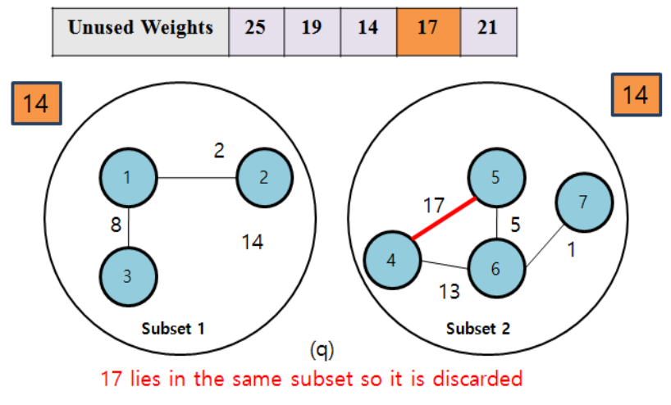
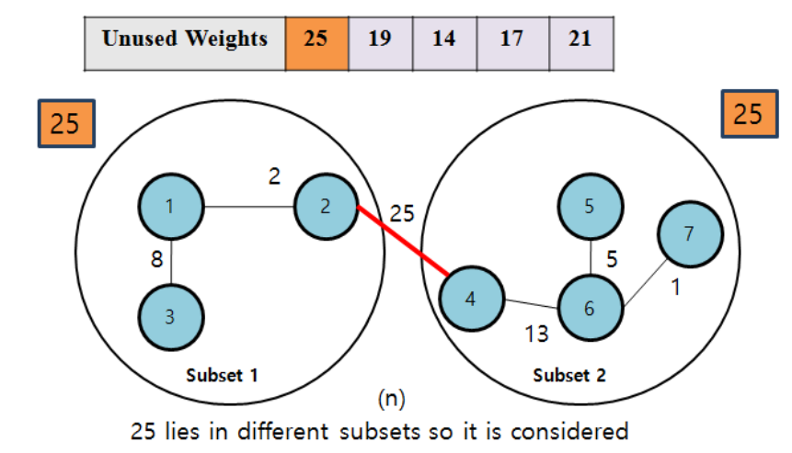
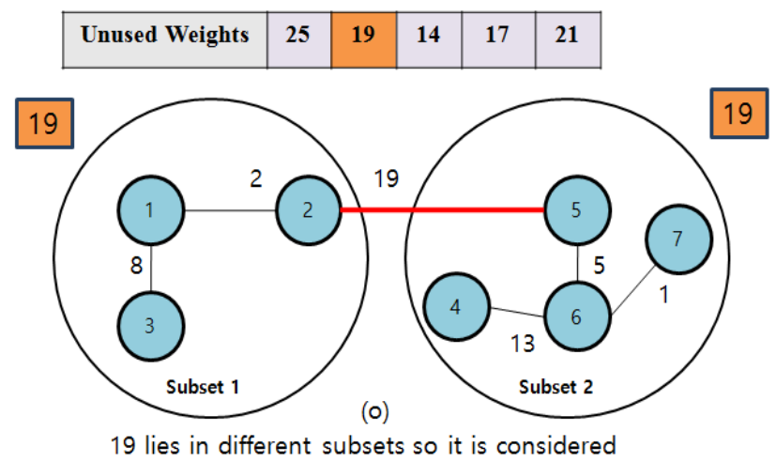
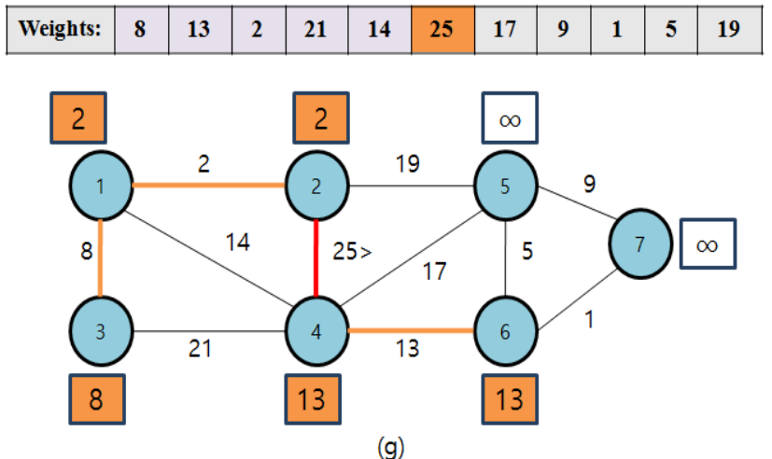
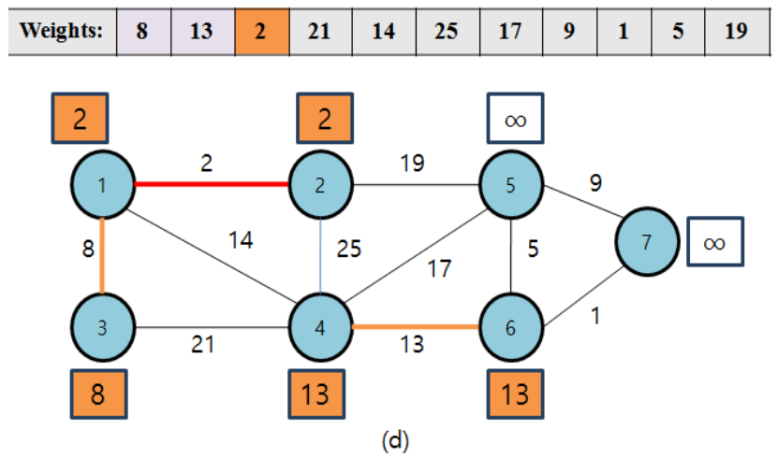
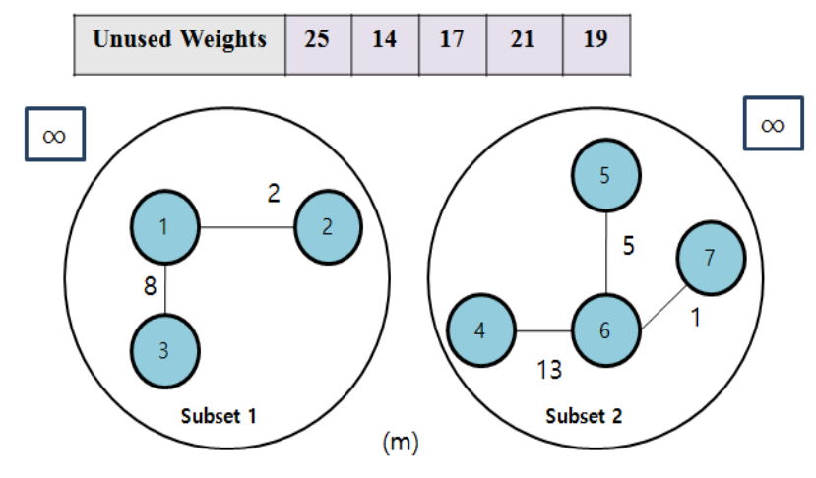
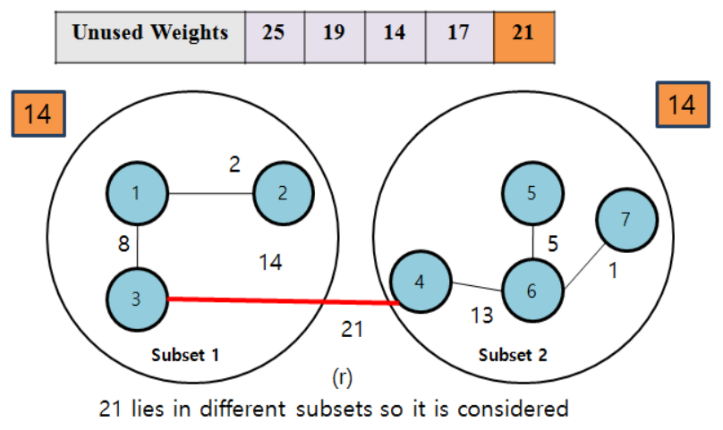
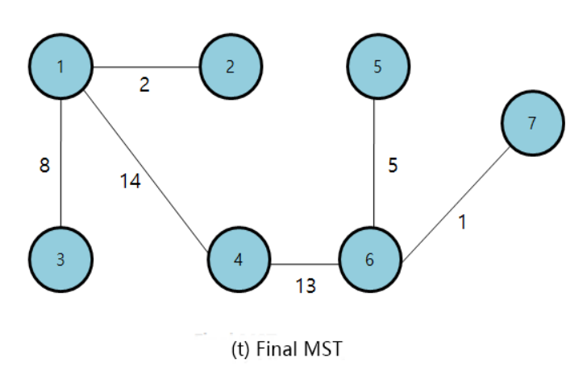

Slide 7
Time Complexity
O(|V|) + O(|E|) + O(|E′|log |E′|)
≈ O(|E|log|E|)

Slide 8
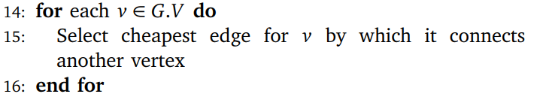
Time Complexity
Traversing each node, we select the nearest vertex from it using its node weight. We obtained subsets of the graph where each node is connected to its nearest vertex i.e. connected to other node with the minimum edge weight (Line 14 – 16).
Can be improved?

Slide 9
Thanks
Notes:
Given a string S of length n, an integer p ∈ [1..n] is a period of S if S[i] = S[i + p] for all i ∈ [1..n − p].
S[|S| − p + 1] = c

