Slide 1
Revealing Game Dynamics via Word Embeddings of Gameplay Data
Youne`s Rabii, Michael Cook
In Proceedings of the AAAI Conference on Artificial Intelligence and Interactive Digital Entertainment, 2021
Presenter: Yun-An Chen
Date: Feb. 6, 2024

Slide 2
Abstract
In this paper, we show how word embeddings, a technique used most commonly for natural language processing, can be repurposed to analyze gameplay data. Using a large study of chess games and applying the popular Word2Vec algorithm, we show that the resulting vector representation can reveal both common knowledge and subtle details about the game, including relative piece values and the natural spatial flow of chess play. Our results suggest that word embeddings are a cheap and simple technique that can provide a broad overview of a game’s dynamics, helping designers and critics form new hypotheses about a game’s design, structure and flow.

Slide 3
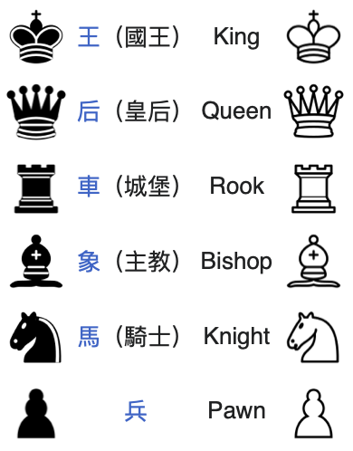
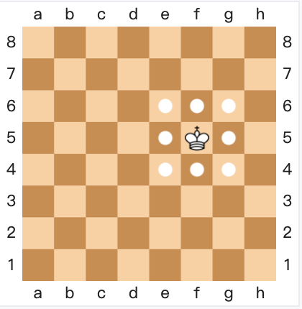
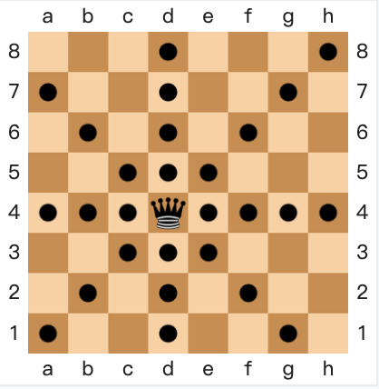
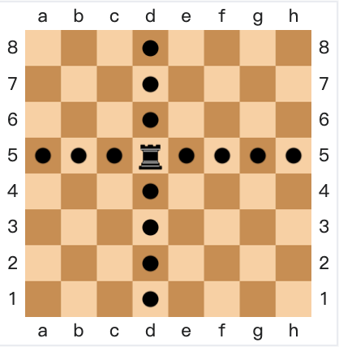
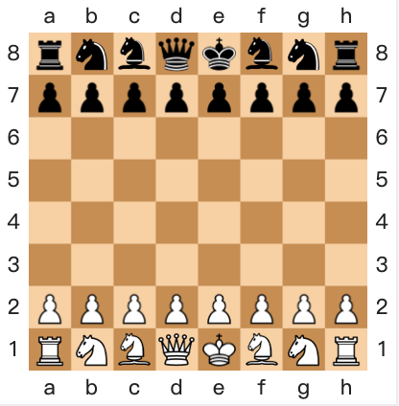
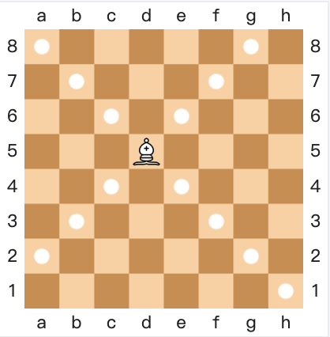
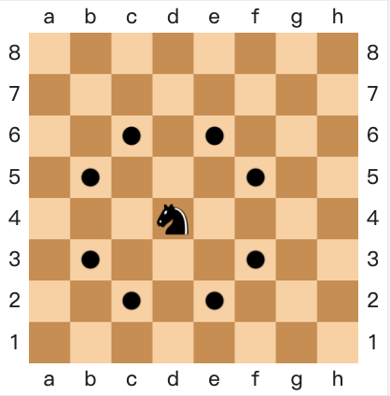
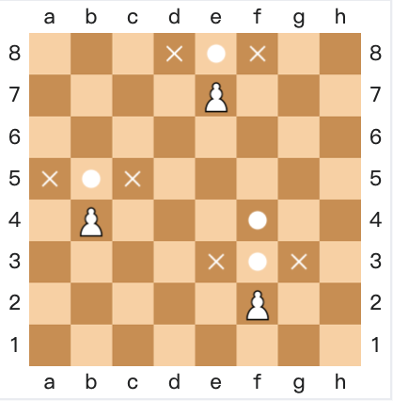
Chess
Pictures: https://zh.wikipedia.org/zh-tw/國際象棋

Slide 4
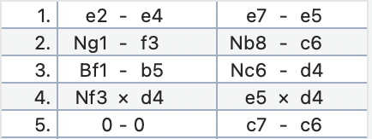
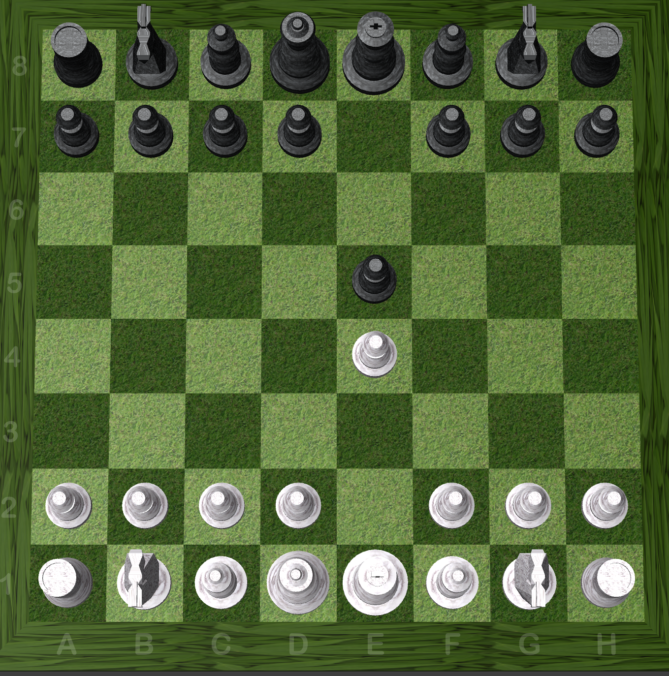
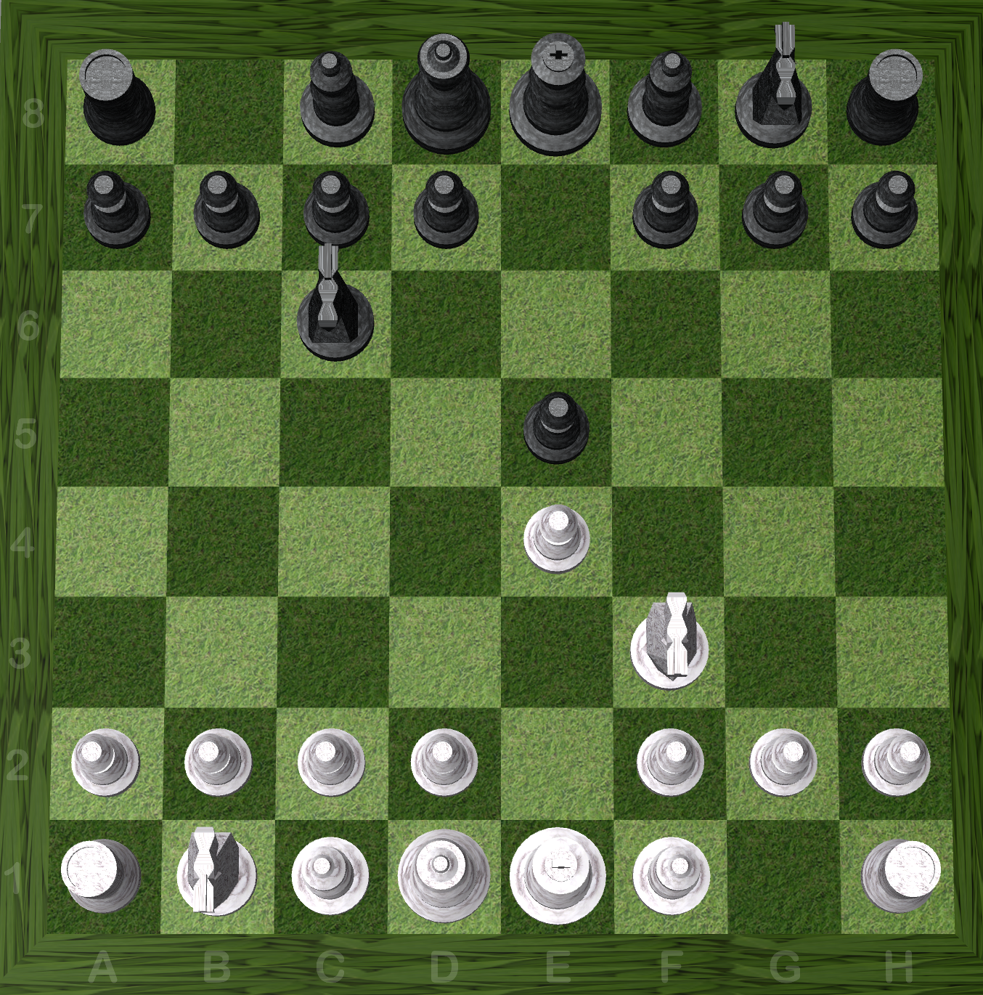
Chess

Slide 5
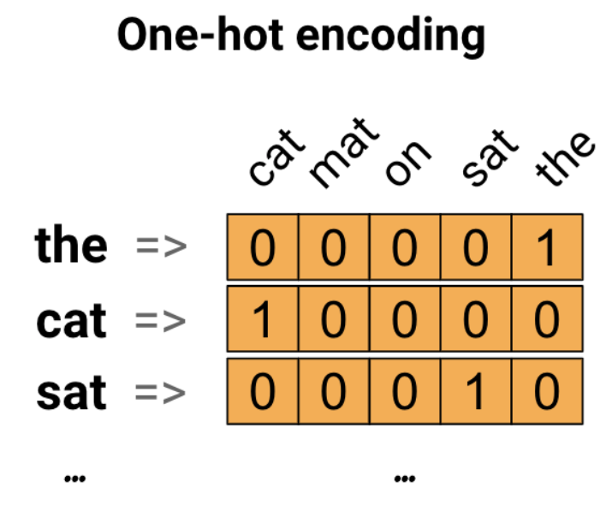
Word embedding
A technique represents words as vectors, capturing semantic relationships based on contextual similarities in language.
Representing text as numbers:
One-hot encodings
Encoding each word with a unique number
E.g., “The cat sat on the mat”
unique number
[5, 1, 4, 3, 5, 2]
https://www.tensorflow.org/text/tutorials/word_embeddings

Slide 6
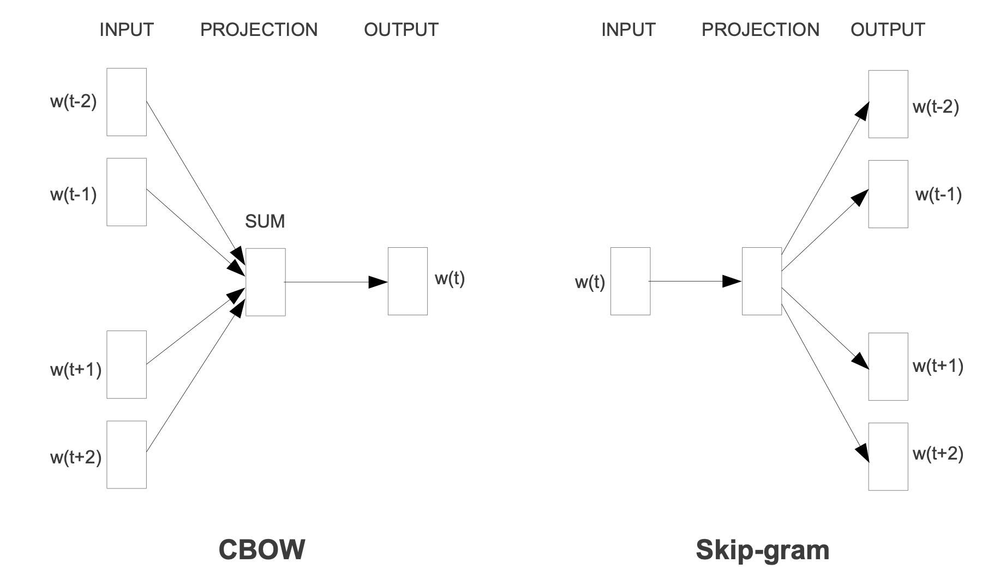
Word2Vec
(Continuous Bag-of-Words)
Picture: Efficient Estimation of Word Representations in Vector Space. arXiv:1301.3781

Slide 7
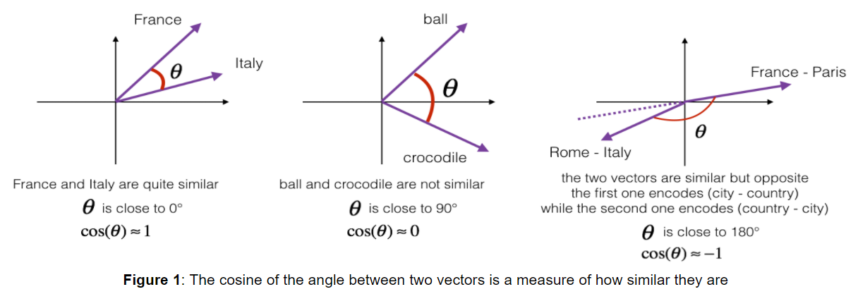
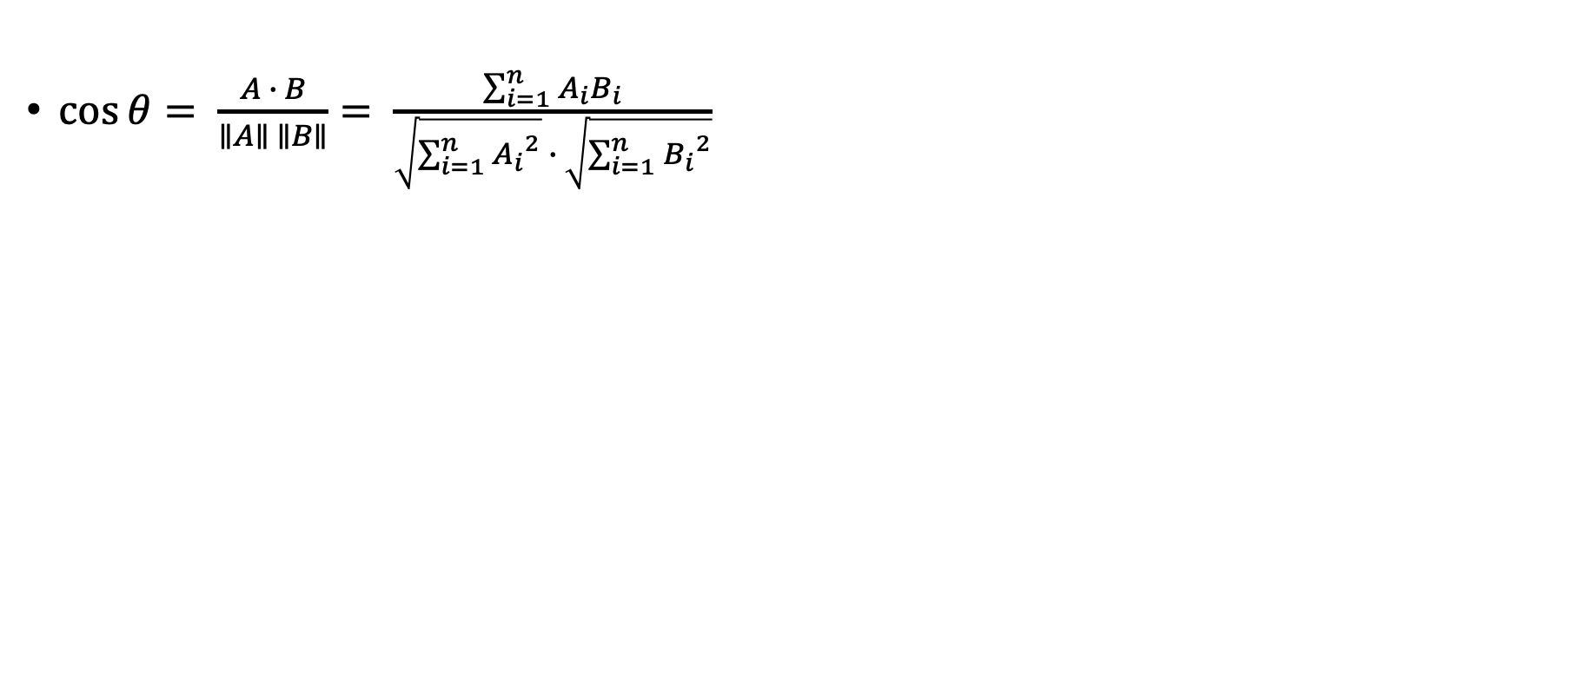
Word similarity
$\cos{θ}= \frac{A ∙ B}{∥A∥ ∥B∥}= \frac{\sum_{i=1}^{n}{A_{i}B_{i}}}{\sqrt{\sum_{i=1}^{n}{{A_{i}}^{2}}} ∙ \sqrt{\sum_{i=1}^{n}{{B_{i}}^{2}}}}$
Picture: https://ithelp.ithome.com.tw/articles/10268777

Slide 8
Problem Setup
Dataset: 250,000 chess games from the Lichess Open Database.
Word2Vec implementation: Gensim.
Game logs: converting the Portable Game Notation (PGN) format into a more verbose language.
Each game log begins with the Start token and ends with the End token.
For each turn of the game, adding a new line of tokens with the syntax:
Turn [Player] [Piece] [Start] [Dest] [Actions] [State]
Black moved a Pawn from (5,1) to (5,0), promoting it to a Queen. The game is in check.
Turn Black Pawn C5 R1 C5 R0 promote Queen check.

Slide 9
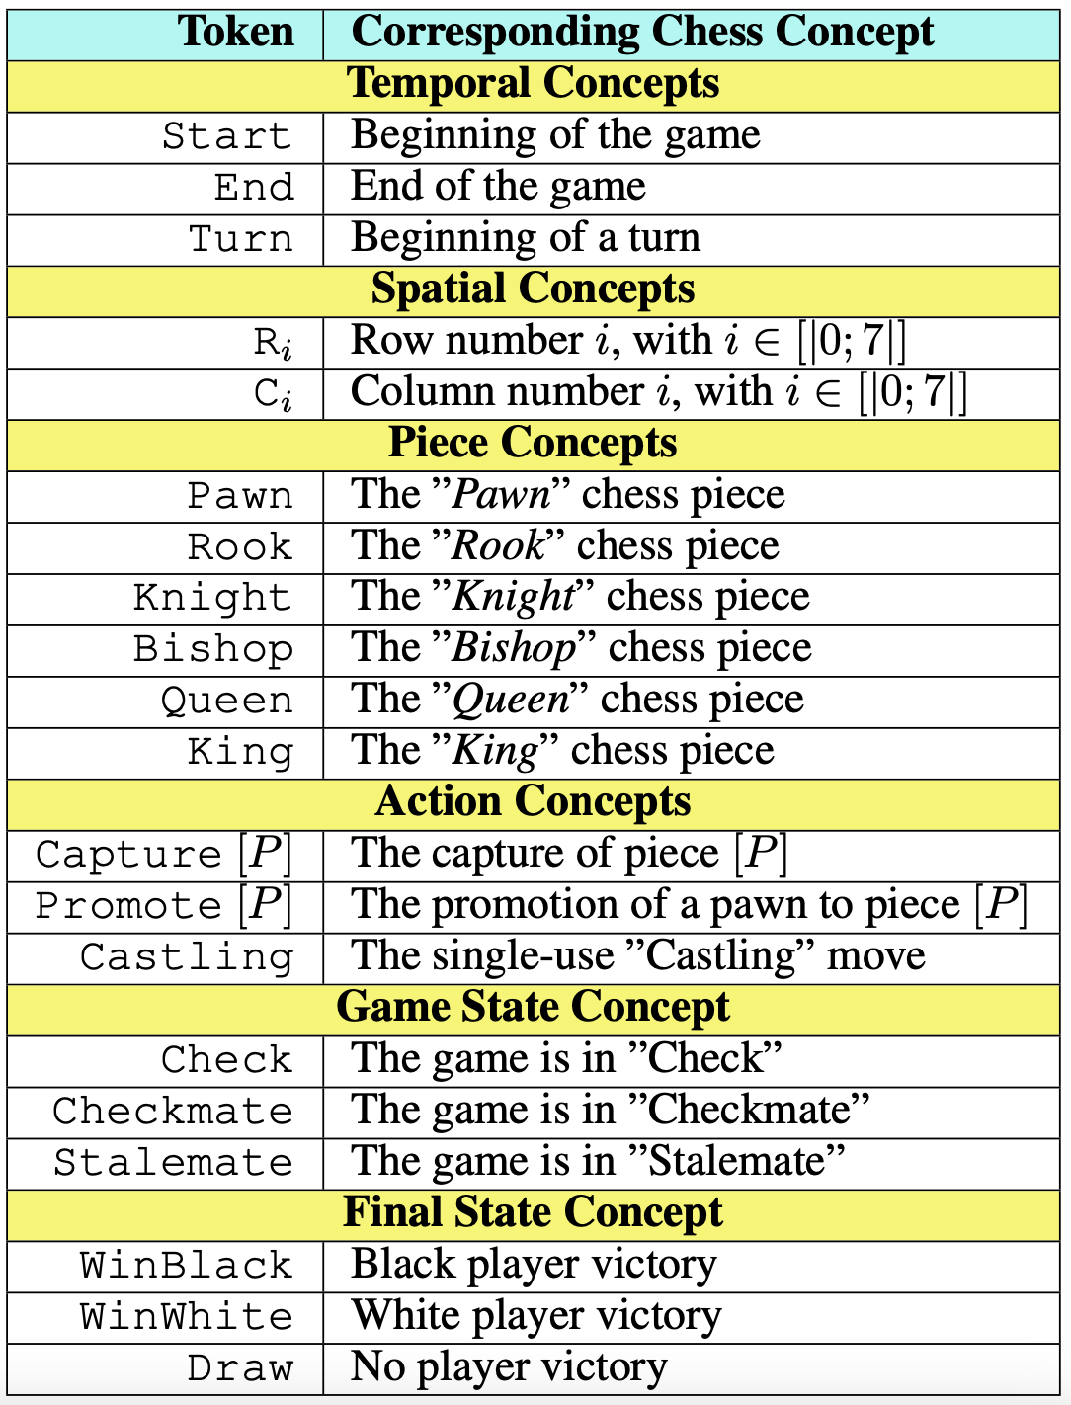
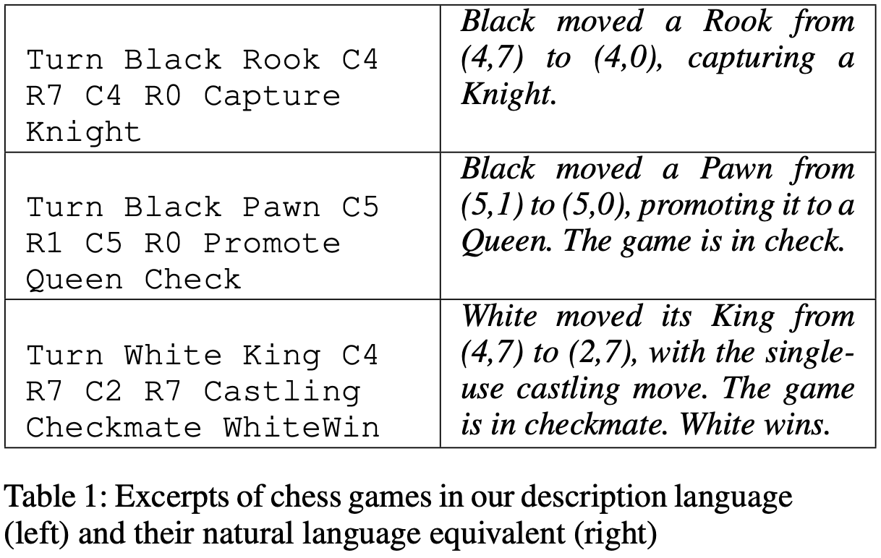
Problem Setup

Slide 10
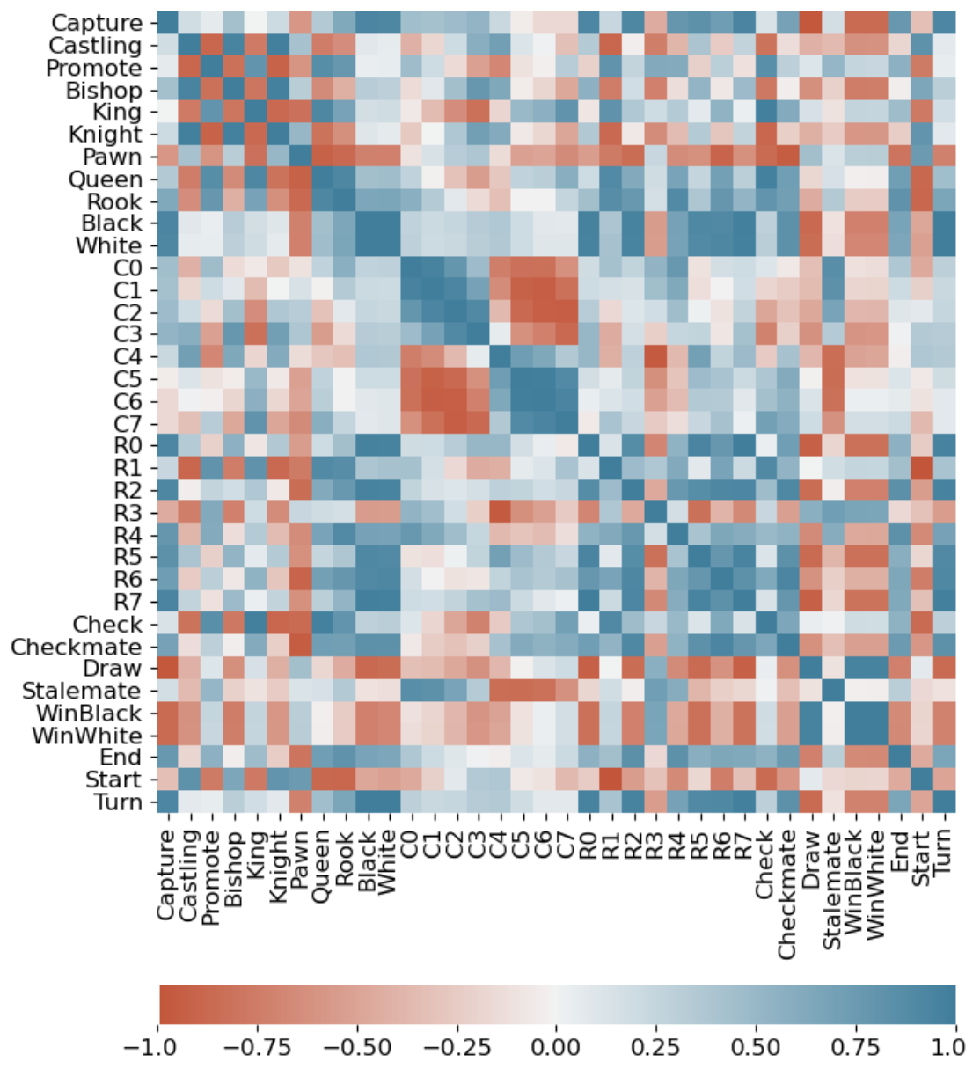
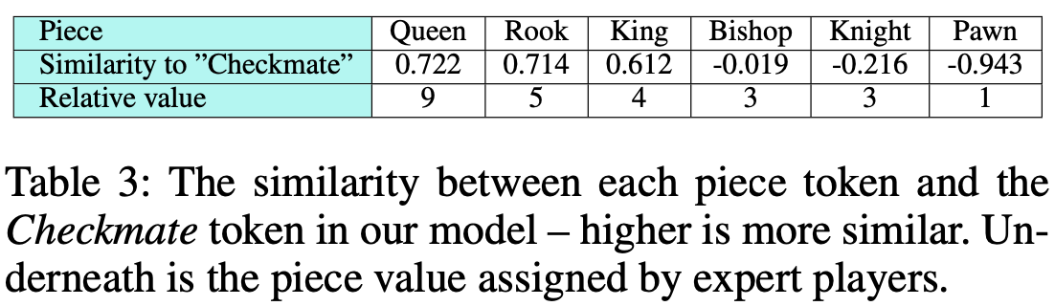
Relative Piece Value
The similarity of each piece token to the Checkmate token.

Slide 11
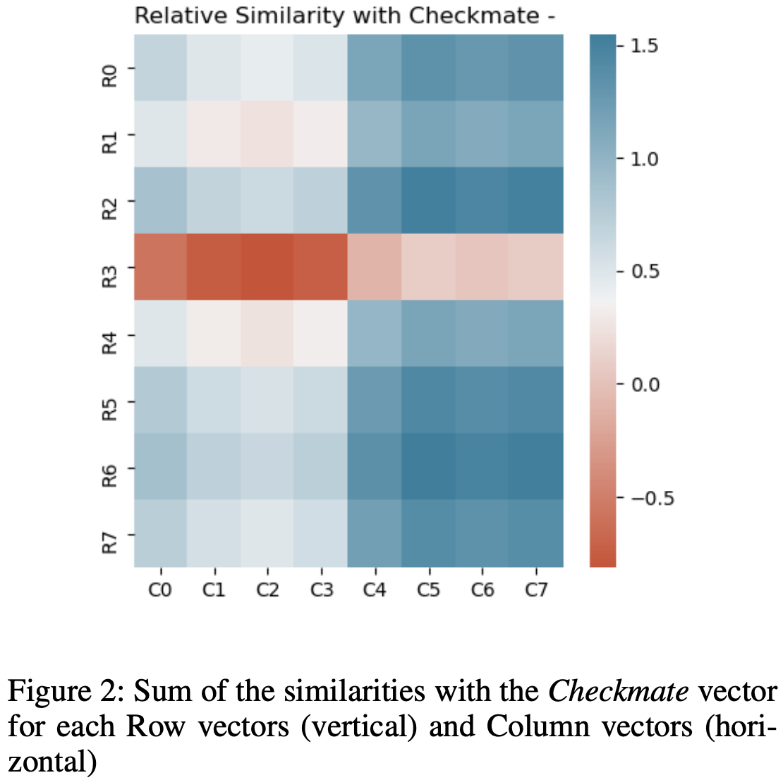

Spatial Relationships
$h_{ij}=dist\left(V\left(m\right), V\left(r_{i}\right)\right)+dist\left(V\left(m\right), V\left(c_{j}\right)\right)$
m: checkmate token
$V(x)$: the vector of the token $x$
$dist$ : the cosine distance function

Slide 12
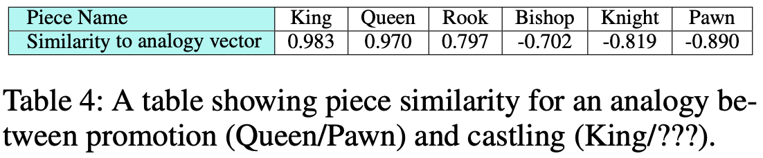
Special Piece Relationships
The use of vector arithmetic to express relationships between words.
king – man + woman = queen
Paris – France + Morocco = Rabat
Queen – Pawn + King = ?

Slide 13
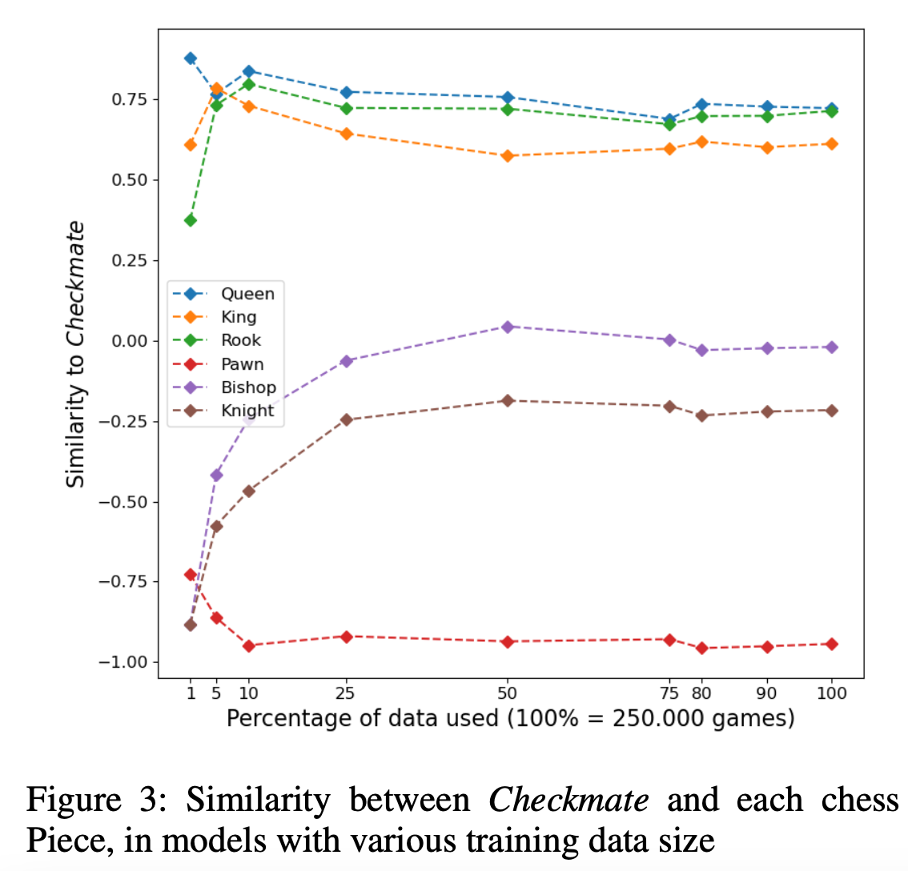
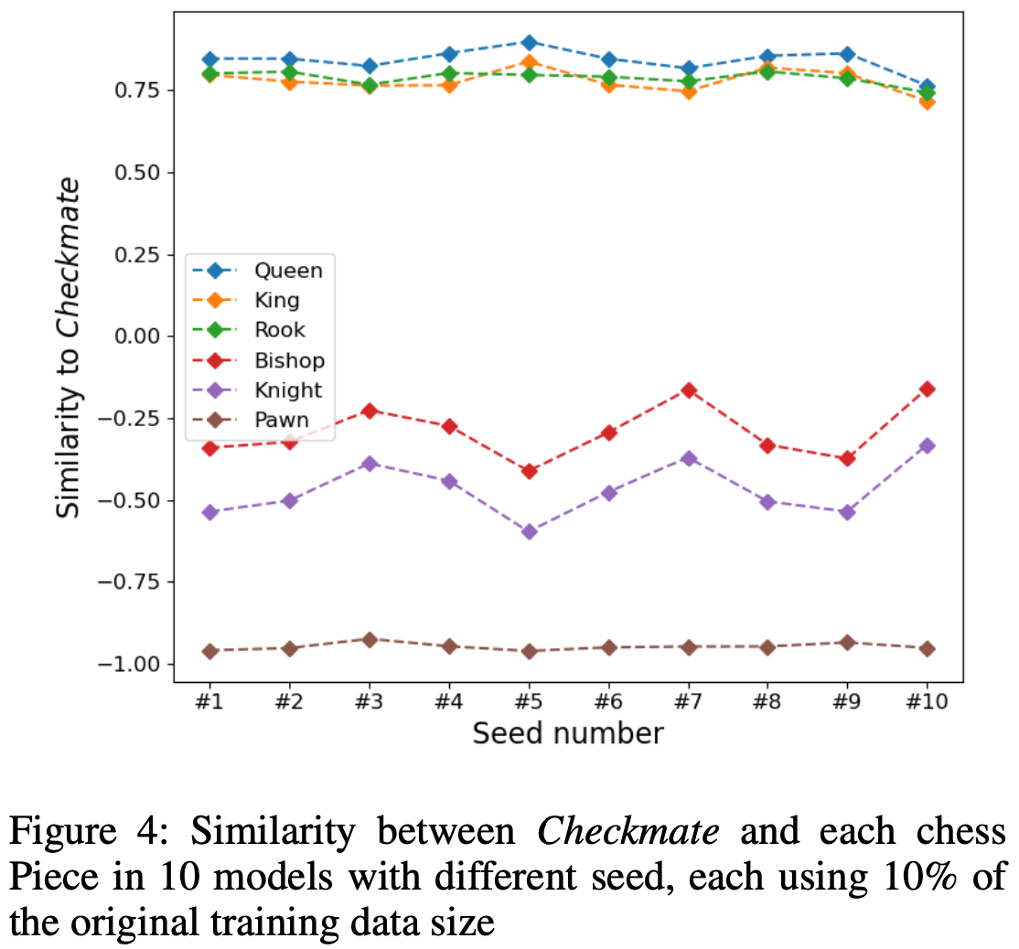
Stability of Results

