Slide 1
A New Lossless Data Compression Algorithm Exploiting Positional Redundancy
Venkatram, Pranav. arXiv preprint arXiv:2107.13801 (2021).
Presenter: Yen-Yu Chen
Date: Feb.6, 2024

Slide 2
Abstract
A new run length encoding algorithm for lossless data compression that exploits positional redundancy by representing data in a two-dimensional model of concentric circles is presented. This visual transform enables detection of runs (each of a different character) in which runs need not be contiguous and hence, is a generalization of run length encoding. Its advantages and drawbacks are characterized by comparing its performance with TurboRLE.

Slide 3
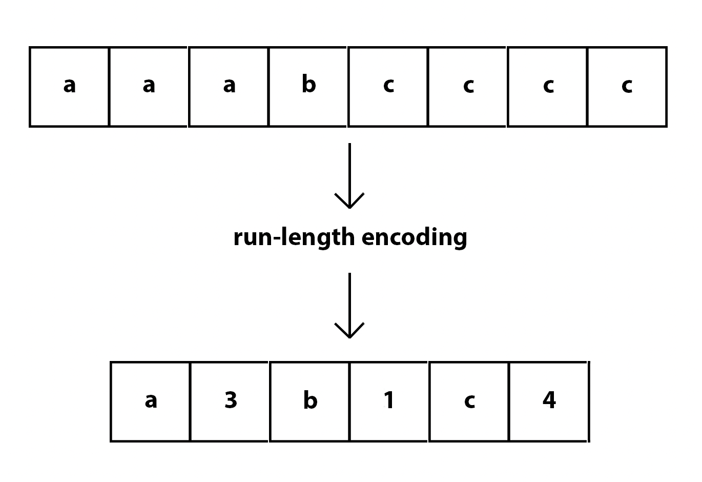
Run-Length Encoding (RLE)

Slide 4
Concentric Circles (CC) Compression
delimiter
line up
encode

Slide 5
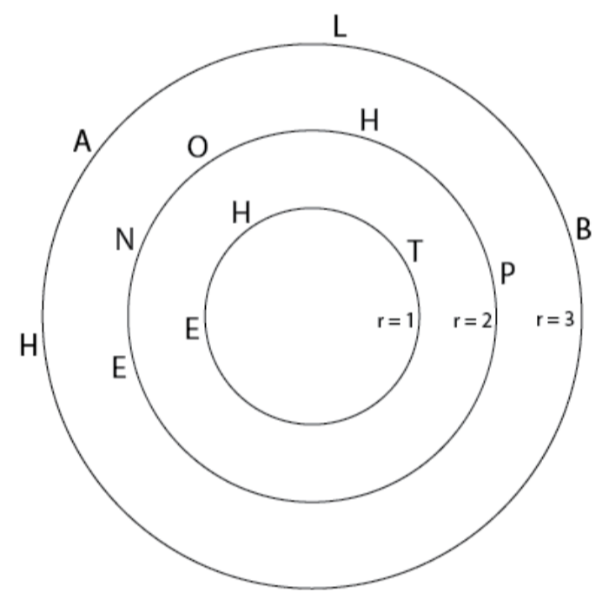
Space Delimiter
Input string S: THE PHONE BLAH
THE
PHONE
BLAH

Slide 6
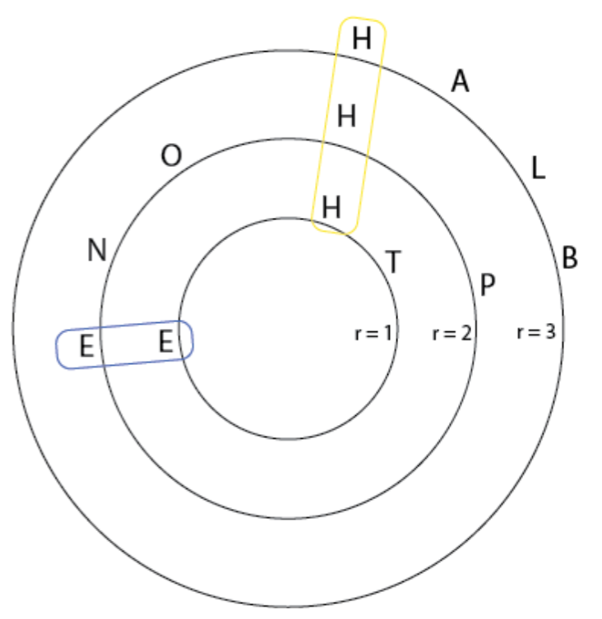
Line Up
Input string S: THE PHONE BLAH
THE
PHONE
BLAH

Slide 7
Entry
(H,1,2)
(E,1,1)

Slide 8
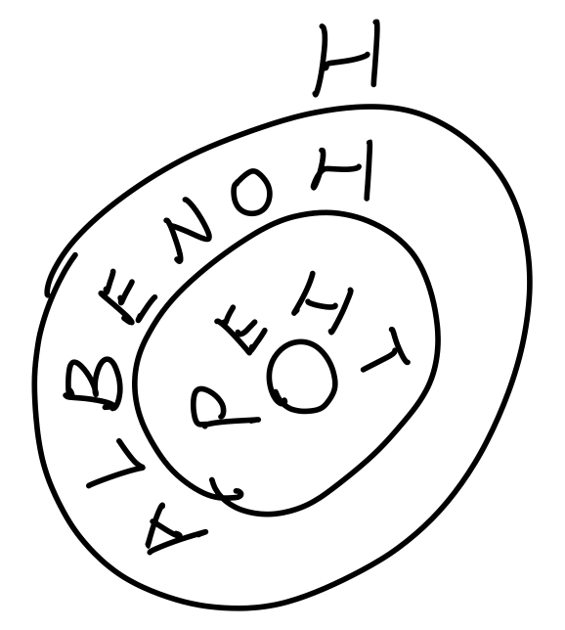
Same Characters Delimiter
Input string S: THE PHONE BLAH
THEP
HONEBLA
H

Slide 9
Output
Bit flag prefix
Non-compressible literal
Compress entries

Slide 10
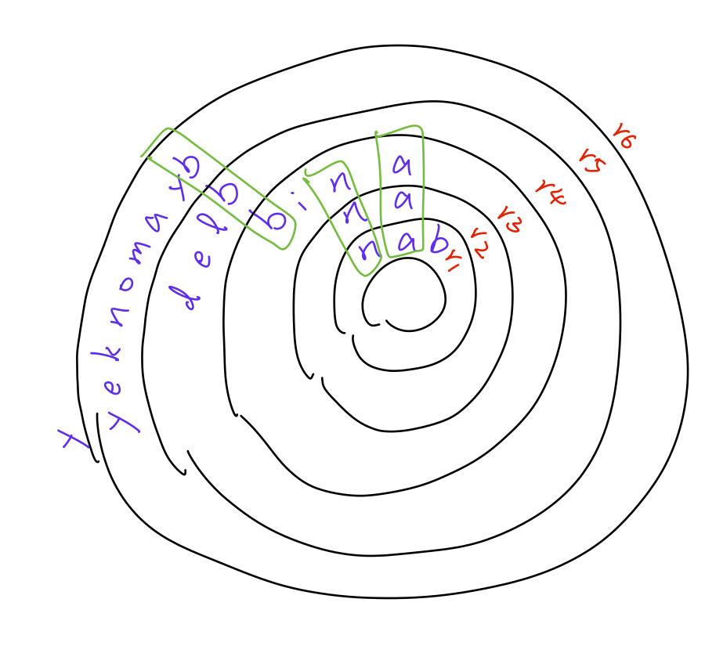
Example
banananibbledbyamonkey
ban
an
anib
bled
byamonkey

Slide 11
Bit flag prefix
banananibbledbyamonkey
0111111011000100000000

Slide 12
Non-compressible literal
banananibbledbyamonkey
biledyamonkey

Slide 13
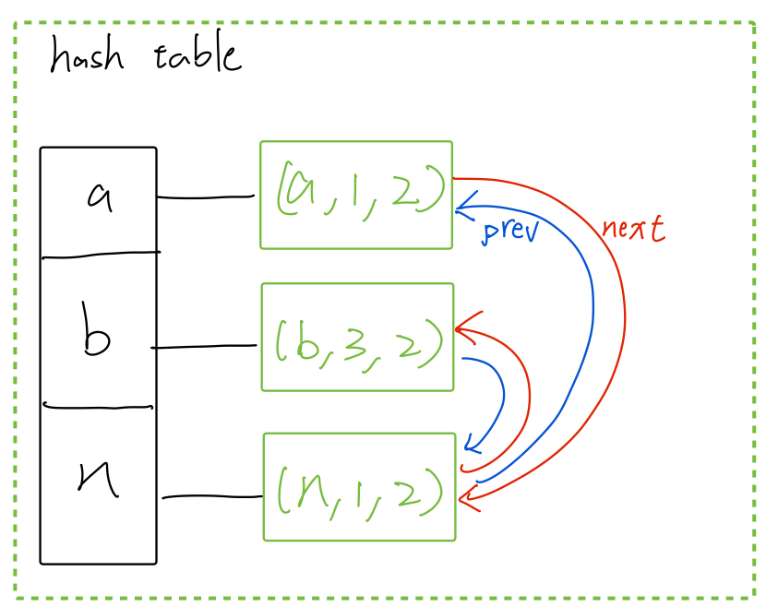
Compress Entries

Slide 14
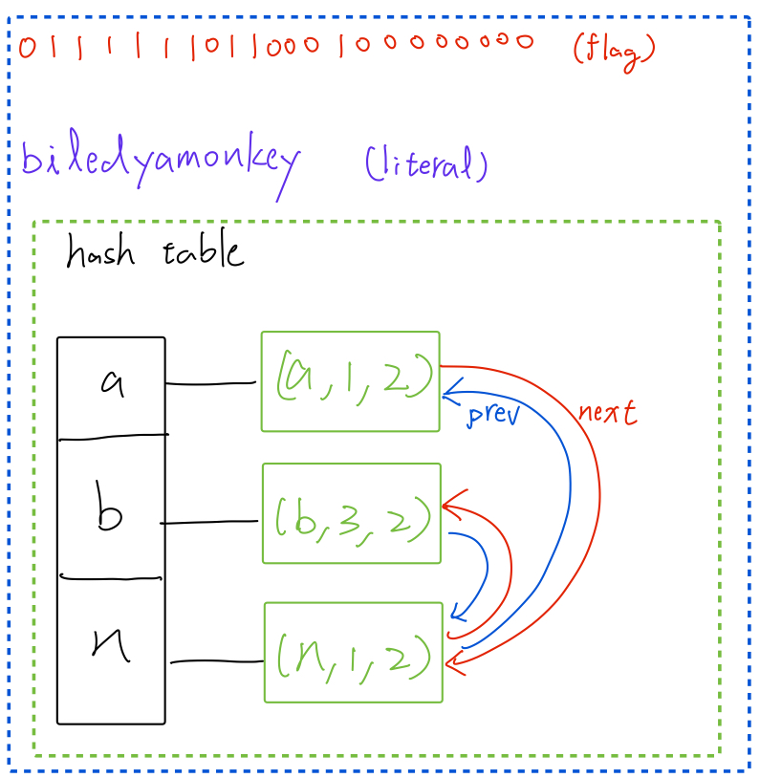
Decompress

Slide 15
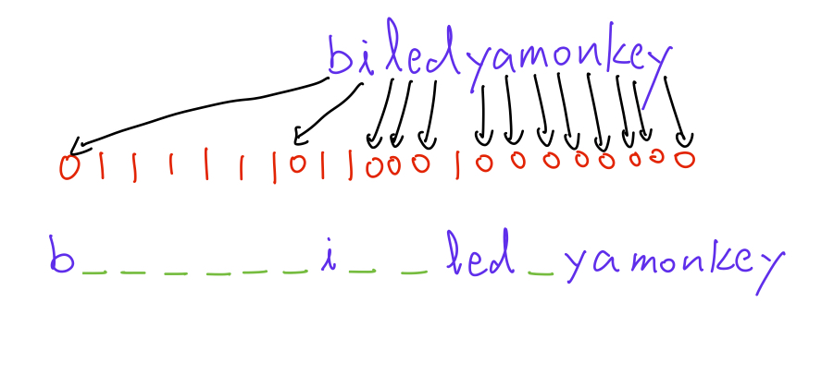
Decompress Literal

Slide 16
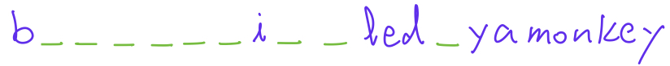
Decompress Entries

Slide 17
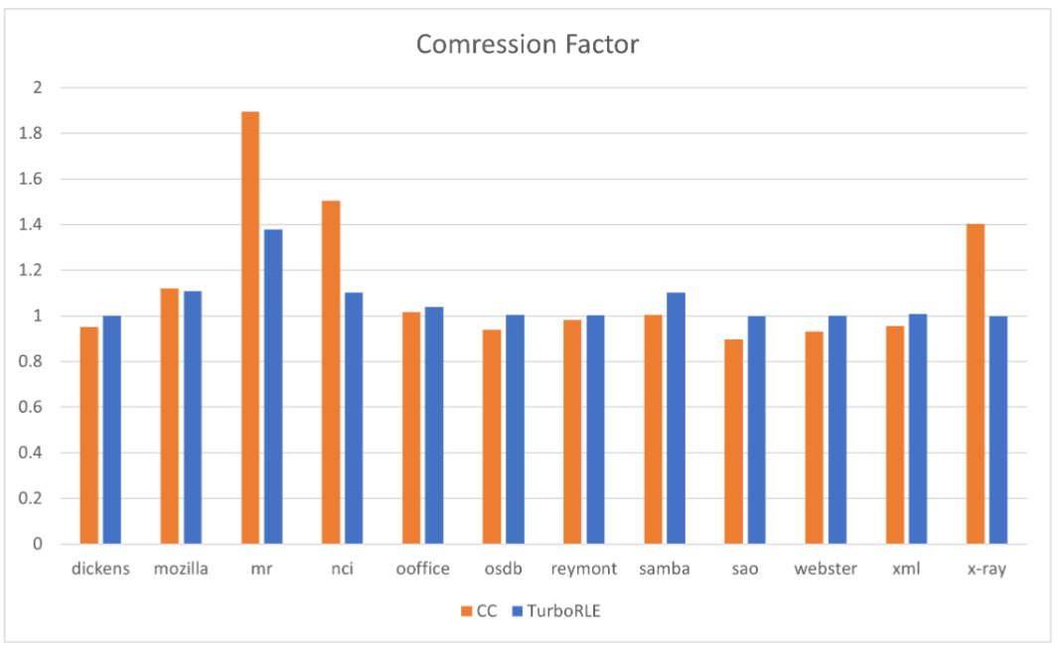
Compression Factor of CC and TurboRLE

Slide 18
Problem
How to line up

