Slide 1
The longest almost-increasing subsequence
Amr Elmasry
Information Processing Letters Volume 110, Issue 16, 31 July 2010, Pages 655-658
Presenter: Shih-Hong Li
Date: Feb. 6, 2024

Slide 2
Abstract
Given a sequence of n elements, we introduce the notion of an almost-increasing subse quence as the longest subsequence that can be converted to an increasing subsequence by possibly adding a value, that is at most a fixed constant, to each of the elements. We show how to optimally construct such subsequence in O(nlogk) time, where k is the length of the output subsequence

Slide 3

The longest increasing subsequence
Given a sequence {a₁,a₂,…a_{n}}
Exist a subsequence A = {a₁,a₂,…a_{m}} which a₁<a₂<…<a_{m} where 0 $≤$m$≤$n
E.g. : {4,1,2,7,6,5,8,9,3}
LIS:{1,2,6,8,9}

Slide 4

The longest almost increasing subsequence
The Recursive formulation
LaIS(h,i) = LaIS(h,h) $∎$ T(h,i)
LaIS(h,h) = LaIS(i’,h-1) $∎$ <x_{h}>

Slide 5
The basic algorithm
Task1 : find a longest almost-increasing subsequence whose largest element is x_{i}
Task2 : append x_{i} to every subsequence found so far whose largest element is larger or equal to x_{i} and smaller than x_{i} +c.

Slide 6
Example
Given a sequence with index from 1 to 12: <7,15,2,14,14,6,8,11,17,15,14,13>
Tolerance c = 2

Slide 7
Iteration 1 <7,15,2,14,14,6,8,11,17,15,14,13>
length
1
1
Index

Slide 8
Iteration 2 <7,15,2,14,14,6,8,11,17,15,14,13>
length
1
1
Index
length
1 | 2
1 | 1
Index

Slide 9
Iteration 3 <7,15,2,14,14,6,8,11,17,15,14,13>
length
1 | 2
1 | 1
Index
length
1 | 2 | 1
1 | 1 | 3
Index

Slide 10
Iteration 4 <7,15,2,14,14,6,8,11,17,15,14,13>
Task1
length
1 | 2 | 1
1 | 1 | 3
Index
length
1 | 2 | 1 | 2
1 | 1 | 3 | 1,3
Index

Slide 11
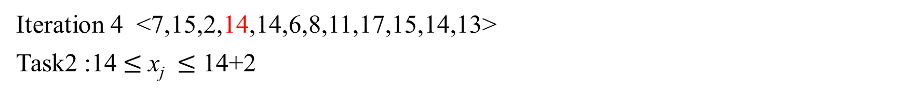
Iteration 4 <7,15,2,14,14,6,8,11,17,15,14,13>
Task2 :14$≤$ x_{j} $≤$ 14+2
length
1 | 2 | 1
1 | 1 | 3
Index
length
1 | 3 | 1 | 2
1 | 1 | 3 | 1,3
Index

Slide 12
Iteration 5 <7,15,2,14,14,6,8,11,17,15,14,13>
Task1
length
1 | 3 | 1 | 2
1 | 1 | 3 | 1,3
Index
length
1 | 3 | 1 | 2 | 2
1 | 1 | 3 | 1,3 | 1,3
Index

Slide 13
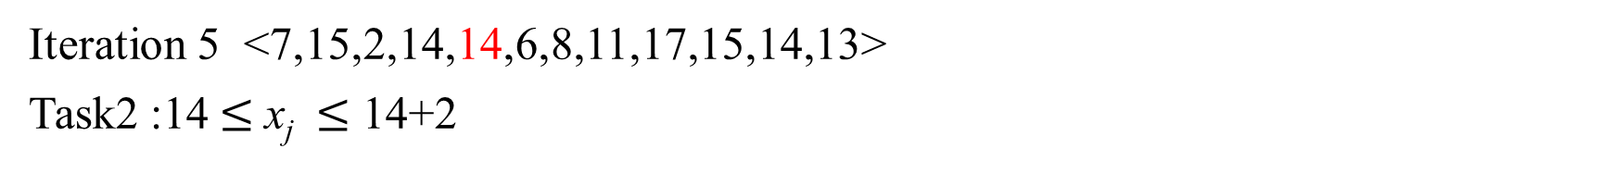
Iteration 5 <7,15,2,14,14,6,8,11,17,15,14,13>
Task2 :14$≤$ x_{j} $≤$ 14+2
length
1 | 3 | 1 | 2
1 | 1 | 3 | 1,3
Index
length
1 | 4 | 1 | 3 | 2
1 | 1 | 3 | 1,3 | 1,3
Index

Slide 14
Iteration 6 <7,15,2,14,14,6,8,11,17,15,14,13>
Task1
length
1 | 4 | 1 | 3 | 2
1 | 1 | 3 | 1,3 | 1,3
Index
length
1 | 4 | 1 | 3 | 2 | 2
1 | 1 | 3 | 1,3 | 1,3 | 3
Index

Slide 15
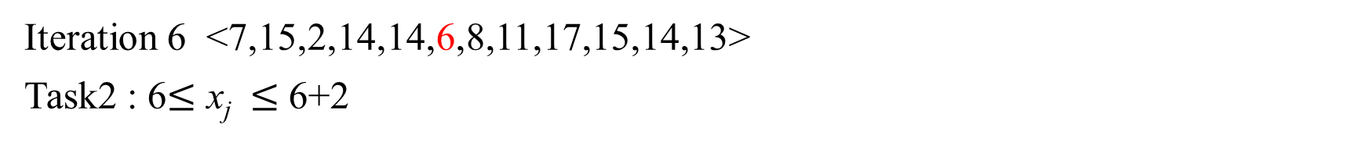
Iteration 6 <7,15,2,14,14,6,8,11,17,15,14,13>
Task2 : 6$≤$ x_{j} $≤$ 6+2
length
1 | 4 | 1 | 3 | 2
1 | 1 | 3 | 1,3 | 1,3
Index
length
2 | 4 | 1 | 3 | 2 | 2
1 | 1 | 3 | 1,3 | 1,3 | 3
Index

Slide 16
Iteration 7 <7,15,2,14,14,6,8,11,17,15,14,13>
Task1
length
2 | 4 | 1 | 3 | 2 | 2
1 | 1 | 3 | 1,3 | 1,3 | 3
Index
length
2 | 4 | 1 | 3 | 2 | 2 | 3
1 | 1 | 3 | 1,3 | 1,3 | 3 | 1,6
Index

Slide 17

Iteration 7 <7,15,2,14,14,6,8,11,17,15,14,13>
Task2 : 8$≤$ x_{j} $≤$ 8+2
length
2 | 4 | 1 | 3 | 2 | 2
1 | 1 | 3 | 1,3 | 1,3 | 3
Index
length
2 | 4 | 1 | 3 | 2 | 2 | 3
1 | 1 | 3 | 1,3 | 1,3 | 3 | 1,6
Index

Slide 18
Iteration 8 <7,15,2,14,14,6,8,11,17,15,14,13>
Task1
length
2 | 4 | 1 | 3 | 2 | 2 | 3
1 | 1 | 3 | 1,3 | 1,3 | 3 | 1,6
Index
length
2 | 4 | 1 | 3 | 2 | 2 | 3 | 4
1 | 1 | 3 | 1,3 | 1,3 | 3 | 1,6 | 7
Index

Slide 19
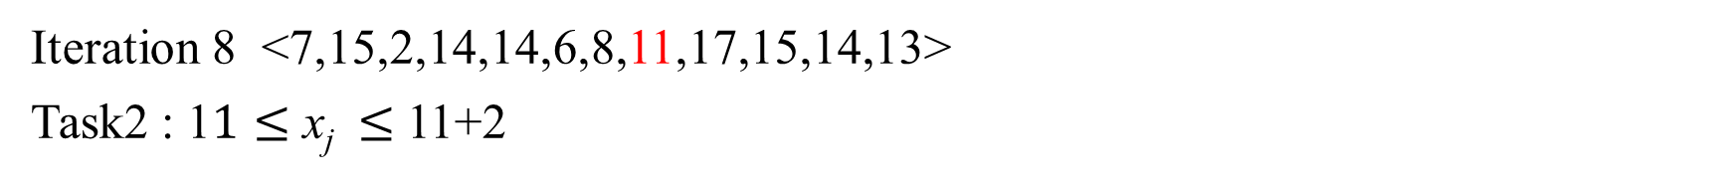
Iteration 8 <7,15,2,14,14,6,8,11,17,15,14,13>
Task2 : 1$1≤$ x_{j} $≤$ 11+2
length
2 | 4 | 1 | 3 | 2 | 2 | 3
1 | 1 | 3 | 1,3 | 1,3 | 3 | 1,6
Index
length
2 | 4 | 1 | 3 | 2 | 2 | 3 | 4
1 | 1 | 3 | 1,3 | 1,3 | 3 | 1,6 | 7
Index

Slide 20
Iteration 9 <7,15,2,14,14,6,8,11,17,15,14,13>
Task1
length
2 | 4 | 1 | 3 | 2 | 2 | 3 | 4
1 | 1 | 3 | 1,3 | 1,3 | 3 | 1,6 | 7
Index
length
2 | 4 | 1 | 3 | 2 | 2 | 3 | 4 | 5
1 | 1 | 3 | 1,3 | 1,3 | 3 | 1,6 | 7 | 2,8
Index

Slide 21
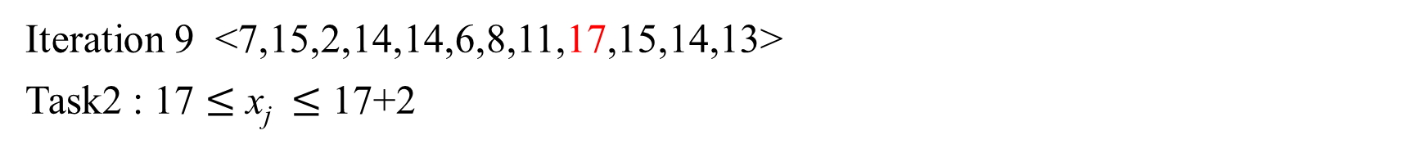
Iteration 9 <7,15,2,14,14,6,8,11,17,15,14,13>
Task2 : 17 $≤$ x_{j} $≤$ 17+2
length
2 | 4 | 1 | 3 | 2 | 2 | 3 | 4
1 | 1 | 3 | 1,3 | 1,3 | 3 | 1,6 | 7
Index
length
2 | 4 | 1 | 3 | 2 | 2 | 3 | 4 | 5
1 | 1 | 3 | 1,3 | 1,3 | 3 | 1,6 | 7 | 2,8
Index

Slide 22
Iteration 10 <7,15,2,14,14,6,8,11,17,15,14,13>
Task1
length
2 | 4 | 1 | 3 | 2 | 2 | 3 | 4 | 5
1 | 1 | 3 | 1,3 | 1,3 | 3 | 1,6 | 7 | 2,8
Index
length
2 | 4 | 1 | 3 | 2 | 2 | 3 | 4 | 5 | 5
1 | 1 | 3 | 1,3 | 1,3 | 3 | 1,6 | 7 | 2,8 | 8
Index

Slide 23
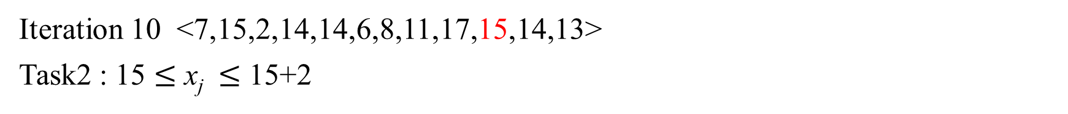
Iteration 10 <7,15,2,14,14,6,8,11,17,15,14,13>
Task2 : 15 $≤$ x_{j} $≤$ 15+2
length
2 | 4 | 1 | 3 | 2 | 2 | 3 | 4 | 5
1 | 1 | 3 | 1,3 | 1,3 | 3 | 1,6 | 7 | 2,8
Index
length
2 | 5 | 1 | 3 | 2 | 2 | 3 | 4 | 5 | 5
1 | 1 | 3 | 1,3 | 1,3 | 3 | 1,6 | 7 | 2,8 | 8
Index

Slide 24
Iteration 11 <7,15,2,14,14,6,8,11,17,15,14,13>
Task1
length
2 | 5 | 1 | 3 | 2 | 2 | 3 | 4 | 5 | 5
1 | 1 | 3 | 1,3 | 1,3 | 3 | 1,6 | 7 | 2,8 | 8
Index
length
2 | 5 | 1 | 3 | 2 | 2 | 3 | 4 | 5 | 5 | 5
1 | 1 | 3 | 1,3 | 1,3 | 3 | 1,6 | 7 | 2,8 | 8 | 8
Index

Slide 25
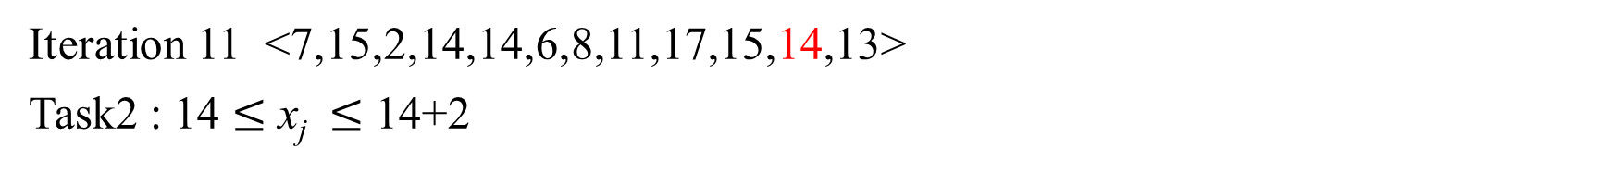
Iteration 11 <7,15,2,14,14,6,8,11,17,15,14,13>
Task2 : 14 $≤$ x_{j} $≤$ 14+2
length
2 | 5 | 1 | 3 | 2 | 2 | 3 | 4 | 5 | 5
1 | 1 | 3 | 1,3 | 1,3 | 3 | 1,6 | 7 | 2,8 | 8
Index
length
2 | 6 | 1 | 4 | 3 | 2 | 3 | 4 | 5 | 6 | 5
1 | 1 | 3 | 1,3 | 1,3 | 3 | 1,6 | 7 | 2,8 | 8 | 8
Index

Slide 26
Iteration 12 <7,15,2,14,14,6,8,11,17,15,14,13>
Task1
length
2 | 6 | 1 | 4 | 3 | 2 | 3 | 4 | 5 | 6 | 5
1 | 1 | 3 | 1,3 | 1,3 | 3 | 1,6 | 7 | 2,8 | 8 | 8
Index
length
2 | 6 | 1 | 4 | 3 | 2 | 3 | 4 | 5 | 6 | 5 | 5
1 | 1 | 3 | 1,3 | 1,3 | 3 | 1,6 | 7 | 2,8 | 8 | 8 | 8
Index

Slide 27
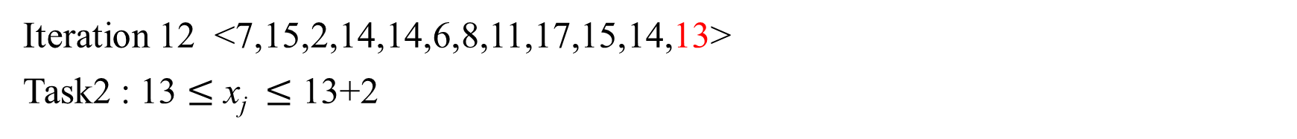
Iteration 12 <7,15,2,14,14,6,8,11,17,15,14,13>
Task2 : 13 $≤$ x_{j} $≤$ 13+2
length
2 | 6 | 1 | 4 | 3 | 2 | 3 | 4 | 5 | 6 | 5
1 | 1 | 3 | 1,3 | 1,3 | 3 | 1,6 | 7 | 2,8 | 8 | 8
Index
length
2 | 6 | 1 | 5 | 4 | 2 | 3 | 4 | 5 | 6 | 6 | 5
1 | 1 | 3 | 1,3 | 1,3 | 3 | 1,6 | 7 | 2,8 | 8 | 8 | 8
Index

Slide 28
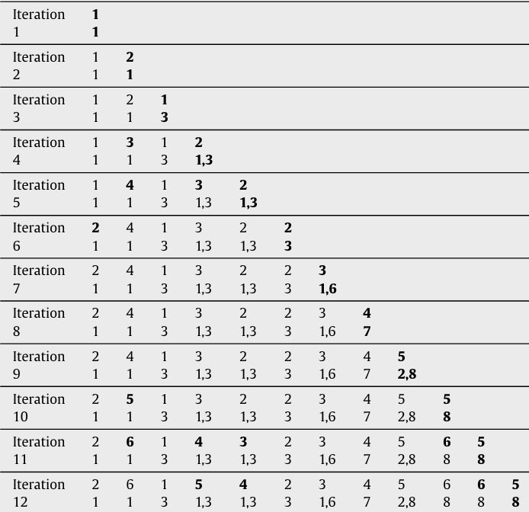
After iteration
1 | 2 | 3 | 4 | 5 | 6 | 7 | 8 | 9 | 10 | 11 | 12
7 | 15 | 2 | 14 | 14 | 6 | 8 | 11 | 17 | 15 | 14 | 13
Lais with length 6
<7,15,14,14,15,14>
<7,6,8,11,15,14>
<2,6,8,11,15,14>
<7,6,8,11,14,13>
<2,6,8,11,14,13>
Time complexity: O(n²)

Slide 29
The improved algorithm
Instead of storing each length of element，improved algo use each only have one element

Slide 30
Iteration 1 <7,15,2,14,14,6,8,11,17,15,14,13>
Binary search find the element < 7
Binary search find the element $≥$ 7+2
Length array
1 | 2 | 3 | 4 | 5 | 6
7
index array
1

Slide 31
Iteration 2 <7,15,2,14,14,6,8,11,17,15,14,13>
Binary search find the element < 15
Binary search find the element $≥$ 15+2
Length array
1 | 2 | 3 | 4 | 5 | 6
7
1 | 2 | 3 | 4 | 5 | 6
7 | 15
index array
1
1 | 1

Slide 32
Iteration 3 <7,15,2,14,14,6,8,11,17,15,14,13>
Binary search find the element < 2
Binary search find the element x_{i} $≥$2+2
Length array
1 | 2 | 3 | 4 | 5 | 6
7
1 | 2 | 3 | 4 | 5 | 6
2 | 15
index array
1 | 1
1 | 1 | 3

Slide 33
Iteration 4 <7,15,2,14,14,6,8,11,17,15,14,13>
Binary search find the element < 14
Binary search find the element x_{i} $≥$14+2
Length array
1 | 2 | 3 | 4 | 5 | 6
2 | 15
1 | 2 | 3 | 4 | 5 | 6
2 | 14 | 15
index array
1 | 1 | 3
1 | 1 | 3 | 3

Slide 34
Iteration 5 <7,15,2,14,14,6,8,11,17,15,14,13>
Binary search find the element < 14
Binary search find the element x_{i} $≥$14+2
Length array
1 | 2 | 3 | 4 | 5 | 6
2 | 14 | 15
1 | 2 | 3 | 4 | 5 | 6
2 | 14 | 14 | 15
index array
1 | 1 | 3 | 3
1 | 1 | 3 | 3 | 3

Slide 35
Iteration 6 <7,15,2,14,14,6,8,11,17,15,14,13>
Binary search find the element < 6
Binary search find the element x_{i} $≥$6+2
Length array
1 | 2 | 3 | 4 | 5 | 6
2 | 14 | 14 | 15
1 | 2 | 3 | 4 | 5 | 6
2 | 6 | 14 | 15
index array
1 | 1 | 3 | 3 | 3
1 | 1 | 3 | 3 | 3 | 3

Slide 36
Iteration 7 <7,15,2,14,14,6,8,11,17,15,14,13>
Binary search find the element < 8
Binary search find the element x_{i} $≥$8+2
Length array
1 | 2 | 3 | 4 | 5 | 6
2 | 6 | 14 | 15
1 | 2 | 3 | 4 | 5 | 6
2 | 6 | 8 | 15
index array
1 | 1 | 3 | 3 | 3 | 3
1 | 1 | 3 | 3 | 3 | 3 | 6

Slide 37
Iteration 8 <7,15,2,14,14,6,8,11,17,15,14,13>
Binary search find the element < 11
Binary search find the element x_{i} $≥1$1+2
Length array
1 | 2 | 3 | 4 | 5 | 6
2 | 6 | 8 | 15
1 | 2 | 3 | 4 | 5 | 6
2 | 6 | 8 | 11
index array
1 | 1 | 3 | 3 | 3 | 3 | 6
1 | 1 | 3 | 3 | 3 | 3 | 6 | 7

Slide 38
Iteration 9 <7,15,2,14,14,6,8,11,17,15,14,13>
Binary search find the element < 17
Binary search find the element x_{i} $≥1$7+2
Length array
1 | 2 | 3 | 4 | 5 | 6
2 | 6 | 8 | 11
1 | 2 | 3 | 4 | 5 | 6
2 | 6 | 8 | 11 | 17
index array
1 | 1 | 3 | 3 | 3 | 3 | 6 | 7
1 | 1 | 3 | 3 | 3 | 3 | 6 | 7 | 8

Slide 39
Iteration 10 <7,15,2,14,14,6,8,11,17,15,14,13>
Binary search find the element < 15
Binary search find the element x_{i} $≥1$5+2
Length array
1 | 2 | 3 | 4 | 5 | 6
2 | 6 | 8 | 11 | 17
1 | 2 | 3 | 4 | 5 | 6
2 | 6 | 8 | 11 | 15
index array
1 | 1 | 3 | 3 | 3 | 3 | 6 | 7 | 8
1 | 1 | 3 | 3 | 3 | 3 | 6 | 7 | 8 | 8

Slide 40
Iteration 11 <7,15,2,14,14,6,8,11,17,15,14,13>
Binary search find the element < 15
Binary search find the element x_{i} $≥1$5+2
Length array
1 | 2 | 3 | 4 | 5 | 6
2 | 6 | 8 | 11 | 15
1 | 2 | 3 | 4 | 5 | 6
2 | 6 | 8 | 11 | 14 | 15
index array
1 | 1 | 3 | 3 | 3 | 3 | 6 | 7 | 8 | 8
1 | 1 | 3 | 3 | 3 | 3 | 6 | 7 | 8 | 8 | 8

Slide 41
Iteration 12 <7,15,2,14,14,6,8,11,17,15,14,13>
Binary search find the element < 13
Binary search find the element x_{i} $≥1$3+2
Length array
1 | 2 | 3 | 4 | 5 | 6
2 | 6 | 8 | 11 | 14 | 15
1 | 2 | 3 | 4 | 5 | 6
2 | 6 | 8 | 11 | 13 | 14
index array
1 | 1 | 3 | 3 | 3 | 3 | 6 | 7 | 8 | 8 | 8
1 | 1 | 3 | 3 | 3 | 3 | 6 | 7 | 8 | 8 | 8 | 8

Slide 42
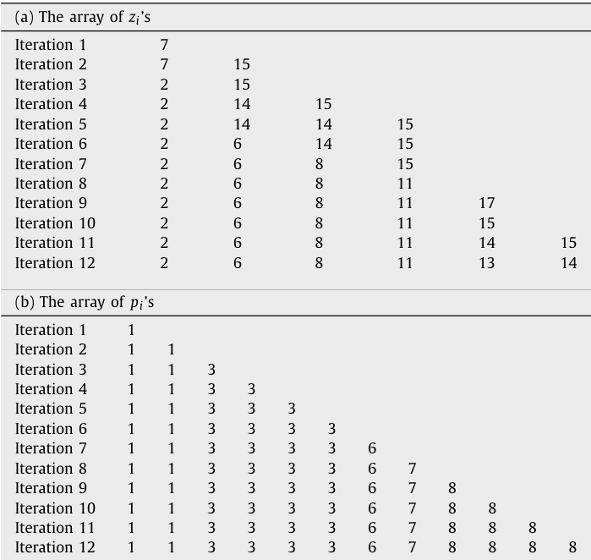
After iteration

Slide 43
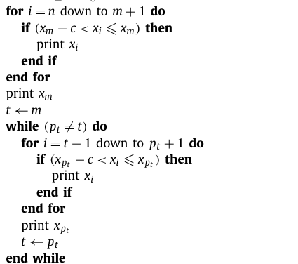
Output of LAIS(1/5)
Maximum element :14
[14,13]
1 | 2 | 3 | 4 | 5 | 6 | 7 | 8 | 9 | 10 | 11 | 12
7 | 15 | 2 | 14 | 14 | 6 | 8 | 11 | 17 | 15 | 14 | 13

Slide 44
Output of LAIS(2/5)
Maximum element :14
[11,14,13]
1 | 2 | 3 | 4 | 5 | 6 | 7 | 8 | 9 | 10 | 11 | 12
7 | 15 | 2 | 14 | 14 | 6 | 8 | 11 | 17 | 15 | 14 | 13
1 | 1 | 3 | 3 | 3 | 3 | 6 | 7 | 8 | 8 | 8 | 8

Slide 45
Output of LAIS(3/5)
Maximum element :14
[8,11,14,13]
1 | 2 | 3 | 4 | 5 | 6 | 7 | 8 | 9 | 10 | 11 | 12
7 | 15 | 2 | 14 | 14 | 6 | 8 | 11 | 17 | 15 | 14 | 13
1 | 1 | 3 | 3 | 3 | 3 | 6 | 7 | 8 | 8 | 8 | 8

Slide 46
Output of LAIS(4/5)
Maximum element :14
[6,8,11,14,13]
1 | 2 | 3 | 4 | 5 | 6 | 7 | 8 | 9 | 10 | 11 | 12
7 | 15 | 2 | 14 | 14 | 6 | 8 | 11 | 17 | 15 | 14 | 13
1 | 1 | 3 | 3 | 3 | 3 | 6 | 7 | 8 | 8 | 8 | 8

Slide 47
Output of LAIS(5/5)
Maximum element :14
[2,8,11,14,13]
end
1 | 2 | 3 | 4 | 5 | 6 | 7 | 8 | 9 | 10 | 11 | 12
7 | 15 | 2 | 14 | 14 | 6 | 8 | 11 | 17 | 15 | 14 | 13
1 | 1 | 3 | 3 | 3 | 3 | 6 | 7 | 8 | 8 | 8 | 8

Slide 48
Time complexity :
binary search O(logk)
Insert and remove element in list O(logk) (the data structure use AVL tree)
Total : O(nlogk)

Slide 49
Thanks

