Slide 1
RAID: High-Performance, Reliable Secondary Storage
Peter M. Chen, Edward K. Lee, Garth A. Gibson, Randy H. Ketz and David A. Patterson
ACM Computing Surveys, Volume 26,Issue 2, June 1994,
pp. 145–185
Presenter: Jing-Ping Jan
Date: Aug. 31, 2021

Slide 2
Abstract
Disk arrays were proposed in the 1980s as a way to use parallelism between multiple disks to improve aggregate I/O performance. Today they appear in the product lines of most major computer manufacturers. This article gives a comprehensive overview of disk arrays and provides a framework in which to organize current and future work. First, the article introduces disk technology and reviews the driving forces that have popularized disk arrays: performance and reliability. It discusses the two architectural techniques used in disk arrays: striping across multiple disks to improve performance and redundancy to improve reliability. Next, the article describes seven disk array architectures, called RAID (Redundant Arrays of Inexpensive Disks) levels 0–6 and compares their performance, cost, and reliability.

Slide 3
Abstract
It goes on to discuss advanced research and implementation topics such as refining the basic RAID levels to improve performance and designing algorithms to maintain data consistency. Last, the article describes six disk array prototypes or products and discusses future opportunities for research, with an annotated bibliography of disk array-related literature.

Slide 4
RAID
Redundant Arrays of Inexpensive Disks

Slide 5
RAID
Target: 1.Reliability 2. Performance
Method:
Striping
Mirror
Error correcting code

Slide 6
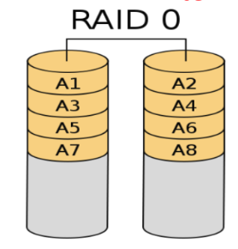
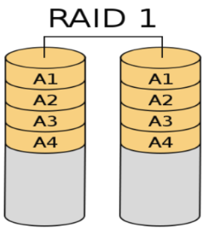
RAID0、1

Slide 7
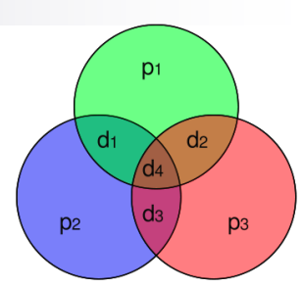
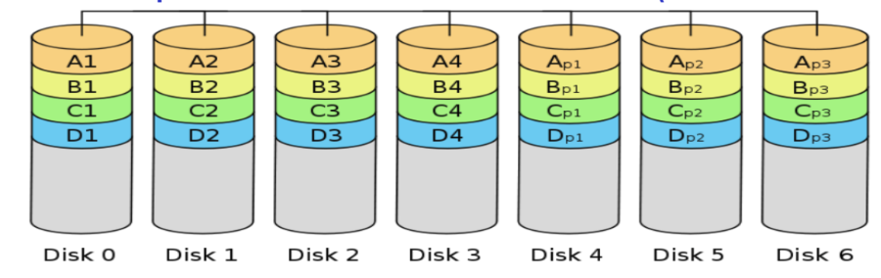
RAID2

Slide 8
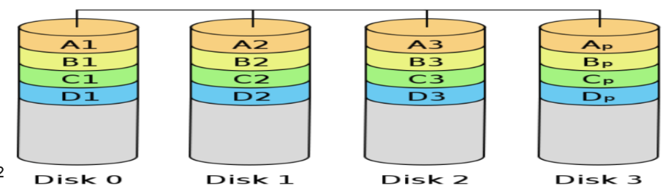
RAID3、4

Slide 9
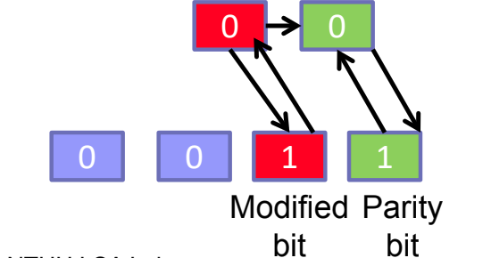
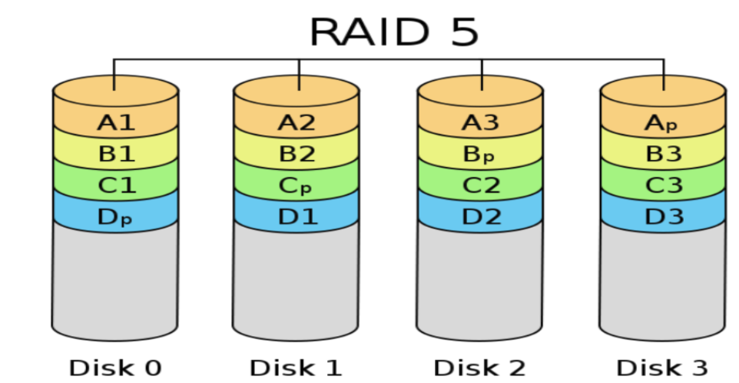
RAID5

Slide 10
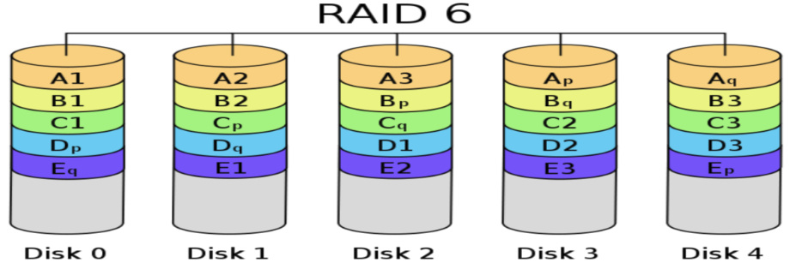
RAID6

Slide 11
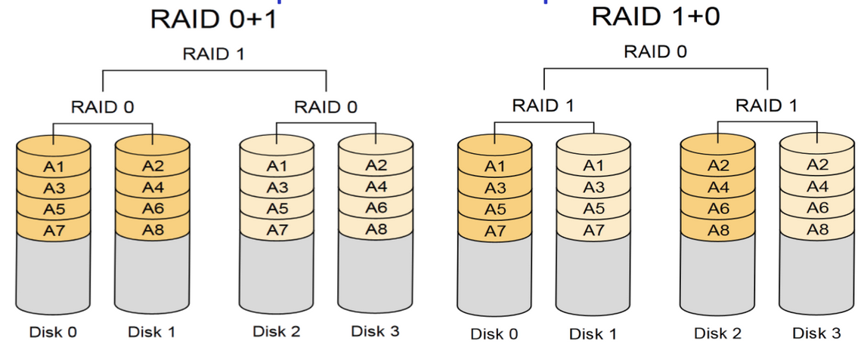
RAID01、10

Slide 12
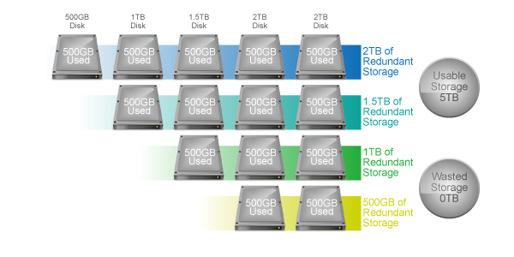
Synology Hybrid RAID (SHR)

Slide 13
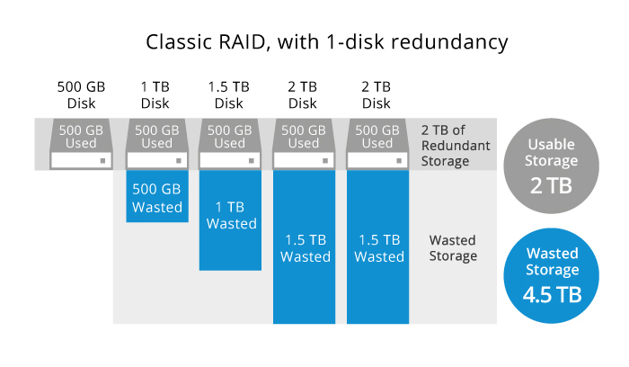
Why SHR
Usage calculator

Slide 14
PPLAB
HTTP server(PPLAB、CPE judge server…)
Everyone
65
Mail server
VM
41
HTML
HTTP server(CPE 網站、橋牌比賽報名網站…)
FTP
Mount
SSH
User
48
NAS 69
HTML
Mount
還原
備份
Database
NAS 68

