Slide 1
TC-DTW: Accelerating Multivariate Dynamic Time Warping Through Triangle Inequality and Point Clustering
Daniel S. Shen, Min Chi
Presenter: Shin-Cheng Lin
Date: Sept. 7, 2021

Slide 2
Abstract(1/2)
Dynamic time warping (DTW) plays an important role in analytics on time series. Despite the large body of research on speeding up univariate DTW, the method for multivariate DTW has not been improved much in the last two decades. The most popular algorithm used today is still the one developed seventeen years ago. This paper presents a solution that, as far as we know, for the first time consistently outperforms the classic multivariate DTW algorithm across dataset sizes, series lengths, data dimensions, temporal window sizes, and machines.

Slide 3
Abstract(2/2)
The new solution, named TC-DTW, introduces Triangle Inequality and Point Clustering into the algorithm design on lower bound calculations for multivariate DTW. In experiments on DTW-based nearest neighbor nding, the new solution avoids as much as 98% (60% average) DTW distance calculations and yields as much as 25× (7.5× average) speedups.

Slide 4
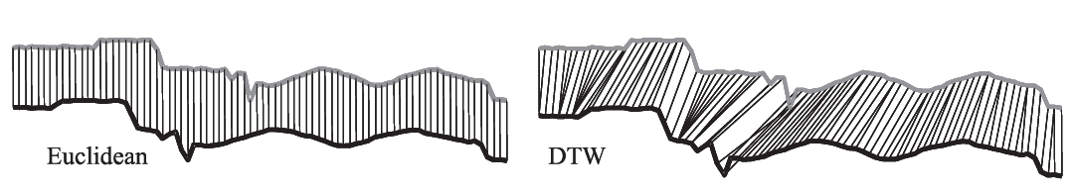
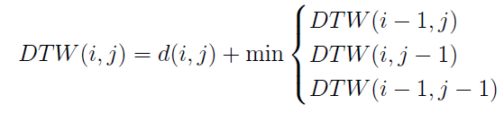
DTW : Dynamic Time Warping
O(mn)

Slide 5
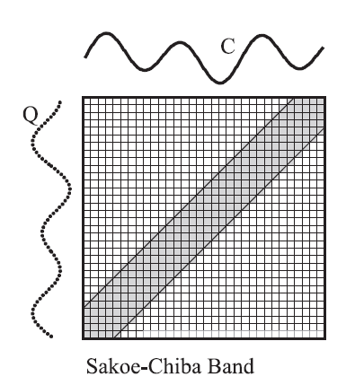
Window DTW

Slide 6
Search for the candidate series in a collection that is the most similar to a query series.
Avoid computing the DTW distance if the lower bound of current DTW distance exceeds the best-so-far.

Slide 7
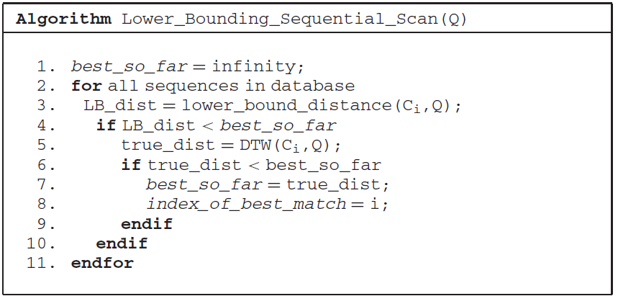

Slide 8
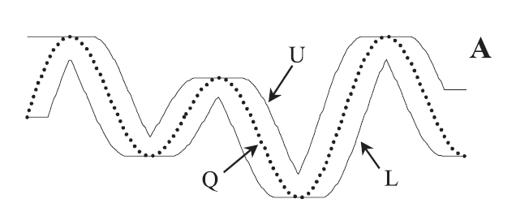
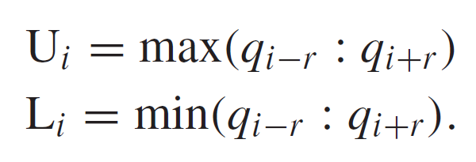
LB_Keogh

Slide 9
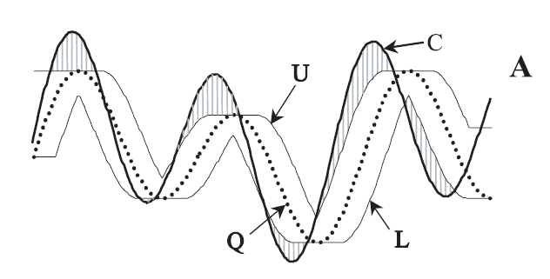
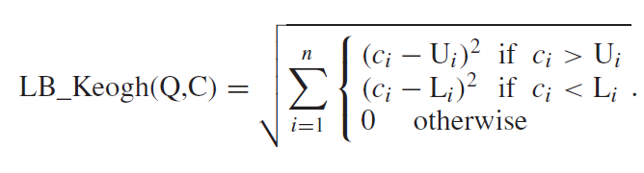
LB_Keogh

Slide 10
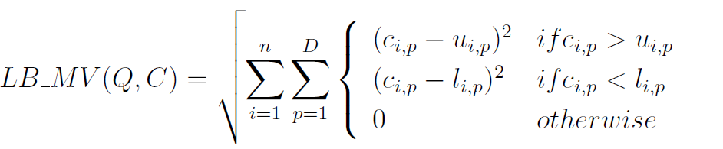
LB_MV

Slide 11
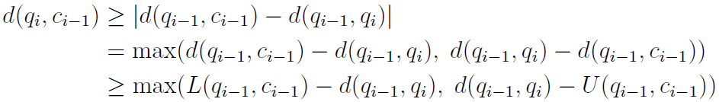
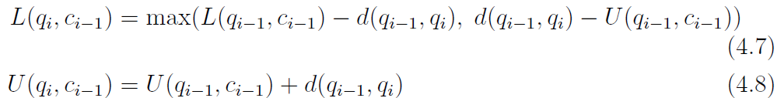
Triangle DTW (LB_TI)
c_{i-1}
d(q_{i-1}, c_{i-1}) ＞ L(q_{i-1}, c_{i-1})
U(q_{i-1}, c_{i-1}) ＞ d(q_{i-1}, c_{i-1})
q_{i-1}
q_{i}

Slide 12
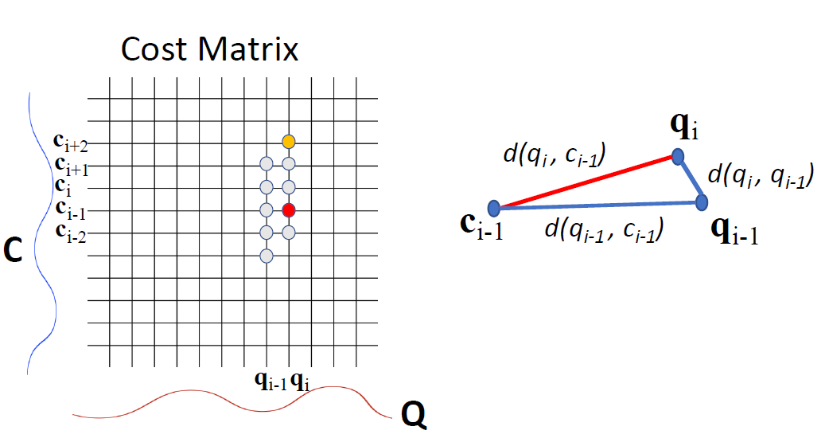
Triangle DTW (LB_TI)
w=5

Slide 13
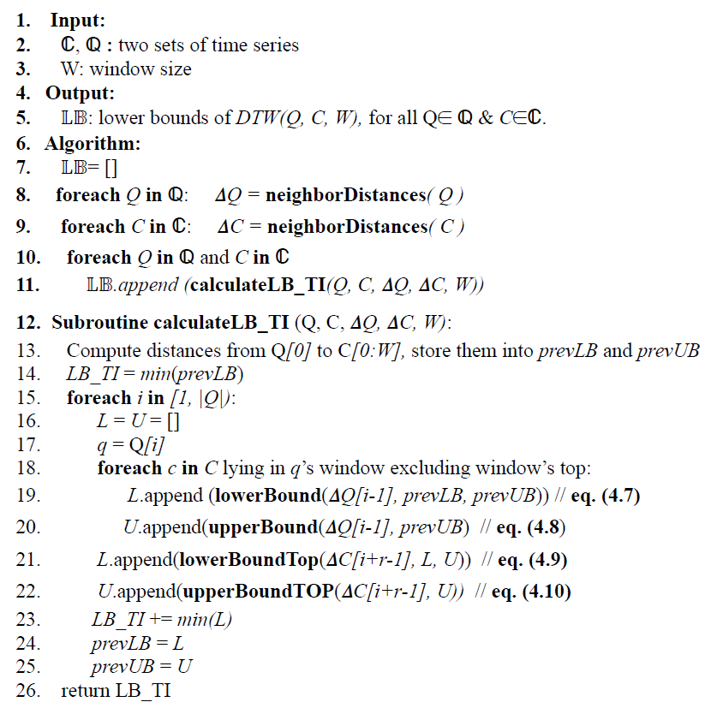

Slide 14

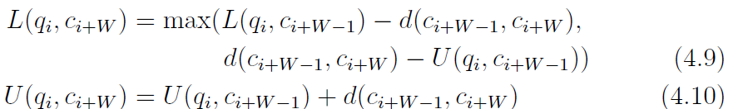
Triangle DTW (LB_TI)

Slide 15
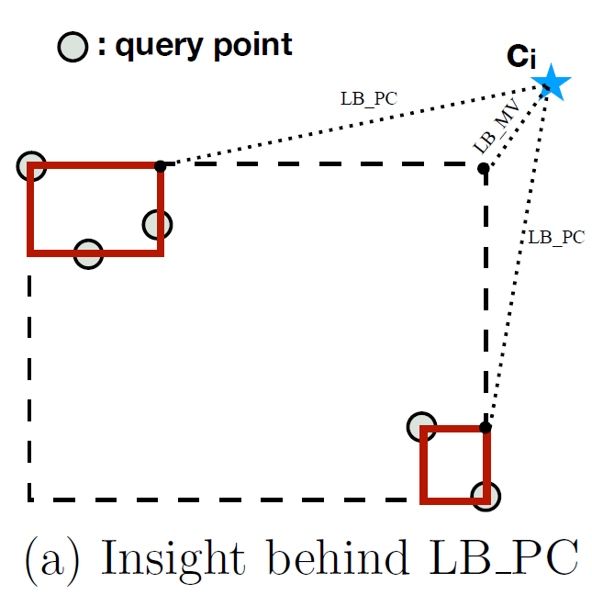
Clustering DTW (LB_PC)

Slide 16
Selective Deployment, TC-DTW
first apply LB MV
a threshold e
if e < LB_MV/d_{best} < 1, apply the advanced algorithms

Slide 17
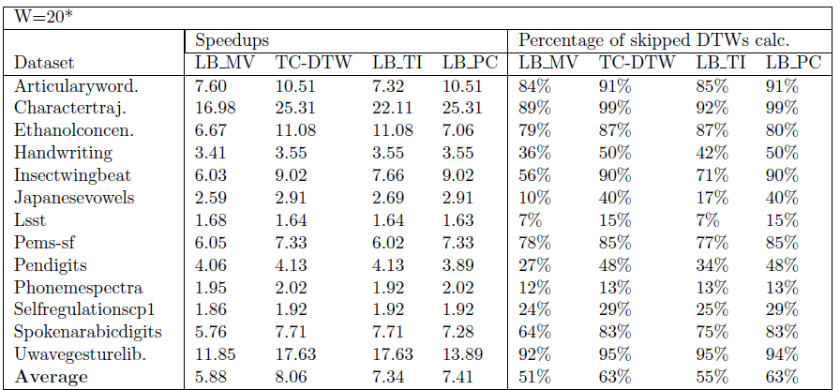

Slide 18
