Slide 1
Applying a Hybrid Model of Neural Network and Decision Tree Classifier for
Predicting University Admission
Simon Fong, Yain-Whar Si, Robert P. Biuk-Aghai
7th International Conference on Information, Communications and Signal Processing (ICICS),December 8-10 2009
Presenter: Ying-Yu Lin
Date: Oct. 5, 2021

Slide 2
Abstract:
This paper proposes a hybrid model of neural network and decision tree classifier that predicts the likelihood of which university a student may enter, by analysing his academic merits, background and the university admission criteria from that of historical records. Our prototype system was tested with live data from sources of Macau secondary school students. In addition to the high prediction accuracy rate, flexibility is an advantage as the system can predict suitable universities that match the students' profiles and the suitable channels through which the students are advised to enter. Our model can be generalized with other attributes and perform faster when compared to using a neural network alone.

Slide 3
no territory-wide standardized test for university admission in Macau
filling the quota of direct admission without entrance examination by selecting top students
finding the best allocation for the selected top students and the universities
likewise for choosing the medium-quality students.

Slide 4
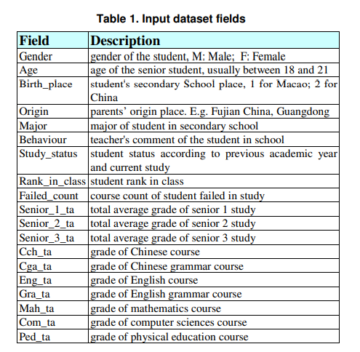
Work flow of Recommender System of Admission to University(RSAU)
Step1): apply back-propagation algorithm to train and build a learning model that calculates the importance of input corresponding to the output, and then sorts the inputs into a list by the feature significance.
Notes:
1.應用back-propagation algorithm訓練並構建學習模型，計算輸入對應輸出的重要性，然後根據特徵重要性將輸入排序成一個列表

Slide 5
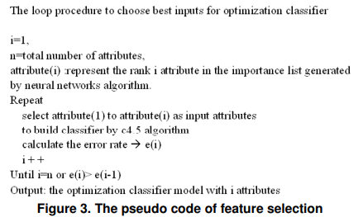
Work flow of Recommender System of Admission to University(RSAU)
Step2): a feature selection model
Notes:
2.特徵選擇模型:每次增加一個重要的輸入變量，在neural network生成的排序列表中由上而下進行，測試C4.5決策樹算法的性能並記錄性能的錯誤率。該過程運行多次，直至達到排名列表的大小或是當迭代 i+1 時輸入的錯誤率高於 i 時，它停止。

Slide 6
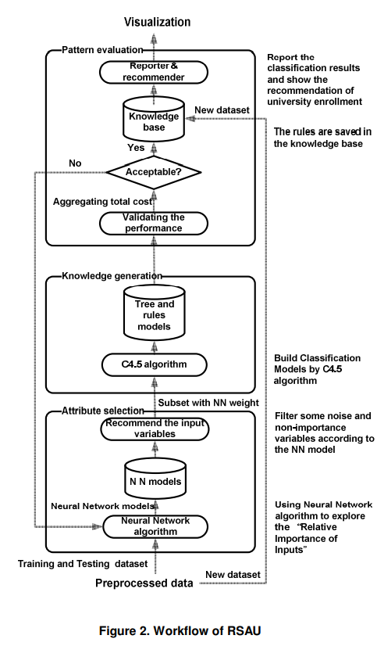
Work flow of Recommender System of Admission to University(RSAU)
Step3): the decision rules generated by C4.5 are validated by measuring its performance. When it satisfactorily reaches the criterion set by the user, the classifier is ready to be used with new data for classification and prediction of the likelihood of secondary school students being admitted to universities.
Notes:
3.通過C4.5生成的決策規則測量其性能進行驗證。

Slide 7
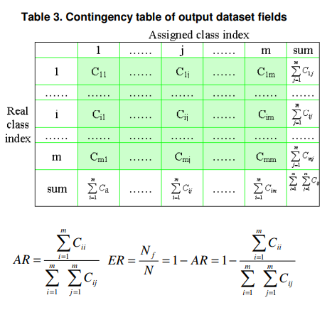
Evaluation Criteria : accuracy and real-time constraints
10-fold cross-validation
Notes:
10-fold cross-validation來進行所有實驗，並在 10 次運行中對結果進行平均。 這相當於對每個數據集的每個測試總共運行 100 次。

Slide 8
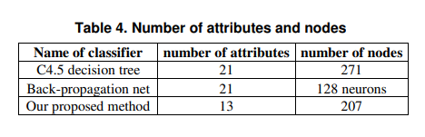
Classification Cost

Slide 9
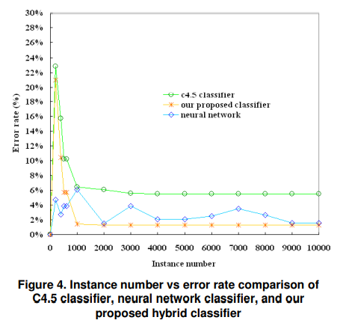
Error Rate
Notes:
觀察記錄數量的增加如何影響分類器的錯誤率。 我們使用的實例數從 500 到 10000 不等。結果表明，隨著實例數的增加，所有三個模型都可以合理地擴展。 我們提出的混合分類器在反向傳播和原始 C4.5 方法中具有最低的錯誤率（平均保持在 2% 以下）。 當實例數小於 1000 時，C4.5 分類器和我們提出的混合分類器的錯誤率相對較高。 這意味著需要一定數量的可用數據來啟動分類器。

Slide 10
Learning Performance
decision trees is that it takes only several seconds to learn a dataset of 10,000 instances, which is considered fast.
In contrast, neural network learning takes a relatively longer time. The learning time for the neural nets was about 20 minutes for the back-propagation networks, on the same computing platform
Notes:
decision tree只需幾秒鐘即可學習1萬個實例的數據集。相比之下，神經網絡學習需要的時間相對較長。在同一計算平台上，反向傳播網絡的神經網絡學習時間約為 20 分鐘

Slide 11
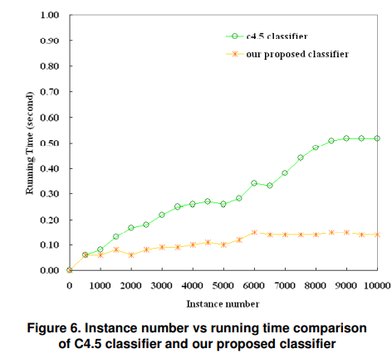
Learning Performance
Notes:
雖然我們的方法需要應用back-propagation來進行特徵選擇，但這只需要做一次就可以對相對於輸出變量的屬性權重進行排序。在將來向數據集引入其他屬性之前，不需再執行此步驟，因此hybrid model的運行時間始終保持在 0.1 秒左右。相比之下，C4.5 分類器線性增加

Slide 12
Conclusion
The experiments showed that a hybrid decision tree and neural network approach improves accuracy in admission to university classification task and performs substantially better than a single decision tree or neural network.
Although the real students’ data used was from Macau, the design of the recommender is generic and applicable to educational systems in other countries such as those cited in

