Slide 1
Double String Tandem Repeats
Amihood Amir, Ayelet Butman, Gad M. Landau, Shoshana Marcus, Dina Sokol
Creative Commons License CC-BY 31st Annual Symposium on Combinatorial Pattern Matching (CPM 2020), Copenhagen; pp. 3:1–3:13
Presenter : Yu-Ju Liao
Date : Oct. 06, 2021

Slide 2
Abstract (1/2)
A tandem repeat is an occurrence of two adjacent identical substrings. In this paper, we introduce the notion of a double string, which consists of two parallel strings, and we study the problem of locating all tandem repeats in a double string. The problem introduced here has applications beyond actual double strings, as we illustrate by solving two different problems with the algorithm of the double string tandem repeats problem. The first problem is that of finding all corner-sharing tandems in a 2-dimensional text, defined by Apostolico and Brimkov. The second problem is that of finding all scaled tandem repeats in a 1d text, where a scaled tandem repeat is defined as a string UU’ such that U ’is discrete scale of U.

Slide 3
Abstract (2/2)
In addition to the algorithms for exact tandem repeats, we also present algorithms that solve the problem in the inexact sense, allowing up to k mismatches. We believe that this framework will open a new perspective for other problems in the future.

Slide 4
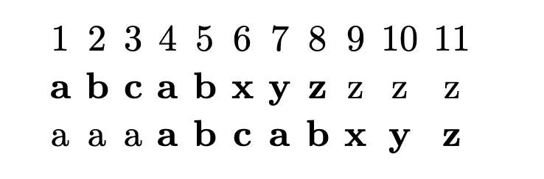
Double String Tandem Repeats
S1=
S2=

Slide 5
Double String Tandem Repeats
S1=
S2=

Slide 6
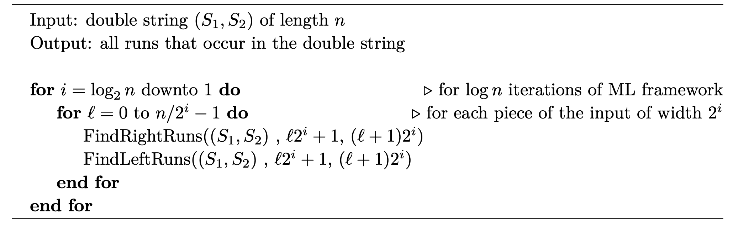
Find Runs in a Double String
(1)
(2)
(3)

Slide 7
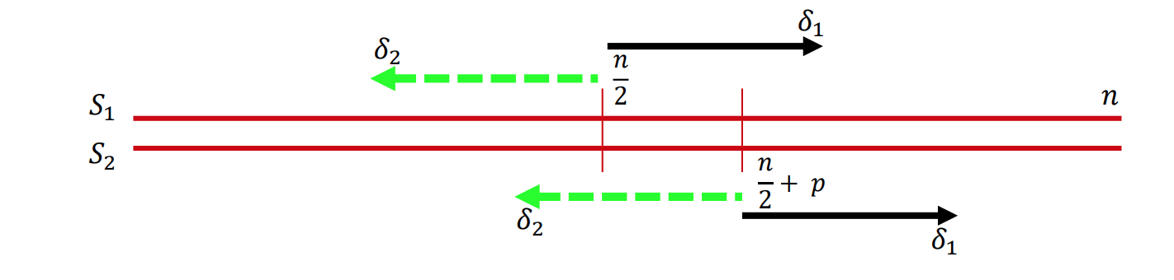
FindRightRuns
mid
S1=
S2=

Slide 8
FindRightRuns
mid
P=3
S1=
S2=

Slide 9
FindRightRuns
mid
P=3
S1=
S2=

Slide 10
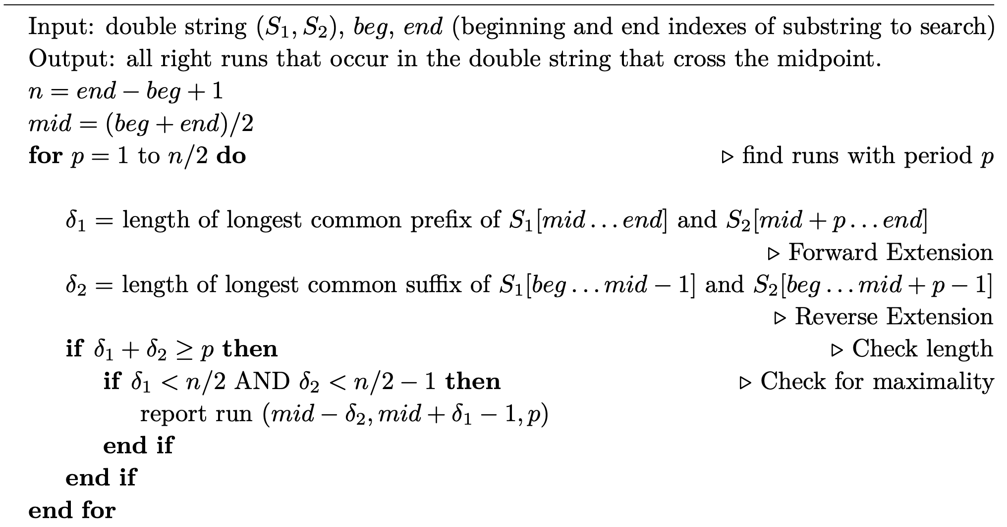
FindRightRuns

Slide 11
Find Runs in a Double String
(1)
(2)
(3)

Slide 12
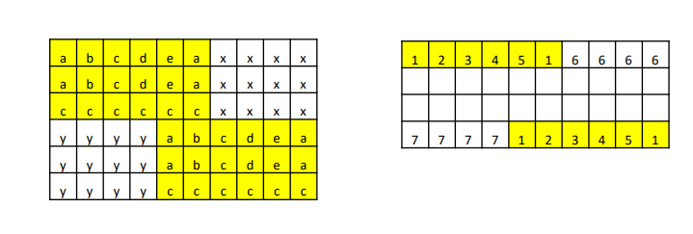
Corner Sharing Tandems
Notes:
=>v_{0,3} to v_{4,9}

Slide 13
Corner Sharing Tandems
Notes:
=>v_{0,3} to v_{4,9}

Slide 14
Corner Sharing Tandems
Notes:
=>v_{0,3} to v_{4,9}

Slide 15
Scaled Tandem Repeats
(1)
S=abaabb
=>aabb = [ab]²
(2)
S=abaabbaa
=>aabbaa = [aba]²
Notes:
=>v_{0,3} to v_{4,9}

Slide 16
Sharp Scaled Tandem Repeats
(1)
T=abdabaabbcdd
Notes:
=>v_{0,3} to v_{4,9}

Slide 17
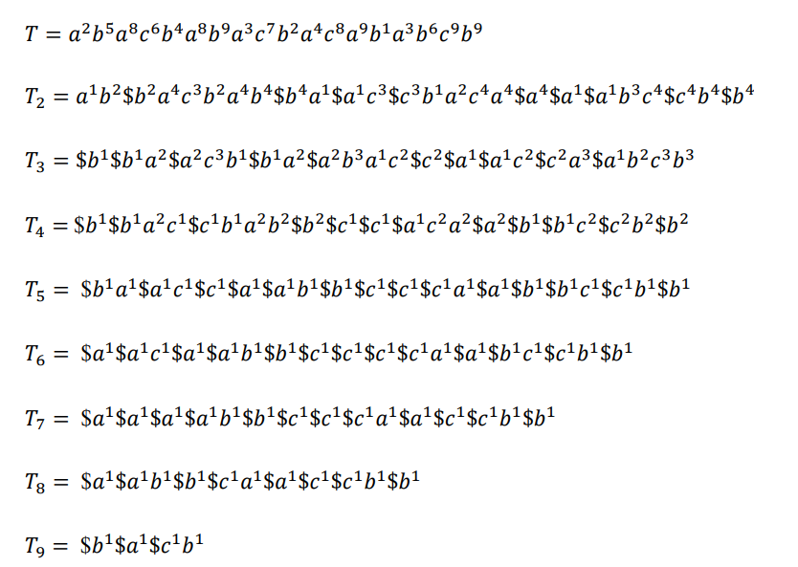
Algorithm
Notes:
=>v_{0,3} to v_{4,9}

Slide 18
Algorithm
T₃ =$b$
Notes:
=>v_{0,3} to v_{4,9}

Slide 19
Algorithm
T₃ =$b$ba² $
Notes:
=>v_{0,3} to v_{4,9}

Slide 20
Algorithm
T₃ =$b$ba² $a²c²b $
Notes:
=>v_{0,3} to v_{4,9}

Slide 21
Scaled Tandem Repeats (Algorithm)
T₃ =$b$ba² $a²c²b $ba²$
Notes:
=>v_{0,3} to v_{4,9}

Slide 22
Algorithm
T₃ =$ b $ ba² $ a²c²b $ ba² $ a²b³ac² $ c² $ a¹ $ a¹c² $ c²a³ $ ab²c³b³
Notes:
=>v_{0,3} to v_{4,9}

Slide 23
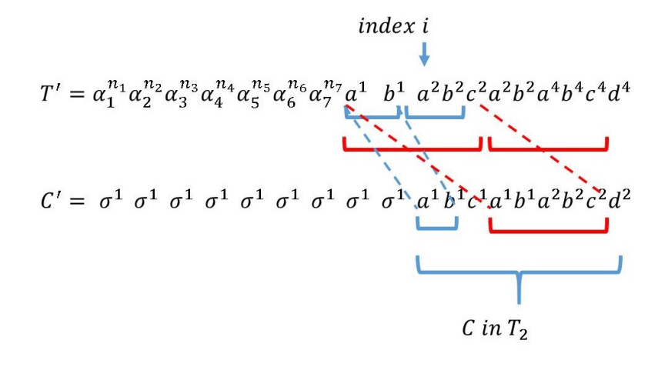
Algorithm
Notes:
=>v_{0,3} to v_{4,9}

Slide 24
Algorithm
Notes:
=>v_{0,3} to v_{4,9}

Slide 25
Algorithm
Notes:
=>v_{0,3} to v_{4,9}

Slide 26
Algorithm
Notes:
=>v_{0,3} to v_{4,9}

