Slide 1
Total flow time minimization in a flowshop sequence-dependent group scheduling problem
NasserSalmasi , RasaratnamLogendran ,Mohammad RezaSkandari
Computers & Operations Research
Volume 37, Issue 1, January 2010, Pages 199-212
Date: Oct. 6, 2021
Presenter: Jue-Jun, Wu

Slide 2
Abstract
We have developed a mathematical programming model for minimizing total flow time of the flow shop sequence dependent group scheduling (FSDGS) problem, typically classified as F_{m}|fmls, S_{plk}, prmu|∑C_{j}. As the problem is shown to be strongly NP-hard, a tabu search (TS) algorithm as well as a hybrid ant colony optimization (HACO) algorithm have been developed to heuristically solve the problem. A lower bounding (LB) method based on the Branch-and-Price algorithm is also developed to evaluate the quality of the metaheuristic algorithms. In order to compare the performance of metaheuristic algorithms, random test problems, ranging in size from small, medium, to large are created and solved by both the TS and the HACO algorithms. A comparison shows that the HACO algorithm has a better performance than the TS algorithm. The results of the heuristic algorithms are also compared with the results of the LB method to evaluate the quality of the solutions. The LB method presented in this paper can be generalized to solve the FSDGS problem with other objective functions.
Notes:
噴漆車間，設置時間（包括清潔噴嘴、區域等），白到綠比黑到綠更容易一些

Slide 3
It is assumed that in a flow shop environment, g groups are assigned to a cell that has m machines (F_{m}).
Each group (p=1,2,…,g) includes b_{p} jobs (fmls).
The setup time of a group (l) on each machine (k) depends on the immediately preceding group (p) that is processed on that machine (i.e., sequence dependent setup time (s_{plk})).
The setup time of each group on each machine can be different.
All jobs and groups are processed in the same sequence on all machines (permutation scheduling (prmu)). This is the only way to produce in some industries. For instance, if a conveyer is used to move jobs between machines, then all jobs should be processed in the same sequence on all machines.
Each job of a group does not need a separate setup time. If it does, the required setup time is assumed to be included in its runtime.
The setup process of a machine for a group can be started before a job that belongs to the group is available (anticipatory).
The jobs belonging to each group should be processed without any preemption by other jobs of other groups (group technology assumption).

Slide 4
Branch and price algorithm
Branch and price algorithm is the combination of branch and bound and column generation.

Slide 5
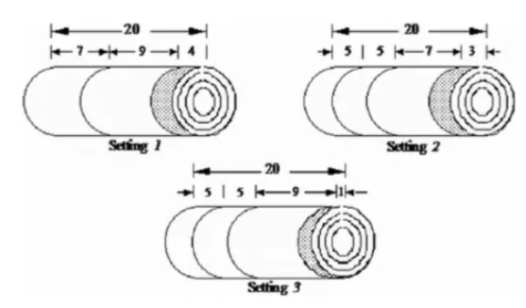

Cutting stock problem
紙捲每個長17公尺，顧客分別要25個3公尺的，20個5公尺的，15個9公尺長的紙捲，怎樣的切割才能浪費的最少?
Min z = 17($x_{1}+$ $x_{2}+$ $x_{3}$ $+$ $x_{4}+$ $x_{5}$ $+$ $x_{6}$)-310
Combination | 3m | 5m | 9m | waste
X1 | 5 | 0 | 0 | 2
X2 | 4 | 1 | 0 | 0
X3 | 2 | 2 | 0 | 1
X4 | 2 | 0 | 1 | 2
X5 | 1 | 1 | 1 | 0
x6 | 0 | 3 | 0 | 2
x7 | 0 | 0 | 1 | 8
Notes:
relax整數的約束，用列生成算法求解，得的變量直向上取整數

Slide 6
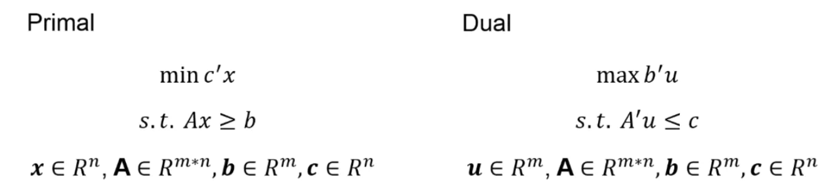
Notes:
對偶變量CBB-1，通過解rmlp對偶問題，得出CBB-1
Subproblem從滔j公式中 尋找檢驗數位富且最小的變量加入到RLMP

Slide 7

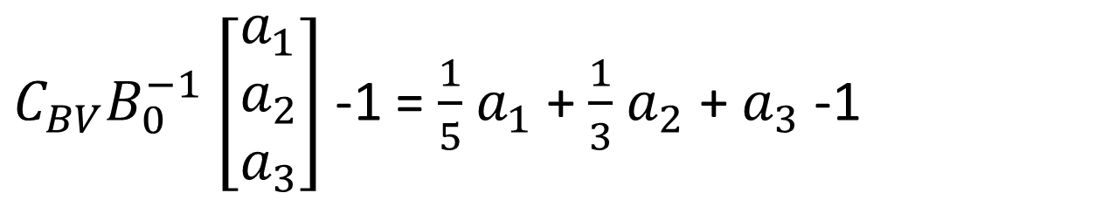
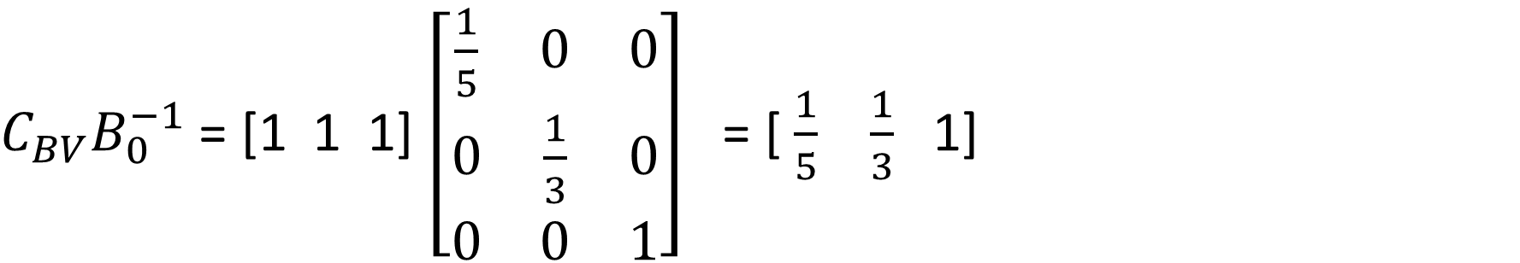
Iteration 0
Combination | 3m | 5m | 9m | waste
X1 | 5 | 0 | 0 | 2
X2 | 4 | 1 | 0 | 0
X3 | 2 | 2 | 0 | 1
X4 | 2 | 0 | 1 | 2
X5 | 1 | 1 | 1 | 0
x6 | 0 | 3 | 0 | 2
x7 | 0 | 0 | 1 | 8
BV(0) = {$x_{1}$, $x_{6}$, $x_{7}$}, $B_{0}^{}=$ $\left[\begin{matrix}5 & 0 & 0 \\ 0 & 3 & 0 \\ 0 & 0 & 1\end{matrix}\right]$
$C_{BV}B_{0}^{−1}$ = [1 1 1] $\left[\begin{matrix}\frac{1}{5} & 0 & 0 \\ 0 & \frac{1}{3} & 0 \\ 0 & 0 & 1\end{matrix}\right]$ = [ $\frac{1}{5}$ $\frac{1}{3}$ 1]
$C_{BV}B_{0}^{−1}$ $\left[\begin{matrix}a_{1} \\ a_{2} \\ a_{3}\end{matrix}\right]$-1 = $\frac{1}{5}$ $a_{1}$+ $\frac{1}{3}$ $a_{2}$ + $a_{3}$ -1
$$3_{a1}+5_{a2}+9_{a3}≤17$$
Notes:
解rmlp對偶問題，CB對偶變量
列生成子問題

Slide 8
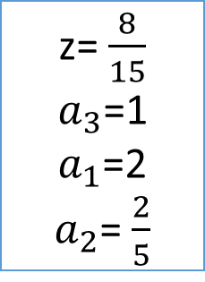
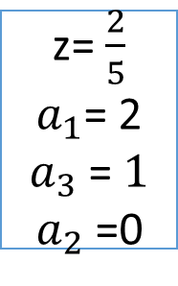
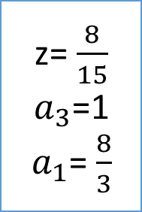

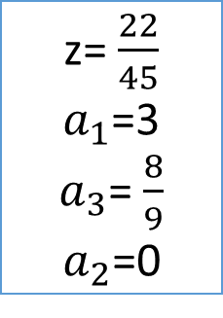
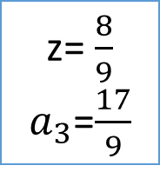

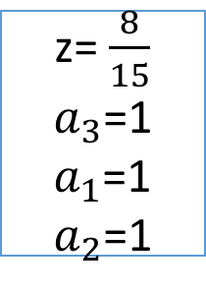




Max z = $\frac{1}{5}$ $a_{1}$+ $\frac{1}{3}$ $a_{2}$ + $a_{3}$ -1
z= $\frac{8}{9}$
$a_{3}$=$\frac{17}{9}$
$$3_{a1}+5_{a2}+9_{a3}≤17$$
z= $\frac{8}{15}$
$a_{3}$=1
$a_{1}$= $\frac{8}{3}$
$$a_{3}≤1$$
$$a_{3}≥2$$
Infeasible
z= $\frac{8}{15}$
$a_{3}$=1
$a_{1}$=2
$a_{2}$= $\frac{2}{5}$
$$a_{1}≤2$$
$$a_{1}≥3$$
z= $\frac{22}{45}$
$a_{1}$=3
$a_{3}$= $\frac{8}{9}$
$a_{2}$=0
z= $\frac{8}{15}$
$a_{3}$=1
$a_{1}$=1
$a_{2}$=1
z= $\frac{2}{5}$
$a_{1}$= 2
$a_{3}$ = $1$
$a_{2}$ =0
$$a_{2}≥1$$
$$a_{2}≤0$$

Slide 9
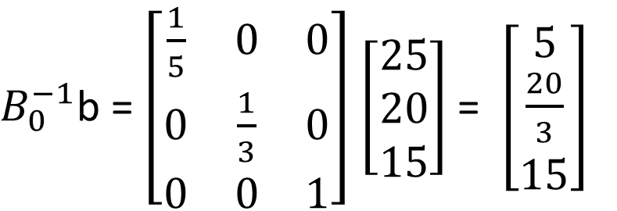
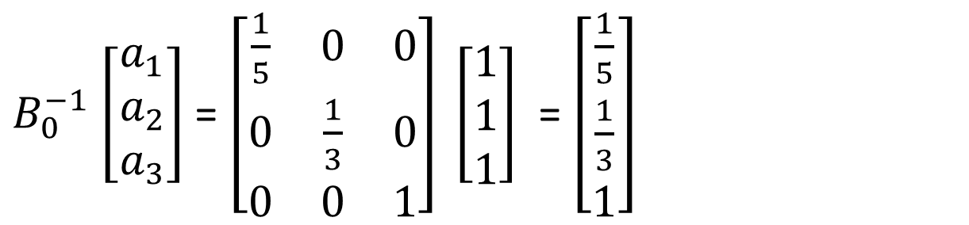
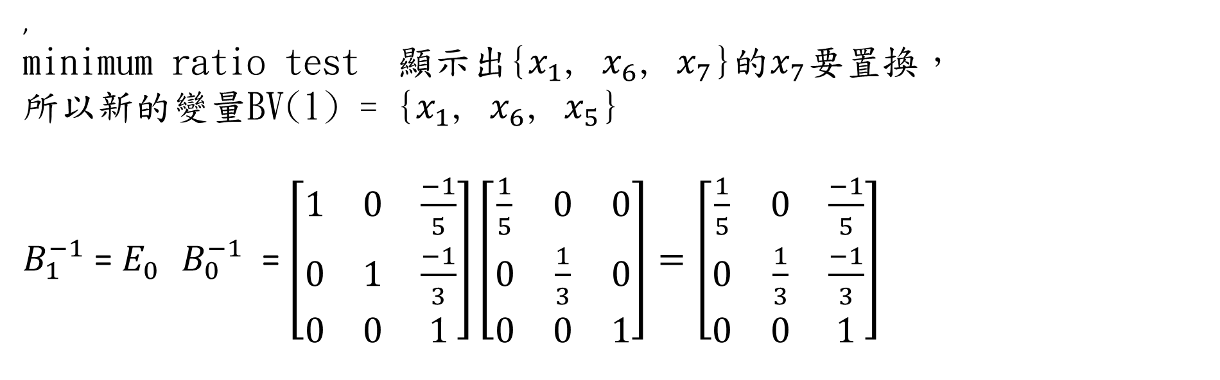
$B_{0}^{−1}$ $\left[\begin{matrix}a_{1} \\ a_{2} \\ a_{3}\end{matrix}\right]$= $\left[\begin{matrix}\frac{1}{5} & 0 & 0 \\ 0 & \frac{1}{3} & 0 \\ 0 & 0 & 1\end{matrix}\right] \left[\begin{matrix}1 \\ 1 \\ 1\end{matrix}\right]$ = $\left[\begin{matrix}\frac{1}{5} \\ \frac{1}{3} \\ 1\end{matrix}\right]$
$B_{0}^{−1}$b = $\left[\begin{matrix}\frac{1}{5} & 0 & 0 \\ 0 & \frac{1}{3} & 0 \\ 0 & 0 & 1\end{matrix}\right]$ $\left[\begin{matrix}25 \\ 20 \\ 15\end{matrix}\right]$ = $\left[\begin{matrix}5 \\ \frac{20}{3} \\ 15\end{matrix}\right]$
,
minimum ratio test 顯示出{$x_{1}$, $x_{6}$, $x_{7}$}的$x_{7}$要置換，
所以新的變量BV(1) = {$x_{1}$, $x_{6}$, $x_{5}$}
$B_{1}^{−1}$ = $E_{0}^{}$ $B_{0}^{−1}$ = $\left[\begin{matrix}1 & 0 & \frac{−1}{5} \\ 0 & 1 & \frac{−1}{3} \\ 0 & 0 & 1\end{matrix}\right]\left[\begin{matrix}\frac{1}{5} & 0 & 0 \\ 0 & \frac{1}{3} & 0 \\ 0 & 0 & 1\end{matrix}\right]=\left[\begin{matrix}\frac{1}{5} & 0 & \frac{−1}{5} \\ 0 & \frac{1}{3} & \frac{−1}{3} \\ 0 & 0 & 1\end{matrix}\right]$

Slide 10

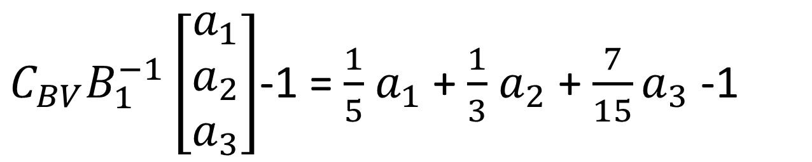
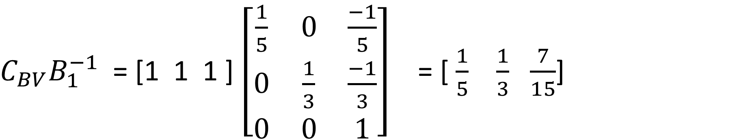
Iteration 1
BV(1) = {$x_{1}$, $x_{6}$, $x_{5}$}
$C_{BV}B_{1}^{−1}$ = [1 1 1 ] $\left[\begin{matrix}\frac{1}{5} & 0 & \frac{−1}{5} \\ 0 & \frac{1}{3} & \frac{−1}{3} \\ 0 & 0 & 1\end{matrix}\right]$ = [ $\frac{1}{5}$ $\frac{1}{3}$ $\frac{7}{15}$]
$C_{BV}B_{1}^{−1}\left[\begin{matrix}a_{1} \\ a_{2} \\ a_{3}\end{matrix}\right]$-1 = $\frac{1}{5}$ $a_{1}$+ $\frac{1}{3}$ $a_{2}$ + ${\frac{7}{15}a}_{3}$ -1
$$3_{a1}+5_{a2}+9_{a3}≤17$$
Notes:
Reduced cost

Slide 11

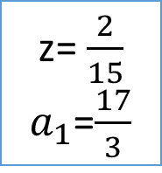


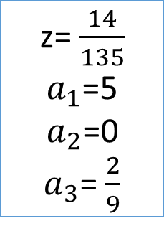
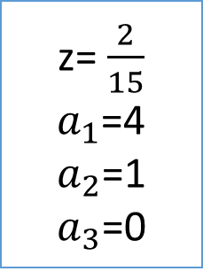

Max z = $\frac{1}{5}$ $a_{1}$+ $\frac{1}{3}$ $a_{2}$ + ${\frac{7}{15}a}_{3}$ -1
z= $\frac{2}{15}$
$a_{1}$=$\frac{17}{3}$
$$3_{a1}+5_{a2}+9_{a3}≤17$$
z= $\frac{8}{15}$
$a_{3}$=1
$a_{1}$= $\frac{8}{3}$
$$a_{1}≤5$$
$$a_{1}≥6$$
Infeasible
z= $\frac{14}{135}$
$a_{1}$=5
$a_{2}$=0
$a_{3}$= $\frac{2}{9}$
z= $\frac{2}{15}$
$a_{1}$=4
$a_{2}$=1
$a_{3}$=0
$$a_{2}≥1$$
$$a_{2}≤0$$

Slide 12
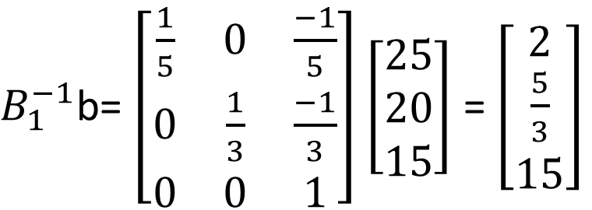
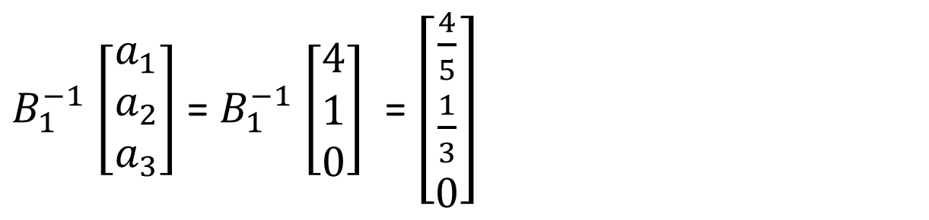
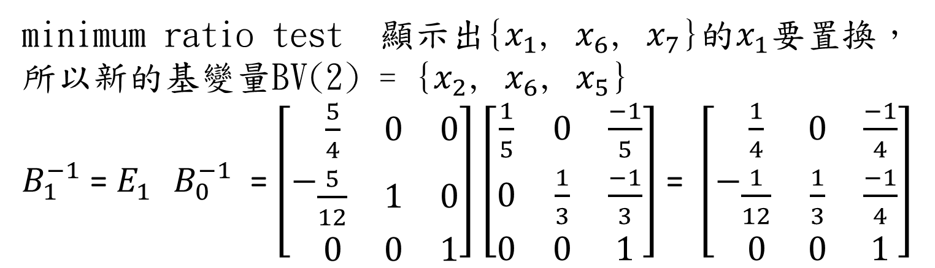
$B_{1}^{−1}$ $\left[\begin{matrix}a_{1} \\ a_{2} \\ a_{3}\end{matrix}\right]$= $B_{1}^{−1}$ $\left[\begin{matrix}4 \\ 1 \\ 0\end{matrix}\right]$ = $\left[\begin{matrix}\frac{4}{5} \\ \frac{1}{3} \\ 0\end{matrix}\right]$
$B_{1}^{−1}$b= $\left[\begin{matrix}\frac{1}{5} & 0 & \frac{−1}{5} \\ 0 & \frac{1}{3} & \frac{−1}{3} \\ 0 & 0 & 1\end{matrix}\right]$ $\left[\begin{matrix}25 \\ 20 \\ 15\end{matrix}\right]$ = $\left[\begin{matrix}2 \\ \frac{5}{3} \\ 15\end{matrix}\right]$
minimum ratio test 顯示出{$x_{1}$, $x_{6}$, $x_{7}$}的$x_{1}$要置換，
所以新的基變量BV(2) = {$x_{2}$, $x_{6}$, $x_{5}$}
$B_{1}^{−1}$ = $E_{1}^{}$ $B_{0}^{−1}$ = $\left[−\begin{matrix}\frac{5}{4} & 0 & 0 \\ \frac{5}{12} & 1 & 0 \\ 0 & 0 & 1\end{matrix}\right]$ $\left[\begin{matrix}\frac{1}{5} & 0 & \frac{−1}{5} \\ 0 & \frac{1}{3} & \frac{−1}{3} \\ 0 & 0 & 1\end{matrix}\right]$ = $\left[−\begin{matrix}\frac{1}{4} & 0 & \frac{−1}{4} \\ \frac{1}{12} & \frac{1}{3} & \frac{−1}{4} \\ 0 & 0 & 1\end{matrix}\right]$

Slide 13

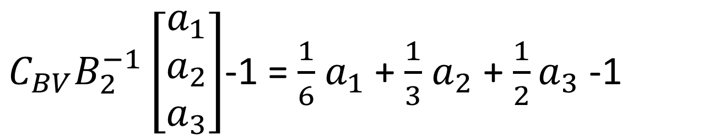
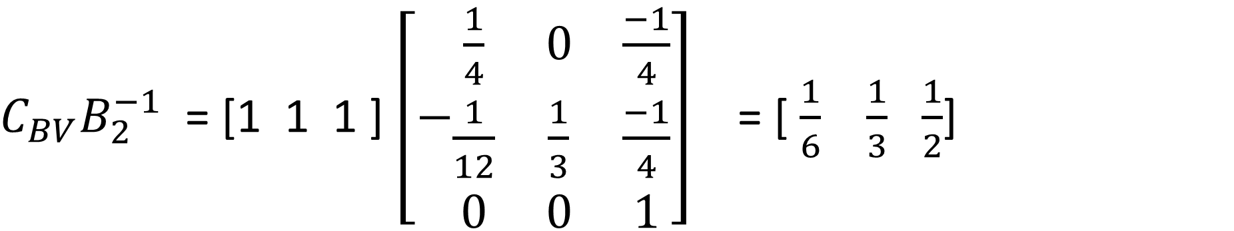
Iteration 2
BV(2) = {$x_{2}$, $x_{6}$, $x_{5}$}
$C_{BV}B_{2}^{−1}$ = [1 1 1 ] $\left[−\begin{matrix}\frac{1}{4} & 0 & \frac{−1}{4} \\ \frac{1}{12} & \frac{1}{3} & \frac{−1}{4} \\ 0 & 0 & 1\end{matrix}\right]$ = [ $\frac{1}{6}$ $\frac{1}{3}$ $\frac{1}{2}$]
$C_{BV}B_{2}^{−1}\left[\begin{matrix}a_{1} \\ a_{2} \\ a_{3}\end{matrix}\right]$-1 = $\frac{1}{6}$ $a_{1}$+ $\frac{1}{3}$ $a_{2}$ + ${\frac{1}{2}a}_{3}$ -1
$$3_{a1}+5_{a2}+9_{a3}≤17$$
Notes:
Reduced cost

Slide 14





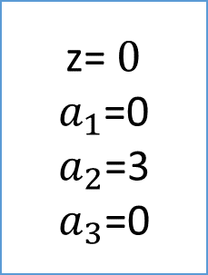
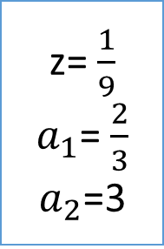
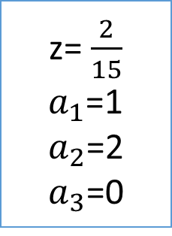
Max z = $\frac{1}{6}$ $a_{1}$+ $\frac{1}{3}$ $a_{2}$ + ${\frac{1}{2}a}_{3}$ -1
z= $\frac{2}{15}$
$a_{2}$=$\frac{17}{5}$
$$3_{a1}+5_{a2}+9_{a3}≤17$$
z= $\frac{1}{9}$
$a_{1}$= $\frac{2}{3}$
$a_{2}$=3
$$a_{2}≤3$$
$$a_{2}≥4$$
Infeasible
$$a_{1}≥1$$
$$a_{1}≤0$$
z= $\frac{2}{15}$
$a_{1}$=1
$a_{2}$=2
$a_{3}$=0
z= $0$
$a_{1}$=0
$a_{2}$=3
$a_{3}$=0
Notes:
非機變量變基變量，現有的基變量。
目前的可行解一定對應著最優解。

Slide 15
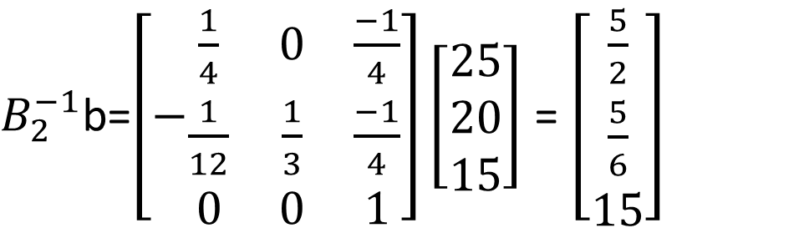
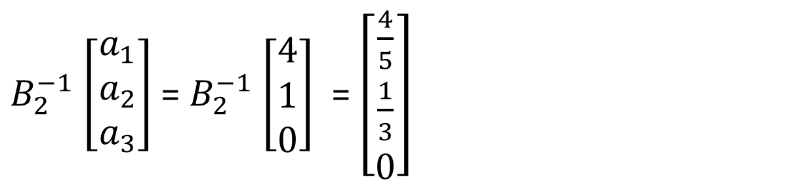

$B_{2}^{−1}$ $\left[\begin{matrix}a_{1} \\ a_{2} \\ a_{3}\end{matrix}\right]$= $B_{2}^{−1}$ $\left[\begin{matrix}4 \\ 1 \\ 0\end{matrix}\right]$ = $\left[\begin{matrix}\frac{4}{5} \\ \frac{1}{3} \\ 0\end{matrix}\right]$
$B_{2}^{−1}$b=$\left[−\begin{matrix}\frac{1}{4} & 0 & \frac{−1}{4} \\ \frac{1}{12} & \frac{1}{3} & \frac{−1}{4} \\ 0 & 0 & 1\end{matrix}\right]\left[\begin{matrix}25 \\ 20 \\ 15\end{matrix}\right]$ = $\left[\begin{matrix}\frac{5}{2} \\ \frac{5}{6} \\ 15\end{matrix}\right]$
所以最佳解為$x_{2 }=\frac{5}{2}$, $x_{6}=\frac{5}{6}$, ${ x}_{5} =$15
近似整數解為$x_{2 }=3$, $x_{6}=1$, ${ x}_{5} =$15

Slide 16
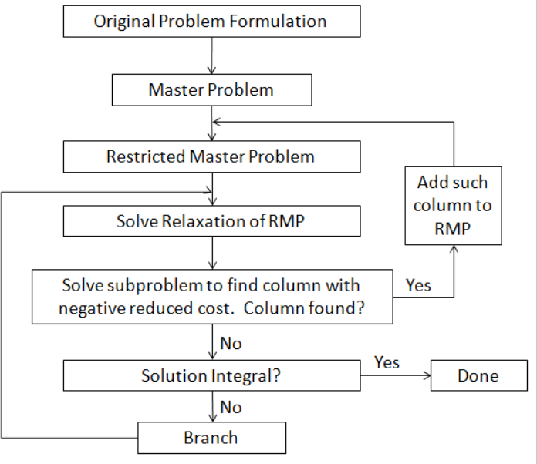

Slide 17
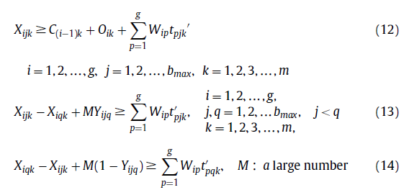
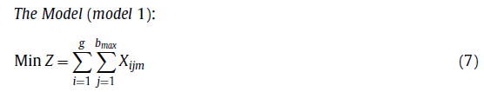
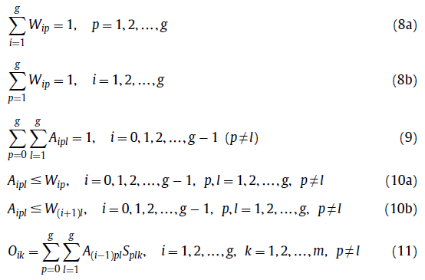
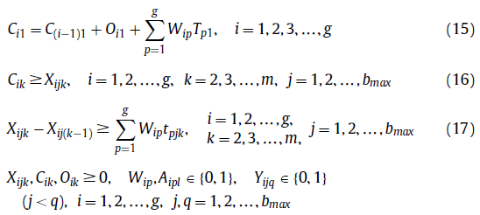
Mixed Integer Linear Programming
Notes:
每個組只分配一個時隙，每個時隙專用於接收一個組。在現實世界的問題中，組有不同數量的工作。

Slide 18
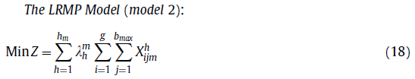

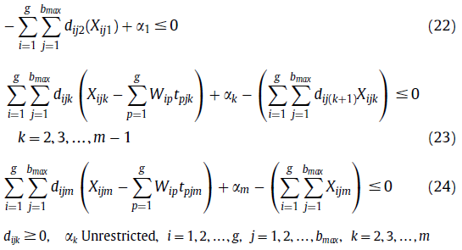
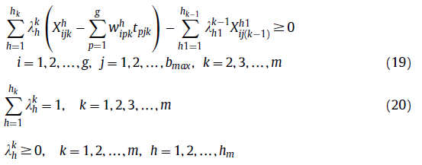
LP relaxation of the restricted master problem (LRMP)
Notes:
LRMP-dual原始問題提供了一個下界。

Slide 19
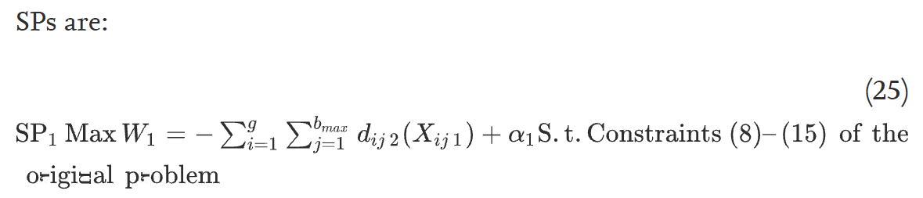
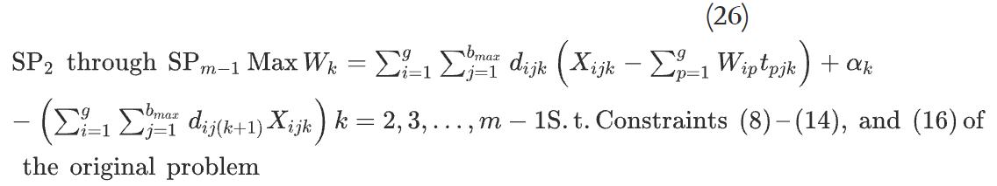
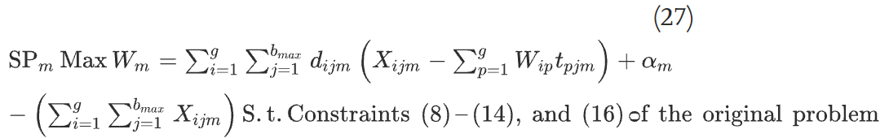
Subproblems
Notes:
如果在 2 小時內無法最優求解 SP，則停止求解 SP，將 SP 的下限視為 SP 的目標函數值。 在求解節點期間，使用廣度優先程序。

Slide 20
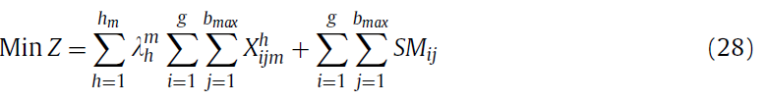

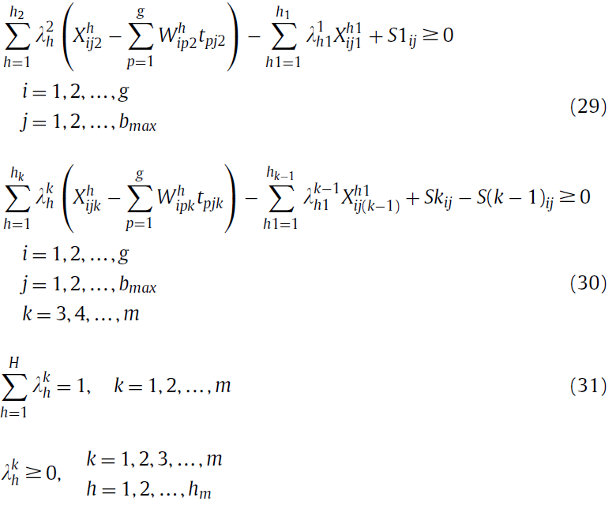
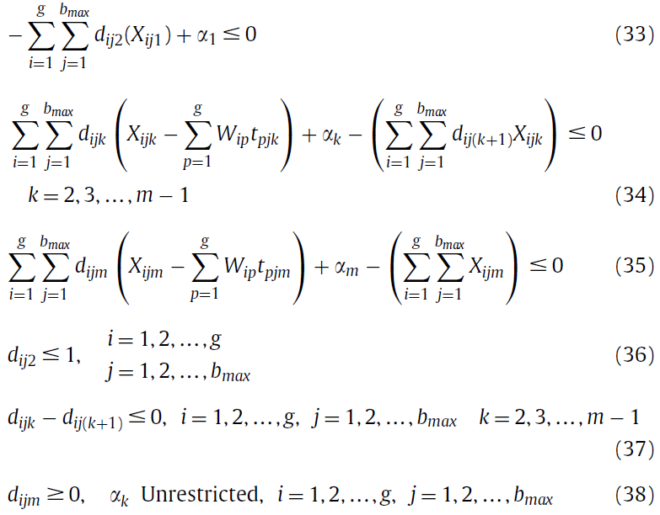
Lower bounding method
Notes:
如果 B&P 算法以最佳方式解決了問題，則它為原始問題提供了一個下界。如果 B&P 算法無法最優解決問題，則使用以下規則計算原始問題的下界。
更新子問題-dual

Slide 21
Test problem specifications
Number of groups: DU [1,5], DU [6,10], and DU [11,16] for small, medium, and large size problems, respectively.
Number of jobs in a group: DU [2,4], DU [5,7], and DU [8,10] for small, medium, and large size problems.
The ratio of setup times of groups on consecutive machines:
First level:M1<M2; Second level: M1=M2; Third level M1>M2;
Level 1/2/3 indicates the problems in which the required setup times for each machine are increased/almost equal/decreased sequentially.
Notes:
在工業中極不可能使用超過六台機器的流水車間。所以考慮了2 3 6台機器
生產線分解為小型但獨立的製造單元。

Slide 22
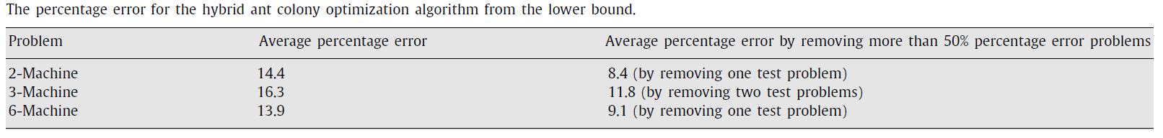
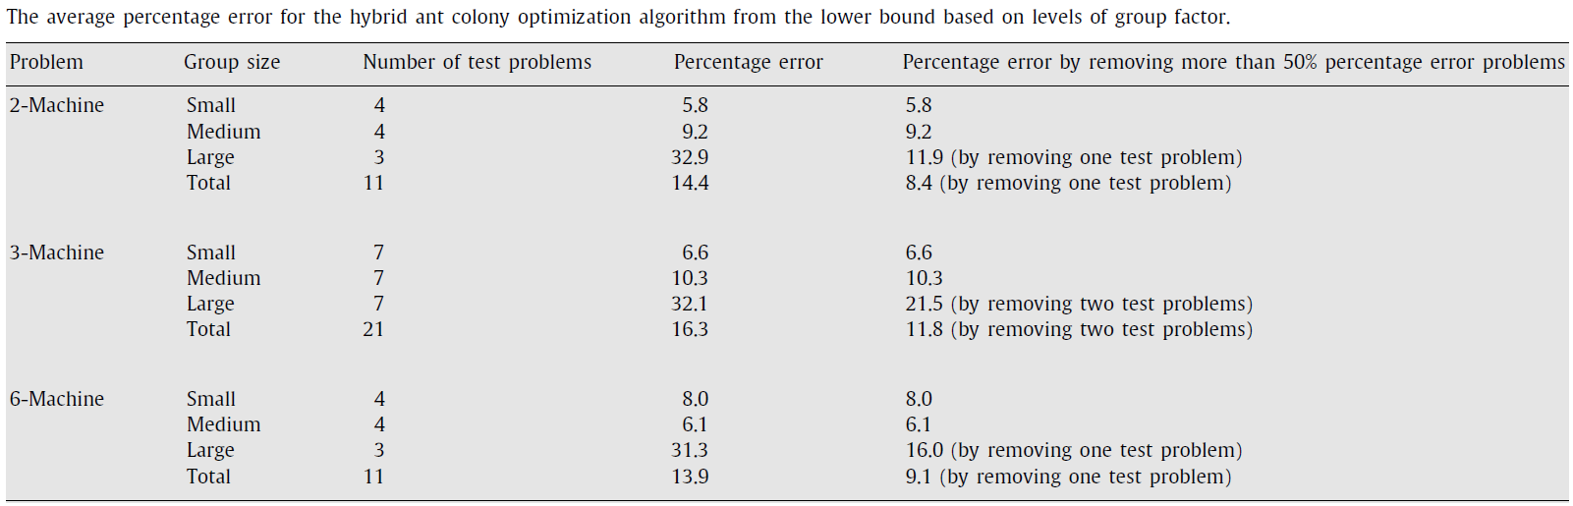

Slide 23
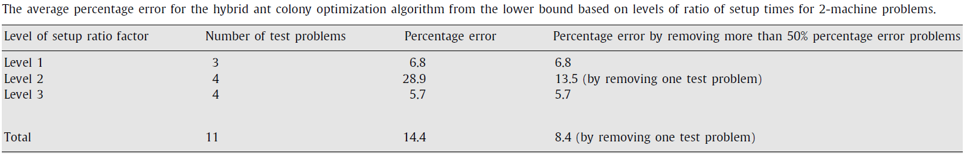
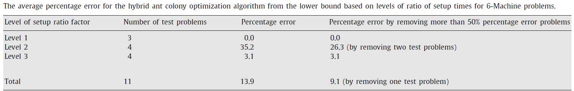
Notes:
級別 1 表示每台機器所需的設置時間按順序增加的問題。 第二層次研究所有機器的設置時間幾乎相等的問題。 最後，第三級調查從第一台機器到最後一台機器減少機器設置時間的問題。

Slide 24


Slide 25
Conclusion
The result of paired t-test shows that the HACO algorithm has a better performance for all problem sizes than the best TS algorithm.
A generalized lower bounding method based on the branch-and-price method is also developed for FSDGS problems to estimate the quality of solutions.
Originally problem is based only on minimization of makespan criterion, further research considering such as minimization of total tardiness and minimization of weighted tardiness, amongst others.
Notes:
開發了一種基於TS的元啟發式算法以及基於蟻群算法的混合啟發式算法來解決FSDGS問題。然後，將TS算法與HACO算法進行比較。 實驗表明，HACO 算法可以為所研究的問題提供高質量的解決方案。
FSDGS 問題的所有工作都僅基於最小化完工標準。

Slide 26
Thanks for listening.

Slide 27


Cutting stock problem
紙捲每個長17公尺，顧客分別要25個3公尺的，20個5公尺的，18個7公尺長的紙捲，怎樣的切割才能浪費的最少?
$a_{ij}$ : 第j種裡類別i的個數
$y_{j}$: 第j種方案的選擇個數

Slide 28





Iteration 1
$3_{a1j}+6_{a2j}+7_{a3j}<1$6

Slide 29




Iteration 2

Slide 30




Iteration 3

Slide 31


Iteration 4
方案一:切成5個3公尺
方案二:切成2個6公尺
方案三:切成2個7公尺
25個3公尺的，20個5公尺的，18個7公尺長的紙捲

Slide 32





Hybrid ant colony optimization algorithm (HACO)
Notes:
1.獨立構建解決方案的（許多）螞蟻群體。
2.使用信息素值和啟發式信息工作的解決方案構建階段。
3.圍繞找到的最佳解決方案應用本地搜索以改進解決方案。
4.更新信息素值階段，根據找到的解決方案的質量更新信息素值，以引導算法朝著有希望的解決方案發展

Slide 33


Slide 34
Hybrid ant colony optimization algorithm (HACO)
1.A colony of (a number of) ants which constructs solutions independently.
2.The solution construction phase that works using pheromone values and heuristic information.
3.Local search that is applied around the best found solution(s) to improve the solution(s).
4.Updating pheromone values phase that updates the pheromone values based on the quality of the solutions found, so as to guide the algorithm toward promising solutions.
Notes:
螞蟻根據他們的合作經驗，通過動態改變環境（信息素的踪跡）來間接引導殖民地的其他成員，以提出從巢穴到食物的更好路徑，反之亦然。一條路徑上的信息素越多，其他螞蟻跟隨該路徑的可能性就越大。

Slide 35
3.2.組中的作業順序
原始 NEH 不是迭代的，除非引入新的群序列，否則不會構建新的解決方案。為了解決上述兩個問題，所提出的算法在第一步中隨機對作業進行排序。所提出算法的步驟如下：
(1)隨機訂購工作。(2)取前兩個作業並安排它們以盡量減少部分流程時間，就好像只有這兩個作業一樣。(3)對於剩餘的作業，嘗試在所有可能的位置一個接一個地插入作業，並選擇最小化部分流程時間的位置，直到所有作業排序。
實驗表明隨機方案優於原始方案。

Slide 36



Slide 37


Slide 38



Slide 39



