Slide 1
An Improved DFA for Fast Regular Expression Matching
Domenico Ficara, Stefano Giordano
ACM SIGCOMM Computer Communication Review
Presenter: Jing-Ping Jan
Date: Jan. 19, 2021
Notes:
Journal of Internet Technology 網際網路技術學刊 2009

Slide 2
Abstract
Modern network devices need to perform deep packet inspection at high speed for security and application-specific services. Finite Automata (FAs) are used to implement regular expressions matching, but they require a large amount of memory. Many recent works have proposed improvements to address this issue. This paper presents a new representation for deterministic finite automata (orthogonal to previous solutions), called Delta Finite Automata (δFA), which considerably reduces states and transitions and requires a transition per character only, thus allowing fast matching. Moreover, a new state encoding scheme is proposed and the comprehensive algorithm is tested for use in the packet classification area.
Notes:
Ʃ = sigma
Ε = epsilon

Slide 3

Introduction
Regular expression R = $b^{+}c$ S = bc, bbc, bbbc, … etc R = $a^{∗}c$ S = c, ac, aac, aaac, … etc

Slide 4

Introduction
 | b | c
1 | 2 | -
2 | 2 | 3
3 | - | -
DFA R = $b^{+}c$
1
b
2
c
3
start
3
b

Slide 5
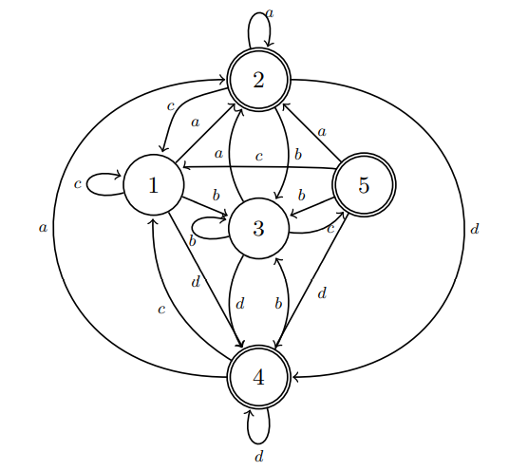

Introduction
DFA R₁ = $a^{+}$ R₂ = $b^{+}c$ R₃ = $c^{∗}d^{+}$
start

Slide 6
Introduction
DFA R₁ = $a^{+}$ R₂ = $b^{+}c$ R₃ = $c^{∗}d^{+}$
DFA | a | b | c | d
1 | 2 | 3 | 1 | 4
2 | 2 | 3 | 1 | 4
3 | 2 | 3 | 5 | 4
4 | 2 | 3 | 1 | 4
5 | 2 | 3 | 1 | 4

Slide 7
Introduction
S = a

Slide 8
Introduction
S = cbc

Slide 9
Introduction
S = cbc

Slide 10
Introduction
S = cbc

Slide 11
Introduction
S = cccbd

Slide 12
Introduction
S = cccbd

Slide 13
Introduction
S = cccbd

Slide 14
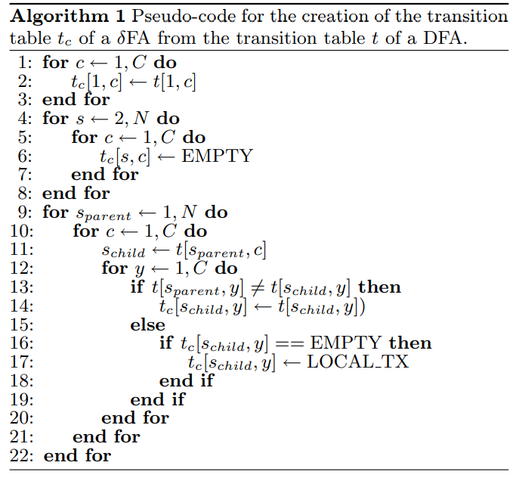

$δFA$ Construction

Slide 15
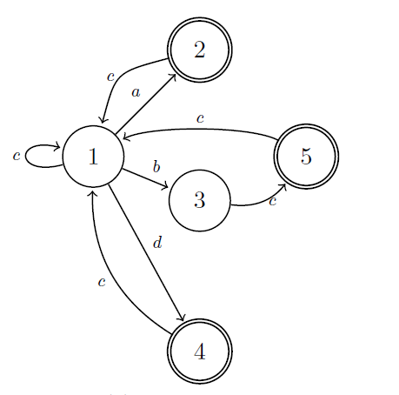
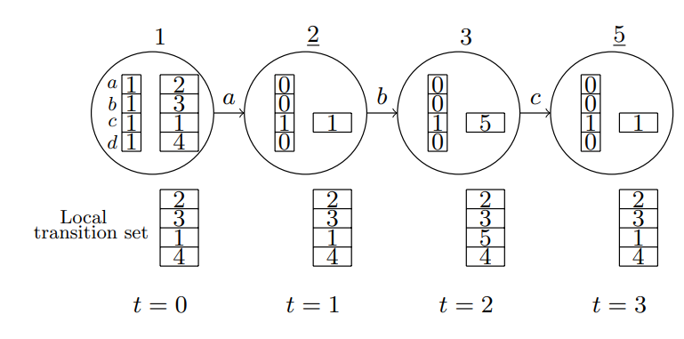
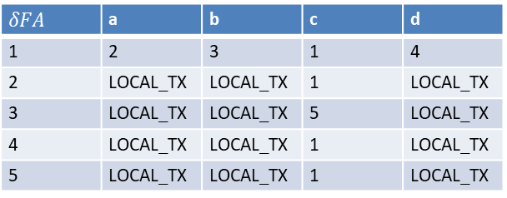
$δFA$ Construction
Char-State | a | b | c | d
1 | 1 | 1 | 1 | 1
2 | 0 | 0 | 1 | 0
3 | 0 | 0 | 1 | 0
4 | 0 | 0 | 1 | 0
5 | 0 | 0 | 1 | 0
$$δFA$$ | a | b | c | d
1 | 2 | 3 | 1 | 4
2 | LOCAL_TX | LOCAL_TX | 1 | LOCAL_TX
3 | LOCAL_TX | LOCAL_TX | 5 | LOCAL_TX
4 | LOCAL_TX | LOCAL_TX | 1 | LOCAL_TX
5 | LOCAL_TX | LOCAL_TX | 1 | LOCAL_TX

Slide 16
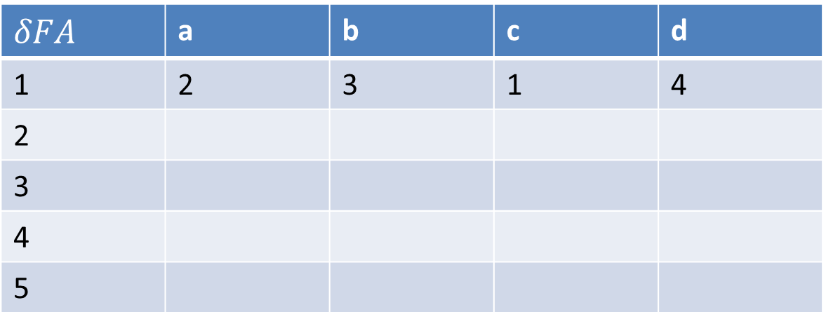
$δFA$ Construction
DFA | a | b | c | d
1 | 2 | 3 | 1 | 4
2 | 2 | 3 | 1 | 4
3 | 2 | 3 | 5 | 4
4 | 2 | 3 | 1 | 4
5 | 2 | 3 | 1 | 4
$$δFA$$ | a | b | c | d
1 | 2 | 3 | 1 | 4
2
3
4
5

Slide 17
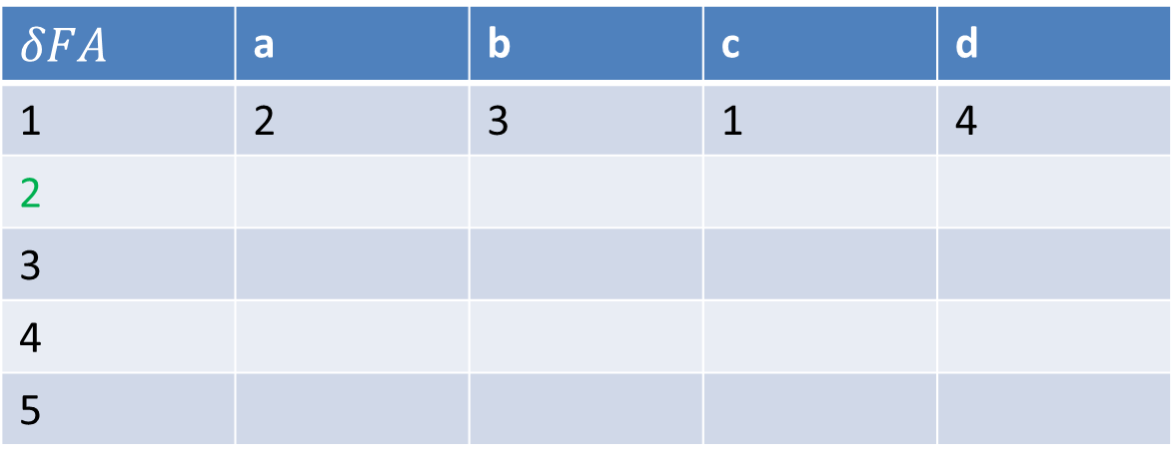
$δFA$ Construction
DFA | a | b | c | d
1 | 2 | 3 | 1 | 4
2 | 2 | 3 | 1 | 4
3 | 2 | 3 | 5 | 4
4 | 2 | 3 | 1 | 4
5 | 2 | 3 | 1 | 4
$$δFA$$ | a | b | c | d
1 | 2 | 3 | 1 | 4
2
3
4
5

Slide 18
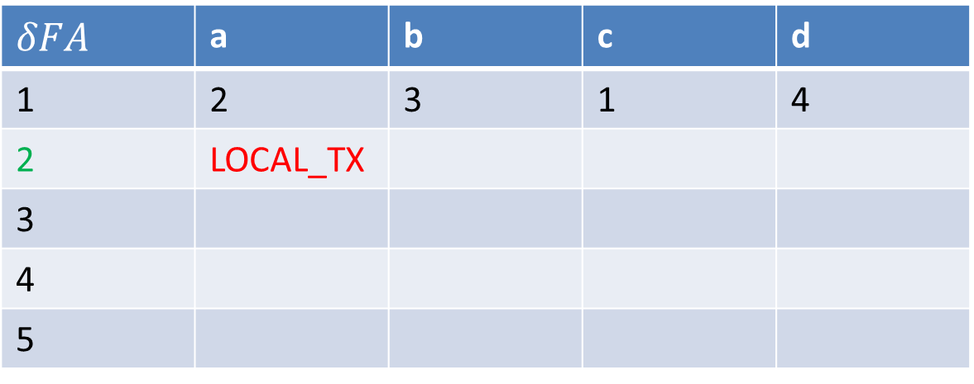
$δFA$ Construction
DFA | a | b | c | d
1 | 2 | 3 | 1 | 4
2 | 2 | 3 | 1 | 4
3 | 2 | 3 | 5 | 4
4 | 2 | 3 | 1 | 4
5 | 2 | 3 | 1 | 4
$$δFA$$ | a | b | c | d
1 | 2 | 3 | 1 | 4
2 | LOCAL_TX
3
4
5

Slide 19
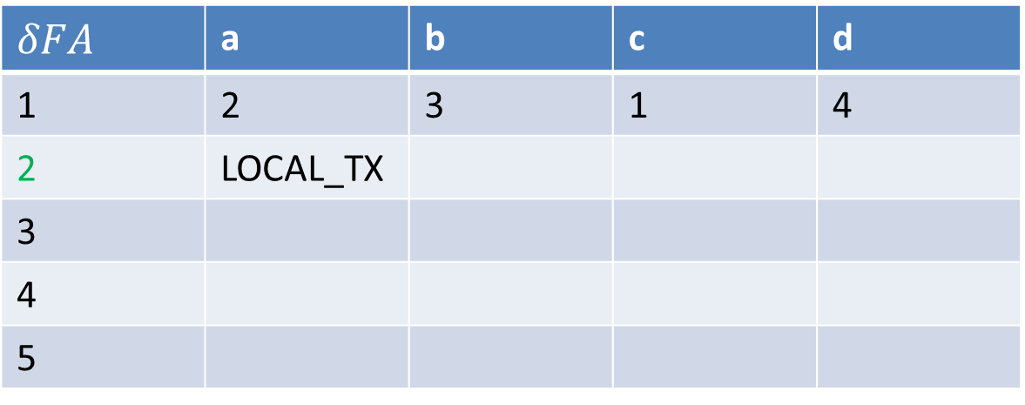
$δFA$ Construction
DFA | a | b | c | d
1 | 2 | 3 | 1 | 4
2 | 2 | 3 | 1 | 4
3 | 2 | 3 | 5 | 4
4 | 2 | 3 | 1 | 4
5 | 2 | 3 | 1 | 4
$$δFA$$ | a | b | c | d
1 | 2 | 3 | 1 | 4
2 | LOCAL_TX
3
4
5

Slide 20
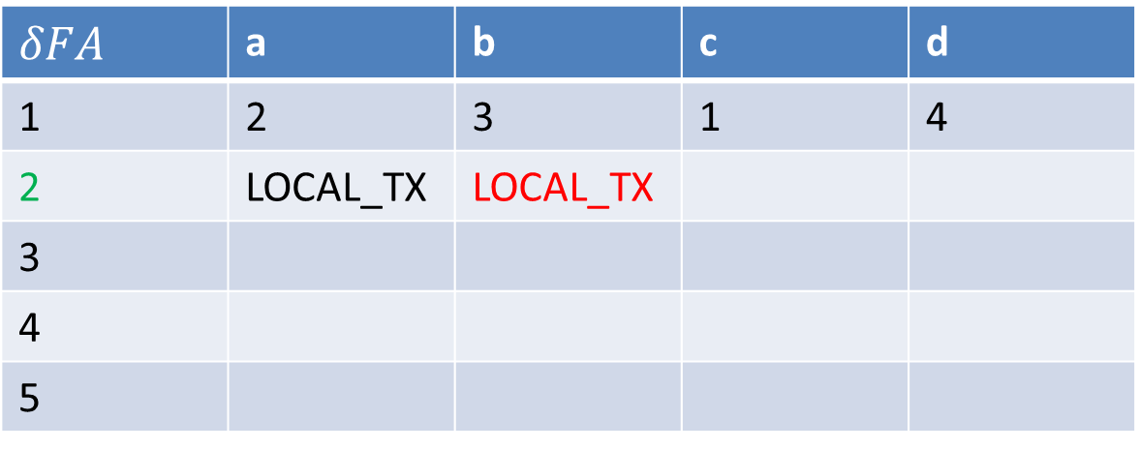
$δFA$ Construction
DFA | a | b | c | d
1 | 2 | 3 | 1 | 4
2 | 2 | 3 | 1 | 4
3 | 2 | 3 | 5 | 4
4 | 2 | 3 | 1 | 4
5 | 2 | 3 | 1 | 4
$$δFA$$ | a | b | c | d
1 | 2 | 3 | 1 | 4
2 | LOCAL_TX | LOCAL_TX
3
4
5

Slide 21
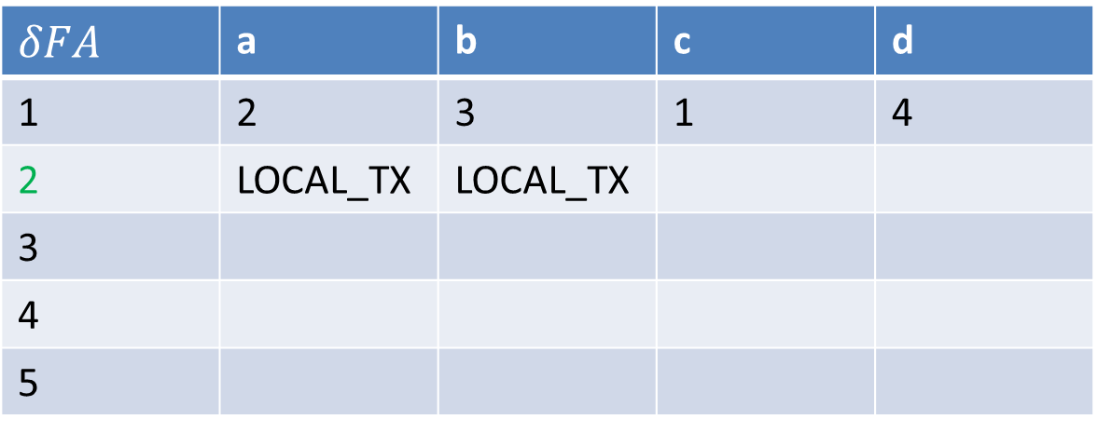
$δFA$ Construction
DFA | a | b | c | d
1 | 2 | 3 | 1 | 4
2 | 2 | 3 | 1 | 4
3 | 2 | 3 | 5 | 4
4 | 2 | 3 | 1 | 4
5 | 2 | 3 | 1 | 4
$$δFA$$ | a | b | c | d
1 | 2 | 3 | 1 | 4
2 | LOCAL_TX | LOCAL_TX
3
4
5

Slide 22
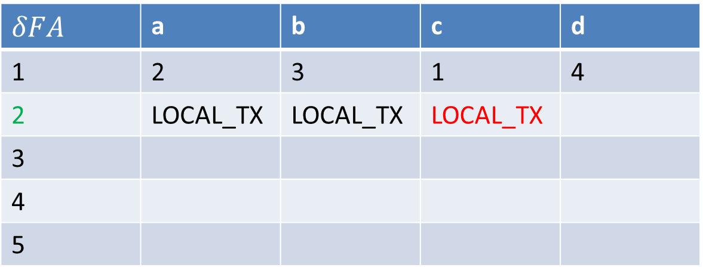
$δFA$ Construction
DFA | a | b | c | d
1 | 2 | 3 | 1 | 4
2 | 2 | 3 | 1 | 4
3 | 2 | 3 | 5 | 4
4 | 2 | 3 | 1 | 4
5 | 2 | 3 | 1 | 4
$$δFA$$ | a | b | c | d
1 | 2 | 3 | 1 | 4
2 | LOCAL_TX | LOCAL_TX | LOCAL_TX
3
4
5

Slide 23
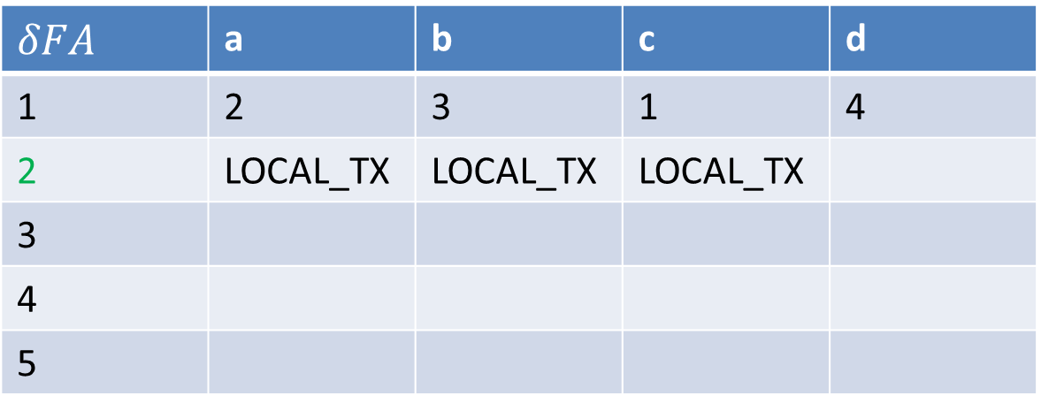
$δFA$ Construction
DFA | a | b | c | d
1 | 2 | 3 | 1 | 4
2 | 2 | 3 | 1 | 4
3 | 2 | 3 | 5 | 4
4 | 2 | 3 | 1 | 4
5 | 2 | 3 | 1 | 4
$$δFA$$ | a | b | c | d
1 | 2 | 3 | 1 | 4
2 | LOCAL_TX | LOCAL_TX | LOCAL_TX
3
4
5

Slide 24
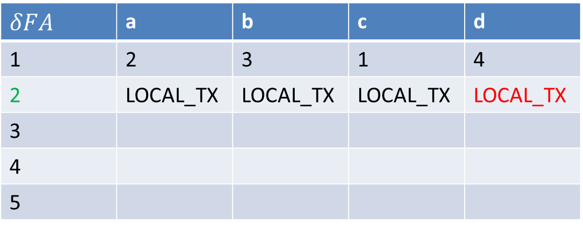
$δFA$ Construction
DFA | a | b | c | d
1 | 2 | 3 | 1 | 4
2 | 2 | 3 | 1 | 4
3 | 2 | 3 | 5 | 4
4 | 2 | 3 | 1 | 4
5 | 2 | 3 | 1 | 4
$$δFA$$ | a | b | c | d
1 | 2 | 3 | 1 | 4
2 | LOCAL_TX | LOCAL_TX | LOCAL_TX | LOCAL_TX
3
4
5

Slide 25
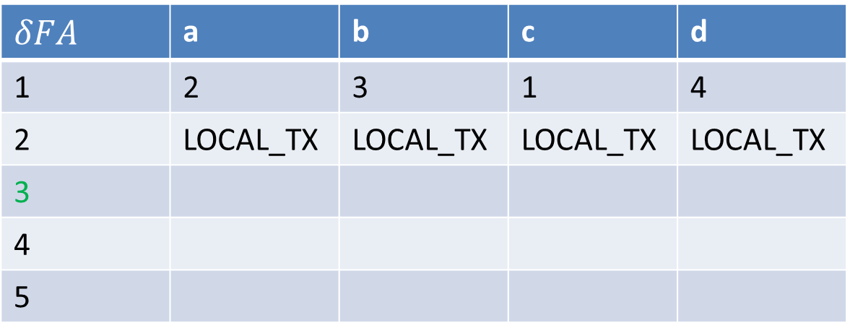
$δFA$ Construction
DFA | a | b | c | d
1 | 2 | 3 | 1 | 4
2 | 2 | 3 | 1 | 4
3 | 2 | 3 | 5 | 4
4 | 2 | 3 | 1 | 4
5 | 2 | 3 | 1 | 4
$$δFA$$ | a | b | c | d
1 | 2 | 3 | 1 | 4
2 | LOCAL_TX | LOCAL_TX | LOCAL_TX | LOCAL_TX
3
4
5

Slide 26
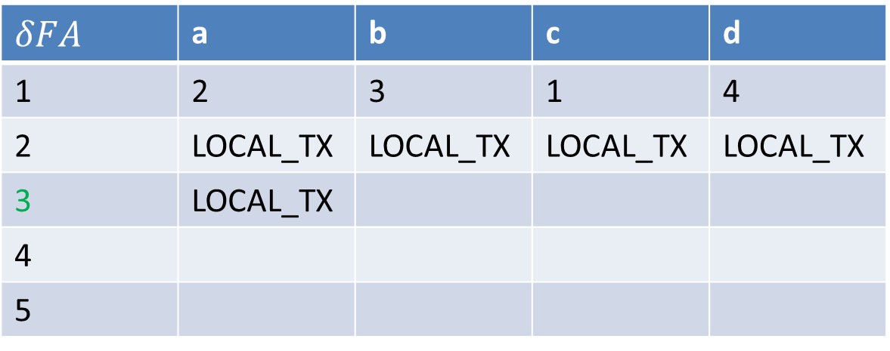
$δFA$ Construction
DFA | a | b | c | d
1 | 2 | 3 | 1 | 4
2 | 2 | 3 | 1 | 4
3 | 2 | 3 | 5 | 4
4 | 2 | 3 | 1 | 4
5 | 2 | 3 | 1 | 4
$$δFA$$ | a | b | c | d
1 | 2 | 3 | 1 | 4
2 | LOCAL_TX | LOCAL_TX | LOCAL_TX | LOCAL_TX
3 | LOCAL_TX
4
5

Slide 27
$δFA$ Construction
DFA | a | b | c | d
1 | 2 | 3 | 1 | 4
2 | 2 | 3 | 1 | 4
3 | 2 | 3 | 5 | 4
4 | 2 | 3 | 1 | 4
5 | 2 | 3 | 1 | 4
$$δFA$$ | a | b | c | d
1 | 2 | 3 | 1 | 4
2 | LOCAL_TX | LOCAL_TX | LOCAL_TX | LOCAL_TX
3 | LOCAL_TX
4
5

Slide 28
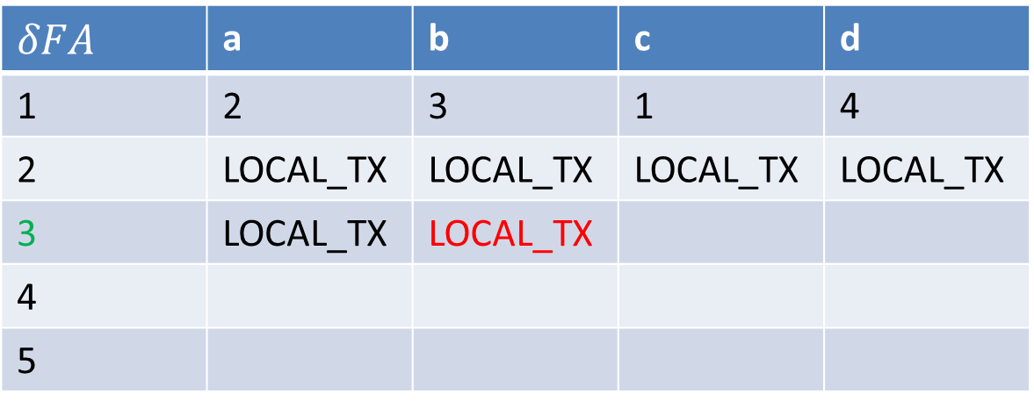
$δFA$ Construction
DFA | a | b | c | d
1 | 2 | 3 | 1 | 4
2 | 2 | 3 | 1 | 4
3 | 2 | 3 | 5 | 4
4 | 2 | 3 | 1 | 4
5 | 2 | 3 | 1 | 4
$$δFA$$ | a | b | c | d
1 | 2 | 3 | 1 | 4
2 | LOCAL_TX | LOCAL_TX | LOCAL_TX | LOCAL_TX
3 | LOCAL_TX | LOCAL_TX
4
5

Slide 29
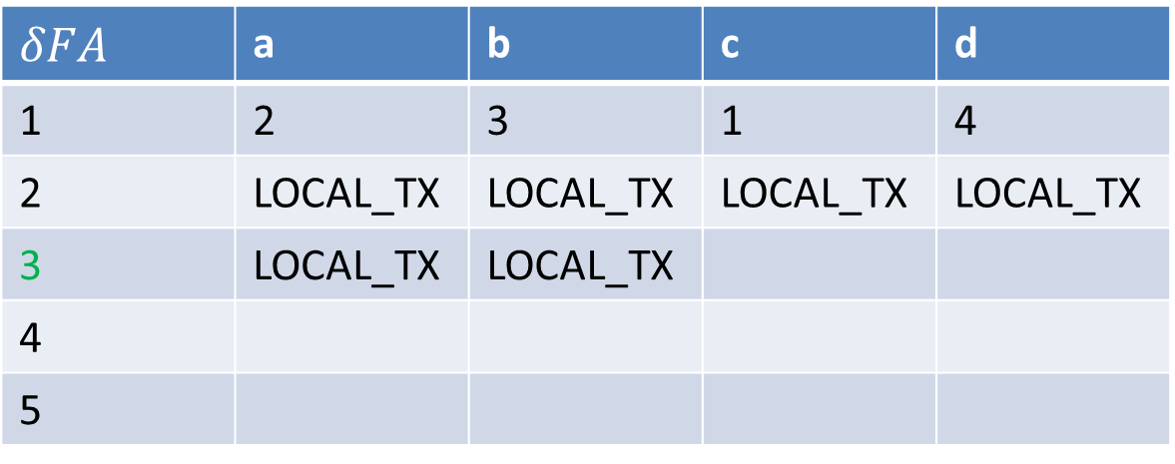
$δFA$ Construction
DFA | a | b | c | d
1 | 2 | 3 | 1 | 4
2 | 2 | 3 | 1 | 4
3 | 2 | 3 | 5 | 4
4 | 2 | 3 | 1 | 4
5 | 2 | 3 | 1 | 4
$$δFA$$ | a | b | c | d
1 | 2 | 3 | 1 | 4
2 | LOCAL_TX | LOCAL_TX | LOCAL_TX | LOCAL_TX
3 | LOCAL_TX | LOCAL_TX
4
5

Slide 30
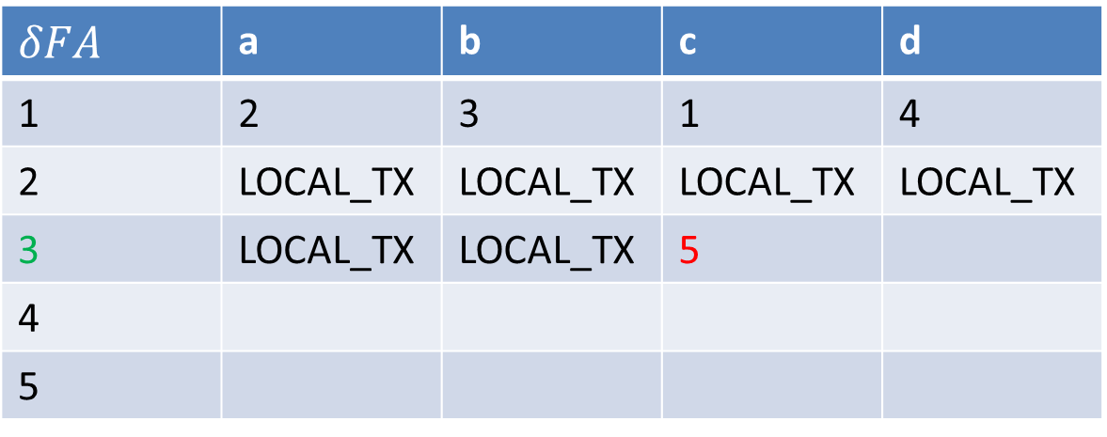
$δFA$ Construction
DFA | a | b | c | d
1 | 2 | 3 | 1 | 4
2 | 2 | 3 | 1 | 4
3 | 2 | 3 | 5 | 4
4 | 2 | 3 | 1 | 4
5 | 2 | 3 | 1 | 4
$$δFA$$ | a | b | c | d
1 | 2 | 3 | 1 | 4
2 | LOCAL_TX | LOCAL_TX | LOCAL_TX | LOCAL_TX
3 | LOCAL_TX | LOCAL_TX | 5
4
5

Slide 31
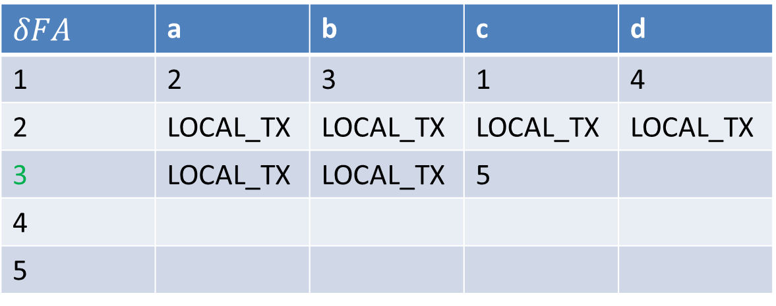
$δFA$ Construction
DFA | a | b | c | d
1 | 2 | 3 | 1 | 4
2 | 2 | 3 | 1 | 4
3 | 2 | 3 | 5 | 4
4 | 2 | 3 | 1 | 4
5 | 2 | 3 | 1 | 4
$$δFA$$ | a | b | c | d
1 | 2 | 3 | 1 | 4
2 | LOCAL_TX | LOCAL_TX | LOCAL_TX | LOCAL_TX
3 | LOCAL_TX | LOCAL_TX | 5
4
5

Slide 32
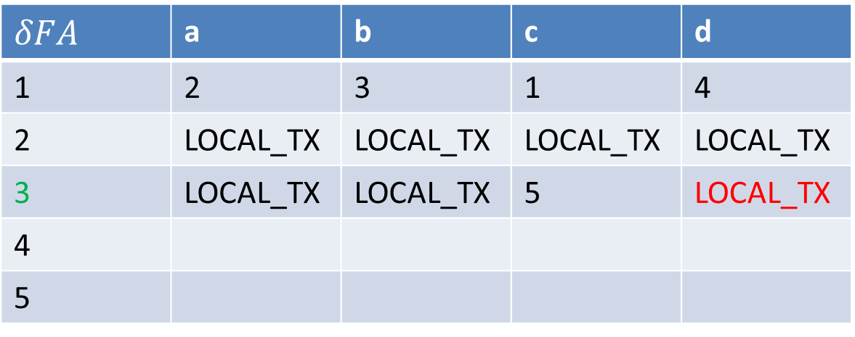
$δFA$ Construction
DFA | a | b | c | d
1 | 2 | 3 | 1 | 4
2 | 2 | 3 | 1 | 4
3 | 2 | 3 | 5 | 4
4 | 2 | 3 | 1 | 4
5 | 2 | 3 | 1 | 4
$$δFA$$ | a | b | c | d
1 | 2 | 3 | 1 | 4
2 | LOCAL_TX | LOCAL_TX | LOCAL_TX | LOCAL_TX
3 | LOCAL_TX | LOCAL_TX | 5 | LOCAL_TX
4
5

Slide 33
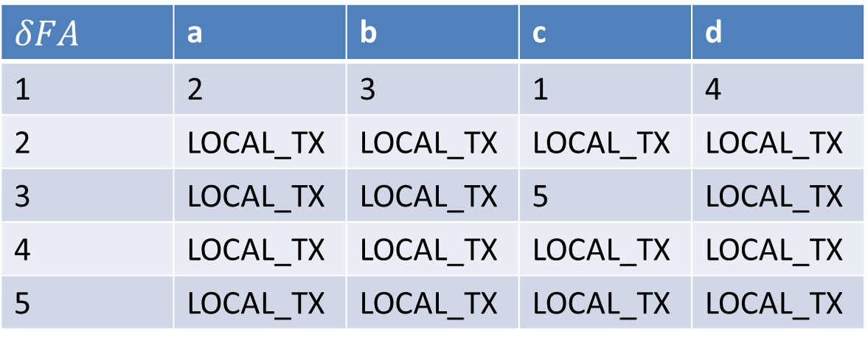
$δFA$ Construction
DFA | a | b | c | d
1 | 2 | 3 | 1 | 4
2 | 2 | 3 | 1 | 4
3 | 2 | 3 | 5 | 4
4 | 2 | 3 | 1 | 4
5 | 2 | 3 | 1 | 4
$$δFA$$ | a | b | c | d
1 | 2 | 3 | 1 | 4
2 | LOCAL_TX | LOCAL_TX | LOCAL_TX | LOCAL_TX
3 | LOCAL_TX | LOCAL_TX | 5 | LOCAL_TX
4 | LOCAL_TX | LOCAL_TX | LOCAL_TX | LOCAL_TX
5 | LOCAL_TX | LOCAL_TX | LOCAL_TX | LOCAL_TX

Slide 34
$δFA$ Construction
DFA | a | b | c | d
1 | 2 | 3 | 1 | 4
2 | 2 | 3 | 1 | 4
3 | 2 | 3 | 5 | 4
4 | 2 | 3 | 1 | 4
5 | 2 | 3 | 1 | 4
$$δFA$$ | a | b | c | d
1 | 2 | 3 | 1 | 4
2 | LOCAL_TX | LOCAL_TX | LOCAL_TX | LOCAL_TX
3 | LOCAL_TX | LOCAL_TX | 5 | LOCAL_TX
4 | LOCAL_TX | LOCAL_TX | LOCAL_TX | LOCAL_TX
5 | LOCAL_TX | LOCAL_TX | LOCAL_TX | LOCAL_TX

Slide 35
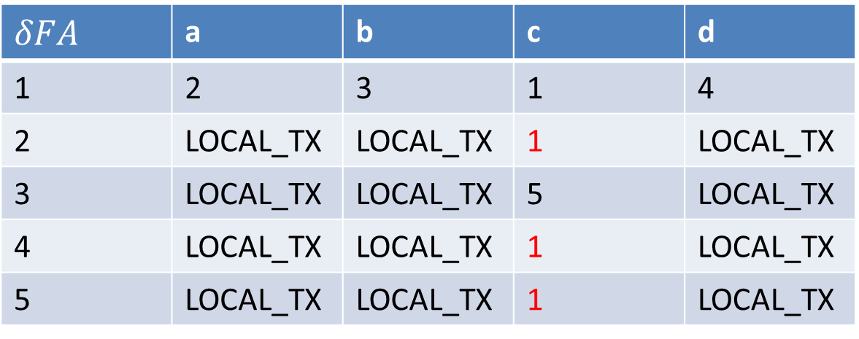
$δFA$ Construction
DFA | a | b | c | d
1 | 2 | 3 | 1 | 4
2 | 2 | 3 | 1 | 4
3 | 2 | 3 | 5 | 4
4 | 2 | 3 | 1 | 4
5 | 2 | 3 | 1 | 4
$$δFA$$ | a | b | c | d
1 | 2 | 3 | 1 | 4
2 | LOCAL_TX | LOCAL_TX | 1 | LOCAL_TX
3 | LOCAL_TX | LOCAL_TX | 5 | LOCAL_TX
4 | LOCAL_TX | LOCAL_TX | 1 | LOCAL_TX
5 | LOCAL_TX | LOCAL_TX | 1 | LOCAL_TX

Slide 36
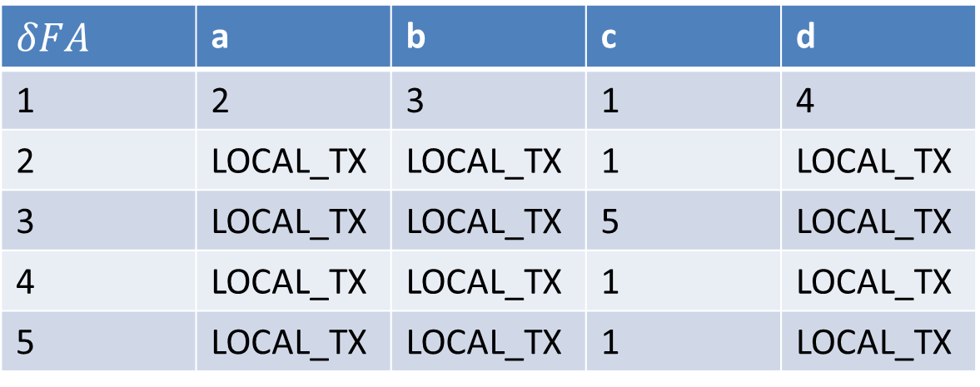
$δFA$ Construction
DFA | a | b | c | d
1 | 2 | 3 | 1 | 4
2 | 2 | 3 | 1 | 4
3 | 2 | 3 | 5 | 4
4 | 2 | 3 | 1 | 4
5 | 2 | 3 | 1 | 4
$$δFA$$ | a | b | c | d
1 | 2 | 3 | 1 | 4
2 | LOCAL_TX | LOCAL_TX | 1 | LOCAL_TX
3 | LOCAL_TX | LOCAL_TX | 5 | LOCAL_TX
4 | LOCAL_TX | LOCAL_TX | 1 | LOCAL_TX
5 | LOCAL_TX | LOCAL_TX | 1 | LOCAL_TX

Slide 37
$δFA$ Construction
DFA | a | b | c | d
1 | 2 | 3 | 1 | 4
2 | 2 | 3 | 1 | 4
3 | 2 | 3 | 5 | 4
4 | 2 | 3 | 1 | 4
5 | 2 | 3 | 1 | 4
$$δFA$$ | a | b | c | d
1 | 2 | 3 | 1 | 4
2 | LOCAL_TX | LOCAL_TX | 1 | LOCAL_TX
3 | LOCAL_TX | LOCAL_TX | 5 | LOCAL_TX
4 | LOCAL_TX | LOCAL_TX | 1 | LOCAL_TX
5 | LOCAL_TX | LOCAL_TX | 1 | LOCAL_TX

Slide 38
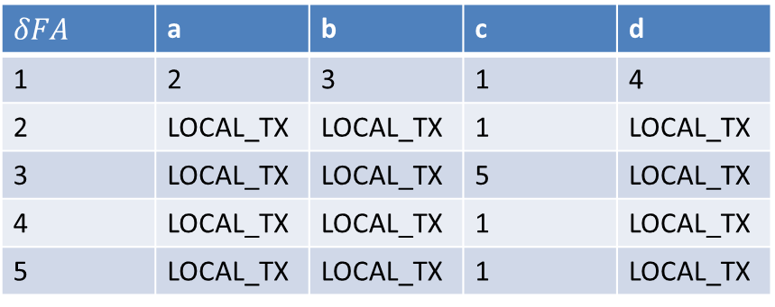
$δFA$ Construction
DFA | a | b | c | d
1 | 2 | 3 | 1 | 4
2 | 2 | 3 | 1 | 4
3 | 2 | 3 | 5 | 4
4 | 2 | 3 | 1 | 4
5 | 2 | 3 | 1 | 4
$$δFA$$ | a | b | c | d
1 | 2 | 3 | 1 | 4
2 | LOCAL_TX | LOCAL_TX | 1 | LOCAL_TX
3 | LOCAL_TX | LOCAL_TX | 5 | LOCAL_TX
4 | LOCAL_TX | LOCAL_TX | 1 | LOCAL_TX
5 | LOCAL_TX | LOCAL_TX | 1 | LOCAL_TX
Char-State | a | b | c | d
1 | 1 | 1 | 1 | 1
2 | 0 | 0 | 1 | 0
3 | 0 | 0 | 1 | 0
4 | 0 | 0 | 1 | 0
5 | 0 | 0 | 1 | 0

Slide 39
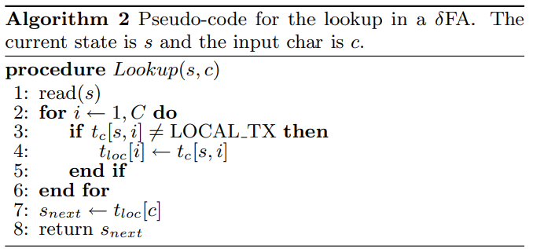

$Lookup$ Construction

Slide 40
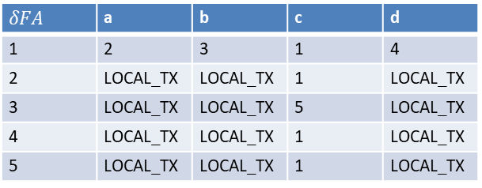
$Lookup$ Construction
Char-State | a | b | c | d
1 | 1 | 1 | 1 | 1
2 | 0 | 0 | 1 | 0
3 | 0 | 0 | 1 | 0
4 | 0 | 0 | 1 | 0
5 | 0 | 0 | 1 | 0
$$δFA$$ | a | b | c | d
1 | 2 | 3 | 1 | 4
2 | LOCAL_TX | LOCAL_TX | 1 | LOCAL_TX
3 | LOCAL_TX | LOCAL_TX | 5 | LOCAL_TX
4 | LOCAL_TX | LOCAL_TX | 1 | LOCAL_TX
5 | LOCAL_TX | LOCAL_TX | 1 | LOCAL_TX

Slide 41
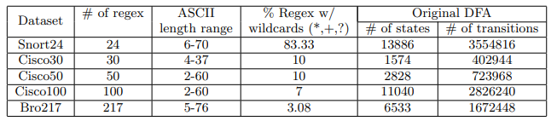
Experimental Results

Slide 42
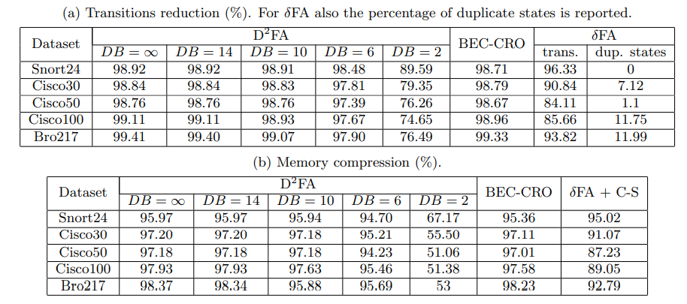
Experimental Results
Notes:
$D^{2}FA$: Delayed Input DFA, the code runs with different values of the diameter bound
DB: 在他的 spanning tree 中，兩點的最遠距離。
設定DB是因為要找最小$D^{2}FA$ 的話，會變成NP-HARD的問題。
DB為1的時候，可以再 polynomial time 轉換成$D^{2}FA$，在DB很大時，轉換又變成NP-Hard 了

Slide 43
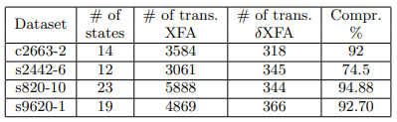
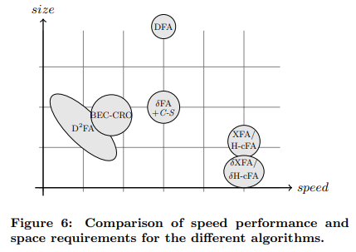
Experimental Results

Slide 44
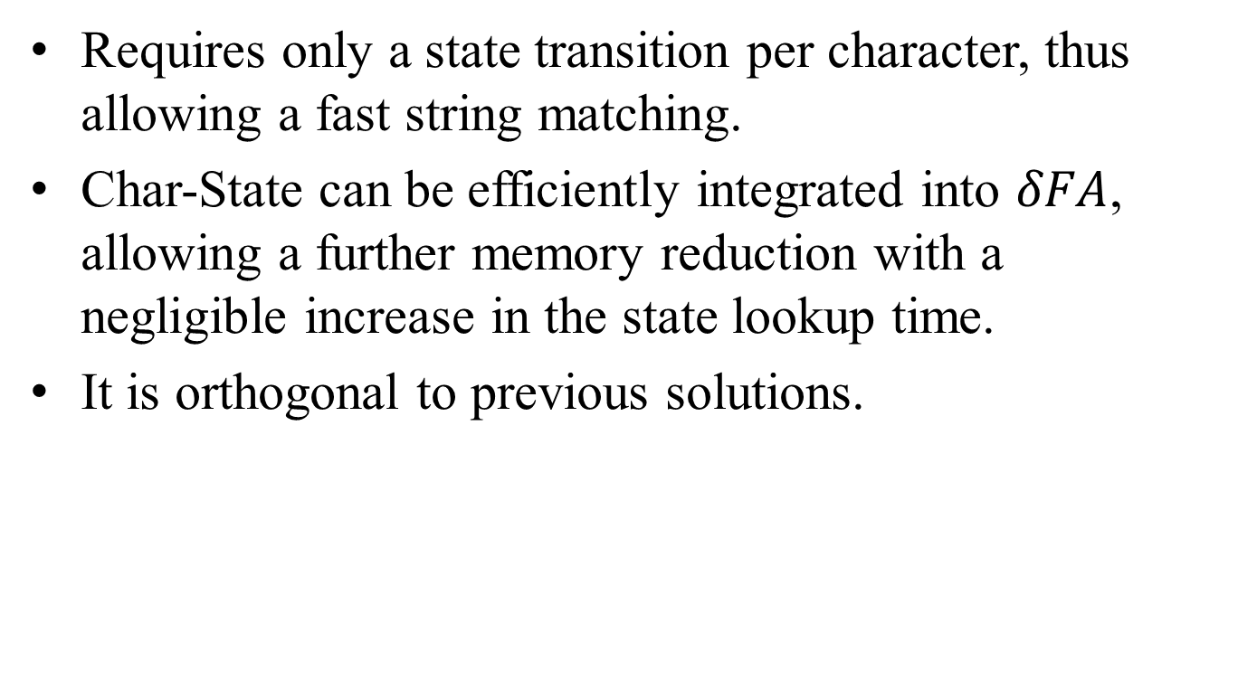
Conclusions
Requires only a state transition per character, thus allowing a fast string matching.
Char-State can be efficiently integrated into $δFA$, allowing a further memory reduction with a negligible increase in the state lookup time.
It is orthogonal to previous solutions.

