Slide 1
An Adaptive Crossover Distribution Mechanism For Genetic Algorithms
J. David Schaffer and Amy Morishima
Genetic Algorithms and their Applications: Proceedings of the Second International Conference on Genetic Algorithms, 1987, pp. 36-40.
Presenter : Tz-Hsu Lee
Date : Jan. 19, 2021.
Notes:
journal

Slide 2
Abstract(1/2)
This paper presents a new version of a class of search procedures usually called genetic algorithms. Our new version implements a modified string representation that includes special punctuation used by the crossover recombination operator. The idea behind this scheme was abstracted from the mechanics of natural genetics and seems to yield a search procedure wherein the action of the recombination operator can be made to adapt to the search space in parallel with the adaptation of the string contents. In addition, this adaptation happens for “for free” in that no additional operations beyond those of the traditional genetic algorithm are employed.

Slide 3
Abstract(2/2)
We present some empirical evidence that suggests this procedure may be as good as or better than the traditional genetic algorithm across a range of search problems and that its action does successfully adapt the search mechanics to the problem space.

Slide 4
Traditional Crossover
Parents :
Chromosome a : 0 0 0 0 0 0 0 0
Chromosome b : 1 1 1 1 1 1 1 1
Offspring :
Chromosome c : 0 0 0 1 1 1 1 1
Chromosome d : 1 1 1 0 0 0 0 0

Slide 5
Crossover with Punctuation
The chromosome : 0 1 1 0 0 0 1 1 0 0 0 1 0 0 1 0 0 0 0 0
Also can be interpreted as :
0 1!1 0 0! 0 1 1 0 0
0 1 0 0 1 0 0 0 0 0
Example :
Parents :
Chromosome a : a a a a a a a!b b b b b b b
Chromosome b : c c c c!d d d d d d!e e e e
Offspring :
Chromosome c : a a a a d d d b b b e e e e
Chromosome d : c c c c!a a a!d d d!b b b b

Slide 6
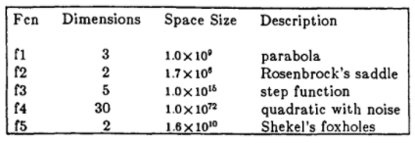
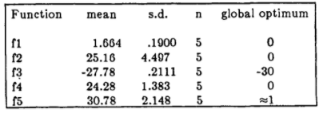
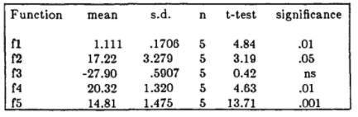
Result
Notes:
5000 times
Populaiton size 40
Crossver rate 0.45
Mutation 0.002
p

Slide 7
Competing Crossovers in an Adaptive GA Framework
A.E. Eiben, I.G. Sprinkhuizen-Kuyper, and B.A. Thijssen
IEEE International Conference on Evolutionary Computation proceedings: IEEE World Congress on Computational Intelligence, 1998, Anchorage, Alaska, USA, pp. 787-792.
Presenter : Tz-Hsu Lee
Date : Jan. 19, 2021.
Notes:
journal

Slide 8
Abstract(1/2)
In this paper we report the results of experiments on multi-parent reproduction in an adaptive genetic algorithm framework. An adaptive mechanism based on competing subpopulations is incorporated into the algorithm in order to detect the best crossovers. Experiments on a number of test functions designed for studying crossover performance show that multi-parent reproduction is superior to traditional two-parent crossover, but the adaptive mechanism is not able to reward better crossovers according to their performance. Nevertheless, the adaptive algorithm exhibits comparable performance to the nonadaptive variant using the best crossover alone.

Slide 9
Abstract(2/2)
This implies that it is sound and safe to use an adaptive GA with competing subpopulations/crossovers, instead of performing time consuming comparisons in search of the best operators.

Slide 10
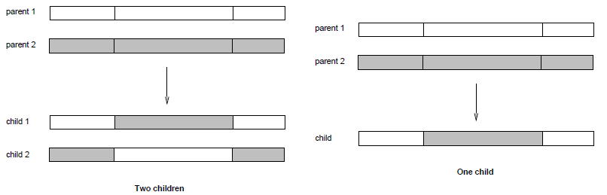
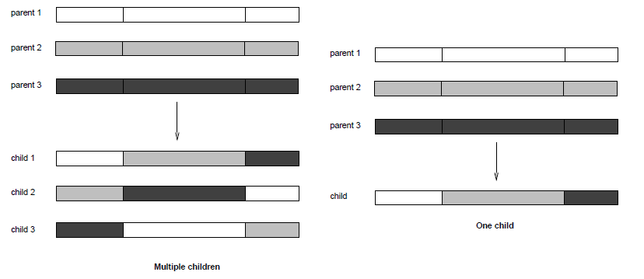
Crossover Operators

Slide 11
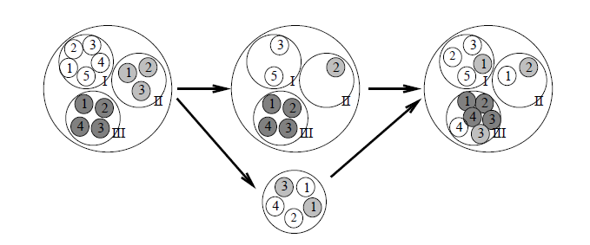
Adaptive GA Framework
Migration : to increase the size of successful subpopulations
Redivision : is to give a second chance to inferior subpopulations and make them increase in size.

Slide 12
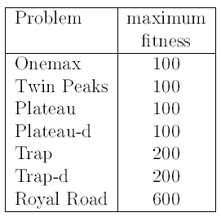
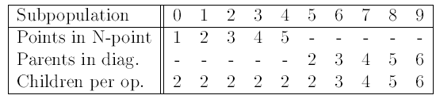
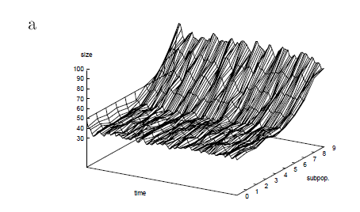
Result(1/5)
Notes:
10 subpopulations, initially containing 50 individuals each
pc = 0.7 and mutation rate pm = 0.005
In each series we executed 50 independent runs on each test function, the presented results are averaged over the 50 runs.
On each test function we observed that the crossovers with more parents were assigned larger subpopulations by the adaptive mechanism.
On the y axis we depict the 10 subpopulations, while the z axis shows the size of the subpopulation.
The maximum number of evaluations is 60000, migration is applied after every 30 evaluations, the frequency of applying the redividing mechanism is
set to 7500 evaluations.

Slide 13
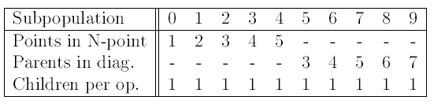
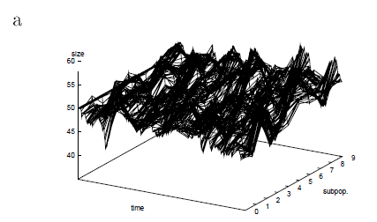
Result(2/5)
Notes:
The migration frequency is 100 evaluations, the redividing frequency is 5000 evaluations.

Slide 14
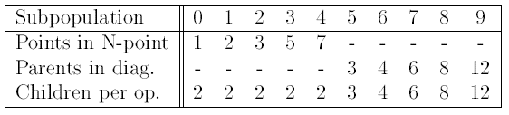
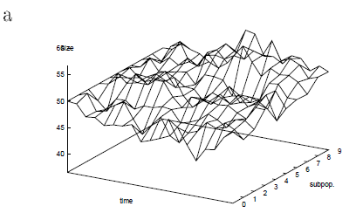
Result(3/5)
Notes:
The migration frequency was 240 evaluations, the redividing frequency was 5000 evaluations.

Slide 15
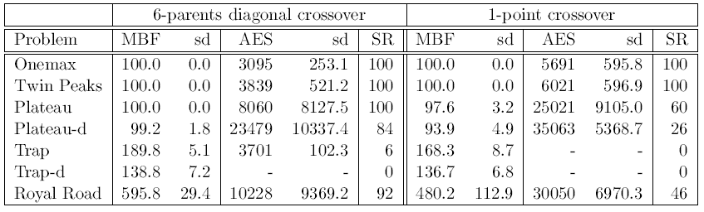
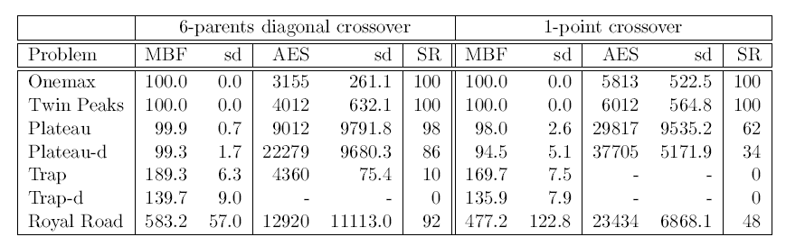
Result(4/5)
Notes:
one subpopulation of 500 individuals and executed 50 independent runs on each test function
the mean best function values (MBF),
the Average number of Evaluations to Solution (AES) with their standard deviations
and the Success Rates (SR) that is the percentage of all runs when an optimal solution was found.

Slide 16
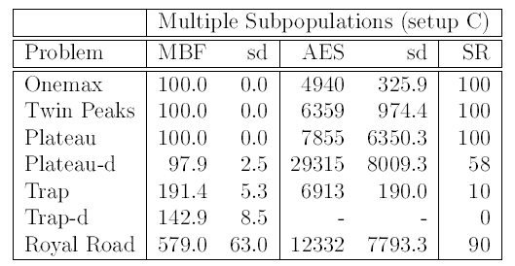
Result(5/5)
Notes:
one subpopulation of 500 individuals and executed 50 independent runs on each test function
the mean best function values (MBF),
the Average number of Evaluations to Solution (AES) with their standard deviations
and the Success Rates (SR) that is the percentage of all runs when an optimal solution was found.

