Slide 1
Who should bid higher, NS or WE, in a given Bridge deal?
Jacek Mańdziuk and Jakub Suchan
International Joint Conference on Neural Networks. Budapest, Hungary. 14-19 July 2019
Presenter: Jing-Ping Jan
Date: Aug. 17, 2021

Slide 2
Abstract
The paper proposes a neural model for a direct comparison of the two so-called Double Dummy Bridge Problem (DDBP) instances, along with a practical use-case for determining which pair, NS or W E, should propose the higher deal during a bidding phase in a Bridge game. The proposed system is composed of two identical subnetworks combined by a comparator layer placed on top of them. The base of each subnetwork is a shallow autoencoder (AE) which is further connected with a Multilayer Perceptron. The system is trained in two phases - an unsupervised one - used to create a meaningful feature-based input representation in AE compression layer, and a supervised one - meant for fine-tuning of the whole model. Training and test data are composed of pairs of Bridge deals in which the second deal in a pair is the first one rotated by 90 degrees.

Slide 3
Abstract
Since the task is to point which of the two deals promise a higher contract for the NS pair, due to deal rotation within a pair, the system effectively answers the title question “Who should bid higher, NS or WE, in a given deal?”. The proposed approach is experimentally compared with two other methods: one relying on a neural system solving the DDBP and the other one employing several estimators of hand strength used by experienced players. The results clearly indicate that both neural network approaches outperform the usage of human-scoring systems by a large margin, most notably in the trump (suit) contract.

Slide 4
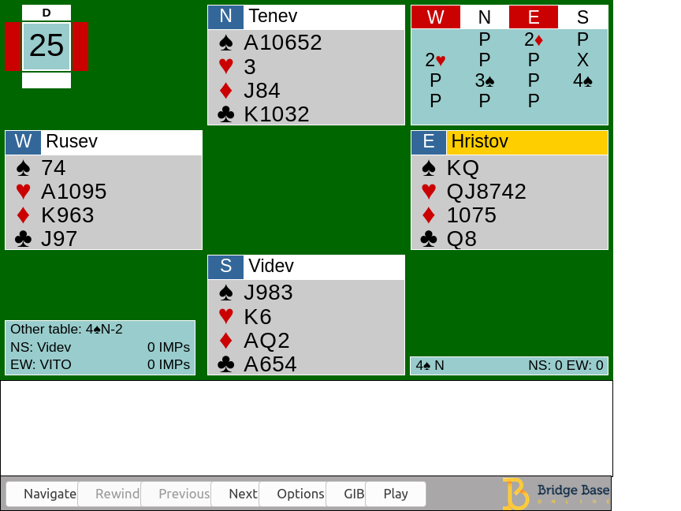
Introduction
Bidding stage Find the most profitable contract for the playing stage
Playing stage 13 rounds of a card-strength competition

Slide 5
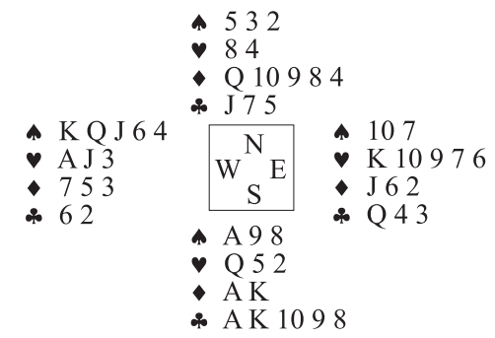
Who should bid higher, NS or WE, in a given Bridge deal?

Slide 6
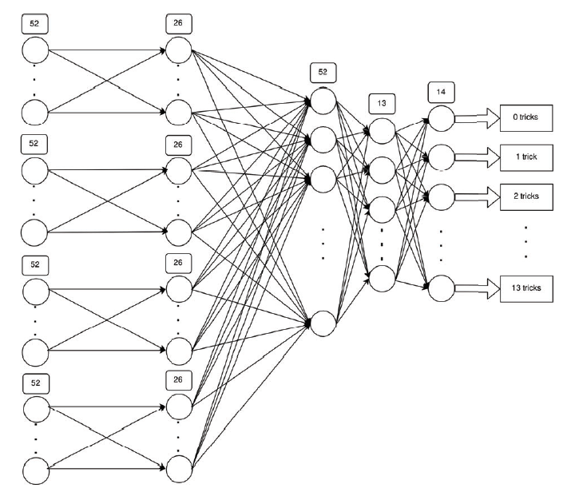
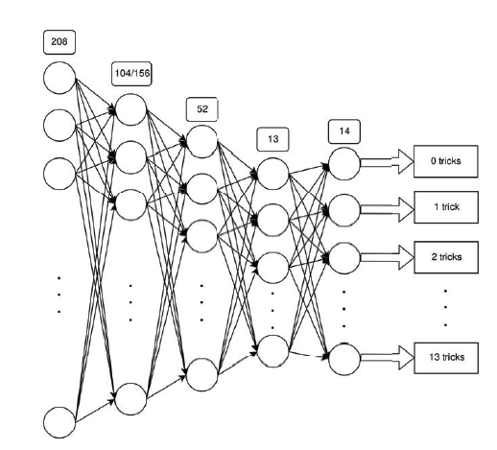
AE network

Slide 7
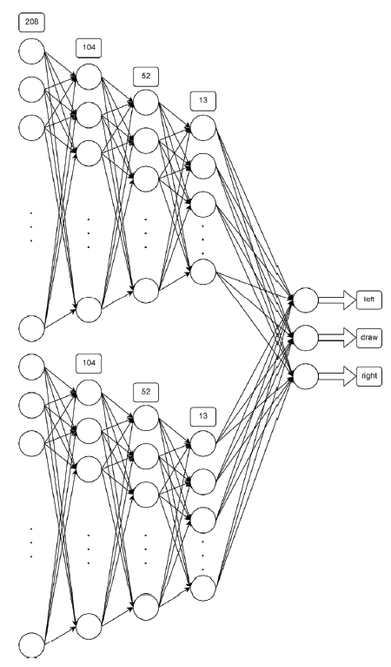
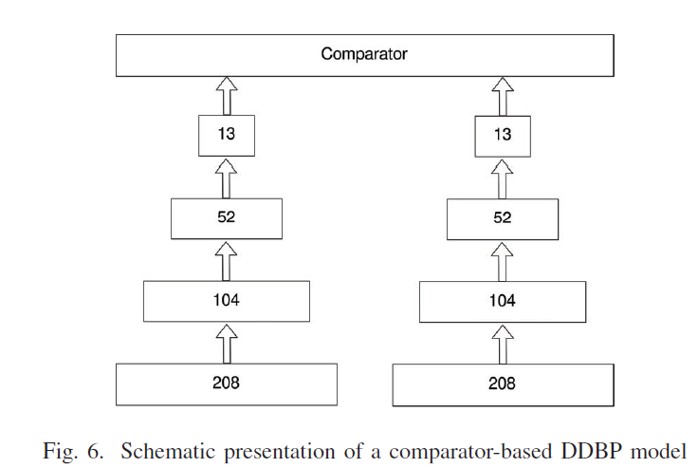
DeepChess-like neural system

Slide 8
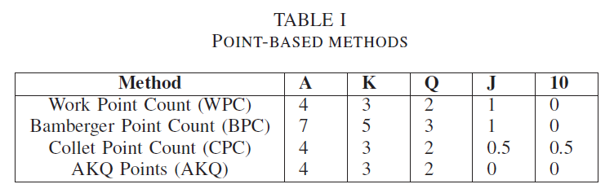
Bridge trick estimation methods
Assert system(AS): voids +2, singletons +1 and for each longer suit with more than 4 cards an additional +1
Rule of three and four (R34):
Trump suit: For each card, starting from the 5th in the trump suit, an additional point is added
Nontrump suit: : For each card, starting from the 4th in the trump suit, an additional point is added
Plus value (PV):
Ace: +0.25
10: with any other honor or with a 9. +0.5
With 3 honors or 2 out of AKQ: +0.5

Slide 9
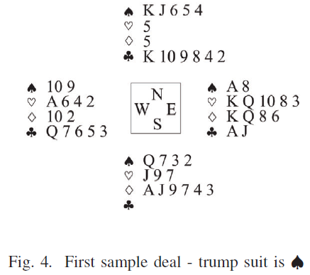
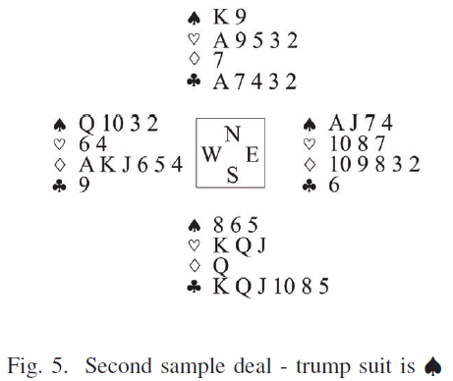
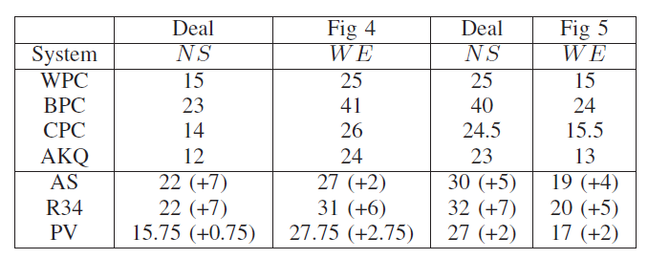
Example

Slide 10
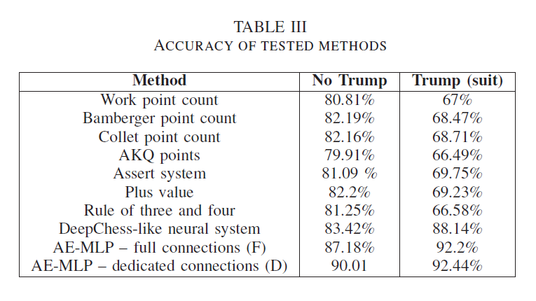
Result

