Slide 1
A New Algorithm for "The LCS Problem" with Application in Compressing
Genome Resequencing Data
Richard Beal, Tazin Afrin, Aliya Farheen and Don Adjeroh
2015 IEEE International Conference on Bioinformatics and Biomedicine (BIBM) 9-12 Nov. 2015
Washington, DC, USA
Presenter: Shin-Cheng Lin
Date: Nov. 9, 2021

Slide 2
Abstract(1/2)
The longest common subsequence (LCS) problem is a classical problem in computer science, and forms the basis of the current best-performing reference-based compression schemes for genome resequencing data. First, we present a new algorithm for the LCS problem. Then, we introduce an LCS-motivated reference-based compression scheme using the components of the LCS, rather than the LCS itself. For the Homo sapiens genome (original size 3,080,436,051 bytes), our proposed scheme compressed the genome to 5,267,656 bytes.

Slide 3
Abstract(2/2)
This can be compared with the previous best results of 19,666,791 bytes (Wang and Zhang, 2011) and 17,971,030 bytes (Pinho, Pratas, and Garcia, 2011). Thus, our compression ratio is about 3.73 to 3.41 times better than those from the state-of-the-art reference-based compression algorithms.

Slide 4
Use the suffix tree to compute the common substrings (CSSs).
Use the CSSs to construct a directed acyclic graph (DAG).
Compute LCS by finding the longest path in the DAG.

Slide 5
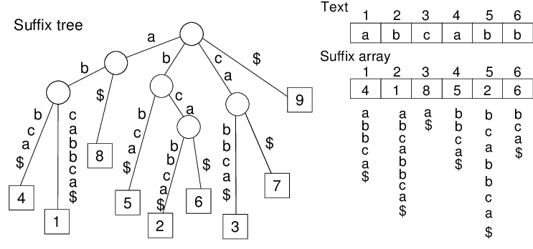
suffix tree

Slide 6
common substrings (CSSs)
X = xabxa, and Y = babxba
xabxa#babxba$

Slide 7
common substrings (CSSs)
MATCH {id, p1, p2}
O(max{n + m, T})

Slide 8
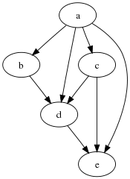
DAG
Use the PREV to find the set of parents
PREV pv
{MATCH table1 [][], table2 [][]; ; HashMap<int,int> ml, m2}

Slide 9
MATCH {id, p1, p2}
HashMap<id,p1> m1
HashMap<id,p2> m2

Slide 10
table1 [|m1|][|m2|] : the closest MATCH with respect to the p1 values
table2 [|m1|][|m2|] : the closest MATCH with respect to the p2 values
Insert all MATCHes to table

Slide 11
MATCH a {id, p1, p2}
table1[a.p1][a.p2]=a
table1[i][j] = table1 [i - l][j] if table1 [i][j] = null
2 | Null | 3 | Null
Null | 4 | Null | Null
2 | 2 | 3 | 3
Null | 4 | 4 | 4

Slide 12
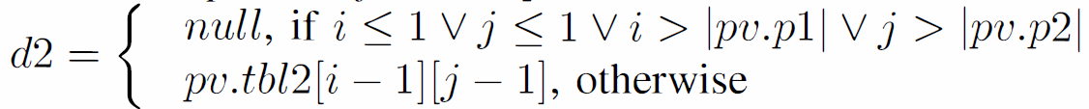
Get all Direct Parents
all Direct Parents:
all MATCHes before d1 and d2

Slide 13
LSC
Topological Sorting for DAG

Slide 14
Complexity Analysis
(i) O(max{n + m, T})
(ii) O(max{ nm, T × t_{getprnts}})
Worst O(max{nm, T × max{n, m}})
Average O(max{nm, × |Σ|})
(iii) O(T+E)
O(max{nm, T × max{n, m}})

Slide 15
Compression
If CSS < k, simply encode the symbol
Otherwise, encode this CSS with the triple (pT, pZ, l)
pT is the starting position of the CSS in T
pZ is the starting position of the CSS in Z[l...i - 1], Z=R◦T
l = LPF[i] is the length of the CSS.

