Slide 1
Recommending Bids on Dou-DiZhu Poker Games:
A Deep Learning Approach
Bo Yuan, Shuqin Li
Chinese Automation Congress (CAC), November 6-8, 2020
Presenter: Ying-Yu Lin
Date: Nov. 9, 2021

Slide 2
Abstract:
Dou-DiZhu game is a famous traditional Chinese poker game, which requires one player playing cards against the alliance of the other two players. This paper has made a first attempt to establish a machine-aided playing strategy to help player to call bids with a higher gain. In particular, a Convolutional Neural Network (CNN) based recommendation model is proposed to combine the feature of player's hand sequence and strength. To validate the feasibility of the proposed method, a real-world dataset is utilized to examine the performance of the recommendation results outputted the proposed model. The results of comparative experiments show that the proposed model achieves a higher precision, recall, F1 and accuracy performance than traditional machine learning models and single-feature based deep learning models.

Slide 3

鬥地主規則介紹-叫地主
兩位農民合攻一位地主
只要一位農民出完牌就算農民獲勝
地主不是通賠就是通殺
輪流當莊家
從莊家開始逆時針叫地主
叫地主分數:0,1,2,3,6,12,24
地主可多擁有三張牌

Slide 4
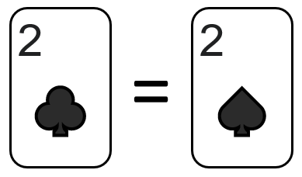

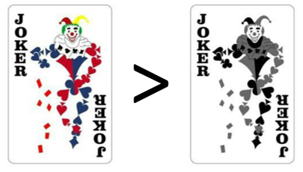
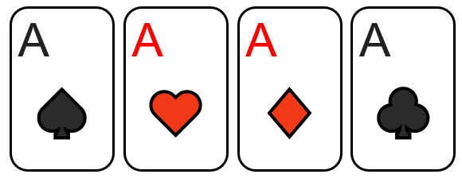
鬥地主規則介紹-玩牌
所有的牌只比點數大小不比花色
鬼牌在鬥地主中是王牌，彩色鬼牌比黑白鬼牌大
火箭:同時拿到兩張鬼牌，可壓倒所有牌型，積分也翻倍
炸彈(鐵支):四張一樣的牌，積分翻倍

Slide 5
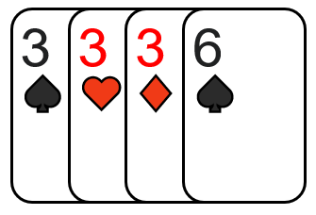
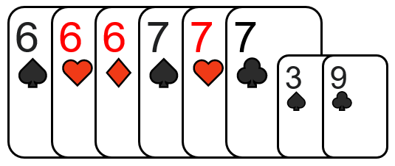
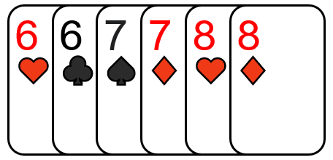
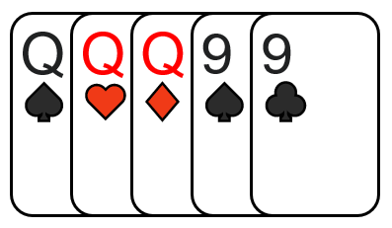
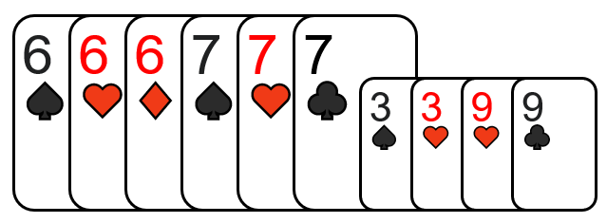
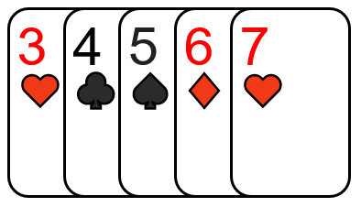
鬥地主規則介紹-玩牌
三帶一:三張一樣的牌加上一張廢牌
三帶二:三張一樣的牌加上一對
飛機:連號的三帶一或三帶二，2除外
連對:只要三組以上連號的對子可以一起出，2除外
順子:至少五張最多12張，從3~A都可以一起出

Slide 6
card sequence vector
1 | 0 | 0 | 0 | 0 | 0 | 0 | 0 | 0 | 0 | 0 | 0 | 0 | 0 | 0
0 | 1 | 0 | 0 | 0 | 0 | 0 | 0 | 0 | 0 | 0 | 0 | 0 | 0 | 0
0 | 0 | 0 | 1 | 0 | 0 | 0 | 0 | 0 | 0 | 0 | 0 | 0 | 0 | 0
0 | 0 | 0 | 1 | 0 | 0 | 0 | 0 | 0 | 0 | 0 | 0 | 0 | 0 | 0
0 | 0 | 0 | 1 | 0 | 0 | 0 | 0 | 0 | 0 | 0 | 0 | 0 | 0 | 0
0 | 0 | 0 | 0 | 1 | 0 | 0 | 0 | 0 | 0 | 0 | 0 | 0 | 0 | 0
0 | 0 | 0 | 0 | 1 | 0 | 0 | 0 | 0 | 0 | 0 | 0 | 0 | 0 | 0
0 | 0 | 0 | 0 | 0 | 1 | 0 | 0 | 0 | 0 | 0 | 0 | 0 | 0 | 0
0 | 0 | 0 | 0 | 0 | 1 | 0 | 0 | 0 | 0 | 0 | 0 | 0 | 0 | 0
0 | 0 | 0 | 0 | 0 | 0 | 1 | 0 | 0 | 0 | 0 | 0 | 0 | 0 | 0
0 | 0 | 0 | 0 | 0 | 0 | 0 | 1 | 0 | 0 | 0 | 0 | 0 | 0 | 0
0 | 0 | 0 | 0 | 0 | 0 | 0 | 0 | 1 | 0 | 0 | 0 | 0 | 0 | 0
0 | 0 | 0 | 0 | 0 | 0 | 0 | 0 | 0 | 1 | 0 | 0 | 0 | 0 | 0
0 | 0 | 0 | 0 | 0 | 0 | 0 | 0 | 0 | 0 | 0 | 1 | 0 | 0 | 0
0 | 0 | 0 | 0 | 0 | 0 | 0 | 0 | 0 | 0 | 0 | 0 | 1 | 0 | 0
0 | 0 | 0 | 0 | 0 | 0 | 0 | 0 | 0 | 0 | 0 | 0 | 1 | 0 | 0
0 | 0 | 0 | 0 | 0 | 0 | 0 | 0 | 0 | 0 | 0 | 0 | 0 | 0 | 1

Slide 7
card strength vector
7種牌張數的統計
(火箭、炸彈、三帶一、三帶二、飛機、連對、順子)
結合8種遊戲中組合牌型抽取結果
card sequence vector + card strength vector
=18*15 input matrix
單張 | 15
順子 | 36
一對 | 13
連對 | 52
三張 | 13
三順 | 45
三帶一 | 13
飛機帶單 | 38
三帶二 | 13
飛機帶對 | 30
四帶二單 | 13
四帶二對 | 13
炸彈 | 13
火箭 | 1
pass | 1

Slide 8
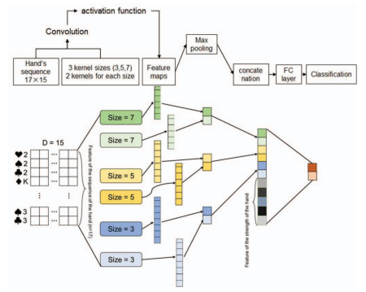





(1)
(2)
(3)
(4)
(5)
Cross-Entropy Loss function

Slide 9
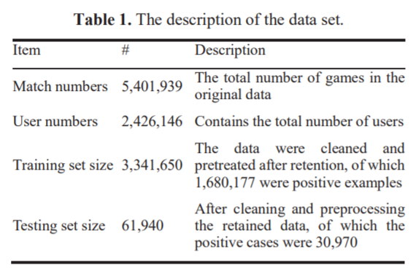
Data set

Slide 10
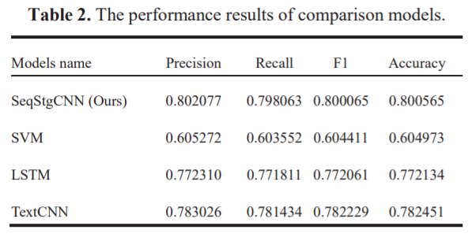
Experimental result

