Slide 1
Energy-efficient bi-objective single-machine scheduling with power-down mechanism
Che, Ada, Wu, Xueqi, Peng, Jing, Yan, Pengyu
Computers & Operations Research Volume 85, September 2017, Pages 172-183
Date: Nov. 9, 2021
Presenter: Jue-Jun Wu
Notes:
車 無薛琦 鵬竟

Slide 2
Abstract
This paper considers a single-machine scheduling problem with power-down mechanism to minimize both total energy consumption and maximum tardiness. The aim is to find an optimal processing sequence of jobs and determine if the machine should be executed a power-down operation between two consecutive jobs. To formulate the problem, a mixed-integer linear programming (MILP) model is developed. Then a basic ε − constraint method is proposed to obtain the complete Pareto front of the problem. Considering the particularity of the problem, we also develop local search, preprocessing technique and valid inequalities to strengthen the basic ε − constraint method. Finally, to obtain approximate Pareto fronts for large-size problems, we utilize the method of cluster analysis to divide the jobs into several sorted clusters according to their release times and due dates. Any job in a preceding cluster must be processed before all jobs in a subsequent cluster. Thus, the solution space is reduced significantly. Computational experiments on benchmark and randomly generated instances demonstrate the effectiveness of the proposed exact and approximation approaches.

Slide 3
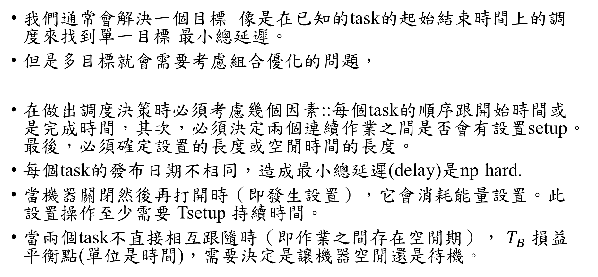
我們通常會解決一個目標 像是在已知的task的起始結束時間上的調度來找到單一目標 最小總延遲。
但是多目標就會需要考慮組合優化的問題，
在做出調度決策時必須考慮幾個因素::每個task的順序跟開始時間或是完成時間，其次，必須決定兩個連續作業之間是否會有設置setup。最後，必須確定設置的長度或空閒時間的長度。
每個task的發布日期不相同，造成最小總延遲(delay)是np hard.
當機器關閉然後再打開時（即發生設置），它會消耗能量設置。此設置操作至少需要 Tsetup 持續時間。
當兩個task不直接相互跟隨時（即作業之間存在空閒期）， $T_{B}$ 損益平衡點(單位是時間)，需要決定是讓機器空閒還是待機。

Slide 4
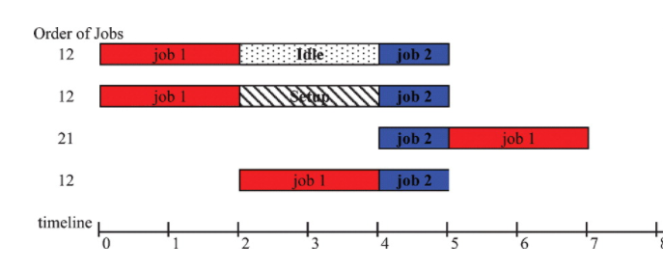
 | Processing time | Release time | Due date
Job1 | 2 s | Begin 0 s | End 3 s
Job2 | 1s | Begin 4 s | End 6 s
Processing power | Idle power | Setup energy (1.5 hp.sec , 2s)
2 hp | 1 hp | 1.5 hp
Total energy consumption | Total Tardiness (Delay)
8 hp | 0
7.5 hp | 0
6 hp | 4
6 hp | 1
Notes:
複雜性源於調度目標以及作業之間的設置，以及決定設置的長度和空閒持續時間

Slide 5
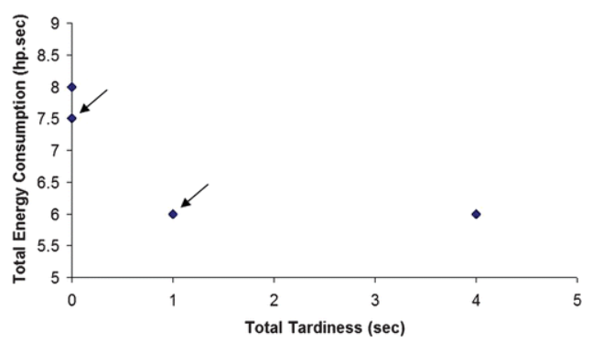
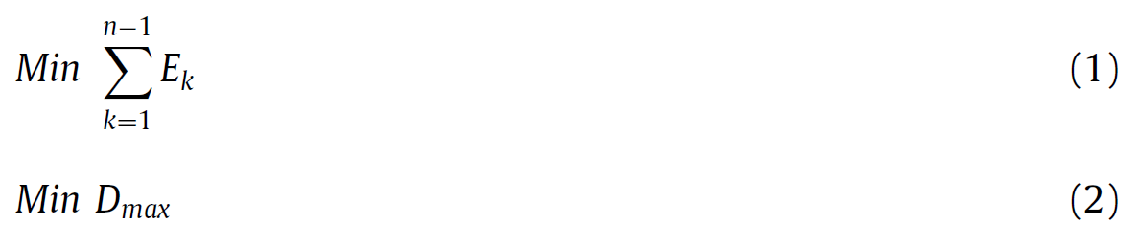
Total energy consumption | Total Tardiness (Delay)
8 hp | 0
7.5 hp | 0
6 hp | 4
6 hp | 1

Slide 6
Randomly parameter generated
1. The processing time of each job follows a uniform distribution between 1 and 5 time units.
2. The release time of each job follows an exponential distribution with a mean of 10 time units.
3. The due date of each job is the sum of three parts: its release time, processing time and a slack time
4. The parameter β reflects the degree of how far the due date deviates from the release time. As the value of β increases, the due dates become more spread over time.
Notes:
複雜性源於調度目標以及作業之間的設置，以及決定設置的長度和空閒持續時間
參數 β 確定截止日期與發布日期之間的距離

Slide 7

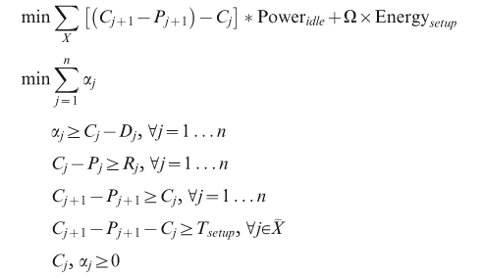
Notes:
我們通常會解決一個目標 像是在已知的task的起始結束時間上的調度來找到單一目標 最小總延遲。
但是多目標就會需要考慮組合優化的問題，
當作業的順序和設置順序是已知的，必須將非線性的總延遲目標線性化.變成一個線性問題。

Slide 8
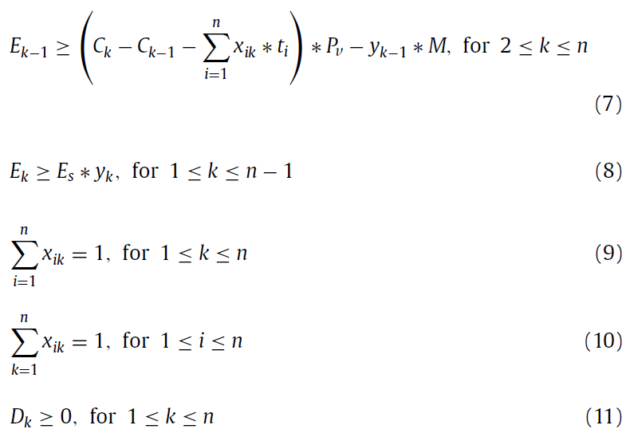
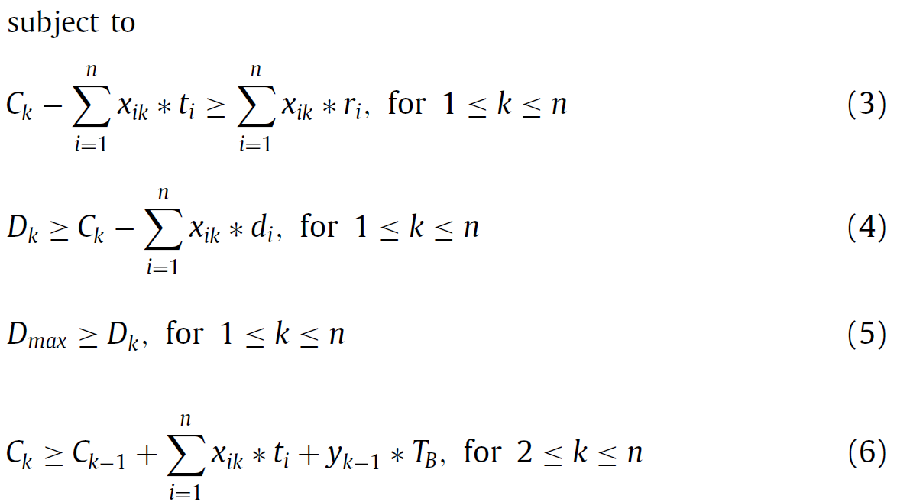
Notes:
作業的順序和設置順序是已知的
必須將非線性的總延遲目標線性化

Slide 9
Process
1. Append one task to the solution, from the candidate list by its due date and release date.
2. During the construction, first append the task to the sequence(no matter if there is a setup or not) to evaluate each candidate task.
3. Might have many different length answers, by idle or setup time, compare the different solution cause by different candidate solution, we separate the dominate and non-dominate solution.
4. The restricted candidates list is composed of the candidates leading to the non‐dominated solution, then it is added to the pareto set. As a result, after each iteration of the local search an approximate pareto front is obtained.
Notes:
在構建階段，首先，必須通過將此作業添加到序列中（無論是否設置setup）來評估每個候選作業。在此評估中， 可能會導致具有不同長度的空閒週期或設置持續時間的多個解決方案。比較每個候選工作的解決方案，並將非主導的解決方案與主導的解決方案分開。
在multiobjective 問題下，使用Local search 會變成像是在解單一問題。 我們試著找到一系列的solutions 而不是唯一的最佳解。

Slide 10
Single objective total tardiness problem
 | 1.The exchange of two jobs 2.The insertion of a job between two consecutive jobs | 1.Swapping the positions of two consecutive jobs 2. Setup or not
Size | n×(n−1)/2 ,very time‐consuming | 2×(n−1), in a reasonable amount of time
1 | NS | 2 | S | 3 | NS | 4
2 | S | 1 | S | 3 | NS | 4
1 | NS | 3 | S | 2 | NS | 4
1 | NS | 2 | S | 3 | NS | 4
1 | NS | 3 | NS | 2 | NS | 4
1 | NS | 2 | S | 4 | S | 3
Notes:
在構建階段，首先，必須通過將此作業添加到序列中（無論是否設置setup）來評估每個候選作業。
在此評估中， 可能會導致具有不同長度的空閒週期或設置持續時間的多個解決方案。

Slide 11
Process
1. Append one task to the solution, from the candidate list by its due date and release date.
2. During the construction, first append the task to the sequence(no matter if there is a setup or not) to evaluate each candidate task.
3. Might have many different length answers, by idle or setup time, compare the different solution cause by different candidate solution, we separate the dominate and non-dominate solution.
4. The restricted candidates list is composed of the candidates leading to the non‐dominated solution, then it is added to the pareto set. As a result, after each iteration of the local search an approximate pareto front is obtained.
Notes:
在構建階段，首先，必須通過將此作業添加到序列中（無論是否設置setup）來評估每個候選作業。
在multiobjective 問題下，使用Local search 會變成像是在解單一問題。 我們試著找到一系列的solutions 而不是唯一的最佳解。

Slide 12
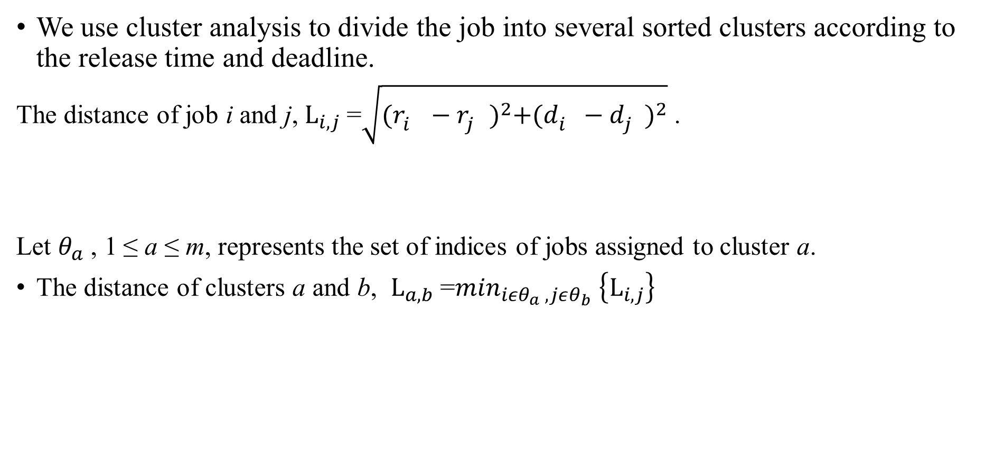
Clustering of jobs to obtain approximate Pareto front
We use cluster analysis to divide the job into several sorted clusters according to the release time and deadline.
The distance of job i and j, $L_{i,j}$=$\sqrt{{(r_{i}^{}−r_{j}^{})}^{2}+{(d_{i}^{}−d_{j}^{})}^{2}}$ .
Let $θ_{a}$, 1 ≤ a ≤ m, represents the set of indices of jobs assigned to cluster a.
The distance of clusters a and b, $L_{a,b}$=$\min_{iεθ_{a} , jεθ_{b}} \left\{L_{i,j}\right\}$
Notes:
生成的集群總數需要預先確定。在每次迭代中，距離最短的兩個簇合併為一個，直到簇數等於 m。
請注意，使用較少的集群數量，我們將修復較少的二元變量的值，這會導致更精確的帕累托前沿，同時消耗更多的計算時間。

Slide 13
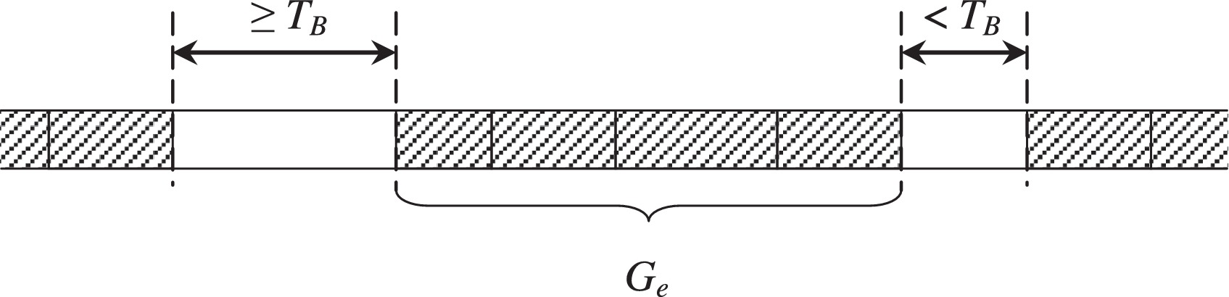
Local search to enhanced ε–constraint method
If there exists only one effective group in the solution corresponding to (E⁰,D⁰), then we can obtain the feasible point (E⁰ − P_{v} ,D⁰ + 1) with local search, without missing out any of the integer Pareto optimal points.
k₁ (k₁ ≥ 1) effective groups ->obtain the feasible point (E⁰ − k₁*P_{v},D⁰ + 1).
The above local search fails when there exists no effective group in the solution.
Notes:
(E0,D0)對應的解中存在有效組的情況，第一種局部搜索是將每個有效組中所有作業的開始時間推遲一個時間單位。那麼我們就可以得到一個可行解，

Slide 14
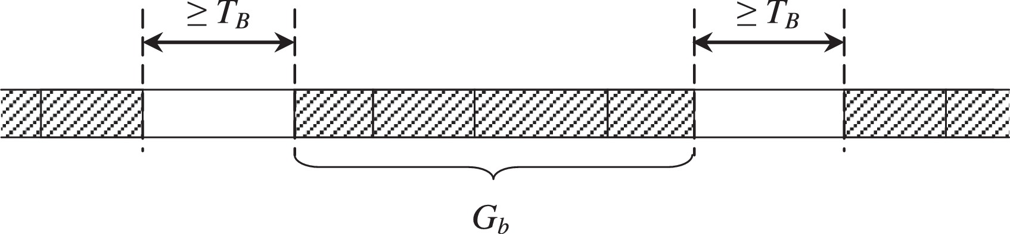
We checked the point (E⁰ − P_{v} ,D⁰ + k₂), where k2 is the time units by which the chosen blocked group has been postponed. (E⁰ − P_{v} ,D′(E⁰ − P_{v})) is the next Pareto optimal point.
If no effective group, local search will postpone the only blocked group and the job with maximum tardiness must lie in it.
Notes:
Note that in the second type of local search, we only need to postpone one blocked group.

Slide 15
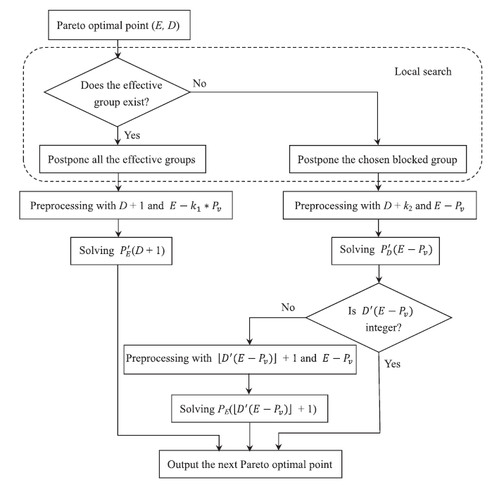
Notes:
請注意，k1 表示對應於 (E, D) 的解中有效組的數量，而 k2 是所選阻塞組被推遲的時間單位。

Slide 16
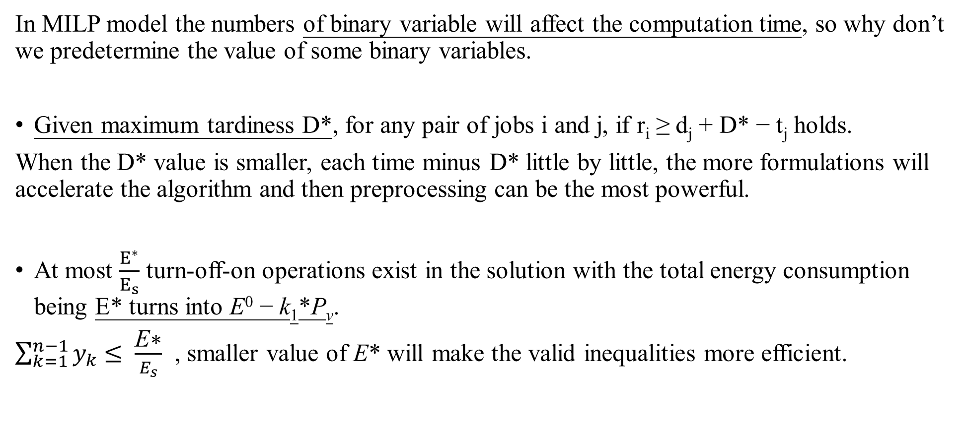
Dynamic preprocessing technique and valid inequalities
In MILP model the numbers of binary variable will affect the computation time, so why don’t we predetermine the value of some binary variables.
Given maximum tardiness D*, for any pair of jobs i and j, if r_{i} ≥ d_{j} + D* − t_{j} holds.
When the D* value is smaller, each time minus D* little by little, the more formulations will accelerate the algorithm and then preprocessing can be the most powerful.
At most $\frac{E^{∗}}{E_{s}}$ turn-off-on operations exist in the solution with the total energy consumption being E* turns into E⁰ − k₁*P_{v}.
$\sum_{k=1}^{n−1}{y_{k}}$ $≤ \frac{\text{E}\text{∗}}{E_{s}}$ , smaller value of E* will make the valid inequalities more efficient.
Notes:
D* 和 E* 會隨著迭代的進行而動態變化，
yk 表示在第 k 個作業和第 (k + 1) 個作業之間是否應該存在關閉-開啟操作

Slide 17
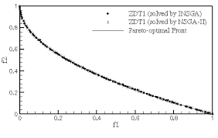
If there exists an effective group in any Pareto optimal point of the problem, then it has infinite number of Pareto optimal points.
We can find all Pareto optimal integer points by decreasing the value of ε by one each time where E and D are restricted to integer values .
Notes:
若存在無限個optimal points，是不可能全部獲得的，所以當限制ED 都為整數時
我們以最大延遲為主要目標，並使用 ε 約束來製定能耗，因為這樣，稍後將介紹的局部搜索和預處理技術可以更容易應用，

Slide 18
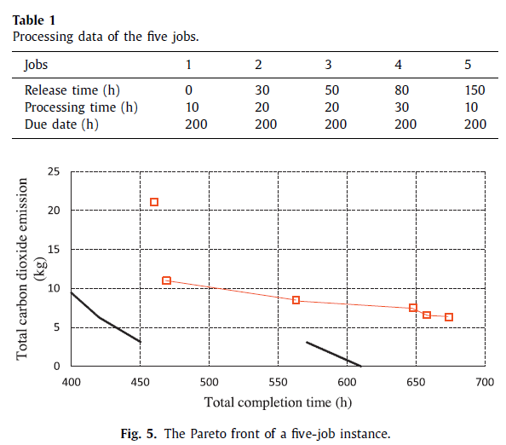
Benchmark instances
The machine consumes 0.4 kw when it is idle and 3 kw when working.
Each turn-off-on operation takes 12 h and requires 4 kwh of electricity.
Liu et al.(2014)
Author’s

Slide 19
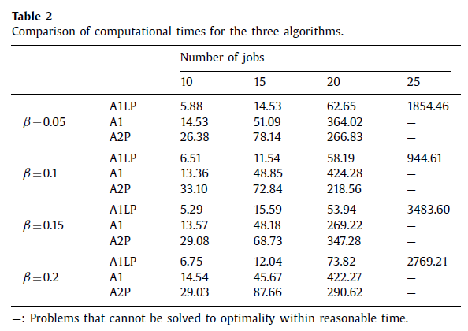
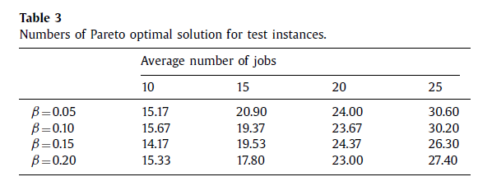

Slide 20
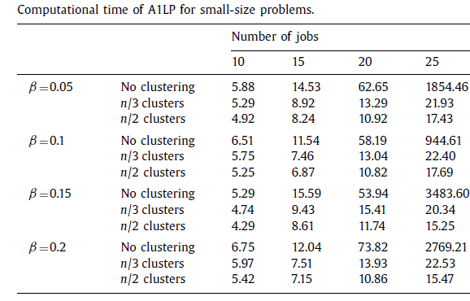
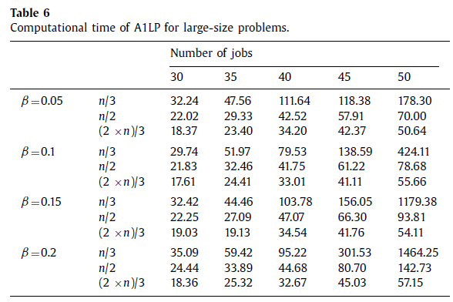
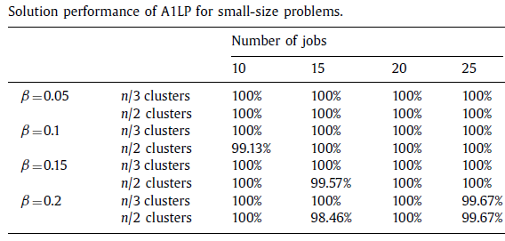
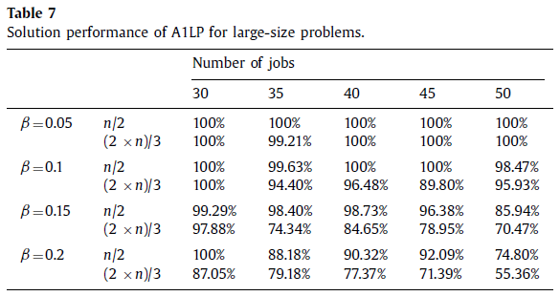
Notes:
它的解決方案性能幾乎不受作業聚類的影響。然而，在聚類過程的幫助下，我們的算法得到了極大的加速。

Slide 21
Conclusion
Author proposed a basic ε − constraint method and developed local search, preprocessing technique and valid inequalities to enhance the proposed model.
In its practical significance, the proposed model and methods provide production managers with a decision support tool to make reasonable trade-offs between energy consumption and maximum tardiness in production scheduling.
Notes:
掉電機制的單機調度問題

Slide 22
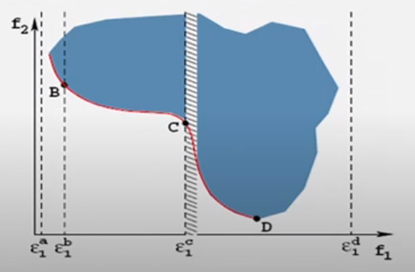
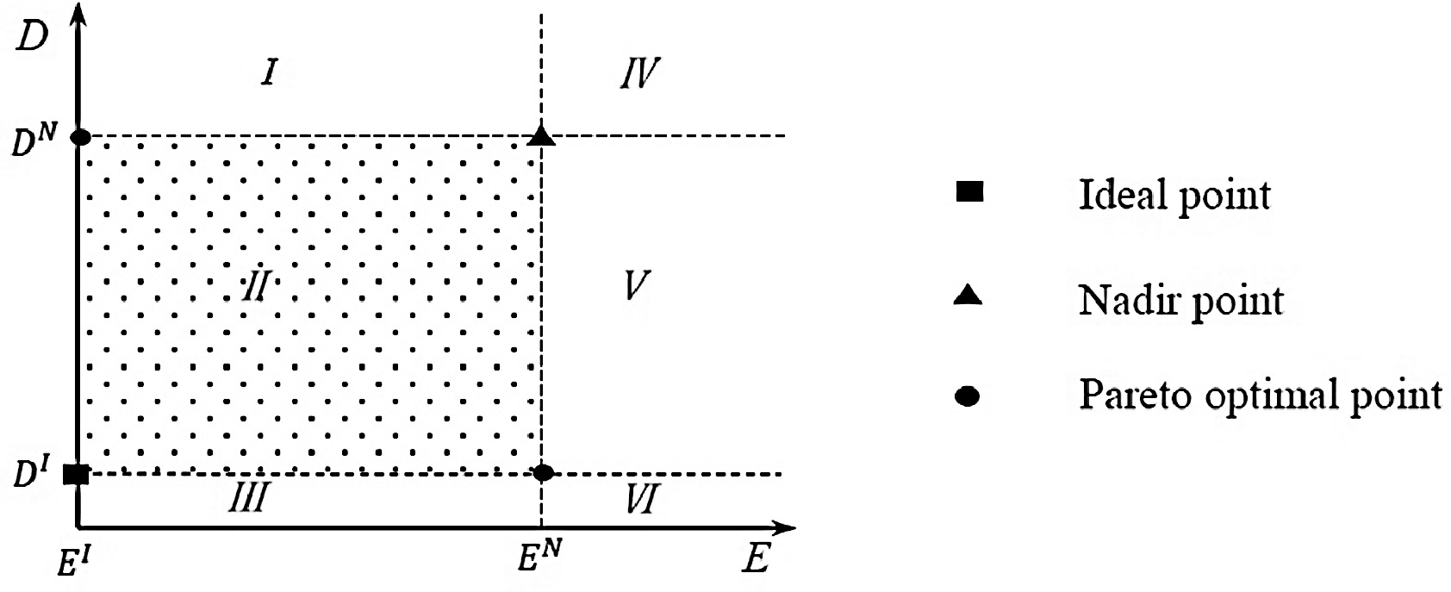

Pareto Optimal Solutions
$T_{B}=max\left(\frac{{Energy}_{setup}}{{Power}_{idle}} , T_{setup}\right)$

