Slide 1
An Encoding Algorithm Based on the Shortest Path Problem
Fanghan Liu, Xiaobing Tang, Zhaohui Yang
Nov. 16-19, 2018
2018 14th International Conference on Computational Intelligence and Security, Pages 35 - 39, Hangzhou, China
Presenter: Guan-Ting Chen
Date: Nov. 16, 2021

Slide 2
Abstract
The transportation network of the city is dynamic and stochastic, The problem of dynamic stochastic shortest path is NP-hard. The optimal problem of path is widely used in the fields of transportation, communication and computer network. An improved self adaptive genetic algorithm is proposed by encoding the chromosomal mode. The paper investigates the shortest path problem based on the genetic algorithm principle, and improved genetic algorithm by adjusting the encoding parameters. Many experiments indicate that the improved genetic algorithm could adapt to new transportation rapidly in global optimization than A* algorithm and Dijkstra algorithm and obtain the better solutions in the shortest path problem in the fields of transportation and computer network.

Slide 3
Dynamic Stochastic Shortest Path Problem
Weight of Nodes
離散隨機變量
Weight of Edge
Dynamic vs. Static
時間
統計成本

Slide 4
Genetic Algorithm
模擬生物
繼承 Inheritance
選擇 Selection
交配 Crossover
突變 Mutation
染色體
由字串組成

Slide 5
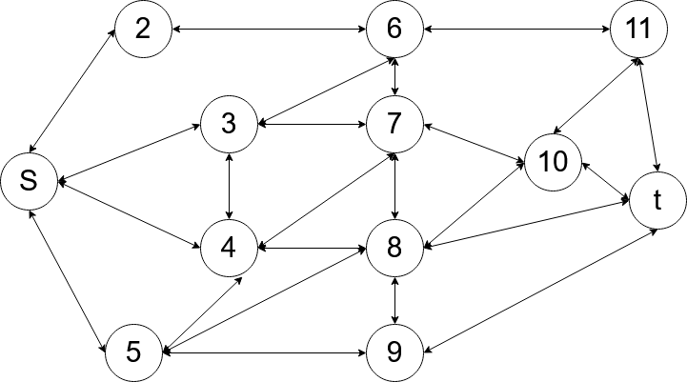
Initialization
Chromosome
不需等長
直接表示路徑長
S | 3 | 7 | 10 | t

Slide 6
Initialization
檢查是否存在 Cycle
s | 4 | 8 | 9 | 5 | 8 | t
s | 4 | 8 | t

Slide 7

Improved Selection Strategy
Fitness function
$f\left(k\right)= \sum{E(W_{v})}+\sum{E(W_{E})}$
Roulette Wheel Selection
Elitist Selection

Slide 8
Example

Slide 9

Crossover
$C_{1}$
$C_{2}$
$C_{1}^{′}$
$C_{2}^{′}$
s | 4 | 3 | 6 | 11 | t
s | 3 | 4 | 5 | 9 | 8 | t
s | 4 | 5 | 9 | 8 | t
s | 3 | 6 | 11 | t

Slide 10

Mutation
$C_{}$
$C_{}^{′}$
s | 2 | 6 | 3 | 7 | 8 | 10 | t
s | 2 | 6 | 3 | 4 | 8 | 10 | t

Slide 11
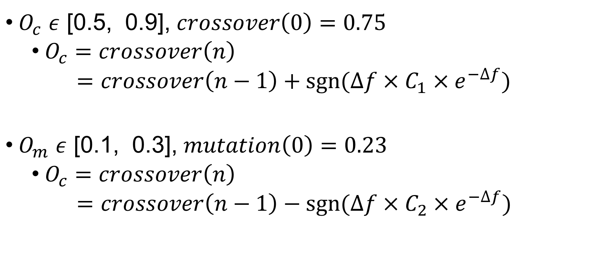
Self-adaptive Adjustment
$O_{c}$ $ε$ [0.5, 0.9], $crossover\left(0\right)=0.75$
$O_{c}=crossover\left(n\right)$
$=crossover\left(n−1\right)+sgn⁡(∆f×C_{1}×e^{−∆f})$
$O_{m}$ $ε$ [0.1, 0.3], $mutation\left(0\right)=0.23$
$O_{c}=crossover\left(n\right)$
$=crossover\left(n−1\right)−sgn⁡(∆f×C_{2}×e^{−∆f})$

Slide 12
Process
Initialize the population
Calculate the fitness function value
Adjust crossover operator and mutation operator
Crossover operation
Selection operation
Mutation operation

Slide 13
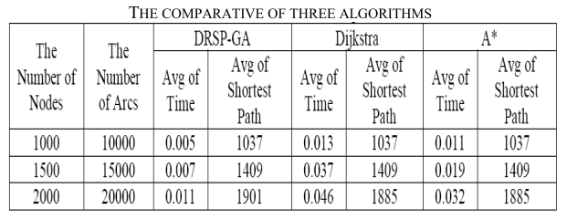
Experiment

