Slide 1
An Efficient Algorithm for Enumerating Longest Common Increasing Subsequences
Chun Lin, Chao-Yuan Huang, and Ming-Jer Tsai
COCOON 2021, LNCS 13025, pp. 25–36, 2021
Presenter : Yu-Ju Liao
Date : Nov. 16, 2021

Slide 2
Abstract
The longest common increasing subsequence (LCIS) problem is the combination of two classic problems in algorithms: the longest increasing subsequence (LIS) problem and the longest common subsequence (LCS) problem. In this paper, we propose an algorithm that finds every LCIS of two sequences a, b of length n in O(n + σ + I_{a}) time and space, where σ denotes the size of the alphabet set and I_{a} the total number of increasing subsequences contained in a (thus, the running time is output-sensitive). Our algorithm employs the trie and some simple data structures, and thus is implementation-wise simple. In addition, it can be proved that our algorithm is optimal in time complexity when σ ≤ log₂ n.

Slide 3
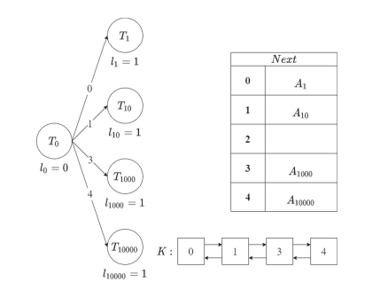
LCIS
a = [1, 4, 1, 0, 3]

Slide 4
LCIS
a = [1, 4, 1, 0, 3]

Slide 5
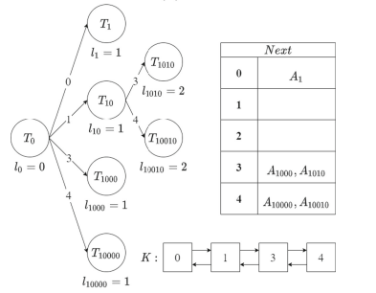
LCIS
a = [1, 4, 1, 0, 3]

Slide 6
LCIS
a = [1, 4, 1, 0, 3]

Slide 7
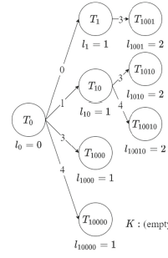
LCIS
a = [1, 4, 1, 0, 3]

Slide 8
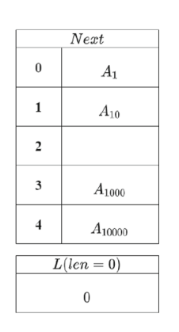
LCIS
a = [1, 4, 1, 0, 3]
b = [1, 4, 3, 1, 3]

Slide 9
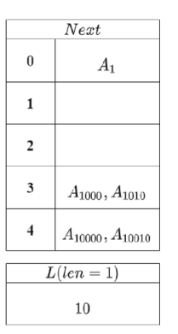
LCIS
a = [1, 4, 1, 0, 3]
b = [1, 4, 3, 1, 3]

Slide 10
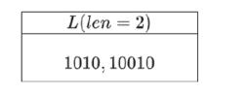
LCIS
a = [1, 4, 1, 0, 3]
b = [1, 4, 3, 1, 3]

Slide 11
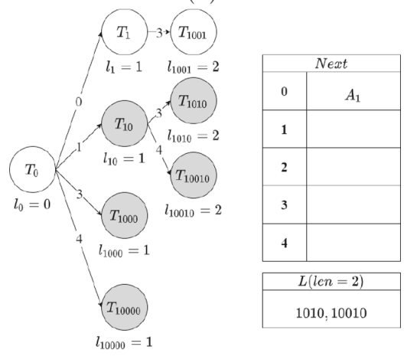
LCIS
a = [1, 4, 1, 0, 3]
b = [1, 4, 3, 1, 3]

Slide 12
Time complexity
initialization steps : O(n + σ)
queue operation : O(I_{a})
I_{a} ≤ 2^{σ}
Total : O(n + σ + I_{a})

