Slide 1
Incremental Multiple Longest Common Subsequences
Luís M. S. Russo, Alexandre P. Francisco and T. Rocher.
arXiv preprint arXiv:2005.02725. (2020)
Presenter: Tsung-Lin Lu
Date: Nov. 16, 2021

Slide 2
Abstract
We consider the problem of updating the information about multiple longest common subsequences. This kind of sub-sequences is used to highlight information that is shared across several information sequences, therefore it is extensively used namely in bioinformatics and computational genomics. In this paper we propose a way to maintain this information when the underlying sequences are subject to modifications, namely when letters are added and removed from the extremes of the sequence. Experimentally our data structure obtains significant improvements over the state of the art.

Slide 3
Outline
Introduction
Cover and Level
Append()
Pop()
Dynamic Orthogonal Range Trees
Results

Slide 4
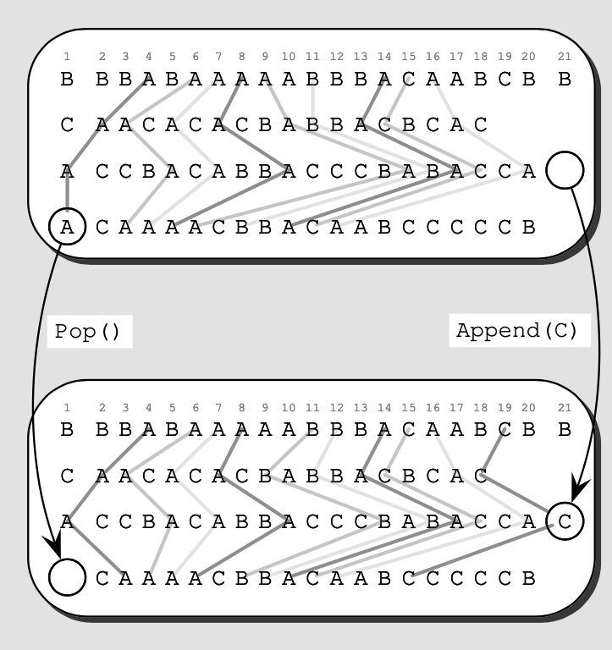
Introduction
A data structure that represents the MLCS information.
Pop() : removes the first letter from one of the strings.
Append() : adds a letter to the end of some of the strings.
Fig. 1. Illustration of updating a MLCS.

Slide 5
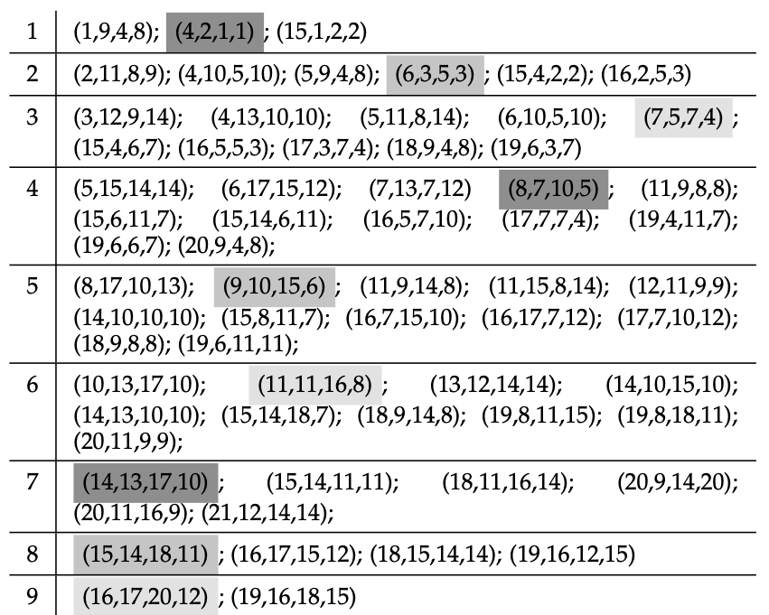
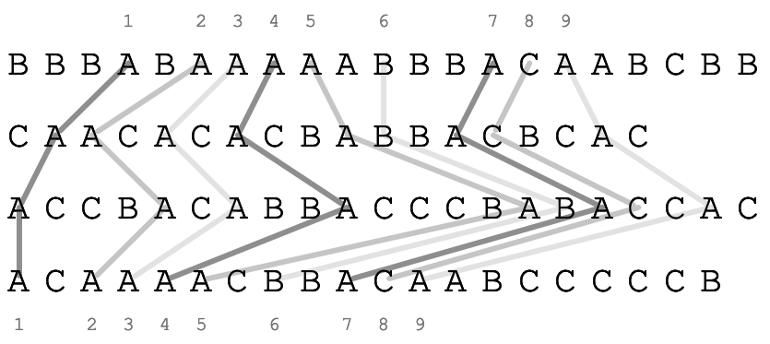
Cover and Level
Fig. 2. Illustration of level classification of matches.
A cover B : A ≤ B
A dominate B : A > B
We can be our attention to non covered matches.
TABLE 1. The classification of uncovered matches according to their maximum level values.

Slide 6

Append()
{15, 19} ×
{1,4,6,8,14,16,18} ×
{21} ×
{2,7,11,15,16,17,18,19}
1st criteria: We only need to consider the points in Table 1 that are dominated by the point (19, 18, 21, 19)
2nd criteria: We only consider the matches that dominate the point (0, 0, 19−1 , 0).
(0, 0, 18, 0) < old points (16, 17, 20, 12) < (19, 18, 21, 19)
(19, 18, 21, 15) dominates (16, 17, 20, 12) in level 9, it is at level 10.

Slide 7
Pop() (1/3)
{4, 6, 7, 8, 9, 10, 14, 16, 17} ×
{2, 3, 5, 7, 10, 13, 17}×
{1, 5, 7, 10, 15, 17, 20}×
{1}
Because 1st match point (4, 2, 1, 1) covers others, we only need to consider the 1st match (4, 2, 1, 1).

Slide 8
Pop() (1/2)
It has an impact in the structure to remove 1st match point (4, 2, 1, 1) from the list.
Some covered points may become non covered.
Some matches at level 2 may be relying on deleted match and may have to be transferred to level 1.

Slide 9

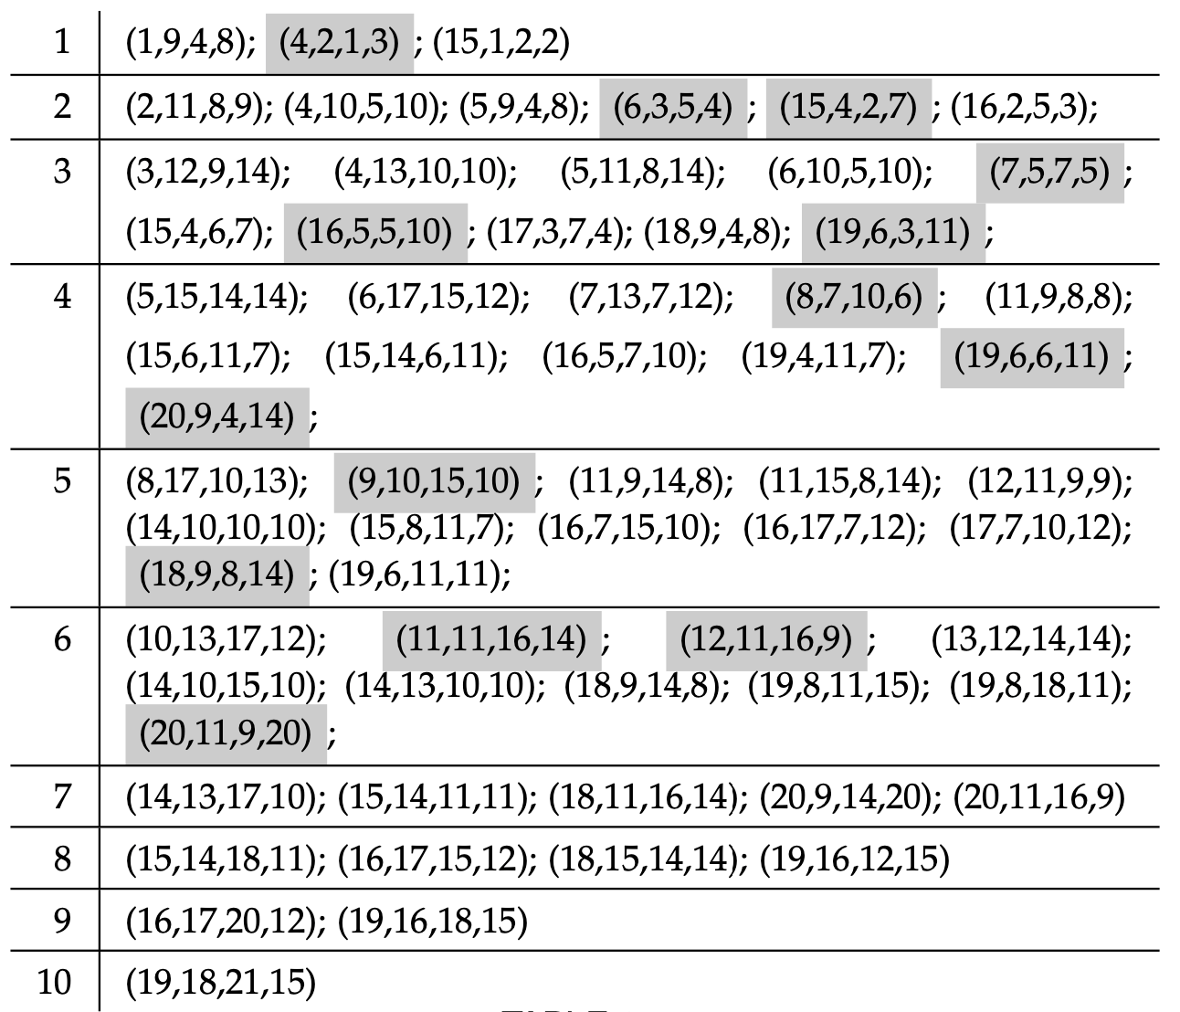
Pop() (1/3)
TABLE 1. Before appending and poping.
TABLE 2. After appending and popping.

Slide 10
Dynamic Orthogonal Range Trees
We could use actual lists, but instead we used orthogonal range trees.
ORT computes dominance in O(log^{d} n) time.
d is the number of strings or dimension of the point space.
n is the number of points in the list.
A 1D ORT is simply a BST. A k dimensional ORT is also a BST, ordered by the last coordinate of the points.
 | Build time | Build space | Search/Insert/Delete | Orthogonal range search
KD-Tree | O(nlogn) | O(n) | O(logn) | O(n^{1-1/d})
Range Tree | O(nlog^{d-1}n) | O(nlog^{d-1}n) | O(log^{d}n) | O(log^{d}n + k)

Slide 11
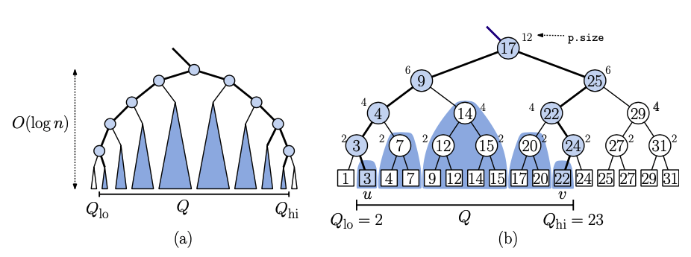
1D Range Trees

Slide 12
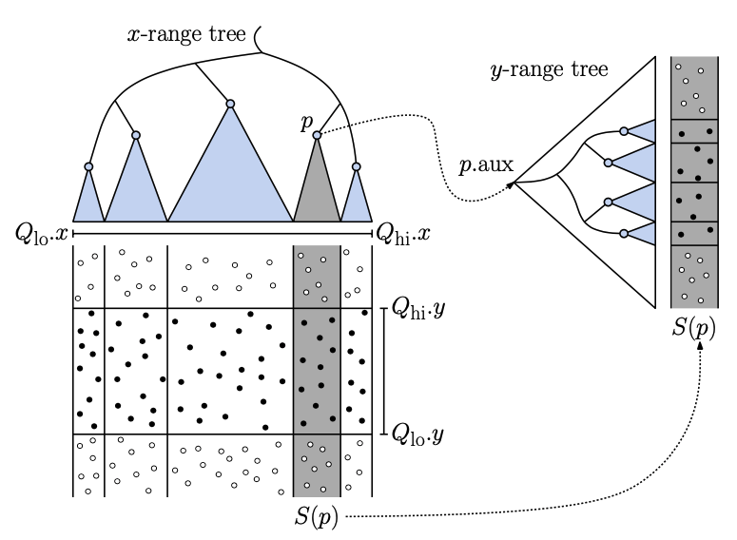
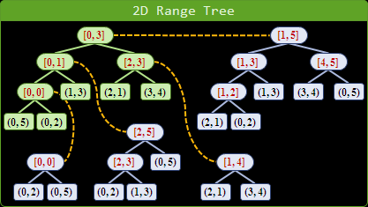
2D Range Trees

Slide 13
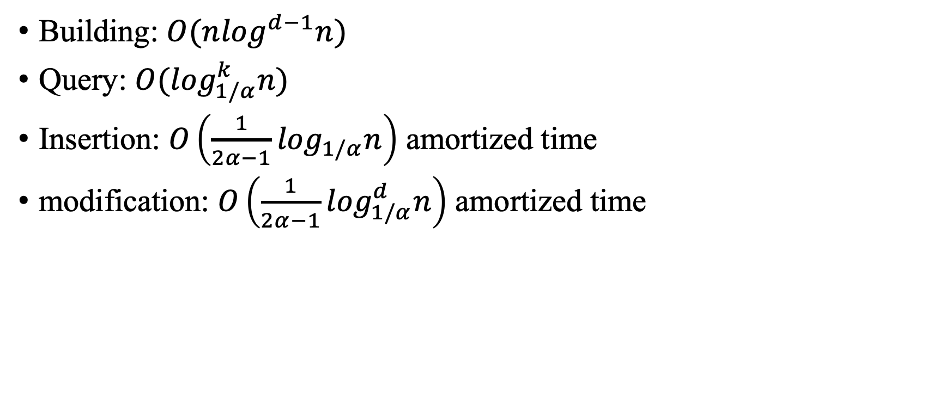
Time complexity
d is the number of strings or dimension of the point space.
n is the number of points in the list.
α is a factor of a weight balanced BST.
Building: $O(n\log^{d−1}n)$
Query: $O(\log_{1/α}^{k}n)$
Insertion: $O\left(\frac{1}{2α−1}\log_{1/α}n\right)$ amortized time
modification: $O\left(\frac{1}{2α−1}\log_{1/α}^{d}n\right)$ amortized time
 | Build time | Build space | Search/Insert/Delete | Orthogonal range search
KD-Tree | O(nlogn) | O(n) | O(logn) | O(n^{1-1/d})
Range Tree | O(nlog^{d-1}n) | O(nlog^{d-1}n) | O(log^{d}n) | O(log^{d}n + k)

Slide 14
Results (1/2)
Debian 4.9.144-3.1 the x86_64 version with 8Gb of RAM and an Intel(R) Xeon(R) CPU E5-2630 v3 @ 2.40GHz with 4 cores.
S : the size of the alphabet.
k : the number of strings.
m : the size of the strings.
IMLCS
Naive (DP)
Quick DP

Slide 15
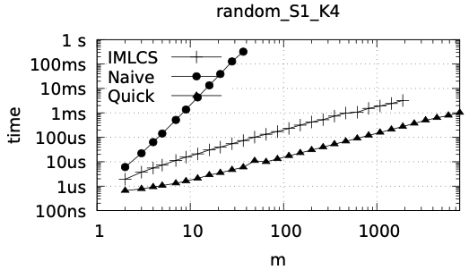
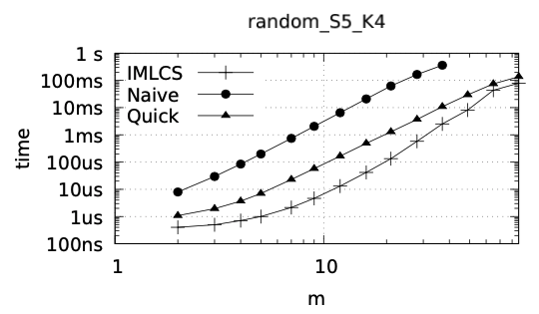
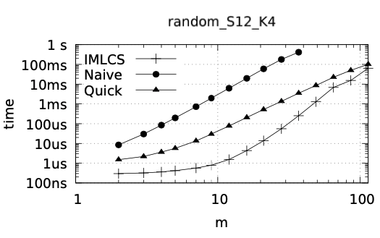
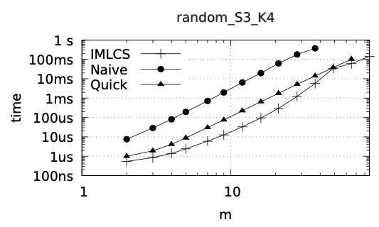
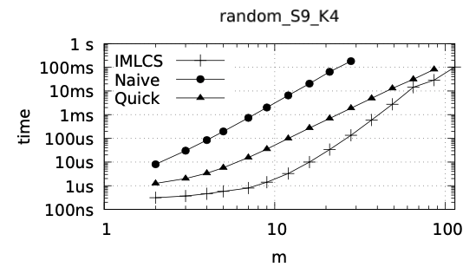
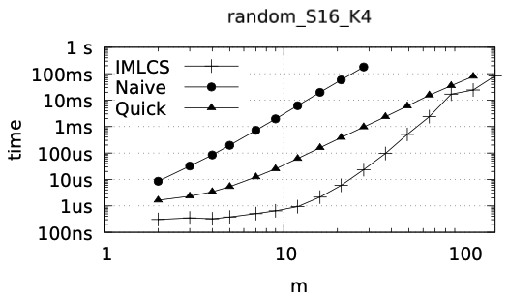
Results (2/2)
Fig. Average value of m versus average operation time for different combinations of k strings and alphabets S.

Slide 16
Thank you for listening

Slide 17
Abstract
s

