Slide 1
A Divide-and-Conquer Algorithm for Computing Voronoi Diagrams
Elijah Smith, Christian Trefftz, Byron DeVries
2020 IEEE International Conference Electro Information Technology (EIT)
31 July-1 Aug. 2020 Chicago, IL, USA
Presenter:Chien-Ting LEE
Date:Nov. 30, 2021
Notes:
伊利諾伊州

Slide 2
Abstract
Identifying the closest of a set of locations typically requires computing the distance to each of these locations, given a current position. However, Voronoi Diagrams precompute the geometric areas that each of these locations is closest to in order to ameliorate the cost of computing distances later on. Problematically, the initial computations required to generate a Voronoi Diagram can be computationally expensive. Naive approaches to generating discretized Voronoi Diagrams require every discretized position to be analyzed with the set of locations. This paper introduces a new algorithm to compute discretized Voronoi Diagrams using a divide-and-conquer approach. Rather than calculate every position, our approach calculates the positions at the four corners of a quadrant. If the corners belong to the same region, there is no need to subdivide this quadrant anymore; but if they are different than the original quadrant is subdivided into smaller quadrants. The process is repeated recursively until the entire diagram has been calculated appropriately.
Notes:
這篇論主要是在講述一種Divide-and-Conquer的計算方法去計算Voronoi Diagram

Slide 3
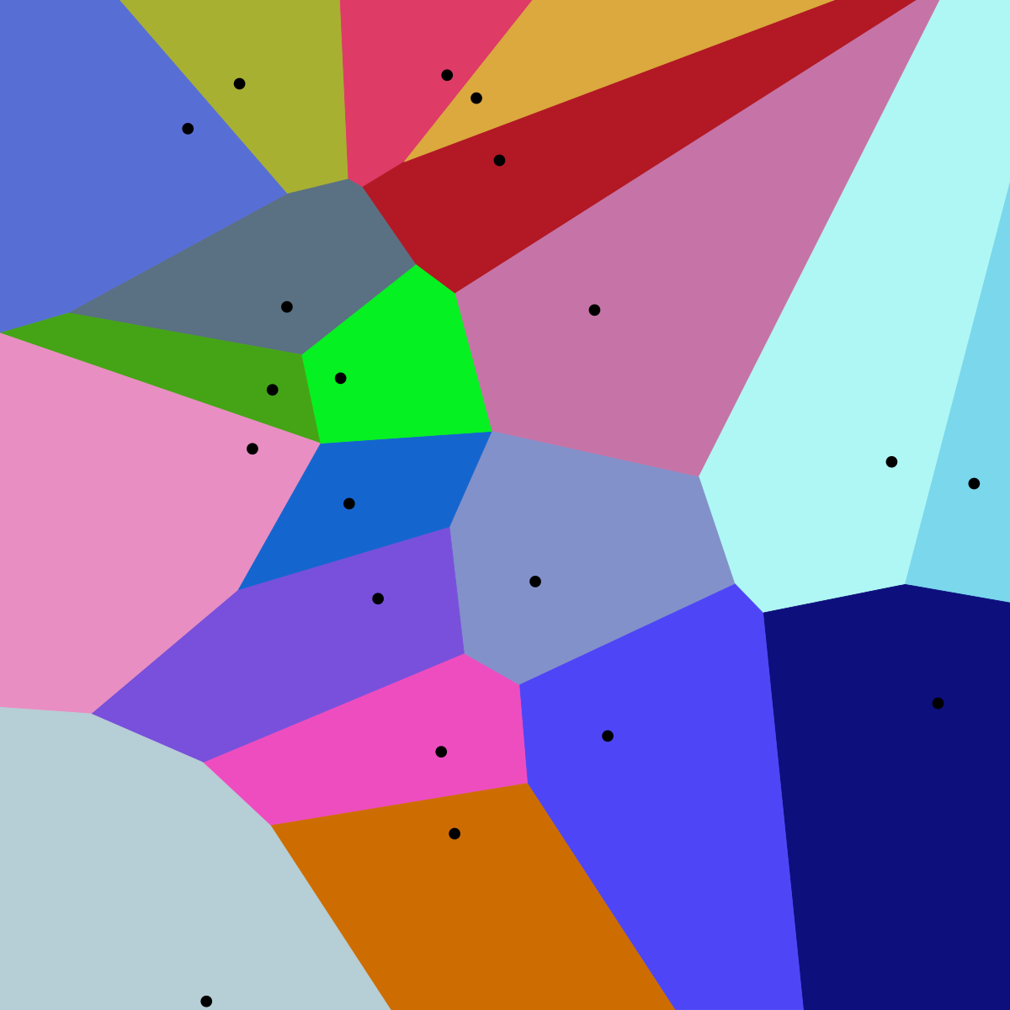
Voronoi Diagram
Notes:
一空間上有N個點(seeds、sites、generators)，N個點各自會有對應到一個區域，像是藍色會應到… 綠色會對應到，
藍色區域裡的任意點都是距離這個點最近
那這篇論文就是在講說如何找些空間

Slide 4
Approach(1)
Step 1: Calculate Points: Assuming that the plane on which the diagram will be computed is rectangular, find the seeds closest to each of the four corners of that rectangle using Euclidean distance. In other words, for every one of the corner points, calculate the distance to all seeds and select the closest seed to each of those corner points
Step 2: Base Case: If all the corner points are closest to the same seed, then assign all points within the rectangle bounded by the four corner points to the region associated with the corners’ closest seed.
Notes:
步驟1:假設計算圖表的平面是矩形，找到矩形每個角落，計算到所有seed到其角落的距離然後就可以找到距離這些角落最近的seed
步驟2:如果所有角落最接近的seed都一樣，然後四個角落以內也就是矩形的範圍，把最接近的seed也設為該seed。

Slide 5
Approach(2)
Step 3: Subdivide Case: If all the corner points are not closest to the same seed, subdivide the rectangle enclosed by the four corner points into four smaller rectangular fragments consisting of the top-left, top-right, bottom-left, and bottomright sub-rectangles of the original plane. Each of these 4 fragments of the original rectangle is then recursively processed by Step 1: Calculate Points
Notes:
如果所有角落不是最接近同一個seed，
則將四個角落包圍的矩形細分為四個較小的矩形片段，
由左上角、右上角、左下角和右下角子矩形組成 原來的平面。 然後通過步驟 1：計算點遞歸處理原始矩形的這 4 個片段中的每一個

Slide 6
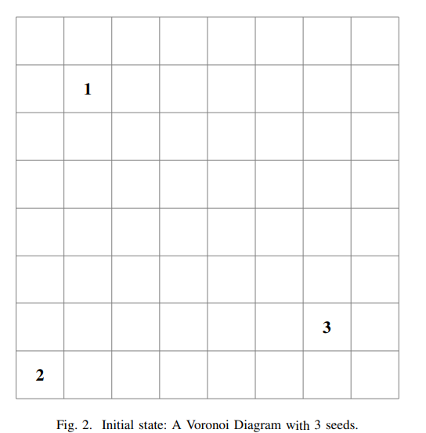
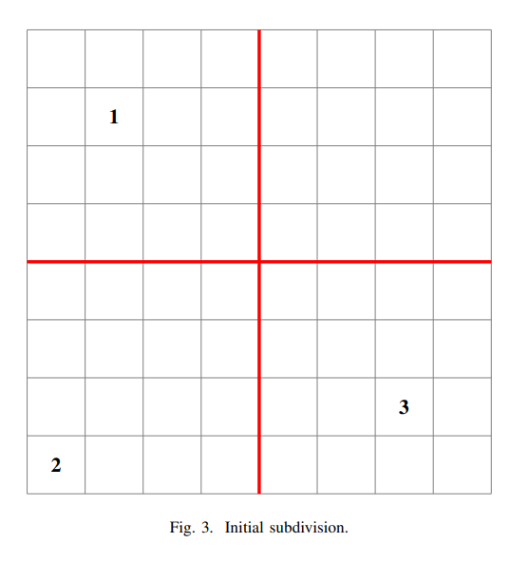
Example
Notes:
1、2、3為seed
首先會先計算四個角落 左上角最靠近 1 右上1、3 左下角 2 右下 3，發現都不一樣然後就會切割為4塊 各自在遞回去做

Slide 7
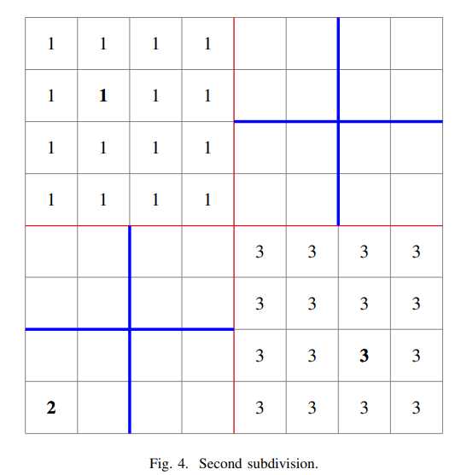
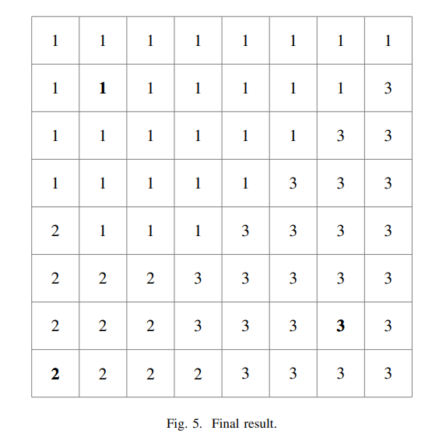
Example

Slide 8
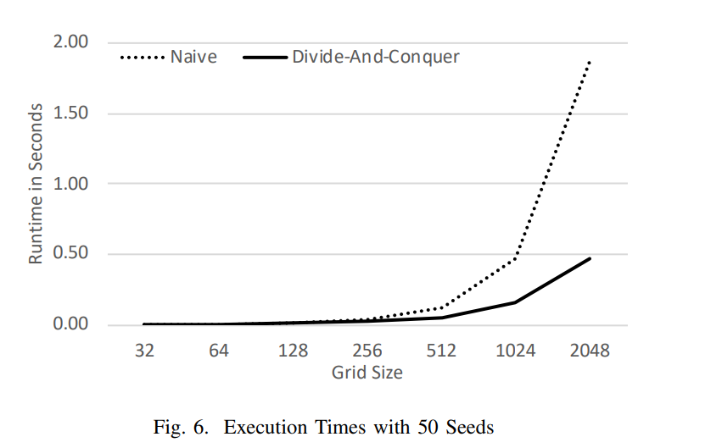
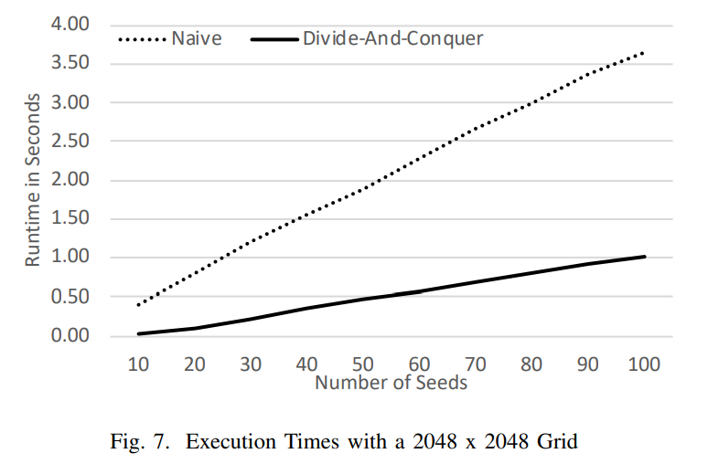
Result
Notes:
圖6、7是作者做的實驗結果
圖6是在50seed情況下，隨著grid範圍的增加，他與naive算法會越來越明顯。
圖7是固定2048*2048的情況下，seed數增加，時間也會縮短。
nm^2
N是seed數 m是grid大小

