Slide 1
Algorithms for the Constrained Longest Common Subsequence Problems with t-length Substrings
Authors: Ke-Xin Zhu (朱可欣),
Chang-Biau Yang (楊昌彪),
Kuo-Tsung Tseng (曾國尊)
Presenter: Tsung-Lin Lu (呂宗霖) 國立中山大學資訊工程學系
Date: December 11, 2021

Slide 2
Longest Common Subsequence (LCS)
LCS with t-length Substrings (LCSt)
A = aactccacta
B = aacccactcta
CLCS_{t}
A = aactccacta
B = aacccactcta
P = ctt
A = aactccacta, B = aacccactcta, P = ctt, t = 3:
LCS
A = aactccacta
B = aacccactcta
Constrained LCS (CLCS)
A = aactccacta
B = aacccactcta
P = ctt
⟹ LCS(A, B) = aacccacta
⟹ LCS₃(A, B) = aac cca cta
⟹ CLCS(A, B, P) = aactcta
⟹ CLCS₃(A, B, P) = act cta

Slide 3
suf() & NextMatch()
Let suf_{t}(i, k) denote the length of the maximum suffix of P_{1..k} contained in A_{i-t+1..i} as a subsequence.
A = aactccacta, B = aacccactcta, P = ctt, t = 3
if k = 3, then suf₃(4, 3) = 1.
NextMatch_{t}(i, j) denotes the smallest j' such that j' ≥ j + t and A_{i-t+1..i} = B_{j'-t+1..j'}. If there is no such j', then NextMatch_{t}(i, j) = ∞.
A = aactccacta, B = aacccactcta, P = ctt, t = 3
NextMatch₃(3, 0) = 3

Slide 4
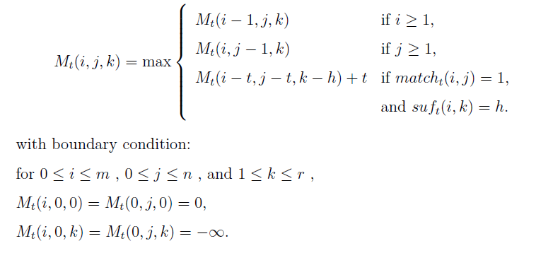
Dynamic Programming for CLCS_{t} (1/3)
O(mnr) in time and O(mnr) in space
Vertical direction
Horizontal direction
Diagonal direction

Slide 5
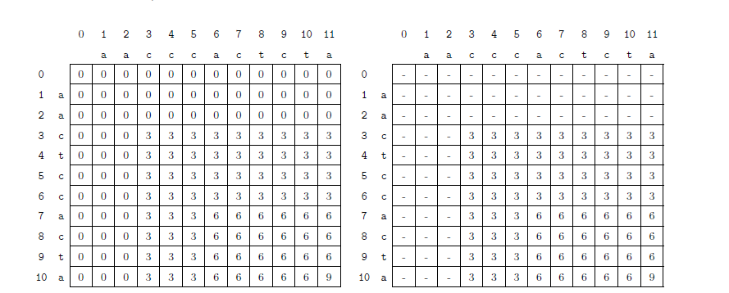
Dynamic Programming for CLCS_{t} (2/3)
A = aactccacta, B = aacccactcta, P = ctt, t = 3:
(1) k = 0
(2) k = 1 (c)

Slide 6
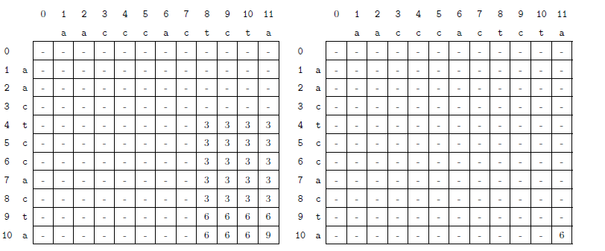
Dynamic Programming for CLCS_{t} (3/3)
A = aactccacta, B = aacccactcta, P = ctt, t = 3:
(3) k = 2 (ct)
(4) k = 3 (ctt)

Slide 7
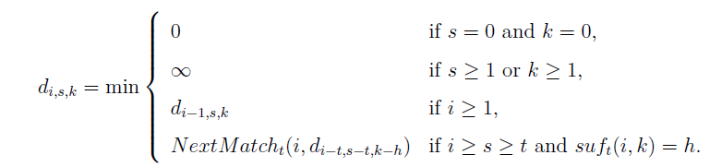
Diagonal Algorithm for CLCS_{t} (1/5)
O(rL(m − L) + R) in time
O(rL + R) in space
Boundary conditions
Boundary conditions
Without match
With match

Slide 8
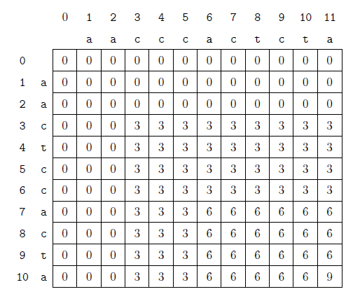
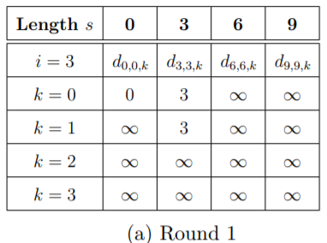
Diagonal Algorithm for CLCS_{t} (2/5)
A = aactccacta, B = aacccactcta, P = ctt, t = 3:
k = 0

Slide 9
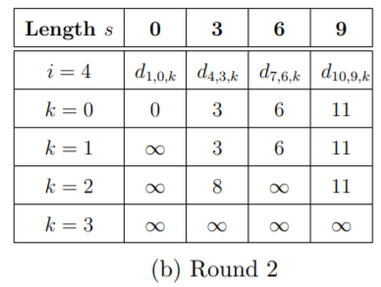
Diagonal Algorithm for CLCS_{t} (3/5)
A = aactccacta, B = aacccactcta, P = ctt, t = 3:
k = 0

Slide 10
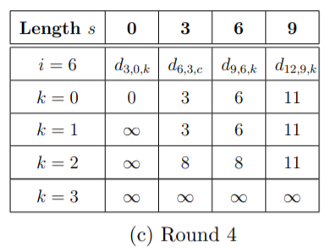
Diagonal Algorithm for CLCS_{t} (4/5)
A = aactccacta, B = aacccactcta, P = ctt, t = 3:
k = 0

Slide 11
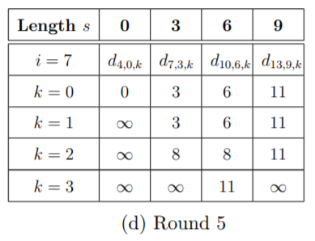
Diagonal Algorithm for CLCS_{t} (5/5)
A = aactccacta, B = aacccactcta, P = ctt, t = 3:
k = 0

Slide 12
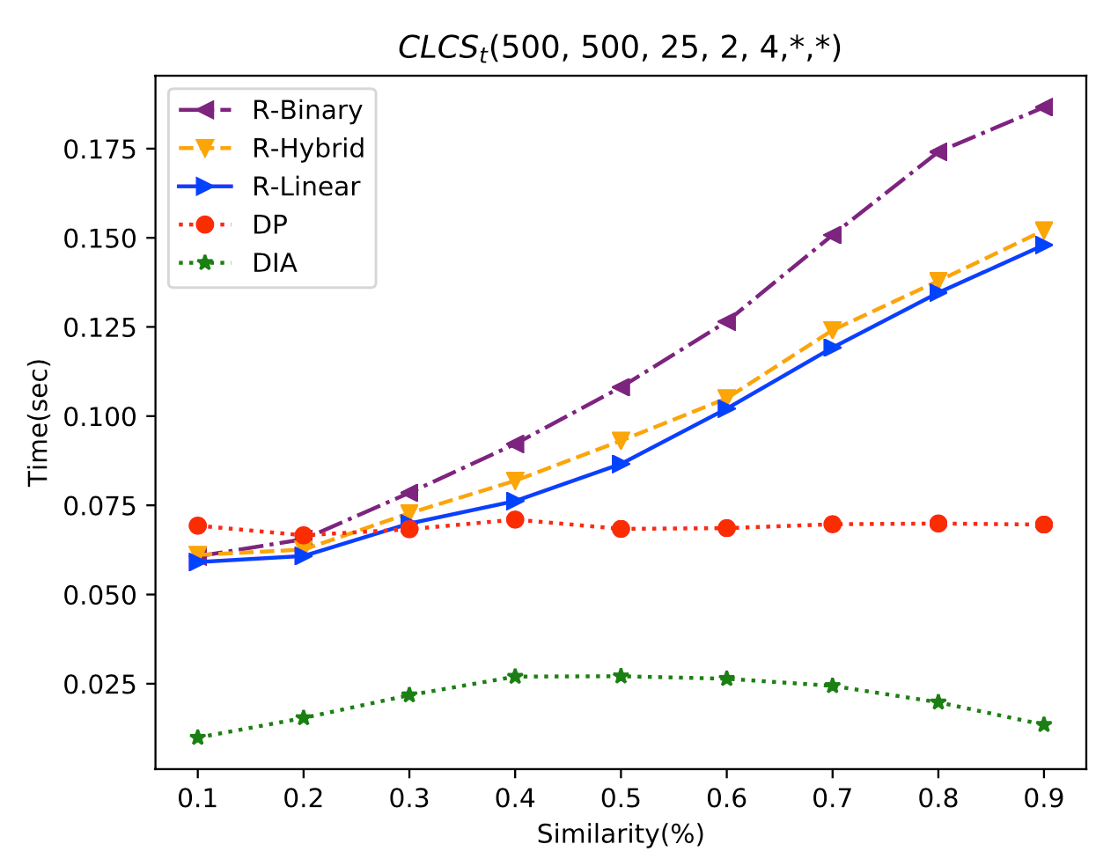
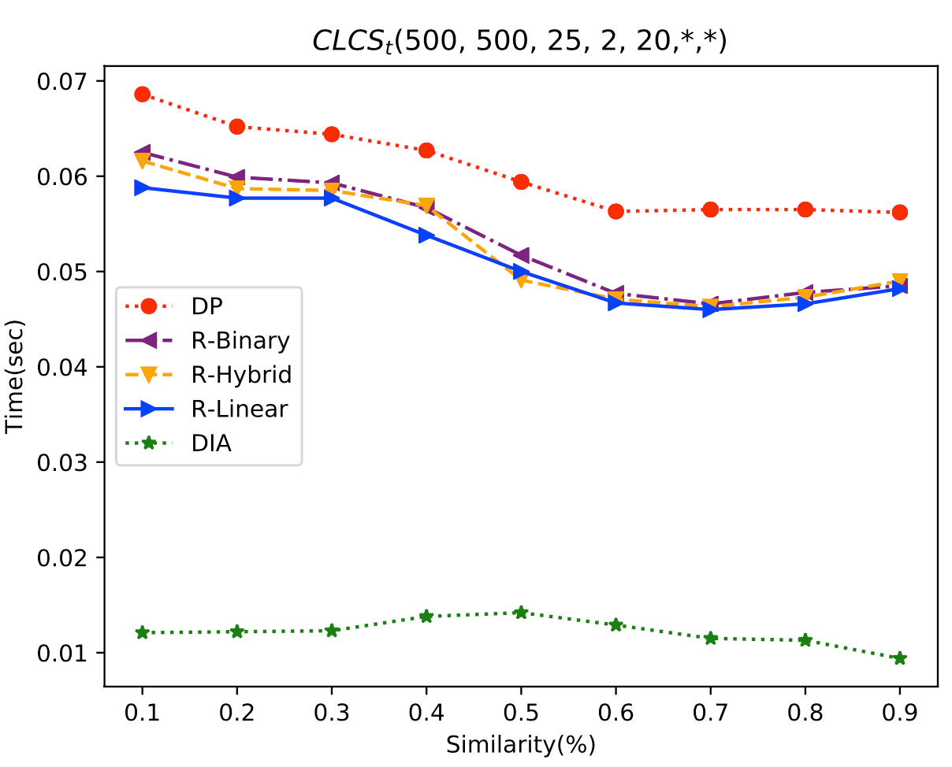
Results
(a) The average execution time for |A| = 500, |B|=500, |P| = 25, t = 2 and |∑| = 4.
(b) The average execution time for |A| = 500, |B|=500, |P| = 25, t = 2 and |∑| = 20.

Slide 13
Thanks for your listening.

Slide 14
Abstract (1/2)
The longest common subsequence (LCS) problem and its variants, such as the constrained LCS (CLCS) problem, and the LCS with t-length substrings (LCS_{t}) problem, are well-studied problems as the similarity measurement for strings or biosequences. In this paper, we first define the new variant, which is the constrained longest common subsequence with t-length substrings (CLCS_{t}) problem.
Then, we propose three algorithms for solving the problem. The time complexity of the dynamic programming algorithm is O(mnr), where m, n, and r are the lengths of the two target sequences and the constraint sequence, respectively.

Slide 15
Abstract (2/2)
The row-wise algorithm is our second method, with O(r * min{mL + R, RlogL} + m + n) time, where L denotes the answer length, and R denotes the number of t-match pairs between the two target sequences. Our third method is the diagonal algorithm with O(rL(m - L) + R) time. As experimental results show, the diagonal algorithm is the most efficient.

Slide 16
Outline
Longest Common Subsequence (LCS)
Constrained LCS (CLCS)
LCS with t-length Substrings (LCS_{t})
Constrained LCS with t-length Substrings (CLCS_{t})
Dynamic Programming
Row-Wise Algorithm
Diagonal Algorithm

Slide 17
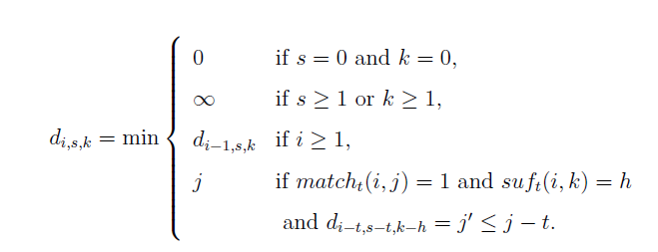
Row-Wise Algorithm for CLCS_{t} (1/5)
O(r * min{mL + R, RlogL} + m + n) in time
O(r (L + m + n)) in space
Boundary conditions
Boundary conditions
Without match
With match

Slide 18
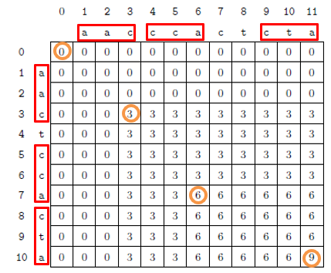
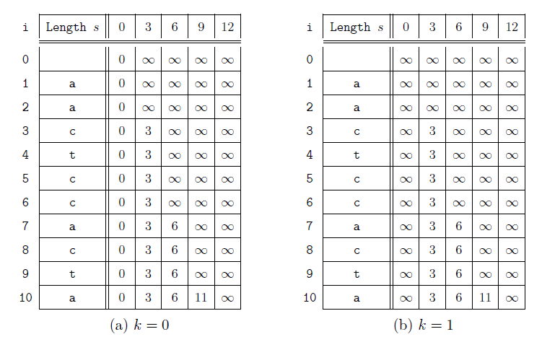
Row-Wise Algorithm for CLCS_{t} (2/5)
A = aactccacta, B = aacccactcta, P = ctt, t = 3:

Slide 19
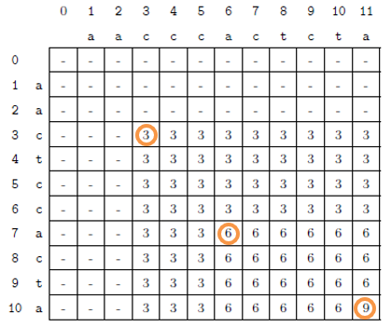
Row-Wise Algorithm for CLCS_{t} (3/5)
A = aactccacta, B = aacccactcta, P = ctt, t = 3:

Slide 20
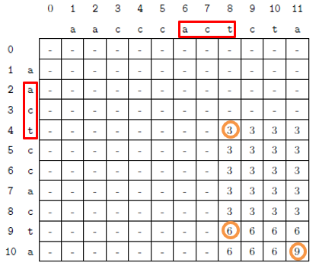
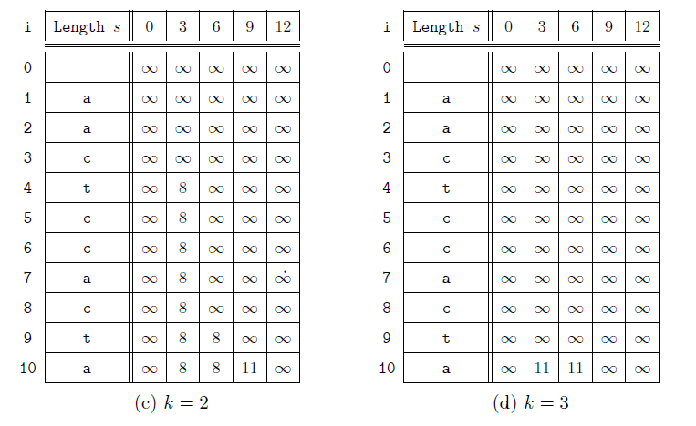
Row-Wise Algorithm for CLCS_{t} (4/5)
A = aactccacta, B = aacccactcta, P = ctt, t = 3:

Slide 21
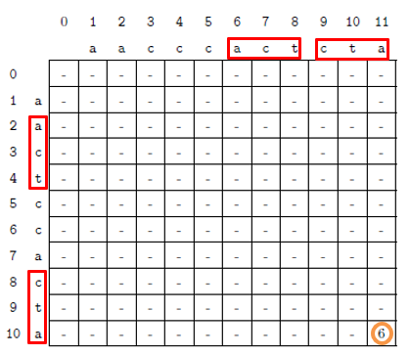
Row-Wise Algorithm for CLCS_{t} (5/5)
A = aactccacta, B = aacccactcta, P = ctt, t = 3:

Slide 22
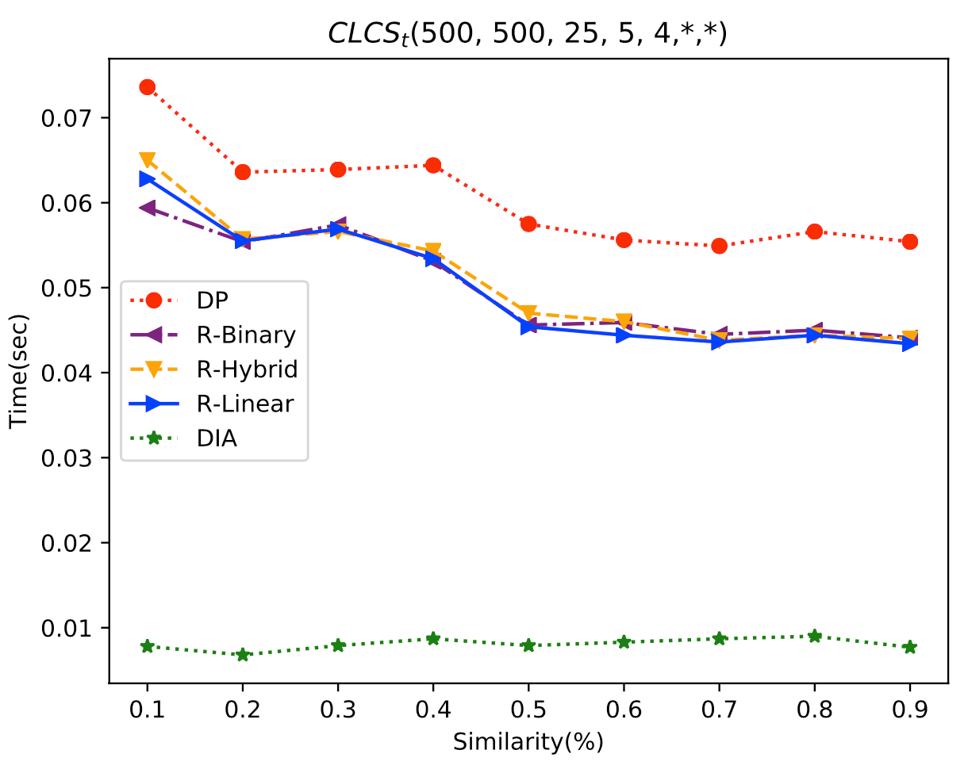
Results
(c) The average execution time for |A| = 500, |B|=500, |P| = 25, t = 5 and |∑| = 4.

Slide 23
Abstract
s

