Slide 1
Modified HEFT Algorithm for Task Scheduling in Cloud Environment
Kalka Dubey, Mohit Kumar, S.C.Sharma
The 6th International Conference on Smart Computing and Communications,India
Procedia Computer Science Volume 125, 2018, Pages 725-732
Presenter: Jue-Jun Wu
Date: Nov. 30, 2021

Slide 2
Abstract
Cloud computing is now dominated in the area of high performance distributing computing and it provides resource polling and on demand services through internet. Therefore task scheduling becomes an important research area in the field of cloud environment because user’s services demand change dynamically. Heterogeneous Earliest Finish Time (HEFT) unable to distribute the task efficiently. We modify HEFT algorithm that distribute the workload among the processor in effective way and reduce the makespan time of applications. Computational results (Fig. 4-5) shows that modify HEFT algorithm perform better than existing HEFT and Critical-Path-on-a-Processor (CPOP) algorithm .

Slide 3

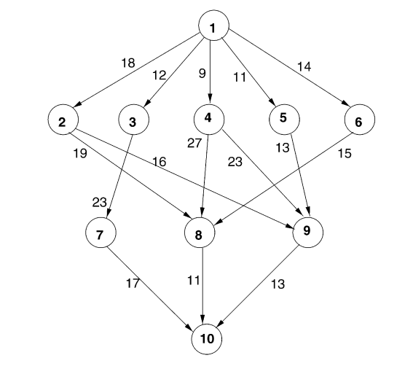
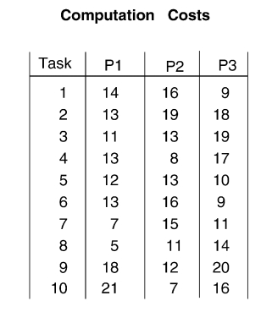
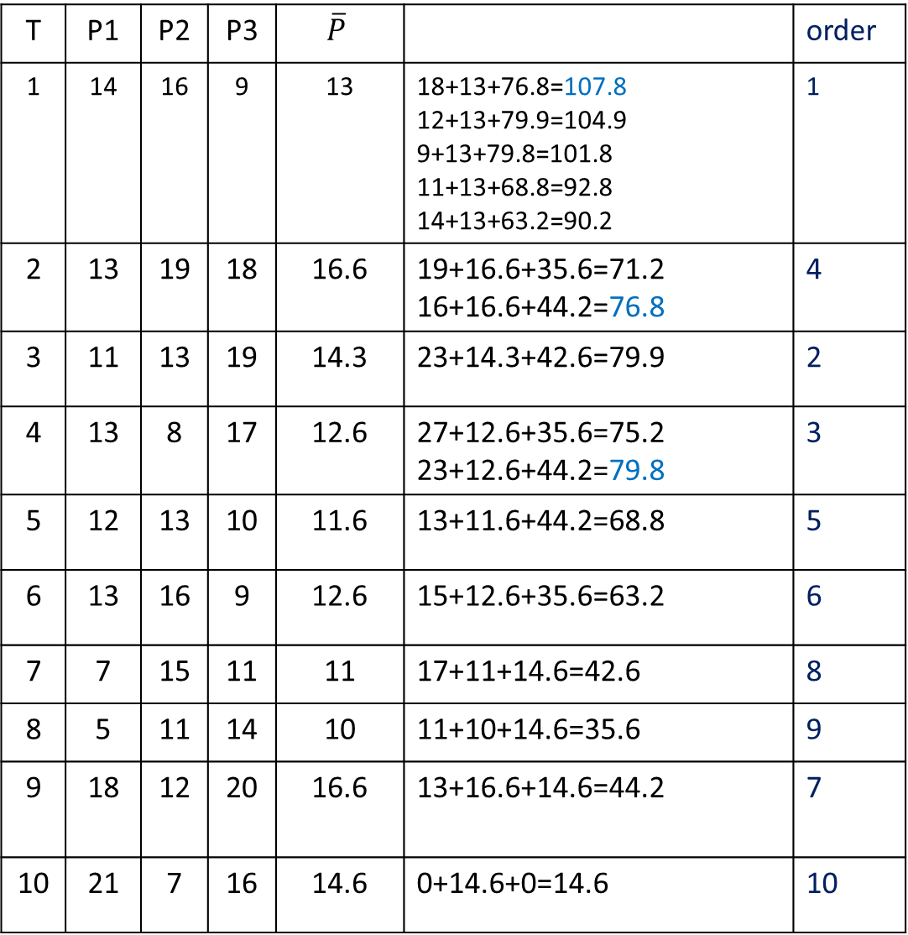
HEFT
T | P1 | P2 | P3 | $$\overline{P}$$ |  | order
1 | 14 | 16 | 9 | 13 | 18+13+76.8=107.8 12+13+79.9=104.9 9+13+79.8=101.8 11+13+68.8=92.8 14+13+63.2=90.2 | 1
2 | 13 | 19 | 18 | 16.6 | 19+16.6+35.6=71.2 16+16.6+44.2=76.8 | 4
3 | 11 | 13 | 19 | 14.3 | 23+14.3+42.6=79.9 | 2
4 | 13 | 8 | 17 | 12.6 | 27+12.6+35.6=75.2 23+12.6+44.2=79.8 | 3
5 | 12 | 13 | 10 | 11.6 | 13+11.6+44.2=68.8 | 5
6 | 13 | 16 | 9 | 12.6 | 15+12.6+35.6=63.2 | 6
7 | 7 | 15 | 11 | 11 | 17+11+14.6=42.6 | 8
8 | 5 | 11 | 14 | 10 | 11+10+14.6=35.6 | 9
9 | 18 | 12 | 20 | 16.6 | 13+16.6+14.6=44.2 | 7
10 | 21 | 7 | 16 | 14.6 | 0+14.6+0=14.6 | 10

Slide 4
 | P1 |  |  | P2 |  |  | P3 |  |  | choice
Task | start | cost | Finish | start | cost | finish | start | cost | finish
1 | 0 | 14 | 14 | 0 | 16 | 16 | 0 | 9 | 9 | P3
3 | 9+12 | 11 | 32 | 9+12 | 13 | 34 | 9 | 19 | 28 | P3
4 | 9+9 | 13 | 31 | 9+9 | 8 | 26 | 28 | 17 | 45 | P2
2 | 9+18 | 13 | 40 | 9+18 | 19 | 44 | 28 | 18 | 46 | P1
5 | 40 | 12 | 52 | 26 | 13 | 38 | 28 | 10 | 38 | P3
6 | 40 | 13 | 53 | 26 | 16 | 42 | 38 | 9 | 47 | P2
9 | 40 38+13 25+26 | 18 | 58 72 66 | 40+16 38+13 42 | 12 | 68 63 54 | 40+16 38+13 25+23 | 20 | 76 71 68 | P2
7 | 28+23 | 8 | 58 | 28+23 68 | 15 | 83 | 38 | 11 | 49 | P3
8 | 40 25+27 42+15 | 5 | 45 57 62 | 40+16 68 | 11 | 67 79 | 40+16 25+27 42+15 | 14 | 70 66 71 | P1
10 | 49+17 62 68+13 | 21 | 87 83 102 | 49+17 62+11 68 | 7 | 73 80 75 | 49 62+11 68+13 | 16 | 65 89 97 | P2

Slide 5

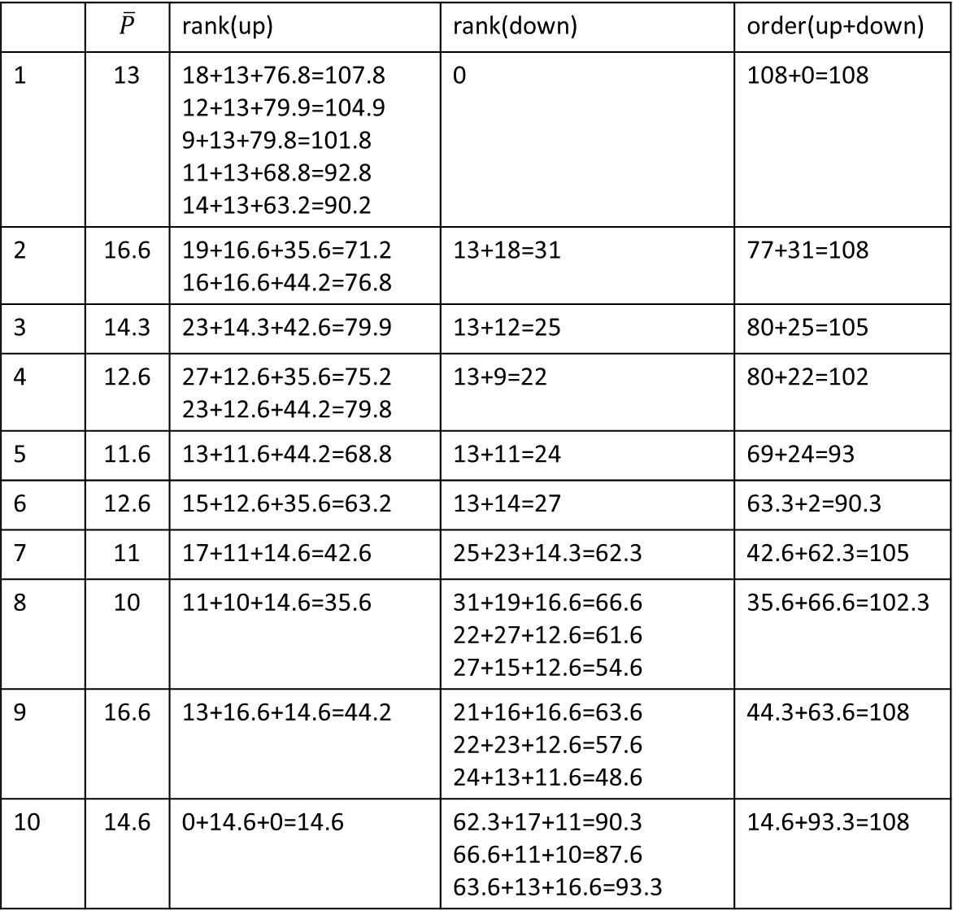
 | $$\overline{P}$$ | rank(up) | rank(down) | order(up+down)
1 | 13 | 18+13+76.8=107.8 12+13+79.9=104.9 9+13+79.8=101.8 11+13+68.8=92.8 14+13+63.2=90.2 | 0 | 108+0=108
2 | 16.6 | 19+16.6+35.6=71.2 16+16.6+44.2=76.8 | 13+18=31 | 77+31=108
3 | 14.3 | 23+14.3+42.6=79.9 | 13+12=25 | 80+25=105
4 | 12.6 | 27+12.6+35.6=75.2 23+12.6+44.2=79.8 | 13+9=22 | 80+22=102
5 | 11.6 | 13+11.6+44.2=68.8 | 13+11=24 | 69+24=93
6 | 12.6 | 15+12.6+35.6=63.2 | 13+14=27 | 63.3+2=90.3
7 | 11 | 17+11+14.6=42.6 | 25+23+14.3=62.3 | 42.6+62.3=105
8 | 10 | 11+10+14.6=35.6 | 31+19+16.6=66.6 22+27+12.6=61.6 27+15+12.6=54.6 | 35.6+66.6=102.3
9 | 16.6 | 13+16.6+14.6=44.2 | 21+16+16.6=63.6 22+23+12.6=57.6 24+13+11.6=48.6 | 44.3+63.6=108
10 | 14.6 | 0+14.6+0=14.6 | 62.3+17+11=90.3 66.6+11+10=87.6 63.6+13+16.6=93.3 | 14.6+93.3=108
CPOP
Critical-Path-on-a-Processor (CPOP) algorithm
Notes:
Critical-Path-on-a-Processor (CPOP) algorithm

Slide 6
Critical path{1,2,9,10}
P1: 14+13+18+21=60
P2: 16+19+12+7=54
P3: 9+18+20+16= 63
 | rank(up+down) | entry node | priority Q
1 | 108+0=108 | 1 | 1
2 | 77+31=108 | 23456 | 2
3 | 80+25=105 | 3456 | 123
4 | 80+22=102 | 4567 | 1237
5 | 69+24=93 | 456 | 12374
6 | 63.3+2=90.3 | 56 | 123745
7 | 42.6+62.3=105 | 69 | 1237459
8 | 35.6+66.6=102.3 | 6 | 12374596
9 | 44.3+63.6=108 | 8 | 123745968
10 | 14.6+93.3=108 | 10 | 123745968 10

Slide 7
 | P1 |  |  | P2 |  |  | P3 |  |  | choice
 | start | cost | Finish | start | cost | finish | start | cost | finish
1 | 0 | 14 | 14 | 0 | 16 | 16 | 0 | 9 | 9 | P2
2 | 16+18 | 13 | 47 | 16 | 19 | 35 | 16+18 | 18 | 52 | P2
3 | 16+12 | 11 | 39 | 35 | 13 | 48 | 16+12 | 19 | 47 | P1
7 | 39 | 7 | 46 | 39+23 | 15 | 77 | 29+23 | 11 | 73 | P1
4 | 46 | 13 | 59 | 35 | 8 | 43 | 16+9 | 17 | 42 | P3
5 | 46 | 12 | 58 | 35 | 13 | 48 | 41 | 10 | 51 | P2
9 | 35+16 41+23 48+13 | 18 | 69 82 72 | 48 41+23 48 | 12 | 60 76 60 | 35+16 41 48+13 | 20 | 71 61 81 | P2
6 | 46 | 13 | 59 | 48 76 | 16 | 64 82 | 42 | 9 | 51 | P3
8 | 35+19 42+27 51+15 | 5 | 59 74 71 | 35 42+27 51+15 76 | 11 | 46 80 77 87 | 38+19 42 51 | 14 | 68 56 65 | P3
10 | 47 68+11 76+13 | 21 | 68 100 110 | 47+17 68+11 76 | 7 | 71 86 83 | 47+17 68 76+13 | 16 | 80 84 95 | P2

Slide 8
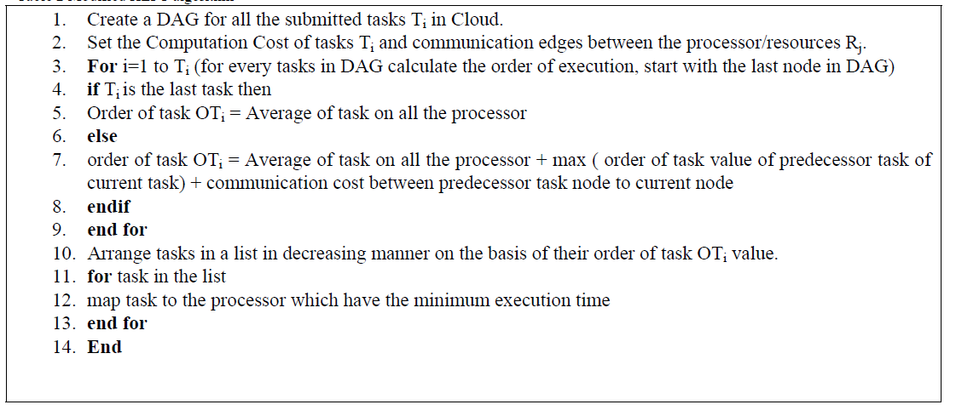
Modify HEFT

Slide 9
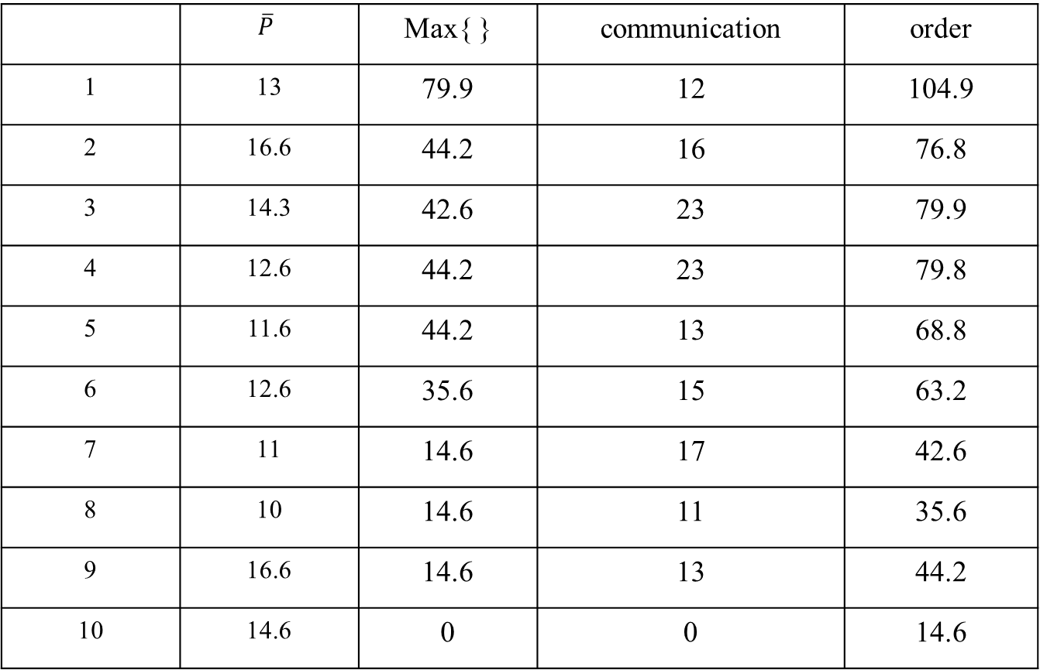
 | $$\overline{P}$$ | Max{ } | communication | order
1 | 13 | 79.9 | 12 | 104.9
2 | 16.6 | 44.2 | 16 | 76.8
3 | 14.3 | 42.6 | 23 | 79.9
4 | 12.6 | 44.2 | 23 | 79.8
5 | 11.6 | 44.2 | 13 | 68.8
6 | 12.6 | 35.6 | 15 | 63.2
7 | 11 | 14.6 | 17 | 42.6
8 | 10 | 14.6 | 11 | 35.6
9 | 16.6 | 14.6 | 13 | 44.2
10 | 14.6 | 0 | 0 | 14.6

Slide 10
Task | P1 |  | P2 |  | P3
1 |  |  |  |  | 0 | 9
3 | 9+12(T1) | 32
4 |  |  | 9+9(T1) | 26
2 | 32(T2) | 45
5 |  |  |  |  | 9(T1) | 19
6 |  |  |  |  | 19(T1) | 28
9 |  |  | 45+16(T2) | 73
7 | 45(T2) | 52
8 | 52 | 58
10 |  |  | 73 | 80

Slide 11
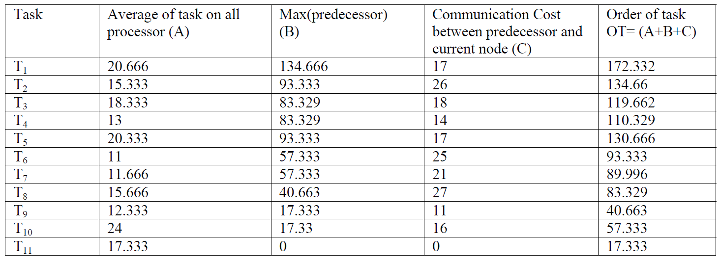
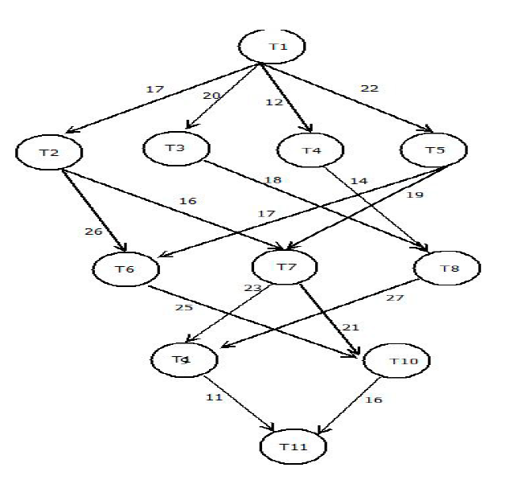
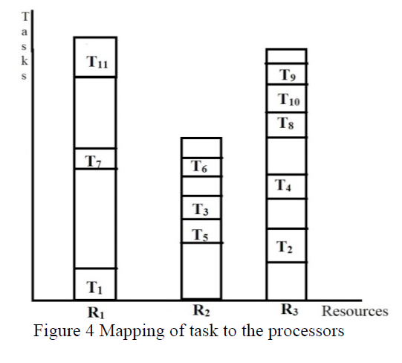
Task | P1 |  | P2 |  | P3
1 | 0 | 16
2 |  |  |  |  | 16+17 | 46
5 |  |  | 16+22 | 57
3 |  |  | 57 | 69
4 |  |  |  |  | 46 | 57
6 |  |  | 42+26(T2) | 81
7 | 57+19(T5) | 84
8 |  |  |  |  | 69+18(T3) | 97
10 |  |  |  |  | 81+25(T6) | 118
9 |  |  |  |  | 118 | 127
11 | 127+11 | 152
T | P1 | P2 | P2
1 | 16 | 19 | 27
2 | 18 | 15 | 13
3 | 21 | 12 | 22
4 | 15 | 13 | 11
5 | 22 | 19 | 20
6 | 13 | 9 | 11
7 | 8 | 11 | 16
8 | 14 | 23 | 10
9 | 15 | 13 | 09
10 | 28 | 32 | 12
11 | 14 | 16 | 22

Slide 12
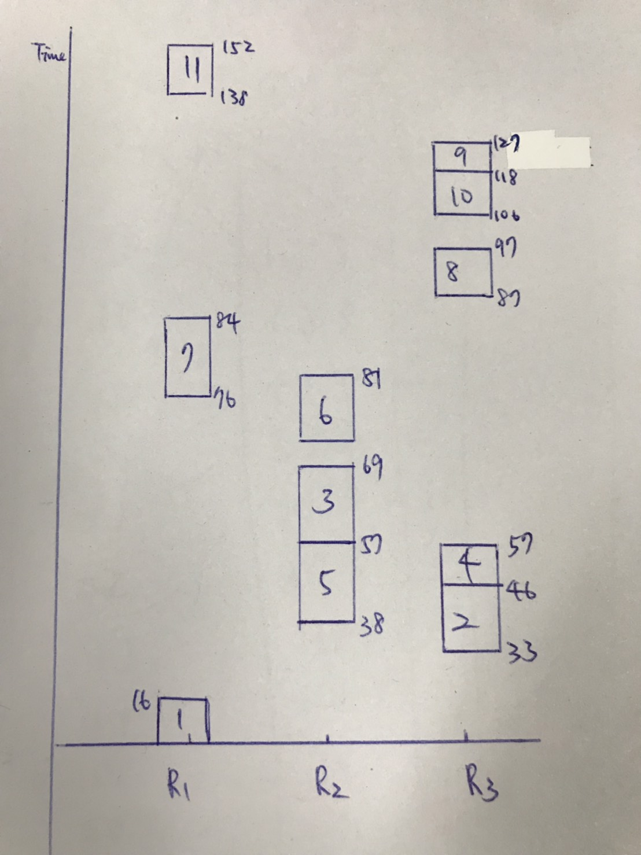
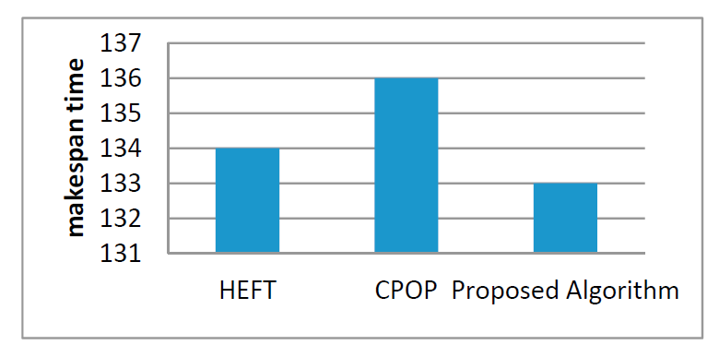
T | P1 | P2 | P2
1 | 16 | 19 | 27
2 | 18 | 15 | 13
3 | 21 | 12 | 22
4 | 15 | 13 | 11
5 | 22 | 19 | 20
6 | 13 | 9 | 11
7 | 8 | 11 | 16
8 | 14 | 23 | 10
9 | 15 | 13 | 09
10 | 28 | 32 | 12
11 | 14 | 16 | 22

Slide 13
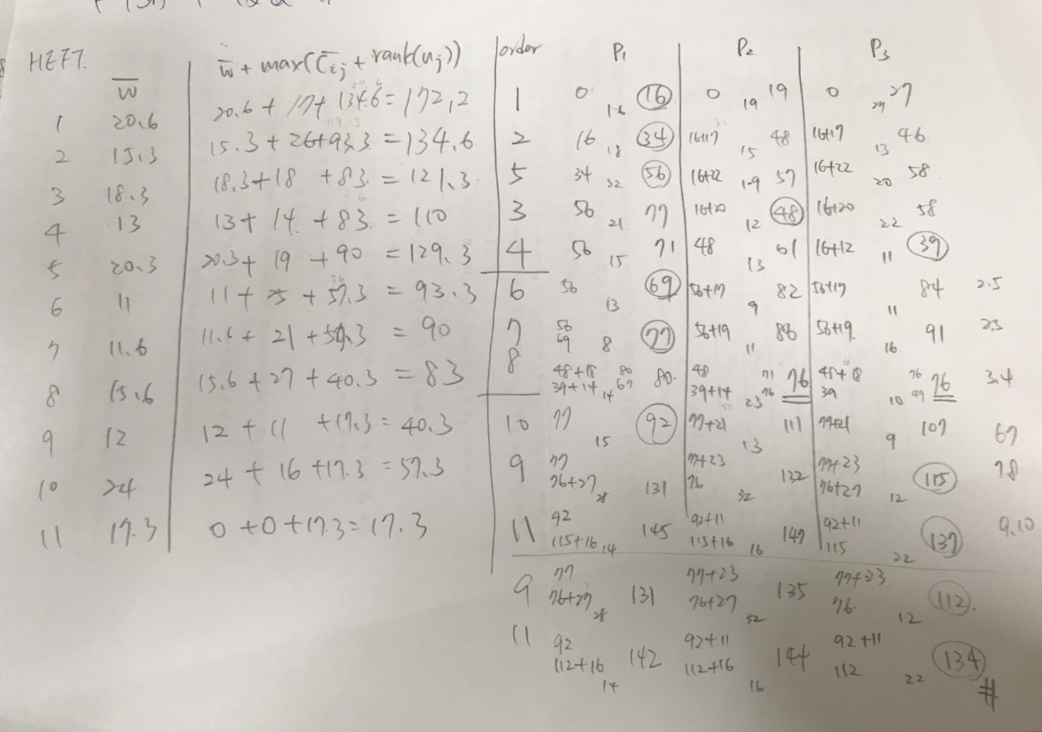
HEFT

Slide 14
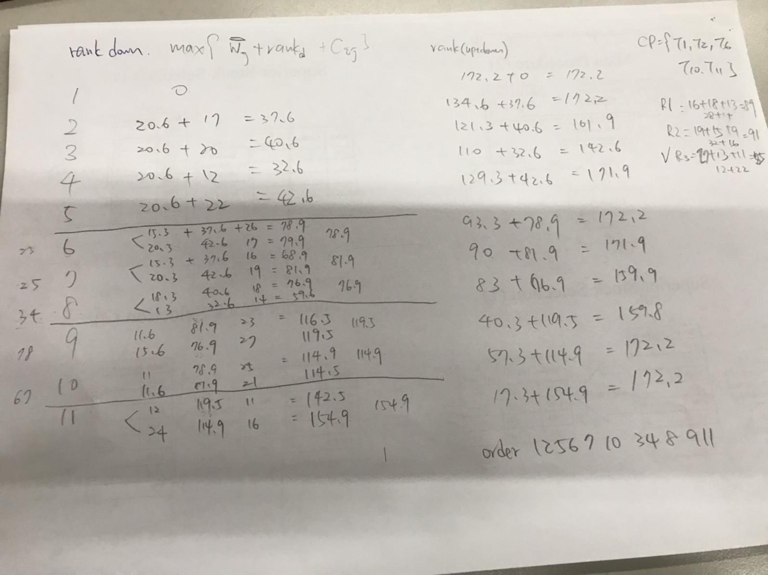
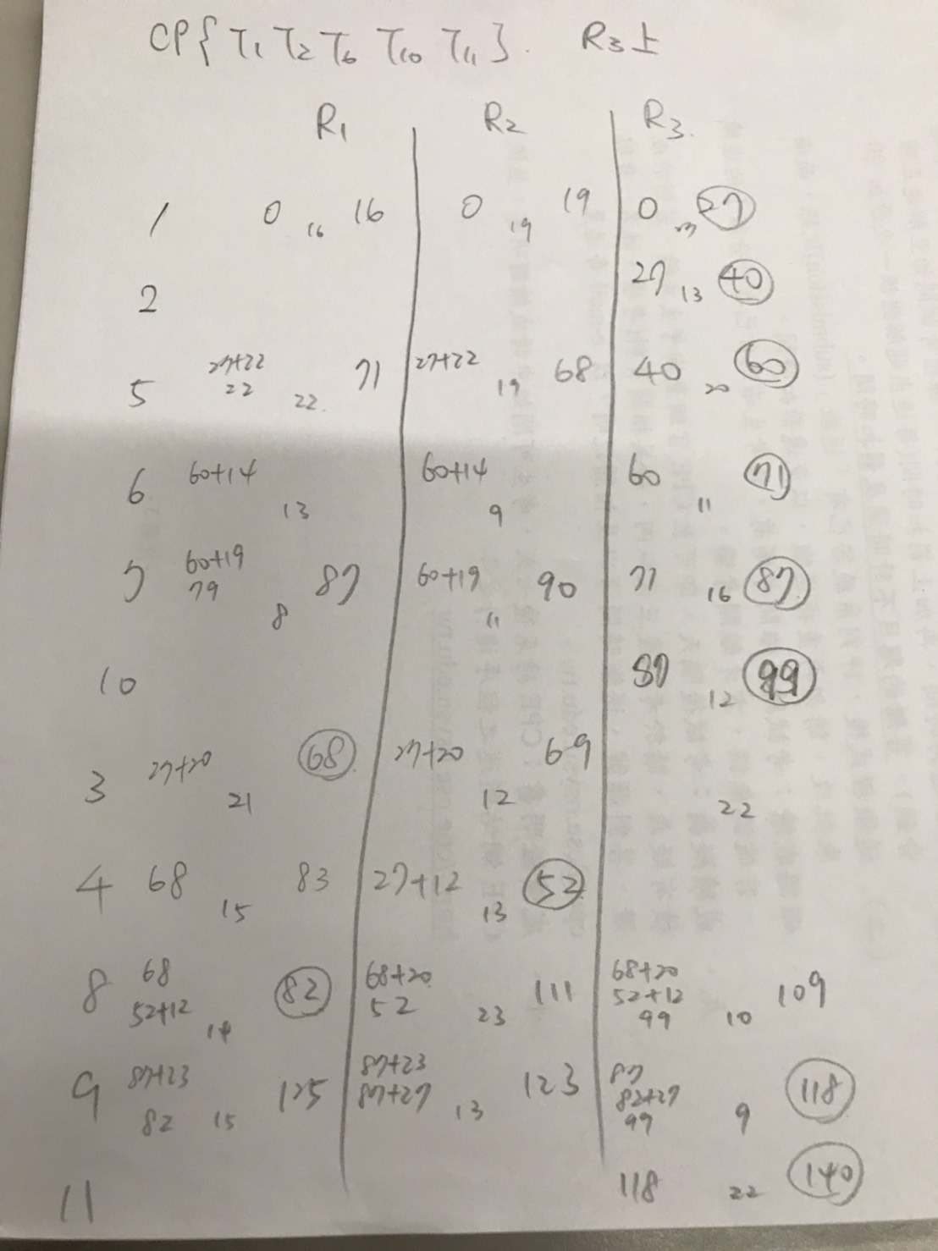
CPOP

Slide 15
Conclusion
In HEFT and CPOP algorithm load is not uniformly distributed some of its resources are overloaded while other in idle condition or have a very few load and this will increased the execution cost of task.
Proposed algorithm reduce the makespan time of tasks and load balancing issues.

Slide 16
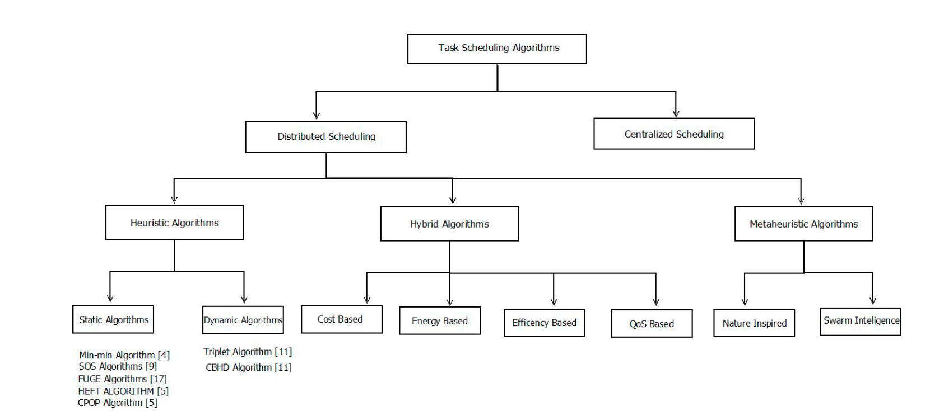

Slide 17
GRP-HEFT: A Budget-Constrained Resource Provisioning Scheme for Workflow Scheduling in IaaS Clouds
Hamid Reza Faragardi , Mohammad Reza Saleh Sedghpour , Saber Fazliahmadi, Thomas Fahringer , Member, IEEE, and Nayereh Rasouli
IEEE TRANSACTIONS ON PARALLEL AND DISTRIBUTED SYSTEMS, VOL. 31, NO. 6, JUNE 2020

Slide 18
Abstract
In Infrastructure as a Service (IaaS) Clouds, users are charged to utilize cloud services according to a pay-per-use model. If users intend to run their workflow applications on cloud resources within a specific budget, they have to adjust their demands for cloud resources with respect to this budget. Although several scheduling approaches have introduced solutions to optimize the makespan of workflows on a set of heterogeneous IaaS cloud resources within a certain budget, the hourly-based cost model of some well-known cloud providers (e.g., Amazon EC2 Cloud) can easily lead to a higher makespan and some schedulers may not find any feasible solution. In this article, we propose a novel resource provisioning mechanism and a workflow scheduling algorithm, named Greedy Resource Provisioning and modified HEFT (GRP-HEFT), for minimizing the makespan of a given workflow subject to a budget constraint for the hourly-based cost model of modern IaaS clouds. As a resource provisioning mechanism, we propose a greedy algorithm which lists the instance types according to their efficiency rate. For our scheduler, we modified the HEFT algorithm to consider a budget limit. GRP-HEFT is compared against state-of-the-art workflow scheduling techniques, including MOACS (MultiObjective Ant Colony System), PSO (Particle Swarm Optimization), and GA (Genetic Algorithm). The experimental results demonstrate that GRP-HEFT outperforms GA, PSO, and MOACS for several well-known scientific workflow applications for different problem sizes on average by 13.64, 19.77, and 11.69 percent, respectively. Also in terms of time complexity, GRP-HEFT outperforms GA, PSO and MOACS.

Slide 19
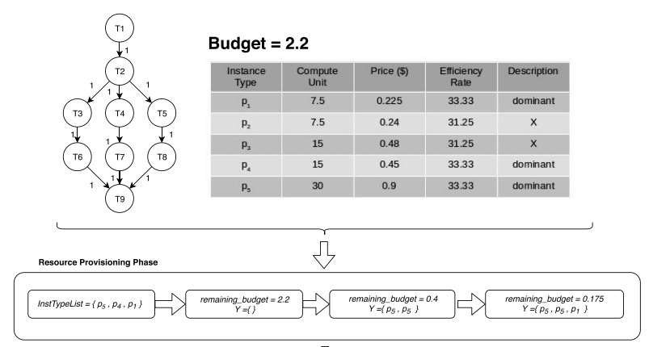
https://aws.amazon.com/tw/ec2/instance-types/
${Price}_{i}≤{Price}_{j}$ & ${CU}_{i}≥{CU}_{j}$
Notes:
什麼型態 要幾個在預算之內

Slide 20
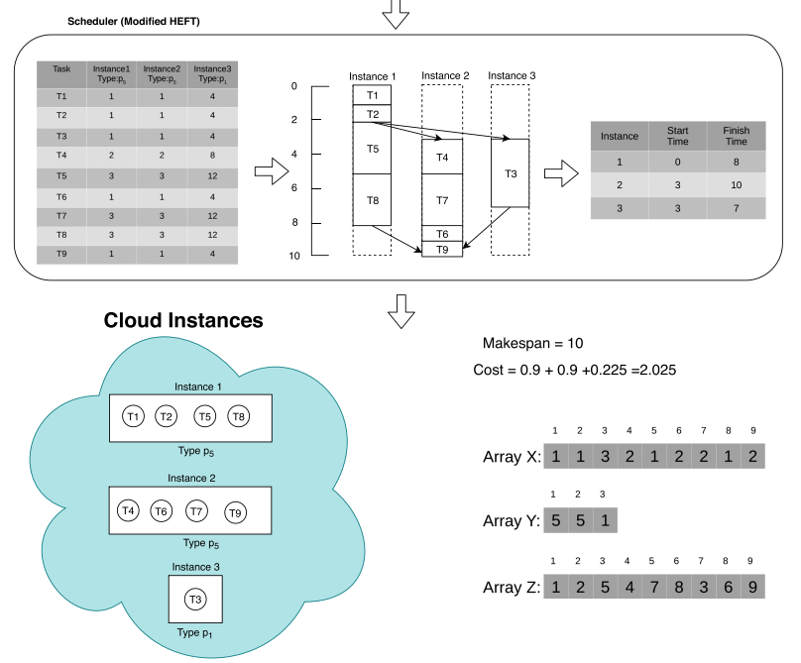

Slide 21
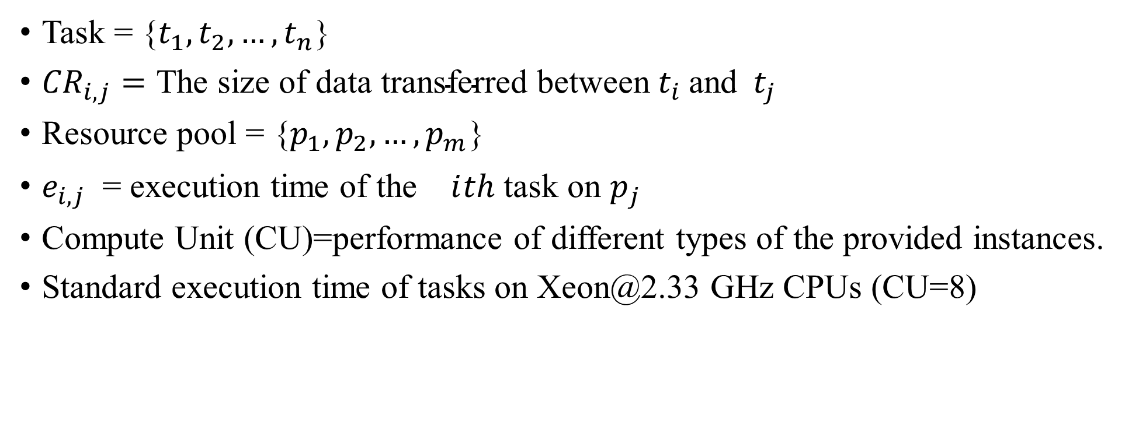
Parameter
Task = {$t_{1},t_{2},…,t_{n}$}
${CR}_{i,j}=\text{The} \text{size} \text{of} \text{data} \text{transferred} \text{between}{ t}_{i} \text{and}{ t}_{j}$
Resource pool = {$p_{1},p_{2},…,p_{m}$}
$e_{i,j}$ = execution time of the ${}_{}^{}ith$ task on $p_{j}$
Compute Unit (CU)=performance of different types of the provided instances.
Standard execution time of tasks on Xeon@2.33 GHz CPUs (CU=8)

Slide 22
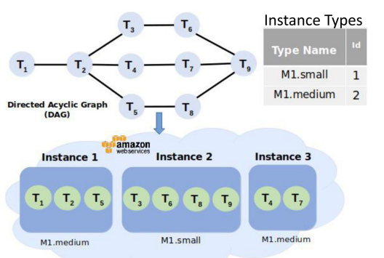
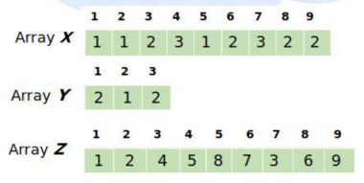
 | CPU | memory | CU
m1.medium | a single virtual CPU | Large | 3.75
m1.small | a single virtual CPU | small | 1.7
Array x: represent the assignment of tasks to instances
Array y: represent the type of each instance
Array z: represent the execution order of tasks

Slide 23
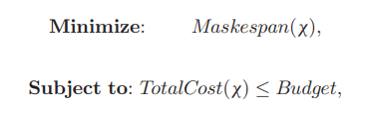
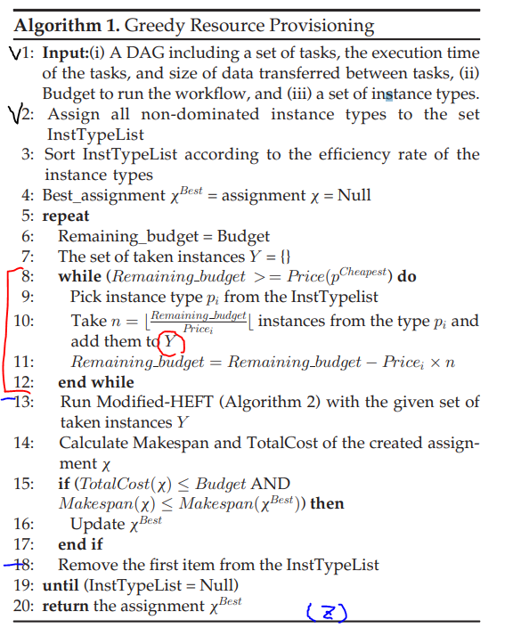
The generated set of instances Y , is given as an input to a modified version of the well-known HEFT algorithm.
The modified-HEFT completes the assignment x by filling the values of X and Z arrays.
Eventually, the best assignment found across all iterations returns the final solution.

Slide 24

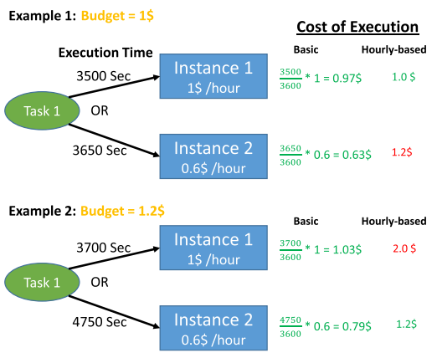

Slide 25
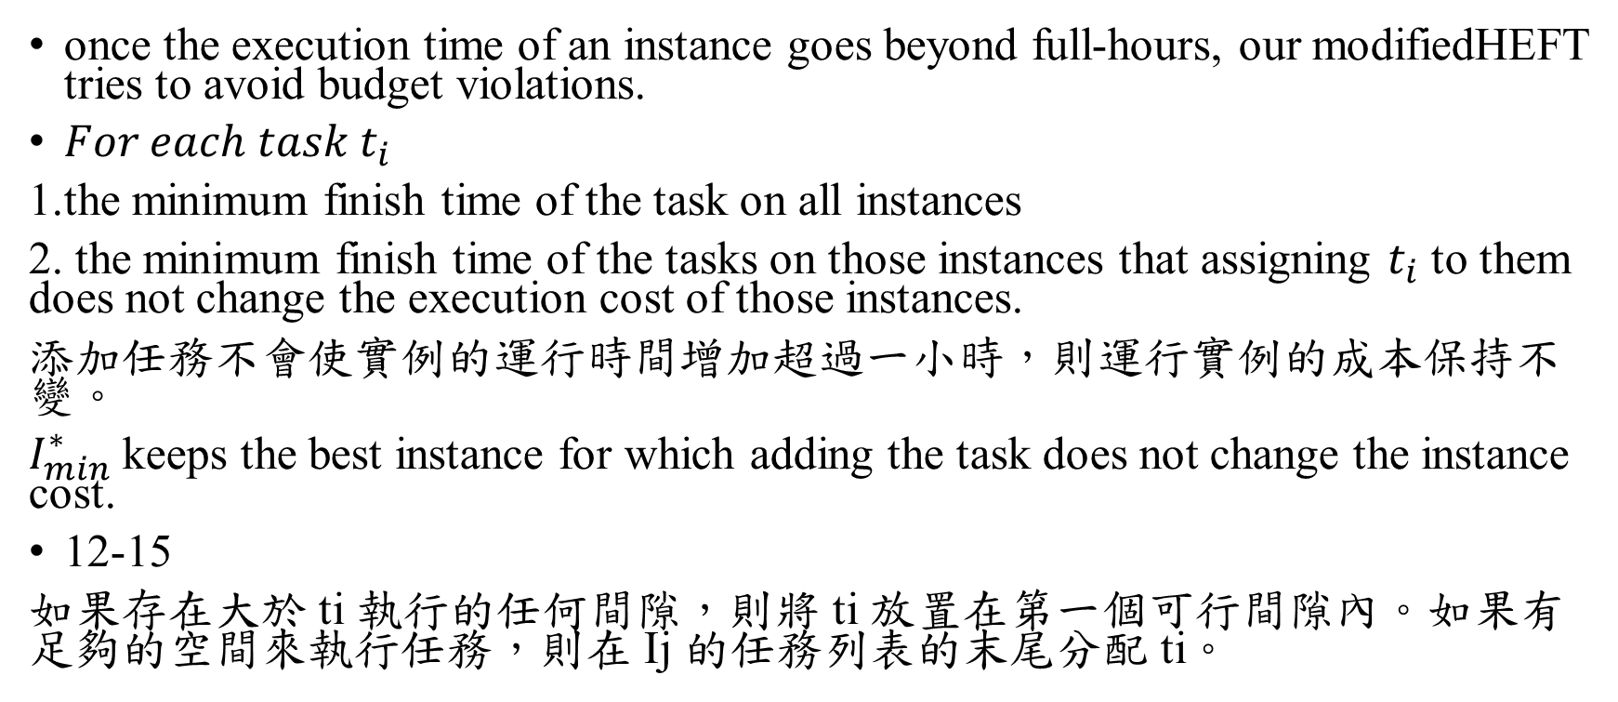
difference
once the execution time of an instance goes beyond full-hours, our modifiedHEFT tries to avoid budget violations.
${For each task t}_{i}$
1.the minimum finish time of the task on all instances
2. the minimum finish time of the tasks on those instances that assigning $t_{i}$ to them does not change the execution cost of those instances.
添加任務不會使實例的運行時間增加超過一小時，則運行實例的成本保持不變。
$I_{min}^{∗}$ keeps the best instance for which adding the task does not change the instance cost.
12-15
如果存在大於 ti 執行的任何間隙，則將 ti 放置在第一個可行間隙內。如果有足夠的空間來執行任務，則在 Ij 的任務列表的末尾分配 ti。
Notes:
由於資源提供方法沒有考慮提供實例的運行時間超過一小時的情況，因此在調度階段可能會違反預算約束。

Slide 26
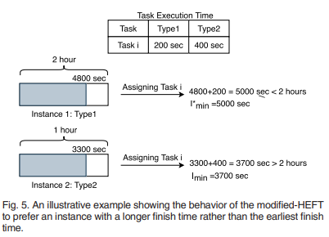
difference
Modified-HEFT employs a Budget-Violation Avoidance(BVA) mechanism for dealing with such situations.
Once the execution time of an instance goes beyond full-hours, our modified HEFT tries to avoid budget violations.
Notes:
添加任務不會使實例的運行時間增加超過一小時，則運行實例的成本保持不變。
Heft不關心預算
如果存在大於 ti 執行的任何間隙，則將 ti 放置在第一個可行間隙內

Slide 27
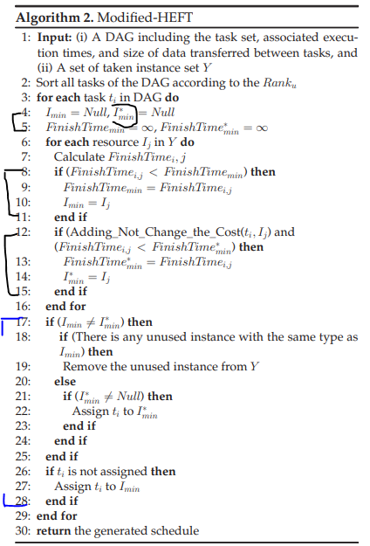

difference
Modified-HEFT employs a Budget-Violation Avoidance(BVA) mechanism for dealing with such situations.
once the execution time of an instance goes beyond full-hours, our modifiedHEFT tries to avoid budget violations.
$I_{min}^{∗}$ keeps the best instance for which adding the task does not change the instance cost.

Slide 28
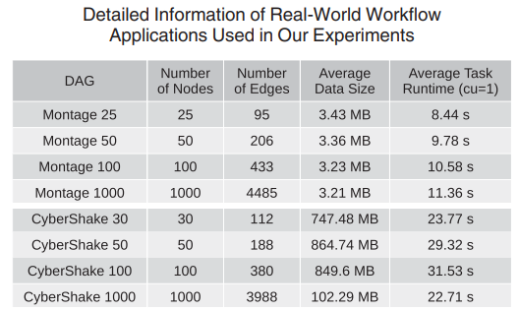
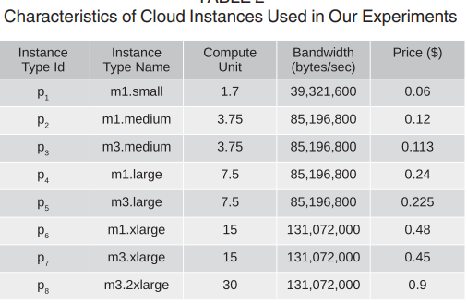
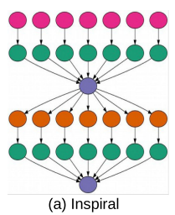
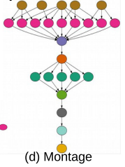
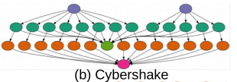
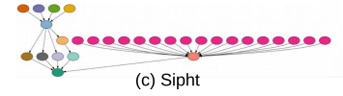

Slide 29
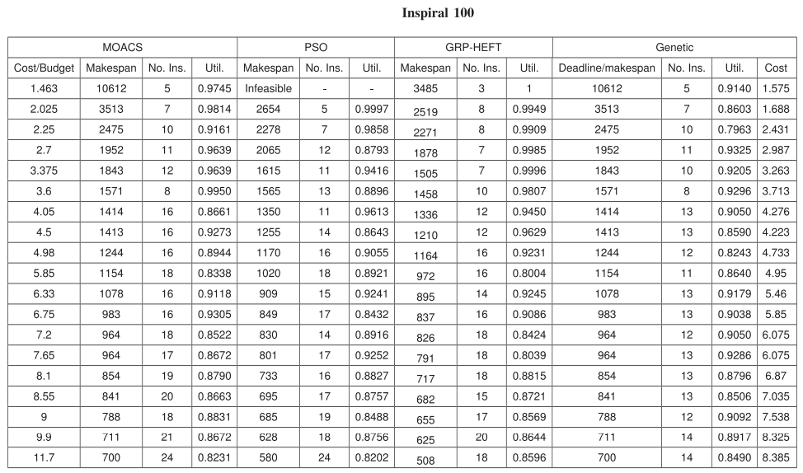


Slide 30
Thanks for listening.

Slide 31
