Slide 1
Neural Networks and the Estimation of Hands’ Strength in Contract Bridge
Jacek Ma’ndziuk and Jakub Suchan
25th International Conference, ICONIP 2018, Siem Reap, Cambodia, December 13-16, 2018
Presenter: Jing-Ping Jan
Date: July 20, 2021

Slide 2
Abstract
This paper presents a new approach to solving the Double Dummy Bridge Problem (DDBP). The DDBP is a hard classification task utilized by bridge playing programs which rely on Monte Carlo simulations. The proposed method employs shallow autoencoders (AEs) during an unsupervised pretraining phase and Multilayer Perceptron networks (MLPs) with three hidden layers, built on top of these trained AEs, in the final fine-tuning training. The results are compared with our previous study in which MLPs with similar architectures, but with no use of AEs and pretraining, were employed to solve this task. Several conclusions concerning efficient weight topologies and fine-tuning schemes of the proposed model, as well as interesting weight patterns discovered in the trained networks are presented and explained.

Slide 3
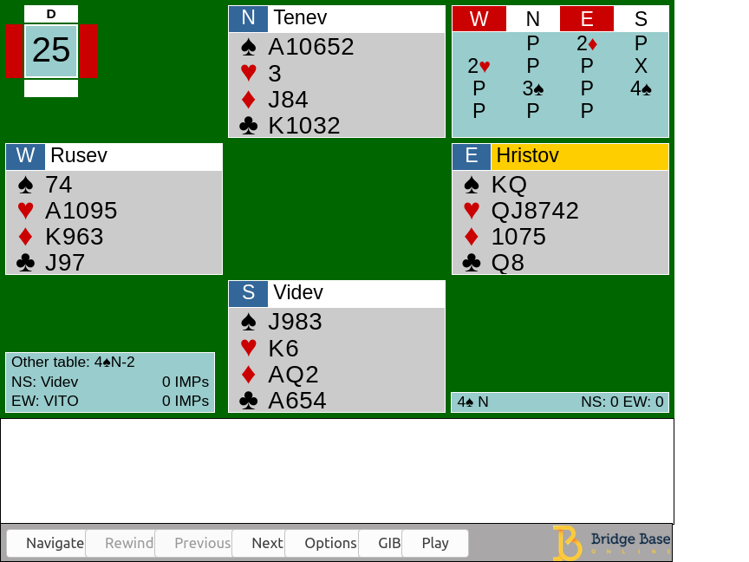
Introduction
Bidding stage Find the most profitable contract for the playing stage
Playing stage 13 rounds of a card-strength competition

Slide 4
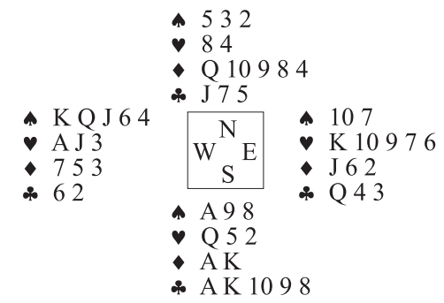
Double Dummy Bridge problem

Slide 5
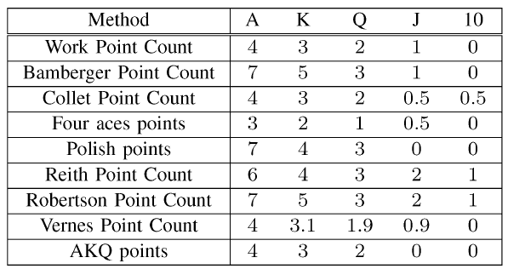
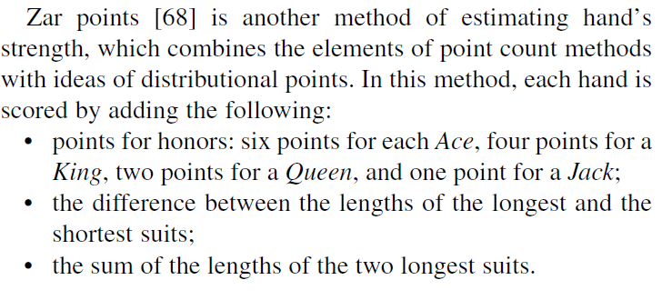
Related work- Point count methods

Slide 6
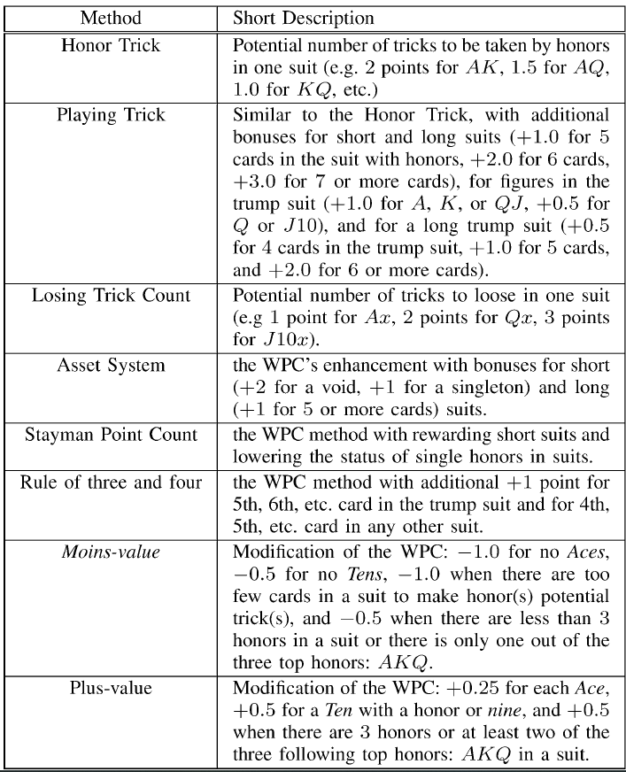
Related work- Distribution Point methods

Slide 7
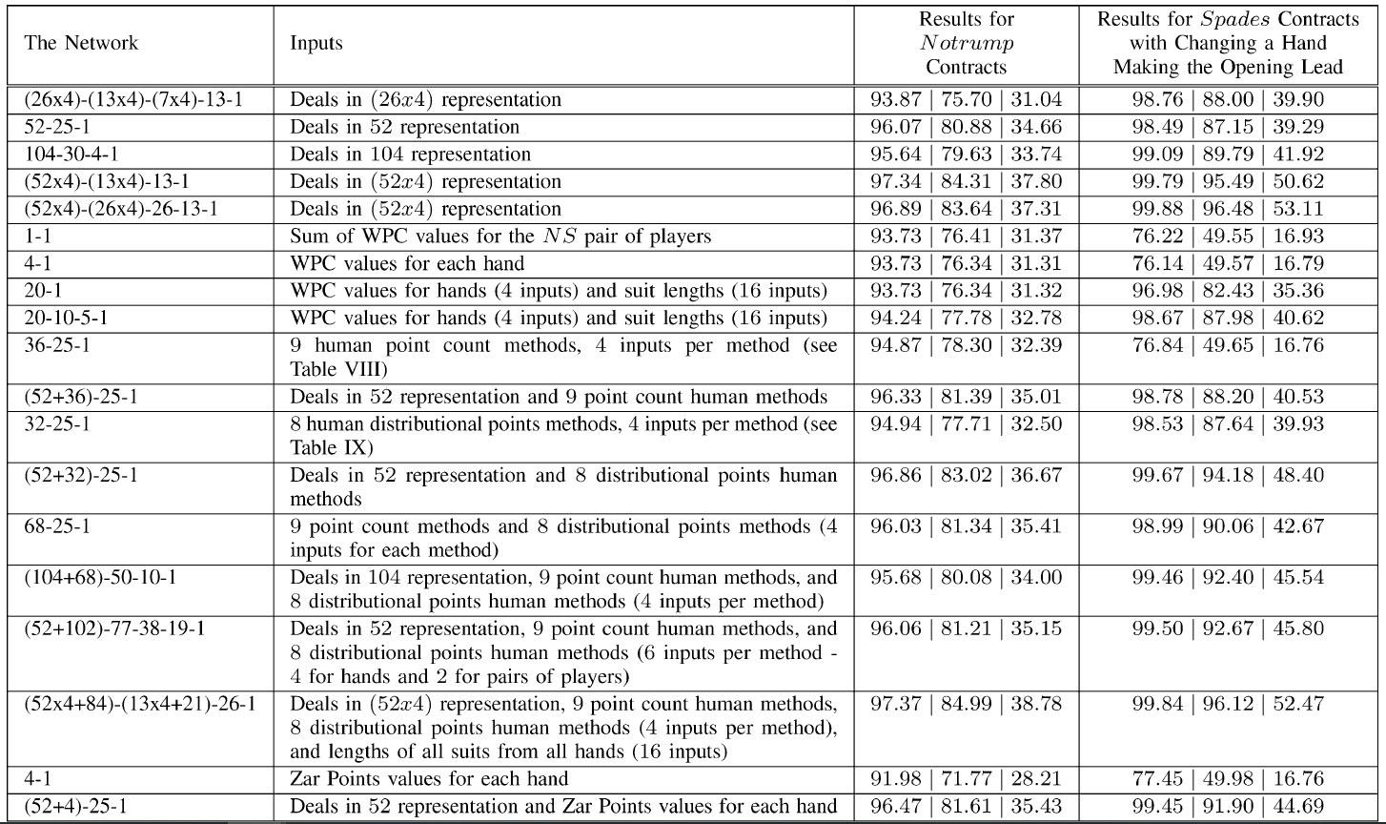
Related work

Slide 8
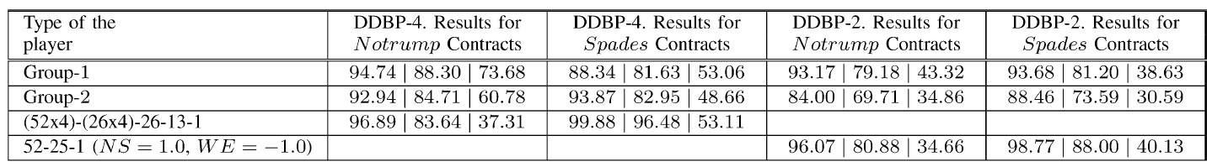
Related work
DDBP-4: fully uncovered version of the problem
DDBP-2:opponents’ hands being hidden
Group1:four Grand Masters, three International Masters, and three Masters, playing in the First or the Second Polish Bridge League
Group2:the lower ranked bridge teams, each having a professional bridge title

Slide 9
Autoencoder
$$H\left(x,z\right)=−Σ_{k=1}^{d}[x_{k}logz_{k}+\left(1−x_{k}\right)log⁡(1−z_{k})]$$
x
Encoder
Decoder
z
208
208

Slide 10
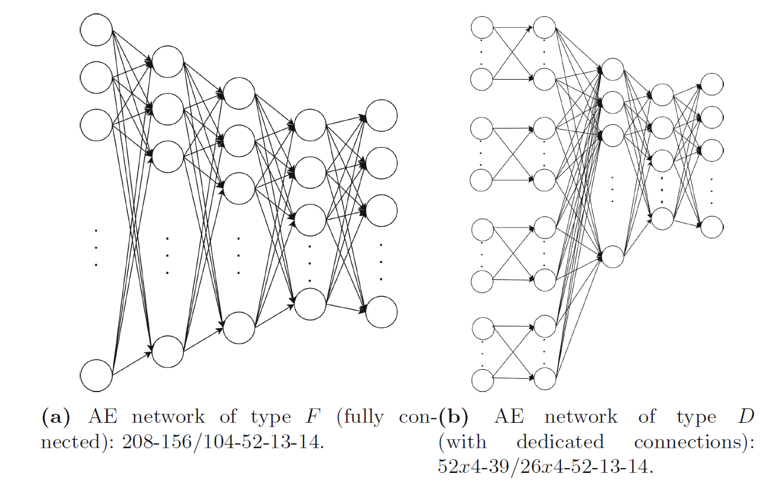
Neural Network

Slide 11
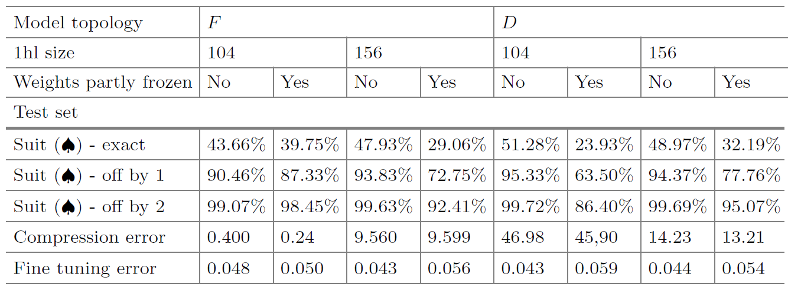
Results-Suit contract
Previous work | 52*4-26*4-26-13-1
Exact | 53.11%
Off by 1 | 96.48%
Off by 2 | 99.88%

Slide 12
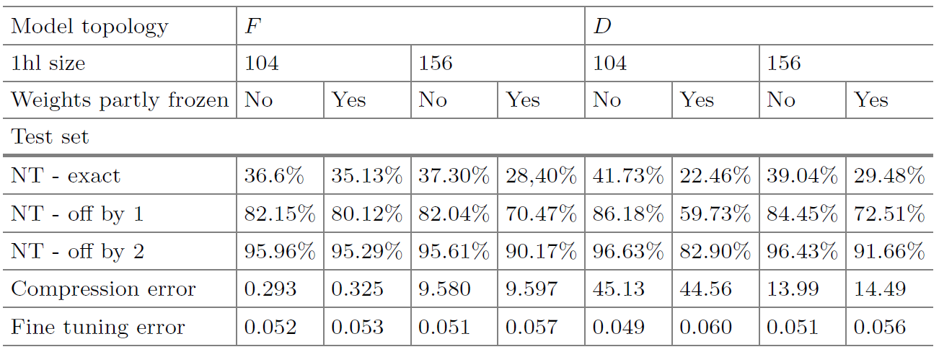
Results-NT contract
Previous work | 52*4-26*4-26-13-1
Exact | 37.31%
Off by 1 | 83.64%
Off by 2 | 96.89%

