Slide 1
Hacker popcount
int hacker_popcnt(unsigned int n) {
n -= (n>>1) & 0x55555555;
n = (n & 0x33333333) + ((n>>2) & 0x33333333);
n = ((n>>4) + n) & 0x0F0F0F0F;
n += n>>8;
n += n>>16;
return n&0x0000003F;
}
32bit

Slide 2
n -= (n>>1) & 0x55555555;
ab : 2a+b
0x5=0101
(ab>>1) & 0x01 = a
ab-a = 2a+b-(a) = a+b

Slide 3
n = (n & 0x33333333) + ((n>>2) & 0x33333333);
0x3=0011
abcd & 0011 = cd
(abcd >> 2) & 0x0011 = ab
ab+cd

Slide 4
n = ((n>>4) + n) & 0x0F0F0F0F;
0x0F=00001111
(abcdefgh >> 4) + abcdefgh = abcd+efgh
a,e = 0
abcd0(bcd+fgh) & 00001111 = bcd+fgh

Slide 5
n += n>>8;
0000abcd0000efgh
0000abcd0000(abcd+efgh)
n += n>>16;
...
return n&0x0000003F;
0x3F=00111111 , 2⁶=64 (0-63), max 32

Slide 6
Compressed Suffix Trees with Full Functionality
Kunihiko Sadakane
Theory of Computing Systems, Volume 41,
issue 4, December 2007, Pages 589-607
Presenter: Shin-Cheng Lin
Date: July 20, 2021

Slide 7
Abstract(1/2)
We introduce new data structures for compressed suffix trees whose size are linear in the text size. The size is measured in bits; thus they occupy only
O(n log|A|) bits for a text of length n on an alphabet A. This is a remarkable improvement on current suffix trees which require O(n log n) bits. Though some components of suffix trees have been compressed, there is no linear-size data structure for suffix trees with full functionality such as computing suffix links, string-depths and lowest common ancestors.

Slide 8
Abstract(2/2)
The data structure proposed in this paper is the first one that has linear size and supports all operations efficiently. Any algorithm running on a suffix tree can also be executed on our compressed suffix trees with a slight slowdown of a factor of polylog(n).

Slide 9
Suffix
T = ababac$
Suffix of T :
ababac$
babac$
abac$
bac$
ac$
c$
$

Slide 10
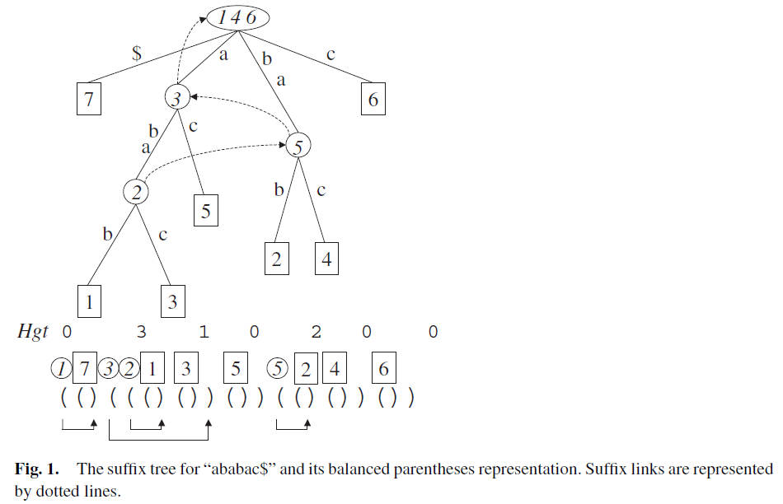
T = ababac$
Suffix of T :
ababac$ 1
babac$ 2
abac$ 3
bac$ 4
ac$ 5
c$ 6
$ 7

Slide 11
Suffix links
suffix link sl(v) of an internal node v with path-label xα points to the node with path-label α.
not only necessary to construct a suffix tree in linear time but also solve problems efficiently.

Slide 12
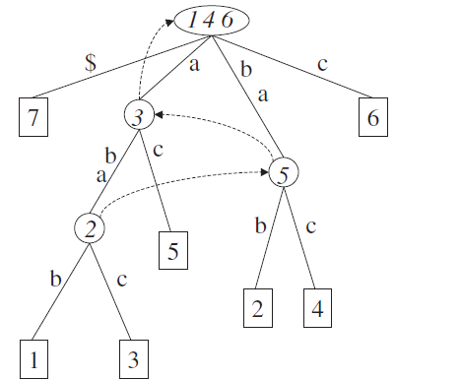
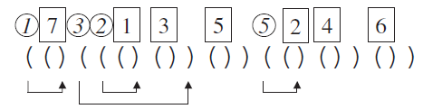
Balanced Parentheses Representations of Trees
During a preorder traversal of the tree:
write an open parenthesis when a node is visited
traverse all subtrees of the node, and write a close parenthesis
Any node in the tree is represented by a pair of ()
there are 2n −1 nodes in a
suffix tree, can be encoded in at
most 4n + o(n) bits.

Slide 13
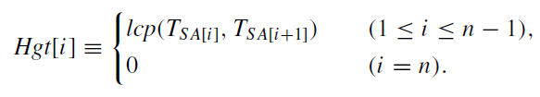
Lcp between two suffixes T_{SA[l]} and T_{SA[r]}
(l < r) is the minimum of
Hgt[l], Hgt[l + 1], . . . , Hgt[r − 1]
$ 1
ababac$ 2
abac$ 3
ac$ 4
babac$ 5
bac$ 6
c$ 7

Slide 14
reduces the problem of computing lca to the RMQ problem :
traverse the nodes of the tree in depth-first manner and store their node-depths in an array L
node depth of a node is the number of nodes on the path from the root to the node
The lca between two nodes can be represented as the minimum value in the subarray of L.
store L as an integer array of size 2n − 1 for an n-node tree.

Slide 15
A compressed suffix tree for a text of length n, can be represented in |CSA| + 6n + o(n)
4n+o(n) for encoded suffix tree and 2n for lca
|CSA| denotes the size of the compressed suffix array. (n log|A|)

Slide 16
The in order rank of an internal node v is defined as the number of visited internal nodes

Slide 17
Finding a Child Node and a Sibling :
In the parentheses sequence all children of an
internal node v are sequentially encoded.
We can therefore compute the first child of v by firstchild(v) = v+1, and the next sibling of a node w by sibling(w) = findclose(P,w)+1.

