Slide 1
Multiple Sequence Alignment with Hidden Markov Models Learned by Random Drift Particle Swarm Optimization
Jun Sun, Vasile Palade, Xiaojun Wu, and Wei Fang
IEEE/ACM Transactions on Computational Biology and Bioinformatics, 2014
vol. 11, no. 1, pp. 243-257
Presenter: Tsung-Lin Lu
Date: July 20, 2021

Slide 2
Abstract
Hidden Markov Models (HMMs) are powerful tools for multiple sequence alignment (MSA), which is known to be an NP-complete and important problem in bioinformatics. Learning HMMs is a difficult task, and many meta-heuristic methods, including particle swarm optimization (PSO), have been used for that. In this paper, a new variant of PSO, called the random drift particle swarm optimization (RDPSO) algorithm, is proposed to be used for HMM learning tasks in MSA problems. The proposed RDPSO algorithm, inspired by the free electron model in metal conductors in an external electric field, employs a novel set of evolution equations that can enhance the global search ability of the algorithm.

Slide 3
Abstract
Moreover, in order to further enhance the algorithmic performance of the RDPSO, we incorporate a diversity control method into the algorithm and, thus, propose an RDPSO with diversity-guided search (RDPSO-DGS). The performances of the RDPSO, RDPSO-DGS and other algorithms are tested and compared by learning HMMs for MSA on two well-known benchmark data sets. The experimental results show that the HMMs learned by the RDPSO and RDPSO-DGS are able to generate better alignments for the benchmark data sets than other most commonly used HMM learning methods, such as the Baum-Welch and other PSO algorithms. The performance comparison with well-known MSA programs, such as ClustalW and MAFFT, also shows that the proposed methods have advantages in multiple sequence alignment.

Slide 4
Outline
Hidden Markov Models (HMMs)
Forwarding algorithm
Viterbi algorithm
Objective function
Log-odds score (LO)
Sum-of-pairs score (SOP)
Particle Swarm Optimization (PSO)
Random Drift Particle Swarm Optimization (RDPSO)
Diversity-guided search (DGS)

Slide 5
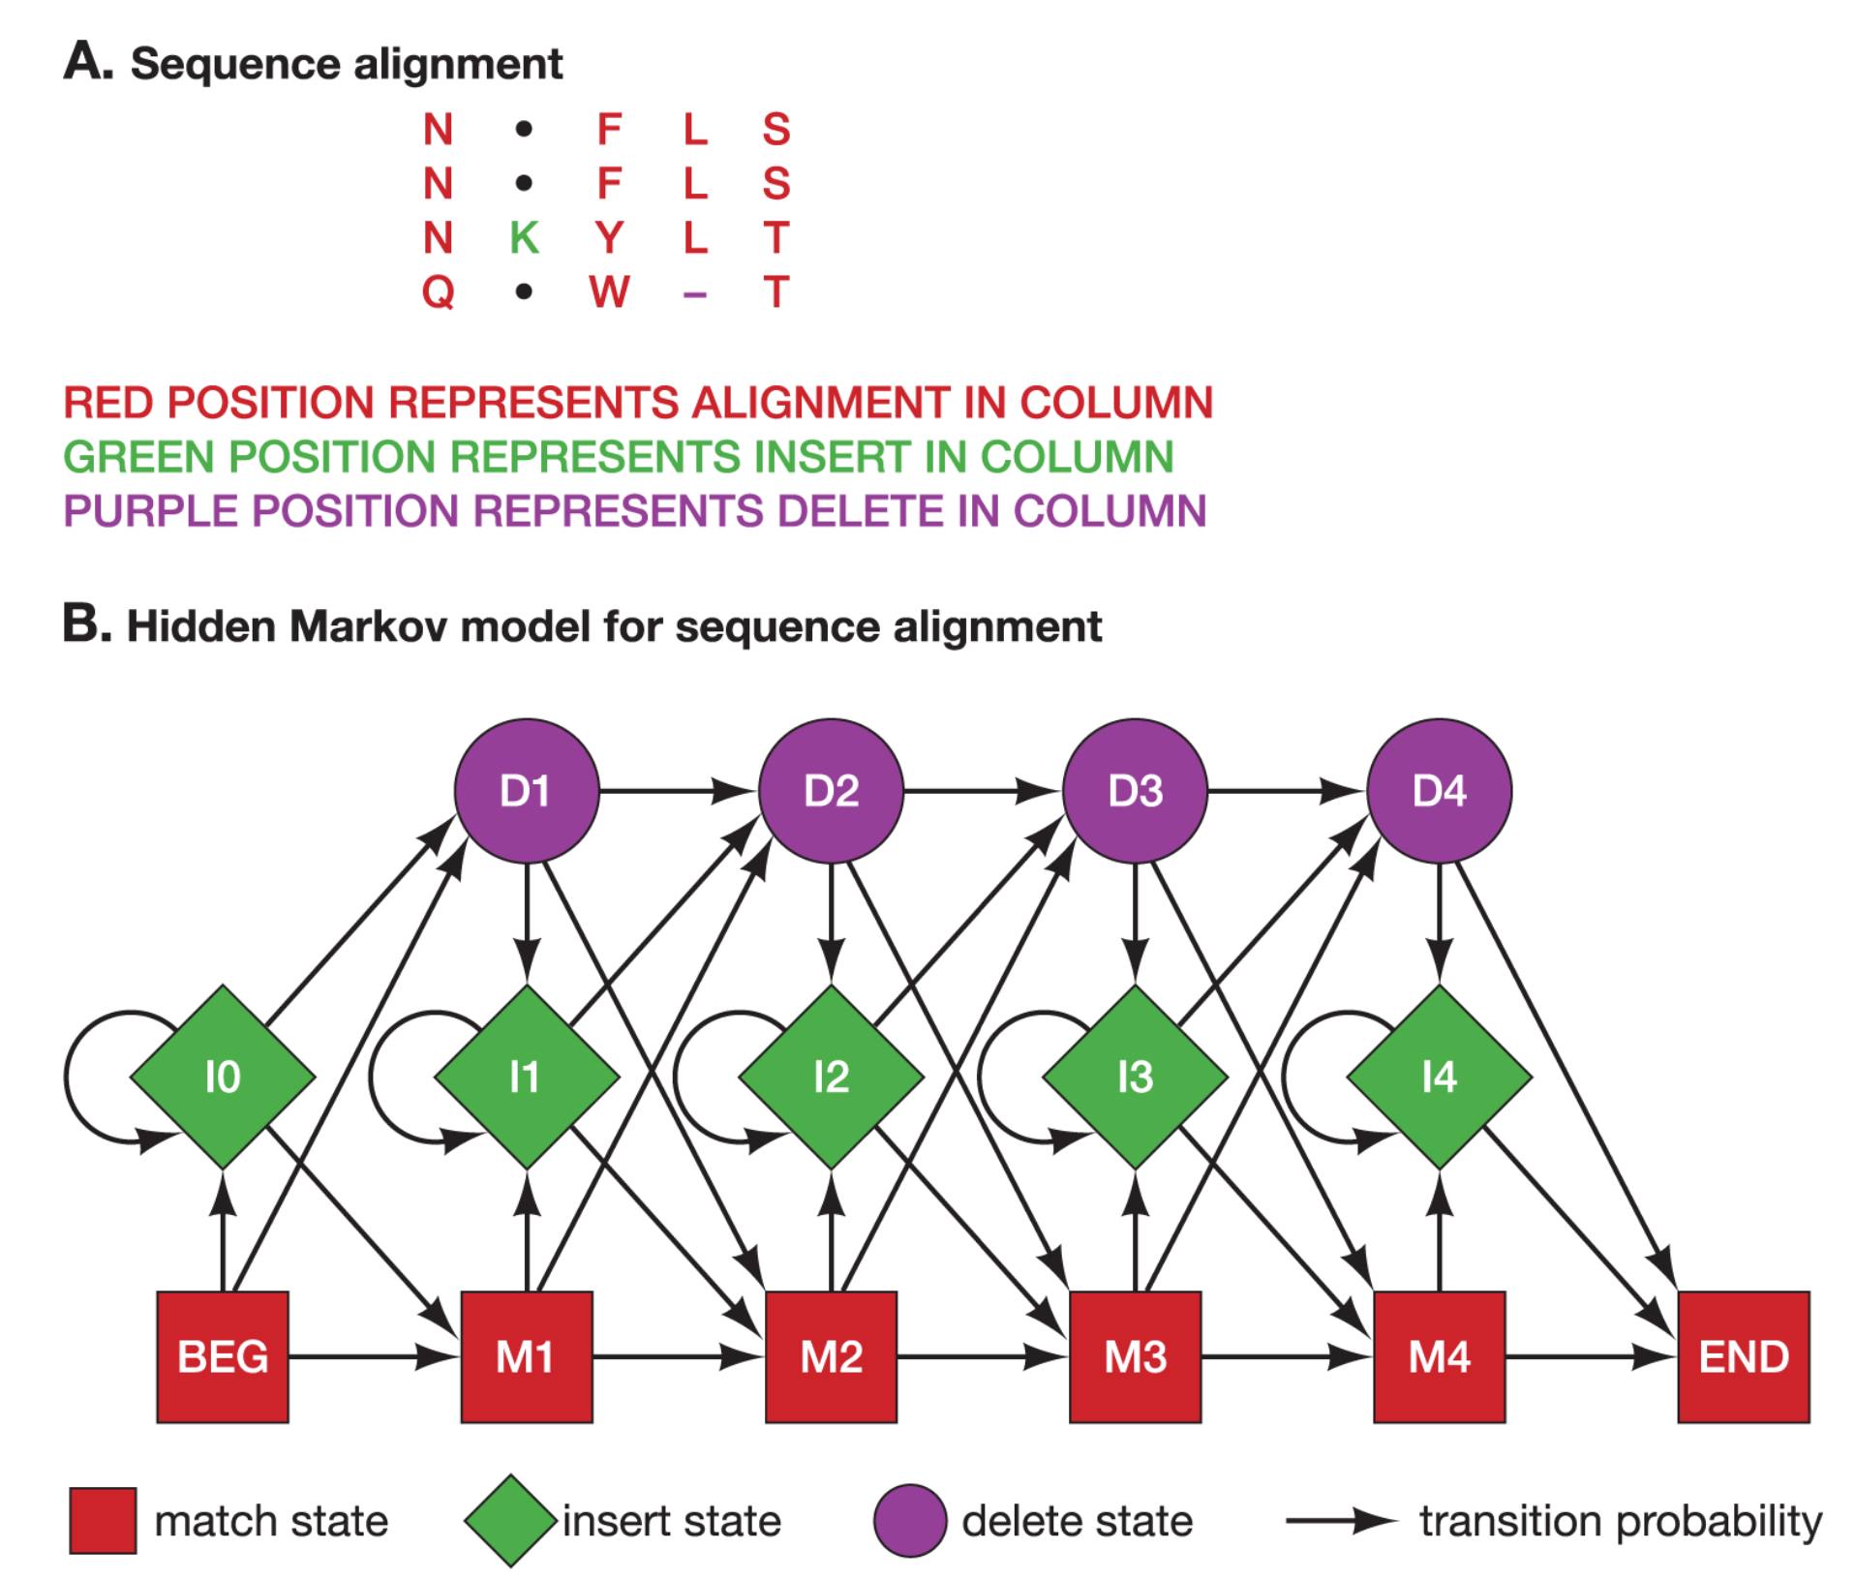
Hidden Markov Models (HMMs)

Slide 6
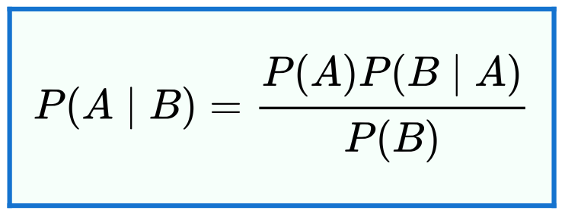
The three basic problems for HMMs
Given the observation sequence Ο = O₁O₂…O_{T} and a model λ = (Α, Β, π)
A：The state transition probability distribution
B：The observation symbol probability distribution
π：The initial state distribution
Problem #1： How do we efficiently compute Ρ(O|λ), the probability of the observation sequence, given the model?
Problem #2：How do we choose a corresponding state sequence Q = q₁q₂…q_{T} which is optimal in some meaningful sense?
Problem #3：How do we adjust the model parameters λ = (Α, Β, π) to maximize Ρ(O|λ)?

Slide 7
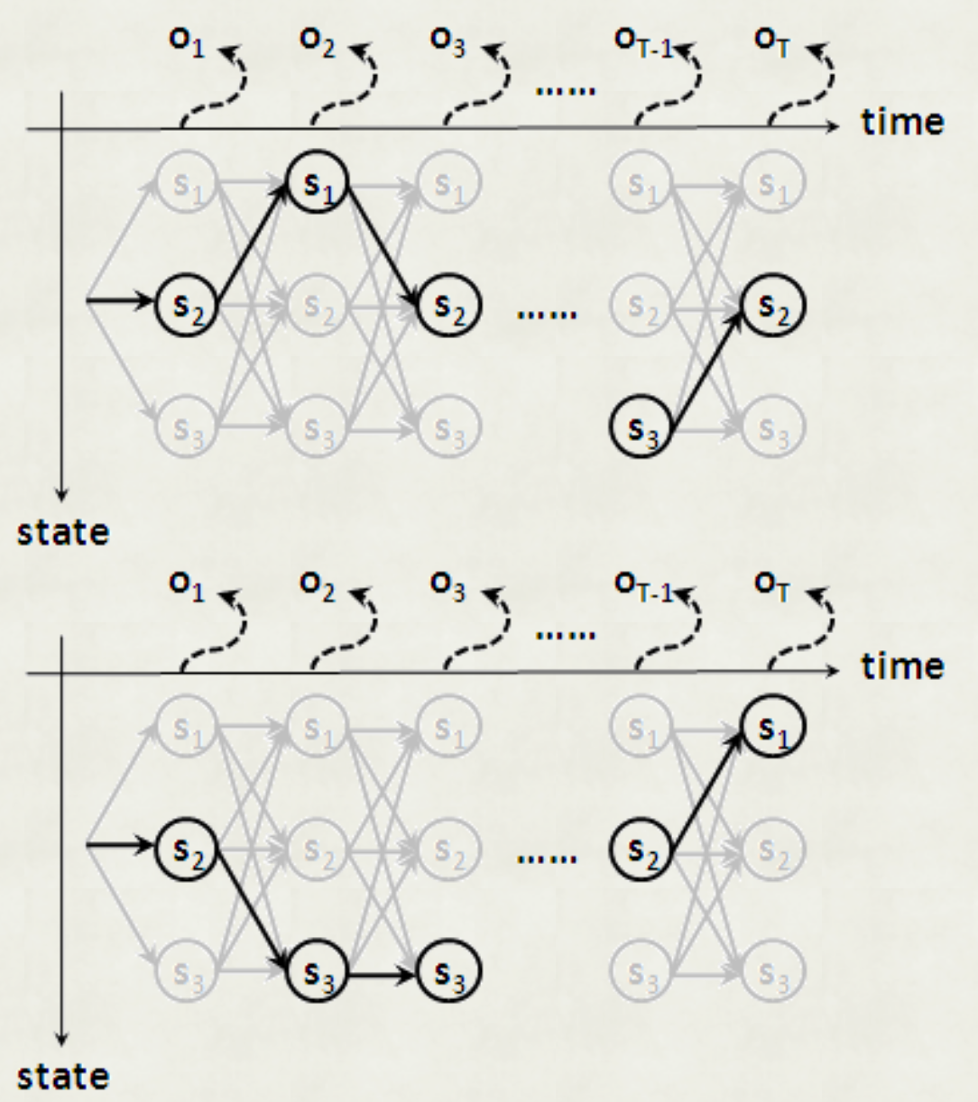
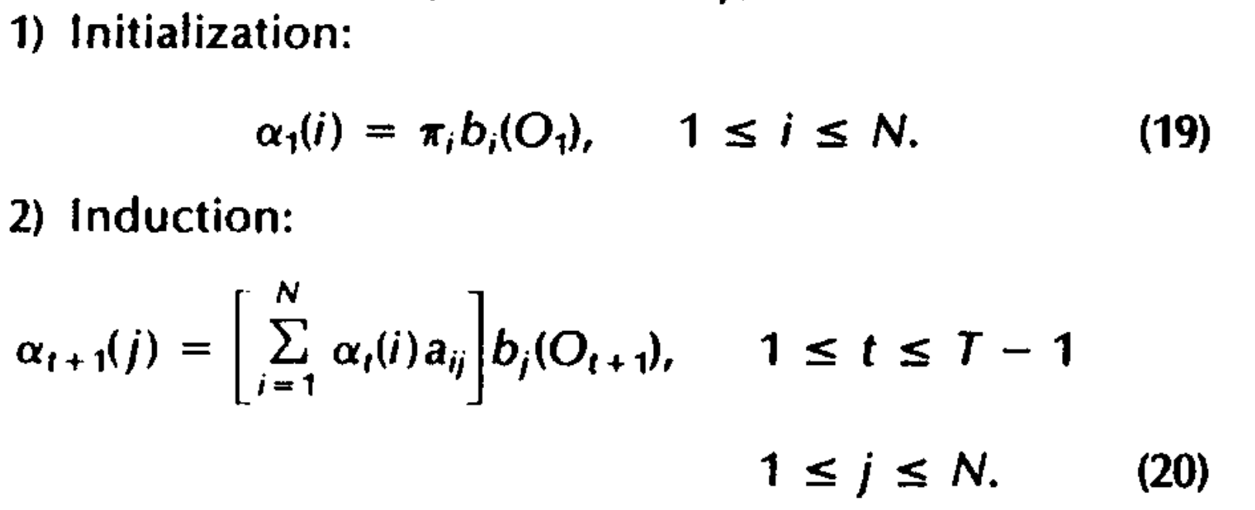
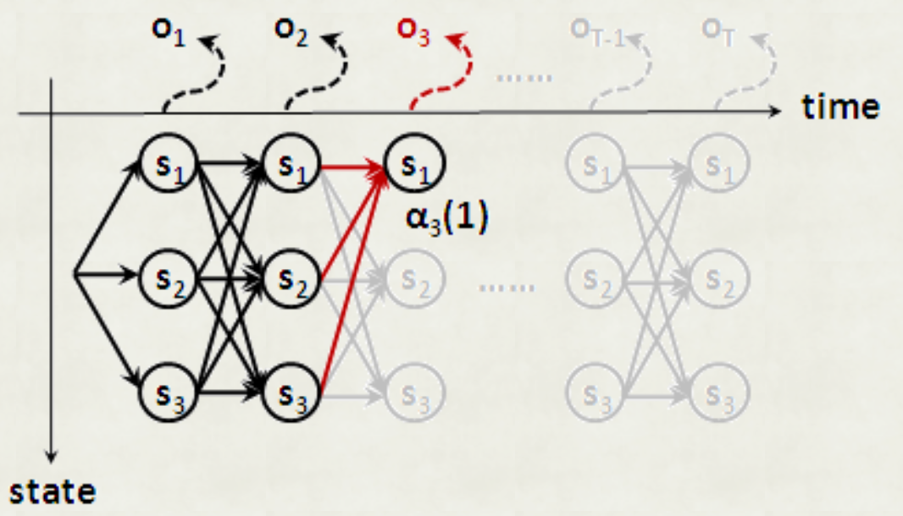
#1 Forwarding algorithm
a. Enumeration O(N^{T}T)
b. Forwarding O(N²T)

Slide 8
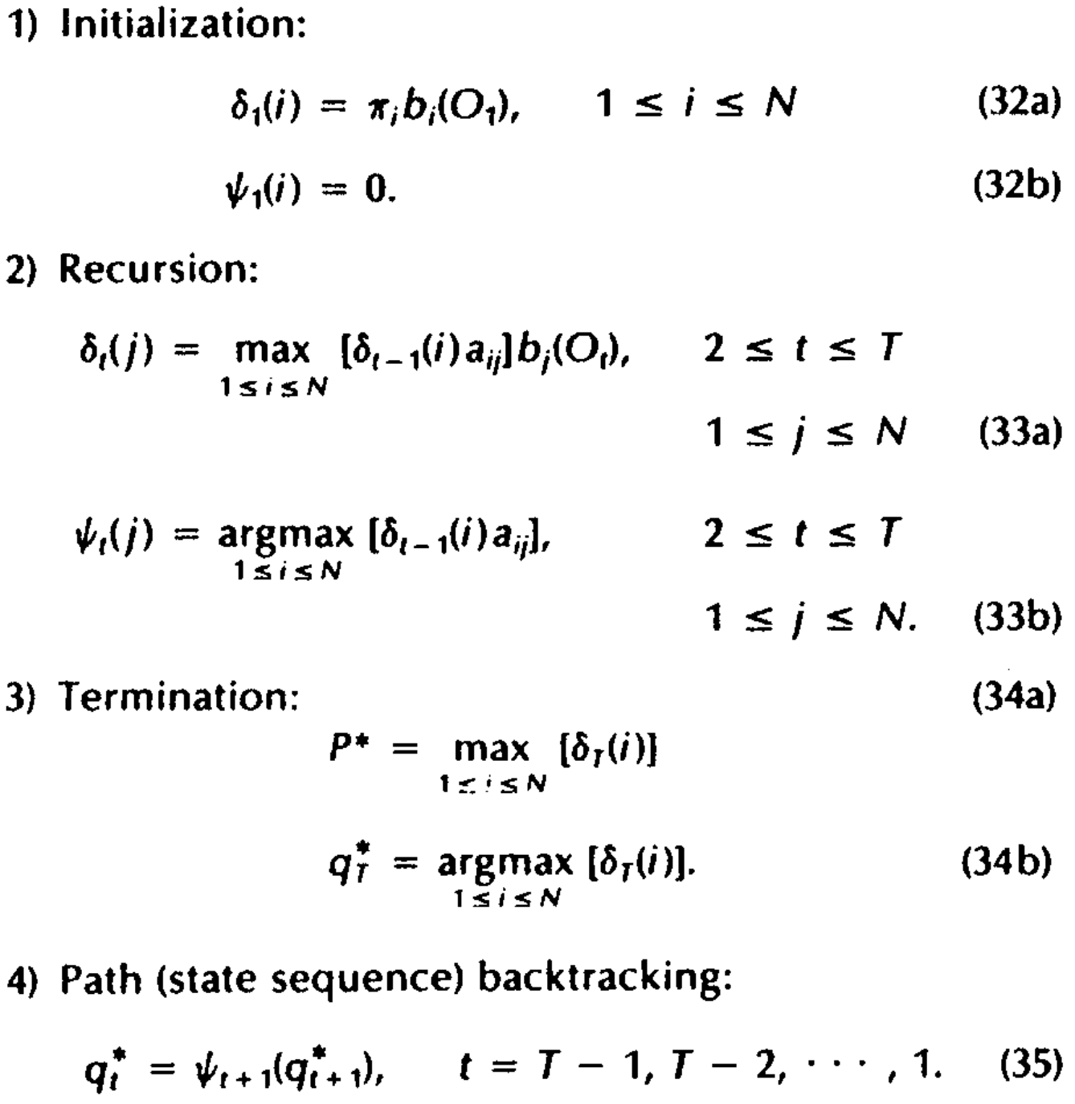
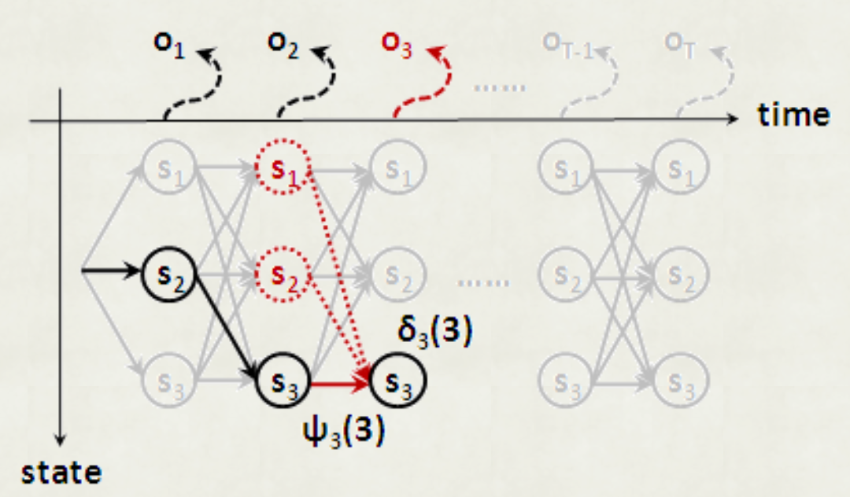
#2 Viterbi algorithm
c. Viterbi O(N^{T}T)

Slide 9
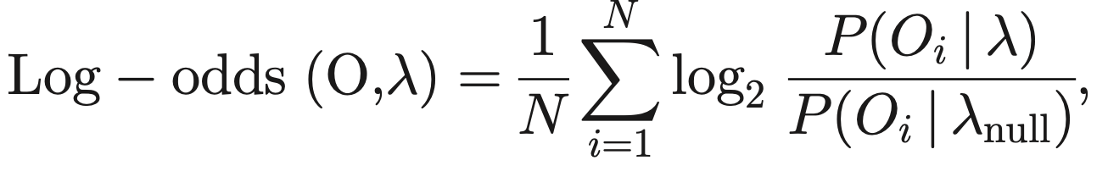
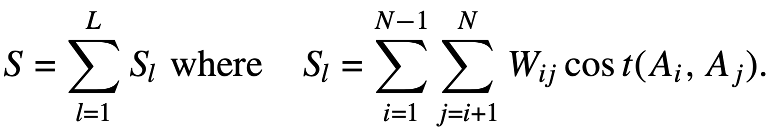
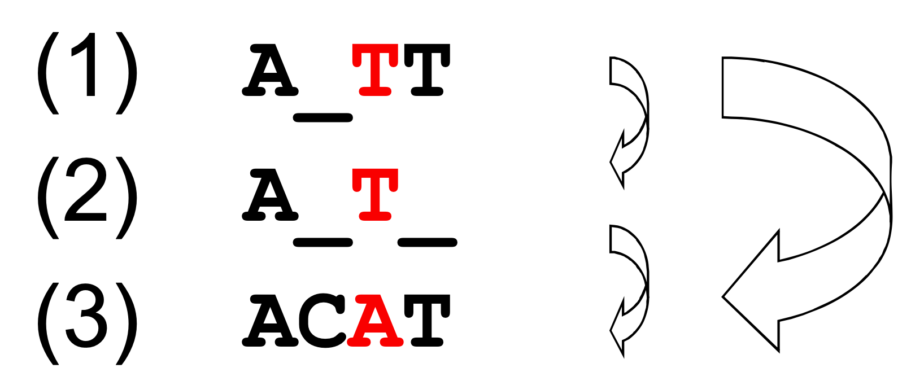

Objective function
Log-odds score (LO)
Sum-of-pairs score (SOP)
a random model is chosen as the λ_{null}

Slide 10
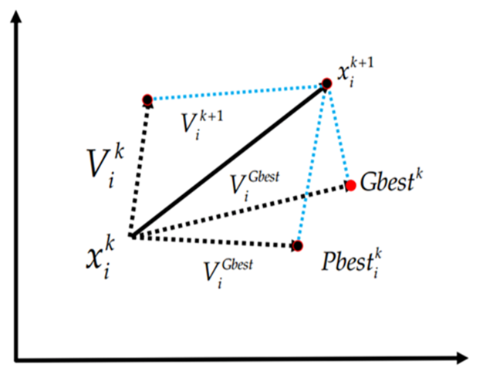
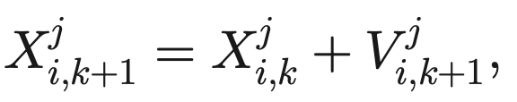
Particle swarm optimization (PSO)
Update velocity
Update position
Current
Pbest
Gbest
V：Velocity
X：Current position
P：Personal best position
G：Global best position
r, R：Random number
w, c1, c2：Constant coefficients

Slide 11
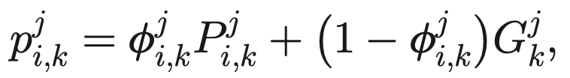
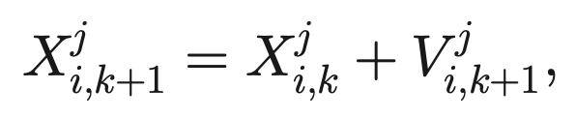
#3 Random drift particle swarm optimization
-
-
-
-
-
-
-
Thermal
+
+
+
+
+
+
+
Local focus
Update velocity
Update position
New
Pbest
Gbest
Old
Drift
Thermal (random)
Drift
p：Personal local focus
P：Personal best position
G：Global best position
V：Velocity
X：Current position
C：The mean best position
𝝓：Random number
𝛼, 𝛽：Constant coefficients

Slide 12
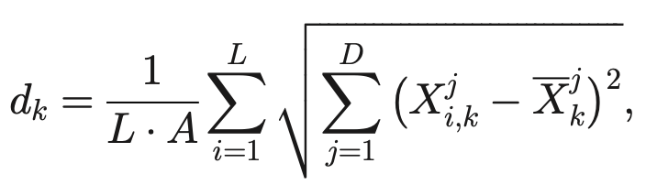
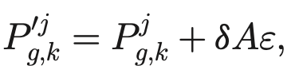
Diversity-guided search (DGS)
Average Euclidean distance
d_{k} < d_{low} → Mutation of global position
A：The length of the longest diagonal
L：The number of population
X：Current position
D：The number of dimension
P_{g}：Global position
𝛿：Constant coefficients
𝜀：Random number (0~1)

Slide 13
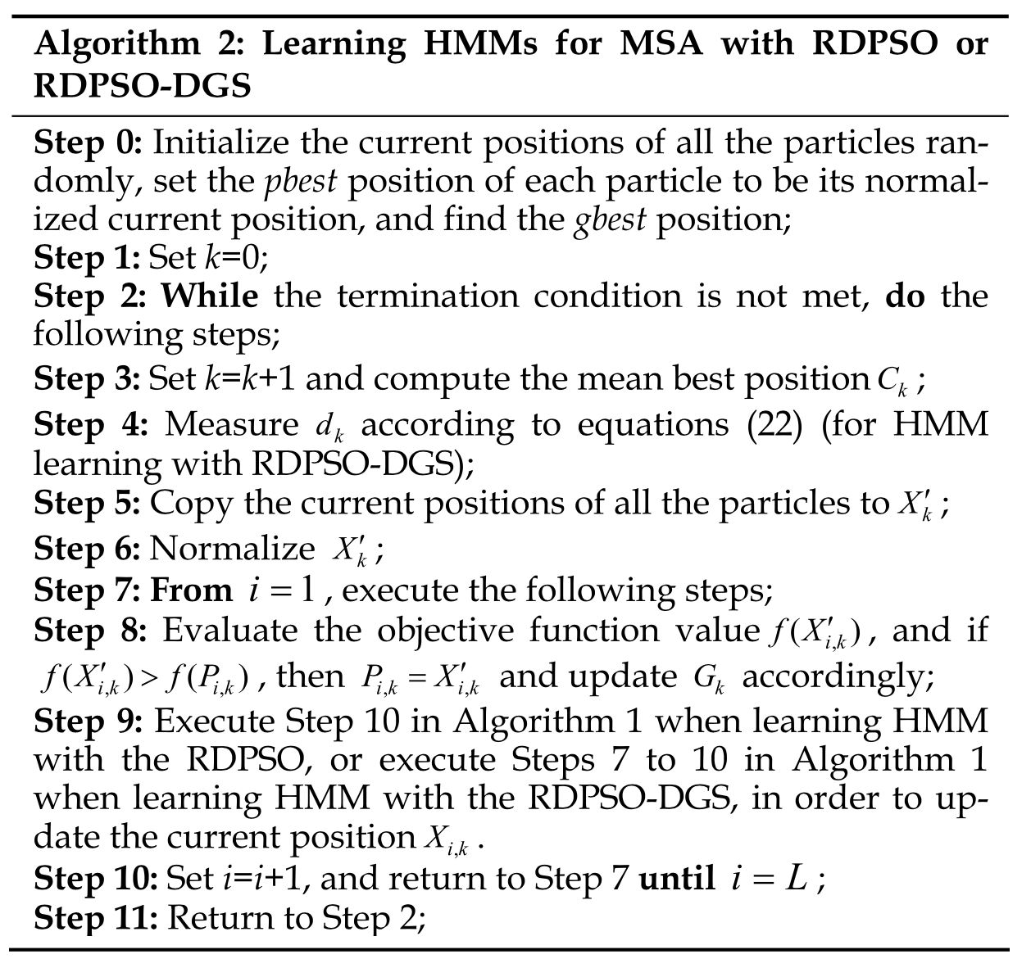
RDPSO-DGS

Slide 14
Results (1/7)
The simulated nucleotide data Set
20 sequences with each having approximately 300 characters
‘low’ or ‘high’ mean divergences
The insertion/deletion length distribution was set to ‘short’ or ‘long’
‘low-short’ ‘low-long’, ‘high-short’, and ‘high-long’.

Slide 15
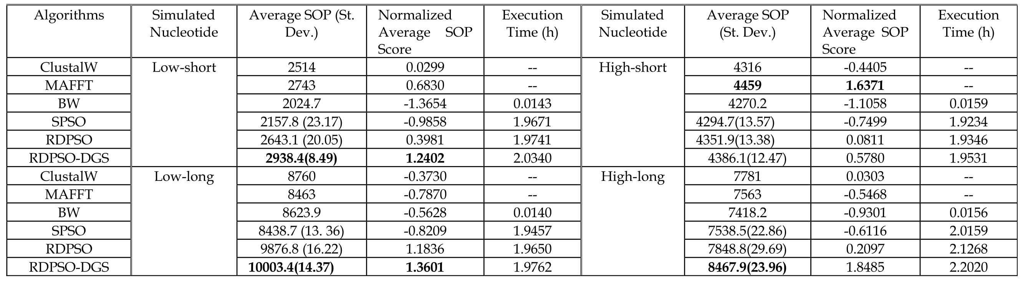
Results (2/7)

Slide 16
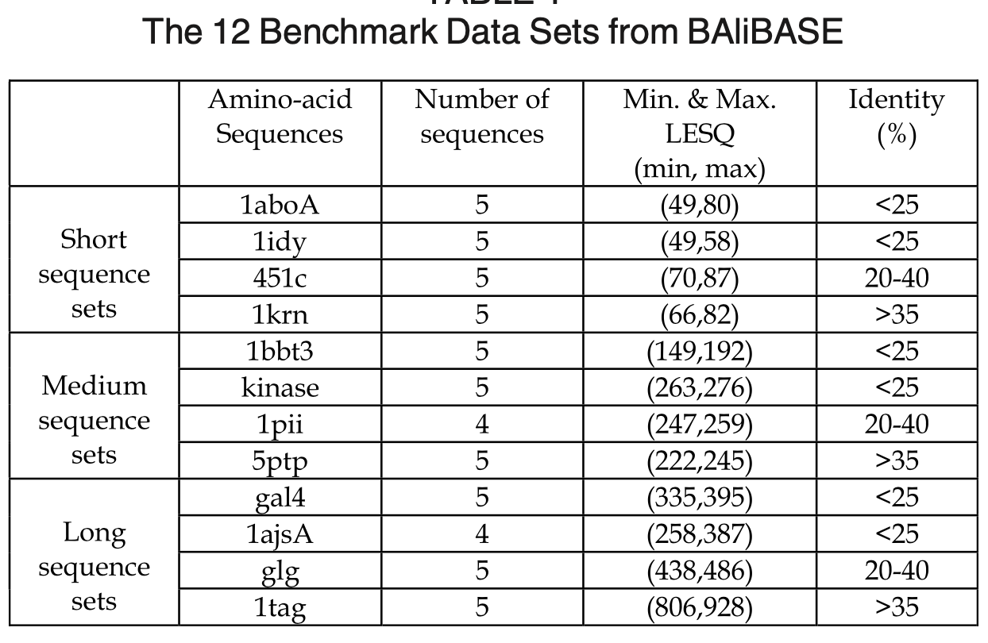
Results (3/7)

Slide 17
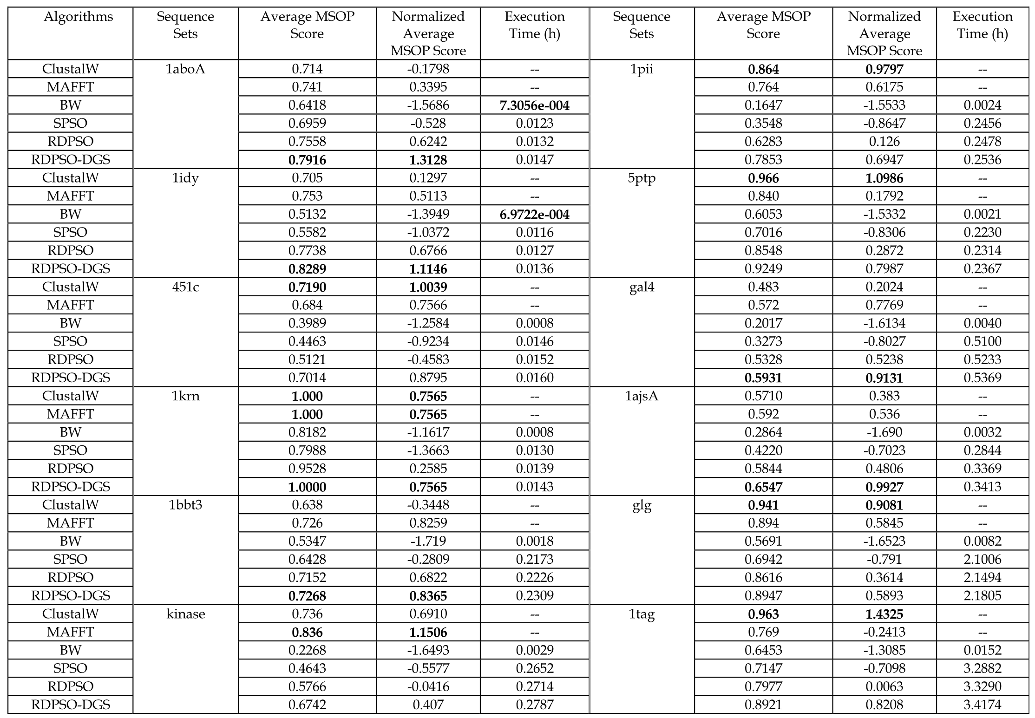

Slide 18
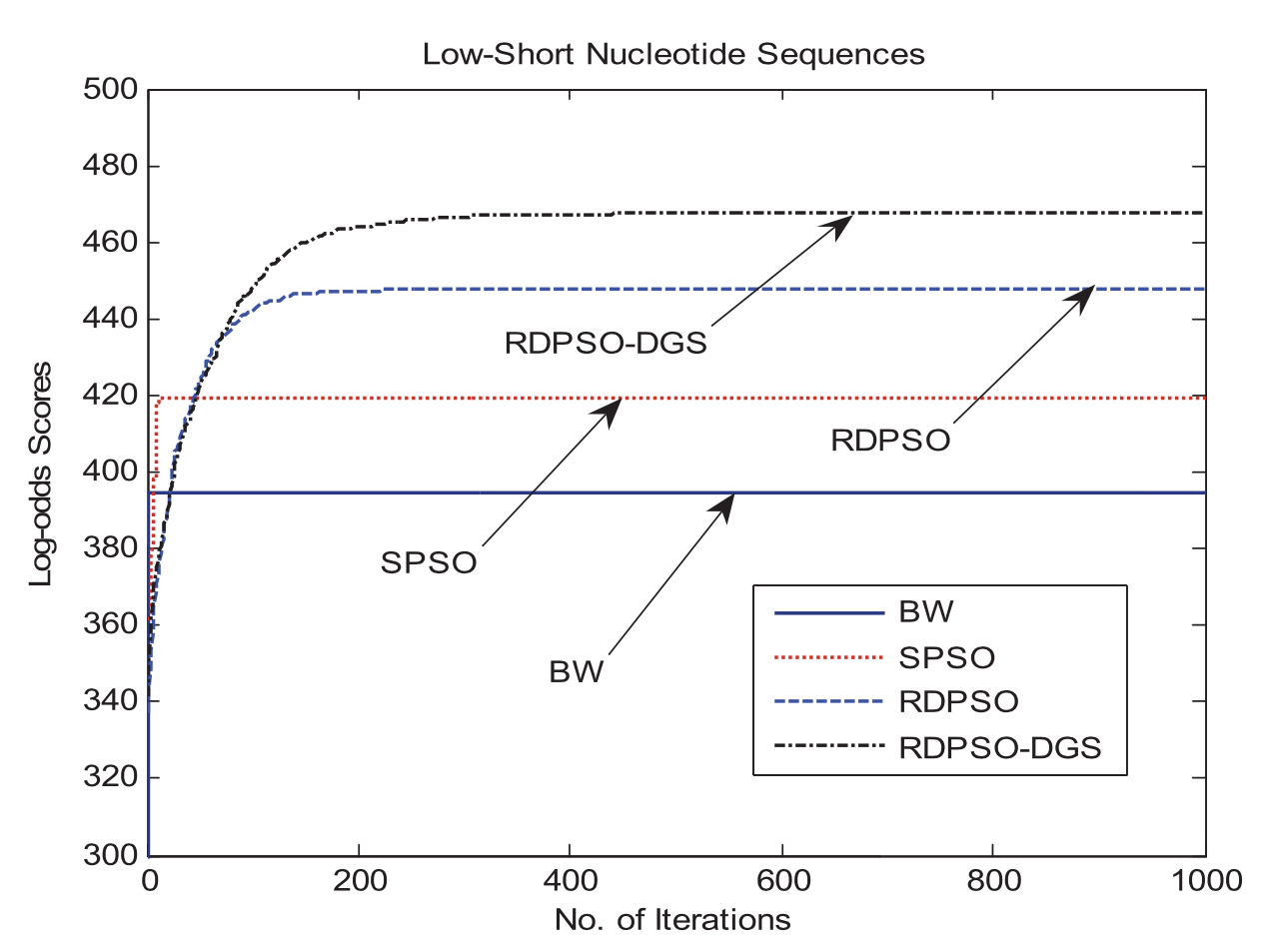
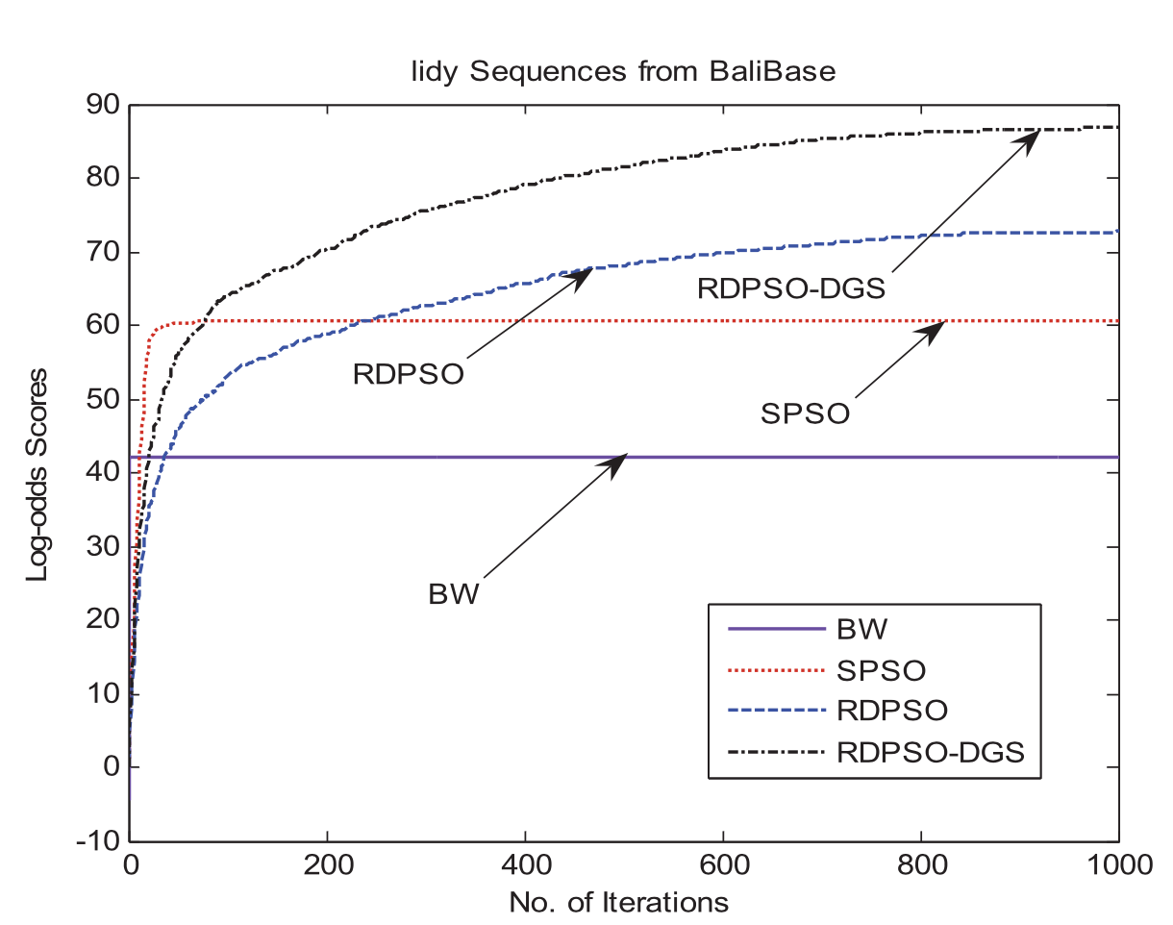
Results (5/7)
s

Slide 19
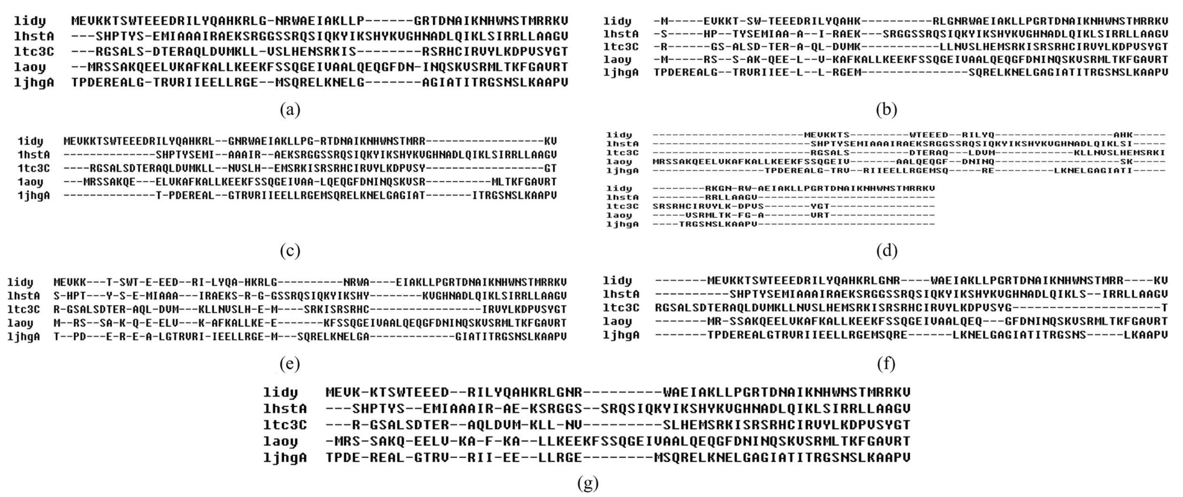
Results (6/7)
s
reference
ClustalW
MAFFT
HMM-BW
HMM-SPSO
HMM-RDPSO
HMM-RDSPO-DGS

Slide 20
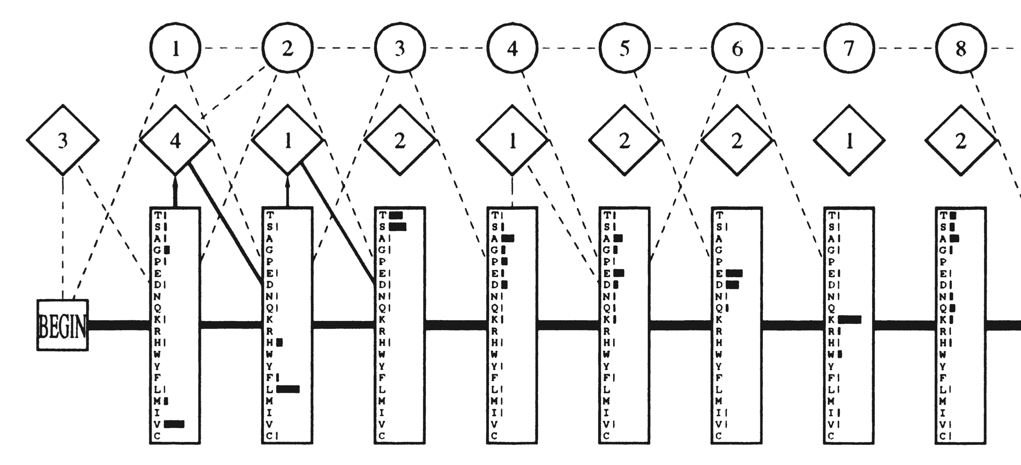
Results (7/7)

Slide 21
Thank you for listening

Slide 22
Results
s

