Slide 1
Fast R-CNN
Ross Girshick
Proceedings of the IEEE International Conference on Computer Vision (ICCV), 2015, pp. 1440-1448
Presenter : Yu-Ju, Liao
Date : July 27, 2021

Slide 2
Abstract
This paper proposes a Fast Region-based Convolutional Network method (Fast R-CNN) for object detection. Fast R-CNN builds on previous work to efficiently classify object proposals using deep convolutional networks. Compared to previous work, Fast R-CNN employs several innovations to improve training and testing speed while also increasing detection accuracy. Fast R-CNN trains the very deep VGG16 network 9× faster than R-CNN, is 213× faster at test-time, and achieves a higher mAP on PASCAL VOC 2012. Compared to SPPnet, Fast R-CNN trains VGG16 3× faster, tests 10× faster, and is more accurate. Fast R-CNN is implemented in Python and C++ (using Caffe) and is available under the open-source MIT License at https: //github.com/rbgirshick/fast-rcnn.

Slide 3
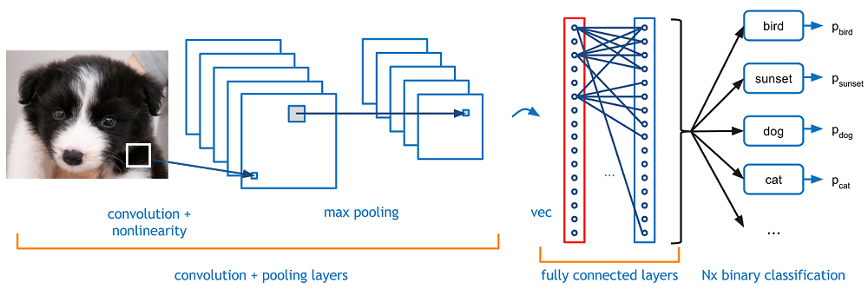
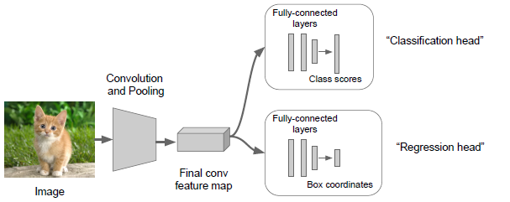
Object Detection
Image Classification
Image Classification + Localization

Slide 4
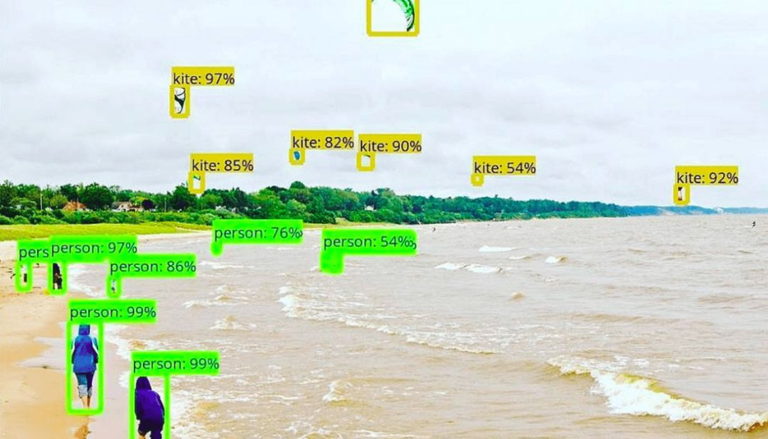
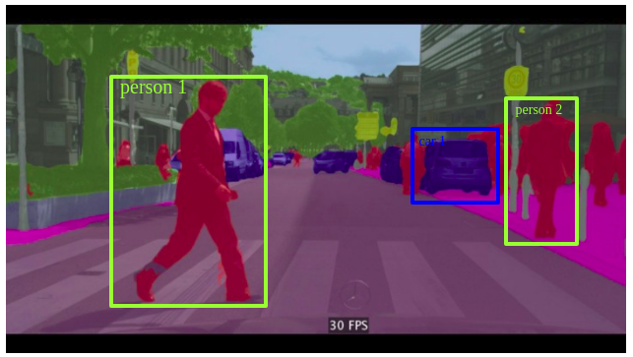
Object Detection
Object Detection (RCNN)
Instance Segmentation

Slide 5
cnn
Feature map

Slide 6
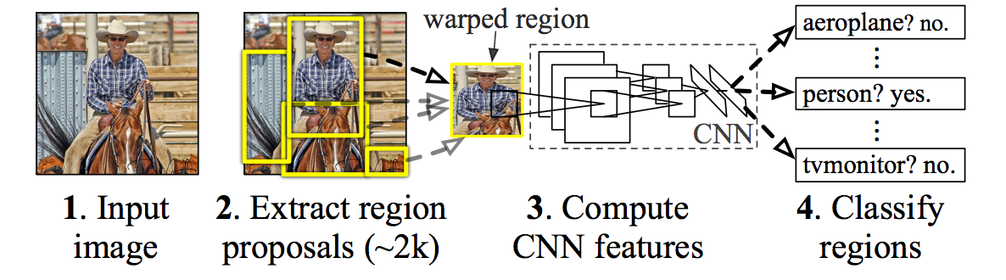
RCNN
5. Bounding-Box regression
(SVM)

Slide 7
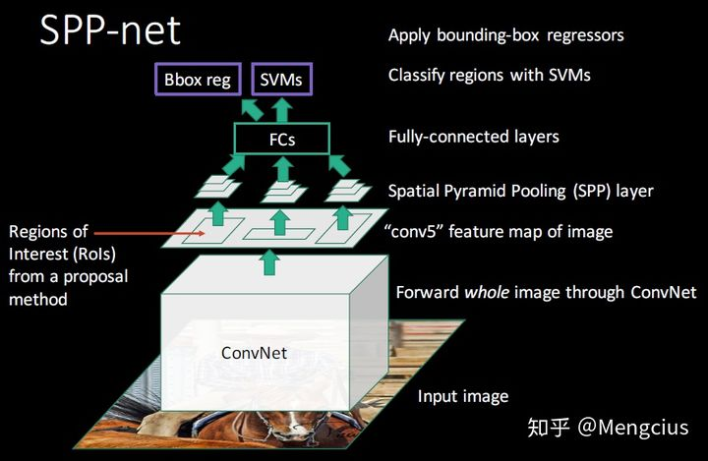
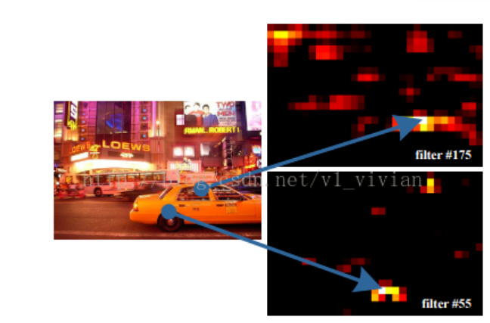
SPPnet
Feature map

Slide 8
cnn
Feature map

Slide 9
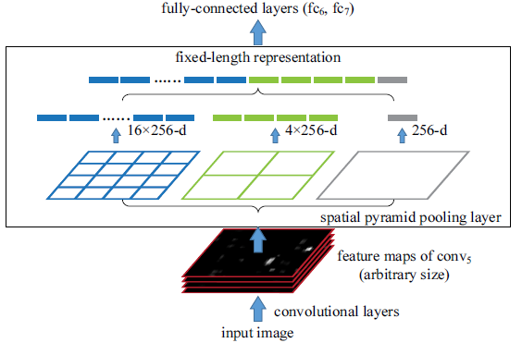
spatial pyramid pooling layer
spatial pyramid pooling layer

Slide 10

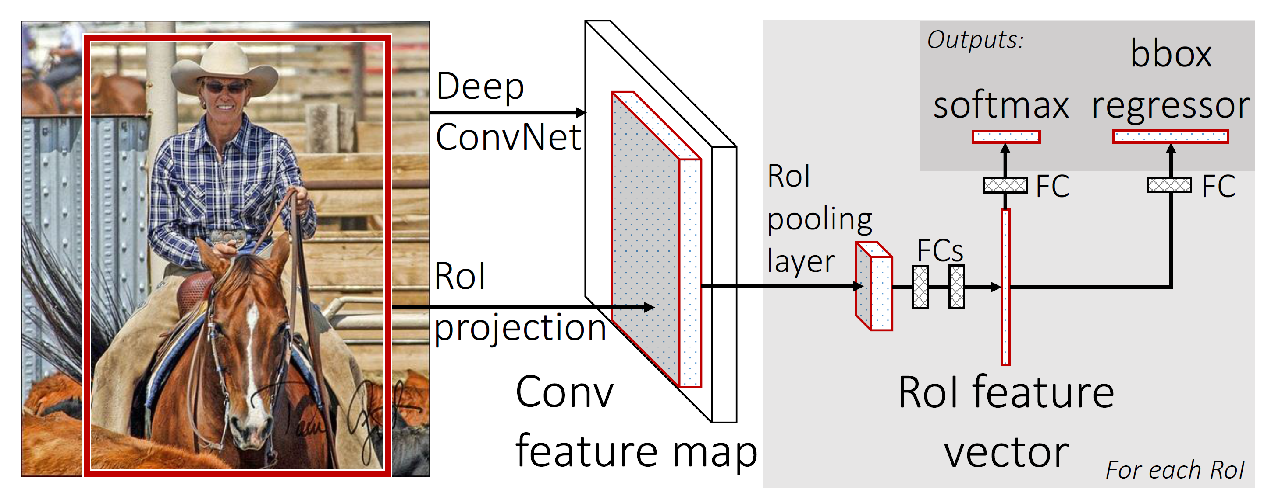

Fast RCNN

Slide 11
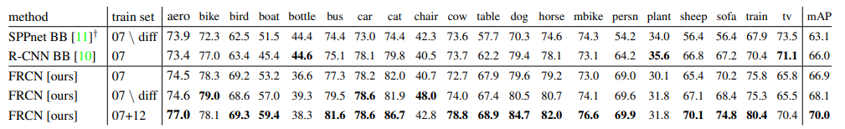
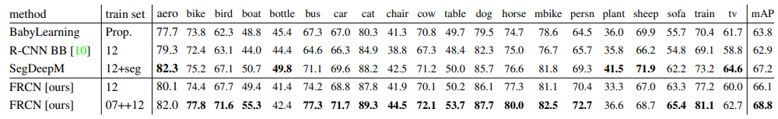
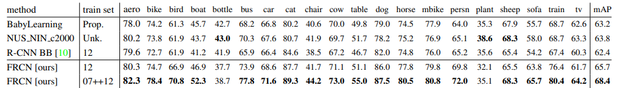
Result
VOC2007
VOC2010
VOC2012

Slide 12
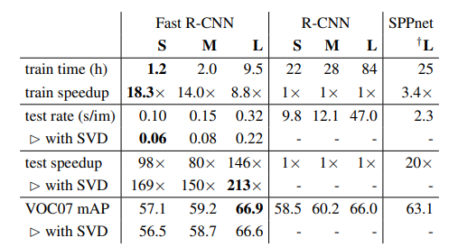

Training and testing time
S : CaffeNet
M : VGG CNN M 1024
L : VGG16

Slide 13
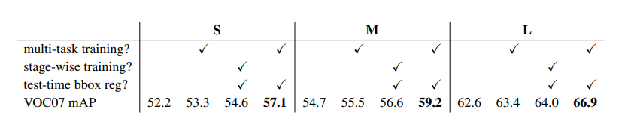
Does multi-task training help?
S : CaffeNet
M : VGG CNN M 1024
L : VGG16

Slide 14
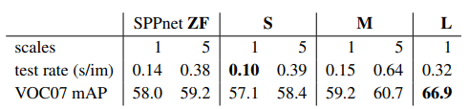
Brute force or finesse
S : CaffeNet
M : VGG CNN M 1024
L : VGG16

