Slide 1
The Study of Linear Programming Approach for Optimal Scheduling of Work in A Corporation With different Models
Manmohan Patidar, Ramakant Bhardwaja , Sanjay Choudharyb
Materialstoday: proceedings, volume 29, Part2, 2020, Pages 661-667
Date: July 27, 2021
Presenter: Jue-Jun Wu

Slide 2
Abstract
In the present research paper, two types of models are discussed for linear programming problems. Models are determining the work of the employee in day-to-day life. The first is Staff Scheduling for Bhopal-Dewas Corridor Toll Plaza and second is worker scheduling for Aqua sure Aquagurad Water Purifiers drinking water Company(Rukmani Beverages Pvt. Ltd.)
Notes:
在本研究論文中，針對線性規劃問題討論了兩種類型的模型。 模型決定了員工在日常生活中的工作。 第一個是 Bhopal-Dewas Corridor Toll Plaza 的員工排班，第二個是 Aquasure Aquagurad Water Purifiers 飲用水公司（Rukmani Beverages Pvt. Ltd.）的員工排班

Slide 3
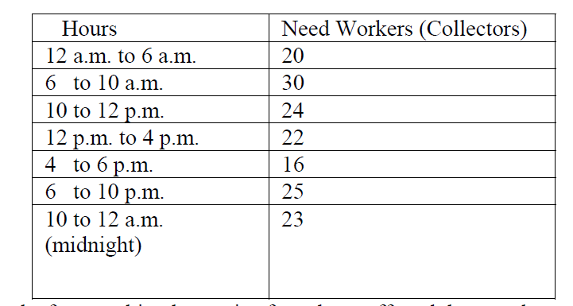
Bhopal-Dewas Corridor Toll Plaza
Each worker (collector) works four working hours, is of one hour off, and then works another four working hours. A collector can start at each working hour.
Notes:
收費員

Slide 4
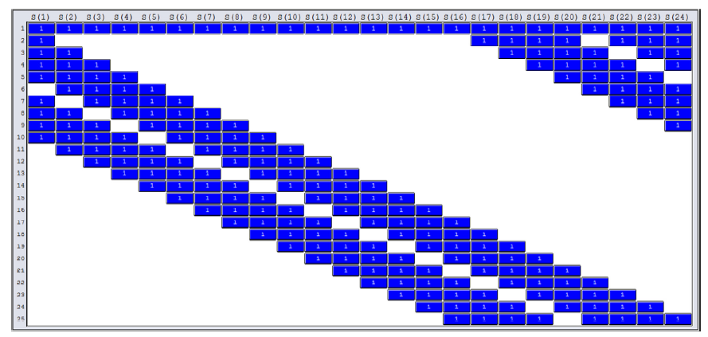
S1 = No. of Toll Plaza collectors to begin work at 12 a.m. midnight S24= No. of Toll Plaza collectors to begin work at 11 p.m.

Slide 5

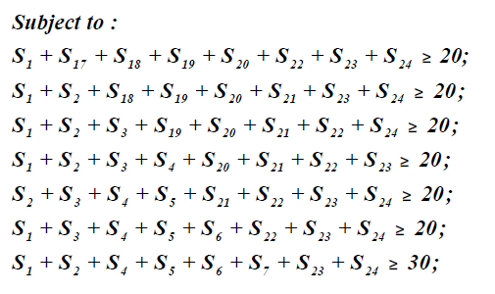
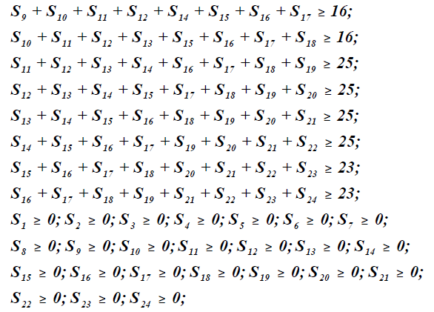
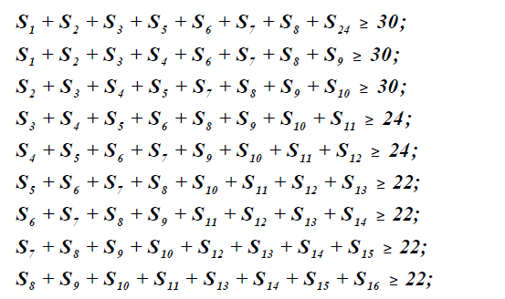

Slide 6
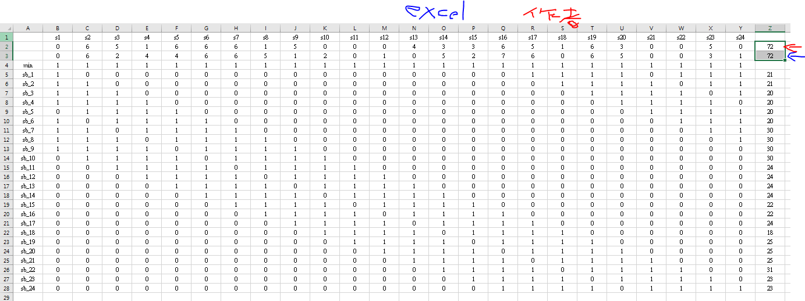
S2 = 6, S5 = 6, S8 = 1,S14 = 3, S17=5, S20= 3,S3 = 5, S6 = 6, S9 = 5, S15 =3, S18=1, S23=5,S4 = 1, S7 = 6, S13 = 4, S16 = 6, S19=6.
解 72人

Slide 7
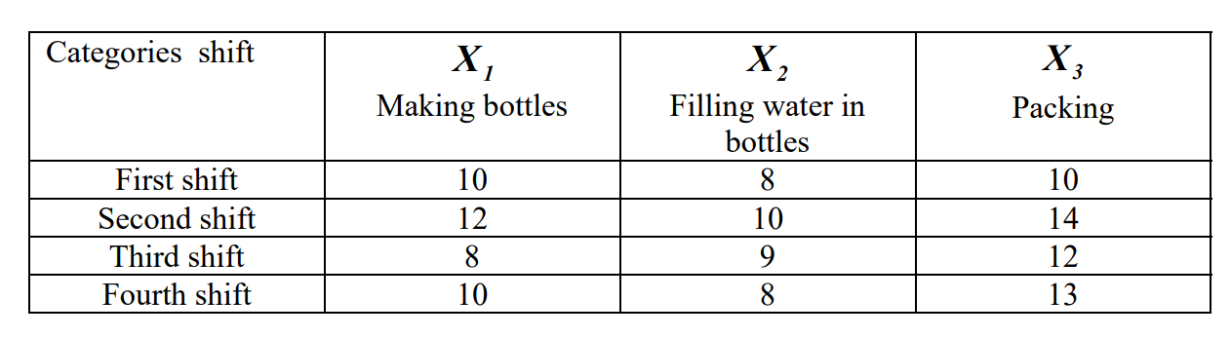
Aqua sure Aquagurad Water Purifiers drinking water Company
First shift 8:00 am - 2:00 pm
Second shift 2:00pm – 8:00pm
Third shift 8:00 pm - 2:00am
Fourth shift 2:00 am - 8:00 am。

Slide 8
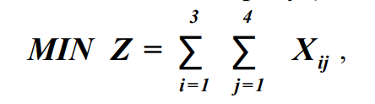
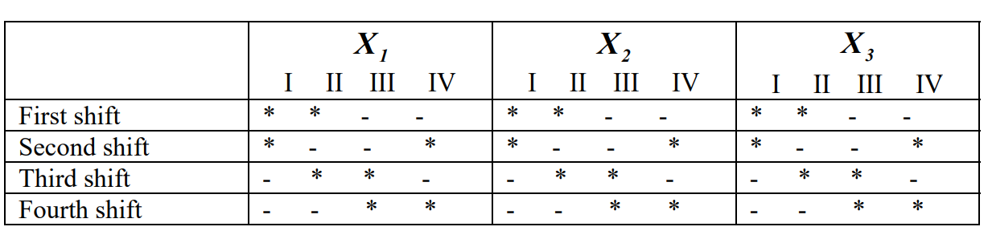

Slide 9
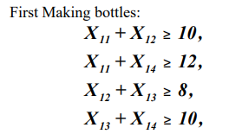
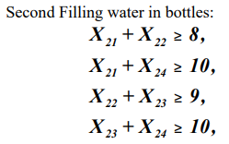
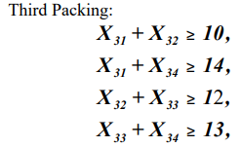
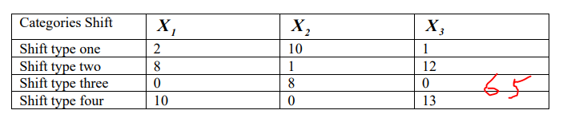
 | X1 | X2 | X3
First shift | 12 | 9 | 14
Second shift | 0 | 1 | 0
Third shift | 10 | 8 | 13
Fourth shift | 0 | 0 | 0
Sum | 22 | 18 | 27 | 67

Slide 10
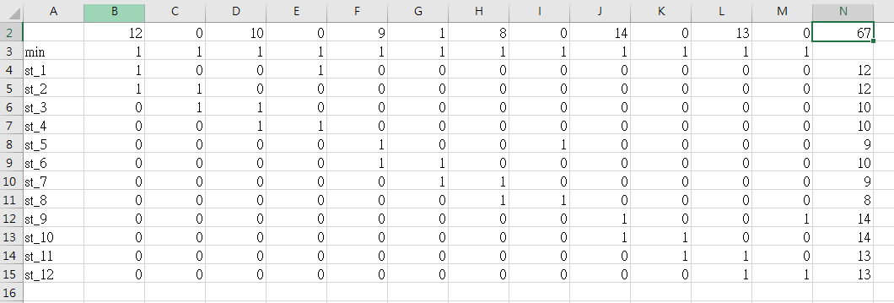

Slide 11
Thanks for listening.

Slide 12
別的範例
早上8:00到中午12:00工作的接線生至少23人
中午12:00到下午4:00工作的接線生至少18人
下午4:00到晚上8:00工作的接線生至少32人
晚上8:00到凌晨12:00工作的接線生至少16人
凌晨12:00到凌晨4:00工作的接線生至少8人
凌晨4:00到早上8:00工作的接線生至少10人
每一位接線生執勤8小時

Slide 13
X1=第一班(8:00-16:00)工作所需人數
類推X2，X3，X4，X5
X6=第六班(4:00-12:00)工作所需人數
X1+X6>=23
X1+X2>=18
X2+X3>=32
X3+X4>=16
X4+X5>=8
X5+X6>=10
解X1=18,X2=0,X3=32,X4=3,X5=5,X6=5 總數63人

Slide 14
