Slide 1
A Fast Randomized Algorithm for Finding the Maximal Common Subsequences
Jin Cao and Dewei Zhong
arXiv:2009.03352v1, Data Structures and Algorithms
Sept. 7 2020
Presenter:Chien-Ting Lee
Date: July 12, 2022

Slide 2
Abstract(1/2)
Finding the common subsequences of L multiple strings has many applications in the area of bioinformatics, computational linguistics, and information retrieval. A well known result states that finding a Longest Common Subsequence (LCS) for L strings is NP-hard, e.g., the computational complexity is exponential in L. In this paper, we develop a randomized algorithm, referred to as Random-MCS, for finding a random instance of Maximal Common Subsequence (MCS) of multiple strings.
Notes:
exempli gratia

Slide 3
Abstract(2/2)
A common subsequence is maximal if inserting any character into the subsequence no longer yields a common subsequence. A special case of MCS is LCS where the length is the longest. We show the complexity of our algorithm is linear in L, and therefore is suitable for large L. Furthermore, we study the occurrence probability for a single instance of MCS, and demonstrate via both theoretical and experimental studies that the longest subsequence from multiple runs of Random-MCS often yields a solution to LCS.

Slide 4
Maximal Common Subsequences
MCS:maximal if and only if inserting any character r into the
subsequence can no longer yield a common subsequence.
string A:TEGAP string B:GAEPR
MCSs={GAP, EP} , AP,GA…就不會是MCS GAP is LCS
LCS是MCS中的一個特例。
Notes:
最大公共子序列 (MCS) 定義為當將任何字元插入子序不能再產生一個共同的子序列

Slide 5
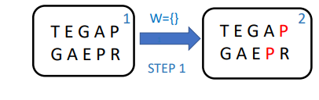
RandomMCS Algorithm
Step1 :隨機挑選字串中皆有出現的字作為common subsequence 令它為W

Slide 6
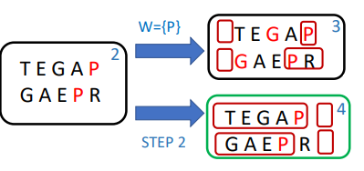
RandomMCS Algorithm
Step2:找出比W更長的，直到找不到為止
字串分為3個部分:shortest prefix ,shortest suffix,剩餘的部分
‘P’可以有2個位置可以插入新字元X，分別形成XP,PX
W[0,0]=‘’ W[0,1]=‘P’
W[0,1]=‘P’ W[1,1]=‘’

Slide 7
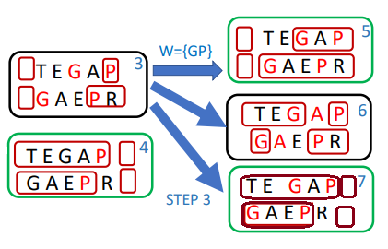
RandomMCS Algorithm
Step2:找出比W更長的，直到找不到為止
‘GP’可以有3個位置可以插入新字元X，分別形成XGP,GXP,GPX
W[0,0]=‘’ W[0,2]=‘GP’
W[0,1]=‘G’ W[1,1]=‘P’
W[0,1]=‘GP’ W[1,1]=‘’

Slide 8
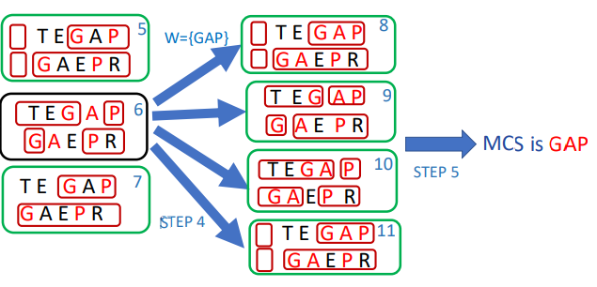
RandomMCS Algorithm
Step2:找出比W更長的，直到找不到為止
‘GAP’可以有4個位置可以插入新字元X，分別形成XGAP,GXAP,GAXP,GAPX
W[0,0]=‘’ W[0,2]=‘GAP’
W[0,1]=‘G’ W[1,1]=‘AP’
W[0,1]=‘GA’ W[1,1]=‘P’
W[0,1]=‘GAP’ W[1,1]=‘’

Slide 9
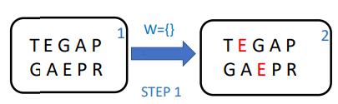
RandomMCS Algorithm
Step1 :隨機挑選字串中皆有出現的字作為common subsequence 令它為W

Slide 10
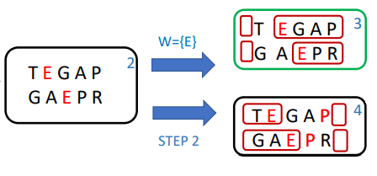
RandomMCS Algorithm
Step2:找出比W更長的，直到找不到為止
字串分為3個部分:shortest prefix ,shortest suffix,剩餘的部分
‘E’可以有2個位置可以插入新字元X，分別形成XE,EX
W[0,0]=‘’ W[0,1]=‘E’
W[0,1]=‘E’ W[1,1]=‘’

Slide 11
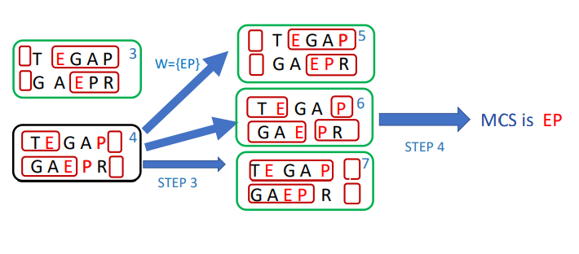
RandomMCS Algorithm
Step2:找出比W更長的，直到找不到為止
‘EP’可以有3個位置可以插入新字元X，分別形成XEP,EXP,EPX
W[0,0]=‘’ W[0,2]=‘EP’
W[0,1]=‘E’ W[1,1]=‘P’
W[0,1]=‘EP’ W[1,1]=‘’

Slide 12
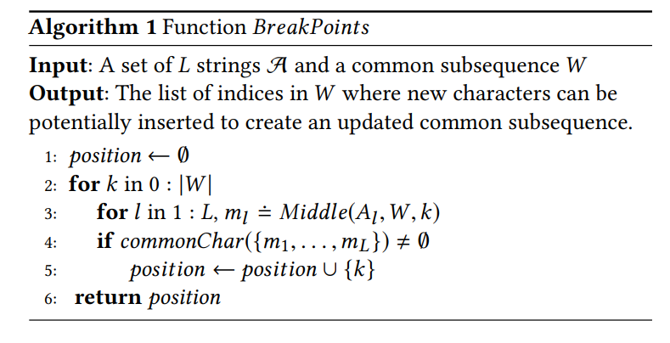
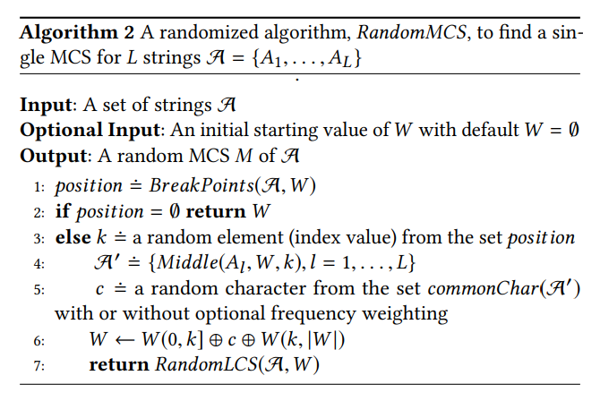
RandomMCS Algorithm
O(n³L)
Notes:
增加字串數量並不會造成運行時間指數成長
也可以用來解決Constrained MCS 只要在一開始將指定的字串作為輸入 那透過這個演算法，如果有答案，最後一定可以找到包含指定字串的MCS

