Slide 1
Comparing Incomplete Sequences via Longest Common Subsequence
Mauro Castelli, Riccardo Dondi, Giancarlo Mauri, Italo Zoppis
Theoretical Computer Science, 2019
Volume 796, pp. 272-285
Presenter: Tsung-Lin Lu
Date: July 12, 2022

Slide 2
Abstract (1/2)
Inspired by scaffold filling, a recent approach for genome reconstruction from incomplete data, we consider a variant of the well-known longest common subsequence problem for the comparison of two sequences. The new problem, called Longest Filled Common Subsequence, aims to compare a complete sequence with an incomplete one, i.e. with some missing elements. Longest Filled Common Subsequence (LFCS), given a complete sequence A, an incomplete sequence B, and a multiset 𝞛 of symbols missing in B, asks for a sequence B∗ obtained by inserting the symbols of 𝞛 into B so that B∗ induces a common subsequence with A of maximum length.

Slide 3
Abstract (2/2)
We investigate the computational and approximation complexity of the problem and we show that it is NP-hard and APX-hard when A contains at most two occurrences of each symbol, and we give a polynomial time algorithm when the input sequences are over a constant-size alphabet. We give a 3/5−approximation algorithm for the Longest Filled Common Subsequence problem. Finally, we present a fixed-parameter algorithm for the problem, when it is parameterized by the number of symbols inserted in B that “match” symbols of A.

Slide 4
Outline
Longest Filled Common Subsequence (LFCS)
Match
Approximation Algorithm
Exact Algorithm

Slide 5
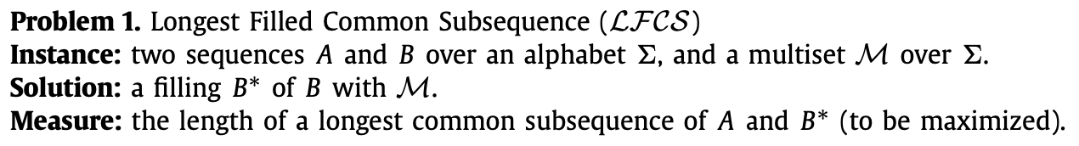
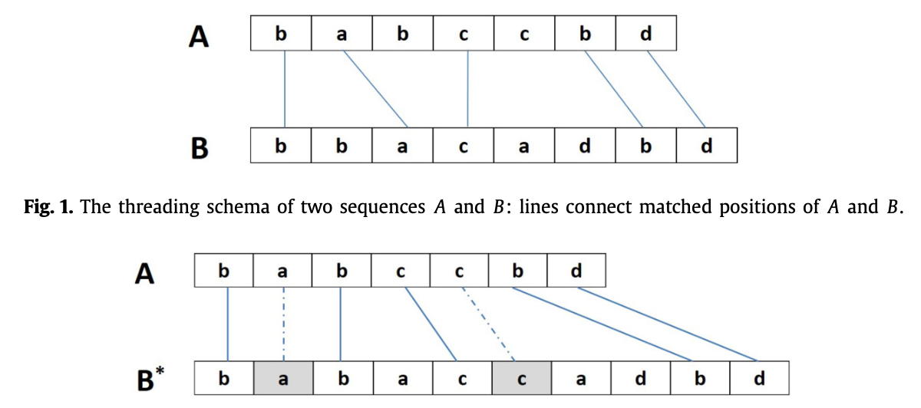
Longest Filled Common Subsequence (LFCS)
(a) LCS
(b) LFCS.
Straight lines represent matches by alignment.
Dashed lines represent matches by insertion.

Slide 6
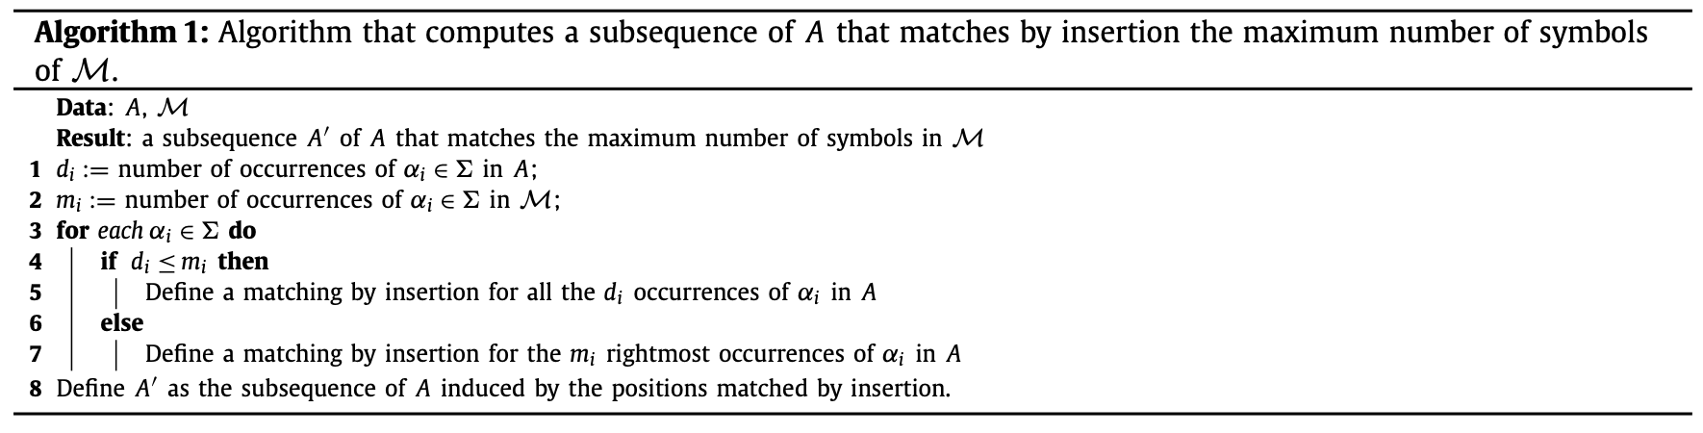
Match
Two types of matches of a matched position of A:
A match by alignment (straight lines)
A match by insertion (deashed lines)

Slide 7
Approximation Algorithm
Approx-algorithm does not return a filling of B with 𝞛, but two disjoint subsets of positions of A that have to be matched by alignment and by insertion, respectively, by a subsequence of A and of a filling of B with 𝞛.
Approx-Algorithm1
Phase1: R_{1,a} = the positions of A matched by alignment.
Phase2: R_{1,i} = the positions of A' matched by insertion. (A' = A – R_{1,a})
Approx-Algorithm2
Phase1: R_{2,i} = the positions of A matched by insertion.
Phase2: R_{2,a} = the positions of A'' matched by alignment. (A'' = A – R_{2,i})
Approximation rate : 3/5

Slide 8
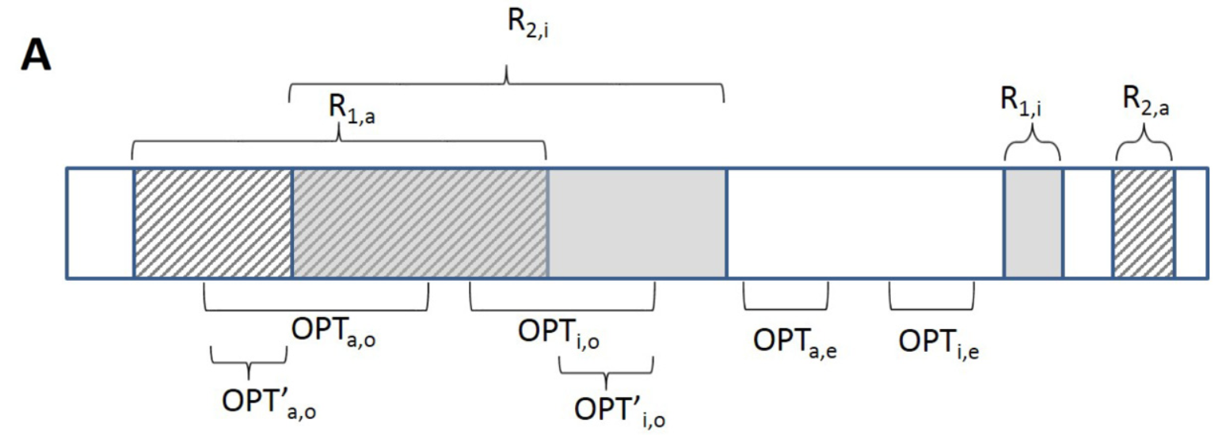
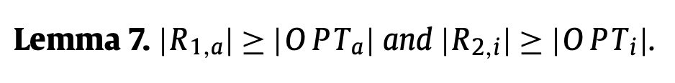


Slide 9
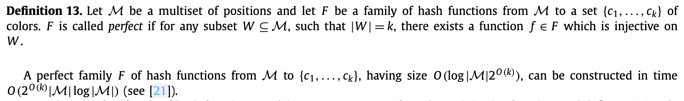
Exact Algorithm 1 (1/2)
An FPT algorithm for LFCS parameterized by the number k of positions of A matched by insertions.
Based on the color-coding technique.

Slide 10
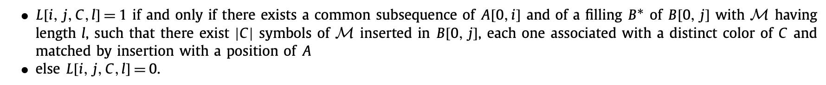
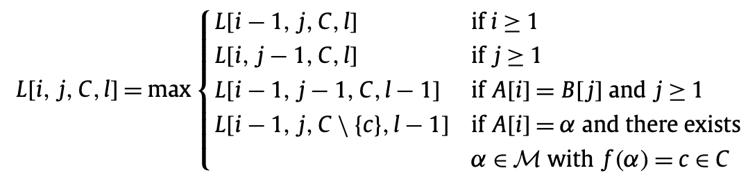
Exact Algorithm 1 (2/2)

Slide 11
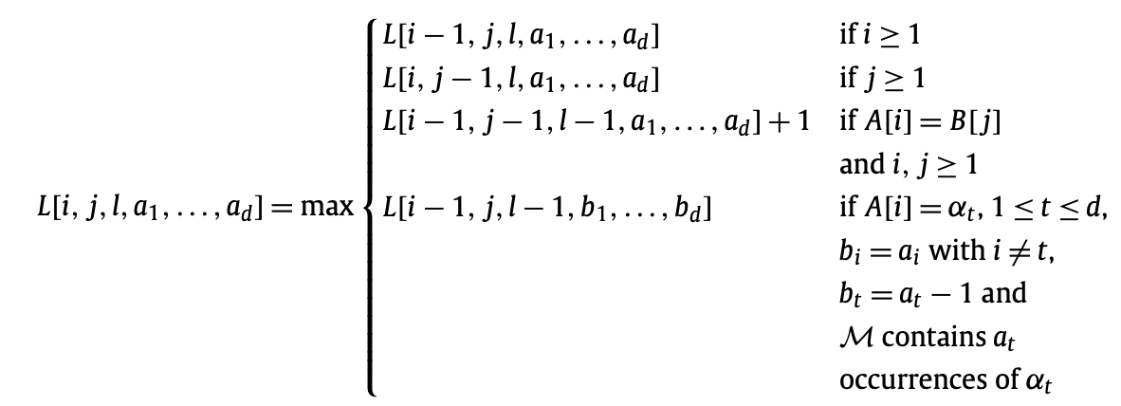
Exact Algorithm 2 (1/2)
A polynomial-time algorithm for LFCS when the alphabet 𝞢 = {α₁, ..., α_{d}}, for some constant d.

Slide 12
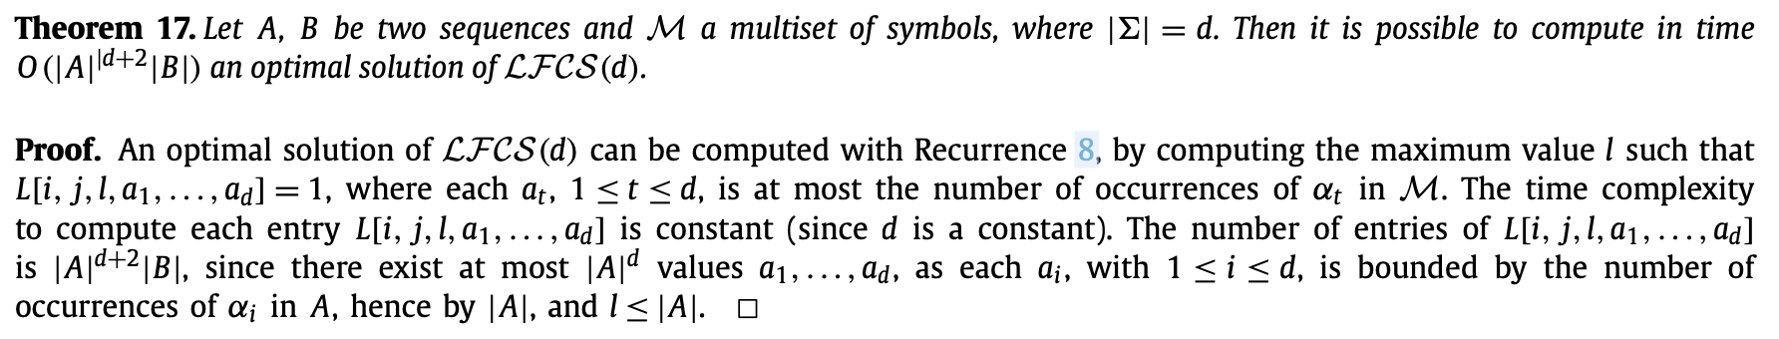
Exact Algorithm 2 (2/2)

Slide 13
Thank you for listening

Slide 14
楊老師反饋
Approximation algorithm for LFCS的approximation rate (3/5)被低估，認為可以再更高。其rate可能跟𝞛大小有關，但原作者證明過程中沒有特別限定𝞛的大小。
故approximation rate可以再逼近，這或許是潛在的研究對象。舉兩個極端例子：
(1) |𝞛| = 0，LFCS即為LCS，match皆為by alignment，故rate = 1
(2) |𝞛| = ∞，match幾乎為by insertion，故rate ≈ 1
2023年1月提醒老師有這一題目！！！

Slide 15
黃國璽學長 反饋
如果Alphabet是固定的，例如：Σ= 4，這個問題可能會變成A與(4 + 1)條序列的merged LCS問題。
A: 目標完整序列，B: 不完整序列。
假設只有4種核酸，給定M = {aaaa, ggg, ccccc, ttttttt} = {4a, 3g, 5c, 7t}。這題答案可能就是mergedLCS(A, B, 4a, 3g, 5c, 7t)。
當序列A一開始就給定，Alphabet也會跟著確定，因為只有在A之中出現過的符號才能拿來填補。這時只要M也在一開始就給定，自然就會回到merged LCS問題。
ExactAlgo1先規定只能有k個insertion，然後從M湊一條長度為k的序列X，再進行mergedLCS(A, B, X)，時間複雜度會與所有X的數量有關。

Slide 16
Abstract
s

