Slide 1
LCS Approximation via Embedding into Locally Non-Repetitive Strings
G.M. Landau, A. Levy, I. Newman
Information and Computation, 2011
Volume 209, pp. 705-716
Presenter: Tsung-Lin Lu
Date: Aug. 30, 2022

Slide 2
Abstract (1/2)
A classical measure of similarity between strings is the length of the longest common subsequence (LCS) between the two given strings. The search for efficient algorithms for finding the LCS has been going on for more than three decades. To date, all known algorithms may take quadratic time (shaved by logarithmic factors) to find large LCS. In this paper, the problem of approximating LCS is studied, while focusing on the hard inputs for this problem, namely, approximating LCS of near-linear size in strings over a relatively large alphabet (of size at least n^{ε} for some constant ε > 0, where n is the length of the string).

Slide 3
Abstract (2/2)
We show that, any given string over a relatively large alphabet can be embedded into a locally non-repetitive string. This embedding has a negligible additive distortion for strings that are not too dissimilar in terms of the edit distance. We also show that LCS can be efficiently approximated in locally-non-repetitive strings. Our new method (the embedding together with the approximation algorithm) gives a strictly sub-quadratic time algorithm (i.e., of complexity O(n^{2−ε}) for some constant ε) which can find common subsequences of linear (and near linear) size that cannot be detected efficiently by the existing tools.

Slide 4
Edit Distance
The edit distance is the number of insertions, deletions, and substitutions needed to transform one string into the other.
Sunday → Saturday : 3
(Replace ‘n’ with ‘r’, insert t, insert a)

Slide 5
Definition
字串重新編碼(embedding)後，其LCS失真程度為𝛒
長度為t的子字串
S 中的每 w 個連續 t 子字串是不同的，如:(3, 4)-non-repetitive
abc | aba | cba | aab

Slide 6
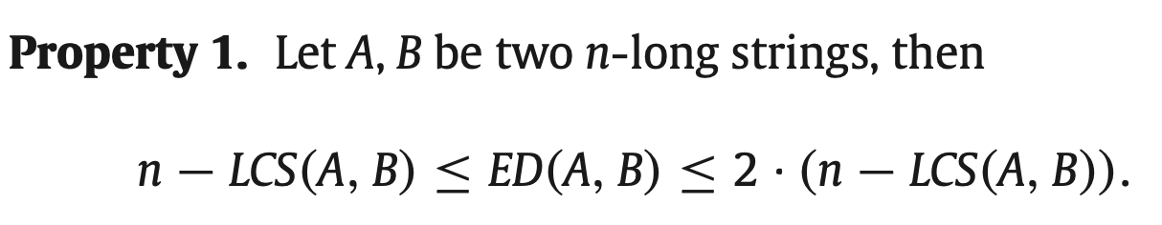
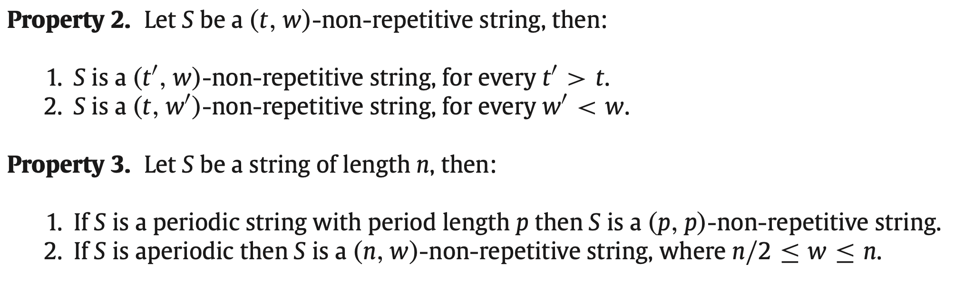
Property
長度-相似長度
（不相似長度）
edit distance
t-substring
可以找出最佳的t和w
... | ... | ... | ...
w
(t,w)-non-repetitive string
a guarantee for worst case parameters of locally strong non-repetitiveness

Slide 7
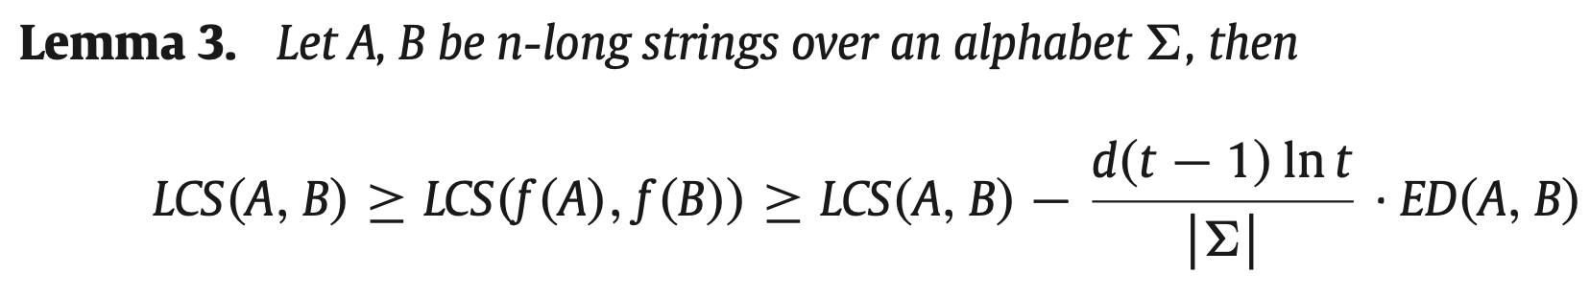
Embedding Strings

Slide 8
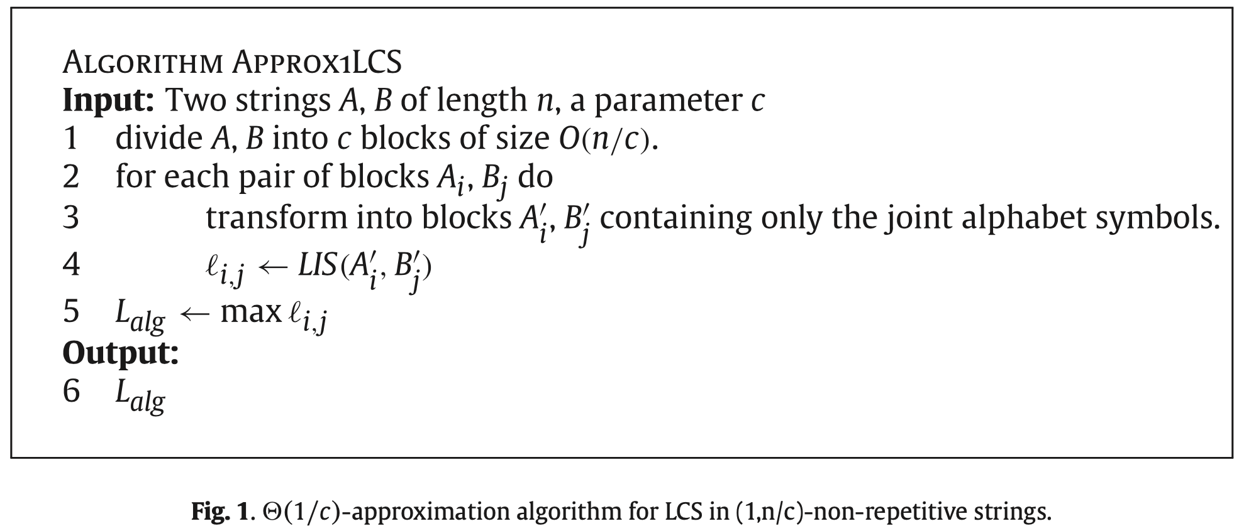
Approx1 LCS
A₁ | A₂ | ... | A_{n/c-1} | A_{n/c}
B₁ | B₂ | ... | B_{n/c-1} | B_{n/c}
從c²pair中
找到一個max LIS(A'_{i}, B'_{i})

Slide 9
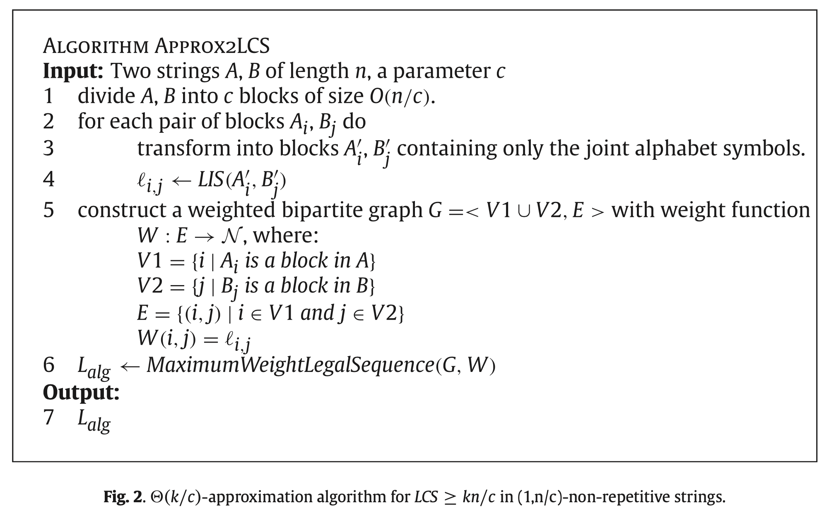
Approx2 LCS
A₁ | A₂ | ... | A_{n/c-1} | A_{n/c}
B₁ | B₂ | ... | B_{n/c-1} | B_{n/c}
從c²pair中
串連出max LIS(A'_{i}, B'_{i})

Slide 10
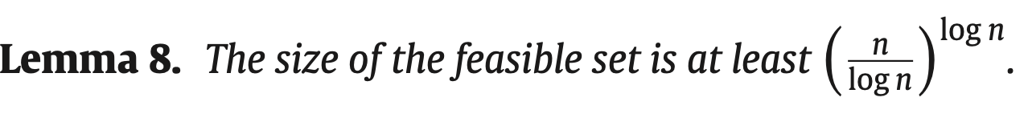
Sketching Local Non-Repetitiveness

Slide 11
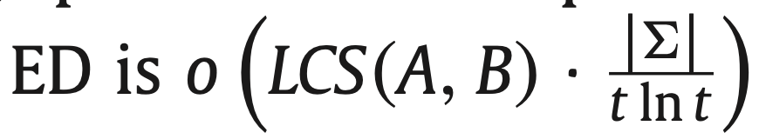
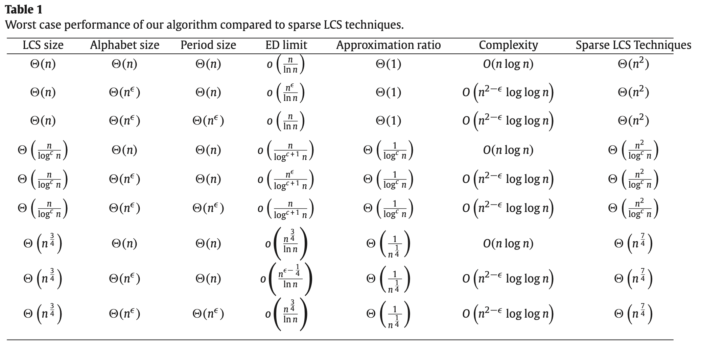
Complexity

Slide 12
Thank you for listening

Slide 13
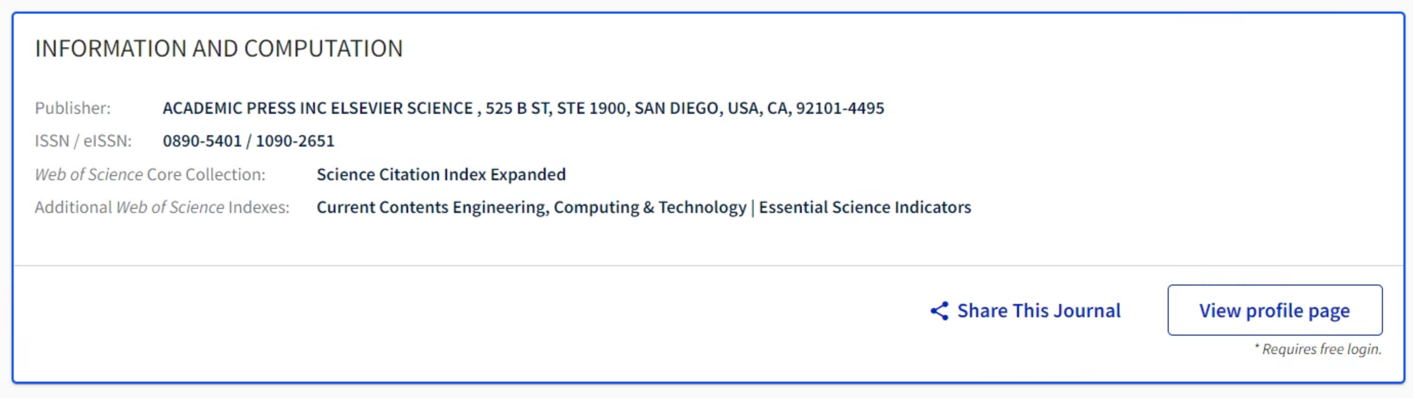
Sci Journal
From WOS

Slide 14
Abstract
s

