Slide 1
A Parallel Algorithm for the Single Step Searching Problem
Richard Chia-Tung Lee, Jeen-Shang Lin, Fang Rong Hsu
Proceedings of the International Symposium on Parallel Architectures, Algorithms and Networks (ISPAN), December 1994, Kanazawa, Japan
Presenter: Lin Yu-Chen
Date: Sept, 20, 2022
Notes:
許芳榮
李家同

Slide 2
Abstract
In this paper, we shall first introduce the single step searching problem which is defined as follows: We are given a graph where each vertex is associated with a weight. Assume that every edge of graph is of equal length. A fugitive can and may be hidden in any edge. We are asked to assign searchers to vertices to search the entire graph in one step such that no fugitive can escape. The cost of a searching plan is related to the weights of the vertices in which the searchers are initially located. Our goal is to minimize the cost of the searching plan.
A parallel algorithm based upon The EREW model is proposed to solve this problem. This algorithm applies the tree contraction technique. The critical point is that we have to transform a general tree to a binary tree including pseudo nodes in order to apply this tree contraction technique. A new algorithm is devised to solve the problem on the transformed binary tree. It can be proved that this new algorithm is correct as it produces a correct solution for the original tree. Our algorithm has an optimal speed up.
Notes:
Fu gi tive

Slide 3
Basic concept of the problem
Given an undirected graph G(V,E) with n edges and m vertices and each vertex associated with a weight wt(v).
A fugitive who can move in any speed is assumed to be hidden in some edge of G.
For each edge of G, an edge searcher is assigned to search him.
The cost of clearing an edge(u, v ) is defined as wt(u) if the edge searcher starts from u.

Slide 4
How to compute the cost?

Slide 6
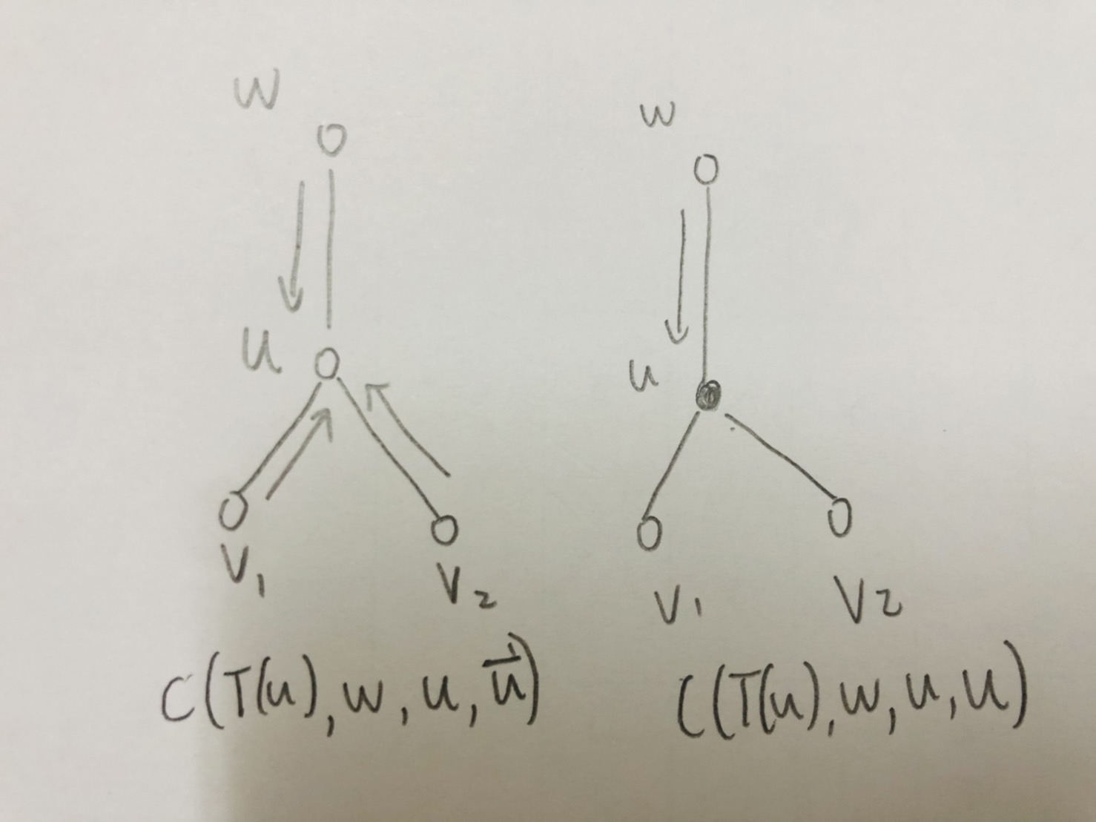
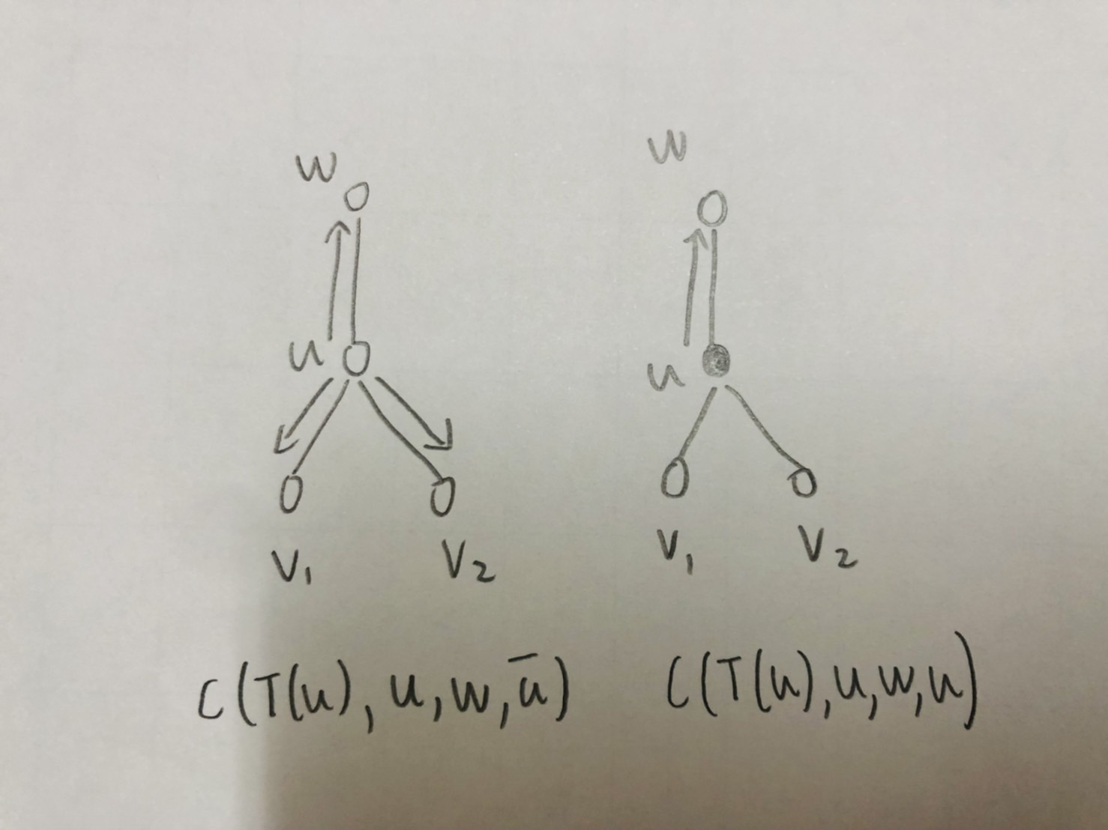

Slide 7
Example

Slide 8
The Reduction of a General Tree to a Binary Tree
The parallel tree contraction technique assumes that the trees are binary trees. Therefore,we should transform a general tree to a binary tree. In this Section, we will describe a method that transforms a general tree to a binary tree for this single step searching problem by repeatedly applying the following procedure:

Slide 10
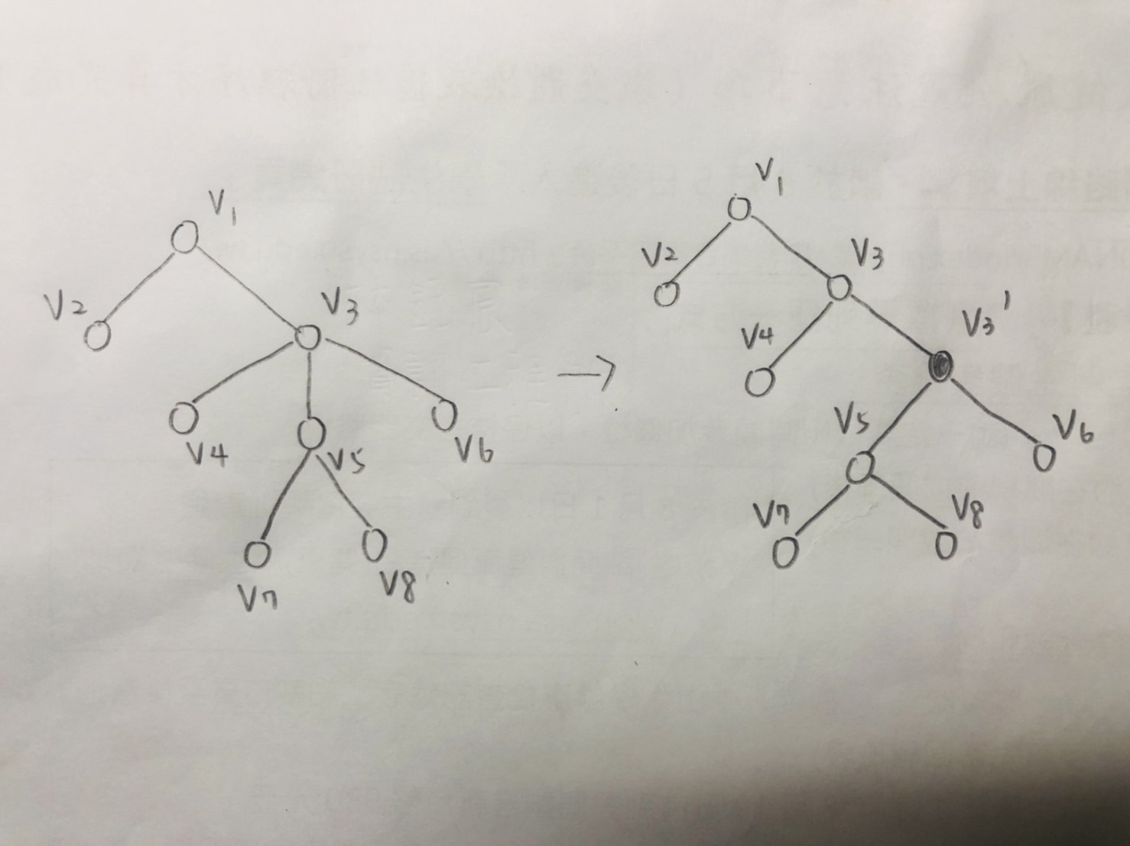

Slide 11
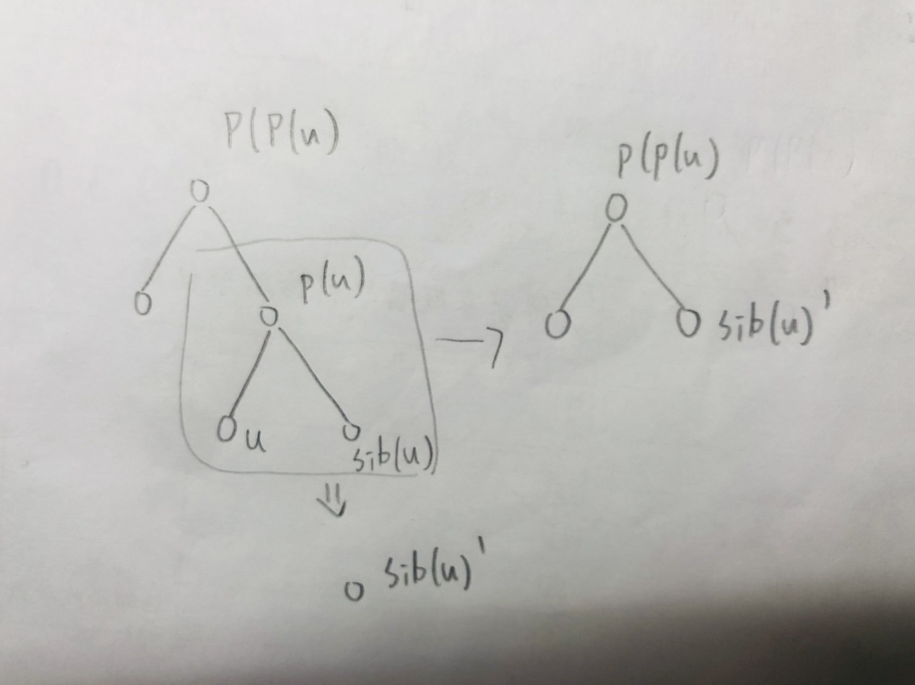
The Optimal Parallel Algorithm for the Weighted Single Step Searching Problem
First select a leaf node U, evaluate the searching costs of node U.
Next,partially evaluate the searching costs of parent node p (U).
Then,we have to contract U, p(U) and sib(U) into one node and connect sib(U) to p(p(U)).

Slide 12
Algorithm PWSSS
Notes:
每條邊剛好經過一次的路線，起點和終點相同。可能有許多種，也可能不存在。

Slide 13
Each step of algorithm PWSSS runs in time O(1ogn) with O(n) operations on EREW PRAM model. By Brent’s theorem, we can show that the algorithm runs in time O(1ogn) with n/ log n processors.
# Brent’s theorem:
For a given parallel algorithm A,W(n) is total workload during time T(n).
Then A can be run on p processors in time t(n)=O(W(n)/p+T(n)).

Slide 14
Conclusion
The method is a systematic way to solve the problems that the sequential algorithm is based on dynamic programming and runs in linear time.
This parallel algorithm for the problem runs in time O(logn) using O(n/logn) processors on EREW-PRAM. Thus, the parallel algorithms all are optimal speedup algorithms.
Notes:
該方法利用動態規劃，在線性時間中系統性的解決順序演算法問題

