Slide 1
Fast Algorithms to Enumerate All Common Intervals of Two Permutations
T. Uno and M. Yagiura
Algorithmica, 2000
Volume 26, pp. 290-309
Presenter: Tsung-Lin Lu
Date: Sept. 20, 2022

Slide 2
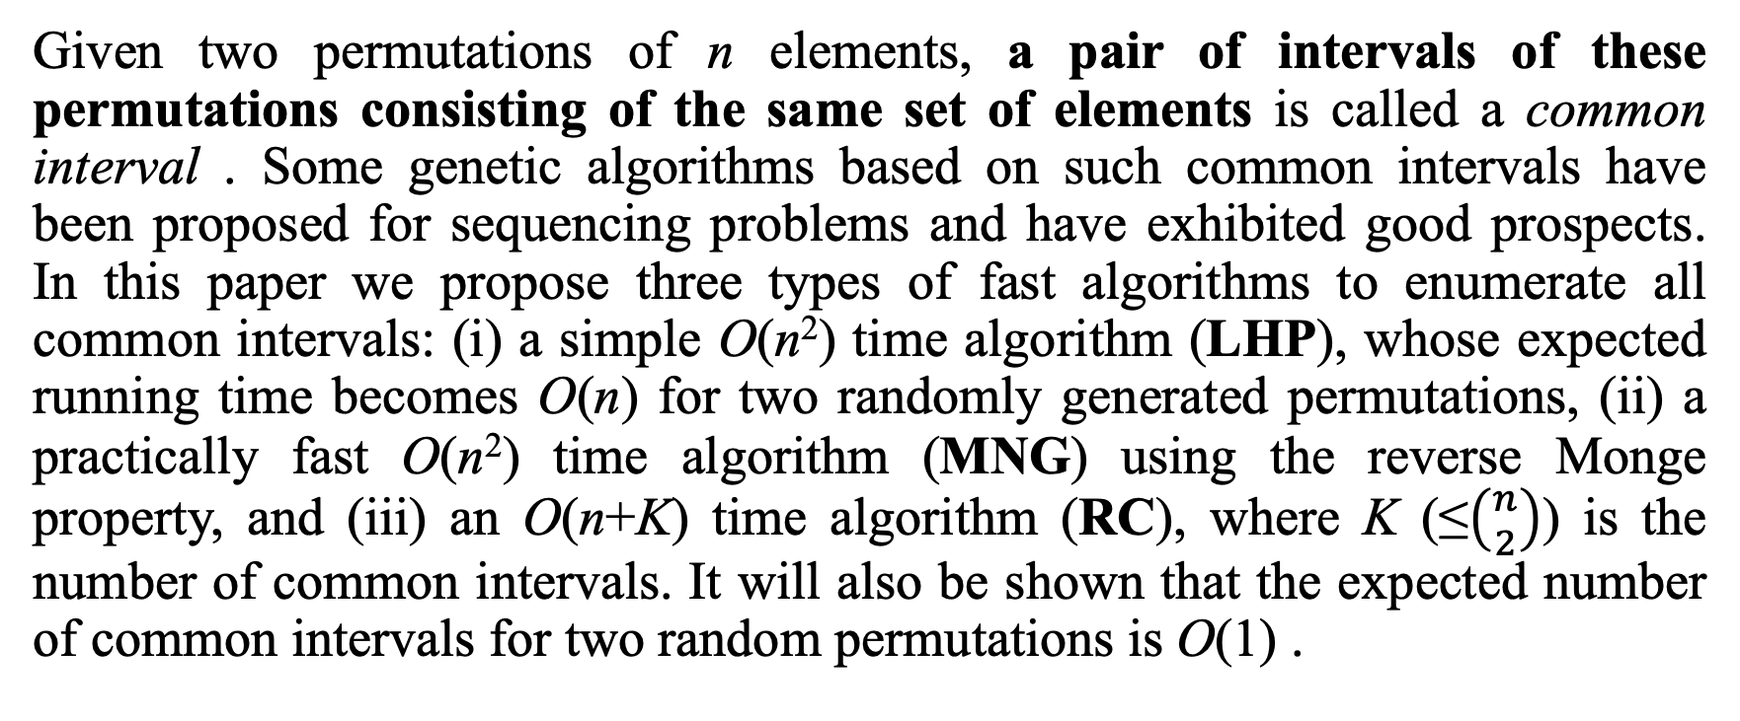
Abstract (1/2)
Given two permutations of n elements, a pair of intervals of these permutations consisting of the same set of elements is called a common interval . Some genetic algorithms based on such common intervals have been proposed for sequencing problems and have exhibited good prospects. In this paper we propose three types of fast algorithms to enumerate all common intervals: (i) a simple O(n²) time algorithm (LHP), whose expected running time becomes O(n) for two randomly generated permutations, (ii) a practically fast O(n²) time algorithm (MNG) using the reverse Monge property, and (iii) an O(n+K) time algorithm (RC), where K (≤$\left({n \atop 2}\right)$) is the number of common intervals. It will also be shown that the expected number of common intervals for two random permutations is O(1) .

Slide 3
Abstract (2/2)
This result gives a reason for the phenomenon that the expected time complexity O(n) of the algorithm LHP is independent of K. Among the proposed algorithms, RC is most desirable from the theoretical point of view; however, it is quite complicated compared with LHP and MNG. Therefore, it is possible that RC is slower than the other two algorithms in some cases. For this reason, computational experiments for various types of problems with up to n=10⁶ are conducted. The results indicate that (i) LHP and MNG are much faster than RC for two randomly generated permutations, and (ii) MNG is rather slower than LHP for random inputs; however, there are cases in which LHP requires Ω(n²) time, but MNG runs in o(n²) time and is faster than both LHP and RC.

Slide 4
Outline
Common Interval
Basic (BSC)
Length and Hole Point (LHP)
Monge (MNG)
Reduce Candidate (RC)
Results

Slide 5
Common Interval
 | 1 | 2 | 3 | 4 | 5 | 6 | 7
A | 3 | 6 | 7 | 5 | 2 | 1 | 4
B | 1 | 4 | 7 | 2 | 6 | 5 | 3
A[2, 4] has not a common interval.
 | 1 | 2 | 3 | 4 | 5 | 6 | 7
A | 3 | 6 | 7 | 5 | 2 | 1 | 4
B | 1 | 4 | 7 | 2 | 6 | 5 | 3
A[2, 5] and B[3, 6] is a common interval.

Slide 6
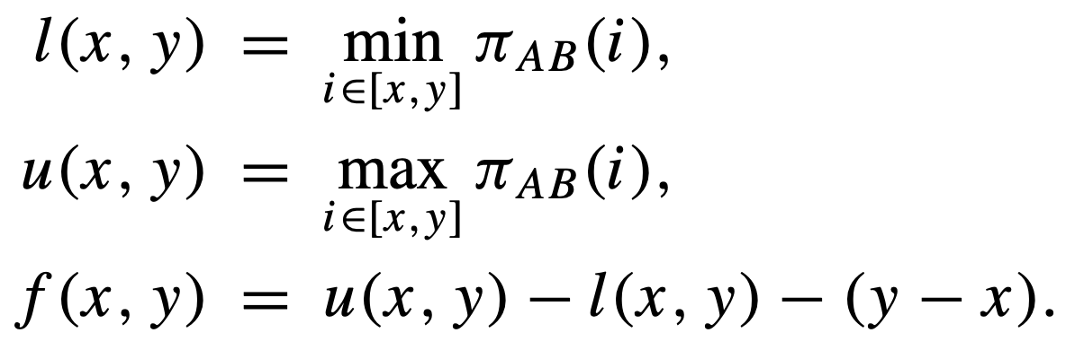
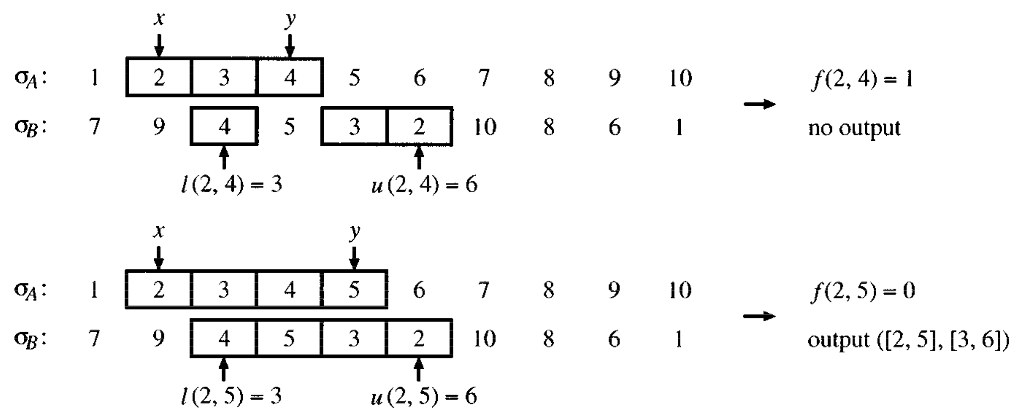
Basic (BSC) (1/2)

Slide 7
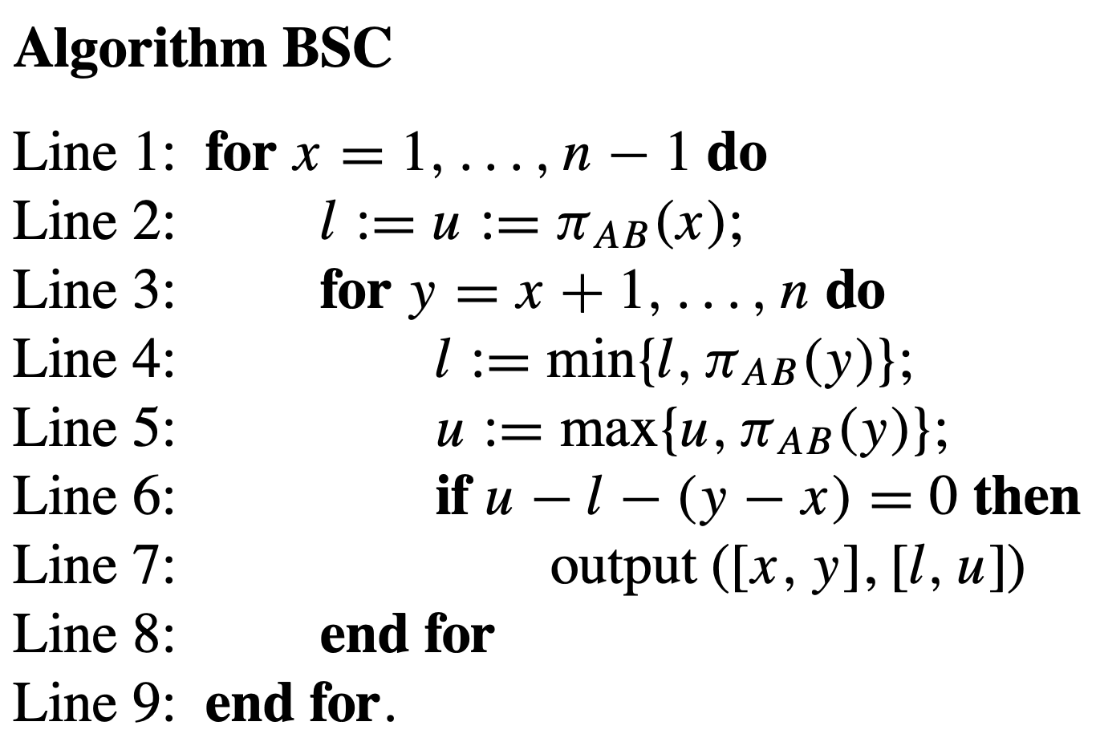
Basic (BSC) (2/2)

Slide 8



Length and Hole Point (LHP)
Length condition:
Hole point condition:
 | 1 | 2 | 3 | 4 | 5 | 6 | 7
A | 2 | 6 | 5 | 7 | 4 | 1 | 3
B | 5 | 2 | 4 | 6 | 1 | 7 | 3
When x = 3:
y = 4: u – l = 6 – 1 = 5 > 4
Skip x = 3
HP is the set of indices of the elements which will not be included in any interval [x, y].
 | 1 | 2 | 3 | 4 | 5 | 6 | 7
A | 2 | 6 | 5 | 7 | 4 | 1 | 3
B | 5 | 2 | 4 | 6 | 1 | 7 | 3
When x = 4:
y = 5: l < h < u (3 < 4 < 6)
Skip x = 4

Slide 9
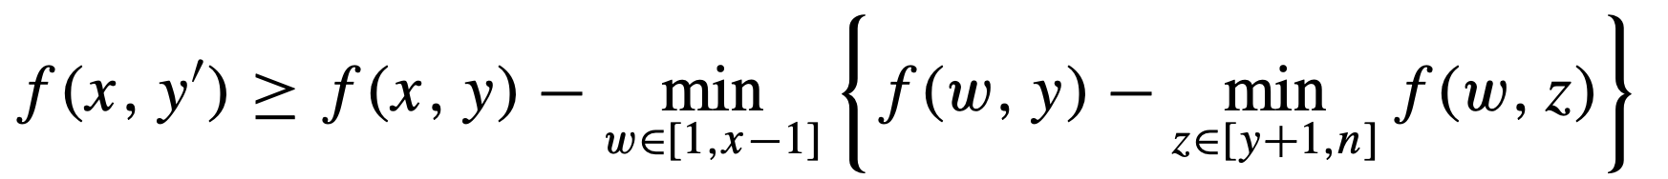
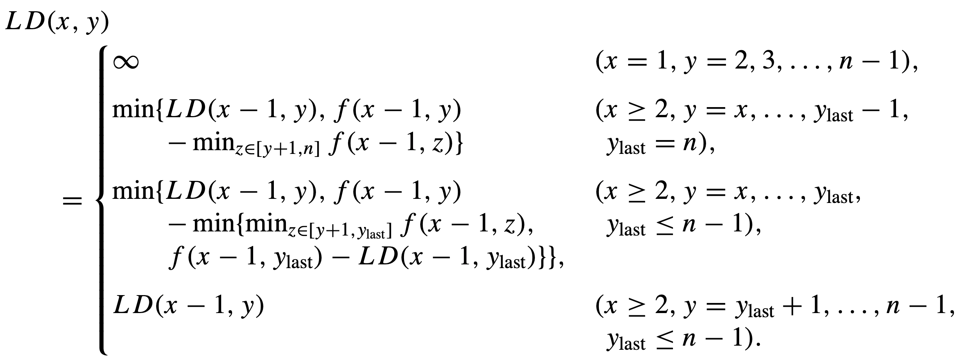
Monge (MNG) (1/2)
f() satisfies reverse Monge property.
Monge condition:
左上
右下
右上
左下
右下
左下
左上
右上
 | 1 | 2 | 3 | 4 | 5 | 6 | 7
A | 2 | 1 | 7 | 4 | 3 | 6 | 5
B | 3 | 5 | 4 | 6 | 1 | 2 | 7

Slide 10
Monge (MNG) (2/2)
Monge condition:
左下
左上
右上
 | 1 | 2 | 3 | 4 | 5 | 6 | 7
A | 2 | 1 | 7 | 4 | 3 | 6 | 5
B | 3 | 5 | 4 | 6 | 1 | 2 | 7
F | 1 | 2 | 3 | 4 | 5 | 6 | 7
1 |  | 0 | 0 | 1 | 2 | 1 | 0
2 |  |  | 1 | 2 | 3 | 2 | 1
3 |  |  |  | 3 | 4 | 3 | 2
4 |  |  |  |  | 1 | 1 | 0
5 |  |  |  |  |  | 2 | 1
6 |  |  |  |  |  |  | 1
7
左上 | 右上
左下 | 右下
1 – (0 – 0) = 1 > 0 → Skip x = 2
3 – (2 – 1) = 2 > 0 → Skip x = 3
F為Monge
可以用左上、左下、右上，得知右下的最小值
1 – (4 – 2) = -1 < 0 → Keep x = 3
2 – (1 – 0) = 1 > 0 → Skip x = 4

Slide 11
Reduce Candidate (RC) (1/5)
 | 1 | 2 | 3 | 4 | 5 | 6 | 7
A | 2 | 1 | 7 | 4 | 3 | 6 | 5
B | 3 | 5 | 4 | 6 | 1 | 2 | 7
U | 1 | 2 | 3 | 4 | 5 | 6 | 7
1 |  | 6 | 7 | 7 | 7 | 7 | 7
2 |  |  | 7 | 7 | 7 | 7 | 7
3 |  |  |  | 7 | 7 | 7 | 7
4 |  |  |  |  | 3 | 4 | 4
5 |  |  |  |  |  | 4 | 4
6 |  |  |  |  |  |  | 4
7
L | 1 | 2 | 3 | 4 | 5 | 6 | 7
1 |  | 5 | 5 | 3 | 1 | 1 | 1
2 |  |  | 5 | 3 | 1 | 1 | 1
3 |  |  |  | 3 | 1 | 1 | 1
4 |  |  |  |  | 1 | 1 | 1
5 |  |  |  |  |  | 1 | 1
6 |  |  |  |  |  |  | 2
7
F | 1 | 2 | 3 | 4 | 5 | 6 | 7
1 |  | 0 | 0 | 1 | 2 | 1 | 0
2 |  |  | 1 | 2 | 3 | 2 | 1
3 |  |  |  | 3 | 4 | 3 | 2
4 |  |  |  |  | 1 | 1 | 0
5 |  |  |  |  |  | 2 | 1
6 |  |  |  |  |  |  | 1
7

Slide 12
Reduce Candidate (RC) (2/5)
 | 1 | 2 | 3 | 4 | 5 | 6 | 7
A | 1 | 2 | 3 | 4 | 5 | 6 | 7
B | 5 | 3 | 1 | 4 | 2 | 7 | 6
U | 1 | 2 | 3 | 4 | 5 | 6 | 7
1 |  | 5 | 5 | 5 | 5 | 7 | 7
2 |  |  | 5 | 5 | 5 | 7 | 7
3 |  |  |  | 4 | 4 | 7 | 7
4 |  |  |  |  | 4 | 7 | 7
5 |  |  |  |  |  | 7 | 7
6 |  |  |  |  |  |  | 7
7
L | 1 | 2 | 3 | 4 | 5 | 6 | 7
1 |  | 3 | 2 | 2 | 1 | 1 | 1
2 |  |  | 2 | 2 | 1 | 1 | 1
3 |  |  |  | 2 | 1 | 1 | 1
4 |  |  |  |  | 1 | 1 | 1
5 |  |  |  |  |  | 1 | 1
6 |  |  |  |  |  |  | 6
7
F | 1 | 2 | 3 | 4 | 5 | 6 | 7
1 |  | 1 | 1 | 0 | 0 | 1 | 0
2 |  |  | 2 | 1 | 1 | 2 | 1
3 |  |  |  | 1 | 1 | 3 | 2
4 |  |  |  |  | 2 | 4 | 3
5 |  |  |  |  |  | 5 | 4
6 |  |  |  |  |  |  | 0
7

Slide 13
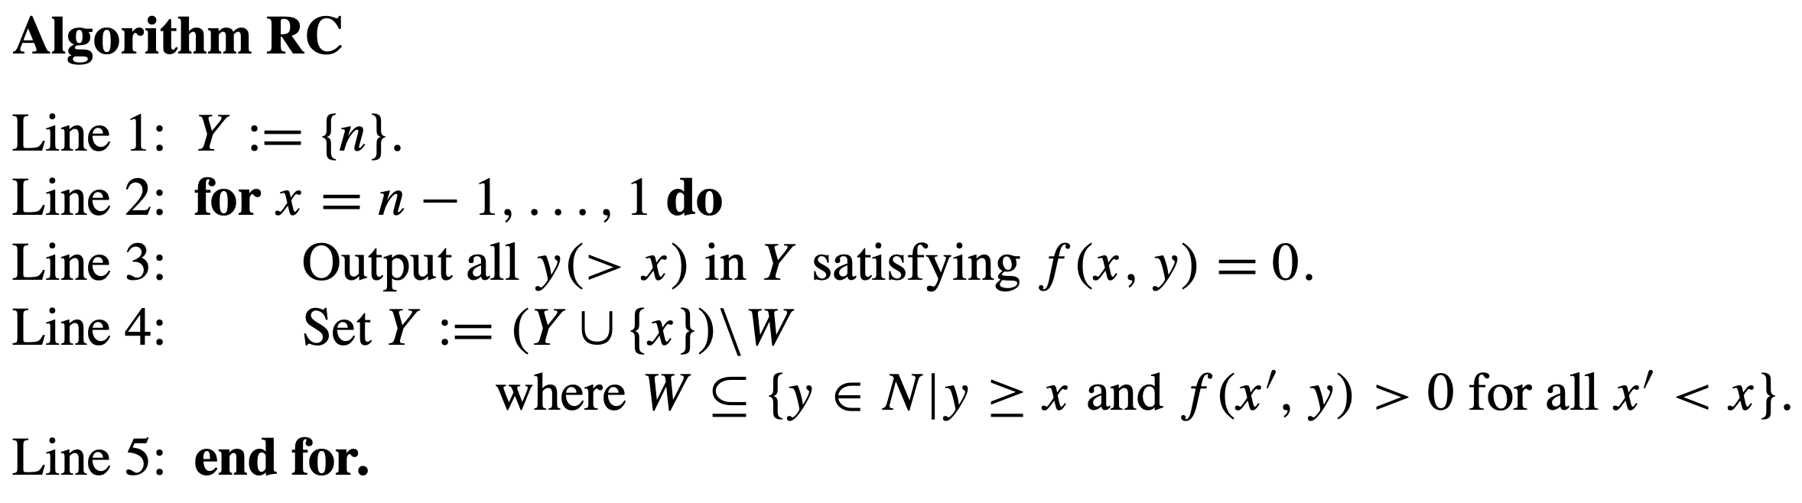
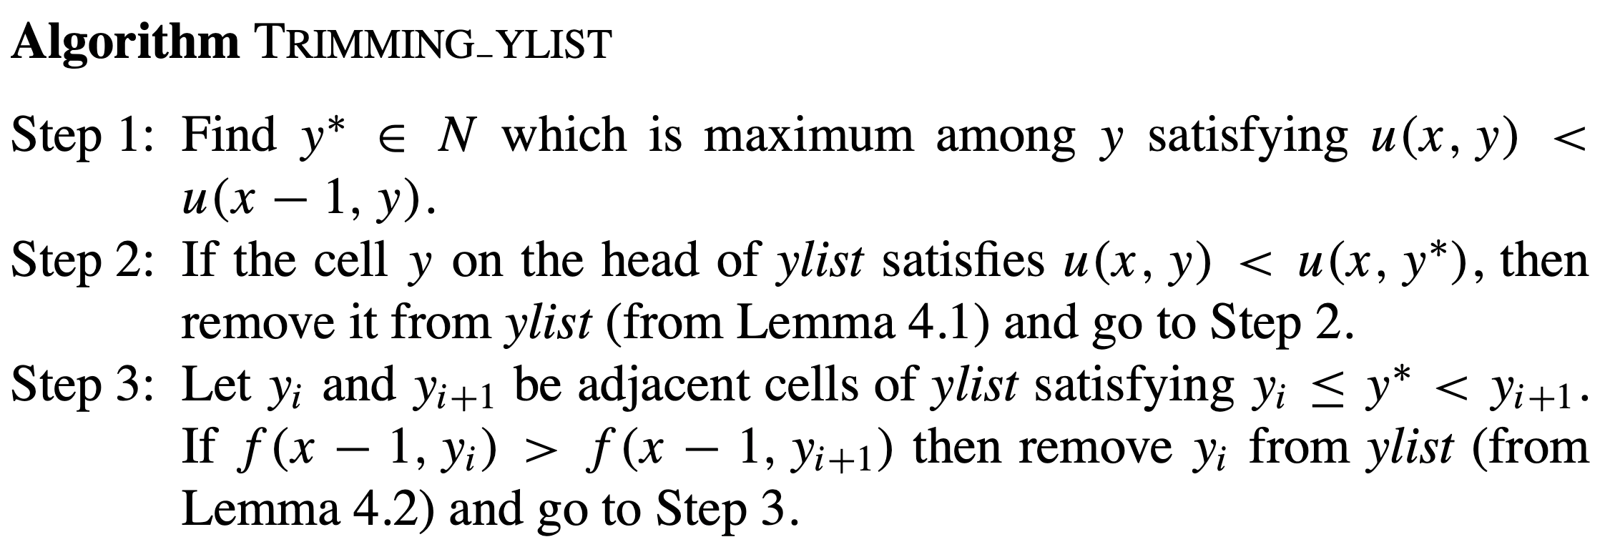
Reduce Candidate (RC) (3/5)

Slide 14
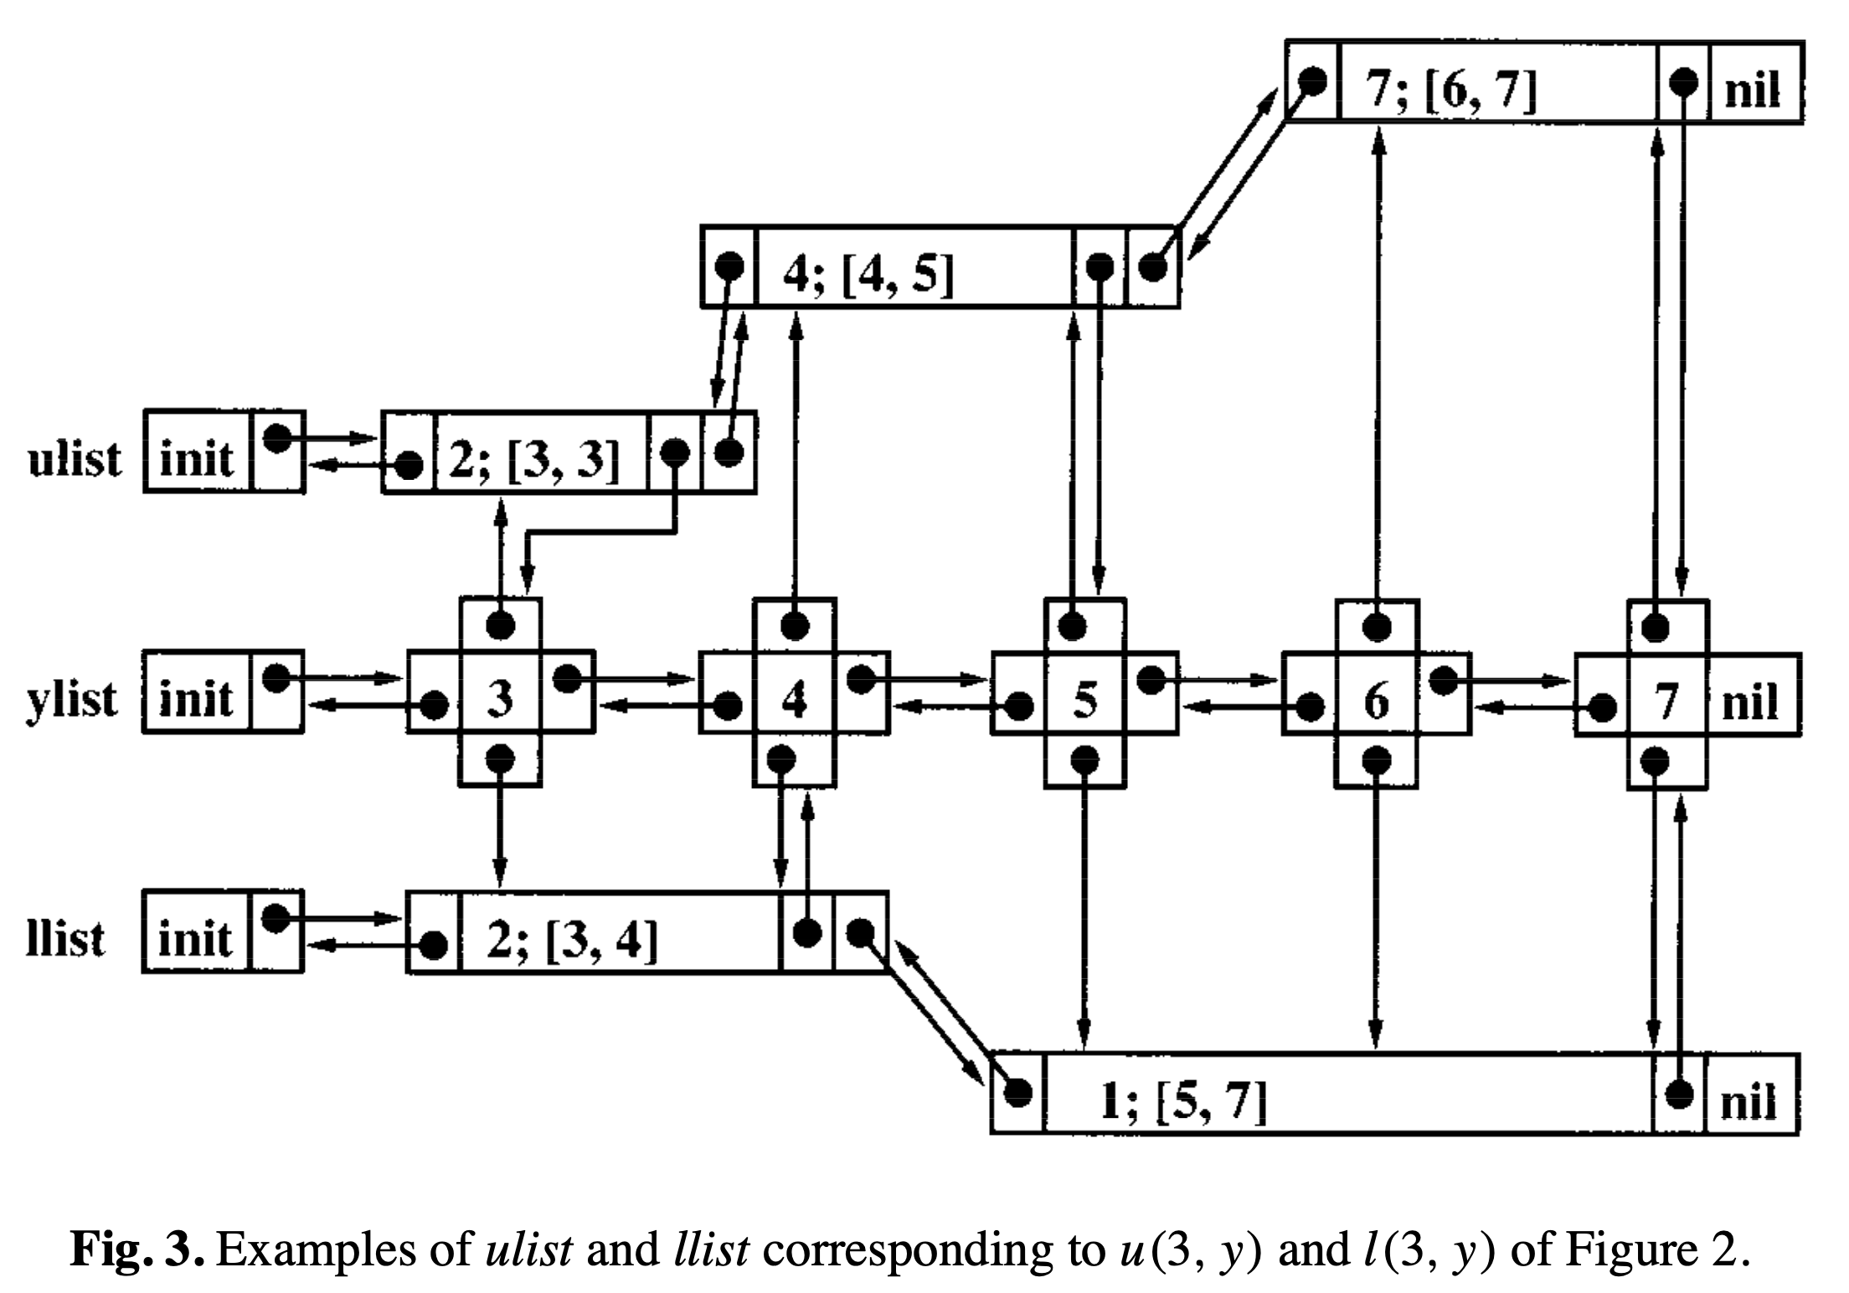
Reduce Candidate (RC) (4/5)
U | 1 | 2 | 3 | 4 | 5 | 6 | 7
1 |  | 5 | 5 | 5 | 5 | 7 | 7
2 |  |  | 5 | 5 | 5 | 7 | 7
3 |  |  |  | 4 | 4 | 7 | 7
4 |  |  |  |  | 4 | 7 | 7
5 |  |  |  |  |  | 7 | 7
6 |  |  |  |  |  |  | 7
7
Pi: 3 5 2 4 1 7 6
L | 1 | 2 | 3 | 4 | 5 | 6 | 7
1 |  | 3 | 2 | 2 | 1 | 1 | 1
2 |  |  | 2 | 2 | 1 | 1 | 1
3 |  |  |  | 2 | 1 | 1 | 1
4 |  |  |  |  | 1 | 1 | 1
5 |  |  |  |  |  | 1 | 1
6 |  |  |  |  |  |  | 6
7

Slide 15
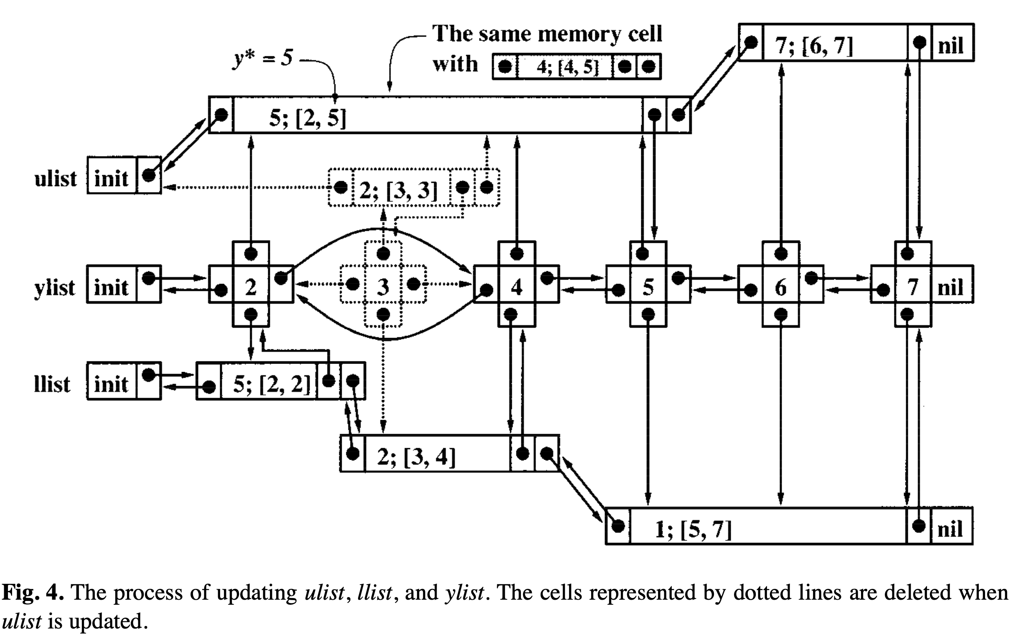
Reduce Candidate (RC) (5/5)
U | 1 | 2 | 3 | 4 | 5 | 6 | 7
1 |  | 5 | 5 | 5 | 5 | 7 | 7
2 |  |  | 5 | 5 | 5 | 7 | 7
3 |  |  |  | 4 | 4 | 7 | 7
4 |  |  |  |  | 4 | 7 | 7
5 |  |  |  |  |  | 7 | 7
6 |  |  |  |  |  |  | 7
7
Pi: 3 5 2 4 1 7 6
L | 1 | 2 | 3 | 4 | 5 | 6 | 7
1 |  | 3 | 2 | 2 | 1 | 1 | 1
2 |  |  | 2 | 2 | 1 | 1 | 1
3 |  |  |  | 2 | 1 | 1 | 1
4 |  |  |  |  | 1 | 1 | 1
5 |  |  |  |  |  | 1 | 1
6 |  |  |  |  |  |  | 6
7

Slide 16
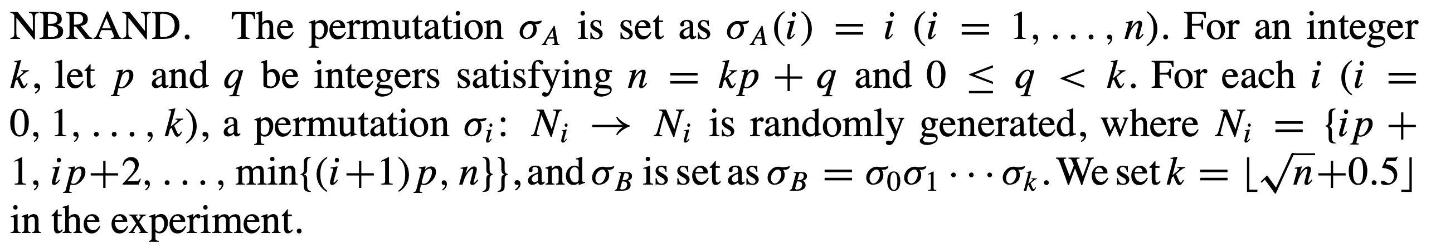
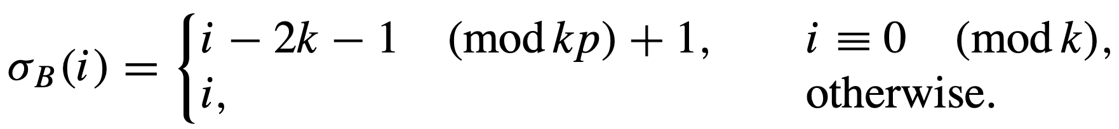
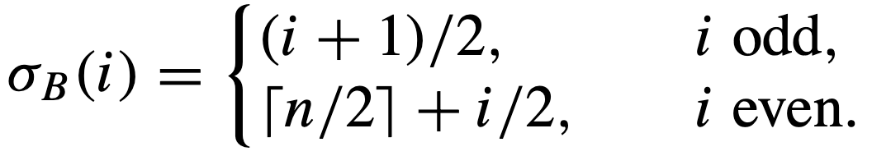
Results (1/3)
Data set:
RAND
SWAP
NBRAND
NBSWAP
SLIDE
NET
C language
n = 10³~10⁶
SLIDE
NET

Slide 17
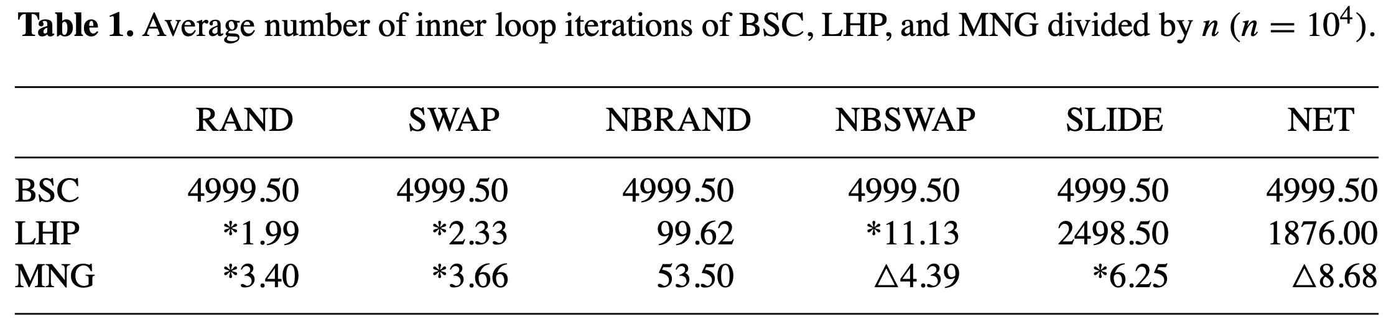
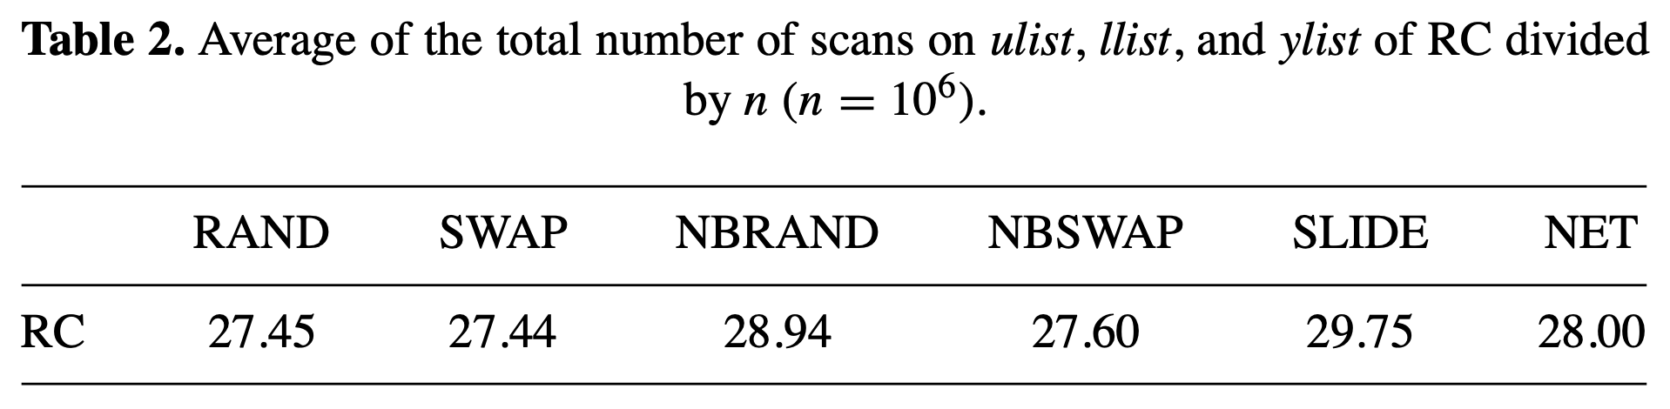
Results (2/3)

Slide 18
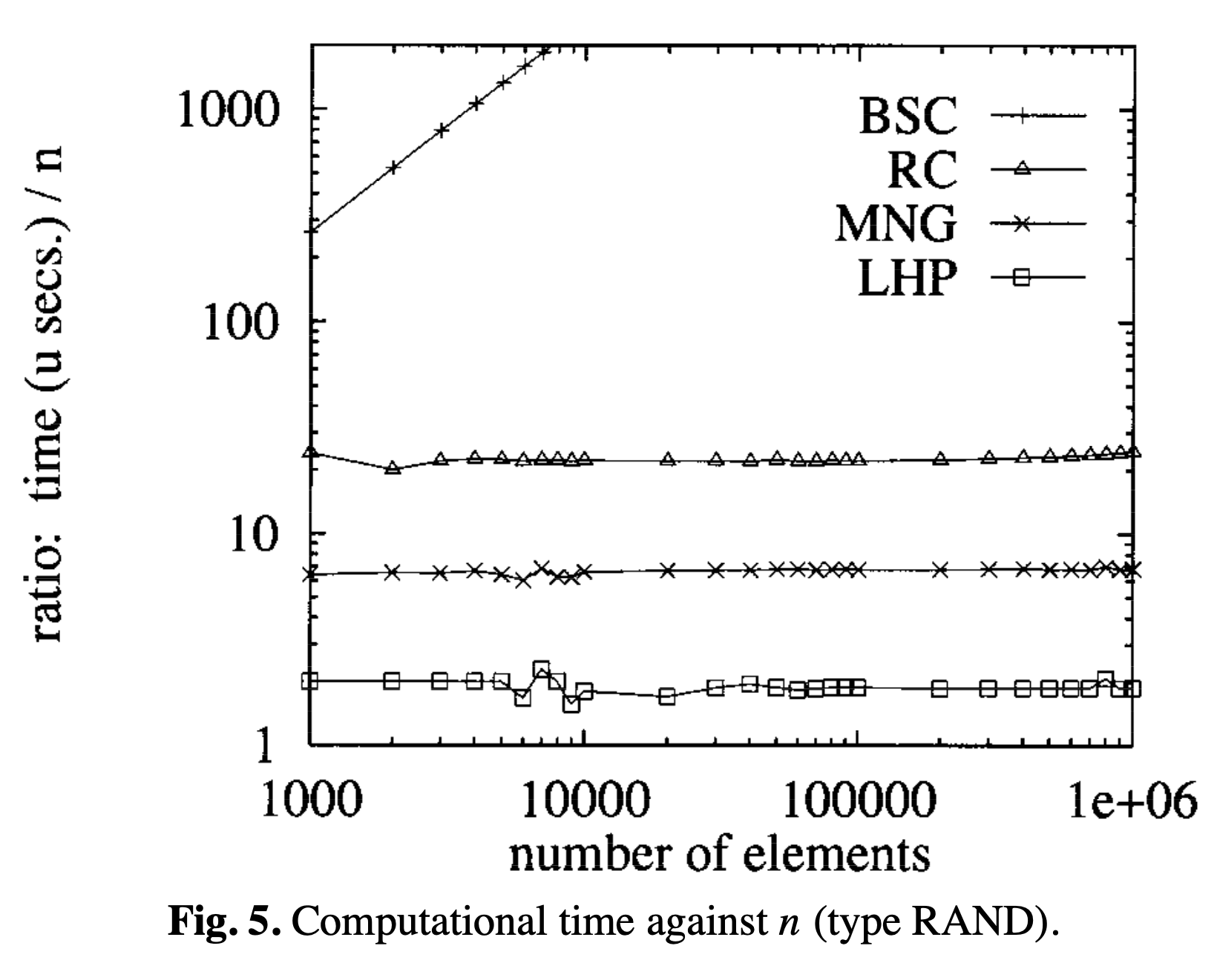
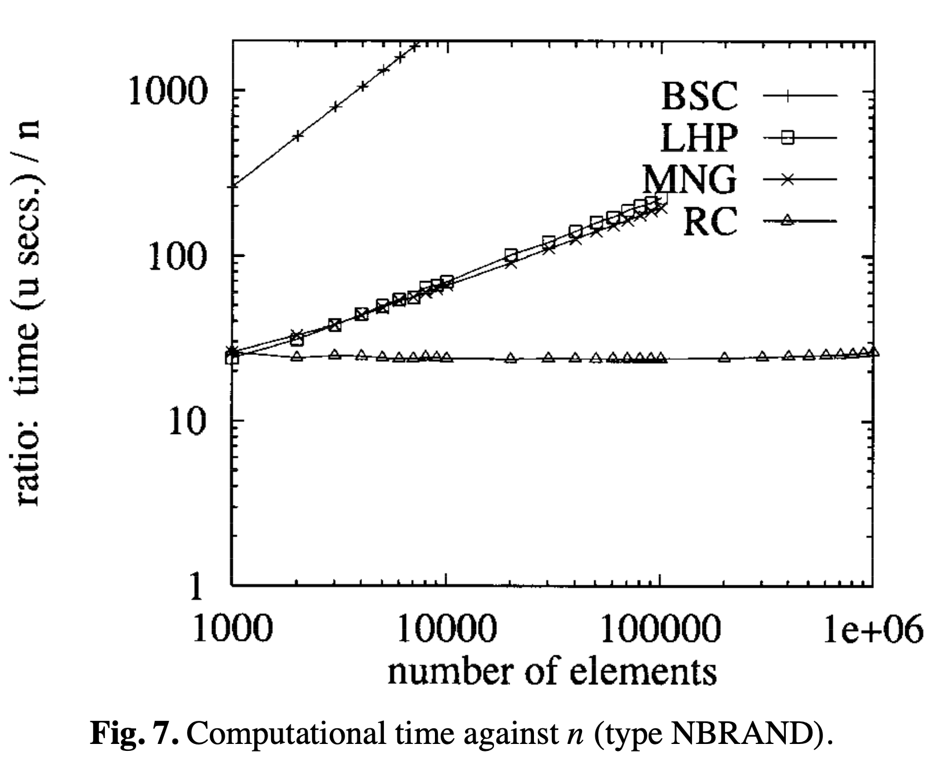
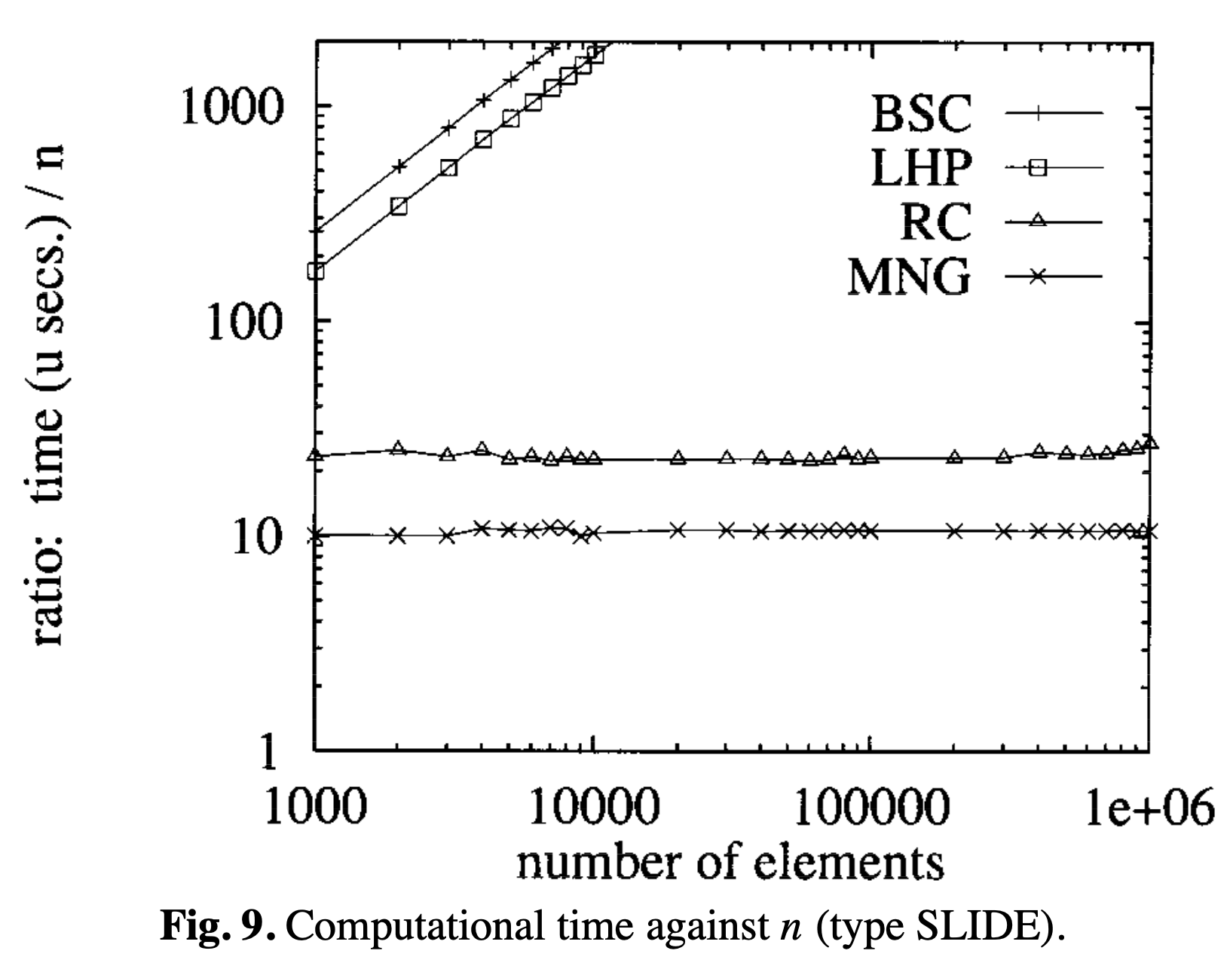

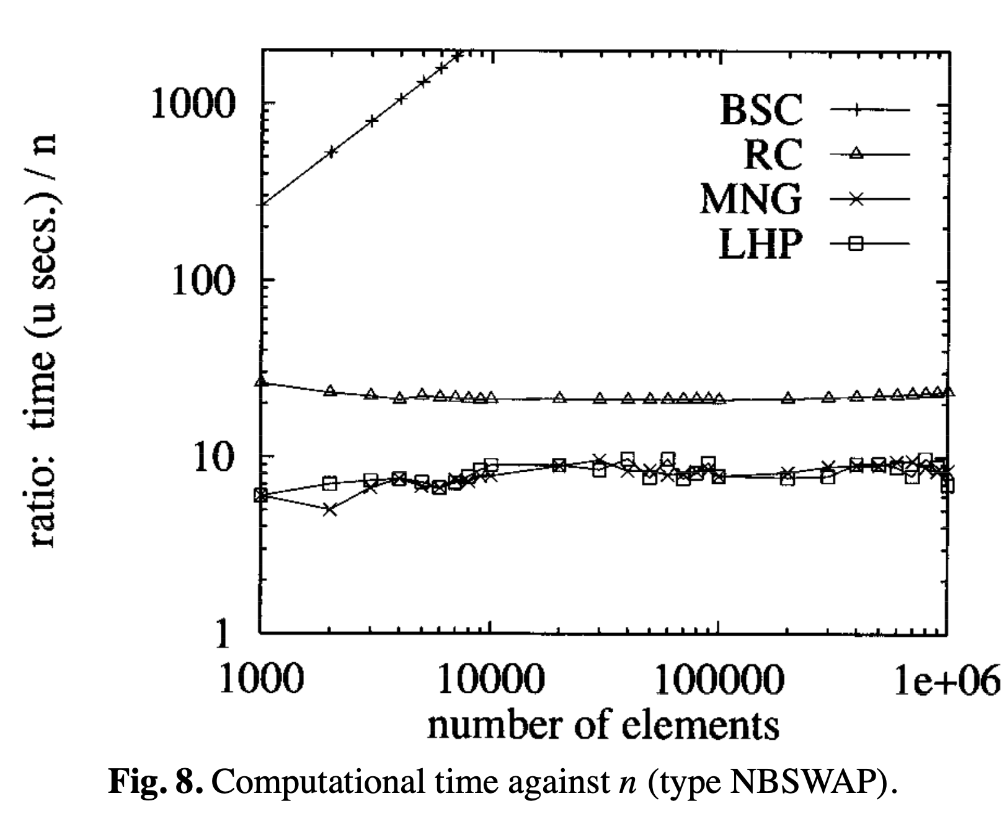
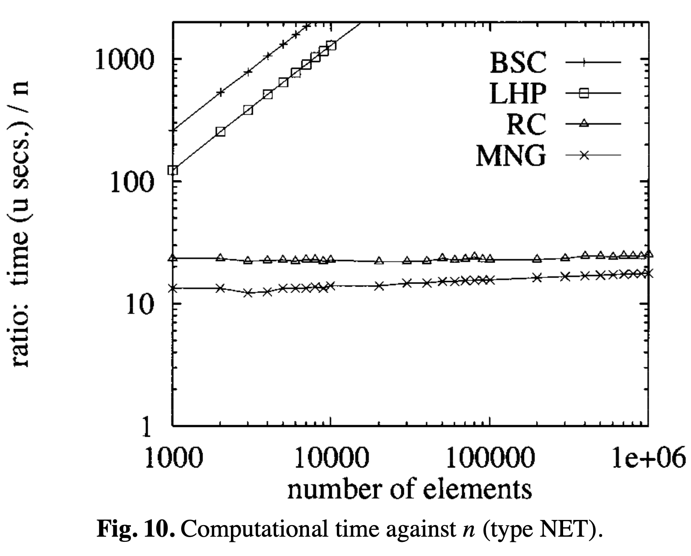

Slide 19
Thank you for listening

Slide 20
Abstract
s

