Slide 1
A New Heuristic for Minimizing Schedule Length in Heterogeneous Computing Systems
D. Sirisha and G.Vijaya Kumari
2015 IEEE International Conference on Electrical, Computer and Communication Technologies (ICECCT)
Presenter: Chih-Hsuan Chien​
Date: Sept. 27, 2022

Slide 2
Abstract
Heterogeneous environments includes resources with diverse capabilities necessitates efficient task-to-processor assignment for accomplishing high performance. In the proposed work a new heuristic approach for scheduling the tasks independent of their levels in the precedence constrained task graph is detailed. Schedules with shorter span are achieved by reducing the start time of the independent tasks. The proposed algorithm is compared with the available literature and an improvement in the schedule length is obtained.

Slide 3
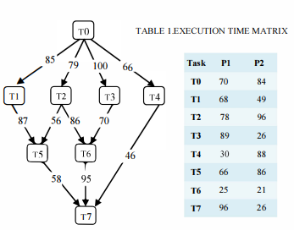
Problem

Slide 4
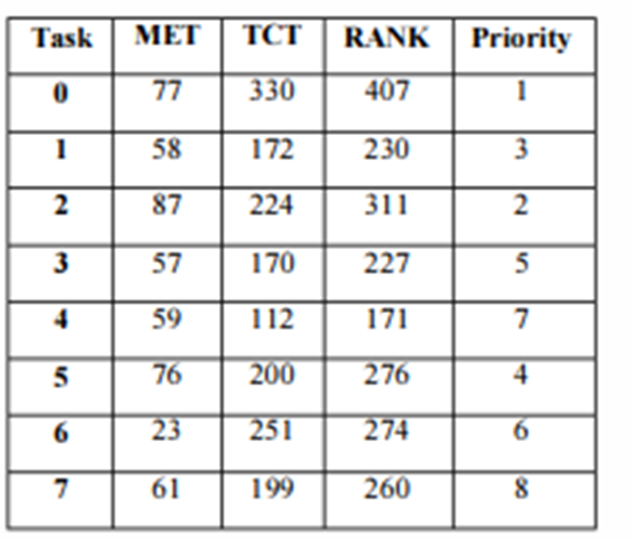
MSL algorithm
Task Ordering Phase
Task Mapping Phase

Slide 5
Related work
HEFT Algorithm
CPOP Algorithm
PETS Algorithm
Notes:
Heft uprank
Cpop uprank +downrank
Pets acc+dtc+rpt

Slide 6
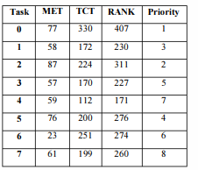

Task Ordering Phase
Rank($t_{i}$)=MET ($t_{i}$) + TCT ($t_{i}$)
Notes:
看起來是要讓可能會用最久時間task的先選processor

Slide 7
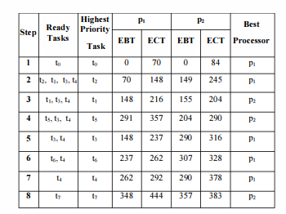
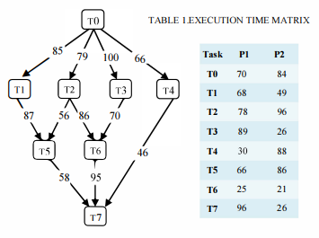
Task Mapping Phase

Slide 8
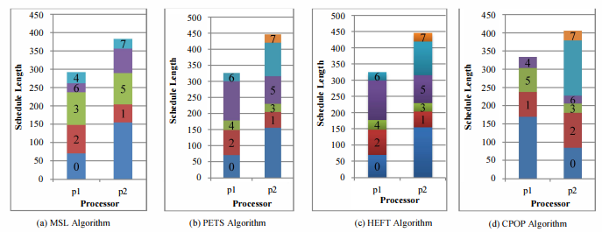
Result

Slide 9
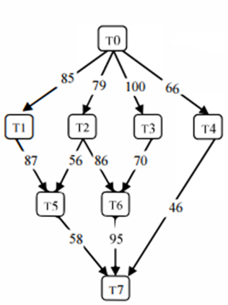
Parameter
Communication to execution ratio
Parallelization factor
Heterogeneity factor
Notes:
Ccr=mean computation time/mean communication time
Parallelization factor 控制高矮胖瘦
Heterogeneity factor 控制在不同processor上的執行時間

Slide 10
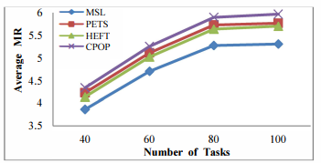
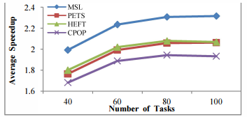
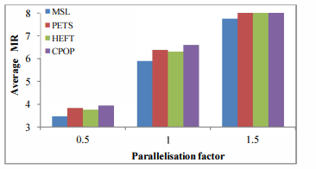
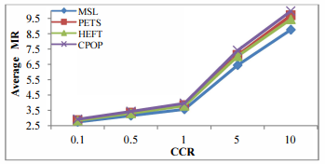
Peformance Analysis
Notes:
Mr=makespan/lower bound
Speedup=sequential excution time/parallel excution time
Efficiency=speed/number of processor used

